Slide 1
Text Transcription with Whisper-CPP
Félix Suárez

Slide 2
Introduction
Explore Whisper Transcription, a Python script utilizing whisper-cpp, custom inference implementation of OpenAI's Whisper model. This tool enables users to transcribe audio files into text directly or via Docker containers.

Slide 3



Prerequisites
Microsoft C++ Build tools required.
Python 3.8 or higher required.
Docker (optional for containerization).
Microsoft Building Tools
Python
Docker

Slide 4
Using Python Script
1. Set up a virtual environment:
python -m venv venv source venv/Scripts/activate
2. Install the necessary Python dependencies:
pip install -r requirements.txt
3. Run the Python script audio_transcriber.py:
python audio_transcriber.py

Slide 5
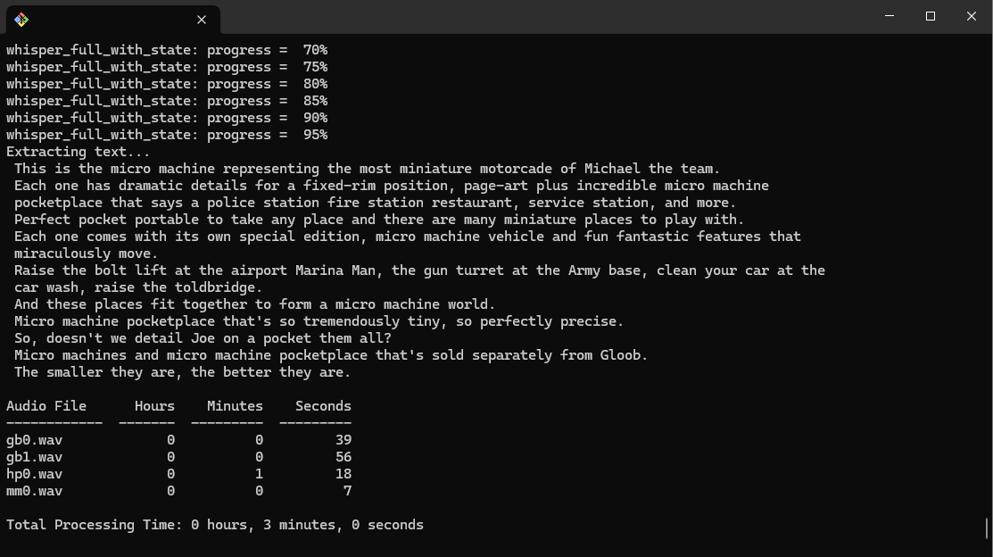
Using Python Script
Example Results:

Slide 6
Using Docker
1. Build the Docker image inside the dockerfile_script folder:
docker build -t demo-whisper-cpp .
2. Execute the python container from outside it:
docker run demo-whisper-cpp
3. Or Get into the docker container and execute the python script inside the container:
docker run -it --rm demo-whisper-cpp bash python batch_audio_transcriber.py

Slide 7
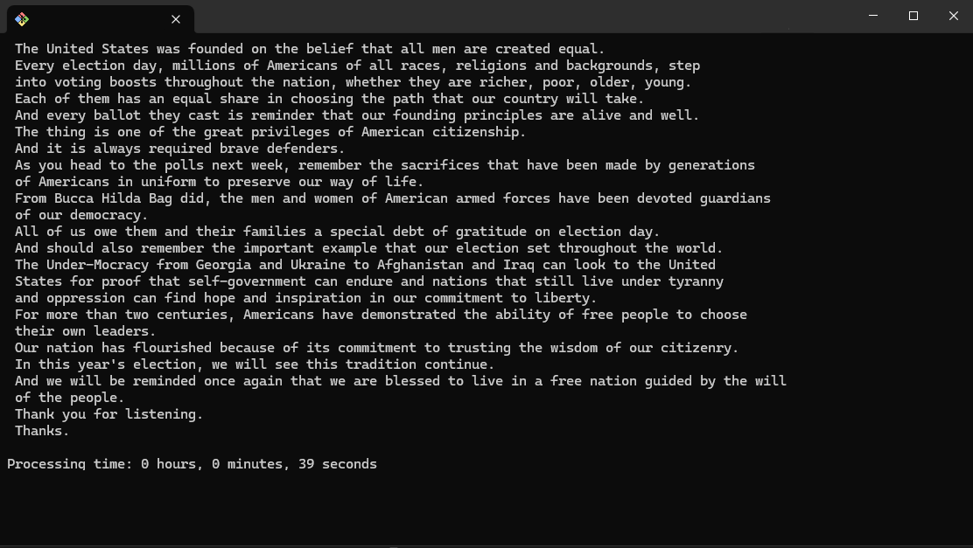
Using Docker
Example Results:
2
3

Slide 8
Using Fast API Endpoint
1. Set up a virtual environment:
python -m venv venv source venv/Scripts/activate
2. Install the necessary Python dependencies:
pip install -r requirements.txt
3. Run the Fast API application:
uvicorn transcription_endpoint:app --reload

Slide 9
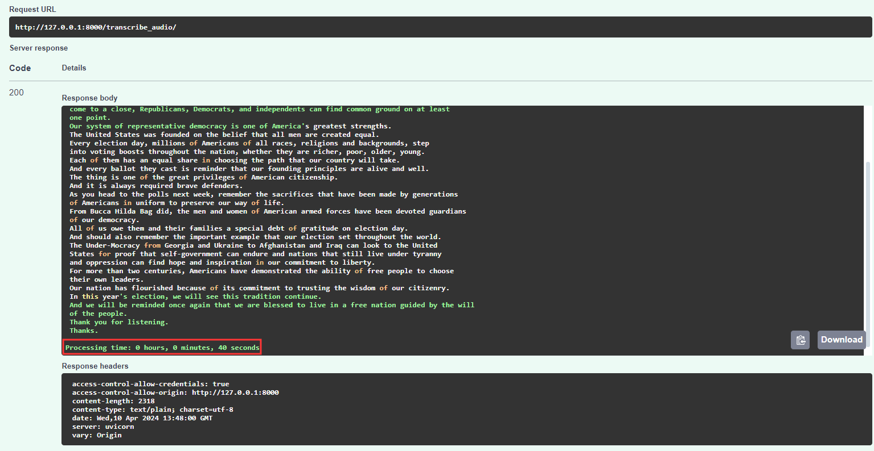
Using Fast API Endpoint
Example Results: Access the endpoint via:
http://127.0.0.1:8000/docs#/default/transcribe_audio_transcribe_audio__post

Slide 10
Audio File Testing on Local Machine
Through an experimental run on a local machine equipped with 6 CPU cores and 16GB RAM, four audio files were tested to assess processing times. The resulting data offers insights into the transcription times for each audio file.

Slide 11
Audio File Testing on Local Machine
Results of processing times for four audio files:
Audio File | Hours | Minutes | Seconds
gb0.wav | 0 | 0 | 39
gb1.wav | 0 | 0 | 56
hp0.wav | 0 | 1 | 18
mm0.wav | 0 | 0 | 7
Total | 0 | 3 | 0
Note: 6 CPU cores processor and 16GB RAM

Slide 12
Audio File Testing on Local Machine
Results of processing times for four audio files:
Audio File | Hours | Minutes | Seconds
gb0.wav | 0 | 0 | 7
gb1.wav | 0 | 0 | 9
hp0.wav | 0 | 0 | 13
mm0.wav | 0 | 0 | 1
Total | 0 | 0 | 30
Note: 6 CPU cores processor and 16GB RAM
(Run with Docker)

Slide 13
Conclusion
In conclusion, text transcription using whisper-cpp bindings, is faster than the alternative utilizing the faster-whisper model and it was found it is even faster when used within a Docker container.

