Slide 1
AI Video Categorizer

Slide 2

About
This project was developed with the aim of addressing the need for tools to organize and analyze large volumes of videos. It provides a solution that leverages artificial intelligence techniques to automatically classify videos uploaded by users, categorizing them based on their visual content.

Slide 3





Tech Stack
Video Proccessing – Google Cloud Video Intelligence
API - Python FastAPI
Frontend - ReactJS
Main Storage – GCP Bucket
Secondary Storage – SQLite

Slide 4
Google Cloud Video Intelligence
Used as the video analysis engine, this Google Cloud-based tool allows for the extraction of key information from videos, such as object detection, scene recognition, and event identification, using machine learning models.

Slide 5
Python FastAPI
It serves as the backend of the system, providing a fast and flexible API to handle user requests, such as video uploads, retrieving generated tags, and managing interactions with Google Cloud Video Intelligence.

Slide 6

ReactJS
It handles the frontend, providing an intuitive interface for users to upload videos, view the processing status, and review the tags generated for each video.

Slide 7


Storage
Videos are stored in Google Cloud Storage, a bucket that serves as a central repository where multimedia files are hosted.
Tags generated from the video analysis are stored in an SQLite database, providing local and efficient storage for the categories and tags assigned to each video.

Slide 8

Workflow
The video categorization process using AI follows a series of well-defined steps to ensure that videos are uploaded, processed, and categorized correctly. The workflow is described in detail as follows.

Slide 9

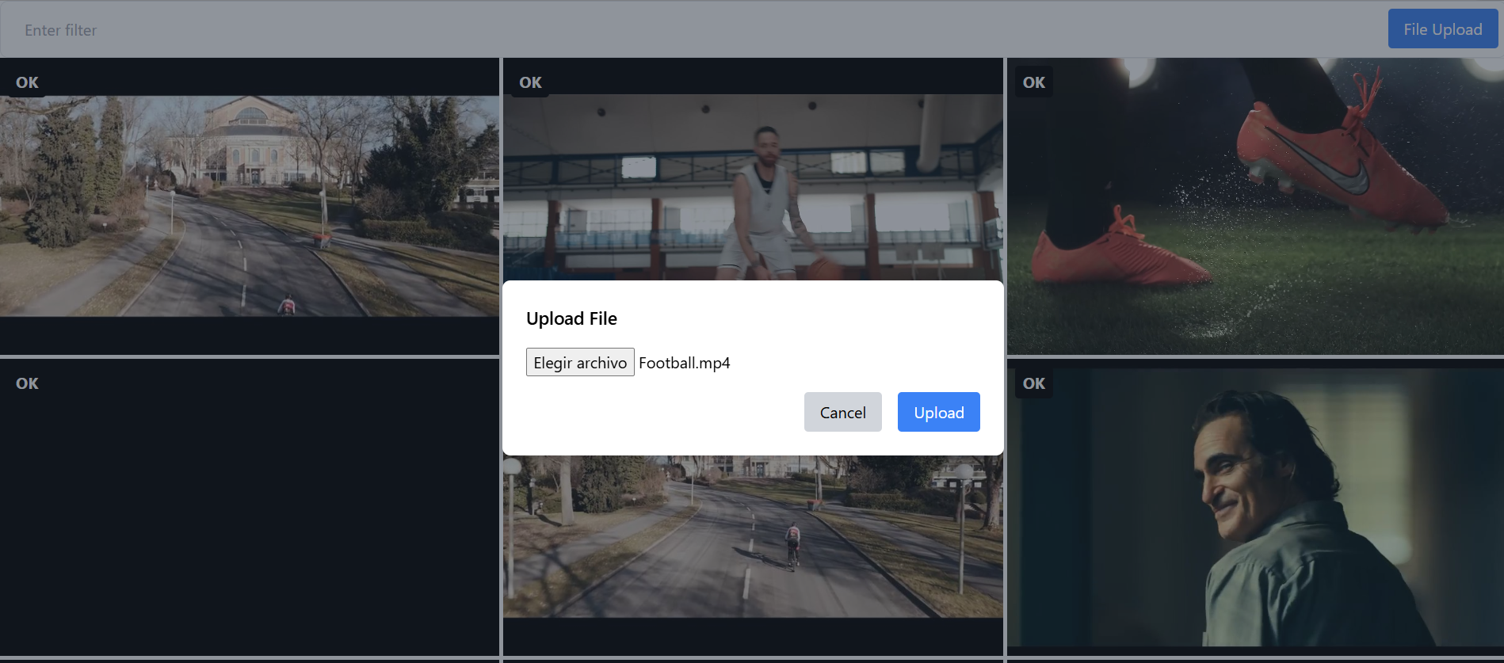
Video Upload
The first step in the workflow is for the user to upload a video file through the application interface. In this case, the file is stored in a Google Cloud Storage (GCP) bucket, though this could be adapted to use any other high-volume data storage system, depending on the requirements.

Slide 10

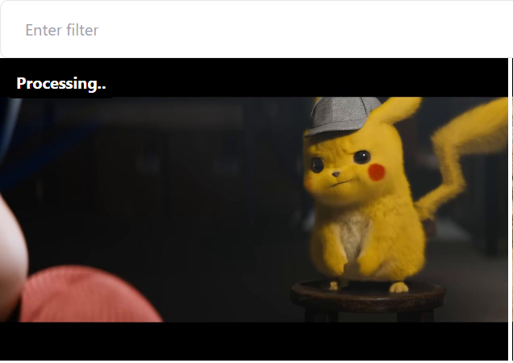
"Processing" Status
Once the video has been uploaded, a background process is automatically triggered to analyze and process the video.
At this stage, the video status changes to "Processing" within the system, indicating that it is being analyzed by artificial intelligence.
During this process, the backend sends a request to Google Cloud Video Intelligence, the AI service that enables the analysis of video content.

Slide 11


“Completed”/“ OK” status
When the video analysis is complete, the video status changes to "Completed" or "OK," indicating that the entire categorization process has finished.
At this point, the tags generated by the Google Cloud Video Intelligence analysis are now available. These tags are categories that describe the video content, such as objects or activities present, and are stored in an SQLite database.

Slide 12
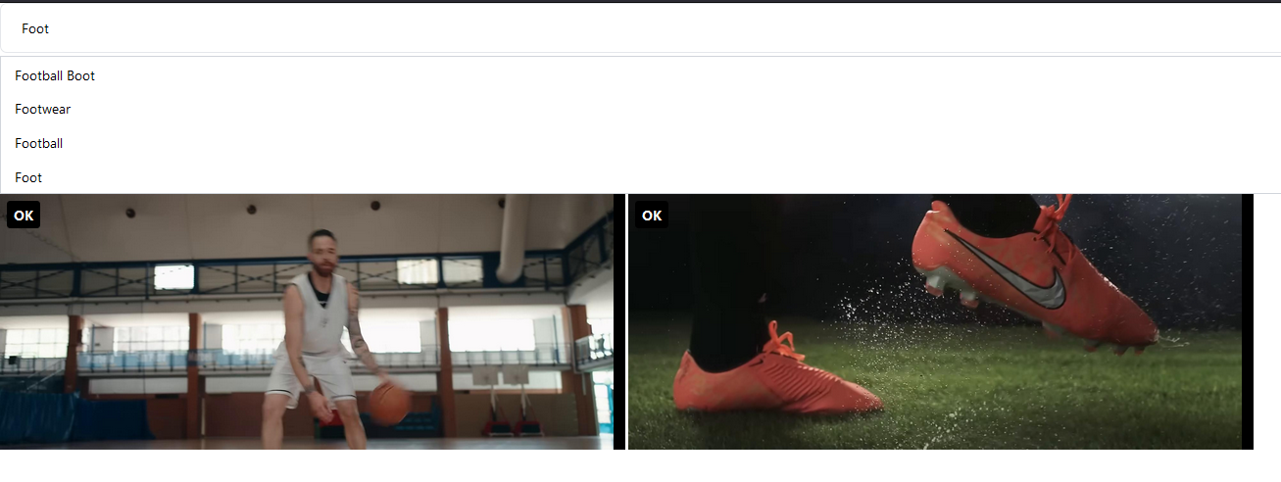
Access to categories
Once the video is in the “Completed” status, users can access the results of the analysis. The user can filter through all the videos by searching for specific categories that have been automatically created.

Slide 13
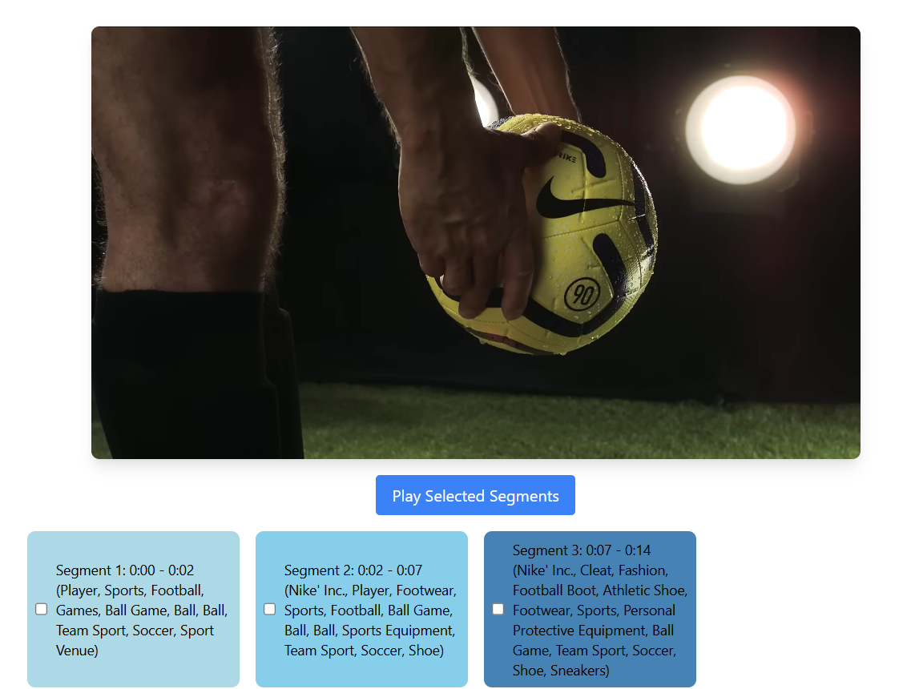
Access to categories
Additionally, the user can watch the video and interactively observe where in the video the AI-generated tags were applied.
For example, if the AI model detected specific scenes or relevant actions (such as “dog” or “sunset”), the system allows highlighting the exact moments in the video where those tags were applied.
This offers the user a complete experience of visual exploration and analysis of the categorized content.

Slide 14

Improvements and Other Uses
Extraction of Clips and Full Scenes: There is the possibility to extend the system with additional tools to capture complete scenes instead of small segments, detecting transitions to obtain more meaningful clips.
Motion and Event Analysis: It is possible to integrate tools that perform motion analysis (abrupt changes) and audio events (dialogues, explosions) to improve classification.
Identification of Important Moments: The functionality could be extended to be able to extract key moments by combining visual and audio analysis, useful for automatic editing of summaries.

Slide 15
Conclusion
This project offers a solution that uses artificial intelligence to automatically process, classify and index videos, making it easier to search for specific videos within large datasets.
It implements a basic video application workflow but improves file storage and management by incorporating AI categorization, thus optimizing video access and organization.

Slide 16
Thanks

