Slide 1

Identification and estimation of causal effects
Felix Thoemmes

Slide 2
Github resources
https://github.com/felixthoemmes/IPN_workshop

Slide 3
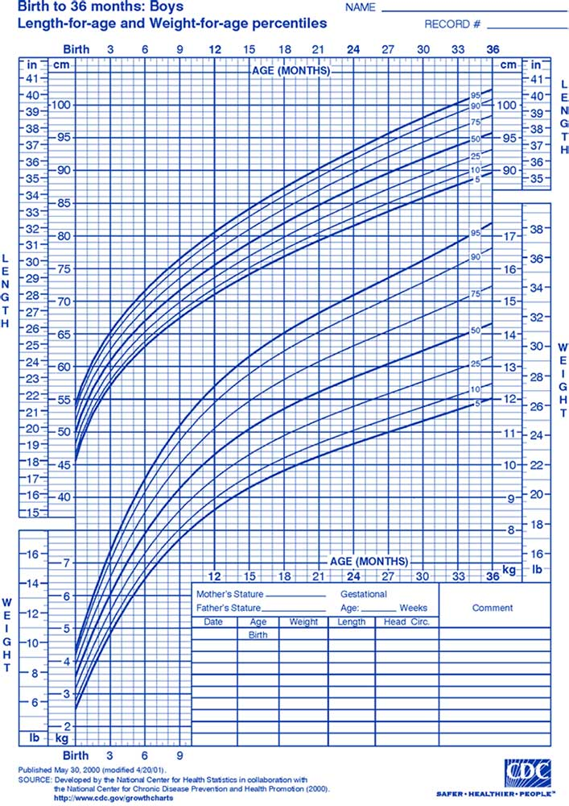
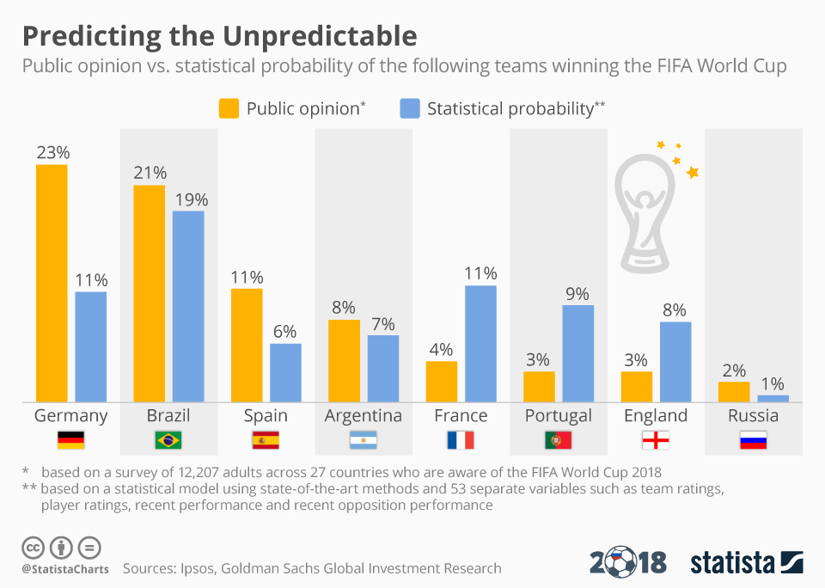
We do not always need causal inference
Description
Prediction

Slide 4
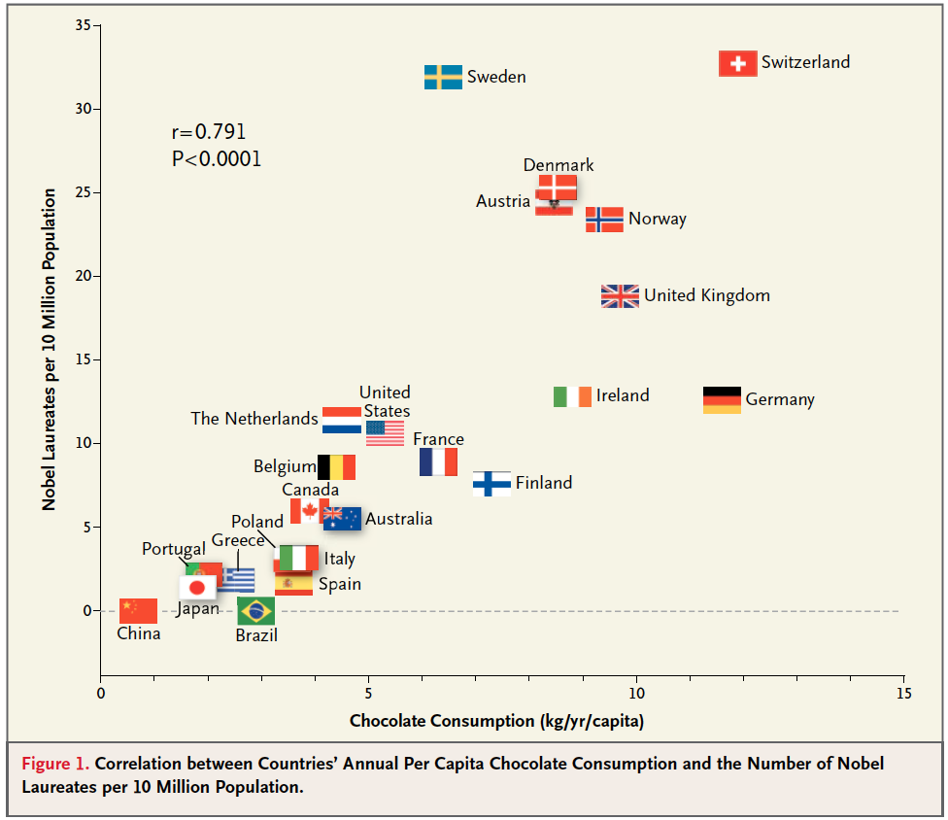

Slide 5
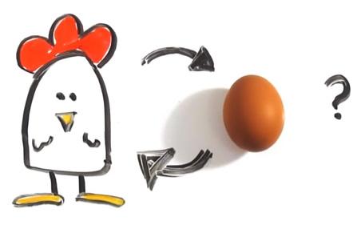
When do we need causality?

Slide 6
When do we need causality?
To answer “causal” questions?
Will changing one variable produce changes in another variable?
Will implementing policy / treatment generate certain outcomes?
To build theory, we need causality

Slide 7

Hormone Replacement therapy
1968 “Feminine Forever“
2002 Women‘s Health Initative trial on hormone replacement therapy

Slide 8
Example
Two variables X and Y are correlated with each other – why?
X causes Y
Y causes X
Common cause C causes both X and Y
X and Y share a common effect that was conditioned on
Random chance

Slide 9
Example
Based on statistical evidence alone, only the last alternative (chance) can be ruled out
X causes Y
Y causes X
Common cause C causes both X and Y
X and Y share a common effect that was conditioned on
Random chance

Slide 10
Example
The remaining four alternative are statistically indistinguishable
X causes Y
Y causes X
Common cause C causes both X and Y
X and Y share a common effect that was conditioned on

Slide 11
Example
Common cause C causes both X and Y
Suppose we observe that stains on hand and lung cancer are correlated
Tobacco use causes stains on hand and lung cancer

Slide 12
Example
X and Y share a common effect that was conditioned on
Suppose wealth and intelligence are unrelated to each other
We restrict our observations to students admitted to Harvard – here wealth and intelligence will be negatively related to each other

Slide 13
Example
Among the most intelligent, it does not matter whether you are rich or not. You will be admitted.
Among the least intelligent, only the richest will be admitted (because their family donated a building to Harvard).
Conditional on admittance to Harvard, wealth and intelligence appear to be negatively correlated

Slide 14
Causal effects
“No causes in, no causes out.” Nancy Cartwright, “Hunting Causes and Using Them”
No statistical model alone yields causal effects
It is always necessary to makes some untestable assumptions.

Slide 15
Brainstorm exercise

Slide 16
Some theory and definitions

Slide 17


TREATMENT
Unit –level Causal Effect
CONTROL

Slide 18


TREATMENT
CONTROL
Average Causal Effect

Slide 19
TREATMENT
CONTROL
Estimate of the Average Causal Effect

Slide 20
τ = τ* ?
“Causation ≠ Association”
Causal identification

Slide 21



CONTROL
TREATMENT
CONTROL
TREATMENT
E(Y_{i1}) = E(Y_{i1} | z_{i} = 1)
E(Y_{i0}) = E(Y_{i0} | z_{i} = 0)
E(Y_{i1}) ≠ E(Y_{i1} | z_{i} = 1)
E(Y_{i0}) ≠ E(Y_{i0} | z_{i} = 0)

Slide 22
E(Y_{i1}) = E(Y_{i1} | z_{i} = 1) Randomized experiment
E(Y_{i0}) = E(Y_{i0} | z_{i} = 0)
E(Y_{i1}) ≠ E(Y_{i1} | z_{i} = 1) Non-randomized E(Y_{i0}) ≠ E(Y_{i0} | z_{i} = 0) experiment

Slide 23
E(Y_{i1}) = E_{x}{E(Y_{i1} | z_{i} = 1, x)} Non-randomized E(Y_{i0}) = E_{x}{E(Y_{i0} | z_{i} = 0, x)} experiment with unconfoundedness assumption
X contains all confounding covariates
Conditional ignorabilty (Rubin, 194)

Slide 24
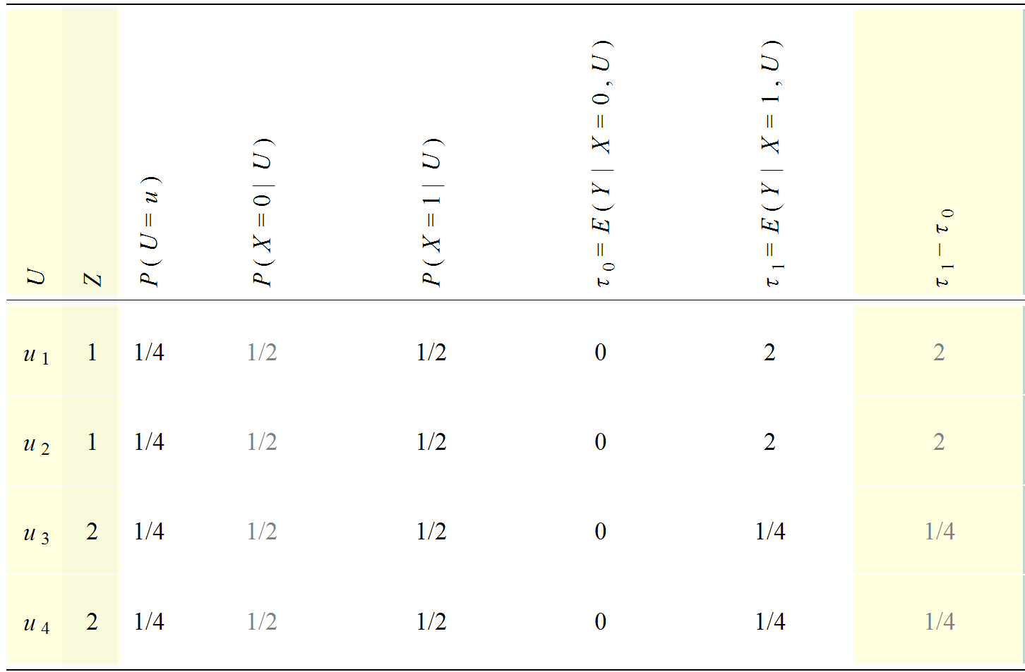
https://www.metheval.uni-jena.de/projekte/book_causal-effects/tools.php

Slide 25
Z | T | Y0 | Y1
1 | 0 | 0 | ●
1 | 1 | ● | 2
1 | 0 | 0 | ●
1 | 1 | ● | 2
2 | 0 | 0 | ●
2 | 1 | ● | 1/4
2 | 0 | 0 | ●
2 | 1 | ● | 1/4
 |  | 0 | 1.125

Slide 26
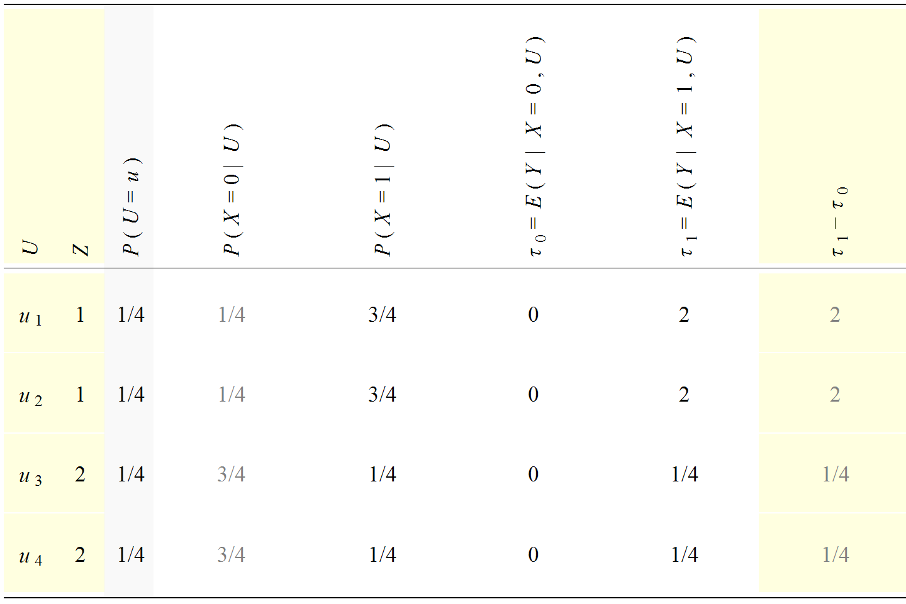

Slide 27
Z | T | Y0 | Y1
1 | 1 | ● | 2
1 | 1 | ● | 2
1 | 1 | ● | 2
1 | 0 | 0 | ●
2 | 0 | 0 | ●
2 | 0 | 0 | ●
2 | 0 | 0 | ●
2 | 1 | ● | 1/4
 |  | 0 | 1.562

Slide 28
τ = τ* ?
“Causation ≠ Association”
Causal identification – but how?

Slide 29
Brainstorm exercise

Slide 30
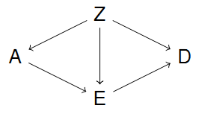
Graphical “language”
Letters in graphs are variables and often referred to as nodes or vertices
Connections between nodes are referred to as arrows or edges
Credit: J. Textor

Slide 31
Graphical “language”
Relationships between nodes
Z is parent of A, D, E
D is a child of Z and E
D is a descendant of A
A is an ancestor of D
Credit: J. Textor

Slide 32
Graphical “language”
Nodes with arrows (directly) emanating into other nodes are referred to as parents (or ancestors)
Nodes with arrows pointing (directly) into them are children (or descendants)

Slide 33
Graphical “language”
A connection via several arrows is referred to as a path (or trail)
A path can have arrows going into different directions, e.g., A ← Z → E → D
Credit: J. Textor

Slide 34
Causal model
A directed arrow between two nodes represents an assumed causal effect between two variables
This effect may be linear, non-linear, deterministic – completely non-parametric

Slide 35
Causal model
A bi-directed arrow between two nodes represents an unobserved cause
We may either draw a latent variable with directed paths or use bi-directed arrows

Slide 36
Causal model
The absence of an arrow between two variables denotes the absence of any direct effect or latent confounding
It is the absence of arrows that is most critical and that must be argued for

Slide 37
Causal model
There might be strong disagreement about how the DAG should look like
However, once researchers agree on the structure of the DAG, there should also be agreement about which effects can be causally interpreted and which model should be used to estimate these effects

Slide 38
Causal model
DAGs put our theoretical assumptions about the relationships between variables of interest in a graphical format
DAGs as a manifestation of your literature review and best known theory

Slide 39
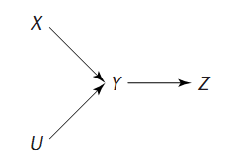
Causal model
What kind of assumptions are advertised in the following DAG?
Credit: M. Glymour

Slide 40
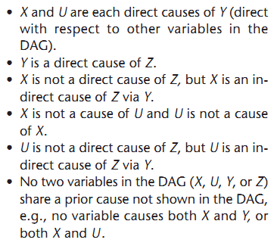
Credit: M. Glymour

Slide 41
Causal model
The back-door criterion relies on a concept called d-separation and the idea of “blocking” paths that would otherwise induce bias

Slide 42
Type of paths
We define a path that has an arrow going out of the treatment variable, as a front-door path
We define a path that has an arrow going into the treatment variable, as a back-door path
We define a path that is not blocked, as open
We define a path that is blocked, as closed
All four combinations of paths can exist

Slide 43
Type of paths
Front-door + open → causal path
Front-door + closed → neutral, but biasing (for total effect) if opened
Back-door + open → biasing path
Back-door + closed → neutral, but biasing if opened

Slide 44
Blocking a path
Blocking refers to holding a variable constant in a graph
In practice, this may mean regression adjustment, or other techniques
Whether or not a variable blocks a particular path is dependent on other variables in the path, and the direction of the arrows

Slide 45
Blocking a path
Common cause (fork)
Mediation (chain)
Mediation (inverted chain)
Collider (inverted fork)

Slide 46
Back-door
Check all paths from your supposed cause X (treatment) to outcome
Block all biasing paths, without blocking any causal paths, or opening any closed front-door paths (leave all front-door paths as they were)
Note that in this process of blocking we might open previously closed back-door paths which could turn into biasing paths, which we will need to close as well

Slide 47
Brainstorm exercise

Slide 48
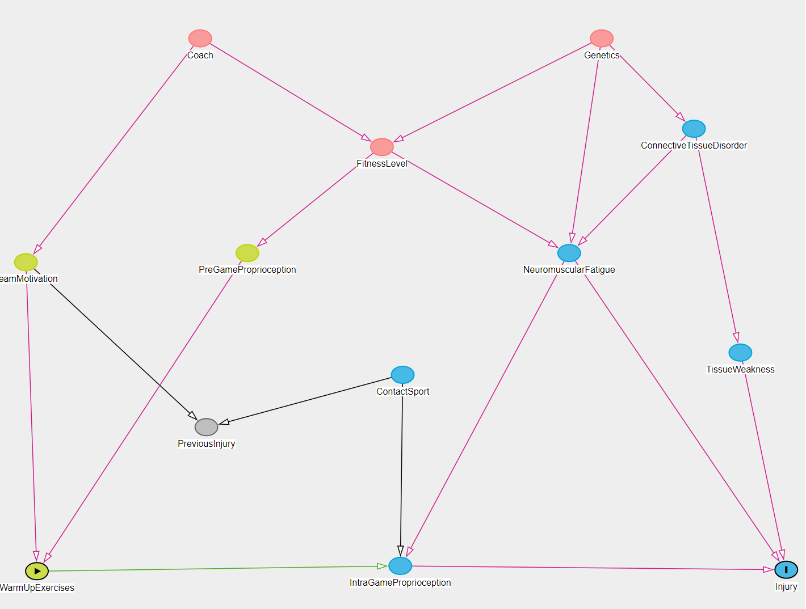

Slide 49
Exercise 1

Slide 50
Exercise 1
Download the “ex1.pdf” file and follow the instructions given in the document
If you have trouble copying and pasting from a PDF, you can also download the source file “ex1.Rmd”

Slide 51
Regression adjustment

Slide 52
Z | T | Y0 | Y1
1 | 1 | ● | 2
1 | 1 | ● | 2
1 | 1 | ● | 2
1 | 0 | 0 | ●
2 | 0 | 0 | ●
2 | 0 | 0 | ●
2 | 0 | 0 | ●
2 | 1 | ● | 1/4
 |  | 0 | 1.562

Slide 53
Z | T | Y0 | Y1
1 | 1 | ● | 2
1 | 1 | ● | 2
1 | 1 | ● | 2
1 | 0 | 0 | ●

Slide 54
Z | T | Y0 | Y1
2 | 0 | 0 | ●
2 | 0 | 0 | ●
2 | 0 | 0 | ●
2 | 1 | ● | 1/4

Slide 55
Z | T | Y0 | Y1
2 | 0 | 0 | 1/4
2 | 0 | 0 | 1/4
2 | 0 | 0 | 1/4
2 | 1 | 0 | 1/4
 |  | 0 | .25
Z | T | Y0 | Y1
1 | 1 | 0 | 2
1 | 1 | 0 | 2
1 | 1 | 0 | 2
1 | 0 | 0 | 2
 |  | 0 | 2
(.25 + 2) / 2 = 1.125

Slide 56
Z | T | Y0 | Y1
1 | 1 | 0 | 2
1 | 1 | 0 | 2
1 | 1 | 0 | 2
1 | 0 | 0 | 2
 |  | 0 | 2

Slide 57
Z | T | Y0 | Y1
2 | 0 | 0 | 1/4
2 | 0 | 0 | 1/4
2 | 0 | 0 | 1/4
2 | 1 | 0 | 1/4
 |  | 0 | .25

Slide 58
Z | T | Y0 | Y1
2 | 0 | 0 | 1/4
2 | 0 | 0 | 1/4
2 | 0 | 0 | 1/4
2 | 1 | 0 | 1/4
 |  | 0 | .25
Z | T | Y0 | Y1
1 | 1 | 0 | 2
1 | 1 | 0 | 2
1 | 1 | 0 | 2
1 | 0 | 0 | 2
 |  | 0 | 2
(.25 + 2) / 2 = 1.125

Slide 59
Adjustment
In the previous slide we saw the fundamental idea behind adjustment
Using a model (here just modeling means within strata of a covariate) and estimating effects within strata of units that are identical
We may also use this model to estimate potential outcomes
Conditional ignorability must hold

Slide 60
Statistical aspects of adjustment
Research manuscripts often mention that variables were adjusted on, or controlled for
What exactly does it mean to control for something?

Slide 61
Statistical aspects of adjustment
In many instances adjustment or controlling for is synonymous with adding a covariate (a potential confounder) to a linear regression model
But other adjustment techniques also exist (matching, weighting)
We will cover all three of them

Slide 62
Statistical aspects of adjustment
Consider that we are interested in the causal effect of a non-randomized treatment
We have covariates at our disposal, and through the use of theory (and maybe a DAG) we feel confident that we have a set of covariates that would fulfill ignorability
How do we adjust on these variables?

Slide 63
Simple example
A non-randomized treatment that hopes to increase academic achievement is offered to a group of students
Students select into treatments and consequently end up differing on important pre-test covariates
One of them is prior academic achievement

Slide 64
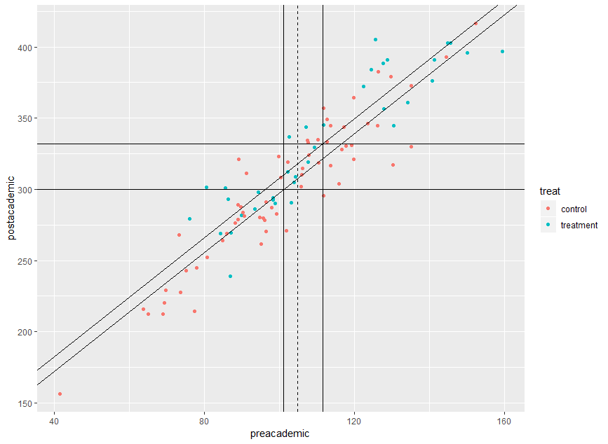

Slide 65
Simple example
Comparison of groups that differ in treatment status AND at the same time differ on their pre-treatment achievement
How would the means of the two groups look like if the pre-treatment achievement scores were identical? (e.g., both were on the overall mean)

Slide 66
Simple example
Using a model (e.g., a parametric linear regression model) we can predict what the post-test score of a unit would be if assigned to the treatment group, or the control group, given values on pre-academic achievement
These predictions emerge from a model, hence this is referred to as model-based adjustment

Slide 67
Simple example
We can use the regression equation to predict the post-test academic achievement for each person, under both control and treatment
From these individual values, we can aggregate means, which are referred to as “adjusted means”
This model is essentially identical to the ANCOVA model

Slide 68
Simple example
Differences between these adjusted means are adjusted treatment effects
They answer the question what the treatment effect would be, if we compared similar units or observed every potential outcome (which we do not)

Slide 69
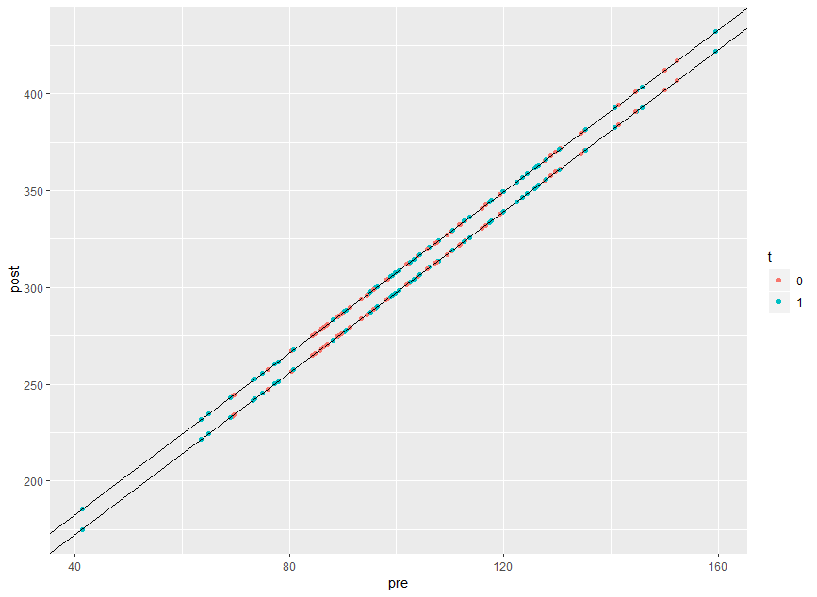

Slide 70
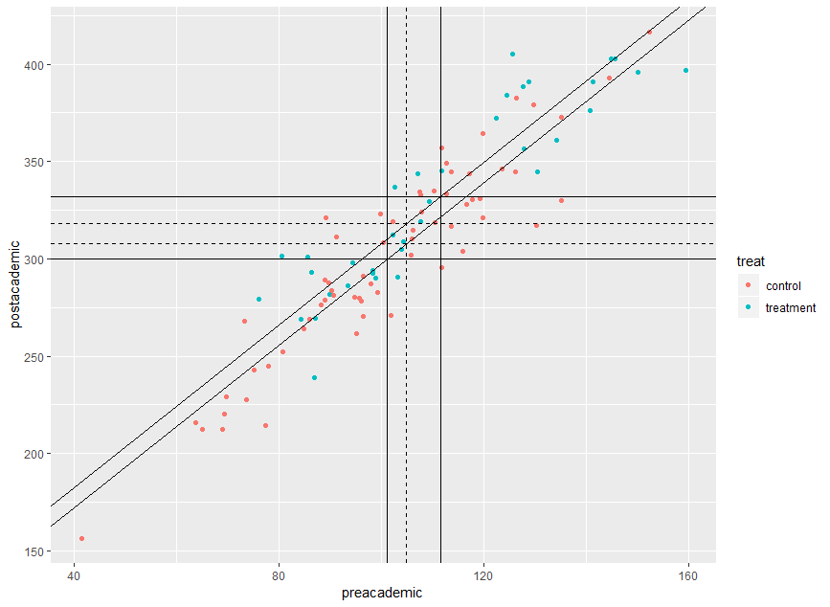

Slide 71
Simple example
It is possible to obtain these treatment effects directly from the (summary) output of a regression model
This however only works in simple (linear, non-interactive) models
More complicated models (with interactions, non-linear effects) require some type of post-processing of the regression estimates

Slide 72
Brainstorm exercise

Slide 73
Simple example
R has various packages that perform this type of analysis
margins – general package for average effects (based on Stata’s margins command)
EffectLiteR – powerful package for causal effects using multi-group SEM
tlme – package for G-estimation, especially useful for doubly robust methods and flexible estimation
emmeans – general purpose package for post-processing regression results with categorical treatment variables

Slide 74


Slide 75
emmeans example
Same example of post-academic achievement, and the effect of treatment, adjusted on pre-academic achievement

Slide 76
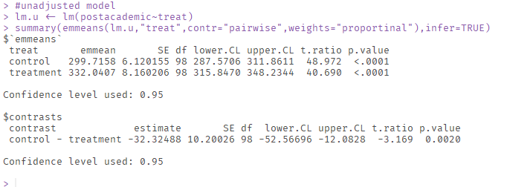
emmeans

Slide 77
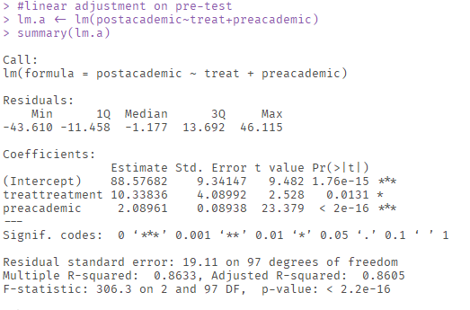
Regression and predicted values

Slide 78
Regression and predicted values

Slide 79
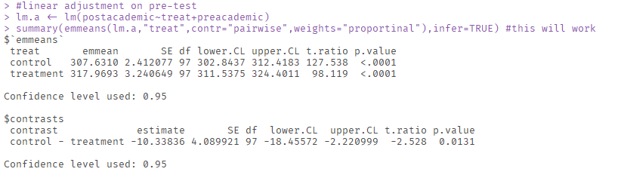
emmeans

Slide 80
Exercise 2

Slide 81
Exercise 2
Download the “ex2.pdf” file and follow the instructions given in the document
If you have trouble copying and pasting from a PDF, you can also download the source file “ex2.Rmd”

Slide 82
ANCOVA
Linearity assumption needs to be confirmed
But can be relaxed
No-interaction assumption needs to be confirmed
But can be relaxed

Slide 83
ANCOVA
How do we know whether a non-linear effect or an interaction is needed?
Regression diagnostics
Machine learning to circumvent the whole process of selecting functional forms and checking them (tmle SuperLearner)

Slide 84
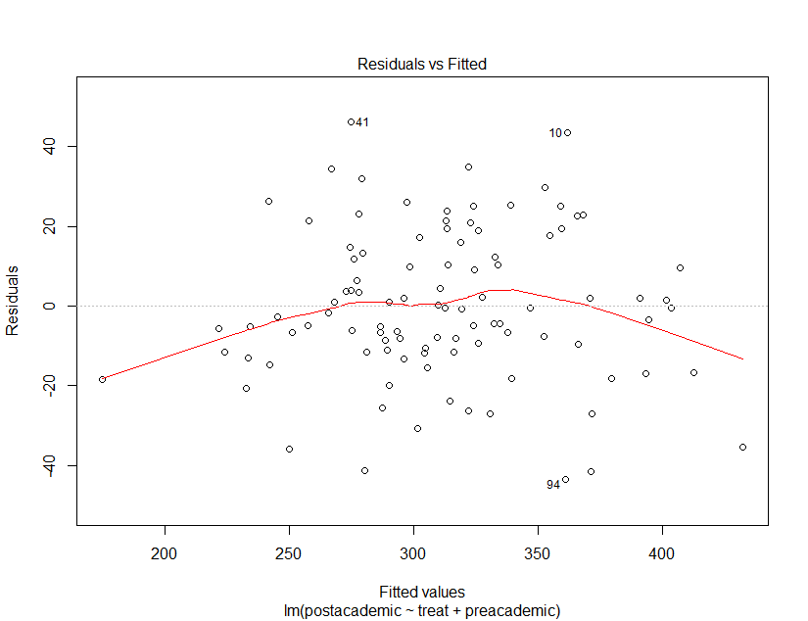

Slide 85
Effect estimation
In the presence of non-linear effects, and interactions, typical regression summaries do not show the treatment effect
The treatment effect can still be derived by generating predicted values for each unit under treatment and under control (and then computing differences, and aggregates of differences)
It is also possible to obtain the same estimates by evaluating group mean differences at the mean value of all covariates
emmeans can do this for us

Slide 87
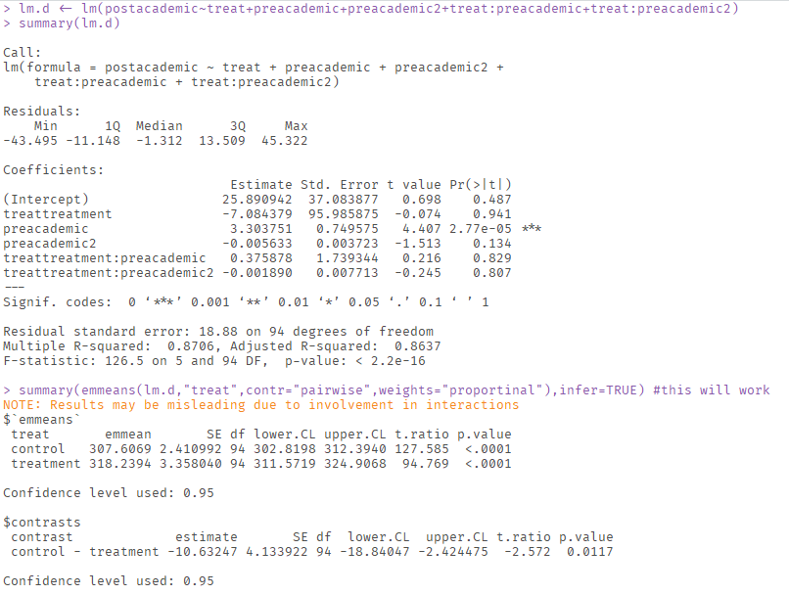

Slide 88
Categorical covariates
The same principle applies if the covariate happens to be categorical and not continuous
We can still predict outcomes under all combinations of covariate levels, and treatment assignments
emmeans treats categorical predictors properly (for causal inference purposes) if we use the weights=“proportional” option

Slide 89
ANCOVA
Additional assumption that there is sufficient overlap (positivity)
Adjusted means represent predictions based on observed regression slopes
These predictions can be far outside the “region of common support”

Slide 90
ANCOVA
Imagine adjusting for many variables
Groups should have some overlap otherwise adjusted means are extrapolated into regions where potentially no data is observed
One way to confront this is to restrict estimation of a causal effect for region in which there is overlap

Slide 91
Convex hull
The convex hull is an area that is defined by the outer limits of a point cloud in multi-dimensional space
We can restrict our analysis to those units that are assigned to one treatment, but still fall in the convex hull of the other units
That way, we never extrapolate in regions that are completely sparse and only exclusively inhabited by one or the other group

Slide 92
Convex hull
Gary King gives an example on the causal effect of effects of democracies vs autocracies
The counterfactual of autocratic Poland in 1990 lies within the range of other democracies
The counterfactual of democratic Canada in 1995 lies far outside the range of other autocracies

Slide 93
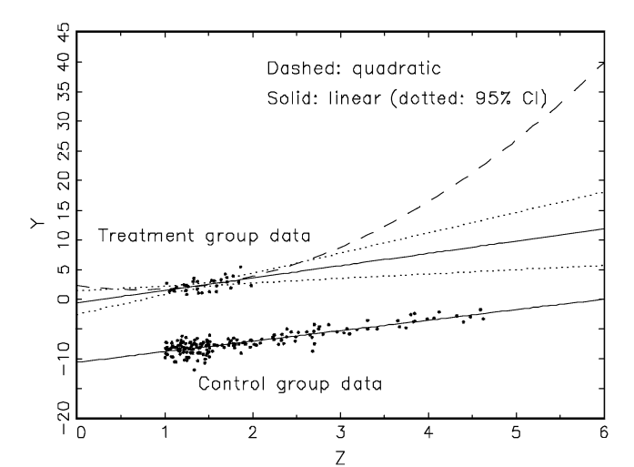

Slide 94
Convex hull
Restricting the analysis to points that lie inside the region of common support reduces model dependency
That means that slightly mis-specified models do not have very severe consequences (more robust)
It also forces us to realize that there are points for which causal inference is unstable

Slide 95
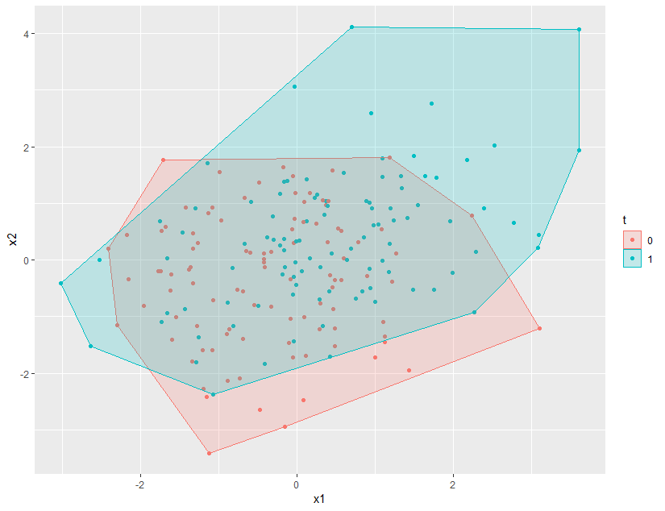

Slide 96
Regression adjustment workflow
Selection
Residual Checks
Model estimation
Effect Estimation

Slide 97
Exercise 3

Slide 98
Exercise 3
Download the “ex3.pdf” file and follow the instructions given in the document
If you have trouble copying and pasting from a PDF, you can also download the source file “ex3.Rmd”

Slide 99
Matching

Slide 100
Matching
In the previous section on adjustment we used a parametric model to predict potential outcome
Instead of using a model, we may choose to try to find pairs of variables that are identical (on covariates) but differ on treatment assignment, so that they can serve as the missing potential outcome for each other

Slide 101
Z | T | Y0 | Y1
1 | 1 | ● | 2
1 | 1 | ● | 2
1 | 1 | ● | 2
1 | 0 | 0 | ●
2 | 0 | 0 | ●
2 | 0 | 0 | ●
2 | 0 | 0 | ●
2 | 1 | ● | 1/4
 |  | 0 | 1.562

Slide 102
Z | T | Y0 | Y1
1 | 1 | ● | 2
1 | 0 | 0 | ●
2 | 0 | 0 | ●
2 | 1 | ● | 1/4
 |  | 0 | 1.125

Slide 103
Z | T | Y0 | Y1
1 | 1 | 0 | 2
1 | 0
2 | 0 | 0 | 1/4
2 | 1
 |  | 0 | 1.125

Slide 104
Matching
An obstacle to matching is that if we have many covariates (and usually we want that, because otherwise ignorability does not hold), the region of common support gets very small
Same issue with convex hull that restricted adjustment to region of common support
Some consider this an advantage, because that means with a matching estimator you virtually never extrapolate

Slide 105
Matching
Consider that we have 16 covariates
8 of them are binary which means 2^8 = 256 combinations
The remaining 8 are continuous and in order to match them, we discretize them into 3 categories each (low, medium, high), so 6561 combinations
Together we have well over a million different combinations of covariate levels – if at a minimum we want at least 1 treated and 1 untreated person in each combination we need a sample size of at least 2 – 3 millions

Slide 106
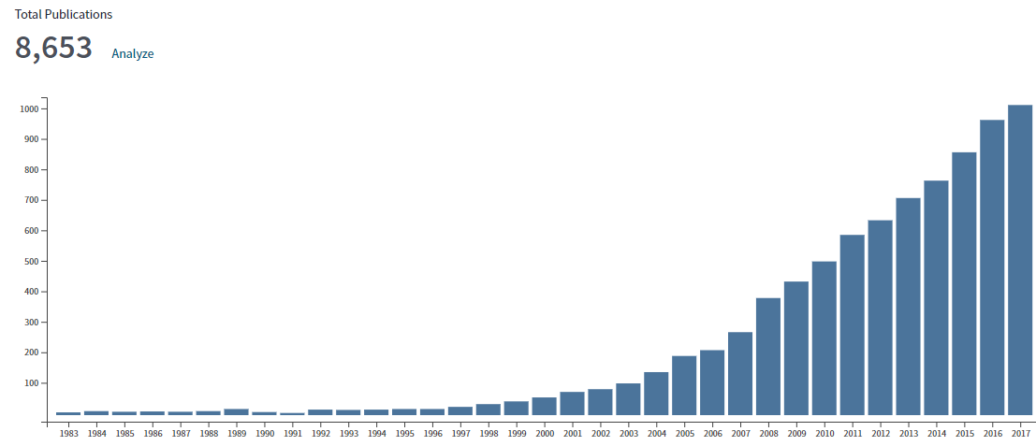
Increasing use of Propensity Scores
Source: Web of Science

Slide 107
Propensity scores
z = treatment assignment 1 = treatment group 0 = control group
Propensity score
conditional on
controlled for
e(x) = p (z=1 | x)
probability
x = vector of covariates

Slide 108
Propensity scores
e(x) = p (z=1 | x)
A single number summary based on all available covariates that expresses the probability that a given subject is assigned to the treatment condition, based on the values of the set of observed covariates

Slide 109
Propensity scores
Actual assignment
Actual assignment
Control
Treatment
Control
Treatment
Likelihood of receiving treatment
Likelihood of receiving treatment

Slide 110
Example of balance property
original sample
a | b | z | e(x)
0 | 0 | 0 | .5
0 | 0 | 1 | .5
1 | 0 | 0 | .33
1 | 0 | 0 | .33
1 | 0 | 1 | .33
0 | 1 | 0 | .66
0 | 1 | 1 | .66
0 | 1 | 1 | .66
1 | 1 | 1 | 1
1 | 1 | 1 | 1
e(x) = p(z=1| x={0 0}) = .5
e(x) = p(z=1| x={1 0}) = .33
e(x) = p(z=1| x={0 1}) = .66
e(x) = p(z=1| x={1 1}) = 1
(a=1 | z=0) = .5
(b=1 | z=0) = 1/4
(a=1 | z=1) = .5
(b=1 | z=1) = .66

Slide 111
Example of balance property
matched sample
a | b | z | e*(x)
0 | 0 | 0 | .5
0 | 0 | 1 | .5
1 | 0 | 0 | .5
1 | 0 | 1 | .5
0 | 1 | 0 | .5
0 | 1 | 1 | .5
p(z, x|e(x)) = p(z |e(x)) p(x |e(x))
Examples for z=1 and x = {0 1}
p(z=1, x={0 1}|e(x)) = 1/6
p(z=1 |e(x)) = .5
p(x={0 1} |e(x)) = .33
p(z |e(x)) p(x |e(x)) = (.5)(.33) = 1/6
(a=1 | z=0) = .5
(b=1 | z=0) = .5
(a=1 | z=1) = .5
(b=1 | z=1) = .5

Slide 112
Propensity scores
Balance on the propensity score implies on average balance on all observed covariates
Importantly, PS matching generates balance in the distributions of covariates, and not necessarily for each single pair of unit

Slide 113
Propensity score
Propensity score models influence of confounders on treatment assignment
In comparisons, ANCOVA models influence of confounders on outcome
Confounder
Treatment
Outcome

Slide 114
Propensity scores | Regression adjustment
Tool to strengthen causal conclusions | Tool to strengthen causal conclusions
Models relationship between confounders and treatment | Models relationship between confounders and outcome
No assumption about functional form of propensity score | Classic ANCOVA assumes lineartiy and absence of interaction, but can be extended
Outcome variable unknown during propensity score analysis | Outcome variable always part of the adjustment
Sample size can be diminished, loss of power | Sample size stays constant, power can increase due to covariates

Slide 115
Brainstorm exercise

Slide 116
Matching
Just like there are modeling choices in the estimation of the outcome model in ANCOVA, so are there choices in the estimation of the propensity score, and the type of matching that is performed
The propensity score is typically estimated using a logistic regression (predicting treatment assignment from covariates), but one could also use machine learning algorithms

Slide 117
Propensity Score
Predicting Selection
Confounder
Predicting Outcome
Treatment
Outcome
Select true confounders and covariates predictive of outcome (back-door criterion, ignorability)

Slide 118
Propensity Score
Estimation of propensity scores can be achieved in numerous ways
Logistic regression
Discriminant analysis
(Boosted) regression trees

Slide 119
Propensity Score
Logistic regression model
Outcome is treatment assignment
Predictors are covariates
can be overfitted to the sample, e.g. include interactions, higher order terms
only interest is prediction and covariate balance
= β₀ + β_{i} X

Slide 120
Propensity Score
Various matching algorithm (full matching, optimal matching, etc.)
Too many to discuss, but here are some of the classic ones
In our exercise, we will mostly use classic matching methods

Slide 121
NN - matching
Nearest-neighbor matching (NN)
Participants are ordered and then one after the other is matched to the unit with the closest propensity score
With or without replacement (sample size bias tradeoff)
1:1 or 1:k matching
With our without caliper (avoids bad matches)

Slide 122
Kernel - matching
Match every unit in one condition to a single unit in the other condition, but weight the matched units by their distance
Weighting is defined through the kernel function (essentially bandwidth parameter)

Slide 123
Trade-offs
 | Bias | Variance
1:1 1:k | ↓ ↑ | ↑ ↓
Caliper No caliper | ↓ ↑ | ↑ ↓
Replacement No Replacement | ↓ ↑ | ↑ ↓
NN Kernel | ↓ ↑ | ↑ ↓
Small bandwidth Large bandwidth | ↓ ↑ | ↑ ↓
Source: Caliendo and Kopeinig, 2005

Slide 124
Propensity Score
Check of covariate balance
standardized difference
graphical assessment (e.g. Q-Q plot)
Region of common support (distributional overlap)
graphical assessment (e.g. histograms)

Slide 125
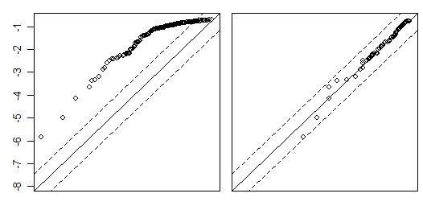
Propensity Score
Before Matching
After Matching
Logit Propensity Score Treatment Group
Quantiles of both distributions are plotted against each other
Logit Propensity Score Control Group

Slide 126
Propensity Score
Before Matching
After Matching

Slide 127
Density
Density of scores
for non-
participants
Density of scores for participants
Region of common support
0
High probability of participating given X
Propensity score
1

Slide 128
Propensity Score
Estimate of treatment effect
Mean difference
Standard error dependent on conditioning scheme (dependent sample standard error or bootstrapping)

Slide 129
Packages
R has various packages that perform this type of analysis
MatchIt – general and flexible package for matching estimators
EffectLiteR – allows inclusion of propensity score in estimation
tlme – allows inclusion of propensity score in estimation
PSAgraphics – package for visualization

Slide 131
Propensity Score Workflow
Selection
Balance Checks
PS Estimation
Matching
Effect Estimation

Slide 132
Exercise 4

Slide 133
Weighting

Slide 134
Weighting
Another idea to adjust for confounding influences is to weight the observed population in a way that creates a “pseudo-population” in which the covariate and the treatment are independent of each other
In such a pseudo-population, there is no more confounding
This could mean that one person gets counted 4 times in a sample, while another person only gets counted ¼ of a time

Slide 135
Propensity scores | Regression adjustment | IPTW
Tool to strengthen causal conclusions | Tool to strengthen causal conclusions | Tool to strengthen causal conclusions
Models relationship between confounders and treatment | Models relationship between confounders and outcome | Construct weights based on confounder and treatment
No assumption about functional form of propensity score | Classic ANCOVA assumes lineartiy and absence of interaction, but can be extended | No assumption about functional form of weight equation
Outcome variable unknown during propensity score analysis | Outcome variable always part of the adjustment | Outcome variable unknown during weight construction
Sample size can be diminished, loss of power | Sample size stays constant, power can increase due to covariates | Sample size stays constant, but weights induce uncertainty in estimate

Slide 136
Z | T | Y0 | Y1
1 | 1 | ● | 2
1 | 1 | ● | 2
1 | 1 | ● | 2
1 | 0 | 0 | ●
2 | 0 | 0 | ●
2 | 0 | 0 | ●
2 | 0 | 0 | ●
2 | 1 | ● | 1/4
 |  | 0 | 1.562

Slide 137
Z | w | T | Y0 | Y1
1 | 1.33 | 1 | ● | 2
1 | 1.33 | 1 | ● | 2
1 | 1.33 | 1 | ● | 2
1 | 4.00 | 0 | 0 | ●
2 | 1.33 | 0 | 0 | ●
2 | 1.33 | 0 | 0 | ●
2 | 1.33 | 0 | 0 | ●
2 | 4.00 | 1 | ● | 1/4
 |  |  | 0 | 1.125
((2 × 1.33) × 3 + (.25 × 4)) / 8 = 1.125
(0 * 1.33) × 3 + (0 × 4) / 8 = 0

Slide 138
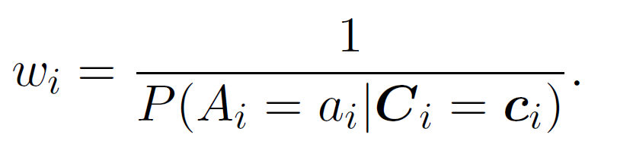
Weighting
Each unit is weighted by the inverse of the probability of being assigned to its treatment, given the covariate values
The denominator of this formula is the propensity score

Slide 139
Weighting
A unit that has covariate values that make it very likely to be in the actual assigned group ends up getting a small weight
A unit that has covariate values that make it very unlikely to be in the actual assigned group ends up getting a large weight
Rare units in the control are up-weighted, and common units down-weighted, and likewise in the treatment
This creates pseudo-populations in which the covariates are equally distributed

Slide 140
Statistical aspects of weighting
Using weights can have some undesirable consequences in small samples
Very rare units can get tremendous weight, and thus making the estimate highly dependent on that particular unit

Slide 141
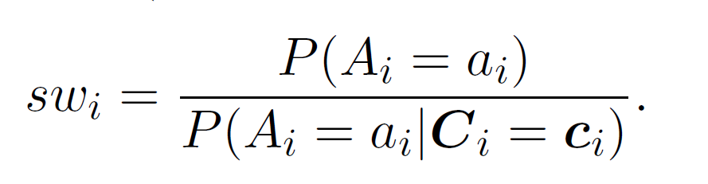
Statistical aspects of weighting
The use of so-called stabilized weights, and weight truncation is encouraged

Slide 142
Z | w | T | Y0 | Y1
1 | .666 | 1 | ● | 2
1 | .666 | 1 | ● | 2
1 | .666 | 1 | ● | 2
1 | 2.00 | 0 | 0 | ●
2 | .666 | 0 | 0 | ●
2 | .666 | 0 | 0 | ●
2 | .666 | 0 | 0 | ●
2 | 2.00 | 1 | ● | 1/4
 |  |  | 0 | 1.125
((2 × .666) × 3 + (.25 × 2)) / 4 = 1.125
(0 * .666) × 3 + (0 × 2) / 4 = 0
Note that stabilized weights preserve the sample size.

Slide 143
Brainstorm exercise

Slide 144
Statistical aspects of weighting
Truncation of the weights means that very large weights are scaled down to some pre-specified percentile
This essentially protects against outliers
Common used percentiles are the 1% and 99% percentile

Slide 145
Statistical aspects of weighting
The outcome analysis is then performed by using a parametric model with the weights
E.g., weighted least squares
Because the estimation of the weights is itself subject to random variability, it is recommended to use robust standard errors for frequentist inference

Slide 146
Statistical aspects of weighting
What makes inverse-probability weighting such a powerful technique is that it can also be used for time-varying treatments
The use of these weights in longitudinal data is in the literature often referred to as a marginal structural model

Slide 147
Packages
R has one package that perform this type of analysis
ipw – general and flexible package for weighting estimators

Slide 149
Weighting workflow
Selection
Weight Checks
Weight Estimation
Effect Estimation

Slide 150
Exercise 5

Slide 151
Combining methods

Slide 152
Combining methods
The discussed methods can be used in conjunction with each other
It is possible to first match participants, and then use regression adjustment to model the outcome
Likewise it is also possible to construct weights, and then use regression adjustment to model the outcome

Slide 153
Combining methods
An interesting property of this approach is that BOTH the relationship between confounders and treatment assignment AND the relationship between confounders and the outcome is modeled
Confounder
Treatment
Outcome

Slide 154
Combining methods
It turns out that if only one of the two models is correct, we still get unbiased estimates
This property is known as “doubly-robust”
Confounder
Treatment
Outcome

Slide 155
Exercise 6

Slide 156
Other identification strategies

Slide 157
Selection on observables
So far all of our models were based on the assumption that we can achieve ignorability (back-door criterion)
But what if that assumption is not really credible?

Slide 158
Other assumptions
We can try to make other causal assumptions that do not rely on having observed all confounders
Whether these assumptions are more or less plausible is always a matter of theory and debate

Slide 159
Instrumental variables
One such causal assumption is that we are able to identify one (or more) variables that are so-called instruments
Confounder
Instrument
Treatment
Outcome

Slide 160
Instrumental variables
An instrument has an effect on the treatment (may or may not be causal)
An instrument is unrelated to the confounders
An instrument does not have a direct effect on the outcome (exclusion restriction)
Confounder
Instrument
Treatment
Outcome

Slide 161
Instrumental variables
Examples:
Randomized treatment assignment in which not everybody responds to treatment. Smoking cessation program -> Smoking frequency -> birth weight
Distance from hospital as instrument for causal relationship between home birth and birth complications

Slide 162
Instrumental variables
IV estimates identify a causal effect for individuals “who can be induced to change [treatment] status by a change in the instrument”
Local treatment effect is instrument-dependent, meaning that one and same effect with different instruments will give different results

Slide 163
Instrumental variables
IV can be estimated through 2-stage least-squares regression or using structural equation models
It is customary to statistically compare estimates from an unadjusted model with those from the IV model (Hausman test)
Also report the significance of the relationship between instrument and putative cause
If more than one IV is available, then one can test whether the IV is correlated with the error of the outcome (Sargan test)

Slide 164
Brainstorm exercise

Slide 166
Mechanisms
Similar in spirit to instrumental variables, one may find a unique mechanism (psychologists would call it full mediation)
Cause
Mech
Outcome

Slide 167
Mechanisms
Despite unobserved confounding between the cause and the outcome, the presence of a mechanism allows us to compute the total causal effect
Cause
Mech
Outcome

Slide 168
Mechanisms
The mechanism must not be related to the unobserved confounders
The cause must not directly cause the outcome, only via the mechanism
Cause
Mech
Outcome

Slide 169
Brainstorm exercise

Slide 170
Statistical aspects of mechanisms
One way to estimate the causal effect via a mechanism is to simply use a structural equation model (path model)
We define a full mediation model, but allow the error terms of treatment and outcome to be correlated
This yields a just-identified model from which we can derive the total effect as the product of the two paths (assuming linear models)

Slide 172
Exercise 7

Slide 174


Slide 175
Complications
Latent variables
Missing data
Machine learning
Longitudinal data
Indirect effects

Slide 176
Latent variables
All of our examples so far used manifest variables
What if some of our constructs are latents and we want to model them this way
Use of full structural equation model (with measurement model) necessary, but many questions remain
EffectLiteR currently only package that tackles these issues

Slide 177
Missing data
All of our examples assumed complete data
Missing data can induce unique biases even in perfectly unconfounded effects
Identification of missingness mechanism (m-graphs) and techniques to recover effects (imputation) rely on additional assumptions

Slide 178
Machine learning
All of our exercises were fitted “manually”, entering covariates and doing some model checks
In complex models this seems hopeless
Machine learning algorithms could potentially help here
Some success stories with Bayesian Regression Trees, and SuperLearner (in tmle package)

Slide 179
Longitudinal data
All of our exercises considered a treatment being administered at one point in time
Longitudinal studies with time-varying treatments, and time-varying confounders pose additional problems
Regression adjustment and matching often infeasible, weighting and marginal structural models possible (in ipw package)

Slide 180
Indirect effects
All of our exercises considered the total effect of a treatment
Sometimes we are interested in mechanisms of a treatment (opening the black box)
This translates into indirect (mediated) effects
Flurry of literature on this topic, incuding necessary assumptions, estimation strategies, and designs (in Mediation package)

Slide 181
Summary

Slide 182
Respect assumptions

Slide 183
Causal conclusions are hard to get

Slide 184
Many roads lead to Rome

Slide 185
Brainstorm exercise

Slide 186


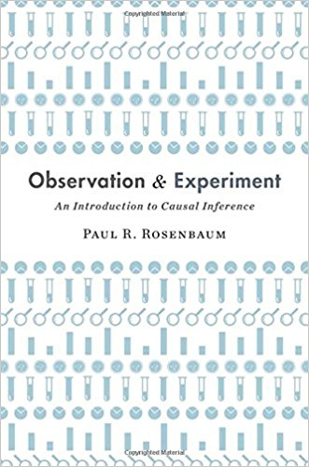
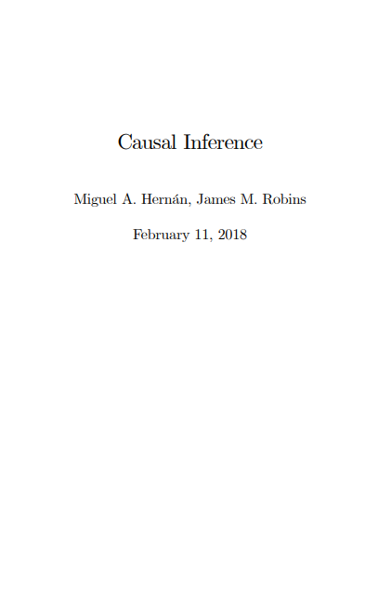
References

Slide 187

felix.thoemmes@cornell.edu felixthoemmes.com @felixthoemmes

