Slide 1
Visitor Counting Console
Features and technical specification

Slide 2
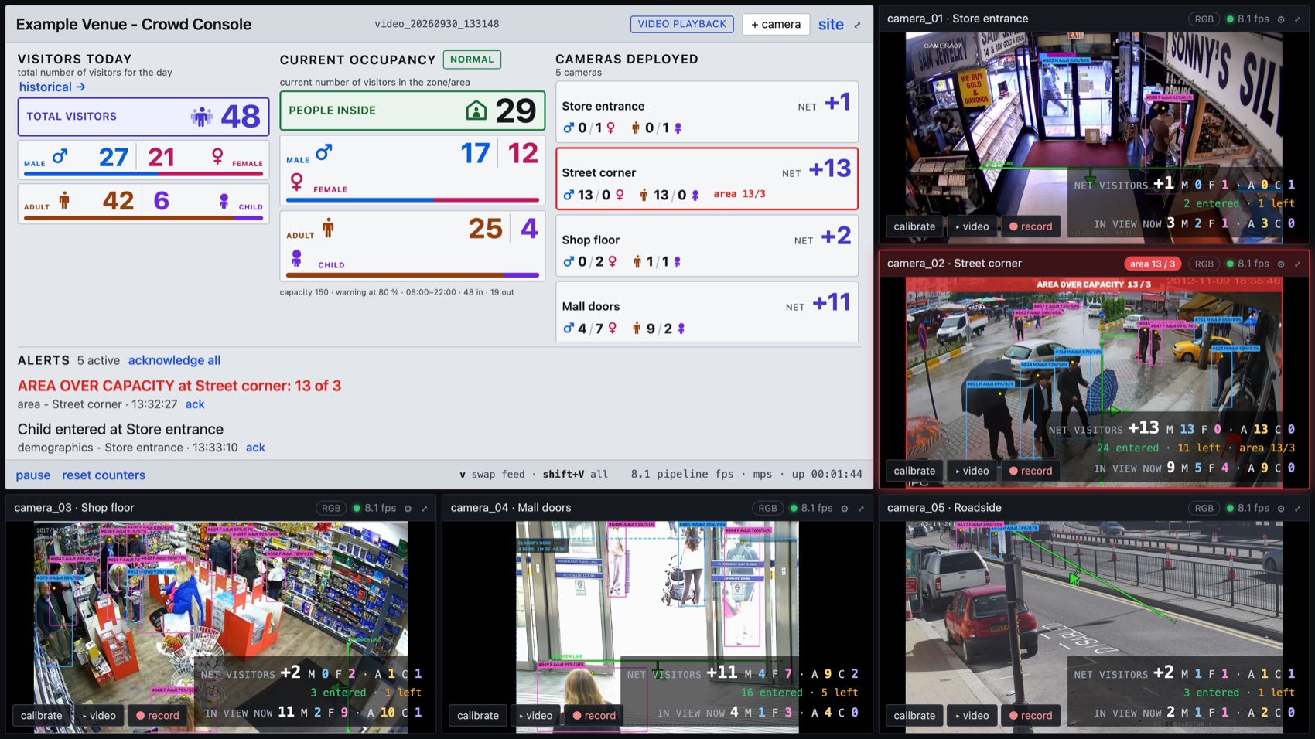
Visitor counting on the CCTV a venue already has

Slide 3
Five entrances, one site. No turnstile, no new hardware, no app.

Slide 4
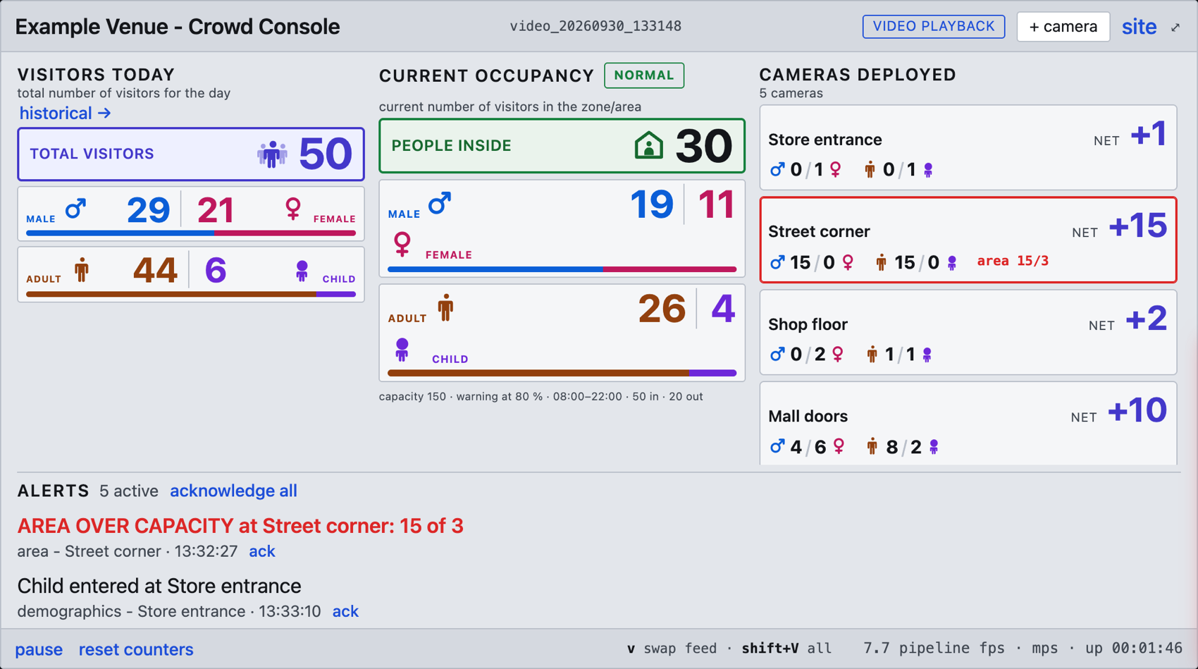
What the operator sees

Slide 5
Visitors today, current occupancy and every camera, side by side.

Slide 6
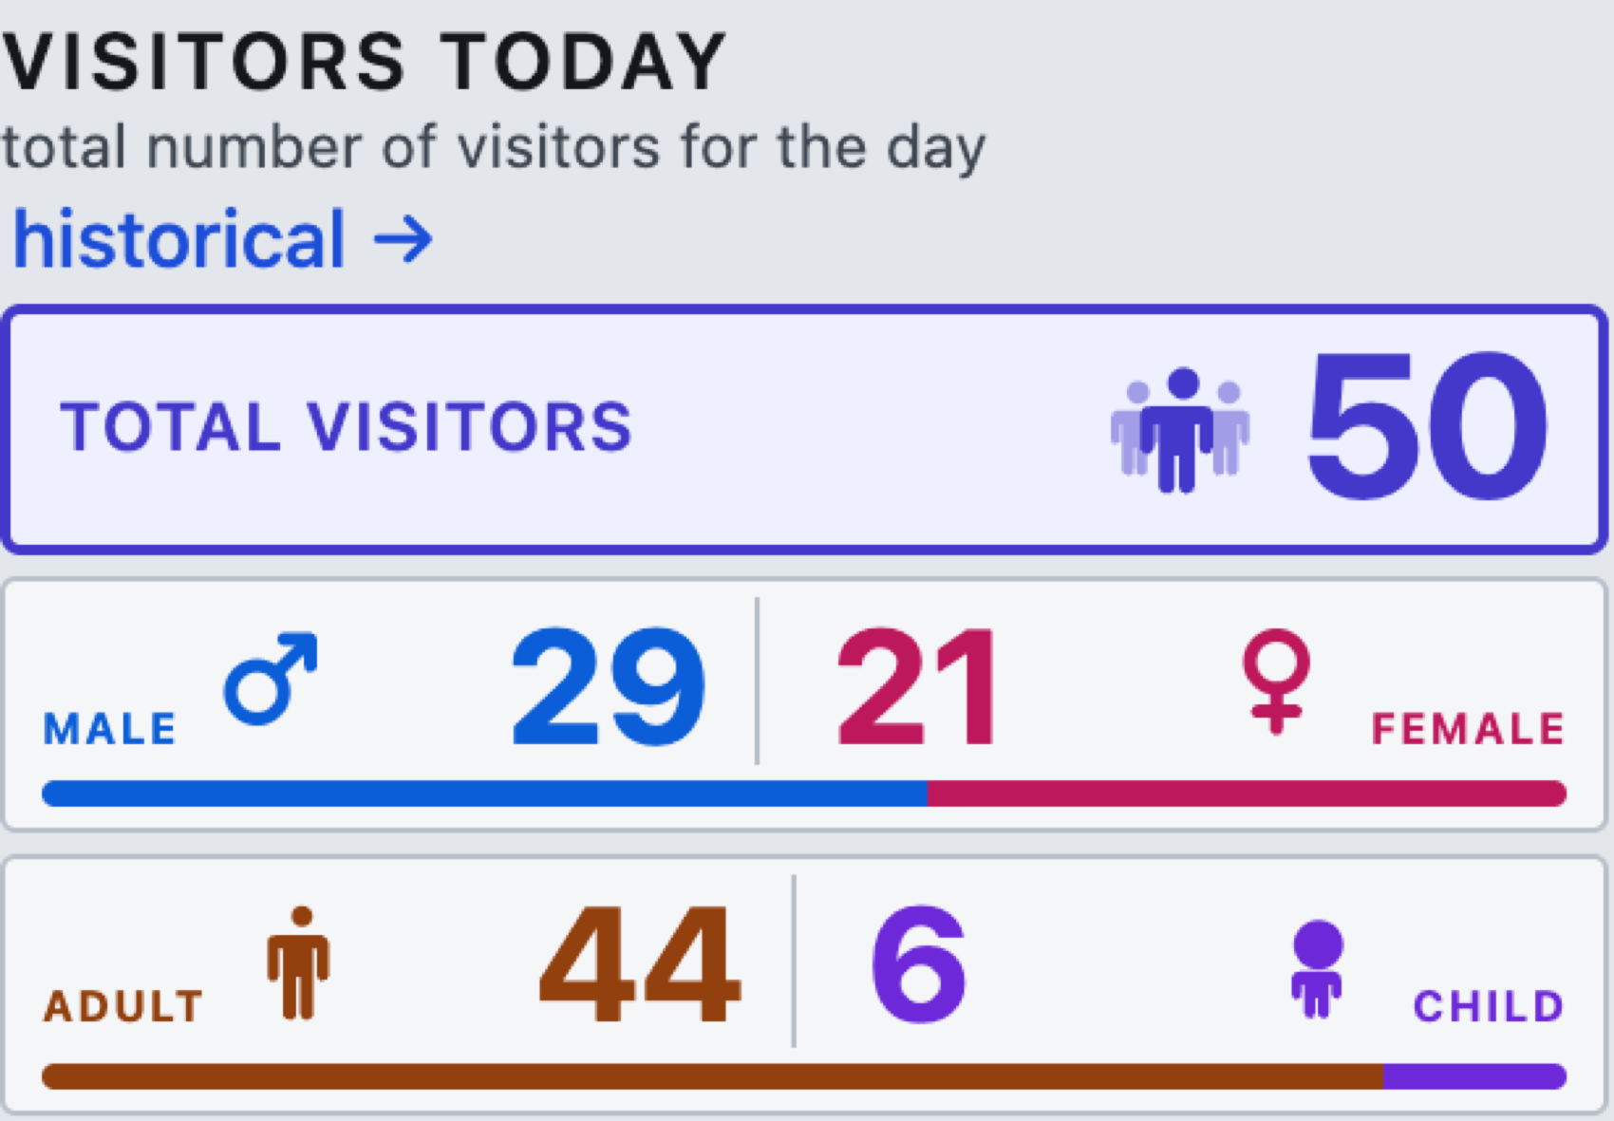
Two figures, deliberately different

Slide 7
Visitors today counts entries only and never falls
Current occupancy is net, and falls again when people leave
Someone who walks in and out has still visited. Conflating the two is the most common way a footfall dashboard misleads.

Slide 8
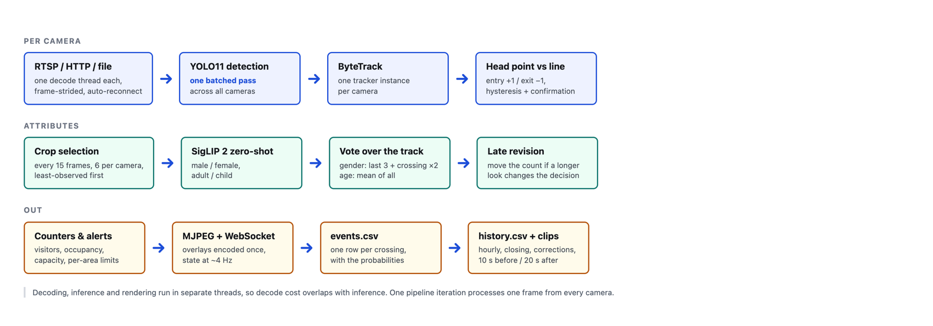
How it works

Slide 9
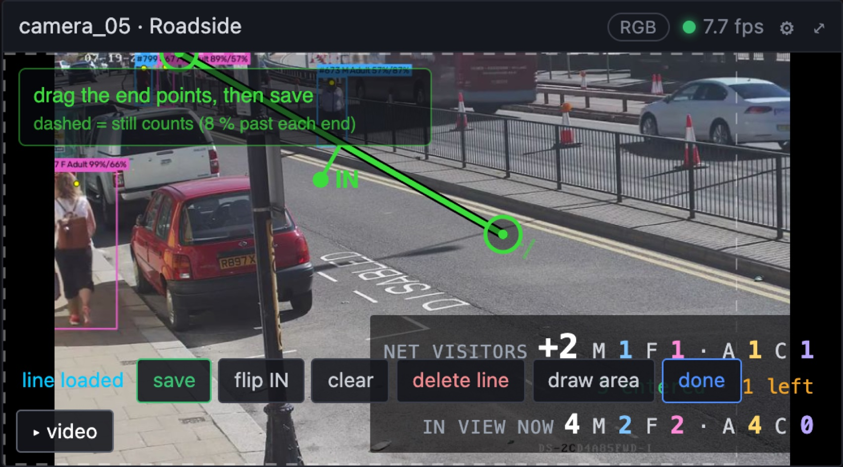
A trigger line, and what it really covers

Slide 10
The dashed extension past each end is the 8 % that still counts. It is drawn, because an invisible tolerance is indistinguishable from a bug when the numbers look wrong. A line saved within 4 % of the frame edge warns.

Slide 11
Demographics: two attributes, two strategies
attribute | averaging everything | split strategy
gender | 90.9 % | 94.5 %
adult / child | 96.4 % | 100 %
Gender — the last three looks plus one at the moment of crossing, counted double. The read swings early in a track and settles at the line.
Age — averages every observation. “Child” is noisy per frame and smooths out.
Measured on 56 hand-labelled crossings:

Slide 12
Undecided people are reported as unknown, never guessed, so the splits always reconcile to the total.

Slide 13
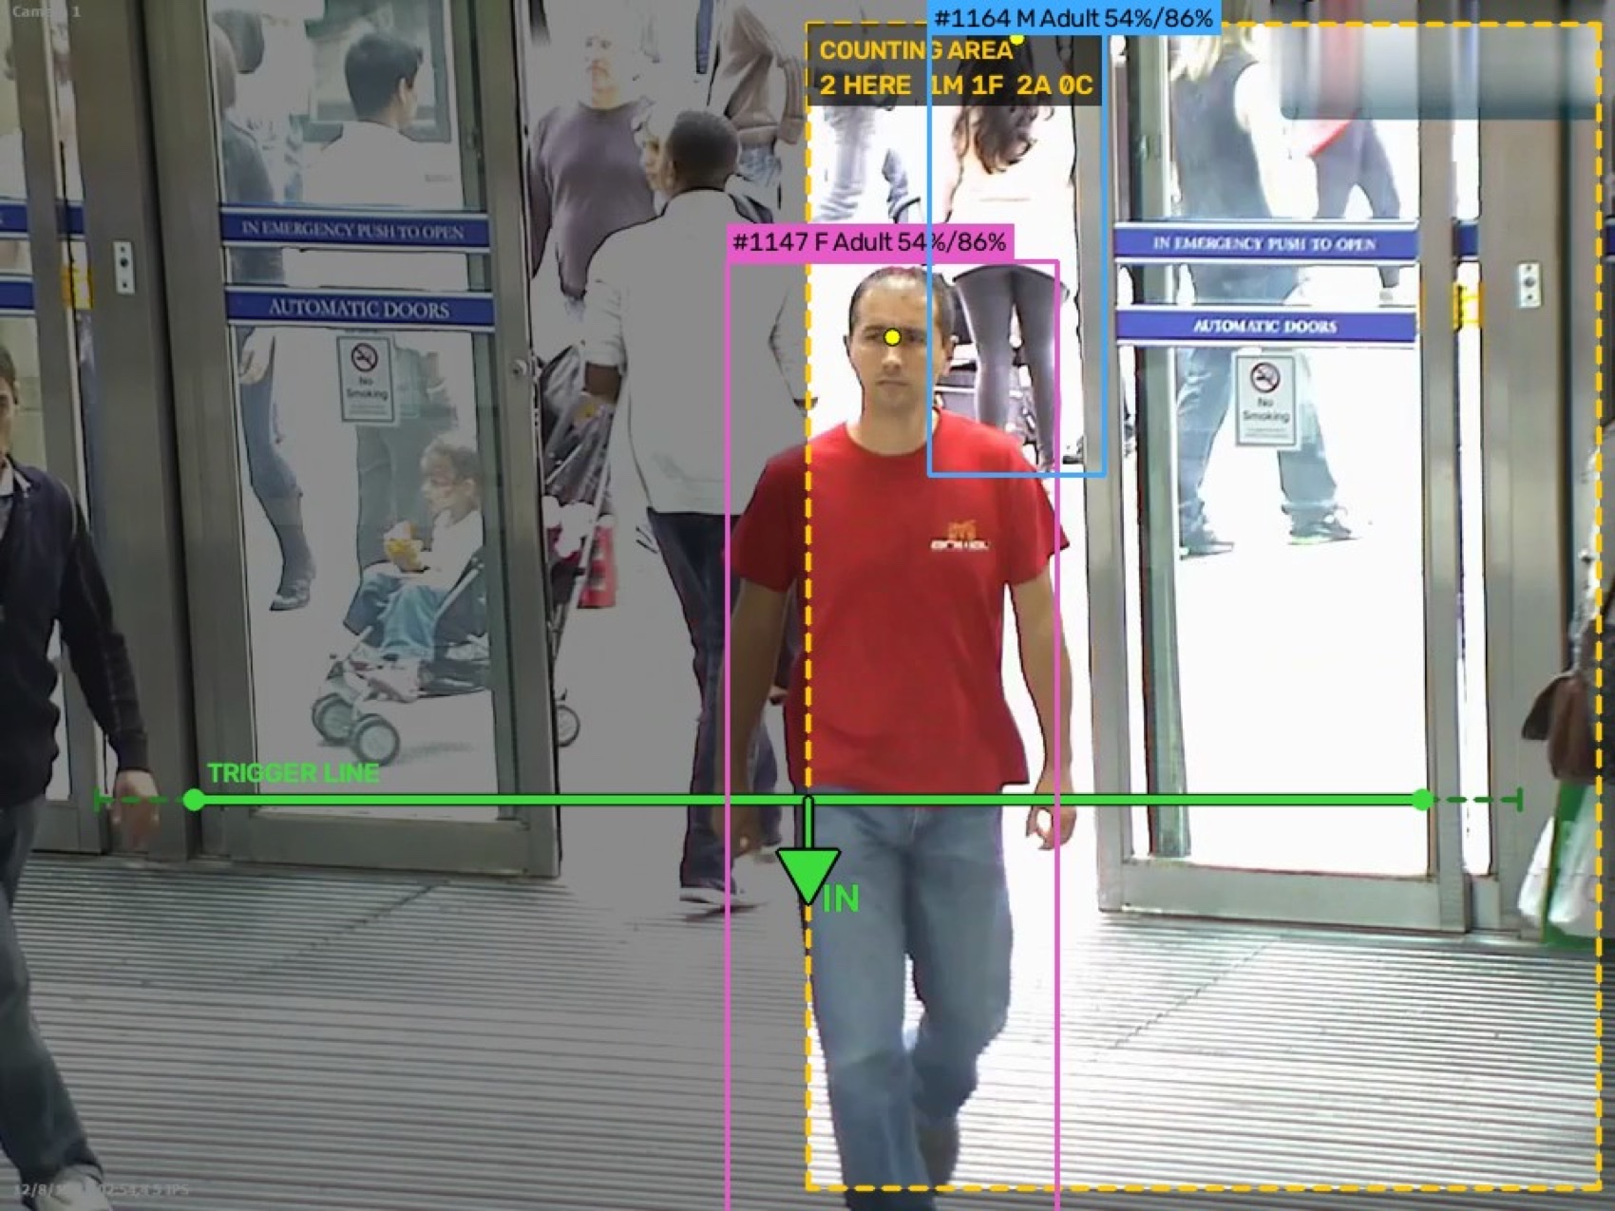
Counting areas have a role: count only inside

Slide 14
Only people inside the box are tracked at all — outside is dimmed, and the people there carry no boxes. The area reports its own population: 2 HERE 1M 1F 2A 0C.

Slide 15
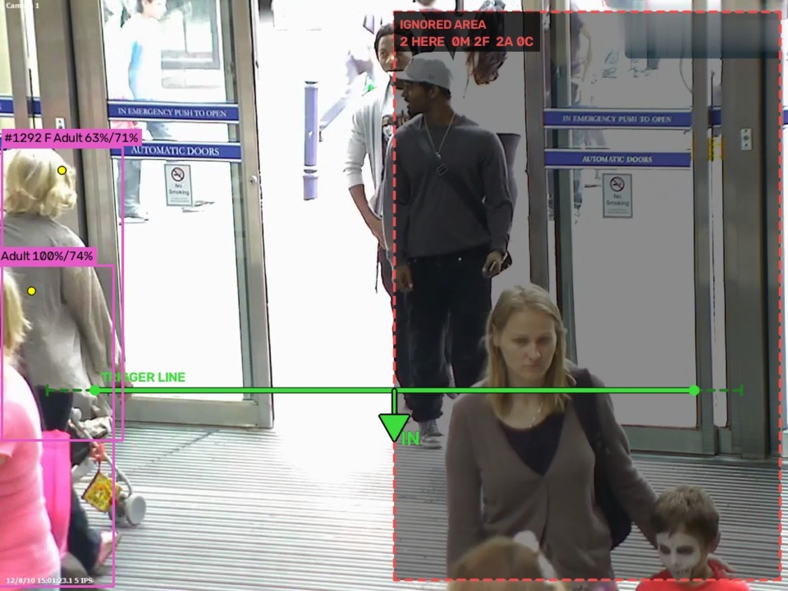
Ignore inside

Slide 16
The mirror image: people inside the box are skipped entirely. For a window, a mirror, a poster or a screen that the detector would otherwise count.

Slide 17
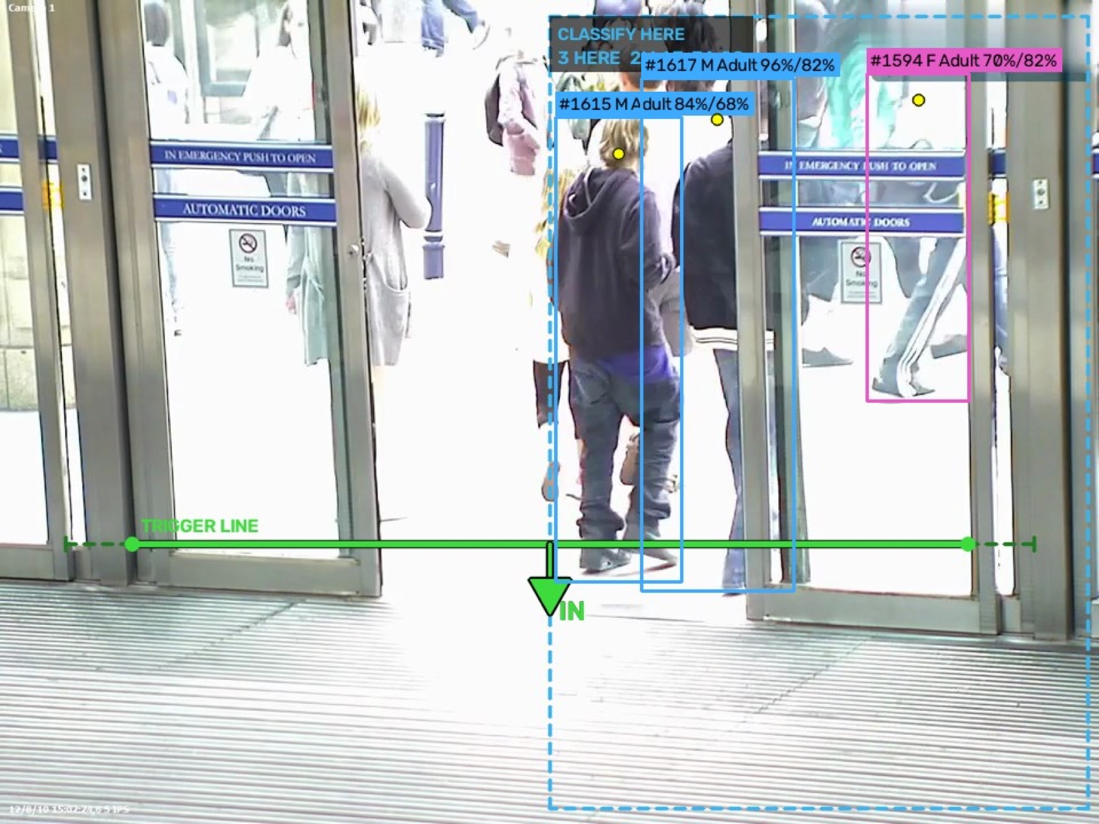
Classify only inside

Slide 18
Everyone is still counted; only those inside are sexed and aged. The accuracy lever on a wide scene — spend the crop budget where people are large and clear, instead of on distant figures.

Slide 19
Why the role matters
role | tracking | classifying | line may sit outside?
count only inside | inside only | inside only | no — saving warns
ignore inside | outside only | everyone tracked | yes
classify only inside | everyone | inside only | yes
Restricting what is tracked and restricting what is classified are different needs.

Slide 20
Count only inside must contain the whole trigger line: a person is only tracked once inside the box, so one approaching from outside is first seen already at the line. The console says so rather than quietly counting nothing.

Slide 21
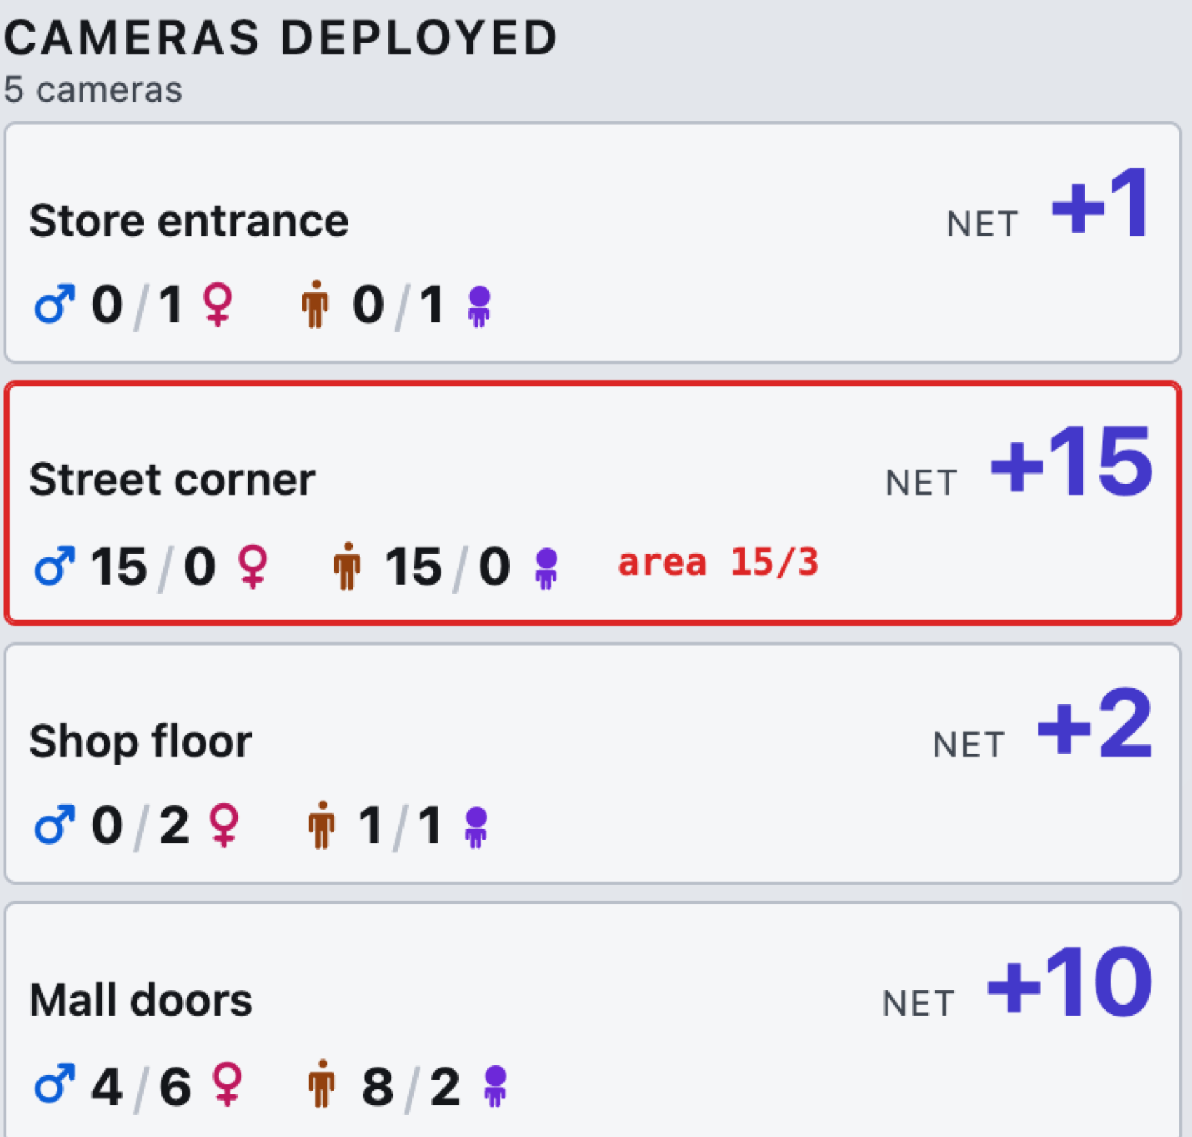
Cameras

Slide 22
Up to six, added and removed while running
One row per camera, whatever the count; the list scrolls on its own
Paired feeds: one key swaps a panel between its live camera and a saved clip
An offline camera hides its figures rather than showing frozen ones

Slide 23
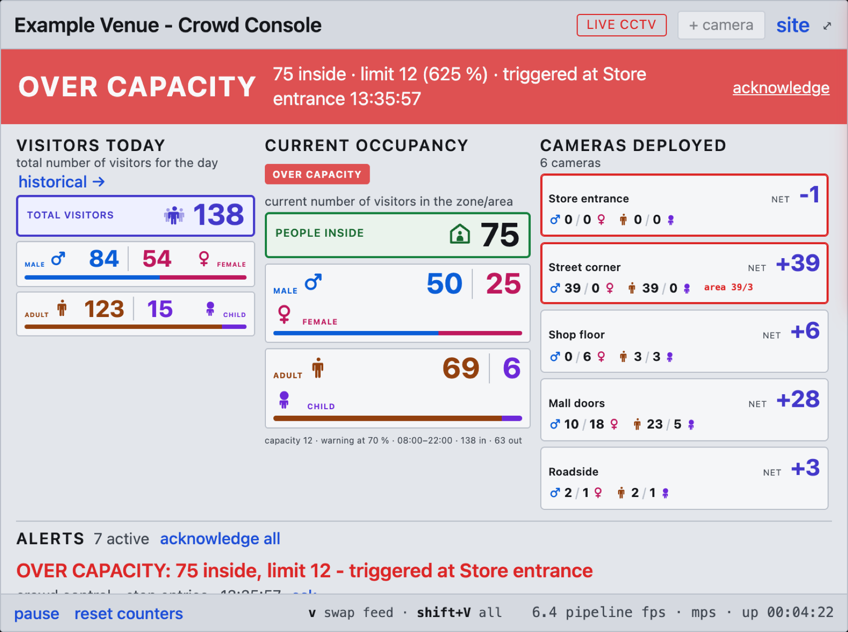
Capacity, alerts, evidence

Slide 24
The banner names the entrance that tipped the count, a clip is recorded automatically, and any entrance can carry its own limit.

Slide 25
Interfaces and data
24 HTTP and WebSocket endpoints — state, history, cameras, lines, areas, capacity, recording
MJPEG overlay stream per camera, encoded once and shared between viewers
JSON state pushed over WebSocket at about 4 Hz
events.csv — one row per crossing, with the probabilities and observation count behind the decision, so any number can be audited back to the frames that produced it.
history.csv — hourly rows, closing totals, corrections, recorded events.

Slide 26
Configuration stays on the machine
Three JSON files, written by the application, excluded from source control, seeded from committed templates:
sources.json — the live and video source sets
lines.json — trigger lines and counting areas, in normalised coordinates
site.json — hours, capacity, thresholds
A source update can never collide with a machine’s own calibration, and camera credentials never reach the repository.

Slide 27
Platforms and performance
platform | acceleration
Ubuntu 22.04 / 24.04 | NVIDIA CUDA
Windows 10 / 11 | NVIDIA CUDA
macOS (Apple Silicon) | Apple MPS
Ubuntu + Docker | NVIDIA CUDA

Slide 28
RTX 3060 Ti, three 1080p streams: detection and tracking ~40 ms per iteration, classification ~10–25 ms, ~11–14 iterations per second. Throughput divides across cameras.

Slide 29
Known limits
Counting is the robust part. It needs the camera to see heads cleanly across the line — overhead or high-angle works best, along a corridor is much harder.
Zero-shot classification is a baseline, not a purpose-trained attribute model, and will not match one.
Distant people are counted but not classified, and are reported as unknown.
The detector is AGPL-3.0. Offering this as a network service may oblige disclosure or a commercial licence. One file imports it.

Slide 30
Summary
Runs on existing CCTV, one machine, no cloud, no per-site training
Two figures that mean different things, and are never conflated
Accuracy work is measured, not asserted
Unknowns are reported, not guessed
Every number is auditable back to the frames that produced it

