Slide 1
Shawshank Redemption
Word Cloud Dashboard

Slide 2
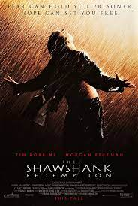
Plot
A man was convicted of a double murder of his wife and his lover. He pleaded guilty but in reality, he was innocent. He got a life sentence and sent to prison only to realize that the prison is corrupt. When we had evidence to prove his innocence, the warden shot the person who can get him out of prison. He managed to escape with his friend.

Slide 3
Themes this Movie Teaches us
Hope
Faith
Patience
Virtue
Charity

Slide 4
Word Cloud Dashboard
https://github.com/felixz3003/EC_BA380_DA_fp
The purpose of this word cloud dashboard is to show the most notable phrases from this movie. These words and phrases help viewers such myself recognize the great movie this is really is.

