Slide 1
Bounded Biharmonic Weights for Real-Time Deformation (2011 paper by Alec Jacobson, Ilya Baran, Jovan Popovic, Olga Sorkine-Hornung)
David cohn
Yuri feldman

Slide 2
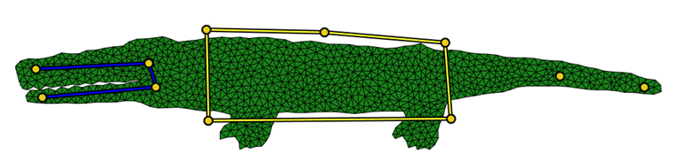
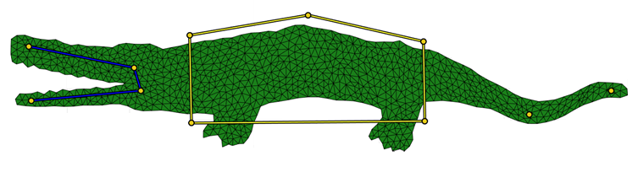
Introduction
3 Kinds of handles:
Points
Bones
Cages

Slide 3
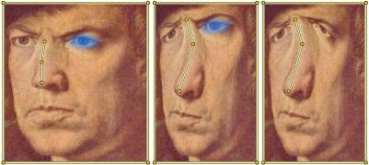
Introduction
Bind Time – user sets the handles
Pose Time – user defines transformations on the handles (real time)
Notes:
אולי כאן כדאי לציין שמוצאים קדקודים קשורים (ב-bind time שזו בדיוק משמעות המושג)

Slide 4
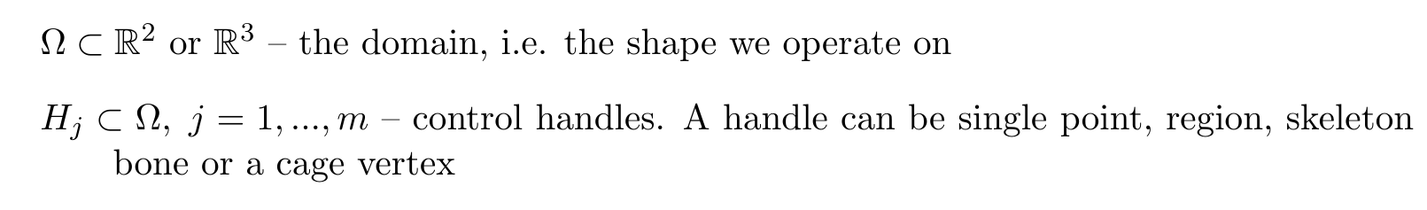
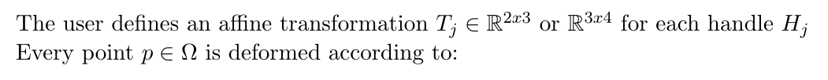
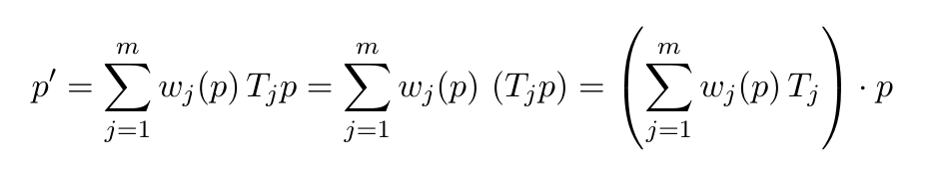
Problem Statement
(linear blend of transformations)
Notes:
חשוב לציין שאת המשקלים מחשבים מראש (bind time), בזמן pose time צריך רק לחשב את הטרנס' שהמשתמש עשה ולחשב סכום משוקלל ביניהן
יכול להיות שכדאי לציין שקודם מנסחים למקרה רציף
להדגיש שלכל נקודה m משקלים

Slide 5
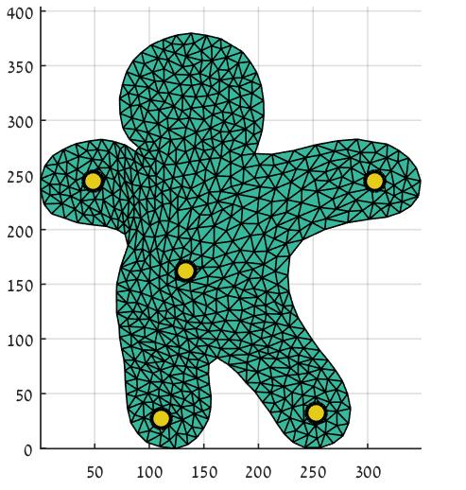
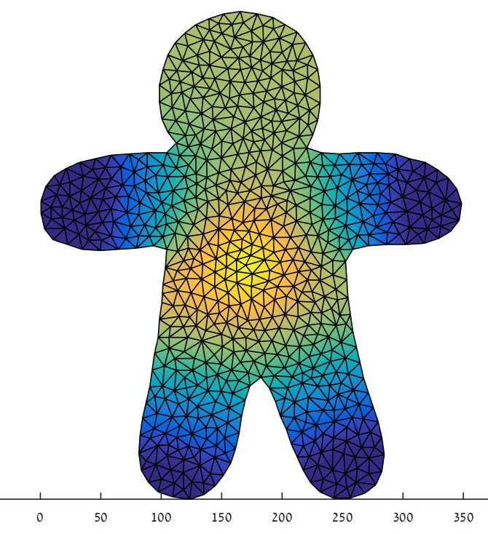
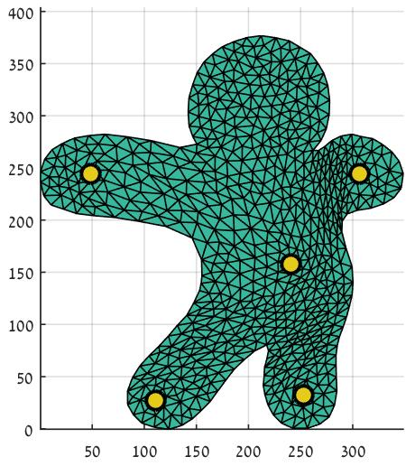
Problem Statement - Example
Each vertex moves by a weighted average among belly and other handles
Center: weights for the belly handle transformation. Brighter yellow = higher weight.

Slide 6
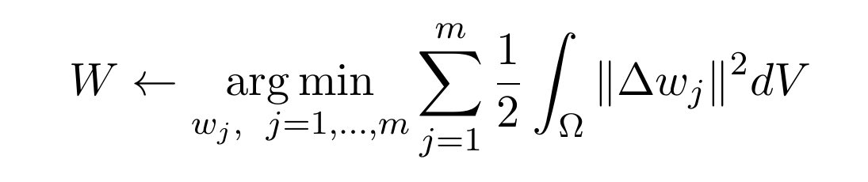
Setting the Weights 1
Logic: we look for weights providing a ‘nice’ interpolation of the transformations over the shape.
Let’s try minimizing the Laplacian!

Slide 7





Setting the Weights 2
- cages’ boundaries (edges/faces)
(see example in the appendix )
Notes:
להוסיף ציון ש-F_C הם הצלעות של הכלובים

Slide 8
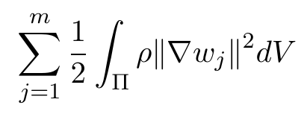
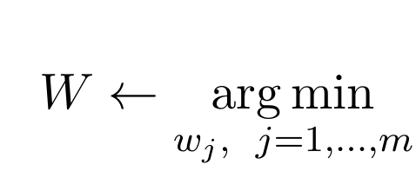
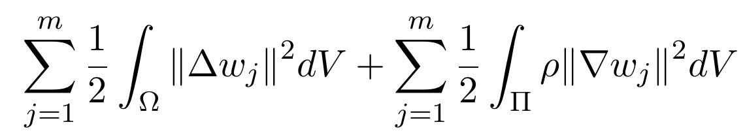
Setting the Weights 3
To constrain a region to retain its shape we add:
The final energy function:
Can add additional terms when needed
Notes:
לציין ש-rho ממשקל את חשיבות שמירת הצורה
כנראה לא צריך לציין שבאופן כללי רו יכול להיקבע פר קדקוד אבל אפשר גם כללי לכל הרכיב החיבורי

Slide 9
Properties
Non-negativity

Slide 10
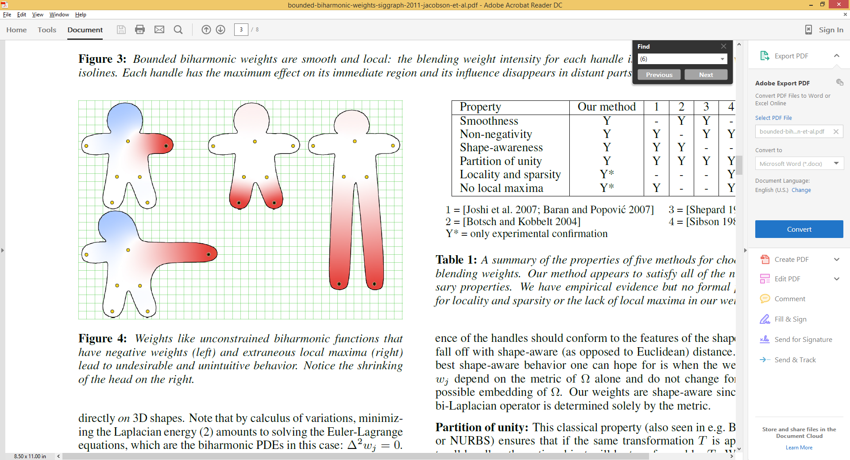
Properties – Non-negativity
Weights should be positive, otherwise:
Moving the black handle right results in unwanted left motion of the head, hence the non-negativity constraint.

Slide 11
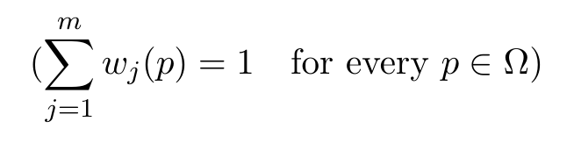
Properties
Non-negativity
Partition of unity
Notes:
POU: each point is transformed according to a convex combination of all the user-specified transformations (see

Slide 12
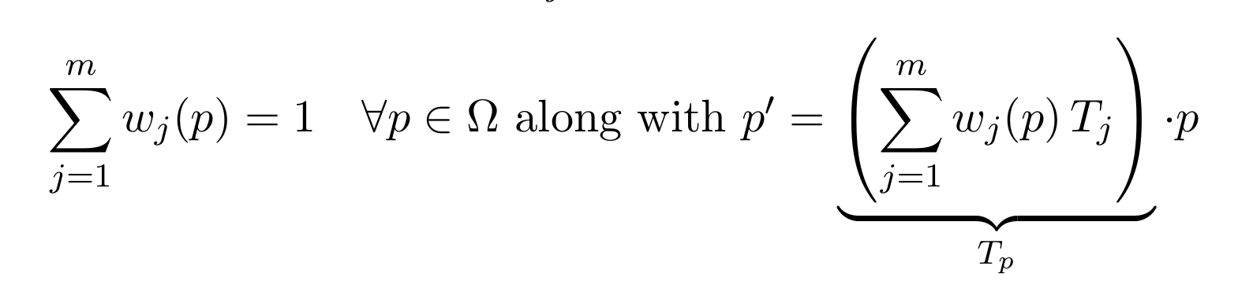
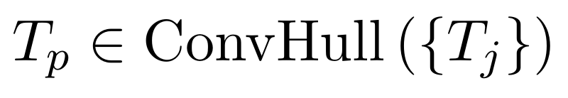
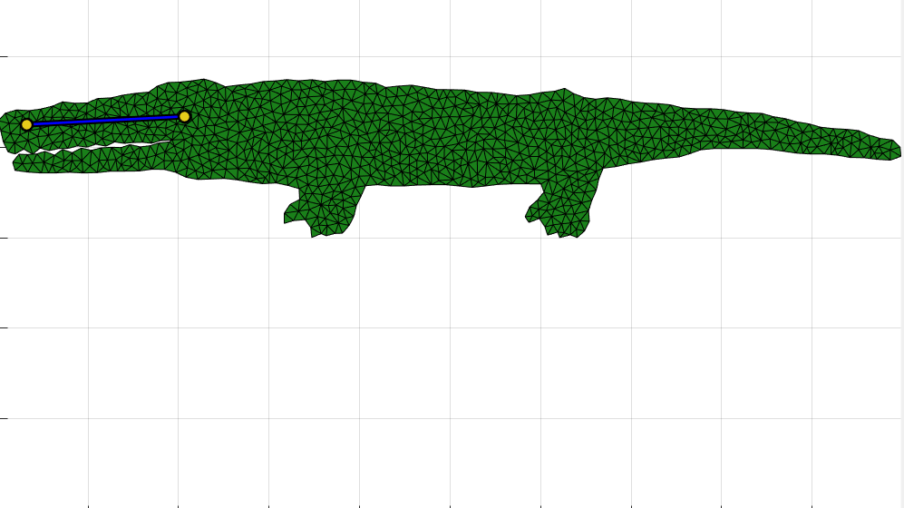
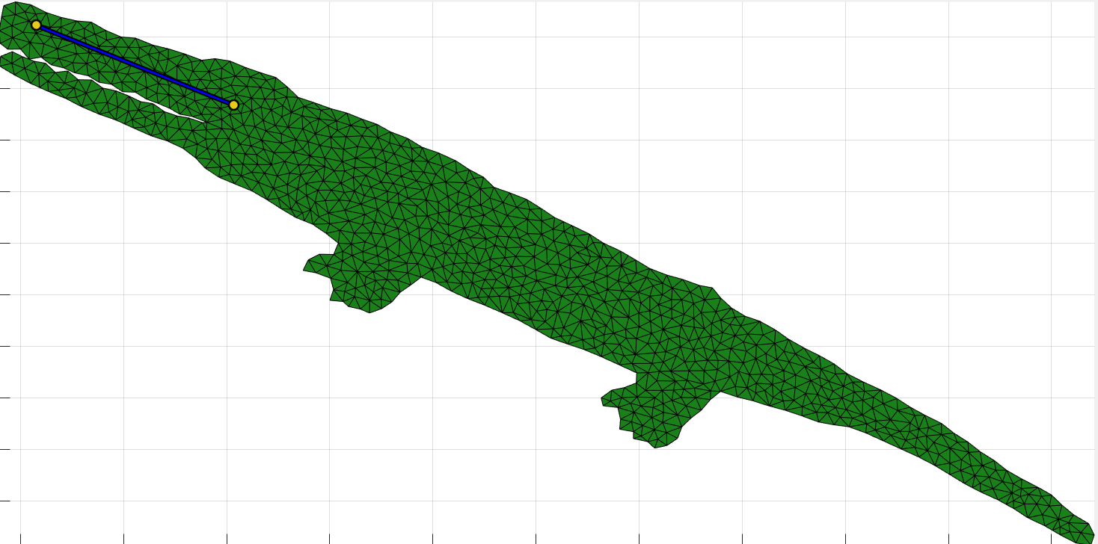

Properties – POU (Partition of unity)
For mesh vertex p
$T_{p}$ - is convex sum of user transformations
For m=1, the whole mesh is transformed according to the specified transformation:
along with
give
Notes:
לטפל במלל

Slide 13
Properties
Non-negativity
Partition of unity
Locality
Notes:
POU: each point is transformed according to a convex combination of all the user-specified transformations (see

Slide 14
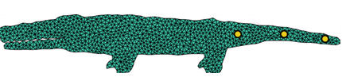
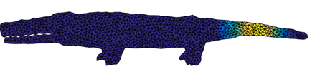

Properties - Locality
Each handle mainly controls nearby shape features
Every point is influenced only by a few closest handles
Notes:
רצוי להוסיף handle רביעי נוסף
חשוב!!! לציין שצהוב הוא משקל גבוה

Slide 15
Properties
Non-negativity
Partition of unity
Locality
No local maxima
Notes:
אולי אפשר לציין שה-partition of unity משמעותו צירוף קמור של הטרנס', כלומר הטרנס' על כל הנקודות הן בקמור.

Slide 16

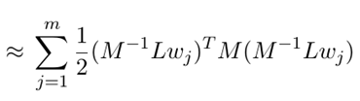
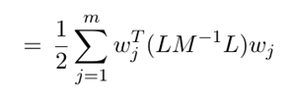
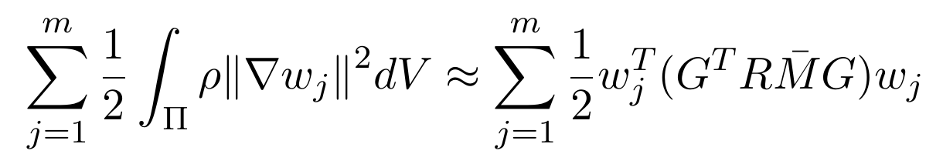
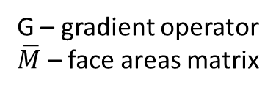
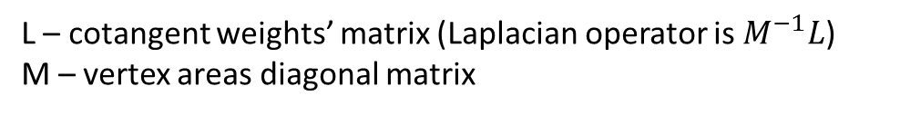

Implementation 1
The smoothness term:
The shape conservation term:
L – cotangent weights’ matrix (Laplacian operator is $M^{−1}L$)
M – vertex areas diagonal matrix
G – gradient operator
$\overline{M}$ – face areas matrix
R – mask for$Π$ (incorporating $ρ$)
Notes:
\bar{M} אולי להגיד face per element areas matrix
90 sec

Slide 17
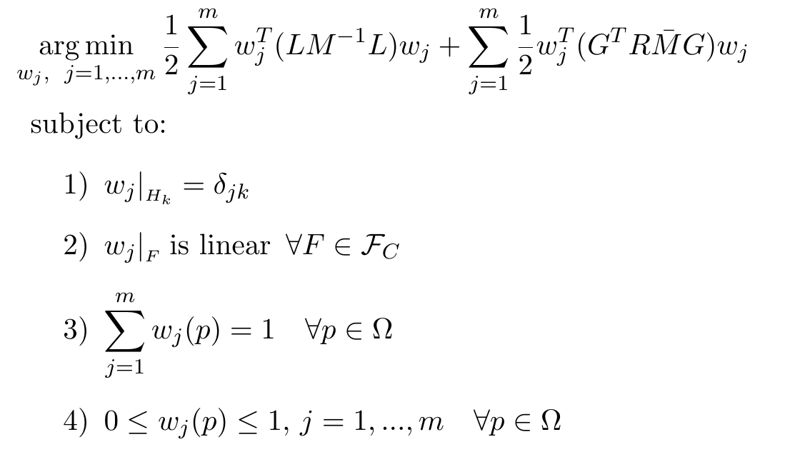
Implementation 2
We get a quadratic optimization problem:
Target function is convex and so are the constraints
In matlab can use quadprog to solve
Notes:
לכתוב פה את בעיית האופטימיזציה ולספר אם יהיה זמן על האופטימ שעשו במאמר (עזבו את ההגבלה על סכום המשקלים 1).
30 שניות

Slide 18
Questions?

Slide 19
Thank you!

Slide 20
Appendix

Slide 21
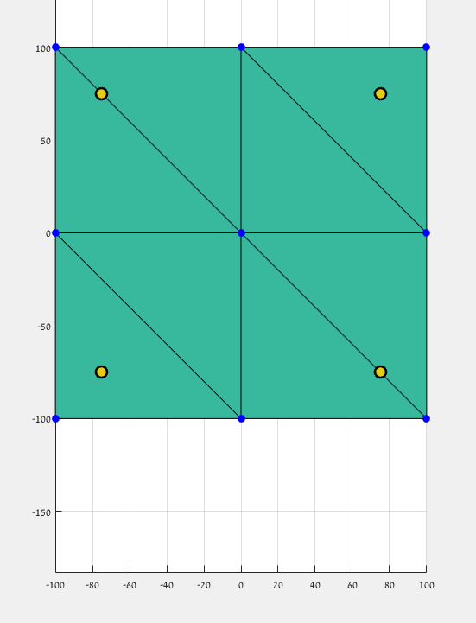
Simple example
W=(0,1,0,0)
W=(0.05,0.45,0.05,0.45)
W=(0,0,0,1)
7
8
9
Suppose we have the following mesh:
The mesh has:
9 vertices
8 faces
4 point handles
2
4
W=(0.45,0.45,0.05,0.05)
W=(0.25,0.25,0.25,0.25)
W=(0.05,0.05,0.45,0.45)
4
5
6
1
3
1
2
3
W=(1,0,0,0)
W=(0.45,0.05,0.45,0.05)
W=(0,0,1,0)

Slide 22
Simple example - continue
W=(0,1,0,0)
W=(0.05,0.45,0.05,0.45)
W=(0,0,0,1)
7
8
9
The coordinates of the vertices:
V1 = (-100,-100), V2 = (0,-100), V3 = (100,-100)
V4 = (-100,0), V5 = (0,0), V6 = (100,0)
V7 = (-100,100), V8 = (0,100), V9 = (100,100)
The coordinates of the points handles:
C1 = (-75,-75), C2 = (-75,75), C3 = (75,-75), C4 = (75,75)
The weights were calculated for all vertices (each vertex has 4 weights. Weight i is the weight of the transformation of handle i in this vertex).
2
4
W=(0.45,0.45,0.05,0.05)
W=(0.25,0.25,0.25,0.25)
W=(0.05,0.05,0.45,0.45)
4
5
6
1
3
1
2
3
W=(1,0,0,0)
W=(0.45,0.05,0.45,0.05)
W=(0,0,1,0)

Slide 23
Simple example - continue
W=(0,1,0,0)
W=(0.05,0.45,0.05,0.45)
W=(0,0,0,1)
7
8
9
We want to translate handle point number 4 100 steps to the right.
Therefore, only the weights marked in blue are suitable for this case.
100
2
4
W=(0.45,0.45,0.05,0.05)
W=(0.25,0.25,0.25,0.25)
W=(0.05,0.05,0.45,0.45)
4
5
6
1
3
1
2
3
W=(1,0,0,0)
W=(0.45,0.05,0.45,0.05)
W=(0,0,1,0)

Slide 24
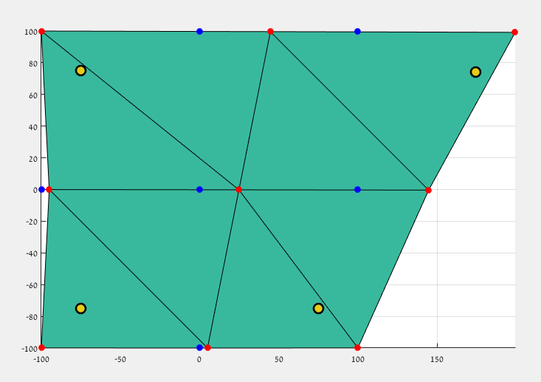
Simple example - continue
W=(0,1,0,0)
W=(0.05,0.45,0.05,0.45)
W=(0,0,0,1)
This is the how the mesh looks after the transformation.
Only vertex 9 did the full transformation (100 steps right) since its weight for handle 4 is 1.
The rest of the vertices did part of the transformation (and some didn’t move at all like vertices 1,3,7)
7
8
9
100
2
4
4
5
6
W=(0.45,0.45,0.05,0.05)
W=(0.25,0.25,0.25,0.25)
W=(0.05,0.05,0.45,0.45)
1
3
1
2
3
W=(1,0,0,0)
W=(0.45,0.05,0.45,0.05)
W=(0,0,1,0)

