Slide 1
Bounded Biharmonic Weights for Real-Time Deformation (2011 paper by Alec Jacobson, Ilya Baran, Jovan Popovic, Olga Sorkine-Hornung)
David cohn
Yuri feldman

Slide 2
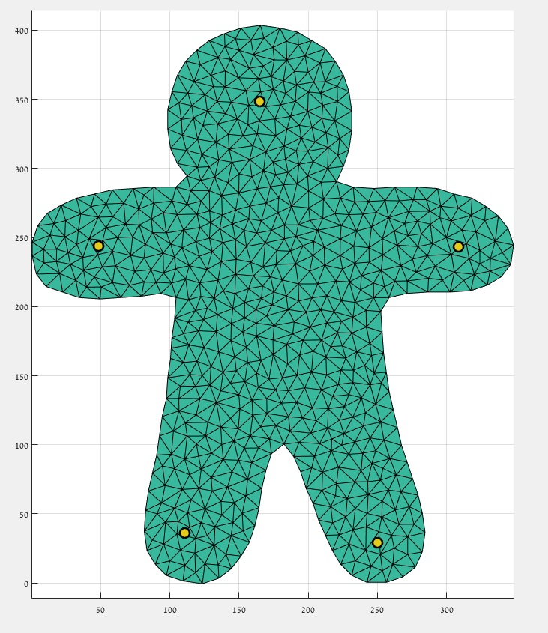
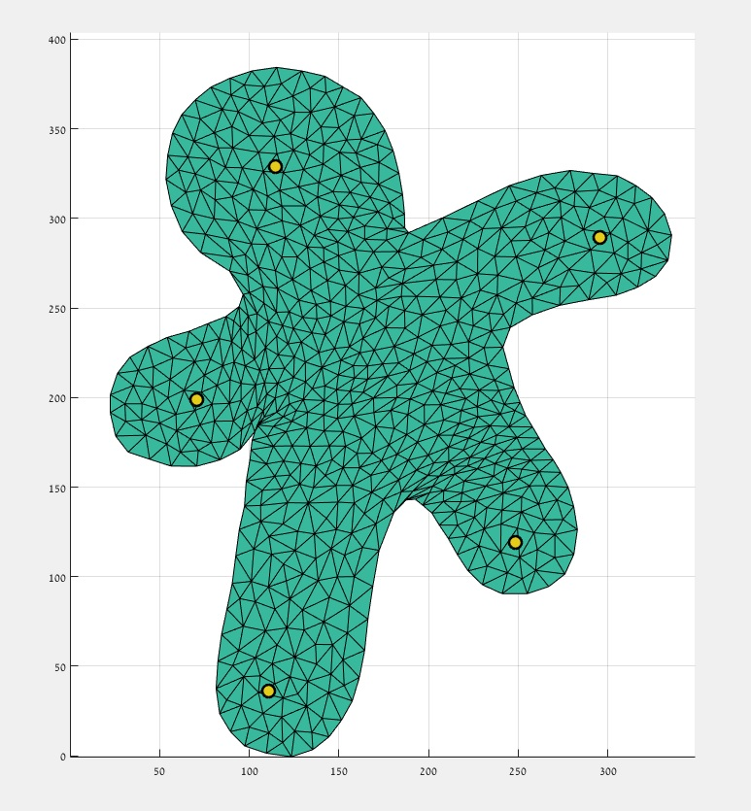
Mission: Deform stuff

Slide 3
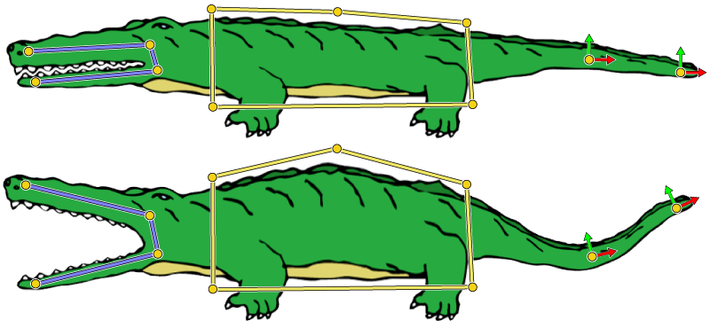
Mission: Deform stuff
3 Kinds of handles:
Points
Bones
Cages

Slide 4
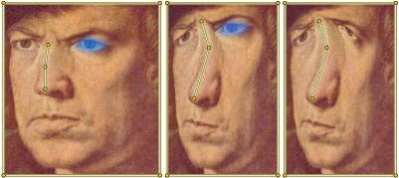
Mission: Deform stuff
Bind Time – user sets the handles
Pose Time – user defines transformations on the handles

Slide 5
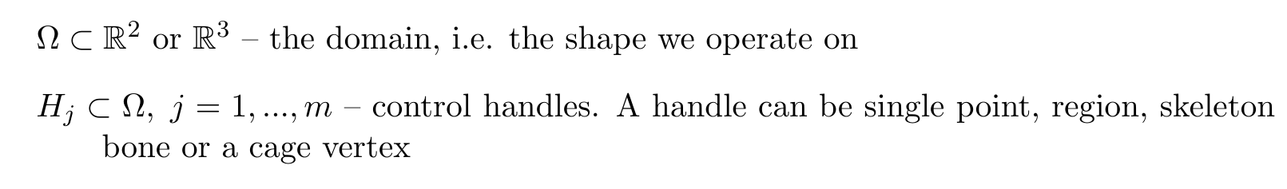
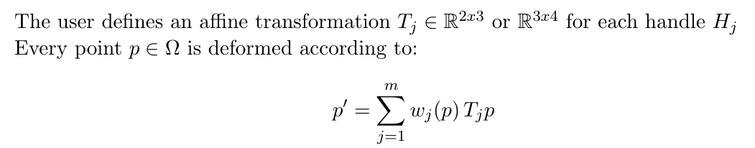
Problem Statement
(linear blend of transformations)
Notes:
חשוב לציין שאת המשקלים מחשבים מראש (bind time), בזמן pose time צריך רק לחשב את הטרנס' שהמשתמש עשה ולחשב סכום משוקלל ביניהן

Slide 6
Problem Statement
Add a screen capture showing the weights

Slide 7
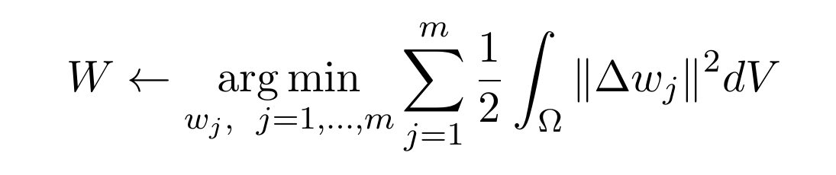
Setting the Weights
Logic: we look for weights providing a ‘nice’ interpolation of the transformations over the shape.
Let’s try minimizing the Laplacian!

Slide 8





Setting the Weights

Slide 9
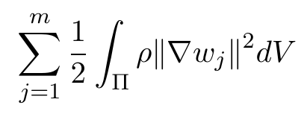
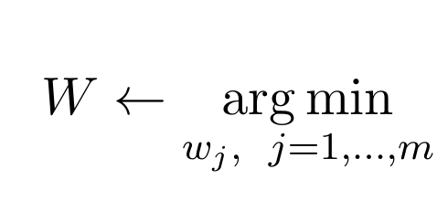
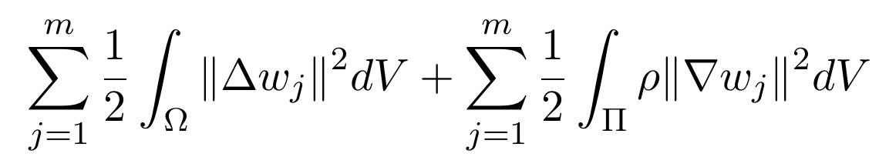
Setting the Weights
To constrain a region to retain its shape we add:
The final energy function:
Can add additional terms when needed

Slide 10

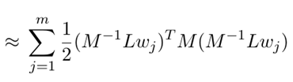
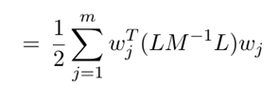
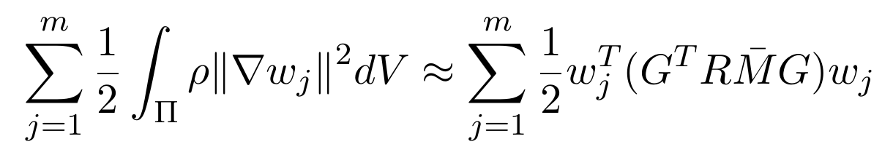
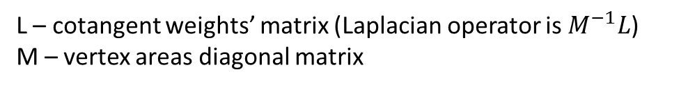
Implementation
The smoothness term:
The shape conservation term:
L – cotangent weights’ matrix (Laplacian operator is $M^{−1}L$)
M – vertex areas diagonal matrix

Slide 11
Properties

Slide 12
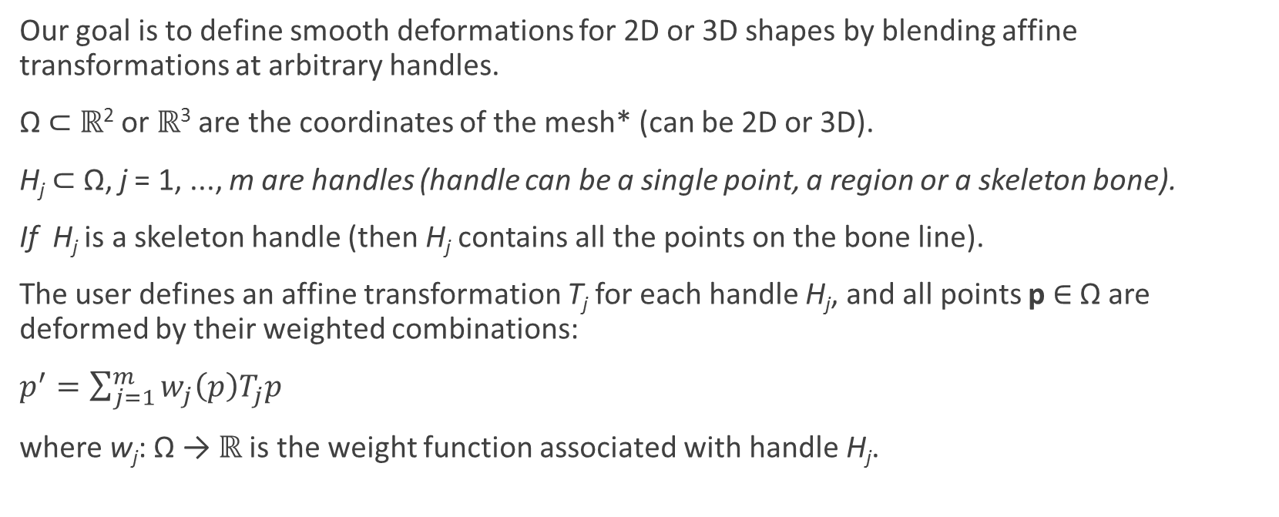
Our goal is to define smooth deformations for 2D or 3D shapes by blending affine transformations at arbitrary handles.
Ω ⊂ ℝ² or ℝ³ are the coordinates of the mesh* (can be 2D or 3D).
H_{j} ⊂ Ω, j = 1, ..., m are handles (handle can be a single point, a region or a skeleton bone).
If H_{j} is a skeleton handle (then H_{j} contains all the points on the bone line).
The user defines an affine transformation T_{j} for each handle H_{j}, and all points p ∈ Ω are deformed by their weighted combinations:
$p^{′}=\sum_{j=1}^{m}{w_{j}\left(p\right)T_{j}p}$
where w_{j}: Ω → ℝ is the weight function associated with handle H_{j}.

Slide 13
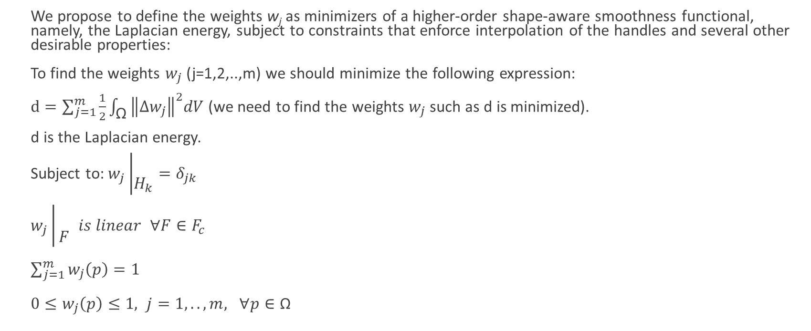
We propose to define the weights w_{j} as minimizers of a higher-order shape-aware smoothness functional, namely, the Laplacian energy, subject to constraints that enforce interpolation of the handles and several other desirable properties:
To find the weights $w_{j}$ (j=1,2,..,m) we should minimize the following expression:
$d=\sum_{j=1}^{m}{\frac{1}{2}\int_{\text{Ω}}{{\left\|∆w_{j}\right\|}^{2}dV}}$ (we need to find the weights $w_{j}$ such as d is minimized).
d is the Laplacian energy.
Subject to: $w_{j}\left|\begin{matrix} \\ H_{k}\end{matrix}\right.=δ_{jk}$
$w_{j}\left|\begin{matrix} \\ F\end{matrix}\right. is linear ∀F∈F_{c}$
$\sum_{j=1}^{m}{w_{j}\left(p\right)=1}$
$0≤w_{j}\left(p\right)≤1, j=1,..,m, ∀p∈\text{Ω}$

Slide 14

For minimizing d = $\sum_{j=1}^{m}{\frac{1}{2}\int_{\text{Ω}}{{\left\|∆w_{j}\right\|}^{2}dV}}$,
We need to minimize each of the integrals $\int_{\text{Ω}}{{\left\|∆w_{j}\right\|}^{2}dV}$, therefore ${\left\|∆w_{j}\right\|}^{2}$=0 for j=1,2,..,m.

Slide 15
From link:
http://www.ctralie.com/Teaching/LapMesh/
Triangular meshes have become the ubiquitous surface representation in recent years in computer graphics, so a lot of research has been put into manipulating them in an efficient, meaningful way. Unfortunately, it's sometimes difficult to do operations on meshes that store geometry in absolute coordinates. For instance, for meshes that store the absolute position of vertices along with the topology of the mesh, doing holistic deformations that preserve overall shape is not easy operating on a point-by-point basis, nor is doing spectral analysis of the mesh. Laplacian meshes store the geometry of triangle meshes in an alternative way by keeping track of differential vertex information instead of absolute information. This turns out to be a much better way to preserve the relationship between vertices when certain transformations (especially deformations) are done on the mesh. It also allows for a very natural way to do smooth function interpolation across the surface, and it allows approximation of a lot of metrics from differential geometry, such as mean curvature, with very little effort. And finally, Laplacian Meshes give rise to a transformation that can be viewed as a spectral decomposition over surfaces similar to the Discrete Fourier Transform.

Slide 16
L=stiffness matrix
The stiffness matrix represents the system of linear equations that must be solved in order to ascertain an approximate solution to the differential equation.
Also read about cotangent laplacian:
http://igl.ethz.ch/projects/bbw/a-cotangent-laplacian-for-images-as-surfaces-2012-jacobson-sorkine.pdf
Or https://en.wikipedia.org/wiki/Laplacian_matrix:
Under: Symmetric normalized Laplacian
Is this the L matrix?
A is the adjacency matrix and D is the degree matrix.

Slide 17
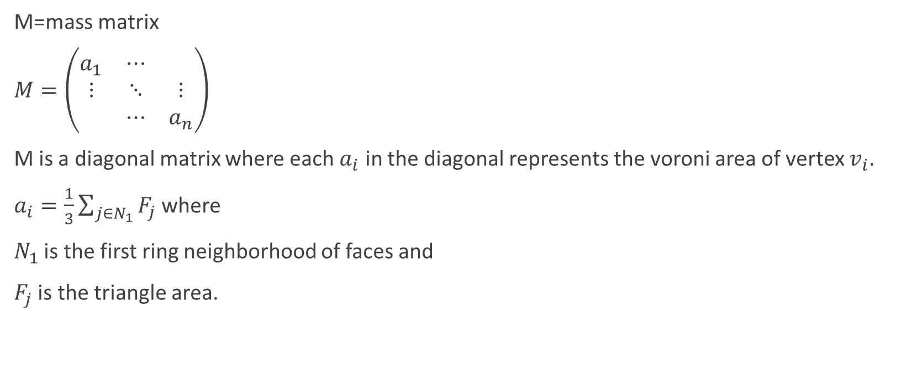
M=mass matrix
$M=\left(\begin{matrix}a_{1} & ⋯ & \\ ⋮ & ⋱ & ⋮ \\ & ⋯ & a_{n}\end{matrix}\right)$
M is a diagonal matrix where each $a_{i}$ in the diagonal represents the voroni area of vertex $v_{i}$.
$a_{i}=\frac{1}{3}\sum_{j∈N_{1}}{F_{j}}$ where
$N_{1}$ is the first ring neighborhood of faces and
$F_{j}$ is the triangle area.
Notes:
אולי לצמצם – זה ה-vertex

Slide 18
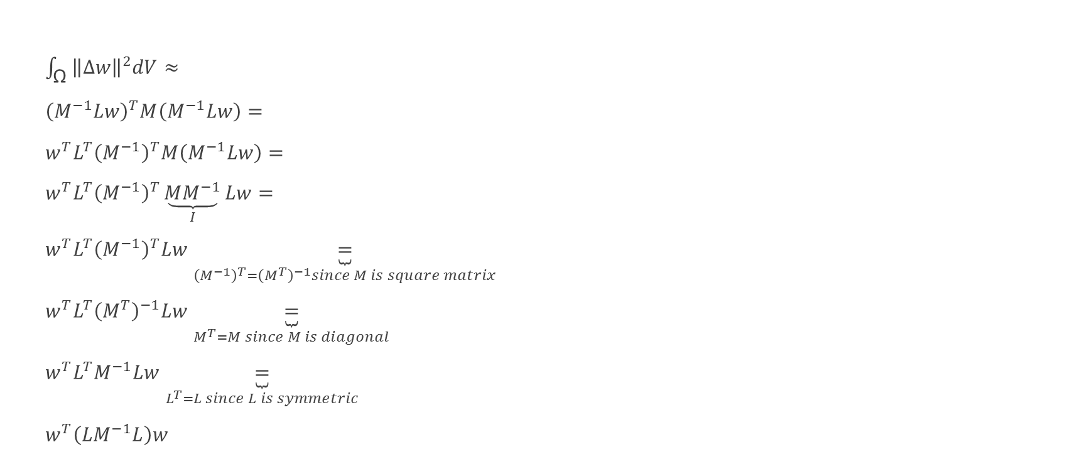
$\int_{\text{Ω}}{{\left\|∆w\right\|}^{2}dV}≈$
${\left(M^{−1}Lw\right)}^{T}M\left(M^{−1}Lw\right)=$
$w^{T}L^{T}{\left(M^{−1}\right)}^{T}M\left(M^{−1}Lw\right)=$
$w^{T}L^{T}{\left(M^{−1}\right)}^{T}\underset{I}{\underbrace{MM^{−1}}}Lw=$
$w^{T}L^{T}{\left(M^{−1}\right)}^{T}Lw\underset{{\left(M^{−1}\right)}^{T}={\left(M^{T}\right)}^{−1}since M is square matrix}{\underbrace{=}}$
$w^{T}L^{T}{\left(M^{T}\right)}^{−1}Lw\underset{M^{T}=M since M is diagonal}{\underbrace{=}}$
$w^{T}L^{T}M^{−1}Lw\underset{L^{T}=L since L is symmetric}{\underbrace{=}}$
$w^{T}\left(LM^{−1}L\right)w$

Slide 19

The weights matrix
$w=\left(\begin{matrix}\begin{matrix}w_{1,1} & w_{1,2}\end{matrix} & \begin{matrix}w_{1,3} & … & w_{1,m}\end{matrix} \\ \begin{matrix}w_{2,1} & w_{2,2}\end{matrix} & \begin{matrix}w_{2,3} & … & w_{2,m}\end{matrix} \\ \begin{matrix}w_{3,1} & w_{3,2}\end{matrix} & \begin{matrix}w_{3,3} & … & w_{3,m}\end{matrix} \\ \begin{matrix}\begin{aligned}. \\ . \\ .\end{aligned} & \begin{aligned}. \\ . \\ .\end{aligned}\end{matrix} & \begin{matrix}\begin{aligned}. \\ . \\ .\end{aligned} & \begin{aligned}... \\ … \\ ...\end{aligned} & \begin{aligned}. \\ . \\ .\end{aligned}\end{matrix} \\ \begin{matrix}w_{\left|V\right|,1} & w_{\left|V\right|,2}\end{matrix} & \begin{matrix}w_{\left|V\right|,3} & … & w_{\left|V\right|,m}\end{matrix}\end{matrix}\right)$

Slide 20

$d=\sum_{j=1}^{m}{\frac{1}{2}\int_{\text{Ω}}{{\left\|∆w_{j}\right\|}^{2}dV}}≈$
$\sum_{j=1}^{m}{\frac{1}{2}}{\left(M^{−1}Lw_{j}\right)}^{T}M\left(M^{−1}Lw_{j}\right)=$
$\frac{1}{2}\sum_{j=1}^{m}{{w_{j}}^{T}}\left(LM^{−1}L\right)w_{j}$

Slide 21
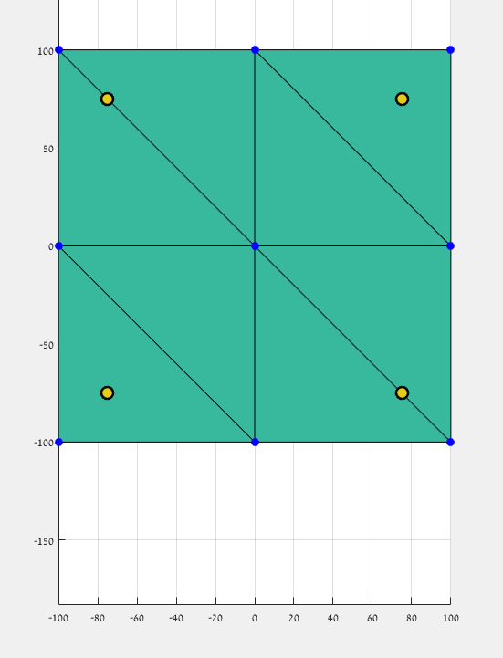
W=(0,1,0,0)
W=(0.05,0.45,0.05,0.45)
W=(0,0,0,1)
7
8
9
2
4
W=(0.45,0.45,0.05,0.05)
W=(0.25,0.25,0.25,0.25)
W=(0.05,0.05,0.45,0.45)
4
5
6
1
3
1
2
3
W=(1,0,0,0)
W=(0.45,0.05,0.45,0.05)
W=(0,0,1,0)

Slide 22
W=(0,1,0,0)
W=(0.05,0.45,0.05,0.45)
W=(0,0,0,1)
7
8
9
Translate point 4 100 steps right:
100
2
4
W=(0.45,0.45,0.05,0.05)
W=(0.25,0.25,0.25,0.25)
W=(0.05,0.05,0.45,0.45)
4
5
6
1
3
1
2
3
W=(1,0,0,0)
W=(0.45,0.05,0.45,0.05)
W=(0,0,1,0)

Slide 23
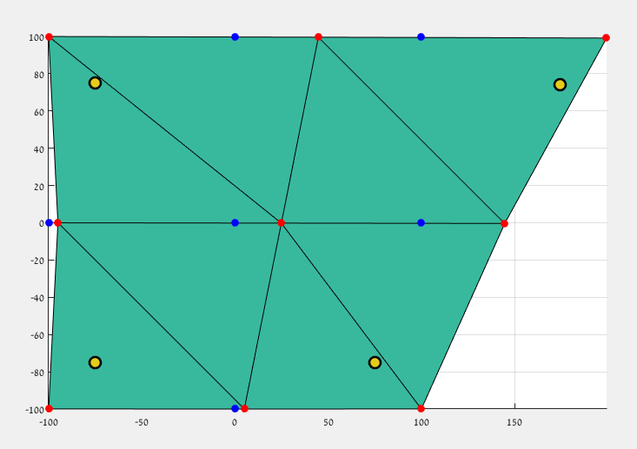
W=(0,1,0,0)
W=(0.05,0.45,0.05,0.45)
W=(0,0,0,1)
7
8
9
100
2
4
4
5
6
W=(0.45,0.45,0.05,0.05)
W=(0.25,0.25,0.25,0.25)
W=(0.05,0.05,0.45,0.45)
1
3
1
2
3
W=(1,0,0,0)
W=(0.45,0.05,0.45,0.05)
W=(0,0,1,0)

