Slide 1

Corona_Virus_Report
Done by Fella Laribi

Slide 2
Overview
Total_Data_Months
18
Start_Date | End_Date
22-01-2022 | 13-06-2021

Slide 3

Data_Analysis

Slide 4

ToTal_Cases
Year | Month | Total_Confirmed | Total_Deaths | Total_Recovered
2020 | 1 | 6384 | 190 | 143
2020 | 2 | 68312 | 2651 | 31405
2020 | 3 | 769236 | 41346 | 133070
2020 | 4 | 2336798 | 191833 | 792987
2020 | 5 | 2744333 | 144561 | 1519547
2020 | 6 | 3969634 | 137757 | 2535417
2020 | 7 | 6838092 | 167613 | 4693120
2020 | 8 | 7694938 | 179200 | 6202833
2020 | 9 | 8244794 | 160671 | 6647749
2020 | 10 | 11515841 | 175484 | 6782150
2020 | 11 | 16595938 | 262247 | 9172292
2020 | 12 | 19336799 | 339996 | 11924903
2021 | 1 | 18672205 | 401893 | 9164347
2021 | 2 | 10492664 | 298239 | 6719785
2021 | 3 | 13924790 | 282620 | 7888013
2021 | 4 | 21711021 | 362387 | 14205507
2021 | 5 | 19121083 | 366549 | 19131842
2021 | 6 | 5022282 | 132657 | 5544438

Slide 5

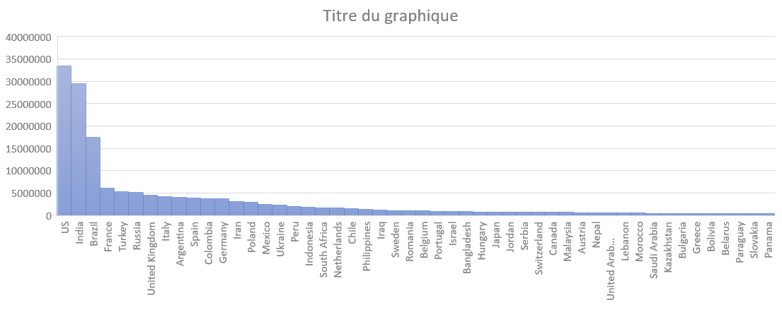
Confirmed_Cases

Slide 6
Averages, Variance and Stdev
Year | Month | Total_Confirmed | Total_Deaths | Average_Confirmed | Variance_Confirmed | Stdev_Confirmed
2020 | 1 | 6384 | 190 | 4,15 | 4832,91 | 69,52
2020 | 2 | 68312 | 2651 | 15,3 | 78489,45 | 280,16
2020 | 3 | 769236 | 41346 | 161,13 | 1026414 | 1013,12
2020 | 4 | 2336798 | 191833 | 505,8 | 7012063 | 2648,03
2020 | 5 | 2744333 | 144561 | 574,85 | 6063580 | 2462,43
2020 | 6 | 3969634 | 137757 | 859,23 | 13779212 | 3712,04
2020 | 7 | 6838092 | 167613 | 1432,36 | 46914023 | 6849,38
2020 | 8 | 7694938 | 179200 | 1611,84 | 54408583 | 7376,22
2020 | 9 | 8244794 | 160671 | 1784,59 | 69314699 | 8325,54
2020 | 10 | 11515841 | 175484 | 2412,2 | 68988159 | 8305,91
2020 | 11 | 16595938 | 262247 | 3592,19 | 1,96E+08 | 13993,42
2020 | 12 | 19336799 | 339996 | 4050,44 | 4,6E+08 | 21444,94
2021 | 1 | 18672205 | 401893 | 3911,23 | 3,16E+08 | 17784,96
2021 | 2 | 10492664 | 298239 | 2433,36 | 79587921 | 8921,21
2021 | 3 | 13924790 | 282620 | 2916,8 | 83725265 | 9150,15
2021 | 4 | 21711021 | 362387 | 4699,36 | 5,01E+08 | 22383,32
2021 | 5 | 19121083 | 366549 | 4005,25 | 6,29E+08 | 25072,85
2021 | 6 | 5022282 | 132657 | 2508,63 | 1,11E+08 | 10532,46

Slide 7
Top 5 Recoveries

