Slide 1
Deutsche Bahn Data Portal

Slide 2
Motivation
Fleet Overview
 | Data Analysis | Result
Focus | Stuttgart Region
Data signals from DB API | station code, passenger count, train category; train number; train type; planned arrival time; actual arival; planned departure, actual departure, start, middle and destination station codes; service id; geo data; longitude; latitude
Unique Trains per Day, with multiple trips | 59
Training Data duration for our predictive model | History data of 2 months
Total number of stops |  | 4991980
Total number of trips |  | 383998

Slide 3
Problem
 | Data Analysis | Result
Distribution Fleet | min delay | 0
 | max delay | 380159.0 mins
 | avg delay | 28.7172039952 mins
 | median of delay | 1.0 min
Clustering | total number of times more than 30 mins delays occurred in last 2 months in stuttgart: | 1423
Focusing on trains with delay more than 30 mins | per week : | 94
 | per day : | 7

Slide 4
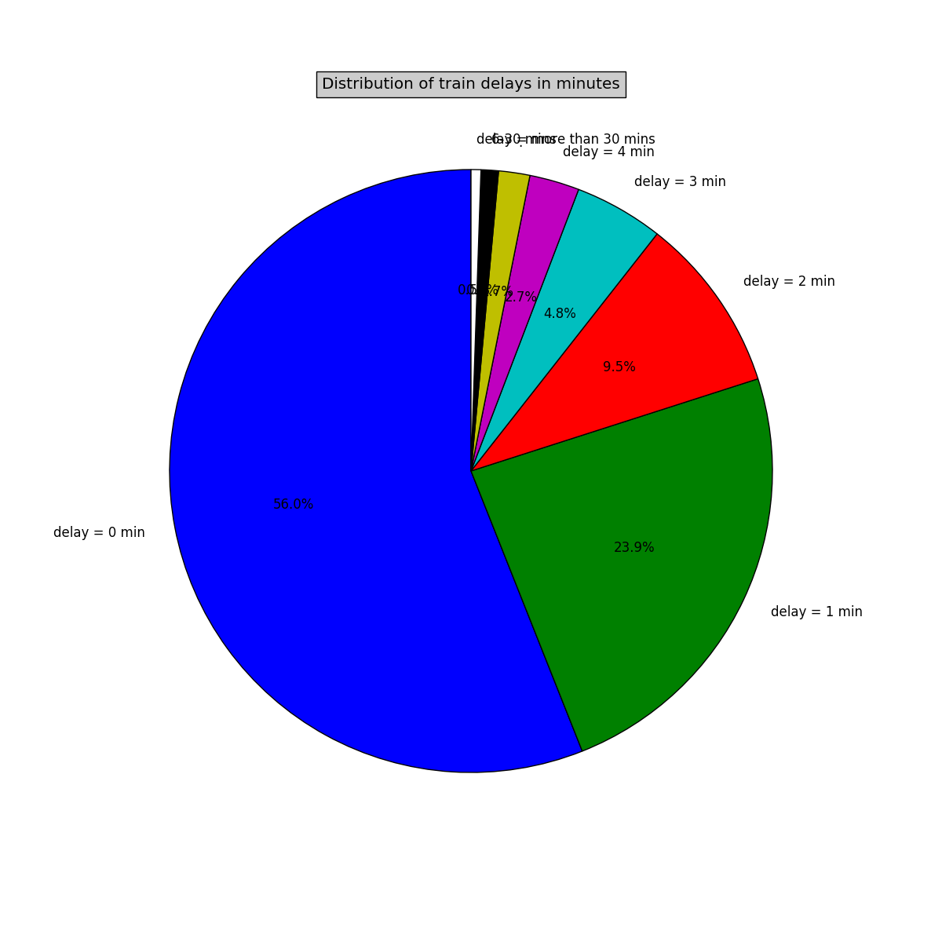
DB Fleet Overview

Slide 5
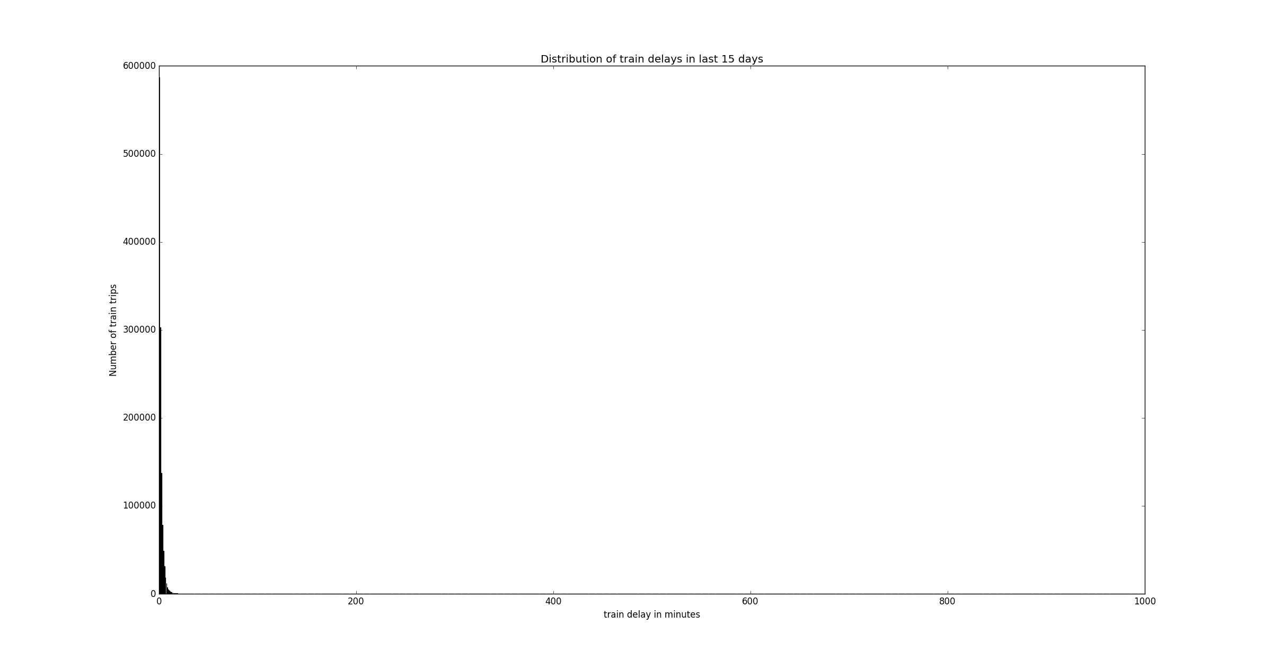
Histogram

Slide 6
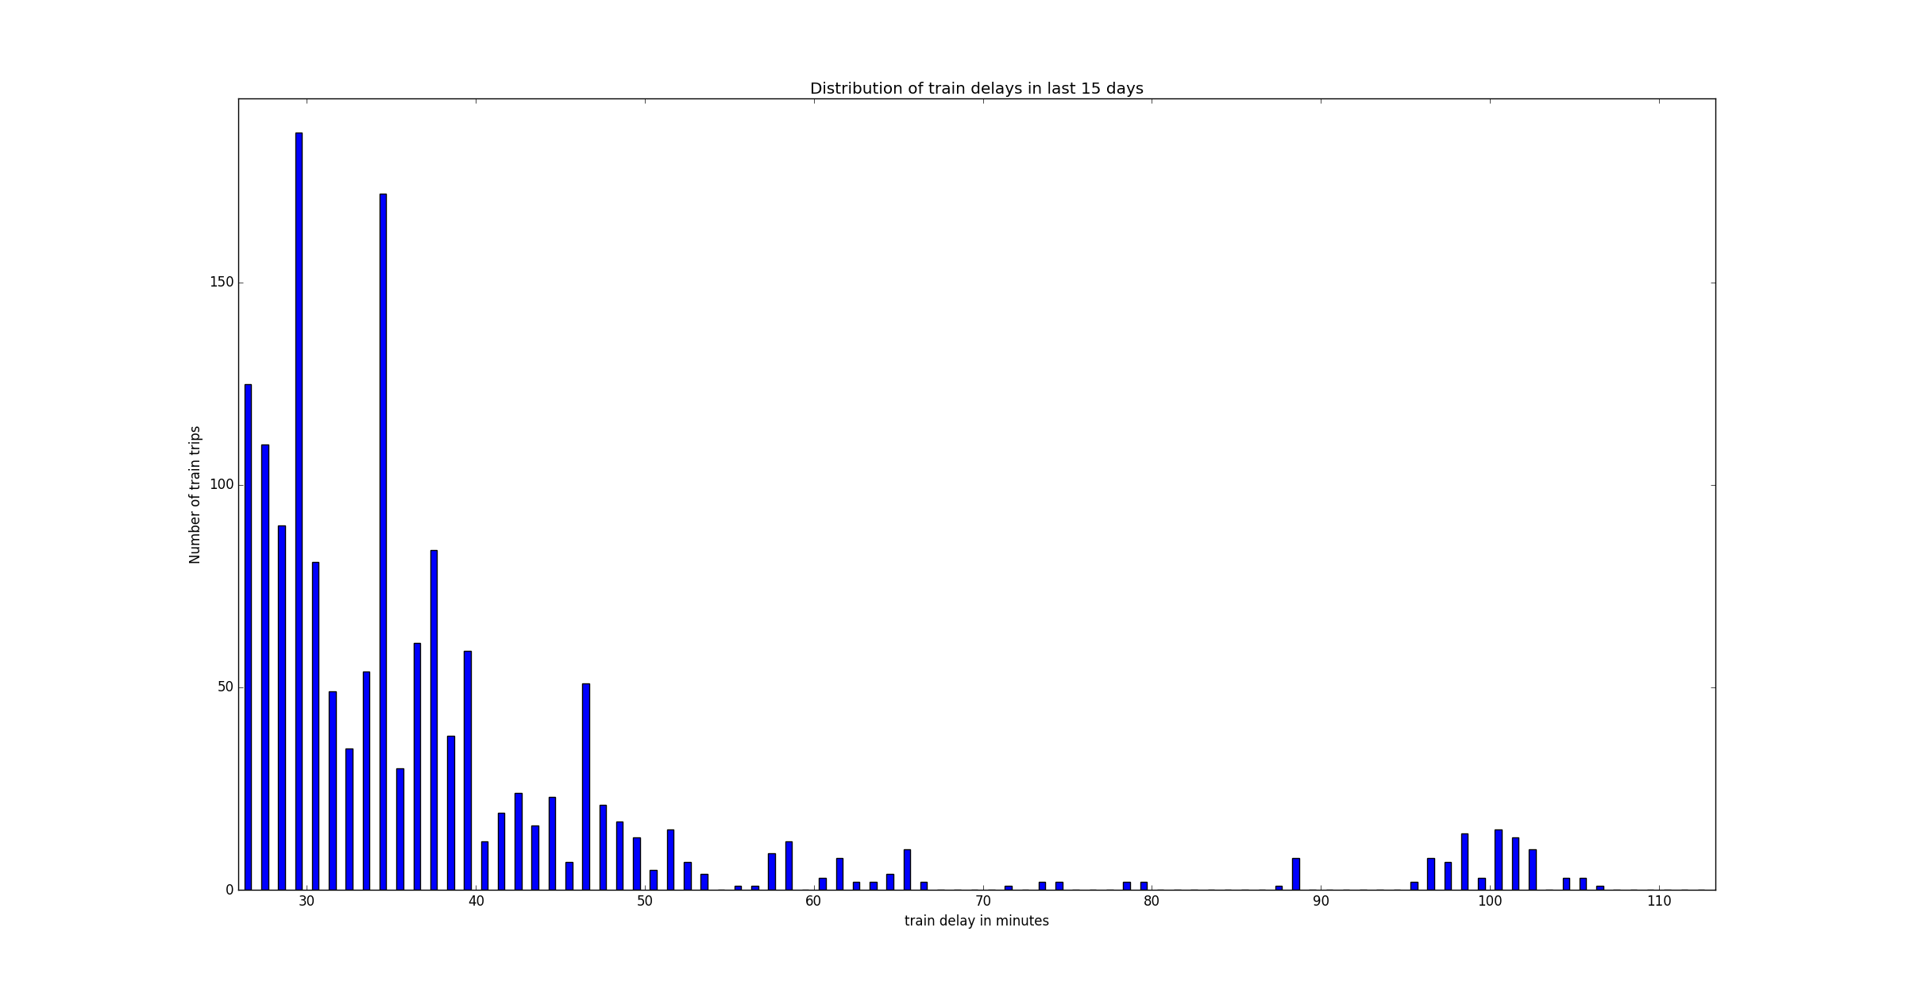
Number of trains with delay more between 30 mins and 100 mins

Slide 7
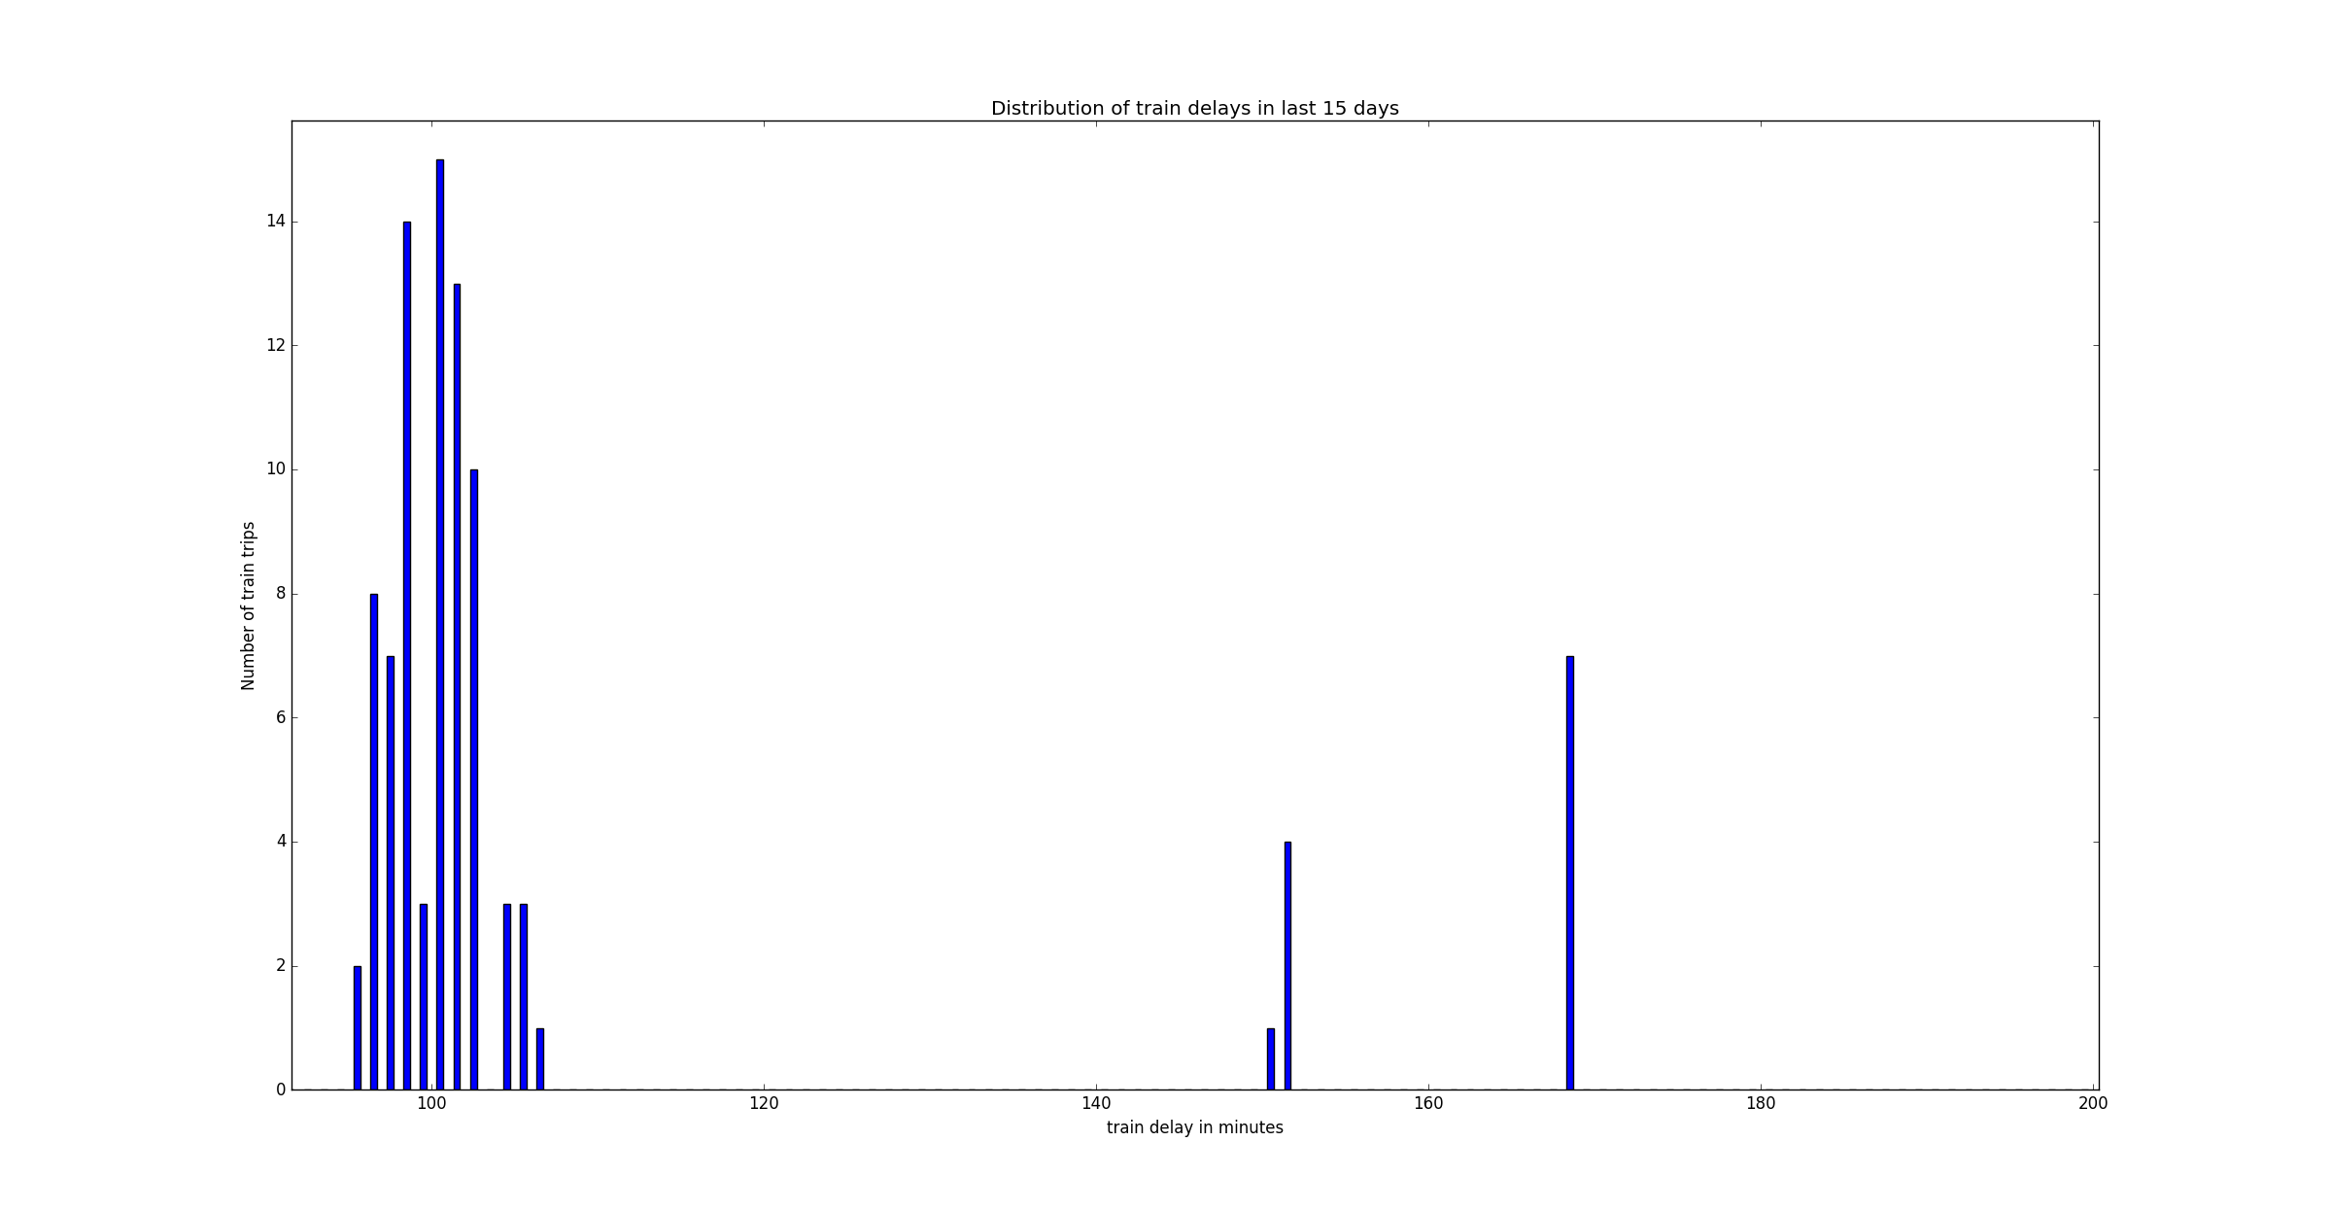
Number of trains with delay more between 100 mins and 200 mins

Slide 8
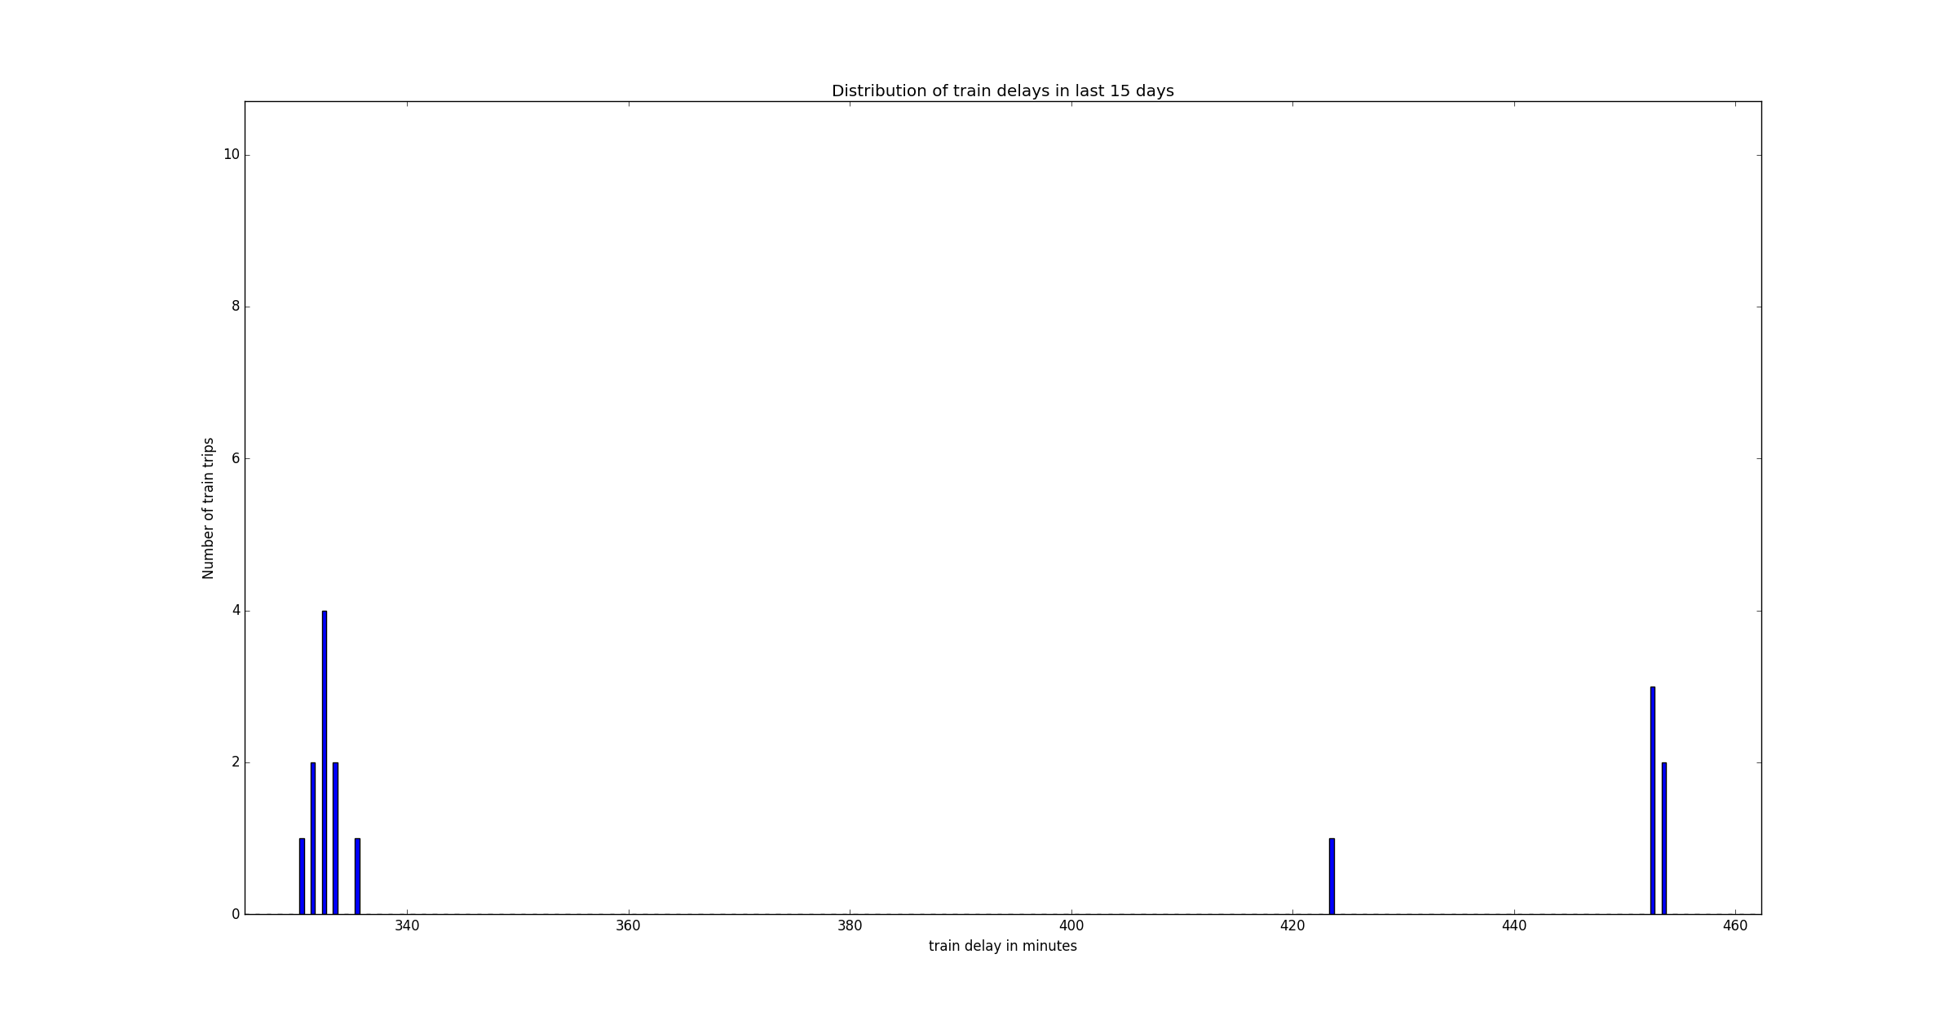
Outliers
Number of trains with delay more than 200 mins

Slide 9
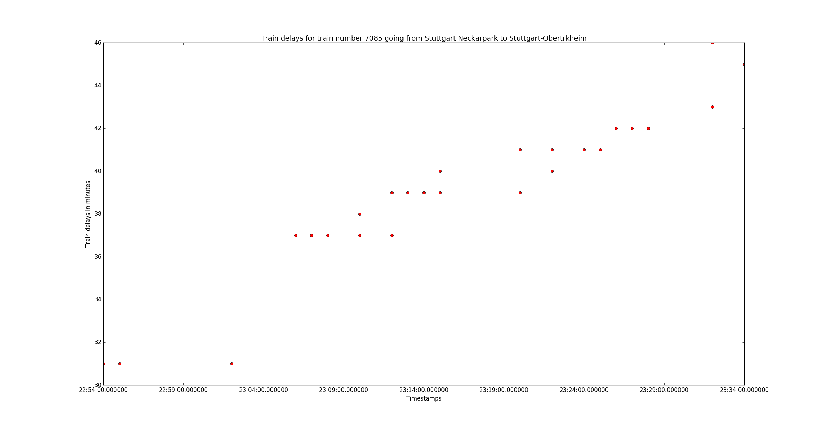
Specific Train case:
From Stuttgart Neckarpark to Obertrkheim

Slide 10
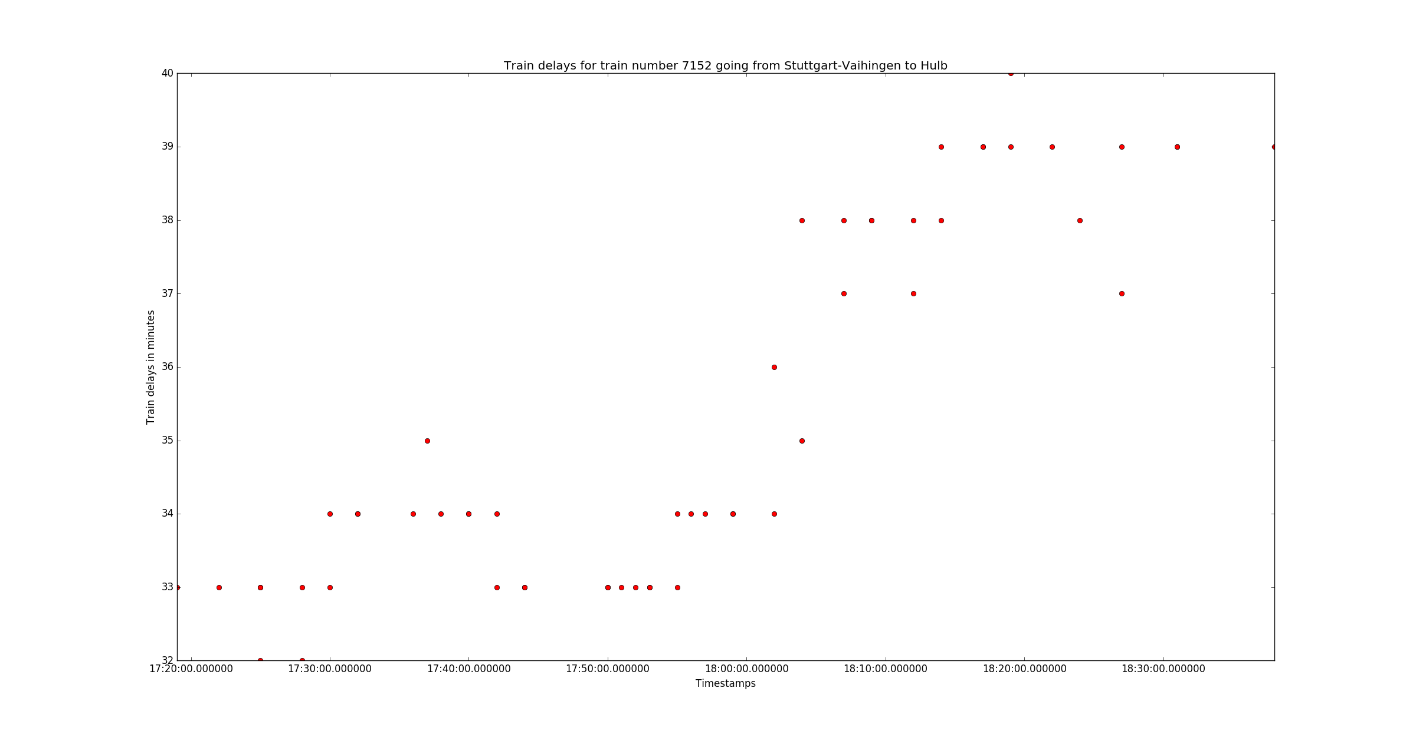
Specific Train case:
From Stuttgart Vaihingen to Hulb

Slide 11
Short Term Pattern Recognition
Holt Winter Forecasting (Hourly basis)

Slide 12
Long Term Pattern Recognition
Holt Winter Forecasting (every 3 months)
To be implemented

Slide 13
Thank you :)

