Slide 1
Fun with C++11
#define fun
or,
#define fun true

Slide 2

Why C++?

Slide 3

Why C++?

Slide 4
Disclaimers
I like a lot of languages in addition to C++: C# (mostly); Python; Java; PHP; Groovy; would like to learn Ruby, Clojure and Go.
I use Microsoft C++ mostly.
I’m not a C++ expert. I find even these challenging: http://cppquiz.org/quiz/question/1
I practice EDD

Slide 5
EDD: Error Driven Development
You can learn a LOT from the compiler warnings and errors. Fun!
Template errors and warnings are getting better. (Have been notoriously bad.)
Fun: “The challenge: Write a piece of C++ code and try to reach the largest possible error message.”
http://tgceec.tumblr.com/post/106626335863/introducing-the-grand-c-error-explosion

Slide 6
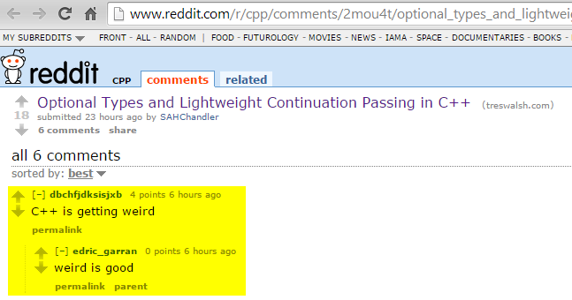

Slide 7
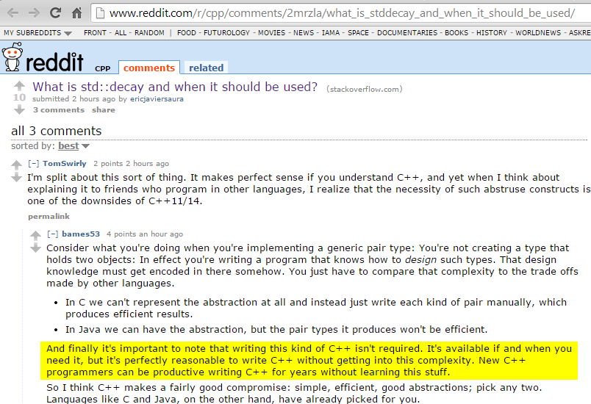

Slide 8
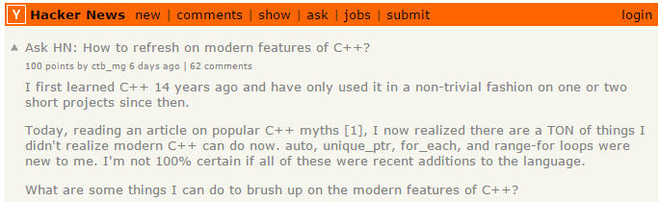
https://news.ycombinator.com/item?id=8788454
todo: read Bjarne Stroustroup’s article on the myths of C++:
https://isocpp.org/blog/2014/12/myths-1

Slide 9
What’s changed?
C++11 standard finally published
Took too long.
For a long time, temporarily named “C++0x”
Finally published - but now we’re in 2015…and C++14 is about to be finalized
Mobile devices want fewer CPU cycles; battery consumption: a big deal
Microsoft: C++ [was] 2nd-class citizen in the .NET era of 2000’s; that changed with ‘RT’
Big internet players really, really need performance and massive scale

Slide 10
Fun with C++ 11
“Conclusion: C++ has changed dramatically over the last decade. It’s no more C with Classes. If you have not looked at C++ recently, it will be the right time to have another look.”
http://blog.madhukaraphatak.com/functional-programming-in-c++/

Slide 11
good/bad news
C++ was big already - and got a lot bigger with C++11
C++14: much smaller set of changes compared to C++11
Regardless, pace of change is increasing

Slide 12
C++ History
Year | C++ Standard | Informal name
1998 | ISO/IEC 14882:1998^{[12]} | C++98
2003 | ISO/IEC 14882:2003^{[13]} | C++03
2007 | ISO/IEC TR 19768:2007^{[14]} | C++TR1
2011 | ISO/IEC 14882:2011^{[4]} | C++11
2014 | N3690 (working draft C++14)^{[15]} | C++14
2017 | to be determined | C++17
source: wikipedia C++ article

Slide 13
C++ History: What happened to Technical Report 2 (TR2)?
In 2005, a request for proposals for a TR2 was made with a special interest in Unicode, XML/HTML, Networking and usability for novice programmers.[3]. Some of the proposals included:
Threads [4]
The Asio C++ library (networking [5][6]).
Signals/Slots [7][8]
Filesystem Library [9] – Based on the Boost Filesystem Library, for query/manipulation of paths, files and directories.
Boost Any Library [10]
Lexical Conversion Library [11]
New String Algorithms [12]
Toward a More Complete Taxonomy of Algebraic Properties for Numeric Libraries in TR2 [13]
Adding heterogeneous comparison lookup to associative containers for TR2 [14]
Since the call for proposals for TR2, changes to ISO procedures meant that there will not be a TR2, instead enhancements to C++ will be published in a number of Technical Specifications. Some of the proposals listed above are already included in the C++ standard or in draft versions of the Technical Specifications.
https://en.wikipedia.org/wiki/C%2B%2B_Technical_Report_1#Technical_Report_2

Slide 14
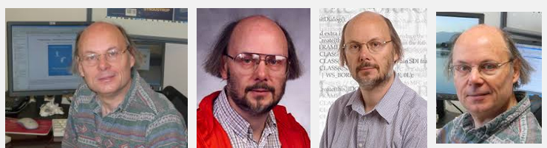
C++ People: Bjarne Stroustrup
On the ISO standards committee
NOT a BDFL
Still writing good books
Hair: Big fun topic at cppcon.
http://scottmeyers.blogspot.com/2014/09/cppcon-hair-poll.html

Slide 15

C++ People: Scott Meyers
Latest book is hot, hot, hot!
Has ‘the hair’

Slide 16
C++ People: Andrei Alexandrescu
Book: Modern C++ Design: Generic Programming and Design Patterns Applied (2001)
Loki framework: “a C++ software library written by Andrei Alexandrescu as part of his book Modern C++ Design. The library makes extensive use of C++ template metaprogramming and implements several commonly used tools: typelist, functor, singleton, smart pointer, object factory, visitor and multimethods.”
Then…created the ‘D’ programming language (!)
Facebook’s ‘Flint’ – written in ‘D’: https://code.facebook.com/posts/729709347050548/under-the-hood-building-and-open-sourcing-flint/

Slide 17
C++ Standard
ISO/IEC 14881:2011
ISO/IEC 14882:2011 specifies requirements for implementations of the C++ programming language. The first such requirement is that they implement the language, and so ISO/IEC 14882:2011 also defines C++. Other requirements and relaxations of the first requirement appear at various places within ISO/IEC 14882:2011.
C++ is a general purpose programming language based on the C programming language as specified in ISO/IEC 9899:1999. In addition to the facilities provided by C, C++ provides additional data types, classes, templates, exceptions, namespaces, operator overloading, function name overloading, references, free store management operators, and additional library facilities.
1300+ pages
isocpp.org: links to free PDF drafts. Fun!
Purchase it here in the U.S. ($30 or $60?).

Slide 18
Drivers of C++ Innovation
all the other cool programming languages
C++ Standard Library (a.k.a. STL)
Boost library: Many things make their way into C++ std lib
Facebook: HipHop transpiler (PHP => C++); many opensource libs
Google – products and tools. Yes; lots - including Chrome web browser (article)
Microsoft – Windows; tools; Office…
.NET not used in tools or Office…or drivers. ☹
LLVM: all your languages belong to us…and Clang…

Slide 19
Microsoft; Clang; LLVM
Microsoft – Nov 2014:
“The C++ team has made a goal to achieve C++11 and C++14 conformance in the Visual C++ compiler for Visual Studio 2015's final release. But there's more: Visual Studio 2015 will actually support another, modern conformant C++ compiler – Clang for projects targeting non-Microsoft platforms. In this video, Herb Sutter discusses how you'll be able to write a single cross-platform C++ source base and build it to target Windows, Windows Phone, Android, and soon iOS, all from within Visual Studio!
http://channel9.msdn.com/Events/Visual-Studio/Connect-event-2014/311

Slide 20
Sources of C++ Innovation
Dropbox: Cross-platform C++ layer. iOS, Android, …
Catch: “A modern C++-native, header-only, framework for unit-tests, TDD and BDD”
JetBrains (of ReSharper and IntelliJ IDEA): CLion IDE (and plug-in for VS).
Google/Android: tools for C/C++
Intel NDK – native dev for Android
Intel Threading Building Blocks
Cevelop: Eclipse-based C++ IDE with unit testing, refactoring

Slide 21
C++: Alive and Well
Facebook:
“Proxygen makes heavy use of the latest C++ features and depends on Thrift and Folly for its underlying network and data abstractions. We make use of move semantics to avoid extra copies for large objects like body buffers and header representations while avoiding typical pitfalls like memory leaks. Additionally, by using non-blocking IO and Linux's epoll under the hood, we are able to create a memory and CPU efficient server.
todo: study the Folly source code for an excellent overview of Modern C++: http://www.codergears.com/Blog/?p=431

Slide 22
C++: Alive and Well
Qt Framework: Staying current…
“C++14 for Qt programmers”:
http://woboq.com/blog/cpp14-in-qt.html

Slide 23
Yes you Can!
develop with C++ on windows, linux, and OSX;
develop iOS apps;
develop Android apps;
develop for cool little microcontrollers
Aurduino
Raspberry Pi
Beagle Bone

Slide 24
C++ 101
source files: .CPP, .H, …
preprocessor
compiler
3rd-party .OBJ’s, .LIB’s
.OBJ’s, .LIB’s
linker
DLL’s, EXE’s, static LIB’s

Slide 25
C++ 101
C++ is still a superset of C
Anything you can do with C, you can do with C++
C library and runtime still available
instead of this
#include <stdio.h>
do this:
#include <cstdio>
You get all the C stuff – but also get namespace std::

Slide 26
C++ 101
C++ = the language + the Standard Library
The Standard Library == STL
Names can be used interchangeably
STL came first; became the “C++ Standard Library”
The Standard Library is a collection of text files (headers).
If stranded on a desert island, you only need:
#include <iostream>
#include <map>
#include <vector>
#include <string>

Slide 27
C++ is Multi-Paradigm
Procedural
Object Oriented
Functional
Generic
The last two are where the biggest C++ changes are taking place.

Slide 28
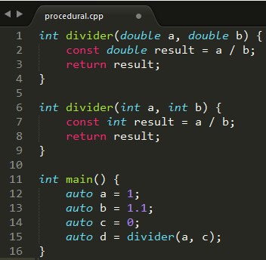
Paradigms: Procedural
statements; expressions; functions; subroutines

Slide 29
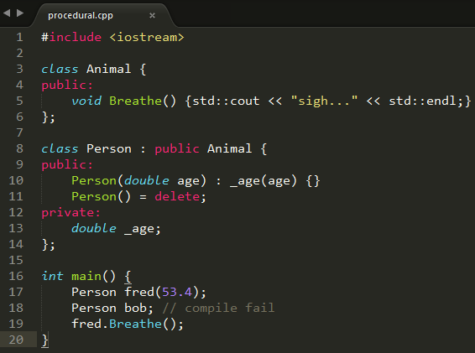
Paradigms: Object Oriented
Classes; objects

Slide 30
Paradigms: Generic
Templates: Fun!
Templated functions
Templated classes
As C++ developers, we need to understand how to read and understand C++ code that uses templates.
So much of C++11/14 Standard Library leverages Generic Programming / templates.
View the source, Luke: Open <string> for example…

Slide 31
We should all be able to read this…
#include <iostream>
#include <string>
template<typename T>
T const max_fun_with_cpp_11(T const& a, T const& b) {
const auto result = a > b ? a : b;
return result;
}
int main() {
std::cout << max_fun_with_cpp_11(7, 29) << std::endl;
std::cout << max_fun_with_cpp_11(
std::string("zebra"), std::string("fred"))
<< std::endl;
}
output:
29
zebra

Slide 32
C++ Standard Library / STL: Not Object Oriented!
Read what the Alexander Stepanov, the creator of the STL has to say about this:
https://en.wikipedia.org/wiki/Alexander_Stepanov#Criticism_of_OOP
He’s got a new book, too:
http://www.informit.com/store/from-mathematics-to-generic-programming-9780321942043

Slide 33
Paradigms: Functional
Lambdas!
“Lambda Expressions” - correct terminology
We know what C / C++ expressions are; makes it a little easier
Pure Functions
Thread safe
Gamasutra article – John Carmack on functional programming in C++
related recent java8 article

Slide 34
Paradigms: Bjarne’s recent take
(Copied from: http://www.stroustrup.com/Myths-final.pdf)
Consider an example:
void rotate_and_draw(vector<Shape*>& vs, int r) {
for_each(vs.begin(),vs.end(), [](Shape* p) { p->rotate(r); }); // rotate all elements of vs
for (Shape* p : vs) p->draw(); // draw all elements of vs
}
Is this object-oriented? Of course it is; it relies critically on a class hierarchy with virtual functions.
It is generic? Of course it is; it relies critically on a parameterized container (vector) and the generic function for_each.
Is this functional? Sort of; it uses a lambda (the [] construct).
So what is it? It is modern C++: C++11.
http://isocpp.org/blog/2014/12/myths-1 // series of 3 recent articles.

Slide 35
C++: what’s [still] missing
XML
Packages / modules
PHP composer; Python pip; Ruby gems; LuaRocks
Java JPM4j anyone?
Microsoft has #import <typelib> for C++ COM
Garbage collection (as C#, Java, Python, …)
Discussion point: Make it optional?
Strings in switch() statement as in C#
Here’s a cute solution on CodeProject
Decimal data type

Slide 36
C++: what’s [still] missing
Serialization:
see google FlatBuffers – good, modern C++
Run-time introspection (C#, Java, Python, …)
C++11 annotations – not much here
Interfaces: Need [ugly] abstract classes
Command-line parsing
Binary-compatible outputs
No standard “name mangling” of C++ classes
Fallback is to expose ‘C’ interfaces instead of rich C++ datatypes and objects. ☹
‘hourglass interfaces’: interesting cppcon presentation.

Slide 37
C++: what’s still missing
Networking: Will probably be stealing Boost.Asio
“Boost.Asio is a cross-platform C++ library for network and low-level I/O programming that provides developers with a consistent asynchronous model using a modern C++ approach.”
http://www.boost.org/doc/libs/1_57_0/doc/html/boost_asio.html

Slide 38
C++: what’s still missing
type fail.cpp
int main() { f(); } void f() {}
cl fail.cpp
Microsoft (R) C/C++ Optimizing Compiler Version 18.00.31101 for x86 Copyright (C) Microsoft Corporation. All rights reserved. fail.cpp fail.cpp(2) : error C3861: 'f': identifier not found

Slide 39
Which C++ compiler am I using?
Windows driver kit (WDK):
c:\apps\WinDDK\7600.16385.1> bin\setenv.bat . WLH
c:\apps\WinDDK\7600.16385.1> cl.exe
Microsoft (R) 32-bit C/C++ Optimizing Compiler Version 15.00.30729.207 for 80x86
This is C++ ’03’

Slide 40
Which C++ compiler?
Set the environment; run CL.EXE
Visual Studio help/about: fail
Look for “C++” here for all MS C++ compiler versions
vs2013env: Microsoft (R) C/C++ Optimizing Compiler Version 18.00.31010 for x86
vs2012env: Microsoft (R) C/C++ Optimizing Compiler Version 17.00.61030 for x86
vs2010env: Microsoft (R) 32-bit C/C++ Optimizing Compiler Version 16.00.40219.01 for 80x86
vs2008env: Microsoft (R) 32-bit C/C++ Optimizing Compiler Version 15.00.30729.01 for 80x86
vs2014env: Microsoft (R) C/C++ Optimizing Compiler Version 19.00.22129.1 for x86

Slide 41
Which C++ compiler?
On a fairly up-to-date linux box:
dwight@dwight-mint17 ~ $ g++ --version
g++ (Ubuntu 4.8.2-19ubuntu1) 4.8.2
Copyright (C) 2013 Free Software Foundation, Inc.
GCC: “GNU compiler collection”
g++ is the C++ compiler command
gcc is the C compiler command

Slide 42
Checking C++11 Conformance
Try it – it might work. Fun!
“compiler shootout” as of march 2014
http://cpprocks.com/c1114-compiler-and-library-shootout/
microsoft has a lot of links. Here’s one:
http://msdn.microsoft.com/en-us/library/hh567368.aspx

Slide 43
MS C/C++ runtime dependencies
c:\apps\vs2013\VC\redist\x64> tree /f /a
+---Microsoft.VC120.CRT
| msvcp120.dll // C++ runtime; 600+ Kb
| msvcr120.dll // C runtime; 2+ Mb
| vccorlib120.dll // C++/CLI (.NET)
+---Microsoft.VC120.CXXAMP // ‘accelerated massive
// parallelism’
| vcamp120.dll
+---Microsoft.VC120.MFC
| mfc120u.dll
| mfcm120u.dll
\---Microsoft.VC120.OpenMP
vcomp120.dll
That last one: “…multi-platform shared-memory parallel programming in C/C++ and Fortran”

Slide 44
C++ Idioms
RAII
“Resource Acquisition Is Initialization”
Acquire and release things in constructor and destructor
SFINAE
“Substitution Failure Is Not An Error”
You won’t get compile-time errors when fiddling with templates

Slide 45
RAII
Constructor acquires resource
e.g. opens file; allocate memory
All other member functions know resource is acquired
Do not need to test and make sure
Destructor releases resources
Works even in the presence of exceptions

Slide 46
C++: Rule of Three
http://en.cppreference.com/w/cpp/language/rule_of_three
“If a class requires a user-defined destructor, a user-defined copy constructor, or a user-defined copy assignment operator, it almost certainly requires all three.

Slide 47
C++11: Rule of 5
http://en.cppreference.com/w/cpp/language/rule_of_three
“Because the presence of a user-defined destructor, copy-constructor, or copy-assignment operator prevents implicit definition of the move constructor and the move assignment operator, any class for which move semantics are desirable, has to declare all five special member functions.”
(Ugh.)

Slide 48
C++11: Rule of Zero! FUN!
"I'd go so far as to claim that these rules are rarely needed. Why is that? Well, as I mentioned in the introduction on ownership, C++ allows us to encapsulate ownership policies into generic reusable classes. This is the important bit! Most often, our ownership needs can be catered for by 'ownership-in-a-package' classes.
http://flamingdangerzone.com/cxx11/2012/08/15/rule-of-zero.html

Slide 49
The Big C++11 Feature List
Wikipedia: take a look. http://en.wikipedia.org/wiki/C%2B%2B11

Slide 50
Hot off the press: C++14, 17 status
http://talesofcpp.fusionfenix.com/post-19/interlude
http://www.bfilipek.com/2014/12/c-status-at-end-of-2014.html

Slide 51
Some of My Favorite Things…

Slide 52
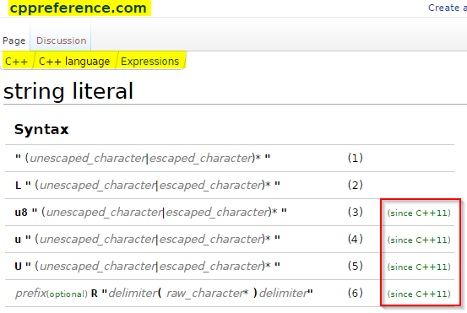
String Literals

Slide 53
String Literals
1) Narrow multibyte string literal. The type of an unprefixed string literal is const char[]
2) Wide string literal. The type of a L"..." string literal is const wchar_t[]
3) UTF-8 encoded string literal. The type of a u8"..." string literal is const char[]
4) UTF-16 encoded string literal. The type of a u"..." string literal is const char16_t[]
5) UTF-32 encoded string literal. The type of a U"..." string literal is const char32_t[]
6) Raw string literal. Used to avoid escaping of any character, anything between the delimiters becomes part of the string, if prefix is present has the same meaning as described above.
Note: C and C++ do not have string types; the libs have 'em!
Note: these Unicode literals are not (yet) in MSVC++ (‘raw’ is)

Slide 54
String Literals: Raw
YAY! Needed this from day 1:
#include <string>
#include <iostream>
int main() {
std::string s = R"#(\>%^\t\n&*(<)#";
std::cout << s << std::endl;
s = R"gobbledygook(a raw string literal with "gobbledygook"
as the delimiter)gobbledygook";
std::cout << s << std::endl;
return 0;
}
output:
\>%^\t\n&*(<
a raw string literal with "gobbledygook" as the delimiter

Slide 55
nullptr
NULL is dead. It’s ambiguous.
Prefer to zero, also.
Use nullptr wherever you used to use NULL.
nullptr is part of the C++ language – not the standard library.
if (NULL == dumbPointer)… // bad
if (nullptr != dumbPointer) … // ok
delete nullptr; // always works

Slide 56
Uniform Initialization a.k.a. “List Initialization”
“C++03 has a number of problems with initializing types. There are several ways to initialize types, and they do not all produce the same results when interchanged. The traditional constructor syntax, for example, can look like a function declaration, and steps must be taken to ensure that the compiler's most vexing parse rule will not mistake it for such. Only aggregates and POD types can be initialized with aggregate initializers (using SomeType var = {/*stuff*/};).
“C++11 provides a syntax that allows for fully uniform type initialization that works on any object. It expands on the initializer list syntax:
wikipedia: http://en.wikipedia.org/wiki/C%2B%2B11#Uniform_initialization
cppreference: http://en.cppreference.com/w/cpp/language/list_initialization

Slide 57

Uniform Initialization
Old:
New:

Slide 58
Uniform Initialization
Avoids ‘narrowing’:
char c1 = 1.234e12; // warning: C4244: 'initializing' : conversion from 'double' to 'char', possible loss of data
char c2 = 54321; // warning C4305 : '=' : truncation from 'int' to 'char‘
char c1 {1.234e12}; // error C2397: conversion from 'double' to 'char' requires a narrowing conversion
char c2 {54321}; // error C2397: conversion from 'int' to 'char' requires a narrowing conversion
It’s FUN to practice EDD!

Slide 59
Smart Pointers
C++ does not have garbage collection: It is deterministic in its acquisition and release of memory and other resources.
std::auto_ptr is deprecated; do not use it
Failed to play well with std lib collections – std::list, std::vector
Still in use; don’t panic.
Just don’t write any new stuff with std::auto_ptr

Slide 60
C++ Smart Pointers std::unique_ptr
New to C++11
Use instead of deprecated std::auto_ptr
Use it wherever you are tempted to use an old fashioned dumb pointer (!!!)
Plays well with std collections
old:
CPrinter* pPrinter = new CPrinter {};
new:
std::unique_ptr <CPrinter> printer (new CPrinter {});

Slide 61
C++ smart pointers
std::unique_ptr if only one object needs access to the underlying pointer
std::shared_ptr if several want to use the same underlying pointer
Cleaned up when the last copy goes out of scope
In <memory> header file
“If you’re using new or delete, you’re doing it wrong.” –Kate Gregory (Microsoft)

Slide 62
Smart Pointers std::shared_ptr
New to C++11
Similar to unique_ptr – but reference counted
Plays well with std collections
Store objects
Store pointers to objects
Has some overhead
As with unique_ptr, you’ll still have a ‘new’ – but no ‘delete’: They’re SMART!

Slide 63
std::to_string
“Converts a numeric value to std::string.”
http://en.cppreference.com/w/cpp/string/basic_string/to_string
Avoid Unicode macros, risky scanf(), CString::Format(), …
use to_wstring() for wide strings
#include <iostream>
#include <string>
int main() {
double f = 23.43;
std::string f_str = std::to_string(f);
std::cout << f_str << std::endl;
}
output: 23.430000

Slide 64
Auto: Type Inference
C / C++ “auto” keyword was rarely used
Different behavior in different compiler implementations
This is just like the “var” keyword in C#
Compiler determines type at compile-time
Your IDE can be your friend: Hover with your mouse, Luke…
Yes; there are a lot of pros/cons for usage in different context.

Slide 65
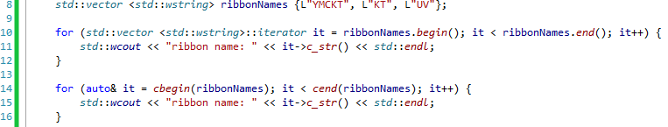
Auto: Type Inference
output (twice):
ribbon name: YMCKT
ribbon name: KT
ribbon name: UV

Slide 66
Lambdas: Lambda Expressions
http://isocpp.org/wiki/faq/cpp11-language#lambda
http://codexpert.ro/blog/2014/10/25/c11-lets-write-a-hello-lambda/

Slide 67
Lambda Expressions
Part of C++11 language – not the C++ Standard Library
Alternative to function objects (‘functors’), and plain functions
Per the ISO standard document: “Lambda expressions provide a concise way to create simple function objects.”
Unnamed
But you can give them names: They are expressions, and you can just assign them to a variable name.
Very useful inside templated functions and classes

Slide 68
In a nutshell, this sounds good:
“But the first thing that struck me when I started using C++11 was the smaller features that I could take advantage of every time I put my fingers to the keyboard. These are the things that make code more concise and simple and allow me to present my intentions more clearly. Stuff I take advantage of every day:
more concise general coding:
lambdas for scoped initialization or inline ‘builder’ functions;
new standard library functionality for string manipulation, particularly std::to_string() and std::stoi() etc;
range-based for loop
clearer declarations:
inline member initialization;
the override, default and delete keywords;
delegating constructors;
uniform initialization, especially when invoking or returning from functions;
auto type deduction everywhere!
far fewer dependencies on Boost
“These are the things I think all C++ programmers should learn first, because they benefit you straight away and confer very little risk of being learned wrong.

