Slide 1
Fun with C++11

Slide 2
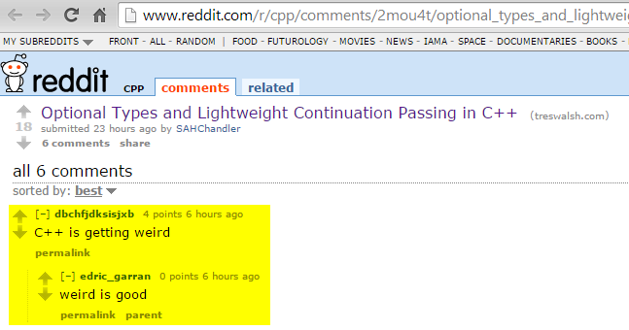

Slide 3
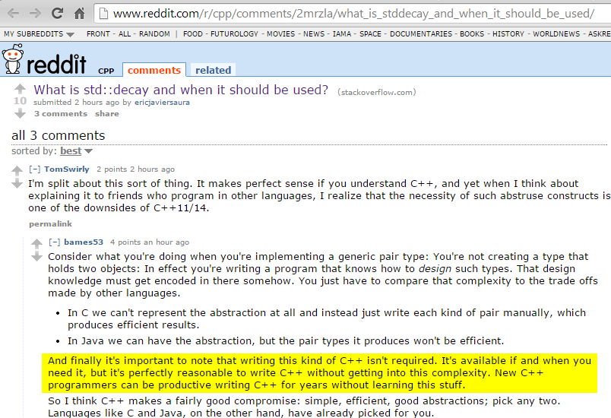

Slide 4
Fun with C++ 11
“Conclusion: C++ has changed dramatically over the last decade. It’s no more C with Classes. If you not looked at C++ recently, it will be the right time to have another look.”
http://blog.madhukaraphatak.com/functional-programming-in-c++/

Slide 5
Disclaimers
I like a lot of languages in addition to C++
C# (mostly); Python; Java; PHP; Groovy; would like to learn Ruby and Clojure
I use Microsoft C++ mostly
I’m not a C++ expert
these challenge me: http://cppquiz.org/quiz/question/1
It’s fun to learn new things and apply them

Slide 6
C++ History
Year | C++ Standard | Informal name
1998 | ISO/IEC 14882:1998^{[12]} | C++98
2003 | ISO/IEC 14882:2003^{[13]} | C++03
2007 | ISO/IEC TR 19768:2007^{[14]} | C++TR1
2011 | ISO/IEC 14882:2011^{[4]} | C++11
2014 | N3690 (working draft C++14)^{[15]} | C++14
2017 | to be determined | C++17
Source: wikipedia C++ article

Slide 7

C++ People: Scott Meyers
Has ‘the hair’

Slide 8

C++ People: Bjarne Stroustrup
Hair: Big fun topic at cppcon.
http://scottmeyers.blogspot.com/2014/09/cppcon-hair-poll.html

Slide 9
C++ People
Andrei Alexandrescu
Book: Modern C++ Design: Generic Programming and Design Patterns Applied (2001)
Loki framework: “a C++ software library written by Andrei Alexandrescu as part of his book Modern C++ Design. The library makes extensive use of C++ template metaprogramming and implements several commonly used tools: typelist, functor, singleton, smart pointer, object factory, visitor and multimethods.”
Facebook’s ‘Flint’ – written in ‘D’: https://code.facebook.com/posts/729709347050548/under-the-hood-building-and-open-sourcing-flint/

Slide 10
C++ Standard
ISO/IEC 14881:2011
ISO/IEC 14882:2011 specifies requirements for implementations of the C++ programming language. The first such requirement is that they implement the language, and so ISO/IEC 14882:2011 also defines C++. Other requirements and relaxations of the first requirement appear at various places within ISO/IEC 14882:2011.
C++ is a general purpose programming language based on the C programming language as specified in ISO/IEC 9899:1999. In addition to the facilities provided by C, C++ provides additional data types, classes, templates, exceptions, namespaces, operator overloading, function name overloading, references, free store management operators, and additional library facilities.
1300+ pages
isocpp.org: links to free PDF drafts. Fun!
Purchase it here in the U.S. ($30 or $60?).

Slide 11
C++ Innovation
LLVM: all your languages belong to us…and Clang…
Boost library: Many things make their way into C++ std lib
Facebook: HipHop transpiler; many opensource libs
Google – products and tools
Microsoft – tools; Office
.NET not used in tools or Office..

Slide 12
Microsoft; Clang; LLVM
Microsoft – Nov 2014:
“The C++ team has made a goal to achieve C++11 and C++14 conformance in the Visual C++ compiler for Visual Studio 2015's final release. But there's more: Visual Studio 2015 will actually support another, modern conformant C++ compiler – Clang for projects targeting non-Microsoft platforms. In this video, Herb Sutter discusses how you'll be able to write a single cross-platform C++ source base and build it to target Windows, Windows Phone, Android, and soon iOS, all from within Visual Studio!
http://channel9.msdn.com/Events/Visual-Studio/Connect-event-2014/311

Slide 13
C++ Innovation
Dropbox: Cross-platform C++ layer. iOS, Android, …
Catch: “A modern, C++-native, header-only, framework for unit-tests, TDD and BDD”
JetBrains (of ReSharper and IntelliJ IDEA): CLion IDE (and plug-in for VS).
Google/Android: tools for C/C++
Intel NDK – native dev for Android
Intel Threding Building Blocks
Cevelop: Eclipse-based C++ IDE with unit testing, refactoring

Slide 14
C++: Alive and Well
Facebook:
Proxygen makes heavy use of the latest C++ features and depends on Thrift and Folly for its underlying network and data abstractions. We make use of move semantics to avoid extra copies for large objects like body buffers and header representations while avoiding typical pitfalls like memory leaks. Additionally, by using non-blocking IO and Linux's epoll under the hood, we are able to create a memory and CPU efficient server.

Slide 15
C++: Alive and Well
Qt Framework: Staying current…
“C++14 for Qt programmers”:
http://woboq.com/blog/cpp14-in-qt.html

Slide 16
C++ is Multi-Paradigm
Procedural
Object Oriented
Generic
Functional

Slide 17
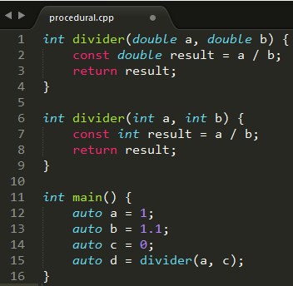
Paradigms: Procedural
Assignment statements; functions; subroutines

Slide 18
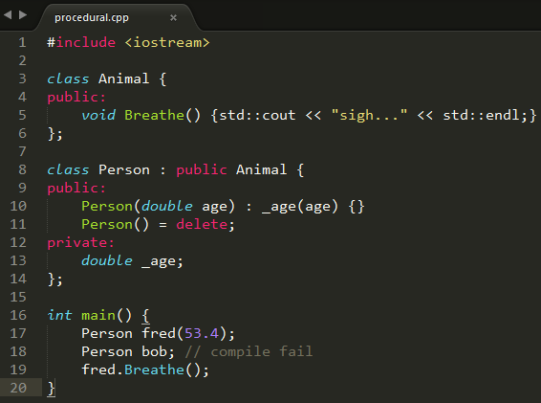
Paradigms: Object Oriented
Classes; objects

Slide 19
Paradigms: Generic
Templates
dlftodo

Slide 20
C++ Standard Library / STL: Not Object Oriented!
Read what the creator of the STL has to say about this:
https://en.wikipedia.org/wiki/Alexander_Stepanov#Criticism_of_OOP
He’s got a new book, too:
http://www.informit.com/store/from-mathematics-to-generic-programming-9780321942043

Slide 21
Paradigms: Functional
Lambdas
map/reduce: use ??? and ??? instead
todo
Gamasutra article – John Carmack

Slide 22
What’s [still] missing
XML
Packages / modules
PHP composer; Python pip; Ruby gems; LuaRocks
Java JPM4j anyone`?
Microsoft has #import <typelib> for C++ COM
Garbage collection (as C#, Java, Python, …)
Strings in switch() statement as in C#
Here’s a cute solution on CodeProject
Decimal data type

Slide 23
What’s [still] missing
Serialization:
see google FlatBuffers – good, modern C++
Run-time introspection (C#, Java, Python, …)
Interfaces: Need [ugly] abstract classes
Command-line parsing
Binary-compatible outputs
No standard “name mangling” of C++ classes
Fallback is to expose ‘C’ interfaces instead of rich C++ datatypes and objects. ☹

Slide 24
Networking: Will probably be stealing Boost.Asio
“Boost.Asio is a cross-platform C++ library for network and low-level I/O programming that provides developers with a consistent asynchronous model using a modern C++ approach.”
http://www.boost.org/doc/libs/1_57_0/doc/html/boost_asio.html

Slide 25
C++ Idioms
RAII
“Resource Acquisition Is Initialization”
Acquire and release things in constructor and destructor
SFINAE
“Substitution Failure Is Not An Error”
You won’t get compile-time errors when fiddling with templates

Slide 26
RAII
Constructor acquires resource
e.g. opens file; allocate memory
All other member functions know resource is acquired
Do not need to test and make sure
Destructor releases resource
Works even in the presence of exceptions

Slide 27
C++: Rule of 3
http://en.cppreference.com/w/cpp/language/rule_of_three
“If a class requires a user-defined destructor, a user-defined copy constructor, or a user-defined copy assignment operator, it almost certainly requires all three.

Slide 28
C++11: Rule of 5
http://en.cppreference.com/w/cpp/language/rule_of_three
“Because the presence of a user-defined destructor, copy-constructor, or copy-assignment operator prevents implicit definition of the move constructor and the move assignment operator, any class for which move semantics are desirable, has to declare all five special member functions.

Slide 29
Which C++ compiler am I using?
c:\apps\WinDDK\7600.16385.1> bin\setenv.bat . WLH
c:\apps\WinDDK\7600.16385.1> cl.exe
Microsoft (R) 32-bit C/C++ Optimizing Compiler Version 15.00.30729.207 for 80x86
Copyright (C) Microsoft Corporation. All rights reserved.
usage: cl [ option... ] filename... [ /link linkoption... ]

Slide 30
Which C++ compiler?
Set the environment; run CL.EXE
Visual Studio help/about: fail
Look for “C++” here for all MS C++ compiler versions
vs2013env: Microsoft (R) C/C++ Optimizing Compiler Version 18.00.31010 for x86
vs2012env: Microsoft (R) C/C++ Optimizing Compiler Version 17.00.61030 for x86
vs2010env: Microsoft (R) 32-bit C/C++ Optimizing Compiler Version 16.00.40219.01 for 80x86
vs2008env: Microsoft (R) 32-bit C/C++ Optimizing Compiler Version 15.00.30729.01 for 80x86
vs2014env: Microsoft (R) C/C++ Optimizing Compiler Version 19.00.22129.1 for x86

Slide 31
Which C++ compiler?
On an up-to-date linux box:
dwight@dwight-mint17 ~ $ g++ --version
g++ (Ubuntu 4.8.2-19ubuntu1) 4.8.2
Copyright (C) 2013 Free Software Foundation, Inc.
“G” is for GNU
“GNU” is for “GNU is Not Unix”
g++ is the C++ compiler command
gcc is the C compiler command
GCC: “GNU compiler collection”

Slide 32
MS C/C++ runtime dependencies
c:\apps\vs2013\VC\redist\x64> tree /f /a
+---Microsoft.VC120.CRT
| msvcp120.dll // C++ runtime
| msvcr120.dll // C runtime
| vccorlib120.dll // C++/CLI
+---Microsoft.VC120.CXXAMP
| vcamp120.dll
+---Microsoft.VC120.MFC
| mfc120u.dll
| mfcm120u.dll
+---Microsoft.VC120.MFCLOC
| //mfc localized stuff
\---Microsoft.VC120.OpenMP
vcomp120.dll

Slide 33
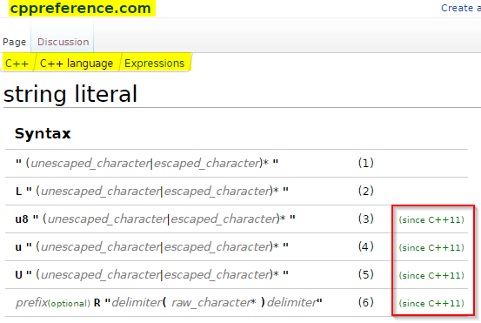
String Literals

Slide 34
String Literals
1) Narrow multibyte string literal. The type of an unprefixed string literal is const char[]
2) Wide string literal. The type of a L"..." string literal is const wchar_t[]
3) UTF-8 encoded string literal. The type of a u8"..." string literal is const char[]
4) UTF-16 encoded string literal. The type of a u"..." string literal is const char16_t[]
5) UTF-32 encoded string literal. The type of a U"..." string literal is const char32_t[]
6) Raw string literal. Used to avoid escaping of any character, anything between the delimiters becomes part of the string, if prefix is present has the same meaning as described above.
Note: C and C++ do not have string types; the libs have 'em!
Note: these Unicode literals are not in MSVC++ (‘raw’ is)

Slide 35
String Literals: Raw
YAY! Needed this from day 1:
#include <string>
#include <iostream>
int main() {
std::string s = R"#(\>%^\t\n&*(<)#";
std::cout << s << std::endl;
s = R"gobbledygook(a raw string literal with "gobbledygook"
as the delimiter)gobbledygook";
std::cout << s << std::endl;
return 0;
}
\>%^\t\n&*(<
a raw string literal with "gobbledygook" as the delimiter

Slide 36
nullptr
NULL is dead. It’s ambiguous.
Prefer to zero, also.
Use nullptr wherever you used to use NULL.
nullptr is part of the C++ language – not the standard library.
if (NULL == dumbPointer)… // bad
if (nullptr != dumbPointer) … // ok
delete nullptr; // always works

Slide 37

Uniform Initialization
Old:
New:

Slide 38
Uniform Initialization
Avoids ‘narrowing’:
char c1 = 1.234e12; // warning: C4244: 'initializing' : conversion from 'double' to 'char', possible loss of data
char c2 = 54321; // warning C4305 : '=' : truncation from 'int' to 'char‘
char c1 {1.234e12}; // error C2397: conversion from 'double' to 'char' requires a narrowing conversion
char c2 {54321}; // error C2397: conversion from 'int' to 'char' requires a narrowing conversion

Slide 39
std::to_string
“Converts a numeric value to std::string.”
http://en.cppreference.com/w/cpp/string/basic_string/to_string
Avoid atof(), atoi(), Unicode macros, …
Use to_wstring() for wide strings
#include <iostream>
#include <string>
int main() {
double f = 23.43;
std::string f_str = std::to_string(f);
std::cout << f_str << std::endl;
}
output: 23.430000

Slide 40
std::to_string
Works with all sorts of numeric types
Caveat (google FlatBuffers):
namespace flatbuffers {
// Convert an integer or floating point value to a string.
// In contrast to std::stringstream, "char" values are converted to a string of digits.
template<typename T> std::string NumToString(T t)
{
// to_string() prints different numbers of digits for floats depending on
// platform and isn't available on Android, so we use stringstream
std::stringstream ss;
ss << t;
return ss.str();
}

Slide 41
Smart Pointers
C++ does not have garbage collection: It is deterministic in its acquisition and release of memory and other resources.
std::auto_ptr is deprecated; do not use it
Failed to play well with std lib collections – std::list, std::vector

Slide 42
Smart Pointers std::unique_ptr
New to C++11
Use instead of deprecated std::auto_ptr
Use it wherever you are tempted to use an old fashioned dumb pointer (!!!)
Plays well with std collections
old:
CPrinter* pPrinter = new CPrinter {};
new:
std::unique_ptr <CPrinter> (new CPrinter {});

Slide 43
C++ smart pointers
std::unique_ptr if only one object needs access to the underlying pointer
std::shared_ptr if several want to use the same underlying pointer
Cleaned up when the last copy goes out of scope
In <memory> header file
“If you’re using new or delete, you’re doing it wrong.” –Kate Gregory
"You still need new." –Dwight Fellman

Slide 44
Smart Pointers std::shared_ptr
New to C++11
Similar to unique_ptr – but reference counted
Plays well with std collections
Store objects
Store pointers to objects
As with unique_ptr, you’ll still have a ‘new’ – but no ‘delete’: They’re SMART!

Slide 45
std::to_string
“Converts a numeric value to std::string.”
http://en.cppreference.com/w/cpp/string/basic_string/to_string
Avoid atof(), atoi(), Unicode macros, …
Use to_wstring() for wide strings
#include <iostream>
#include <string>
int main() {
double f = 23.43;
std::string f_str = std::to_string(f);
std::cout << f_str << std::endl;
}
output: 23.430000

Slide 46
std::to_string
Works with all sorts of numeric types
Caveat (google FlatBuffers):
namespace flatbuffers {
// Convert an integer or floating point value to a string.
// In contrast to std::stringstream, "char" values are converted to a string of digits.
template<typename T> std::string NumToString(T t)
{
// to_string() prints different numbers of digits for floats depending on
// platform and isn't available on Android, so we use stringstream
std::stringstream ss;
ss << t;
return ss.str();
}

Slide 47
Google C++ Guide: Initialization
http://google-styleguide.googlecode.com/svn/trunk/cppguide.html
“Programmers have to understand the difference between auto and const auto& or they'll get copies when they didn't mean to.
The interaction between auto and C++11 brace-initialization can be confusing. The declarations:
auto x(3); // Note: parentheses.
auto y{3}; // Note: curly braces.
mean different things — x is an int, while y is a std::initializer_list<int>. The same applies to other normally-invisible proxy types.

Slide 48
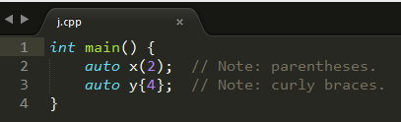
Google C++ guide
cl /FA j.cpp
Directory of D:\temp\j
11/07/2014 08:23 AM 564 j.asm
11/07/2014 08:17 AM 94 j.cpp
11/07/2014 08:23 AM 83,456 j.exe
11/07/2014 08:23 AM 475 j.obj

Slide 49
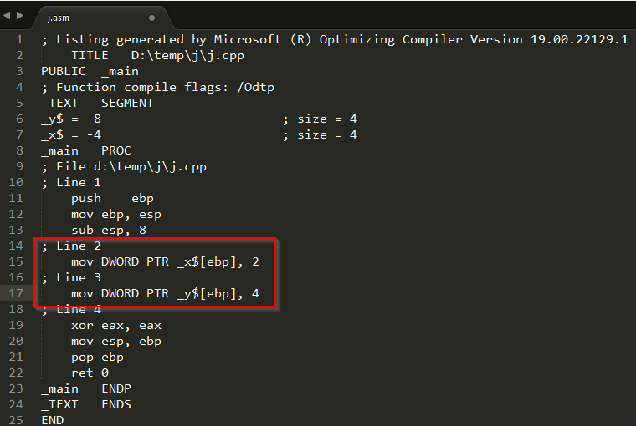
Google C++ guide

Slide 50
Lambdas
http://isocpp.org/wiki/faq/cpp11-language#lambda
http://codexpert.ro/blog/2014/10/25/c11-lets-write-a-hello-lambda/

