Slide 1
Fun with C++11
#define fun
or,
#define fun true

Slide 2
Disclaimers
I like a lot of languages in addition to C++
C# (mostly); Python; Java; PHP; Groovy; would like to learn Ruby, Clojure and Go - and someday: LISP!
I use Microsoft C++ mostly.
I’m not a C++ expert. I find even these challenging: http://cppquiz.org/quiz/question/1
I practice EDD

Slide 3
EDD: Error Driven Development
You can learn a LOT from the compiler warnings and errors. Fun!
Template errors and warnings are getting better. (Have been notoriously bad.)
Fun: “The challenge: Write a piece of C++ code and try to reach the largest possible error message.”
http://tgceec.tumblr.com/post/106626335863/introducing-the-grand-c-error-explosion

Slide 4
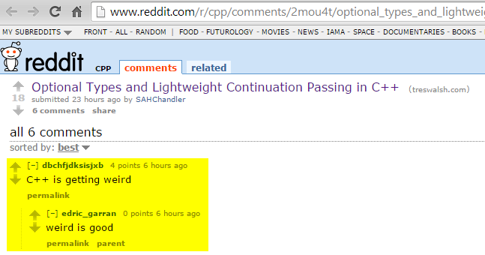

Slide 5
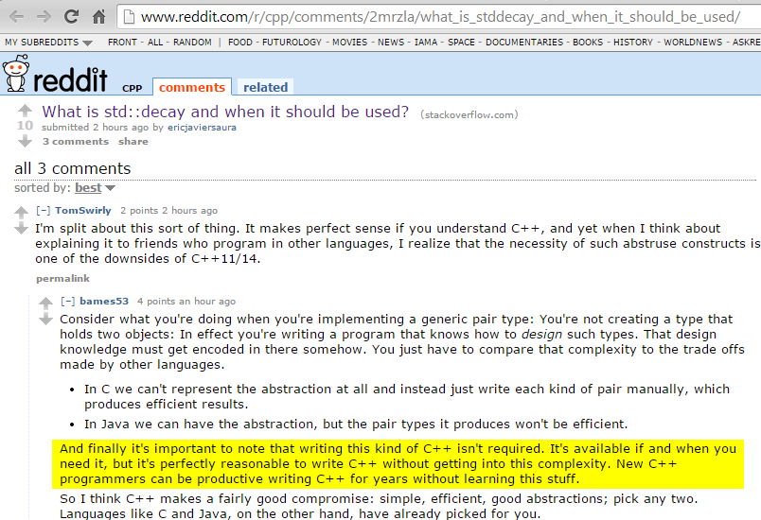

Slide 6
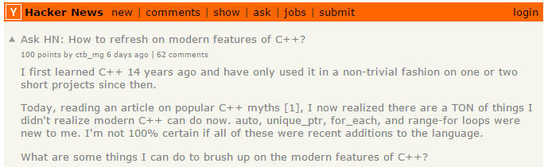
https://news.ycombinator.com/item?id=8788454
https://isocpp.org/blog/2014/12/myths-1

Slide 7
What’s changed?
C++11 standard finally published
Took too long.
For a long time, temporarily named “C++0x”
Finally published - but now we’re in 2015…and C++14 is about to be finalized
Mobile devices want fewer CPU cycles; battery consumption: a big deal
Microsoft: C++ [was] 2nd-class citizen in the .NET era of early 2000’s; that changed with ‘RT’
Big internet players really, really need performance and massive scale

Slide 8
Fun with C++ 11
“Conclusion: C++ has changed dramatically over the last decade. It’s no more C with Classes. If you not looked at C++ recently, it will be the right time to have another look.”
http://blog.madhukaraphatak.com/functional-programming-in-c++/

Slide 9
good/bad news
C++ was big already - and got a lot bigger with C++11
C++14: much smaller set of changes compared to C++11
Regardless, pace of change is increasing

Slide 10
C++ History
Year | C++ Standard | Informal name
1998 | ISO/IEC 14882:1998^{[12]} | C++98
2003 | ISO/IEC 14882:2003^{[13]} | C++03
2007 | ISO/IEC TR 19768:2007^{[14]} | C++TR1
2011 | ISO/IEC 14882:2011^{[4]} | C++11
2014 | N3690 (working draft C++14)^{[15]} | C++14
2017 | to be determined | C++17
source: wikipedia C++ article

Slide 11
C++ History: What happened to Technical Report 2 (TR2)?
In 2005, a request for proposals for a TR2 was made with a special interest in Unicode, XML/HTML, Networking and usability for novice programmers.[3]. Some of the proposals included:
Threads [4]
The Asio C++ library (networking [5][6]).
Signals/Slots [7][8]
Filesystem Library [9] – Based on the Boost Filesystem Library, for query/manipulation of paths, files and directories.
Boost Any Library [10]
Lexical Conversion Library [11]
New String Algorithms [12]
Toward a More Complete Taxonomy of Algebraic Properties for Numeric Libraries in TR2 [13]
Adding heterogeneous comparison lookup to associative containers for TR2 [14]
Since the call for proposals for TR2, changes to ISO procedures meant that there will not be a TR2, instead enhancements to C++ will be published in a number of Technical Specifications. Some of the proposals listed above are already included in the C++ standard or in draft versions of the Technical Specifications.
https://en.wikipedia.org/wiki/C%2B%2B_Technical_Report_1#Technical_Report_2

Slide 12
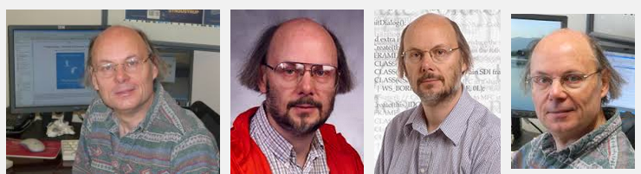
C++ People: Bjarne Stroustrup
On the ISO standards committee
NOT a BDFL
Still writing good books
Hair: Big fun topic at cppcon.
http://scottmeyers.blogspot.com/2014/09/cppcon-hair-poll.html

Slide 13

C++ People: Scott Meyers
Latest book is hot, hot, hot!
Has ‘the hair’

Slide 14
C++ People
Andrei Alexandrescu
Book: Modern C++ Design: Generic Programming and Design Patterns Applied (2001)
Loki framework: “a C++ software library written by Andrei Alexandrescu as part of his book Modern C++ Design. The library makes extensive use of C++ template metaprogramming and implements several commonly used tools: typelist, functor, singleton, smart pointer, object factory, visitor and multimethods.”
Facebook’s ‘Flint’ – written in ‘D’: https://code.facebook.com/posts/729709347050548/under-the-hood-building-and-open-sourcing-flint/

Slide 15
C++ Standard
ISO/IEC 14881:2011
ISO/IEC 14882:2011 specifies requirements for implementations of the C++ programming language. The first such requirement is that they implement the language, and so ISO/IEC 14882:2011 also defines C++. Other requirements and relaxations of the first requirement appear at various places within ISO/IEC 14882:2011.
C++ is a general purpose programming language based on the C programming language as specified in ISO/IEC 9899:1999. In addition to the facilities provided by C, C++ provides additional data types, classes, templates, exceptions, namespaces, operator overloading, function name overloading, references, free store management operators, and additional library facilities.
1300+ pages
isocpp.org: links to free PDF drafts. Fun!
Purchase it here in the U.S. ($30 or $60?).

Slide 16

Why C++?

Slide 17
Sources of C++ Innovation
all the other cool programming languages
C++ Standard Library (a.k.a. STL)
LLVM: all your languages belong to us…and Clang…
Boost library: Many things make their way into C++ std lib
Facebook: HipHop transpiler (PHP => C++); many opensource libs
Google – products and tools. Yes; lots
Microsoft – Windows; tools; Office…
.NET not used in tools or Office…or drivers. ☹

Slide 18
Microsoft; Clang; LLVM
Microsoft – Nov 2014:
“The C++ team has made a goal to achieve C++11 and C++14 conformance in the Visual C++ compiler for Visual Studio 2015's final release. But there's more: Visual Studio 2015 will actually support another, modern conformant C++ compiler – Clang for projects targeting non-Microsoft platforms. In this video, Herb Sutter discusses how you'll be able to write a single cross-platform C++ source base and build it to target Windows, Windows Phone, Android, and soon iOS, all from within Visual Studio!
http://channel9.msdn.com/Events/Visual-Studio/Connect-event-2014/311

Slide 19
Sources of C++ Innovation
Dropbox: Cross-platform C++ layer. iOS, Android, …
Catch: “A modern C++-native, header-only, framework for unit-tests, TDD and BDD”
JetBrains (of ReSharper and IntelliJ IDEA): CLion IDE (and plug-in for VS).
Google/Android: tools for C/C++
Intel NDK – native dev for Android
Intel Threading Building Blocks
Cevelop: Eclipse-based C++ IDE with unit testing, refactoring

Slide 20
C++: Alive and Well
Facebook:
Proxygen makes heavy use of the latest C++ features and depends on Thrift and Folly for its underlying network and data abstractions. We make use of move semantics to avoid extra copies for large objects like body buffers and header representations while avoiding typical pitfalls like memory leaks. Additionally, by using non-blocking IO and Linux's epoll under the hood, we are able to create a memory and CPU efficient server.

Slide 21
C++: Alive and Well
Qt Framework: Staying current…
“C++14 for Qt programmers”:
http://woboq.com/blog/cpp14-in-qt.html

Slide 22
Yes you Can!
Develop with C++ on windows, linux, and OSX
Develop iOS apps
Develop Android apps
Develop for cool little microcontrollers
Aurduino
Raspberry Pi
Beagle Bone

Slide 23
C++ 101
source files: .CPP, .H, …
preprocessor
compiler
3rd-party .OBJ’s, .LIB’s
.OBJ’s, .LIB’s
linker
DLL’s, EXE’s, static LIB’s

Slide 24
C++ is Multi-Paradigm
Procedural
Object Oriented
Functional
Generic
The last two are where the biggest C++ changes are taking place.

Slide 25
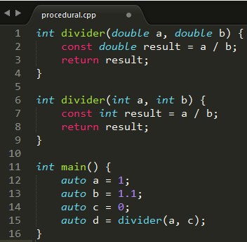
Paradigms: Procedural
statements; expressions; functions; subroutines

Slide 26
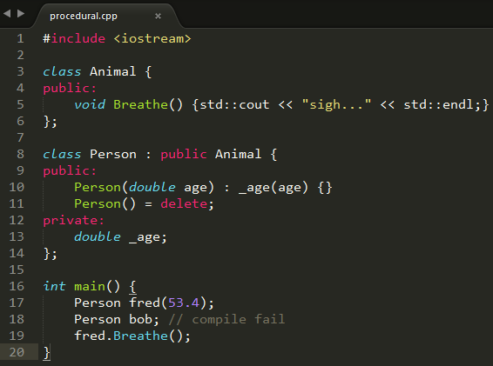
Paradigms: Object Oriented
Classes; objects

Slide 27
Paradigms: Generic
Templates
Templated functions
Templated classes
As C++ developers, we need to understand how to read and understand C++ code that uses templates.
So much of C++11/14 Standard Library leverages Generic Programming / templates.
Read the source, Luke: Open <string> for example…

Slide 28
We should all be able to read this…
#include <iostream>
#include <string>
template<typename T>
T const max_fun_with_cpp_11(T const& a, T const& b)
{
const auto result = a > b ? a : b;
return result;
}
int main() {
std::cout << max_fun_with_cpp_11(7, 29) << std::endl;
std::cout << max_fun_with_cpp_11(
std::string("zebra"), std::string("fred"))
<< std::endl;
}

Slide 29
C++ Standard Library / STL: Not Object Oriented!
Read what the creator of the STL has to say about this:
https://en.wikipedia.org/wiki/Alexander_Stepanov#Criticism_of_OOP
He’s got a new book, too:
http://www.informit.com/store/from-mathematics-to-generic-programming-9780321942043

Slide 30
Paradigms: Functional
Lambdas!
In C++11, “Lambda Expressions” is correct terminology
We know what C / C++ expressions are; makes it a little easier
Pure Functions
Thread safe
Gamasutra article – John Carmack

Slide 31
Paradigms: Bjarne’s recent take
(Copied from: http://www.stroustrup.com/Myths-final.pdf)
Consider an example:
void rotate_and_draw(vector<Shape*>& vs, int r) {
for_each(vs.begin(),vs.end(), [](Shape* p) { p->rotate(r); }); // rotate all elements of vs
for (Shape* p : vs) p->draw(); // draw all elements of vs
}
Is this object-oriented? Of course it is; it relies critically on a class hierarchy with virtual functions.
It is generic? Of course it is; it relies critically on a parameterized container (vector) and the generic function for_each.
Is this functional? Sort of; it uses a lambda (the [] construct).
So what is it? It is modern C++: C++11.
http://isocpp.org/blog/2014/12/myths-1 // series of 3 recent articles.

Slide 32
C++: What’s [still] missing
XML
Packages / modules
PHP composer; Python pip; Ruby gems; LuaRocks
Java JPM4j anyone`?
Microsoft has #import <typelib> for C++ COM
Garbage collection (as C#, Java, Python, …)
Discussion point: Make it optional?
Strings in switch() statement as in C#
Here’s a cute solution on CodeProject
Decimal data type

Slide 33
What’s [still] missing
Serialization:
see google FlatBuffers – good, modern C++
Run-time introspection (C#, Java, Python, …)
C++11 annotations – not much here
Interfaces: Need [ugly] abstract classes
Command-line parsing
Binary-compatible outputs
No standard “name mangling” of C++ classes
Fallback is to expose ‘C’ interfaces instead of rich C++ datatypes and objects. ☹
‘hourglass interfaces’: interesting cppcon presentation.

Slide 34
C++: What’s still missing
Networking: Will probably be stealing Boost.Asio
“Boost.Asio is a cross-platform C++ library for network and low-level I/O programming that provides developers with a consistent asynchronous model using a modern C++ approach.”
http://www.boost.org/doc/libs/1_57_0/doc/html/boost_asio.html

Slide 35
Which C++ compiler am I using?
Windows driver kit (WDK):
c:\apps\WinDDK\7600.16385.1> bin\setenv.bat . WLH
c:\apps\WinDDK\7600.16385.1> cl.exe
Microsoft (R) 32-bit C/C++ Optimizing Compiler Version 15.00.30729.207 for 80x86
This is C++ ’03’

Slide 36
Which C++ compiler?
Set the environment; run CL.EXE
Visual Studio help/about: fail
Look for “C++” here for all MS C++ compiler versions
vs2013env: Microsoft (R) C/C++ Optimizing Compiler Version 18.00.31010 for x86
vs2012env: Microsoft (R) C/C++ Optimizing Compiler Version 17.00.61030 for x86
vs2010env: Microsoft (R) 32-bit C/C++ Optimizing Compiler Version 16.00.40219.01 for 80x86
vs2008env: Microsoft (R) 32-bit C/C++ Optimizing Compiler Version 15.00.30729.01 for 80x86
vs2014env: Microsoft (R) C/C++ Optimizing Compiler Version 19.00.22129.1 for x86

Slide 37
Which C++ compiler?
On a fairly up-to-date linux box:
dwight@dwight-mint17 ~ $ g++ --version
g++ (Ubuntu 4.8.2-19ubuntu1) 4.8.2
Copyright (C) 2013 Free Software Foundation, Inc.
GCC: “GNU compiler collection”
g++ is the C++ compiler command
gcc is the C compiler command

Slide 38
Checking C++11 Conformance
Try it – it might work
“compiler shootout” as of march 2014
http://cpprocks.com/c1114-compiler-and-library-shootout/
microsoft has a lot of links. Here’s one:
http://msdn.microsoft.com/en-us/library/hh567368.aspx

Slide 39
MS C/C++ runtime dependencies
c:\apps\vs2013\VC\redist\x64> tree /f /a
+---Microsoft.VC120.CRT
| msvcp120.dll // C++ runtime; 600+ Kb
| msvcr120.dll // C runtime; 2+ Mb
| vccorlib120.dll // C++/CLI (.NET)
+---Microsoft.VC120.CXXAMP // ‘accelerated massive
// parallelism’
| vcamp120.dll
+---Microsoft.VC120.MFC
| mfc120u.dll
| mfcm120u.dll
\---Microsoft.VC120.OpenMP
vcomp120.dll
That last one: “…multi-platform shared-memory parallel programming in C/C++ and Fortran”

Slide 40
C++ Idioms
RAII
“Resource Acquisition Is Initialization”
Acquire and release things in constructor and destructor
SFINAE
“Substitution Failure Is Not An Error”
You won’t get compile-time errors when fiddling with templates

Slide 41
RAII
Constructor acquires resource
e.g. opens file; allocate memory
All other member functions know resource is acquired
Do not need to test and make sure
Destructor releases resources
Works even in the presence of exceptions

Slide 42
C++: Rule of Three
http://en.cppreference.com/w/cpp/language/rule_of_three
“If a class requires a user-defined destructor, a user-defined copy constructor, or a user-defined copy assignment operator, it almost certainly requires all three.

Slide 43
C++11: Rule of 5
http://en.cppreference.com/w/cpp/language/rule_of_three
“Because the presence of a user-defined destructor, copy-constructor, or copy-assignment operator prevents implicit definition of the move constructor and the move assignment operator, any class for which move semantics are desirable, has to declare all five special member functions.”
(Ugh.)

Slide 44
The Big C++11 List
Wikipedia: take a look. http://en.wikipedia.org/wiki/C%2B%2B11

Slide 45
1 Changes from the previous version of the standard
2 Extensions to the C++ core language
2.1 Core language runtime performance enhancements
2.1.1 Rvalue references and move constructors
2.1.2 constexpr – Generalized constant expressions
2.1.3 Modification to the definition of plain old data
2.2 Core language build time performance enhancements
2.2.1 Extern template
2.3 Core language usability enhancements
2.3.1 Initializer lists
2.3.2 Uniform initialization
2.3.3 Type inference
2.3.4 Range-based for loop
2.3.5 Lambda functions and expressions
2.3.6 Alternative function syntax
2.3.7 Object construction improvement
2.3.8 Explicit overrides and final
2.3.9 Null pointer constant
2.3.10 Strongly typed enumerations
2.3.11 Right angle bracket
2.3.12 Explicit conversion operators
2.3.13 Template aliases
2.3.14 Unrestricted unions
2.4 Core language functionality improvements
2.4.1 Variadic templates
2.4.2 New string literals
2.4.3 User-defined literals
2.4.4 Multithreading memory model
2.4.5 Thread-local storage
2.4.6 Explicitly defaulted and deleted special member functions
2.4.7 Type long long int
2.4.8 Static assertions
2.4.9 Allow sizeof to work on members of classes without an explicit object
2.4.10 Control and query object alignment
2.4.11 Allow garbage collected implementations
2.4.12 Attributes

Slide 46
3 C++ standard library changes
3.1 Upgrades to standard library components
3.2 Threading facilities
3.3 Tuple types
3.4 Hash tables
3.5 Regular expressions
3.6 General-purpose smart pointers
3.7 Extensible random number facility
3.8 Wrapper reference
3.9 Polymorphic wrappers for function objects
3.10 Type traits for metaprogramming
3.11 Uniform method for computing the return type of function objects
4 Improved C compatibility
5 Features originally planned but removed or not included
6 Features removed or deprecated

Slide 47
Hot off the press: C++14, 17 status
http://talesofcpp.fusionfenix.com/post-19/interlude
http://www.bfilipek.com/2014/12/c-status-at-end-of-2014.html

Slide 48
Some of My Favorite Things…

Slide 49
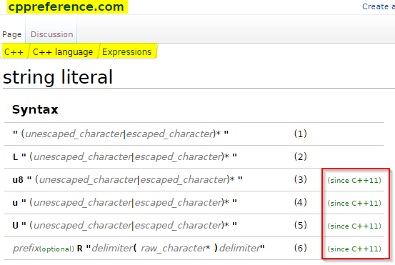
String Literals

Slide 50
String Literals
1) Narrow multibyte string literal. The type of an unprefixed string literal is const char[]
2) Wide string literal. The type of a L"..." string literal is const wchar_t[]
3) UTF-8 encoded string literal. The type of a u8"..." string literal is const char[]
4) UTF-16 encoded string literal. The type of a u"..." string literal is const char16_t[]
5) UTF-32 encoded string literal. The type of a U"..." string literal is const char32_t[]
6) Raw string literal. Used to avoid escaping of any character, anything between the delimiters becomes part of the string, if prefix is present has the same meaning as described above.
Note: C and C++ do not have string types; the libs have 'em!
Note: these Unicode literals are not in MSVC++ (‘raw’ is)

Slide 51
String Literals: Raw
YAY! Needed this from day 1:
#include <string>
#include <iostream>
int main() {
std::string s = R"#(\>%^\t\n&*(<)#";
std::cout << s << std::endl;
s = R"gobbledygook(a raw string literal with "gobbledygook"
as the delimiter)gobbledygook";
std::cout << s << std::endl;
return 0;
}
\>%^\t\n&*(<
a raw string literal with "gobbledygook" as the delimiter

Slide 52
nullptr
NULL is dead. It’s ambiguous.
Prefer to zero, also.
Use nullptr wherever you used to use NULL.
nullptr is part of the C++ language – not the standard library.
if (NULL == dumbPointer)… // bad
if (nullptr != dumbPointer) … // ok
delete nullptr; // always works

Slide 53

Uniform Initialization
Old:
New:

Slide 54
Uniform Initialization
Avoids ‘narrowing’:
char c1 = 1.234e12; // warning: C4244: 'initializing' : conversion from 'double' to 'char', possible loss of data
char c2 = 54321; // warning C4305 : '=' : truncation from 'int' to 'char‘
char c1 {1.234e12}; // error C2397: conversion from 'double' to 'char' requires a narrowing conversion
char c2 {54321}; // error C2397: conversion from 'int' to 'char' requires a narrowing conversion

Slide 55
Smart Pointers
C++ does not have garbage collection: It is deterministic in its acquisition and release of memory and other resources.
std::auto_ptr is deprecated; do not use it
Failed to play well with std lib collections – std::list, std::vector
Still in use; don’t panic.
Just don’t write any new stuff with std::auto_ptr

Slide 56
C++ Smart Pointers std::unique_ptr
New to C++11
Use instead of deprecated std::auto_ptr
Use it wherever you are tempted to use an old fashioned dumb pointer (!!!)
Plays well with std collections
old:
CPrinter* pPrinter = new CPrinter {};
new:
std::unique_ptr <CPrinter> printer (new CPrinter {});

Slide 57
C++ smart pointers
std::unique_ptr if only one object needs access to the underlying pointer
std::shared_ptr if several want to use the same underlying pointer
Cleaned up when the last copy goes out of scope
In <memory> header file
“If you’re using new or delete, you’re doing it wrong.” –Kate Gregory (Microsoft)

Slide 58
Smart Pointers std::shared_ptr
New to C++11
Similar to unique_ptr – but reference counted
Plays well with std collections
Store objects
Store pointers to objects
Has some overhead
As with unique_ptr, you’ll still have a ‘new’ – but no ‘delete’: They’re SMART!

Slide 59
std::to_string
“Converts a numeric value to std::string.”
http://en.cppreference.com/w/cpp/string/basic_string/to_string
Avoid atof(), atoi(), Unicode macros, …
Use to_wstring() for wide strings
#include <iostream>
#include <string>
int main() {
double f = 23.43;
std::string f_str = std::to_string(f);
std::cout << f_str << std::endl;
}
output: 23.430000

Slide 60
std::to_string
Works with all sorts of numeric types
Caveat from Google FlatBuffers:
namespace flatbuffers {
// Convert an integer or floating point value to a string.
// In contrast to std::stringstream, "char" values are converted
// to a string of digits.
template<typename T> std::string NumToString(T t)
{
// to_string() prints different numbers of digits
// for floats depending on platform and isn't available
// on Android, so we use stringstream
std::stringstream ss;
ss << t;
return ss.str();
}

Slide 61
Auto: Type Inference
C / C++ “auto” keyword was rarely used
Different behavior in different compiler implementations
This is just like the “var” keyword in C#
Compiler determines type at compile-time
Your IDE can be your friend: Hover with your mouse, Luke…
Yes; there are a lot of pros/cons for usage in different context.

Slide 62
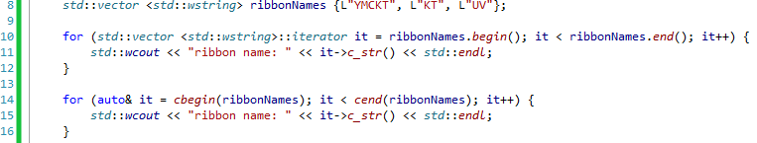
Auto: Type Inference
auto num_printers = 23;
output (twice):
ribbon name: YMCKT
ribbon name: KT
ribbon name: UV

Slide 63
Google C++ Guide: Initialization
http://google-styleguide.googlecode.com/svn/trunk/cppguide.html
“Programmers have to understand the difference between auto and const auto& or they'll get copies when they didn't mean to.
The interaction between auto and C++11 brace-initialization can be confusing. The declarations:
auto x(3); // Note: parentheses.
auto y{3}; // Note: curly braces.
mean different things — x is an int, while y is a std::initializer_list<int>. The same applies to other normally-invisible proxy types.

Slide 64
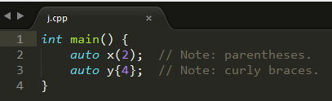
Google C++ guide
cl /FA j.cpp // show me your machine code
Directory of D:\temp\j
11/07/2014 08:23 AM 564 j.asm
11/07/2014 08:17 AM 94 j.cpp
11/07/2014 08:23 AM 83,456 j.exe
11/07/2014 08:23 AM 475 j.obj

Slide 65
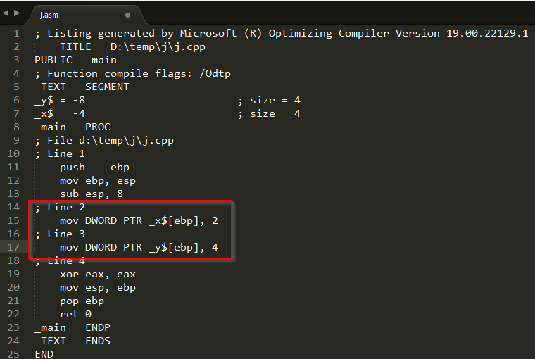
Google C++ guide

Slide 66
Lambdas: Lambda Expressions
http://isocpp.org/wiki/faq/cpp11-language#lambda
http://codexpert.ro/blog/2014/10/25/c11-lets-write-a-hello-lambda/

Slide 67
Lambda Expressions
Part of C++11 language – not the C++ Standard Library
Alternative to function objects (‘functors’), and plain functions
Per the ISO standard document: “Lambda expressions provide a concise way to create simple function objects.”
Unnamed
But you can give them names: They are expressions, and you can just assign them to a variable name.
Very useful inside templated functions and classes

