Slide 1
Fun with C++11

Slide 2
Disclaimers
I like a lot of languages in addition to C++
C# (mostly); Python; Java; PHP; Groovy; would like to learn Ruby and Clojure
I use Microsoft C++ mostly
I’m not a C++ expert
these challenge me: http://cppquiz.org/quiz/question/1
It’s fun to learn new things and apply them

Slide 3
Paradigms
Procedural
Object Oriented
Generic
Functional

Slide 4
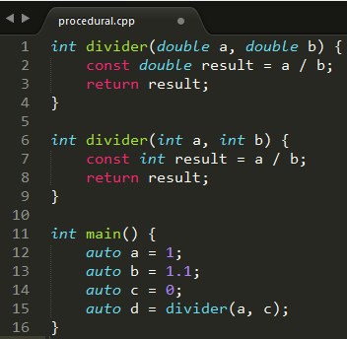
Paradigms: Procedural
Assignment statements; functions; subroutines

Slide 5
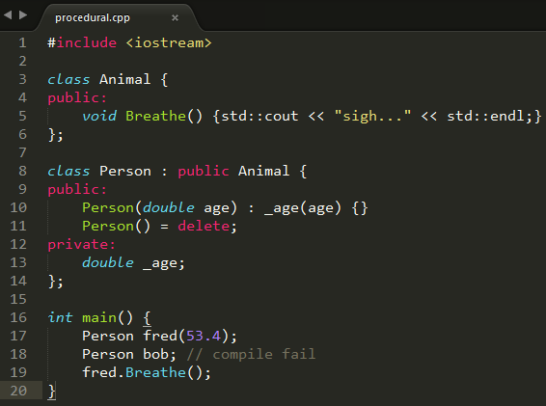
Paradigms: Object Oriented
Classes; objects

Slide 6
C++ Standard Library / STL: Not Object Oriented!
Read what the creator of the STL has to say about this:
https://en.wikipedia.org/wiki/Alexander_Stepanov#Criticism_of_OOP
He’s got a new book, too:
http://www.informit.com/store/from-mathematics-to-generic-programming-9780321942043

Slide 7
What’s missing
XML
Packages / modules
PHP composer; Python pip; Ruby gems
Java .JAR, .WAR; JPM4j
Garbage collection (as C#, Java, Python, …)
Strings in switch() statement (C#)
Decimal
Serialization
see google FlatBuffers – good, modern C++
Run-time introspection (C#, Java, Python, …)
Interfaces: Need [ugly] abstract classes
command-line parsing

Slide 8
C++ Idioms
RAII
“Resource Acquisition Is Initialization”
Acquire and release things in constructor and destructor
SFINAE
“Substitution Failure Is Not An Error”
You won’t get compile-time errors when fiddling with templates

Slide 9
C++ Rule of 3
http://en.cppreference.com/w/cpp/language/rule_of_three
“If a class requires a user-defined destructor, a user-defined copy constructor, or a user-defined copy assignment operator, it almost certainly requires all three.

Slide 10
C++11 Rule of 5
http://en.cppreference.com/w/cpp/language/rule_of_three
“Because the presence of a user-defined destructor, copy-constructor, or copy-assignment operator prevents implicit definition of the move constructor and the move assignment operator, any class for which move semantics are desirable, has to declare all five special member functions.

Slide 11
Which C++ compiler?
c:\apps\WinDDK\7600.16385.1> bin\setenv.bat . WLH
c:\apps\WinDDK\7600.16385.1> cl.exe
Microsoft (R) 32-bit C/C++ Optimizing Compiler Version 15.00.30729.207 for 80x86
Copyright (C) Microsoft Corporation. All rights reserved.
usage: cl [ option... ] filename... [ /link linkoption... ]

Slide 12
Which C++ compiler?
Set the environment; run CL.EXE
Visual Studio help/about: fail
Look for “C++” here for all MS C++ compiler versions
vs2013env: Microsoft (R) C/C++ Optimizing Compiler Version 18.00.31010 for x86
vs2012env: Microsoft (R) C/C++ Optimizing Compiler Version 17.00.61030 for x86
vs2010env: Microsoft (R) 32-bit C/C++ Optimizing Compiler Version 16.00.40219.01 for 80x86
vs2008env: Microsoft (R) 32-bit C/C++ Optimizing Compiler Version 15.00.30729.01 for 80x86
vs2014env: Microsoft (R) C/C++ Optimizing Compiler Version 19.00.22129.1 for x86

Slide 13
MS C/C++ runtime dependencies
c:\apps\vs2013\VC\redist\x64> tree /f /a
+---Microsoft.VC120.CRT
| msvcp120.dll // C++ runtime
| msvcr120.dll // C runtime
| vccorlib120.dll // C++/CLI
+---Microsoft.VC120.CXXAMP
| vcamp120.dll
+---Microsoft.VC120.MFC
| mfc120u.dll
| mfcm120u.dll
+---Microsoft.VC120.MFCLOC
| //mfc localized stuff
\---Microsoft.VC120.OpenMP
vcomp120.dll

Slide 14
Which C++ compiler?
// an up-to-date linux box:
dwight@dwight-mint17 ~ $ g++ --version
g++ (Ubuntu 4.8.2-19ubuntu1) 4.8.2
Copyright (C) 2013 Free Software Foundation, Inc.
“G” is for GNU
“GNU” is for “GNU is Not Unix”
g++ is the C++ compiler command
gcc is the C compiler command
GCC: “GNU compiler collection”

Slide 15
std::to_string
“Converts a numeric value to std::string.”
http://en.cppreference.com/w/cpp/string/basic_string/to_string
Avoid atof(), atoi(), …; unicode; …
Use to_wstring() for wide strings
#include <iostream>
#include <string>
int main()
{
double f = 23.43;
std::string f_str = std::to_string(f);
std::cout << f_str << std::endl;
}
output: 23.430000

Slide 16
std::to_string
Works with all sorts of numeric types
Caveat (google FlatBuffers):
namespace flatbuffers {
// Convert an integer or floating point value to a string.
// In contrast to std::stringstream, "char" values are converted to a string of digits.
template<typename T> std::string NumToString(T t)
{
// to_string() prints different numbers of digits for floats depending on
// platform and isn't available on Android, so we use stringstream
std::stringstream ss;
ss << t;
return ss.str();
}

Slide 17
Google C++
http://google-styleguide.googlecode.com/svn/trunk/cppguide.html
“Programmers have to understand the difference between auto and const auto& or they'll get copies when they didn't mean to.
The interaction between auto and C++11 brace-initialization can be confusing. The declarations:
auto x(3); // Note: parentheses.
auto y{3}; // Note: curly braces.
mean different things — x is an int, while y is a std::initializer_list<int>. The same applies to other normally-invisible proxy types.

Slide 18
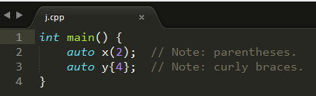
Google C++
cl /FA j.cpp
Directory of D:\temp\j
11/07/2014 08:23 AM 564 j.asm
11/07/2014 08:17 AM 94 j.cpp
11/07/2014 08:23 AM 83,456 j.exe
11/07/2014 08:23 AM 475 j.obj

Slide 19
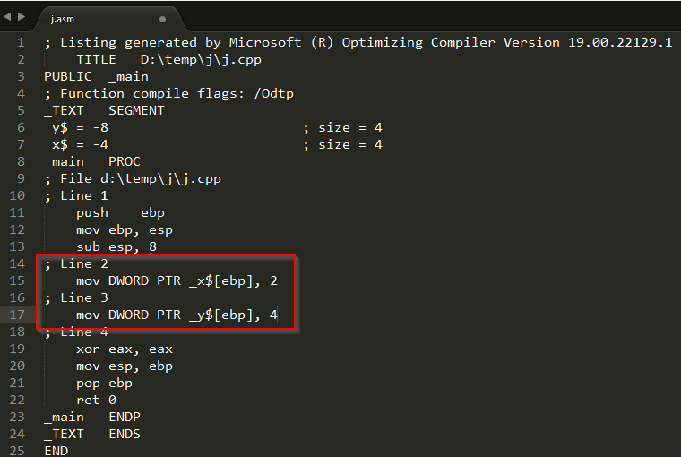
Google C++

