Slide 1
Deep and Wide Contextual Bandits
Weekly Update – February 5, 2021
Aleksey Kocherzhenko

Slide 2
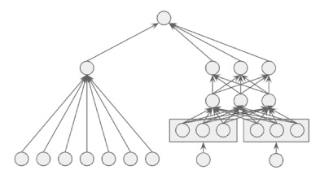
Two parts:
1) Toolkit development for implementing deep and wide contextual bandits
Deep and wide neural network
Deep part
Wide part
Deep-wide connection
Action selection strategy
Memorize individual users
Generalize using contexts
Exploitation only, ε-greedy,
Thompson sampling,
LinUCB, dropout UCB, ...
Action space and feature-agnostic

Slide 3
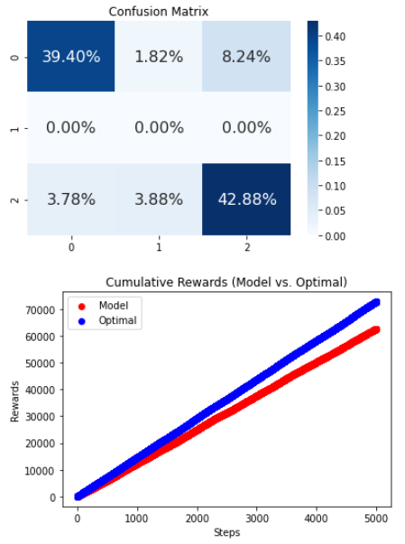
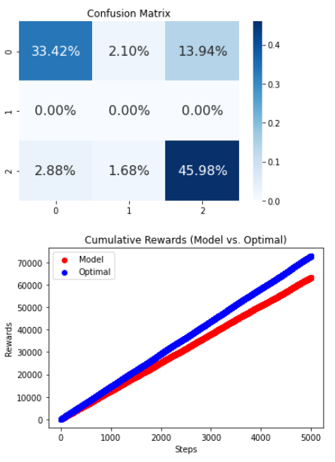
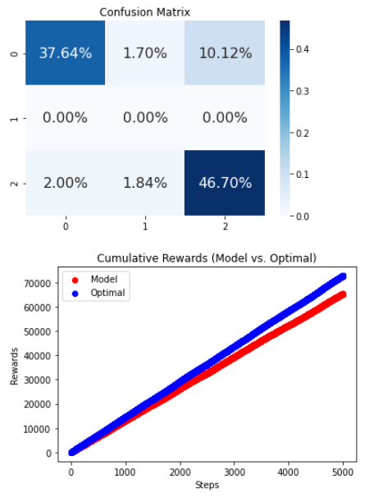
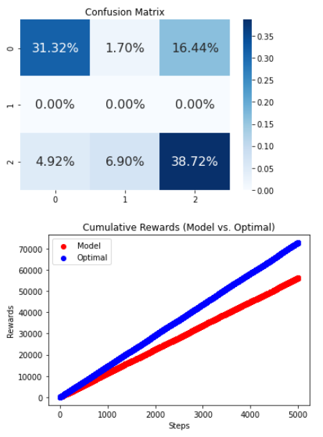
Tests on Generated Data
Wide,
86.02% optimal reward
Deep,
86.88% optimal reward
Deep & wide, rewards concatenated,
89.76% optimal reward
Deep & wide, rewards concatenated + one linear layer,
77.13% optimal reward

Slide 4
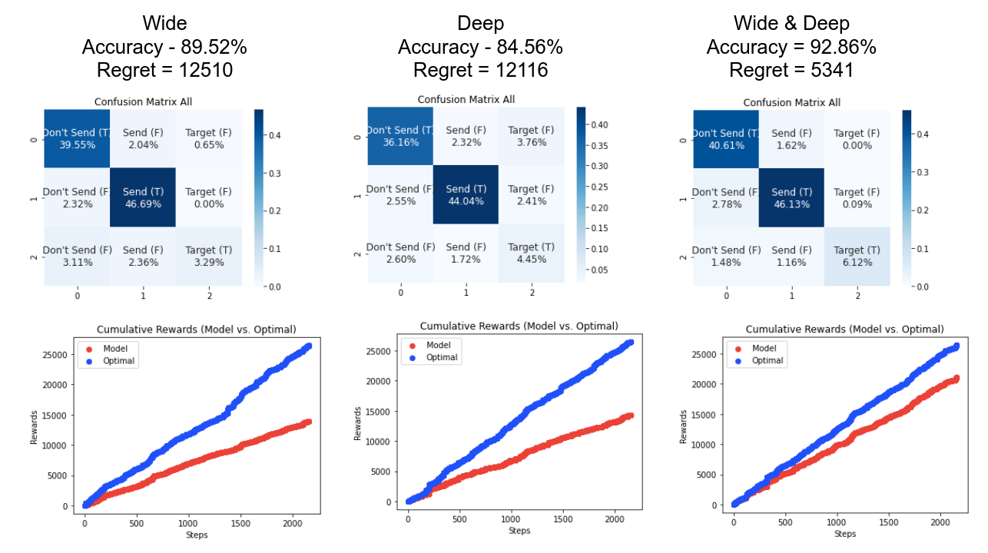
Tests on (Frequent) User Data

Slide 5
Two parts:
2) Specific application
Defining the question
Consideration: data availability
Send/don’t send email?
Best campaign type for customer?
Best day/time to send email?
Too few campaigns
for some campaign types
Defining reward function and features
Users dropped from
mailing list after
ignoring 9 emails
Ensuring that reward matches objectives
Selecting relevant & removing redundant data
Identifying correlations in the data
Correlations between
campaign type and vocabulary

Slide 6
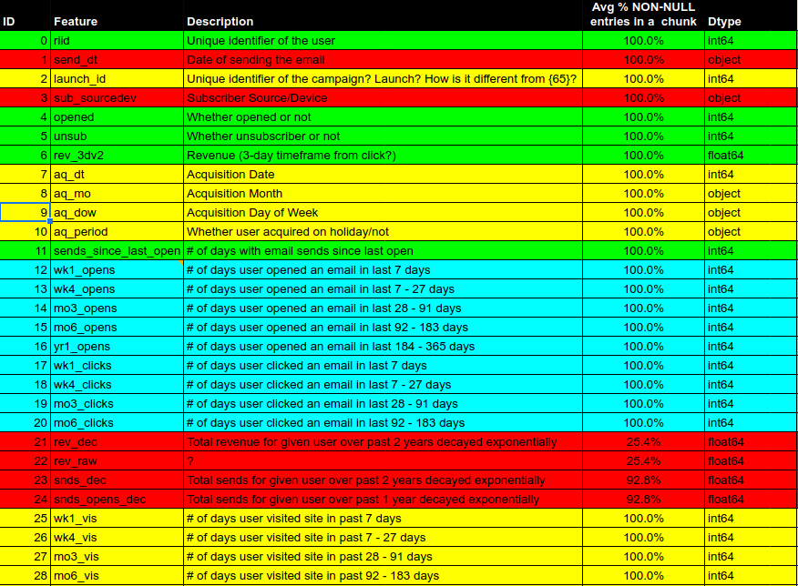
Dataset Cleaning and Feature Engineering

