Slide 1
Deep & wide contextual bandits
Aleksey Kocherzhenko, Update 03/05/2021

Slide 2
Three directions
1) Develop library for implementing deep and wide contextual bandits
2) Use this library to demonstrate performance enhancements
over deep-only contextual bandits for some problem
3) Outperform production model for Levi’s / Dockers email marketing

Slide 3
Library
Several implementations developed;
Tengfei’s version seems most comprehensive and versatile.
Multiple enhancements over space bandits:
– capability to include wide part in models;
– additional action selection algorithms (LinUCB, ε-greedy);
– GPU support for neural network and action selection;
– simple, logical syntax: easier to build and iterate on models.

Slide 4
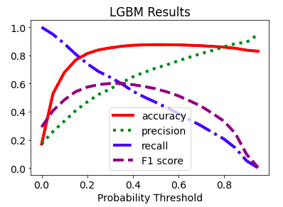
Levi’s / Dockers marketing
– user dictionary;
– decision trees;
– grid sorting (next slide).
Applied deep and wide model + several alternative models:
discussed in previous demos
Compared performance of these models
to production model used for Levi’s / Dockers email marketing

Slide 5
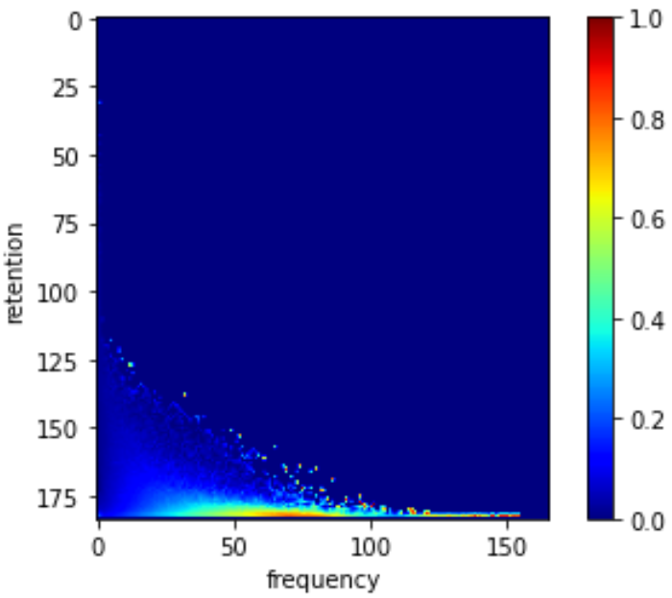
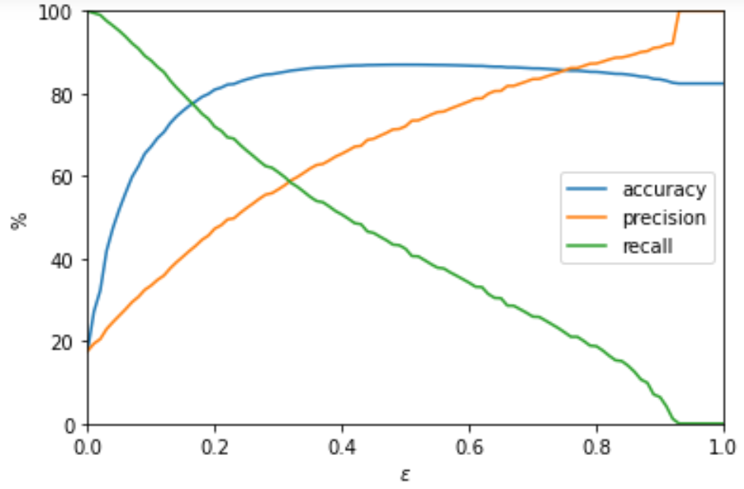
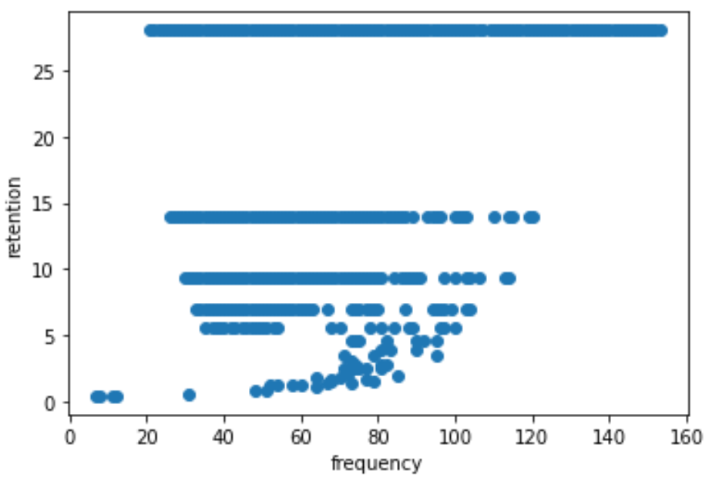
Grid sorting
Fraction of emails opened
Accuracy, precision and recall
as a function of threshold (ε)
Retention score (value #, low to high)
ε = 0.33,
precision
≈ recall
ε = 0.5,
max accuracy
Precision-recall pairs
with optimal action “send” (ε = 0.33)
Frequency score
ε = 0.5
ε = 0.33
Accuracy
0.87
0.86
Precision
0.74
0.60
Recall
0.40
0.57

Slide 6
Model comparison
Outperforms production model
Best
Space
bandits
Grid sorting
User dict, ε = 0.4
Decision
tree
Deep
only
Wide
only
Deep & wide 1*
Deep & wide 2*
ε = 0.5
ε = 0.33
Accuracy
0.80
0.87
0.86
0.86
0.86
0.81
0.74
0.89
0.87
Precision
0.44
0.74
0.60
0.68
0.71
0.40
0.28
0.67
0.79
Recall
0.39
0.40
0.57
0.60
0.58
0.44
0.47
0.48
0.46
Production
model
Previous slide
Discussed in
past demos
Track’s focus
* Deep & wide 1 – User id embeddings crossed with categorical features in wide part
Deep & wide 2 – Only user id embeddings in wide part
All models, except deep only and wide only, outperform production model
on accuracy, precision, and recall

Slide 7





When to use deep and wide bandits
Enhancement from wide part:
variability in optimal action for users with similar feature values
Enhancement from exploration:
under-explored action space, e.g.,
optimal action partially determined by option features, not user features
Recommender systems: a user likes horror, but reaction to a specific film is determined by features of that film.
Grid sorting
User dictionary
ε = 0.33
Accuracy
0.86
0.86
OPEN
IGNORE
Precision
0.60
0.68
Recall
0.57
0.60
Dockers email campaigns: user response determined almost exclusively by user features (especially retention and frequency scores), not by features of specific campaign.
Balance between adding more features
to reduce variability in optimal action or adding wide part to memorize user behavior

