Slide 1
Skin disease Imagery prediction
A mark of distinction or commonality
Team 11

Slide 2

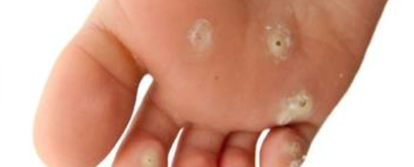
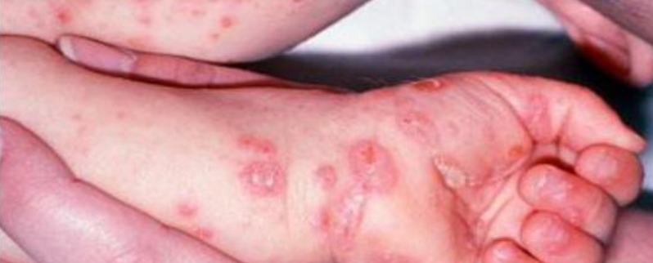
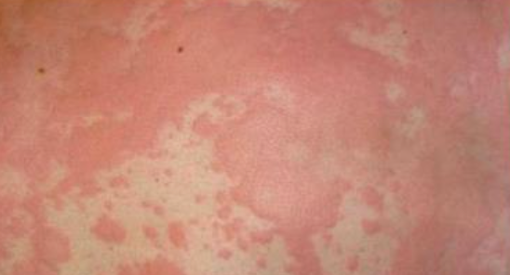
Did you know…
Skin is our largest organ
Adult skin accounts for about 16 percent of total body weight and covers a surface area of approximately 22 square feet.
Fungal infection
Scabies
Rash

Slide 3
Development Review – Quick Facts – why /How
How does it work
What are the benefits of the application

Slide 4
?DashBORD Link?

