Slide 1

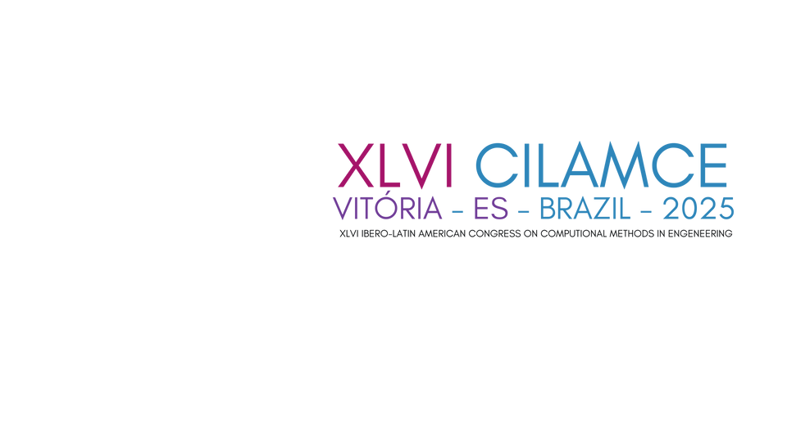
Pressure anisotropy on twin tunnel linings induced by a transverse gallery
construction using time-dependent constitutive models
Felipe P. M. Quevedo
Bianca M. Girardi
Felipe P. M. Quevedo
Samir Maghous

Slide 2

Research problem
The excavation of a transverse gallery significantly modifies the stress field around the main tunnels, generating localized increases in loads and deformations near the intersection.
These additional demands may exceed the capacity of the primary lining, creating potential zones of instability. Therefore, understanding how stresses and displacements are redistributed in this region is essential for defining structural reinforcements and ensuring the safety and long-term performance of the tunnel system.

Slide 3
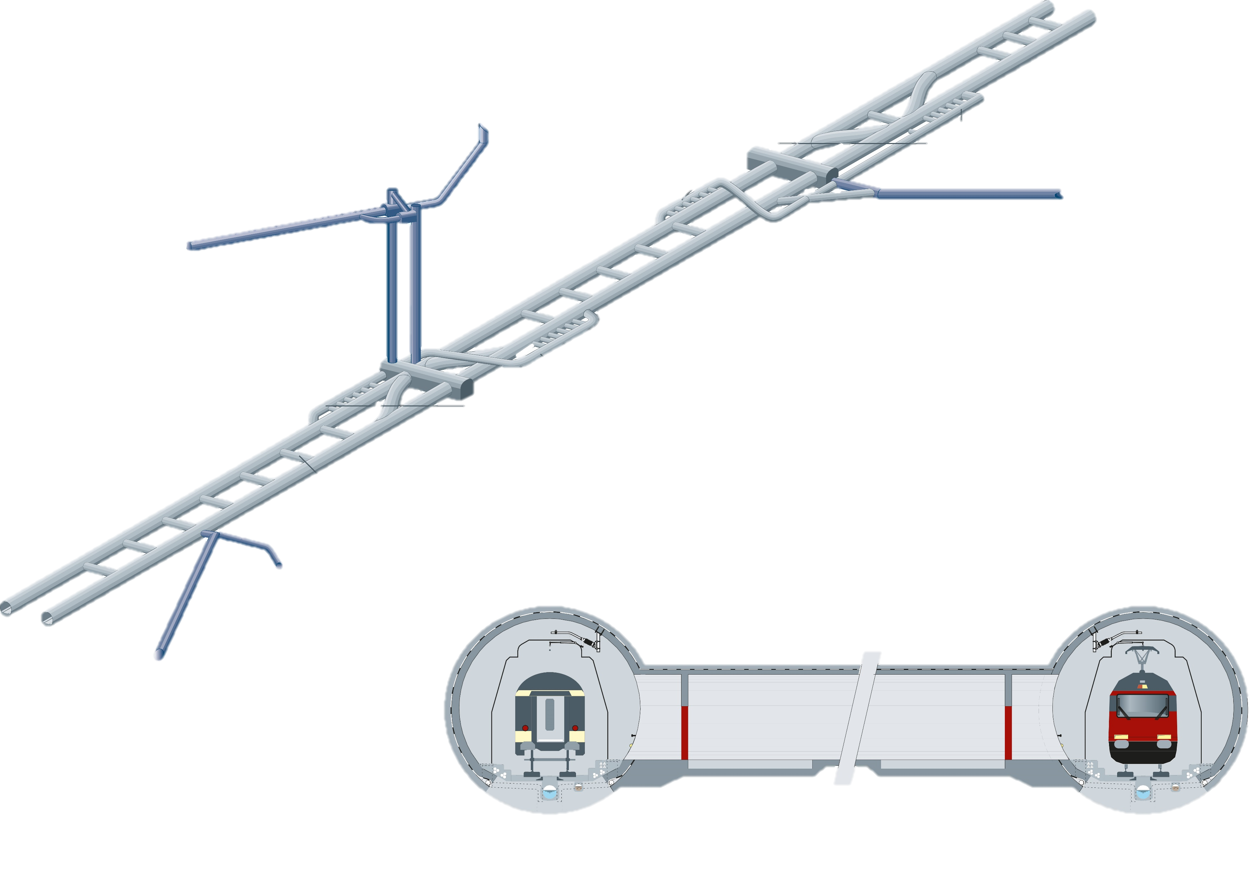
Research problem
Bodio Portal
Access tunnel Faido
Shafts Sedrun
Emergency
stop stations
Transverse Gallery
Erstfeld Portal
Transverse Gallery
Tunnel Access
Amsteg

Slide 4

Objetive
Present a study of the differences in the anisotropic redistribution of lining pressures due to the presence of the twin tunnel and transverse galleries, considering different friction angles in the rock mass and comparing elastic and viscoelastic linings.

Slide 5

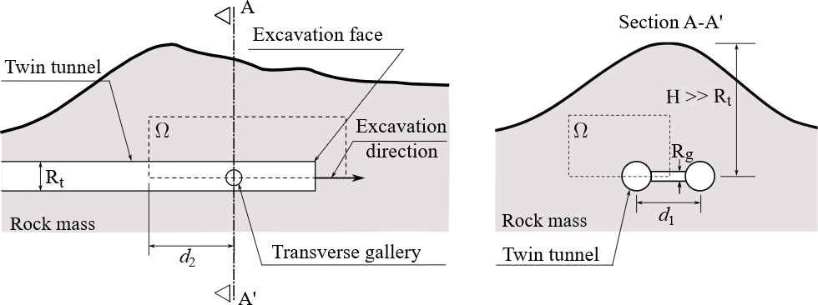
F.E Model
Schematic representation of the geometry problem:
Longitudinal view
Section A-A’

Slide 6

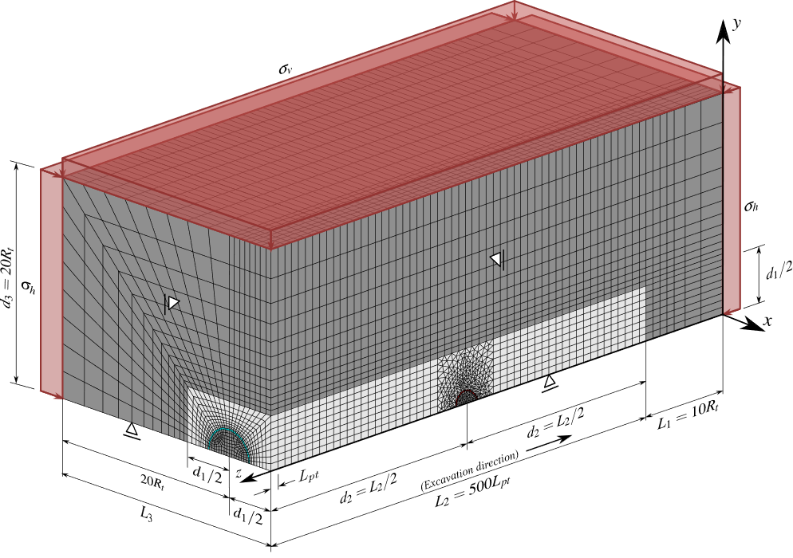
Mesh
Approximately 617,000 elements

Slide 7
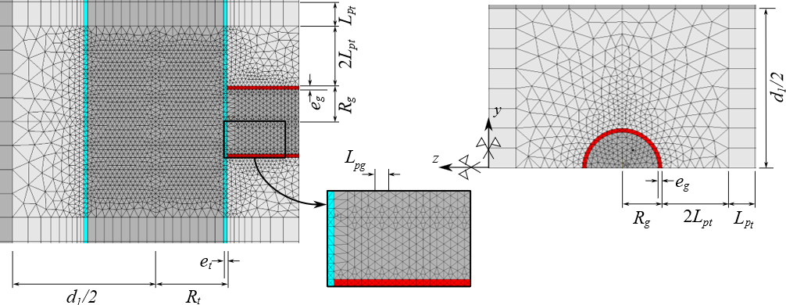
Mesh
8-node trilinear hexahedral;
8-node linear tetrahedral;

Slide 8
Activation and deactivation method

Slide 9
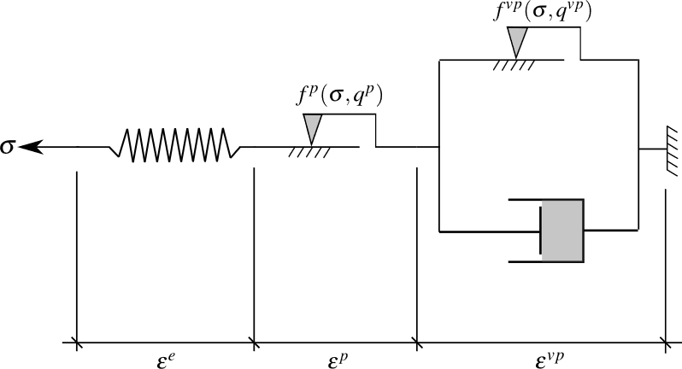
Materials constitutive models
Rockmass:
Coupled elastoplastic-viscoplastic formulation;
Drucker-Prager yield criterion.
E, ν

Slide 10
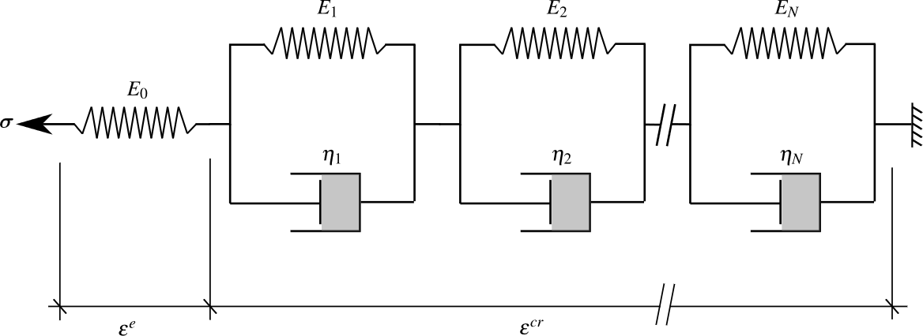
Materials constitutive models
Lining:
Elastic and viscoelastic linings
Schematic representation of Generalized Kelvin model for the concrete

Slide 11
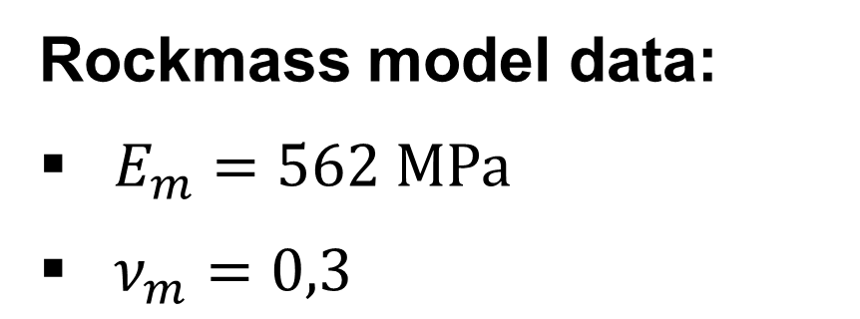
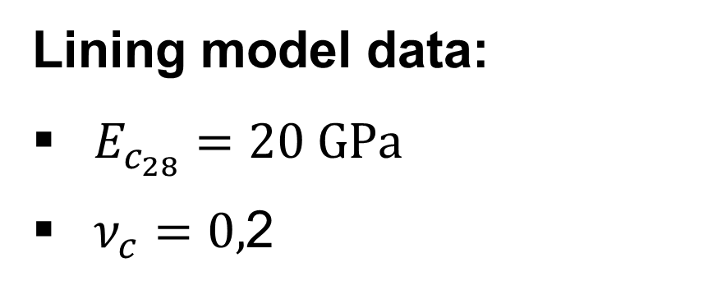
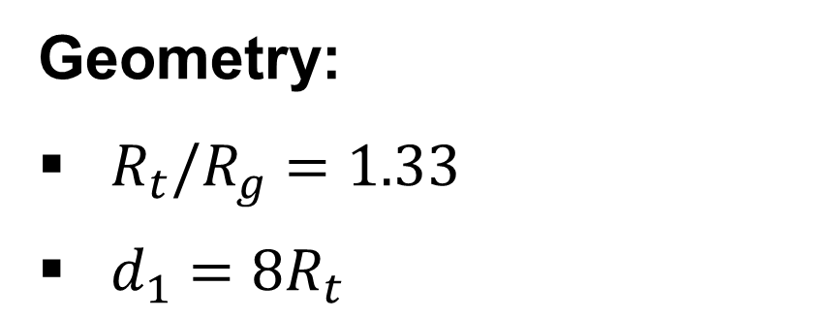
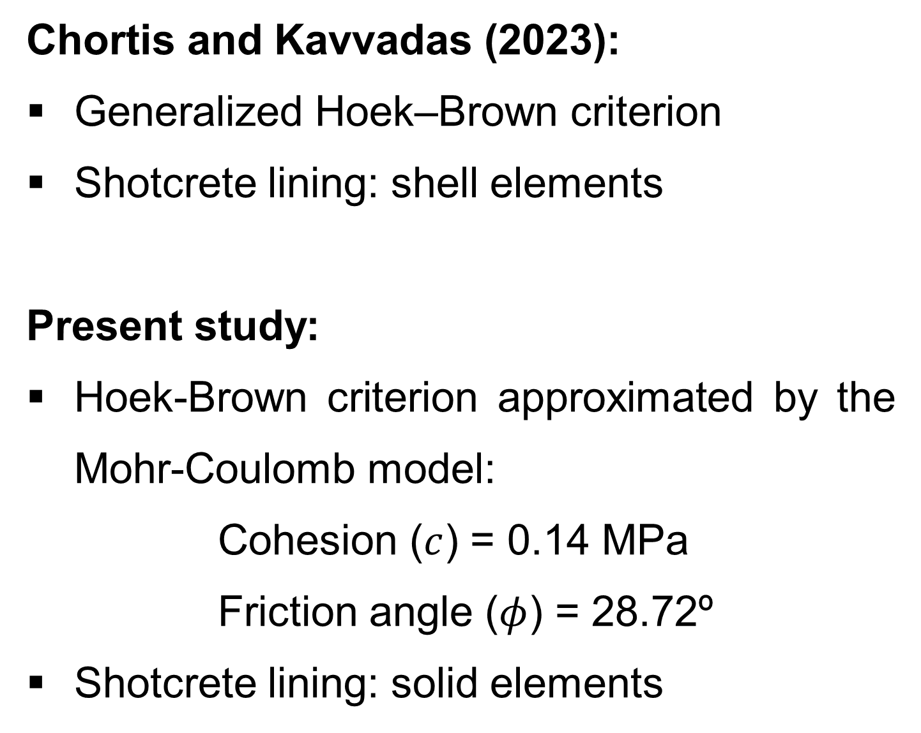
Computational model verification
Chortis and Kavvadas (2023):
Generalized Hoek–Brown criterion
Shotcrete lining: shell elements
Present study:
Hoek-Brown criterion approximated by the Mohr-Coulomb model:
Cohesion ($c$) = 0.14 MPa
Friction angle ($φ$) = 28.72º
Shotcrete lining: solid elements
Geometry:
$R_{t}/R_{g}=1.33$
$d_{1}=8R_{t}$
Rockmass model data:
$E_{m}=562 \text{M}\text{P}\text{a}$
$ν_{m}=0,3$
Lining model data:
$E_{c_{28}}=20 \text{G}\text{P}\text{a}$
$ν_{c}=0,$2

Slide 12
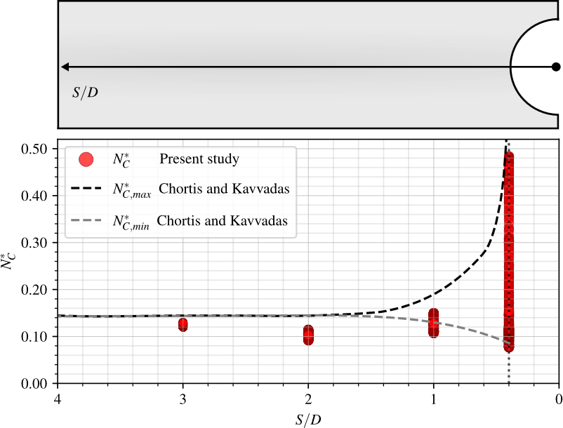
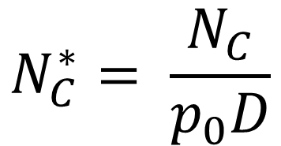
Computational model verification
The purpose is to verify the model’s ability to simulate the internal forces induced in the tunnel lining by the transverse gallery.
$$N_{C}^{∗}= \frac{N_{C}}{p_{0}D}$$
S/D is the normalized longitudinal distance from the center of the intersection zone

Slide 13

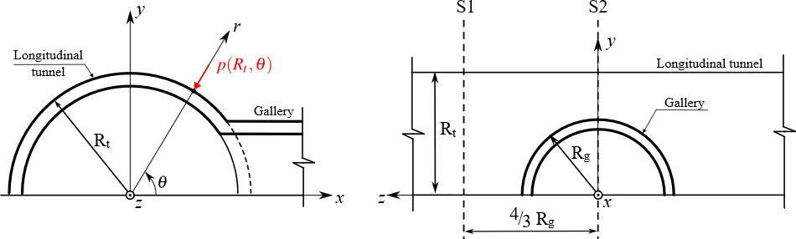
Three-dimensional finite element simulations
Numerical results of lining pressures are presented at the end of construction and after 3,000 days, representing long-term viscous stabilization.
The anisotropies of pressures are represented by:

Slide 14
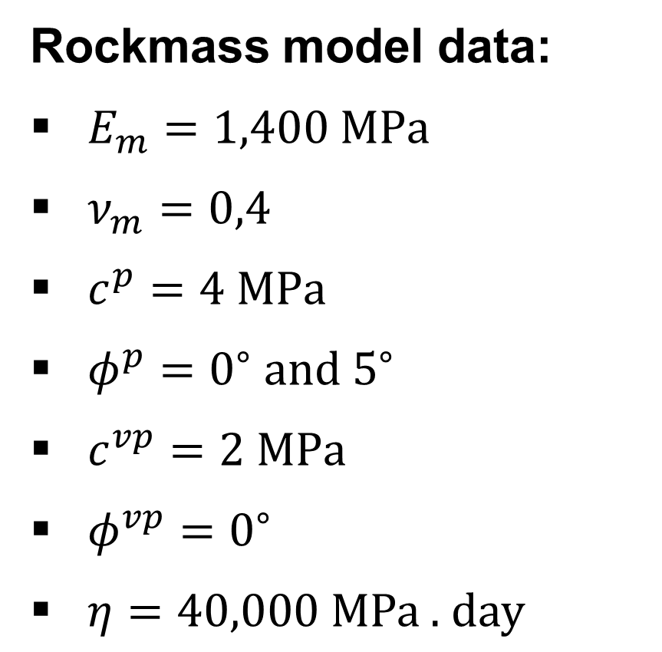
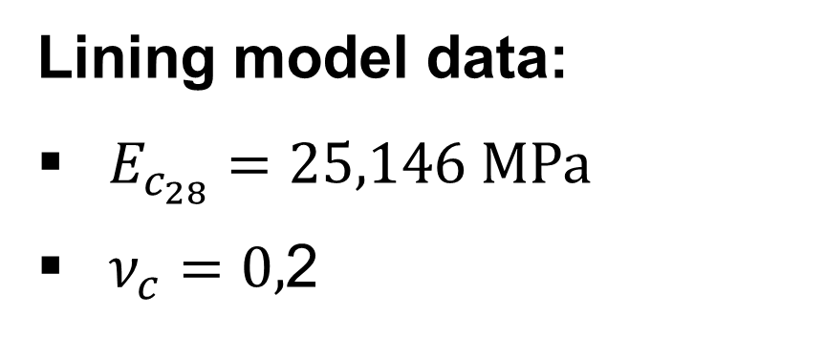
Three-dimensional finite element simulations
Rockmass model data:
$E_{m}=1,400 \text{M}\text{P}\text{a}$
$ν_{m}=0,4$
$c^{p}=4 \text{M}\text{P}\text{a}$
$φ^{p}=0^{∘} \text{and} 5^{∘}$
$c^{vp}=2 \text{MPa}$
$φ^{vp}=0^{∘}$
$η=40,000 \text{MPa}\text{ . }\text{day}$
Lining model data:
$E_{c_{28}}=25,146 \text{M}\text{P}\text{a}$
$ν_{c}=0,$2

Slide 15
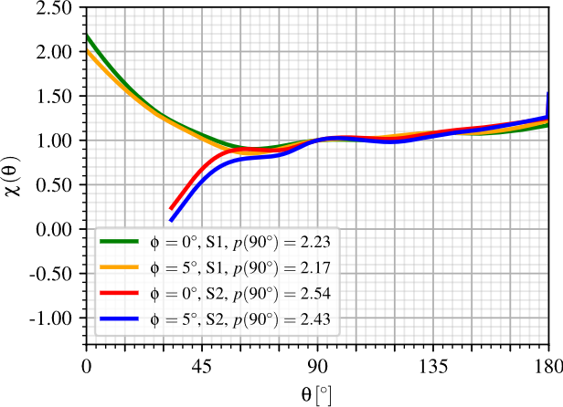
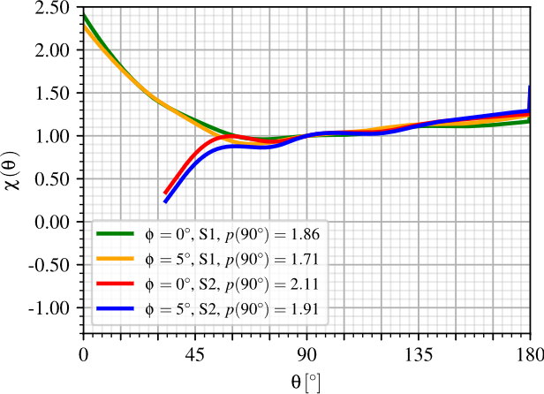
Three-dimensional finite element simulations
Anisotropy of pressures in longitudinal tunnel lining at the end of construction:
(a) Elastic lining
(b) Viscoelastic lining

Slide 16
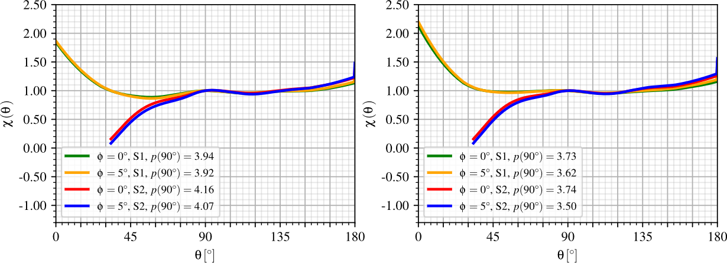
Three-dimensional finite element simulations
Anisotropy of pressures in longitudinal tunnel lining at the long-term:
(c) Elastic lining
(d) Viscoelastic lining

Slide 17
Three-dimensional finite element simulations
In general, the lining pressures remain close to the reference value 𝑝(𝜃 = 90º), except in the range 0º < 𝜃 < 60º (see Fig. (b)), where a significant increase is observed;
Stress concentrations tend to be higher at the lateral sides of the tunnels (𝜃 = 0º and 180º);
The friction angle significantly affects pressure distribution in S2, particularly for 30º < 𝜃 < 90º;
Higher friction angles decrease pressures above the gallery entrance and increase the contrast with the crown;

Slide 18
Three-dimensional finite element simulations
At the end of construction (Fig. (a) and (b)), reference pressures 𝑝(90º) are about 14% higher in section S2 than in S1 for 𝜙=0º in both elastic and viscoelastic linings;
The elastic lining shows higher pressure magnitudes than the viscoelastic one in both cases;
The long-term pressures presented in Fig. (c) and (d) show a similar behavior to the end of construction, with increased magnitudes; however, the influence of the friction angle on the anisotropic response is less pronounced;

Slide 19
Conclusions
By the verification, the model accurately captured internal forces in the lining, especially near the transverse gallery, where interactions are strongest;
The transverse gallery causes a significant increase in lining pressures in the lateral region near the parallel tunnel, particularly in section S1;
Stress concentrations form around the gallery entrance, modifying the pressure distribution along the lining;
Over the long term, pressures increase, but the influence of the friction angle becomes less pronounced;
The viscoelastic lining shows greater anisotropy relative to the crown at 𝜙 = 0º when compared to elastic concrete;
These findings emphasize the importance of considering time-dependent material behavior and rock mass properties in design, especially near tunnel–gallery intersections.

Slide 20
References
F. P. M. Quevedo, C. A. M. M. Colombo, D. Bernaud, and S. Maghous (2025)
Z. P. Baˇzant and S. Prasannan (1989)
CEB-FIP (1993)
F. P. M. Quevedo, R. J. Schmitz, I. B. Morsch, C. F. A., and D. Bernaud. (2018)
D. Bernaud (1991)
F. Chortis and M. Kavvadas (2023)
E. Hoek, C. Carranza-Torres, and B. Corkum (2002)

Slide 21
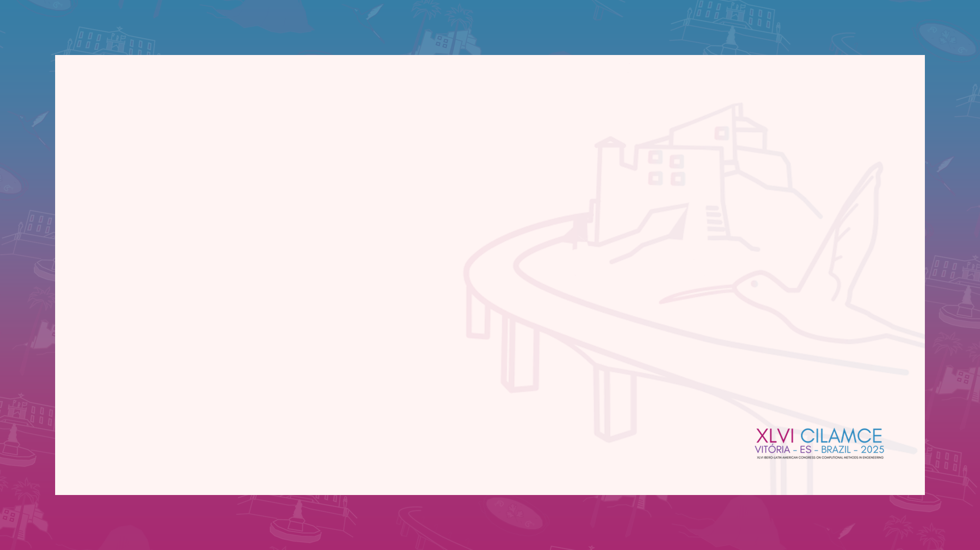

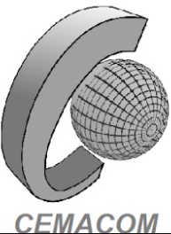



Acknowledgements
Bianca M. Girardi, Felipe P. M. Quevedo, Samir Maghous
Contact information

