Slide 1

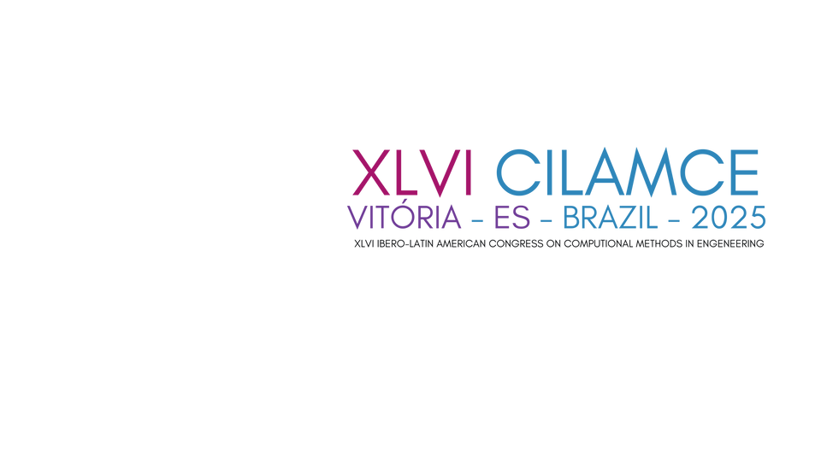
Pressure anisotropy on twin tunnel linings induced by a transverse gallery
construction using time-dependent constitutive models
Bianca M. Girardi
Felipe P. M. Quevedo
Samir Maghous

Slide 2

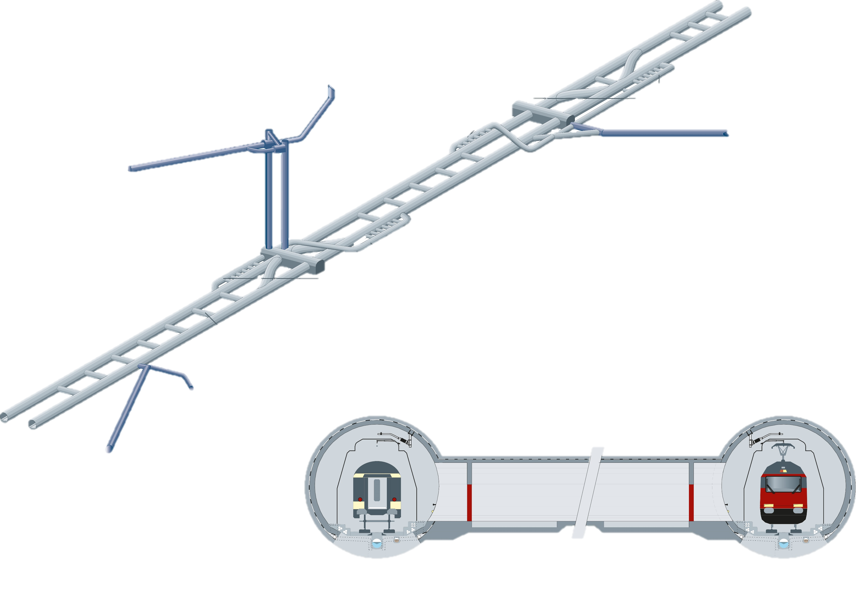
Research problem
Bodio Portal
Access tunnel Faido
Shafts Sedrun
Emergency
stop stations
Transverse Gallery
Erstfeld Portal
Transverse Gallery
Tunnel Access
Amsteg

Slide 3
Research problem
The excavation of a transverse gallery significantly modifies the stress field around the main tunnels;
This modification causes an overload on the main tunnel linings;
Quantifying this additional load is essential for defining structural reinforcements in this region and ensuring the safety of the tunnel system.;
Therefore: How does the construction of the gallery affect the distribution of pressures on the lining?

Slide 4

Objective
Present a study of the differences in the anisotropic redistribution of lining pressures due to the presence of the transverse galleries in twin tunnels comparing elastic and viscoelastic linings in elastoplastic-viscoplastic rockmass.

Slide 5

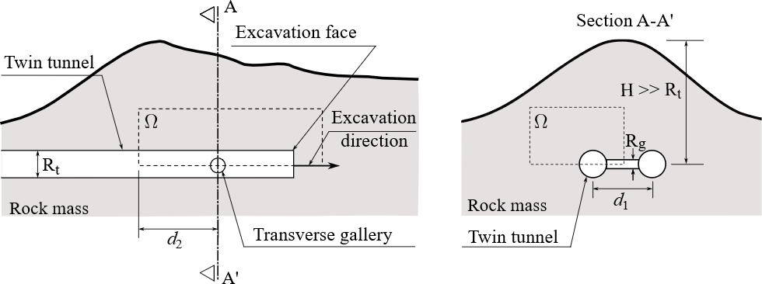
F.E Model
Schematic representation of the geometry problem:
Longitudinal Profile
Section A-A’

Slide 6

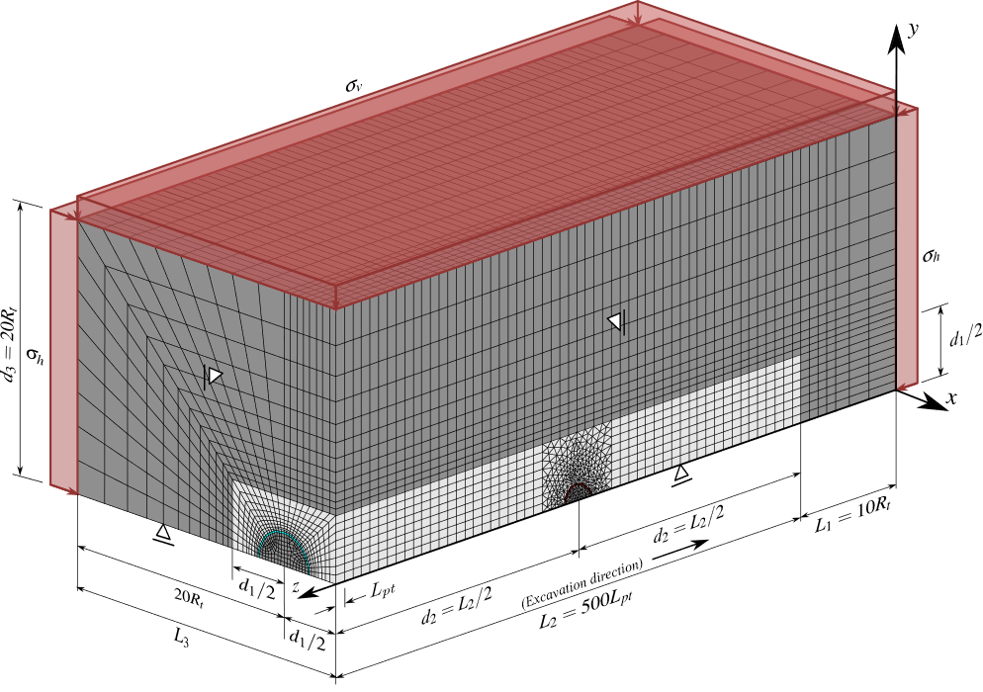
Mesh
Approximately 617,000 elements

Slide 7
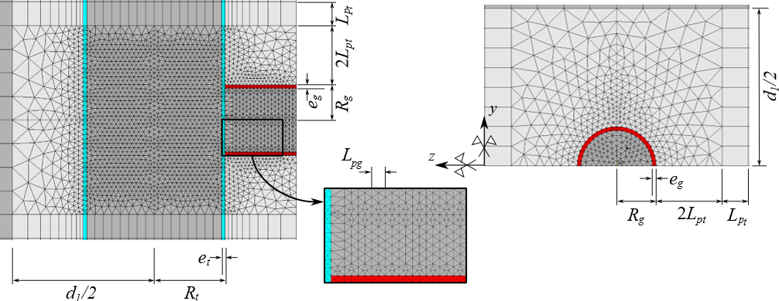
Mesh
8-node trilinear hexahedral;
8-node linear tetrahedral;

Slide 8
Activation and deactivation method

Slide 9
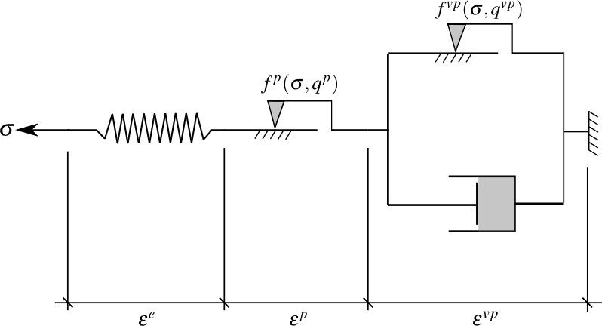
Materials constitutive models
Rockmass:
Coupled elastoplastic-viscoplastic formulation by Rousset (1989) and Quevedo (2021);
Drucker-Prager inscribed in Mohr-Coulomb.
E, ν

Slide 10
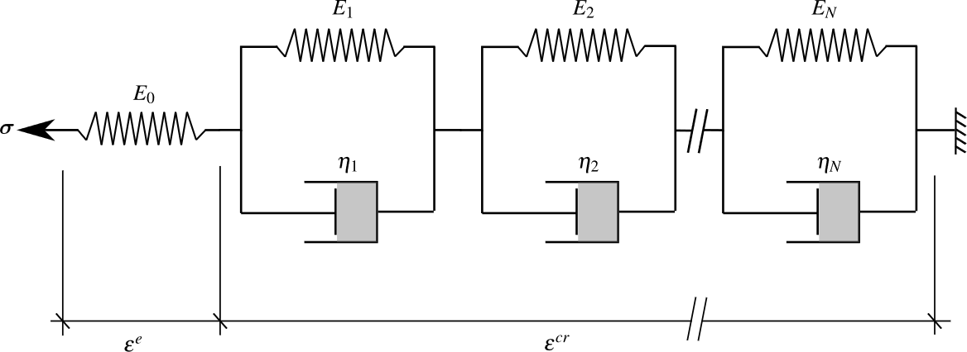
Materials constitutive models
Lining:
Elastic and Viscoelastic linings (Creep and Shrinkage) – Quevedo (2017)
Schematic representation of Generalized Kelvin model for the concrete Bazant & Prasannan (1989) with parameters calibrated by CEBFIP (1990) formulation

Slide 11
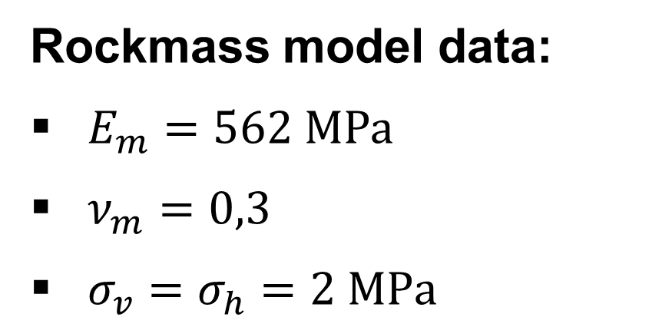
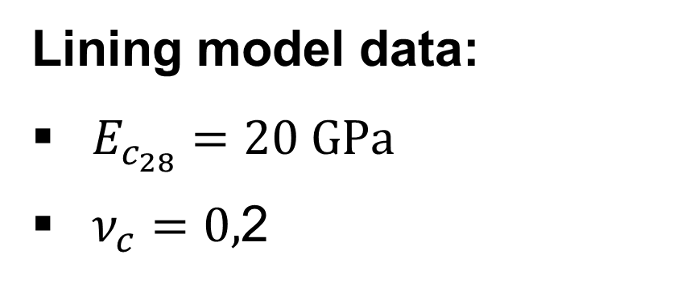
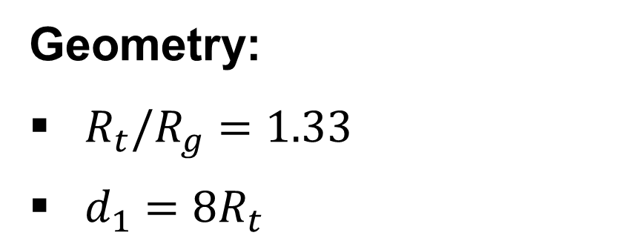
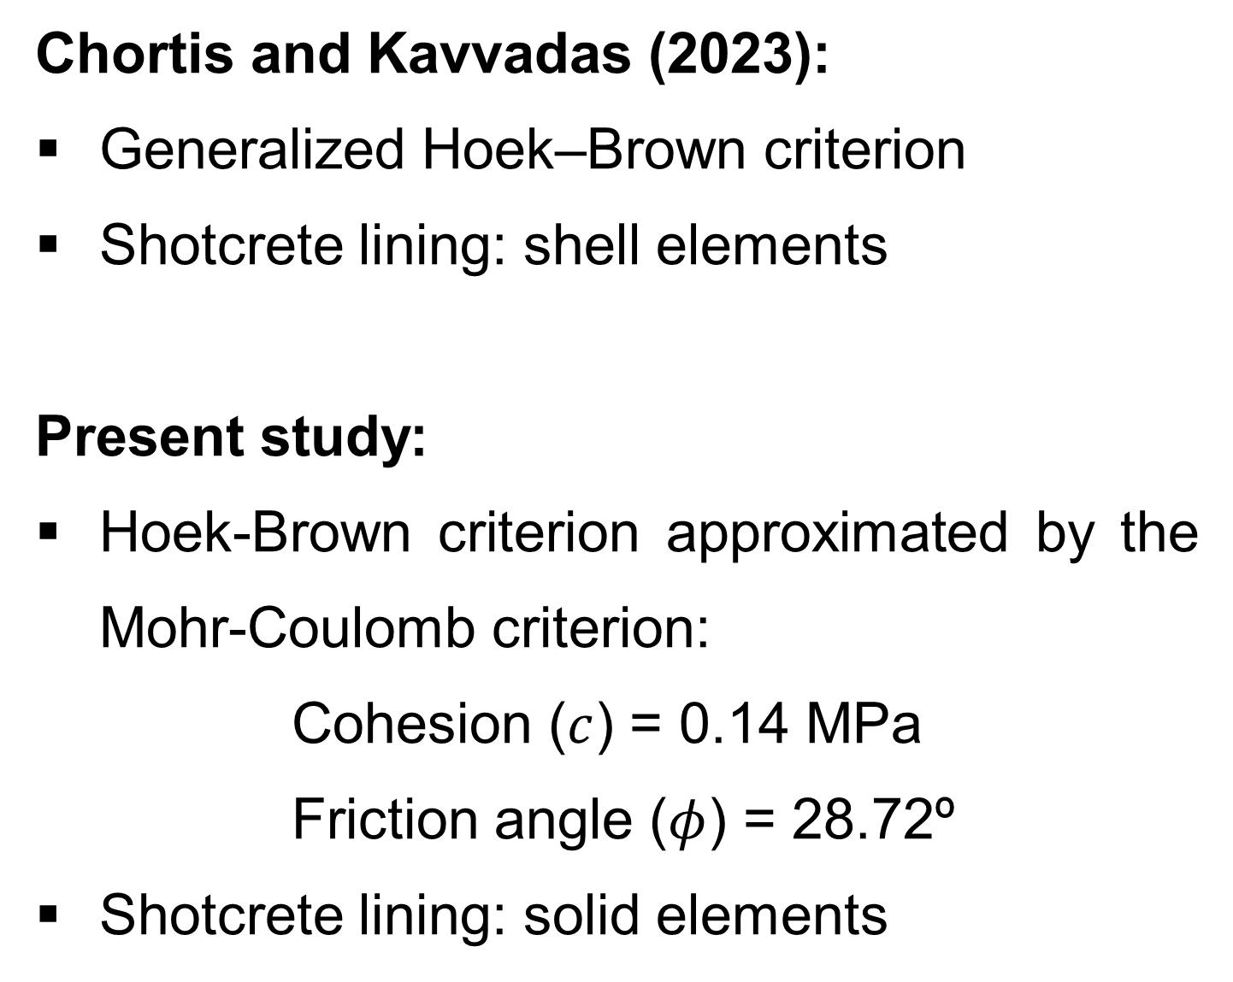
Preliminary verification
Chortis and Kavvadas (2023):
Generalized Hoek–Brown criterion
Shotcrete lining: shell elements
Present study:
Hoek-Brown criterion approximated by the Mohr-Coulomb criterion:
Cohesion ($c$) = 0.14 MPa
Friction angle ($φ$) = 28.72º
Shotcrete lining: solid elements
Geometry:
$R_{t}/R_{g}=1.33$
$d_{1}=8R_{t}$
Rockmass model data:
$E_{m}=562 \text{M}\text{P}\text{a}$
$ν_{m}=0,3$
$σ_{v}=σ_{h}=2 \text{MPa}$
Lining model data:
$E_{c_{28}}=20 \text{GP}\text{a}$
$ν_{c}=0,$2

Slide 12
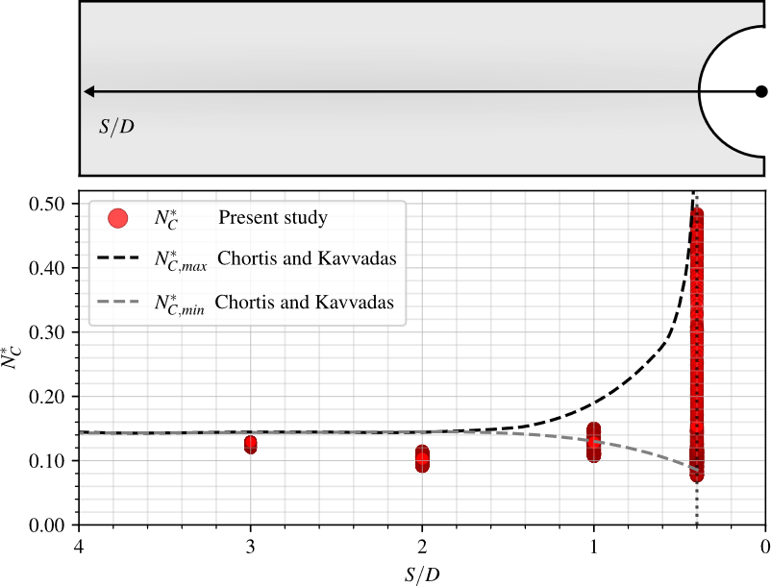
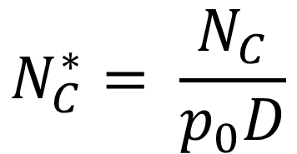
Preliminary verification
The purpose is to verify the model’s ability to simulate the internal forces induced in the tunnel lining by the transverse gallery.
$$N_{C}^{∗}= \frac{N_{C}}{p_{0}D}$$
S/D is the normalized longitudinal distance from the center of the intersection zone

Slide 13

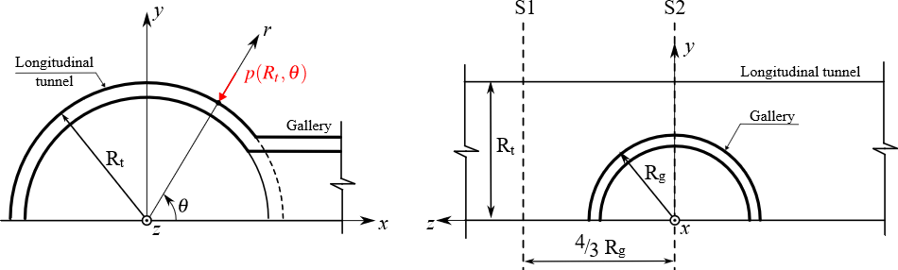
Three-dimensional finite element simulations
Numerical results of lining pressures are presented at the end of construction and after 3,000 days, representing long-term viscous stabilization.
The anisotropies of pressures are represented by:

Slide 14
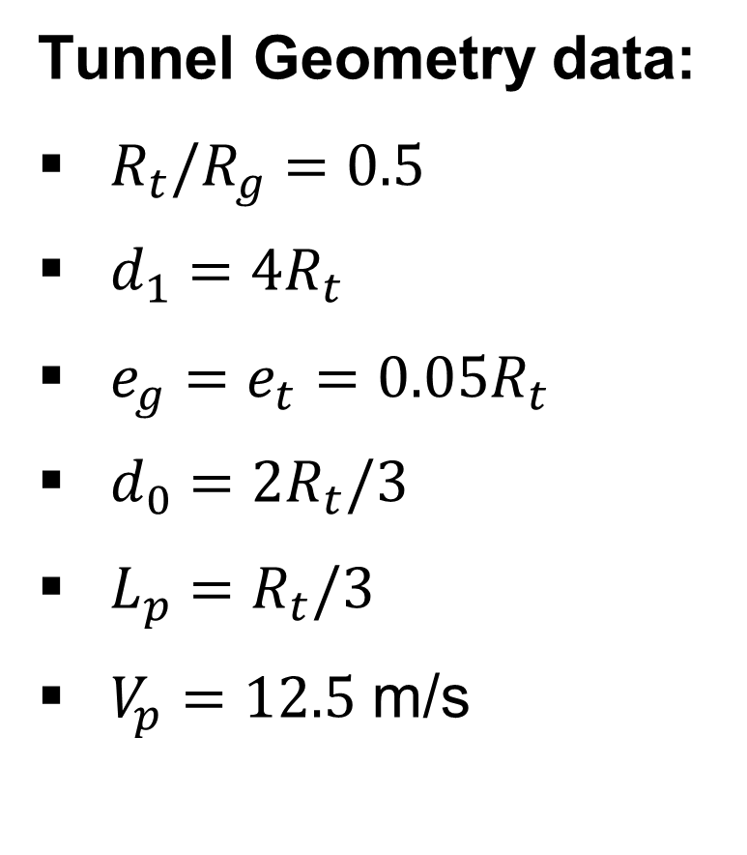
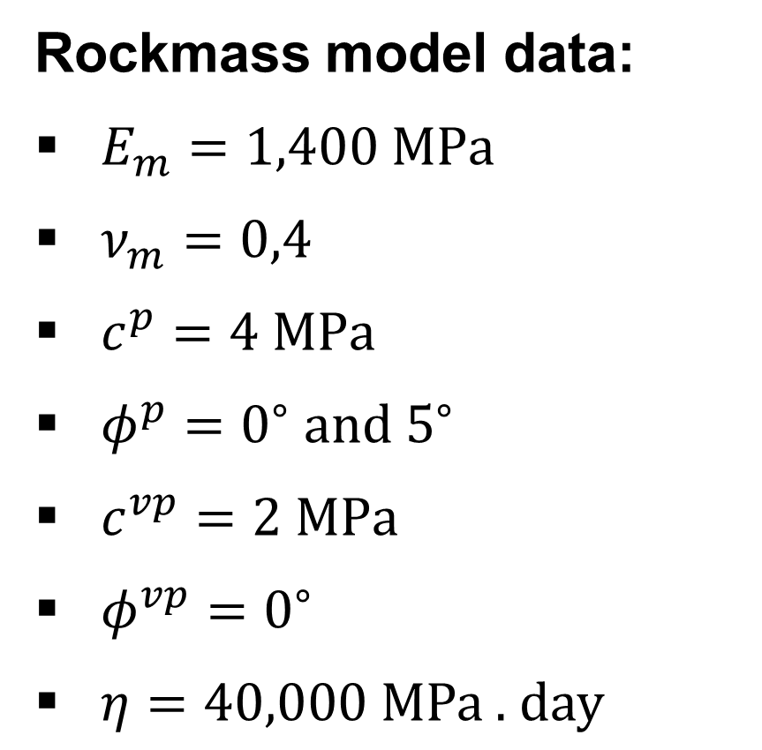
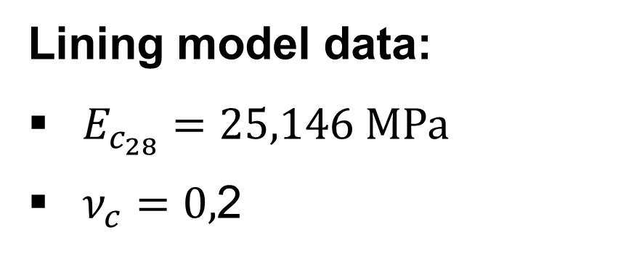
Three-dimensional finite element simulations
Rockmass model data:
$E_{m}=1,400 \text{M}\text{P}\text{a}$
$ν_{m}=0,4$
$c^{p}=4 \text{M}\text{P}\text{a}$
$φ^{p}=0^{∘} \text{and} 5^{∘}$
$c^{vp}=2 \text{MPa}$
$φ^{vp}=0^{∘}$
$η=40,000 \text{MPa}\text{ . }\text{day}$
Lining model data:
$E_{c_{28}}=25,146 \text{M}\text{P}\text{a}$
$ν_{c}=0,$2
Tunnel Geometry data:
$R_{t}/R_{g}=0.5$
$d_{1}=4R_{t}$
$e_{g}=e_{t}=0.05R_{t}$
$d_{0}=2R_{t}/3$
$L_{p}=R_{t}/3$
$V_{p}=12.5$ m/s

Slide 15
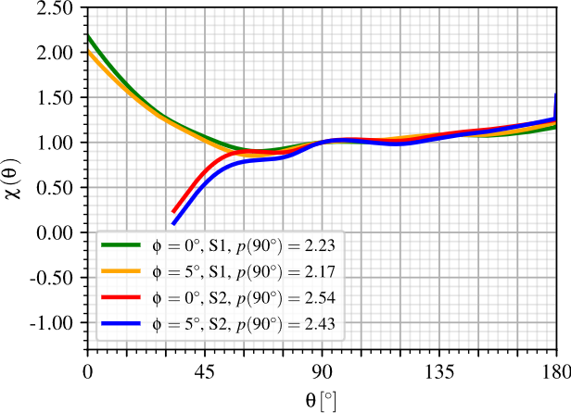
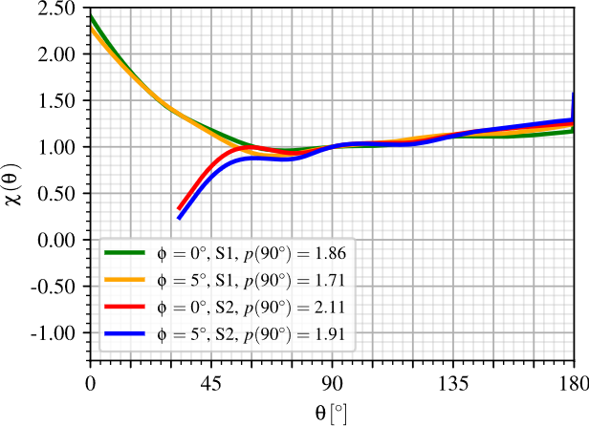
Three-dimensional finite element simulations
Anisotropy of pressures in longitudinal tunnel lining at the end of construction:
(a) Elastic lining
(b) Viscoelastic lining

Slide 16
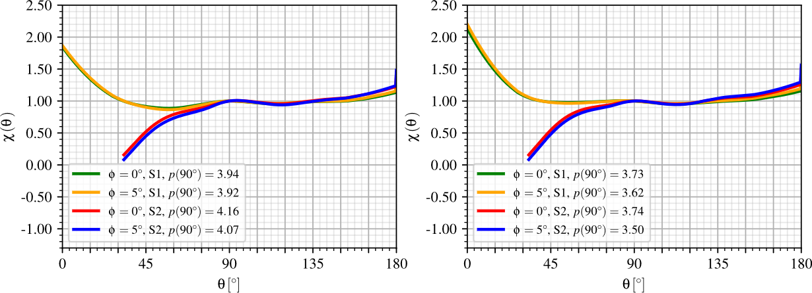
Three-dimensional finite element simulations
Anisotropy of pressures in longitudinal tunnel lining at the long-term:
(c) Elastic lining
(d) Viscoelastic lining

Slide 17
Three-dimensional finite element simulations
Elastic lining higher pressures (see all Figures);
Long-term higher pressures (see all Figures);
In general, the lining pressures remain close to the reference value 𝑝(𝜃 = 90º), except in the range 0º < 𝜃 < 60º, where a significant increase is observed (see Fig. (b));
Horizontal ovalization tunnel wall induced higher pressures at the lateral sides of tunnel wall (𝜃 = 0º and 180º);
The friction angle significantly affect pressure distribution in S2, particularly for 30º < 𝜃 < 90º at end of construction;
Higher friction angles decrease pressures above the gallery entrance. More differences at the end of contruction;

Slide 18
Conclusions
By the verification, the model accurately captured internal forces in the lining, especially near the transverse gallery, where interactions are strongest;
The transverse gallery causes a significant increase in lining pressures in the lateral region near the parallel tunnel, particularly in section S1;
Stress concentrations form around the gallery entrance, modifying the pressure distribution along the lining;
Over the long term, pressures increase, but the influence of the friction angle becomes less pronounced;
The viscoelastic lining shows greater anisotropy relative to the crown at 𝜙 = 0º when compared to elastic concrete;
These findings emphasize the importance of considering time-dependent material behavior and rock mass properties in design, especially near tunnel–gallery intersections.

Slide 19


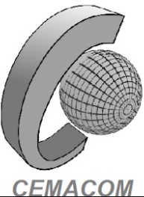



Acknowledgements
Bianca M. Girardi, Felipe P. M. Quevedo, Samir Maghous
eng.biancagirardi@gmail.com

