Slide 1
EasyFest PI - Week one

Slide 2
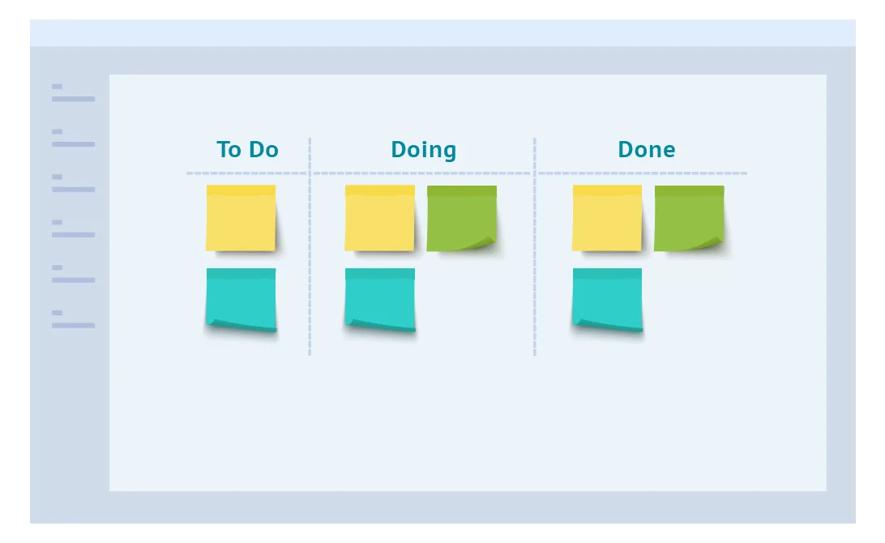
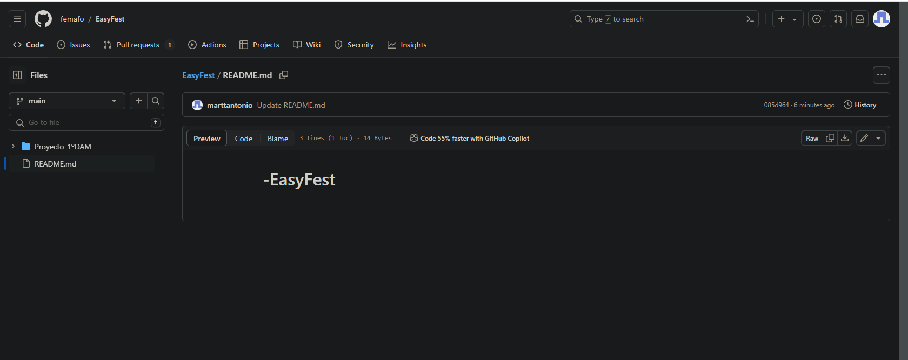
Monday
First of all, we decided to create the kanban board, where we are going to distribute all the work to the group members.
After that, we created the github repository, where we included every group member, and created each repository with the subject name, where we are going to upload every file for every member.
The last thing that we did, was start the database subject, with the diagrams of it and we uploaded to github.

Slide 3
Tuesday
The second day we started by finishing the diagrams of yesterday, and assigned all the work of the day to the group members.
Antonio started by doing the database with all the columns and information.
Alex finished the diagrams and helped Antonio by doing the powerpoint of the database subject.
Fermin started coding for the Programation subject.
Daniela modified the diagrams with the necessary information.
Ivan started with the web development, and Daniela helped him.

Slide 4
Wednesday
The third day we assigned the work for the member groups like this:
-Fermin started researching information about how we could put CSS on our code.
-Antonio and Alex started the English presentation.
-Ivan continued with the web development.
After this, we decided to start all the work and we got a bit of time to start coding and help Ivan with the web development.

Slide 5
Thursday
Fourth day we divided the work in two parts: Web development and coding.
After being developing the code, we had a problem with the database, and we had to do some changes, but after that, Antonio, Daniela and Fermin continued coding and Alex and Ivan continued with the web development.

Slide 6
Friday
The last day of the weekdays we decided to advance with the work of yesterday, Alex and Ivan continued with their work with the web application and Antonio, Fermin and Daniela continued with the coding.

