Slide 1

CRF as RNN for image segmentation
Felix Marti Perez

Slide 2
OVERVIEW
Introduction
Mean Field Algorithm
Deep Dive
Demo

Slide 3
Introduction

Slide 4
Motivation
CNN – Revolutionized image classification
CRF – Most succesfull graphical model in computer visio
Notes:
As everyone here will now. CNN have revolutionized the world of image classification. And maybe it looks like this are the only way to go for computer vision, however other models exist that also perform good. In the context of PGM, CRF are usually the way to go, as they are the most successful graphical model used in computer vision.
So researchers tough, why not combine both?

Slide 5


Conditional Random Fields
Unary cost(φ): Cost of inconsistent label assignement.
*How X comes together to affect the prob of y
*Cost function
Goal: Maximize the probability of assigning the correct label to each pixel.
Pairwise cost(ψ): Cost of assigning different labels to similar pixels.
Normalizing factor
Notes:
To better introduce this, I will first like to give a brief explanation about CRF for computer vision. CRF model the conditional probability of Y given X. This probability is given by the following equation, where E is the cost function and is formed of two components, first the unary cost, where it penalizes incorrect labeling of that pixel , and the second is the pairwise cost, who takes into consideration the labels of near pixels. This is really powerful as it captures the correlation between features.
Then we normalize by Z our normalizing factor, and the goal is to minimize the cost unction or maximize the prob. Of assigning the correct label to each pixel.

Slide 6
Conditional Random Fields
DO NOT FIT IN A DEEP LEARING MODEL!
No trainable parameters
No backpropagation
P(X|Y) not independant
Notes:
However CRF do not fit a deep learning model. How are we going to add a model that has no trainable parameters and which does not fit the framework of deep learning.

Slide 7
Mean Field Algorithm
The solution to our problems
Notes:
For this the authors of this paper present the mean field algorithm to model a CRF as a CNN.

Slide 8

CRF as CNN for one iteration
Approximation = Product of pixel wise distribution
*P not independant, cannot be writen as the producto of pixels.
Maximize
Notes:
As I said before, we want to calculate the conditional probability of Y given X, however P is not independent, what we can do is calculate a new distribution Q that approximates to P. This distribution is equal to the product of the independent pixel wise distribution. Where for each pixel we want to maximize its Q.

Slide 9
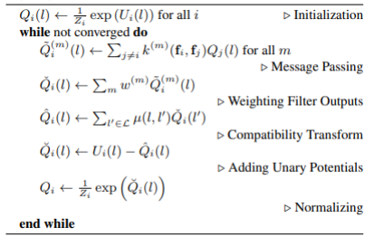
CRF as CNN for one iteration
Mean Field Algorithm
Maximize
Notes:
To achive this Q in a pixel wise level, the mean field algorithm is proposed.

Slide 10
CRF as CNN for one iteration
Unary scores (Will be explained later)
Mean Field Algorithm
For every pixel, caluclates gaussain coefficient for every other pixel.
For each class, weighted sum of output of previous step.
Label compatibility function
Softmax
Q is subtracted from our initial scores
Notes:
For this algorithm, our input will be the unary scores, I will explain later where they come from, this are normalized by a softmax and our loop starts.
Step 1: For every pixel i we calulate the gaussiant coefficient for every other pixel, so the summation of every pixel exclusing its own, where k(fi,fj) is the kernel of the two pixels.
Step 2: For each class, we get the weighted sum of the outputs of the previous step. Where the weights are parameters learned in training.
Step 3: The ouput of the previous step is multiply by the label compatibility function. This function is learned in training.
Step 4: Q is subtracted from our initial scores.
Step 5: Again, this are going to be scores, to transform them into probabilities we need to normalize with softmax.
After a couple of iterations, Q starts converging to the probability.
To achive this Q in a pixel wise level, the mean field algorithm is proposed.

Slide 11
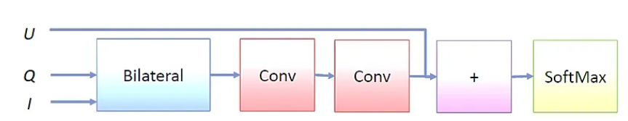
CRF as CNN for one iteration
1x1 Conv
1x1 Conv
Kernel
Notes:
In the end, this algorithm can be seen as a CNN where it contains: a kernel, two 1x1 conv layers, an addition and a softmax.

Slide 12
Advantages and Limitations
It’s a simple algorithm
It is easy to implement with powerful models using back-propagation algorithms.
Significant improvement in accuracy compared to sparse CRFs
However….. fails to provide strong theoretical guarantees on the quality of its solutions.

Slide 13
Deep Dive

Slide 14
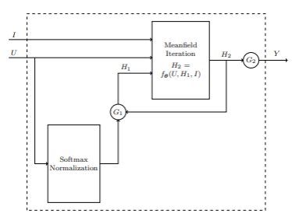
Implementation Details
Recursive iterations = RNN
Notes:
Now that we have seen the mean field algorithm, I am going to explain how all this fits into our final model. Now that we have seen how the mean field iterator fits as a CNN, if we iterate recursively over it, this is equivalent to a RNN.

Slide 15
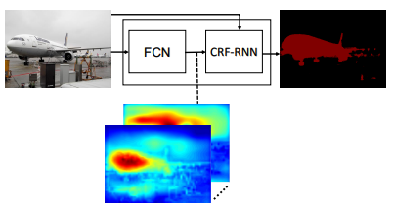
Implementation Details
Input
Model
Output
*Segmentation map created by FCN. This are the unary scores that where feeded to the MFA.
Notes:
Now that we have seen the mean field algorithm, I am going to explain how all this fits into our final model. Now that we have seen how the mean field iterator fits as a CNN, if we iterate recursively over it, this is equivalent to a RNN. With our final model, we have an end-to-end trainable model that combines a FCN with a CRF.

Slide 16
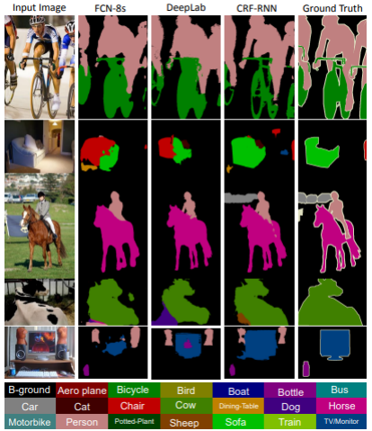
Evaluation
*Evaluation metrics are not always a reliable way of evaluating models. If we look closely in this figure, CRF-RNN outperforms ground truth.

Slide 17
Demo
Notes:
The authors provide a resource for implementing the model in a Jupyter Notebook.
The model exhibits satisfactory segmentation capabilities in various use cases.
However, the model struggles with small objects and certain environments.
This may be due to the nature of CNNs and the loss of small details when fed into the CRF block.

Slide 18
References
[1] Alban Desmaison, Rudy Bunel, Pushmeet Kohli, Philip H. S. Torr, and M. Pawan Kumar. Efficient continuous relaxations for dense CRF. CoRR, abs/1608.06192, 2016.
[2] Philipp Kr¨ahenb¨uhl and Vladlen Koltun. Efficient inference in fully connected crfs with gaussian edge potentials. CoRR, abs/1210.5644, 2012.
[3] Bengong Yu and Zhaodi Fan. A comprehensive review of conditional random fields: Variants, hybrids and applications. Artif. Intell. Rev., 53(6):4289–4333, aug 2020.
[4] Shuai Zheng, Sadeep Jayasumana, Bernardino Romera-Paredes, Vibhav Vineet, Zhizhong Su, Dalong Du, Chang Huang, and Philip H. S. Torr. Conditional random fields as recurrent neural networks. CoRR, abs/1502.03240, 2015.

