Slide 1
Big Mountain Resort
Pricing strategy determination
To: The SENIOR MANAGEMENT TEAM
July 31st, 2020
By Femi Onafalujo

Slide 2
Problem Statement:
Big Mountain has an opportunity to increase sales by 15% next year if it develops a new pricing structure that takes advantage of all of its facilities.

Slide 3
Recommendation:
Big Mountain should raise it’s adult ticket price by $2.50 to $83.50 by adopting a tiered approach in which it offers $82 to early-bird customers that purchase tickets before the season begins and $83.50 to customers once the ski season begins.
Not only does this price increase yield additional revenues of $1.75M dollars over the ski season, it also covers the$1.54 cost of the purchased chair lift.
Big Mountain should also consider adding an additional run, increasing the vertical drop by 15 feet and raising the adult ticket price by $1.99.

Slide 4
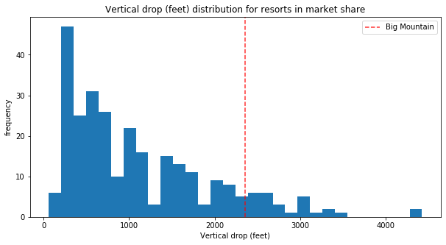
Modeling and Analysis

Slide 5
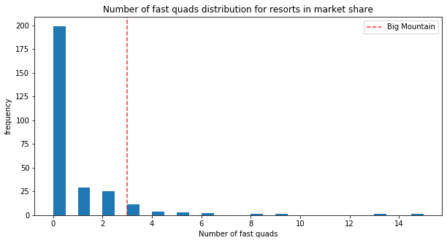
Modeling and Analysis (cont.)

Slide 6
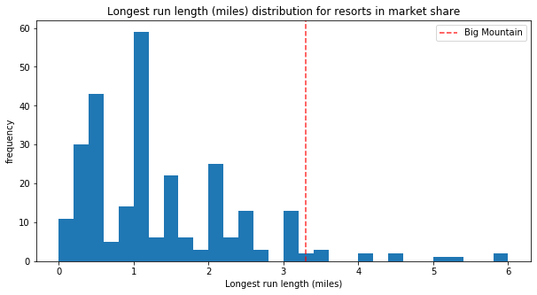
Modeling and Analysis (cont.)

Slide 7
Summary & Conclusion
Our models showed that Big Mountain is able to support the price increase to $83.50 because this price is at the lower end charged by resorts in the U.S.
Although Big Mountain’s price is at the higher end in Montana, it’s features allows for a price increase.
Big Mountain should consider deploying this model in a production environment for sensitivity analysis, especially when considering new investments

