Slide 1


Lead Conversion Analysis and Prediction
FOR TERM DEPOSIT ACCOUNT OPENINGS
Femi Onafalujo
springboard data science
September 26, 2021

Slide 2
“The more you know about the past, the better prepared you are for the future.”
- Theodore Roosevelt (1858-1919)

Slide 3
Project Objectives
Problem
Help banks determine promising sales leads
Solution
Develop a predictive model
Derek Conte
Notes:
Tell people you are recording them

Slide 4
It is a Journey: Solutions Areas & Scopes
Dataset
Data collection
Exploratory Data Analysis
Relationships between positive response and features
Machine Learning
Model development
Model selection
Model application

Slide 5
Dataset
Collecting data

Slide 6
Primary Dataset
Source: UCMachine Learning
Information: Marketing records for selling term deposit accounts
Size: 45,211 records, 21 features
Examples of features
Age
Job
Duration of sales phone call
Type of contact – e.g. cell phone versus landline
Marital status

Slide 7
Exploratory Data Analysis
rent Vs. numerical and categorical features

Slide 8

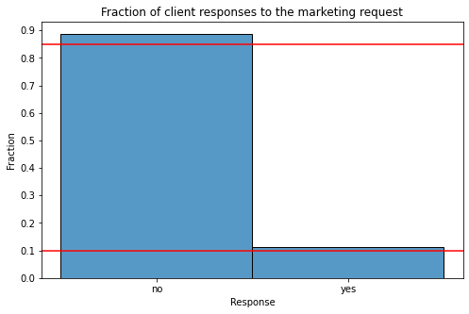



Distribution of response showing imbalanced nature of dataset

Slide 9
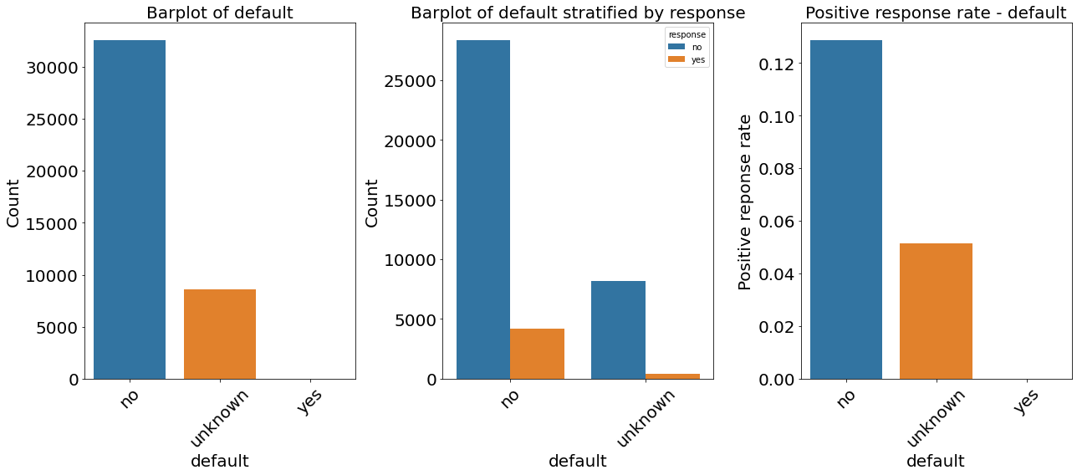
Relationship between a loan default and response

Slide 10
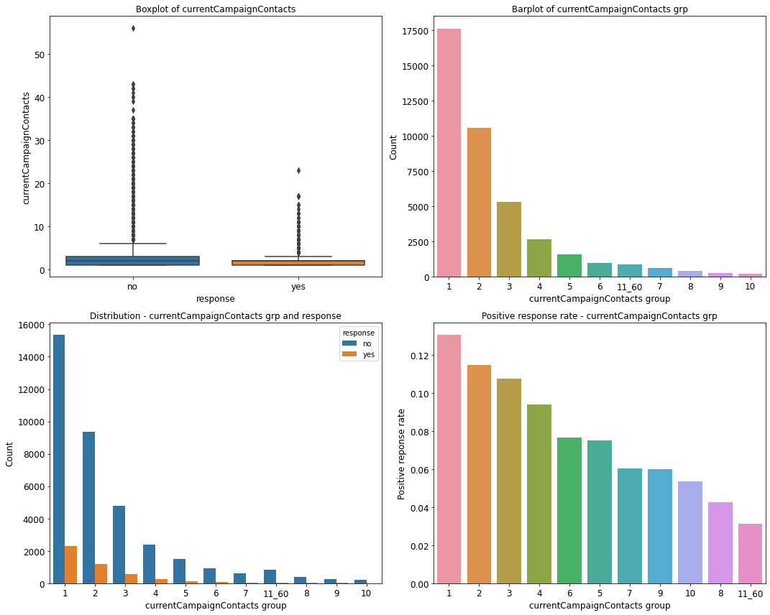
Relationship between current campaign contacts and response

Slide 11
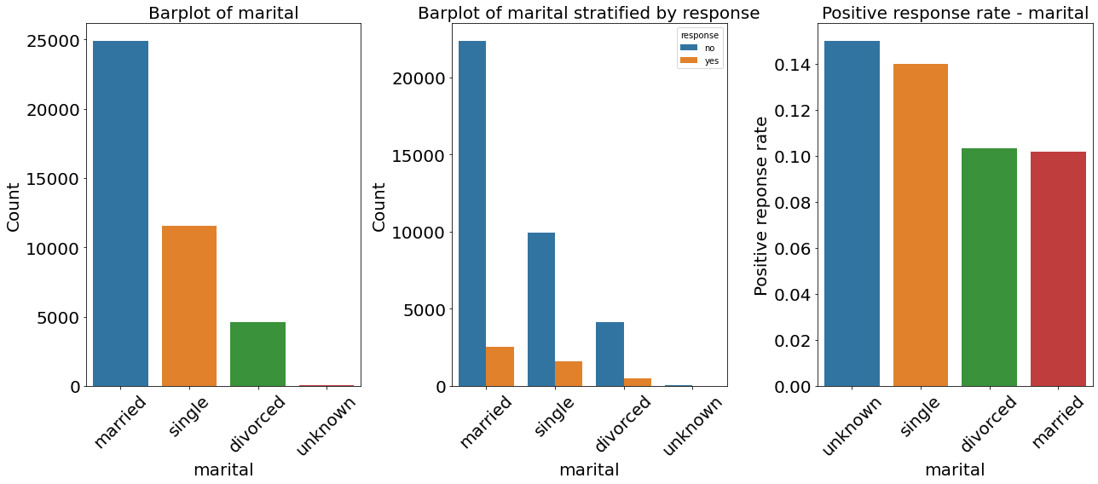
Relationship between marital status and response

Slide 12
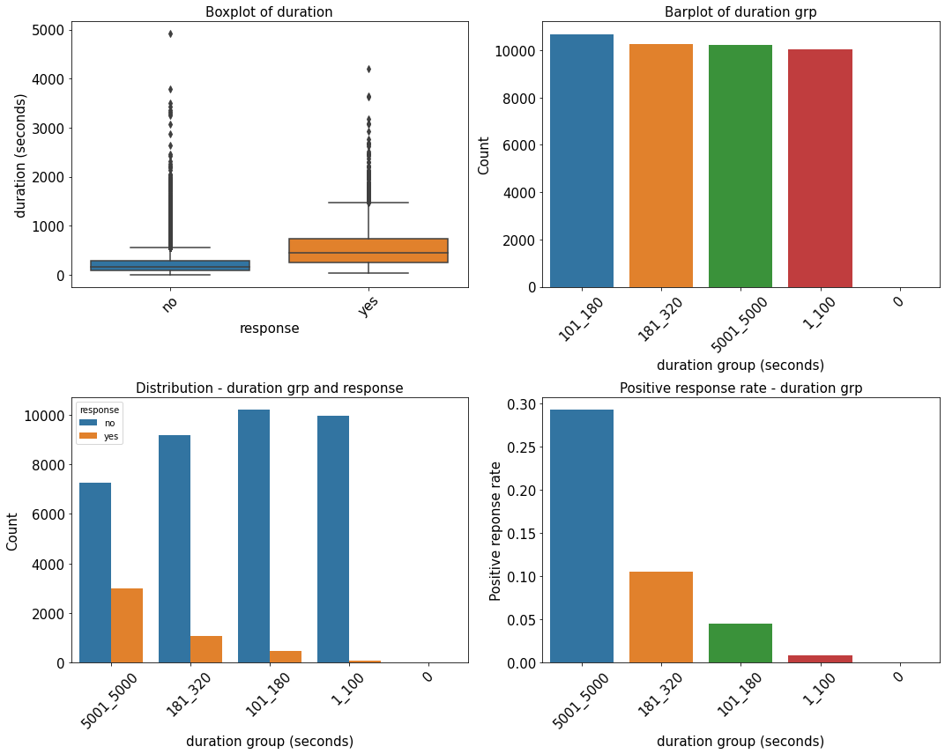
Relationship between duration and response

Slide 13
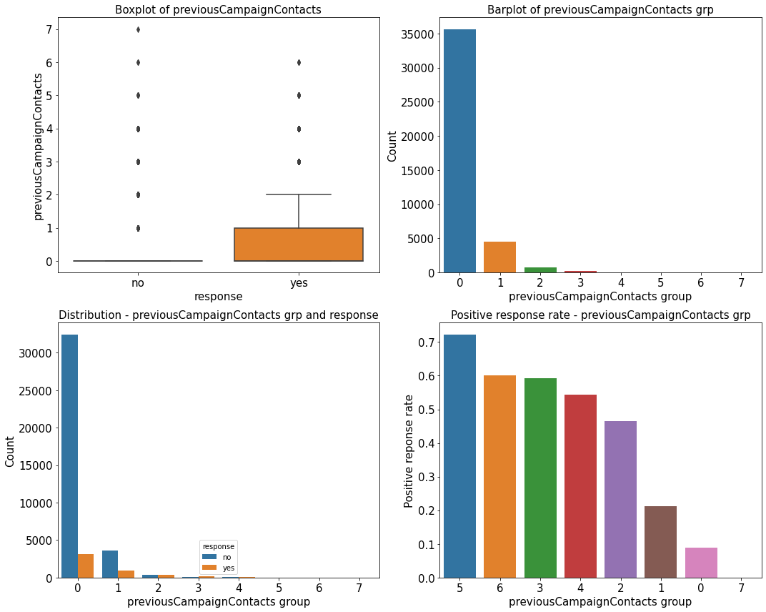
Relationship between previous campaign contacts and response

Slide 14
Machine Learning
Model development | selection | application

Slide 15
Performance of baseline model
Model | Class | Recall | F1 | F2 | AUC-PR | AUC-ROC
Logistic regression | 0 | 0.99 | 0.95 |  | 0.48 | 0.81
 | 1 | 0.25 | 0.37 | 0.29

Slide 16
Log
Logistic regression model - logreg | AUC-PR CV scores | AUC-PR test scores
Logreg | 0.45 | 0.48
Logreg w/ class weights | 0.45 | 0.48
Logreg w/ hyperparameter tuning | 0.45 | 0.47
Logreg w/ feature selection | 0.41 | 0.47

Slide 17
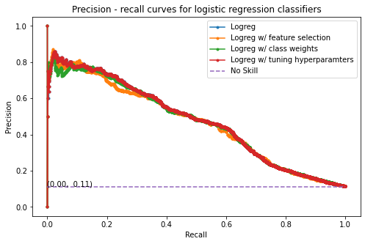
Logistic regression optimization results

Slide 18
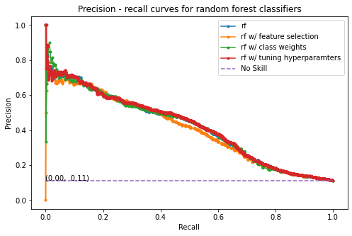
Random forest optimization results

Slide 19
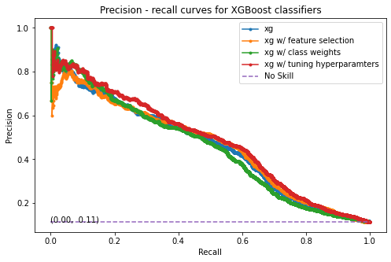
XGBoost optimization results

Slide 20
Best models from algorithms
Best models | AUC-PR CV scores | AUC-PR test scores
xg w/ hyperparameter tuning | 0.46 | 0.48
Logreg | 0.45 | 0.48
rf w/ hyperparameter tuning | 0.41 | 0.42

Slide 21
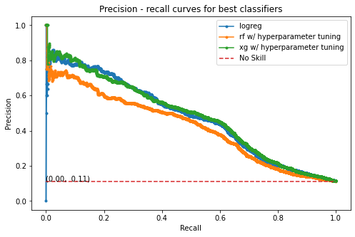
Comparison of algorithm performance

Slide 22
Results from dataset balancing with SMOTE
SMOTE undersampling | AUC-PR CV scores | AUC-PR test scores
xg w/ hyperparameter tuning | 0.93 | 0.48
Logreg | 0.72 | 0.47
rf w/ hyperparameter tuning | 0.94 | 0.41

Slide 23
Performance summary
Model | Class | Recall | F1 | F2 | 5-fold CV : AUC-PR | AUC-PR | AUC-ROC
XGBoost w/ tuning | 0 | 0.98 | 0.95 |  | 0.46 | 0.48 | 0.81
 | 1 | 0.27 | 0.39 | 0.31
Logistic regression | 0 | 0.99 | 0.95 |  | 0.45 | 0.48 | 0.81
 | 1 | 0.25 | 0.37 | 0.29
Random forest w/ tuning | 0 | 0.97 | 0.94 |  | 0.41 | 0.42 | 0.78
 | 1 | 0.31 | 0.40 | 0.34

Slide 24
Model prediction results for 20 clients
 | 1 | 2 | 3 | 4 | 5 | 6 | 7 | 8 | 9 | 10
Age | 39 | 29 | 50 | 40 | 34 | 29 | 28 | 30 | 54 | 43
Response | No | No | No | No | No | No | Yes | No | Yes | No
Predicted | No | No | No | Yes | No | No | No | No | No | Yes
Unable to predict positive class

Slide 25
Conclusion / Recommendation
Determined most important factors for rent
Unclear factors
Predicted response with XGBoost model
AUC-PR: 0.48

Slide 26
Assumptions/Limitations/Opportunities
High uncertainty around data
Additional feature engineering may be beneficial
Higher compute capabilities for hyperparameter tuning

Slide 27
Questions
?

