Slide 1

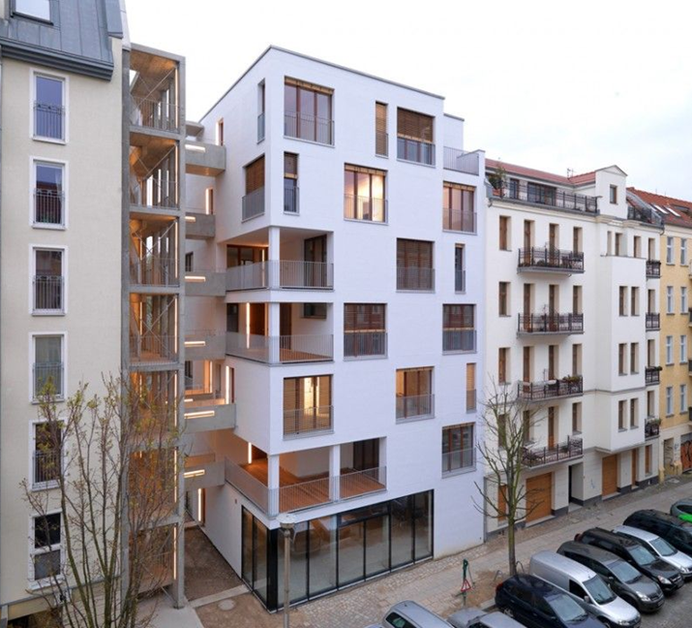
Rent Analysis and Prediction
For apartments in Germany
Femi Onafalujo
springboard data science
September 26, 2021

Slide 2
“The more you know about the past, the better prepared you are for the future.”
- Theodore Roosevelt (1858-1919)

Slide 3
Project Objectives
Problem
Help landlords set the rent for their apartments
Solution
Develop a predictive model
Notes:
Tell people you are recording them

Slide 4
It is a Journey: Solutions Areas & Scopes
Data Wrangling
Collect and organize data
Clean data
Exploratory Data Analysis
Relationships between rent and numerical features
Relationship between rent and categories
Machine Learning
Training data development
Model selection
Model application
Model development
Metrics and testing

Slide 5
Data Wrangling
Collecting data | cleaning data

Slide 6
Primary Dataset – Rental Information
Source: Immoscout24 – largest real estate website in Germany
Information: Record of apartments for rent
Size: 267,859 records, 49 features
Examples of features
Heating cost
Rent (€)
Living space (square meters)
Number of rooms
Interior quality
Location information (State, city / town, municipality, zip code, street address, house number)
Facilities (Balcony, garden, cellar, etc.)

Slide 7
Secondary Dataset – State Information
Source: Wikipedia
Size: 16 states x 5 features
Features
State area
State population
State population per area
GDP per capita
Human development index (HDI)
Information: State macro-economic data

Slide 8
Issues: Cleaning the data
Missing values
High cardinality
Duplicate entries
Inconsistent category names

Slide 9

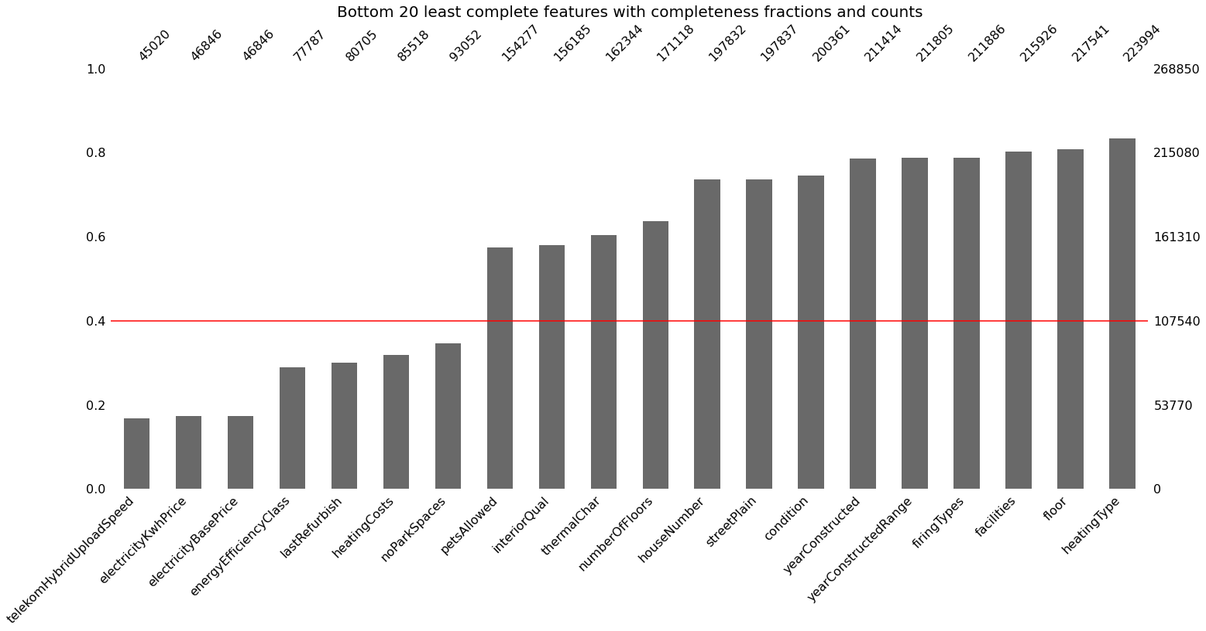




Slide 10
Exploratory Data Analysis
rent Vs. numerical and categorical features

Slide 11
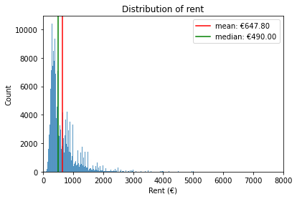

Slide 12
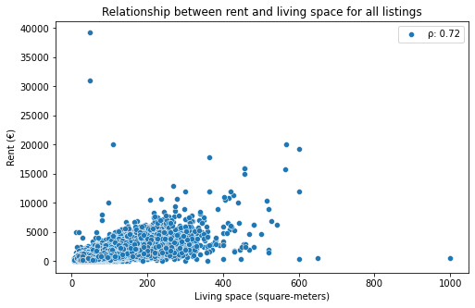

Slide 13
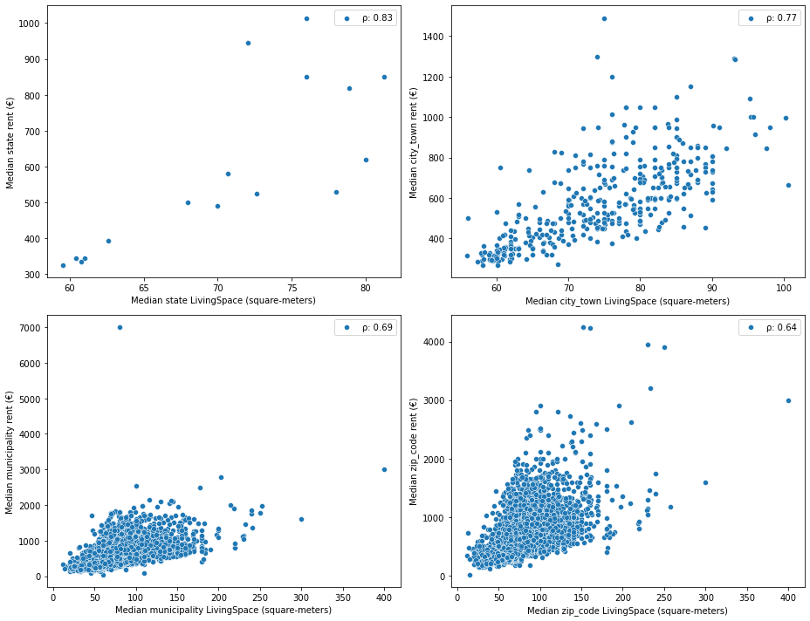
Plot of median rent versus median living space at the state, city / town, municipality, and zip code level

Slide 14
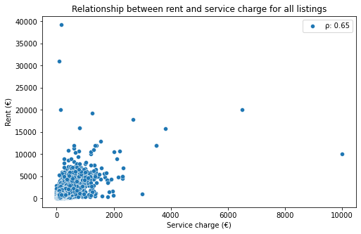

Slide 15
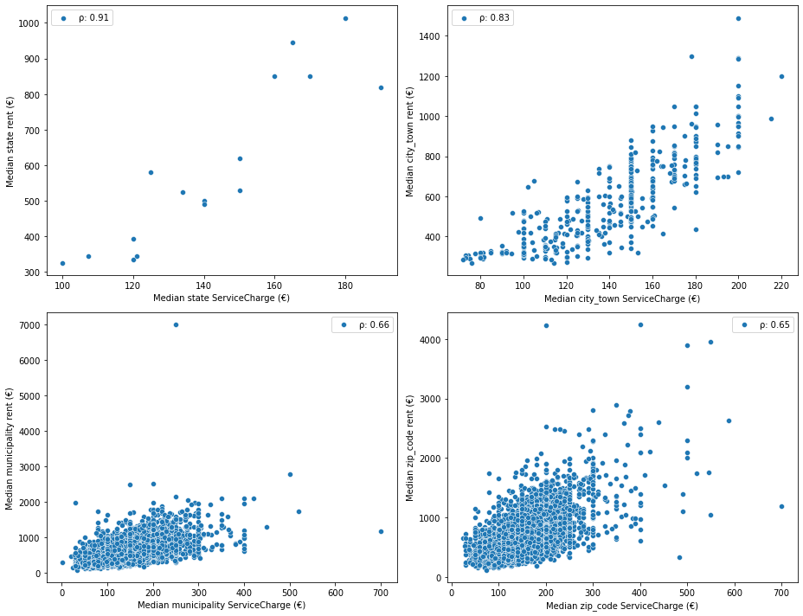
Plot of median rent versus median service charge at the state, city / town, municipality, and zip code level

Slide 16
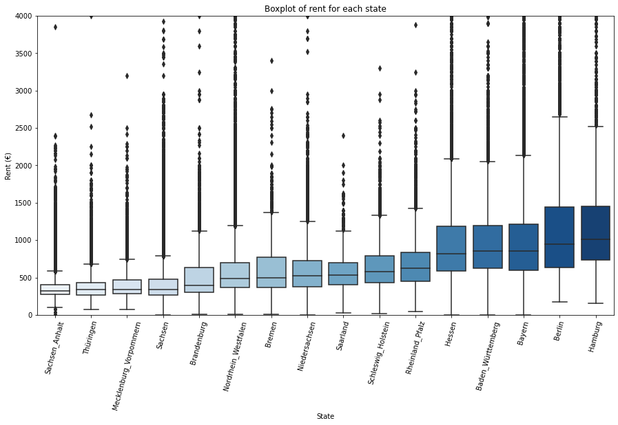

Slide 17
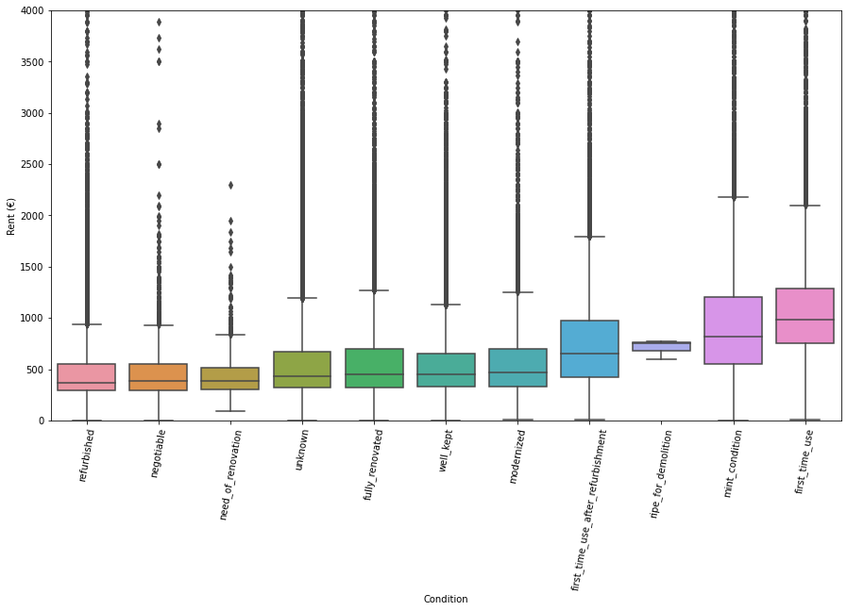
Relationship between rent and condition

Slide 18
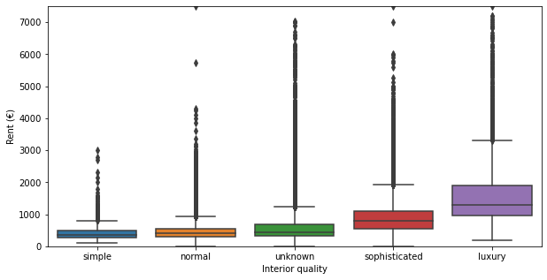
Relationship between rent and quality

Slide 19
Machine Learning
Training data development |metrics |testing | Model development | selection | application

Slide 20
Training data development
Application-set:
5 random samples
Training-set:
70% of remaining observations
Test-set:
30% or remaining observations

Slide 21
Metrics
R-squared score (R2)
$$1 − \frac{Residual sum of square errors}{Total sum of square errors}$$
1 − (𝑅esidual sum of square errors)/(𝑇otal sum of square errors)
Mean Absolute Error (MAE)
$$\sum{\frac{{\left|y− \hat{y}\right)|}^{ }}{N}}$$
∑▒〖|y− 𝑦 ̂ )|〗^( )/𝑁

Slide 22
Testing strategy on training-set (70% of data)
Cross-validation on 70% training set (5 fold)
MAE 1
R2-1
Fold 1 | Fold 2 | Fold 3 | Fold 4 | Fold 5
MAE 2
R2-2
Fold 1 | Fold 2 | Fold 3 | Fold 4 | Fold 5
Mean MAE
Stdev MAE
MAE 3
R2-3
Fold 1 | Fold 2 | Fold 3 | Fold 4 | Fold 5
MAE 4
R2-4
Mean R2
Stdev R2
Fold 1 | Fold 2 | Fold 3 | Fold 4 | Fold 5
MAE 5
R2-5
Fold 1 | Fold 2 | Fold 3 | Fold 4 | Fold 5

Slide 23
Testing strategy (on test-set (30% of data))
Test set performance
MAE performance
R2- performance

Slide 24
Baseline model – linear regression
 | R2 score | Mae (€)
Train set | 0.73 | 146.36
Test set | 0.75 | 147.29

Slide 25
Model development - Algorithms
Linear
Ridge regression
Tree induction
XGBoost
Lasso regression
Random forest

Slide 26
Model optimization for tree-induction
Feature selection
Used feature importance for tree-induction model
Gini importance threshold value of 0.001
Hyperparameter tuning
Random forest
Number of estimators
Maximum depth of tree
XGBoost
Subsample
Maximum depth of tree
Column sample

Slide 27
Model Performance: r-squared
Model | Mean cv r2 score | Stdev of cv r2 scores | R2 test score
XGBoost | 0.837 | 0.045 | 0.866
XGBoost w/ feat sel. | 0.838 | 0.045 | 0.863
Random forest w/ hyper | 0.819 | 0.047 | 0.861
XGBoost w/ hyper | 0.827 | 0.047 | 0.849
Random forest w/ feat sel. | 0.809 | 0.045 | 0.848
Random forest | 0.807 | 0.049 | 0.841
Ridge | 0.730 | 0.048 | 0.748
Lasso | 0.730 | 0.048 | 0.747

Slide 28
Model performance: mean absolute error
Model | Mean cv mae score (€) | Stdev of cv mae scores (€) | mae test score (€)
Random forest w/ hyper | 91.34 | 0.67 | 90.34
XGBoost | 91.90 | 0.31 | 92.04
XGBoost w/ feat sel. | 91.79 | 0.52 | 92.14
Random forest w/ feat sel. | 97.44 | 0.66 | 97.19
Random forest | 97.30 | 0.80 | 97.20
XGBoost w/ hyper | 103.52 | 0.35 | 103.49
Lasso | 145.63 | 0.81 | 146.49
Ridge | 146.35 | 0.82 | 147.20

Slide 29
Common important features
Service charge
Median city picture count
Median zip code service charge
Luxurious interior quality
Living space
Median city service charge
Median city living space

Slide 30
Model selection: XGBoost
Data | Mean cv r2 score | Stdev of cv r2 scores | Mean cv mae score (€) | Stdev of cv mae scores (€)
All | 0.774 | 0.073 | 114.73 | 29.66
Training | 0.837 | 0.045 | 91.90 | 0.31

Slide 31
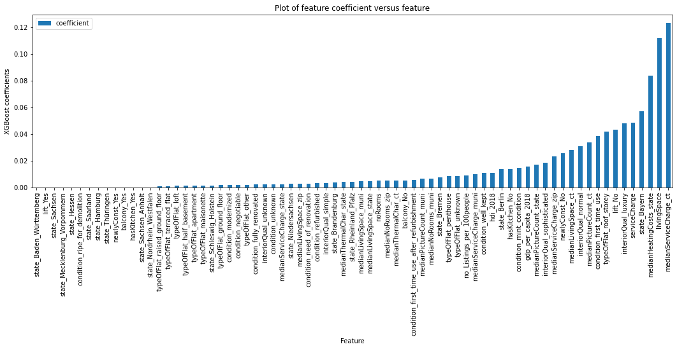

Slide 32
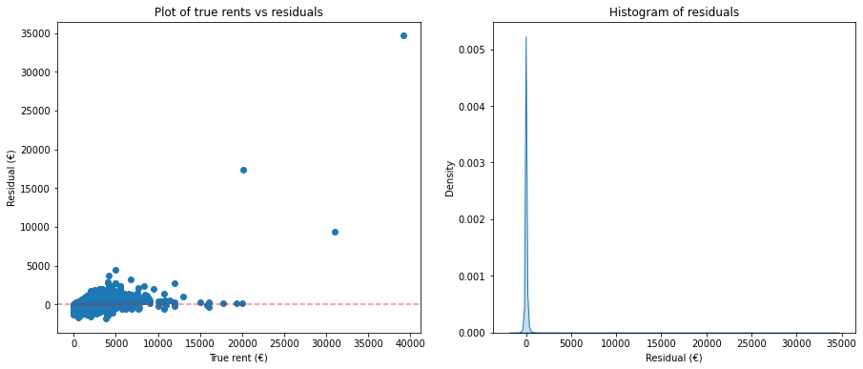
Mean residual: €0 | Median residual: - €5 | Stdev: €157.5 | Skew: 46.5

Slide 33
Model application results
# | State | City/Town | Condition | rooms | Area (sqm) | Predicted rent (€) | Lower limit (€) | Set rent (€) | Higher limit (€)
1 | Brandenburg | Uckermark | First time use | 3.0 | 50.51 | 578.25 | 493.18 | 300.00 | 722.65
2 | Schleswig Holstein | Dithmarschen | First time use after refurbishment | 3.0 | 112.24 | 910.22 | 825.14 | 589.26 | 1054.61
3 | Sachsen | Chemnitz | refurbished | 2.0 | 51.67 | 641.11 | 556.03 | 518.00 | 785.50
4 | Sachsen Anhalt | Halle Saale | negotiable | 1.0 | 28.75 | 328.69 | 243.61 | 285.00 | 473.08
5 | Hessen | Main Kinzig | Well kept | 2.5 | 50.00 | 429.64 | 344.56 | 320.00 | 574.03

Slide 34
Conclusion / Recommendation
Determined most important factors for rent
Living space
Service charge
Interior quality – luxurious
Predicted rent with XGBoost model
R-squared: 0.77
Mean absolute error: €114.73

Slide 35
Assumptions/Limitations/Opportunities
Analysis of text features (i.e. description and facilities)
Including time features in model
Uncertainty around sampling methodology
Higher compute capabilities for hyperparameter tuning

Slide 36
Questions
?

