Slide 1
Practical Project
By Ife Fayanju

Slide 2
Contents
Introduction
Solution
Design
Configuration
CI Pipeline
Summary
Demo

Slide 3
Introduction
Objective: Create an App made up 4 services
Requirements: Use methodologies and tools learnt in pasts weeks of training

Slide 4
Solution
Dungeons and Dragons wild magic effect App
Services:
Front End
Number Generator
Number Generator
Effect Generator

Slide 5
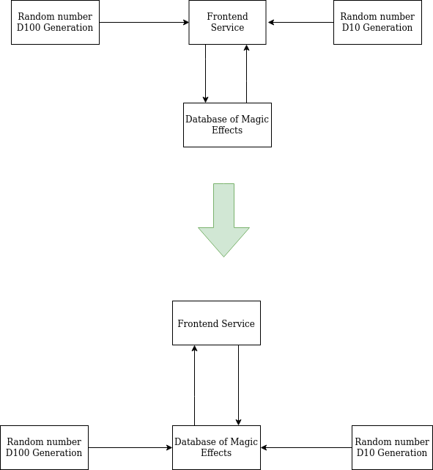
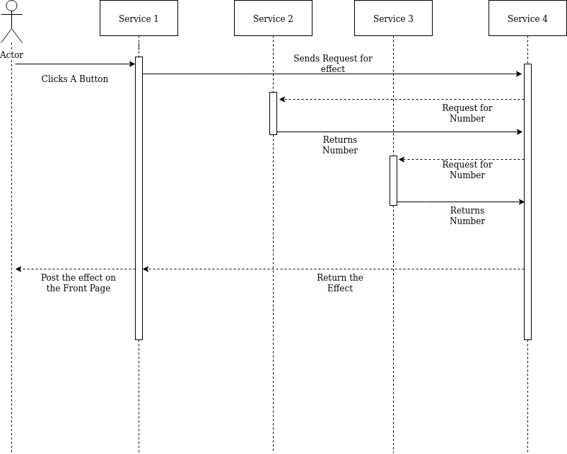
Design

Slide 6
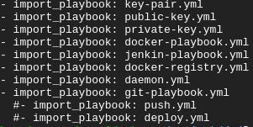
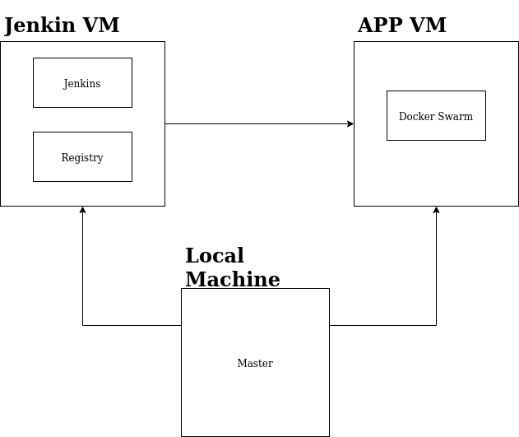

Configuration

Slide 7
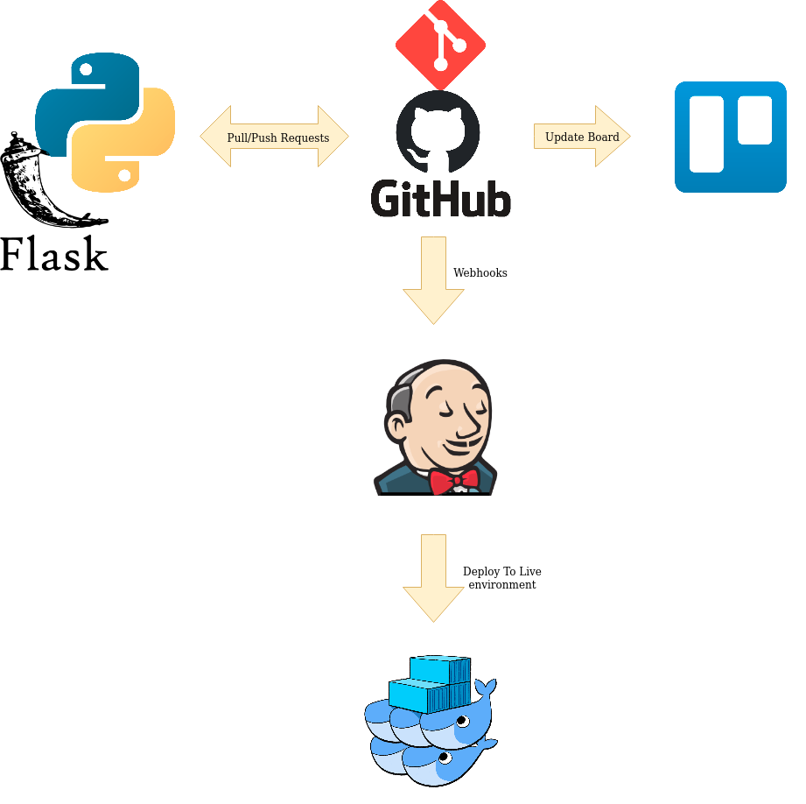
CI Pipeline

Slide 8
Summary
Future Improvements
Automate testing
More detailed Effect Table
Load balancing (Add workers)
Update Ansible Playbook

Slide 9
Demo
http://35.246.77.128/

