Slide 1

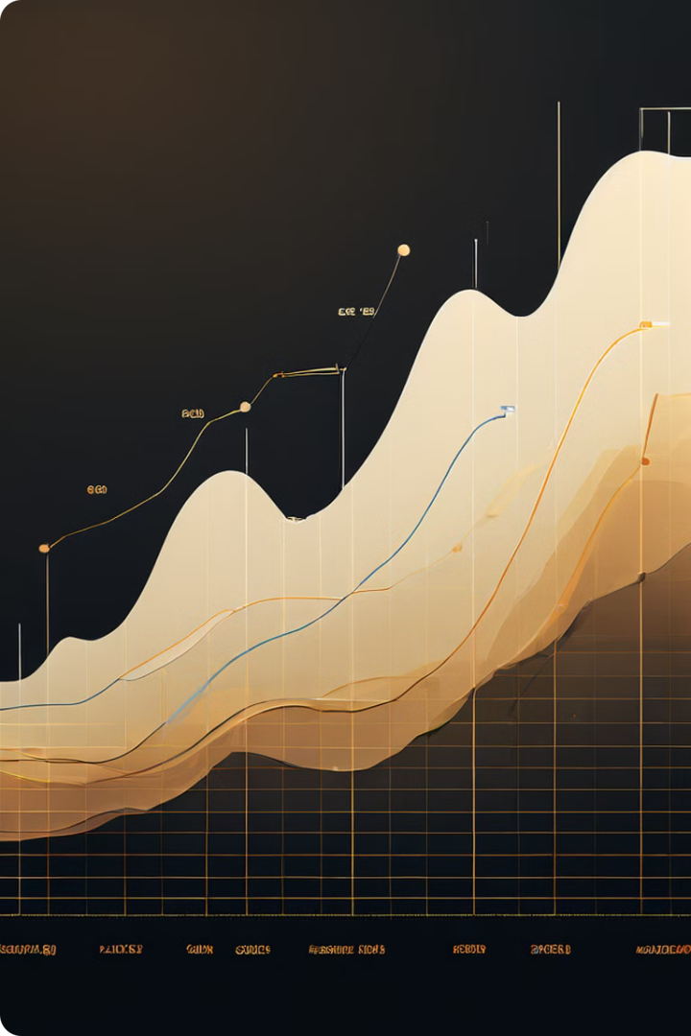
Analyzing the Black-Scholes Model
This presentation analyzes the Black-Scholes model, a widely used option pricing model in finance. The presentation covers the model's core concepts, assumptions, and implementation, culminating in a comparison of predicted and actual option prices.
Olufemi Anthony

Slide 2
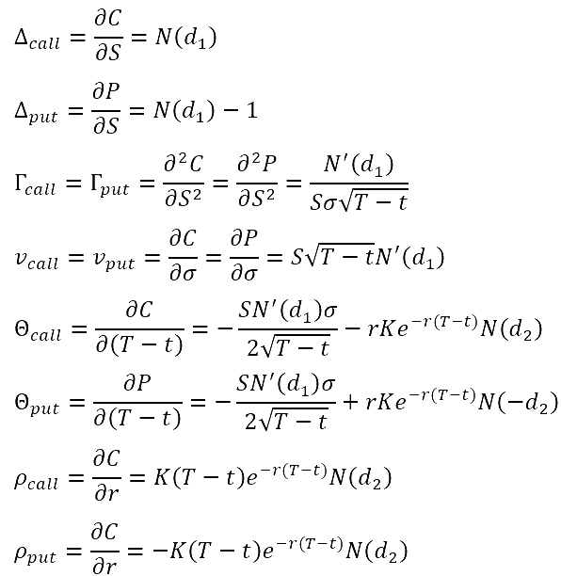
Purpose of the Presentation
1
Explain the Model
Provide a clear understanding of the core concepts and assumptions of the Black-Scholes model.
2
Demonstrate Implementation
Illustrate the practical steps involved in implementing the model using historical data.
3
Compare Predictions
Analyze the model's predictions against real-world option prices to assess its accuracy.

Slide 3

Introduction to the Black-Scholes Model
1
Background
2
Importance
The Black-Scholes model, developed by Fischer Black and Myron Scholes in 1973, provides a theoretical framework for pricing European-style options.
It is a cornerstone of modern finance, revolutionizing the way options are valued and traded.
3
Applications
The model is widely used by investors, traders, and financial institutions to analyze and manage risk.

Slide 4
Explanation of the Black-Scholes Formula
Option Price
Underlying Asset
The formula calculates the fair price of an option contract, taking into account various factors.
The formula considers the price of the underlying asset, such as a stock, on which the option is based.
Time to Expiration
Volatility
The formula accounts for the remaining time until the option expires, which influences its value.
The formula incorporates the volatility of the underlying asset, which measures the magnitude of price fluctuations.

Slide 5
Key Assumptions of the Model
Efficient Markets
Log-Normal Distribution
Constant Volatility
The model assumes that market prices reflect all available information, eliminating arbitrage opportunities.
The model assumes that the price of the underlying asset follows a log-normal distribution, which describes a continuous probability distribution.
The model assumes that the volatility of the underlying asset remains constant over the life of the option.

Slide 6
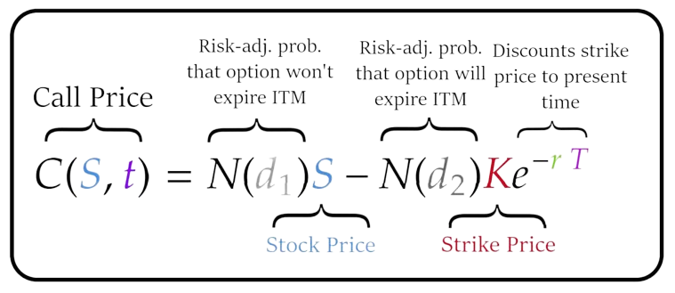

Slide 7

Description of the Historical Data Used
Data Source
Yahoo Finance
Time Period
July 12, 2024
Frequency
Daily
Variables
Stock price, option prices, and volatility

Slide 8

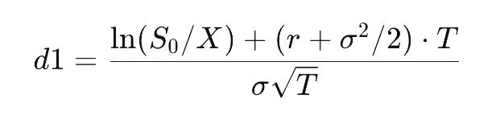




Data
Given Data
Current stock price (S₀​): $230.54
(most recent adjusted close price)
Strike price (X): $207.5-> $255
Risk-free rate (r): 5.25%
(most recent Treasury bill rate)
Time to maturity (T): 6 days
(0.01643 years, calculated as 6/365)
Volatility (σ): 23.04%%
Calculate d1
Calculate d2
Calculate the call option price

Slide 9
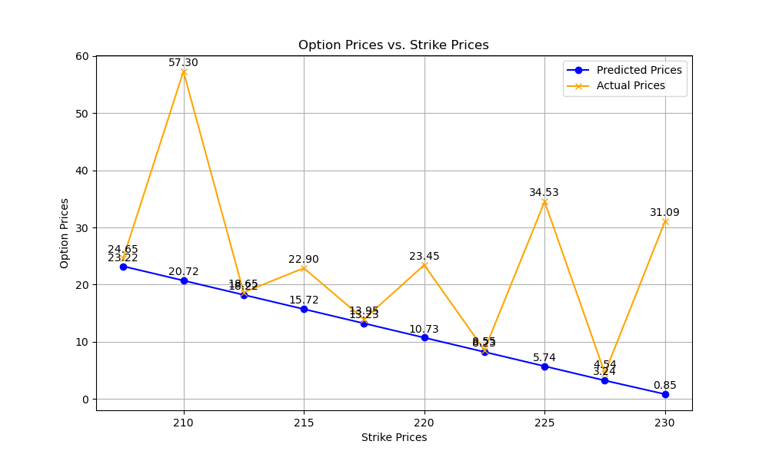
Data
Given Data
Current stock price (S₀​): $230.54
(most recent adjusted close price)
Strike price (X): $207.5-> $255
Risk-free rate (r): 5.25%
(most recent Treasury bill rate)
Time to maturity (T): 6 days
(0.01643 years, calculated as 6/365)
Volatility (σ): 23.04%%
Calculate d1
Calculate d2
Calculate the call option price

Slide 10
Possible Causes
Volatility Surface: Option prices are sensitive to implied volatility, which can vary across different strike prices (known as the volatility smile or surface). If your implied volatilities (iv) are not reflective of market conditions for those specific strike prices, predictions will be inaccurate.
Market Conditions: Actual option prices are influenced by supply and demand dynamics in the market, which might not align with the assumptions of your model (e.g., constant volatility, no dividends).
Model Limitations: The Monte Carlo simulation assumes a geometric Brownian motion for stock price movements, which may not capture all market behaviors or risk factors affecting option prices.
Time to Expiration: As expiration approaches, the sensitivity of option prices (time decay) increases. If the time to expiration varies for your strike prices, it could affect pricing.
Interest Rates: Changes in the risk-free rate can impact option pricing, particularly for longer-dated options.

Slide 11


Implications
Risk Management
Hedging Ineffectiveness: If predicted prices are inaccurate, hedging strategies (e.g., delta hedging) may be less effective, leading to unanticipated losses.
Mispricing Risk: Mispricing can lead to incorrect assessment of risk, resulting in potential financial losses or misallocation of capital.
Trading Strategies
Arbitrage Opportunities: Large discrepancies can create arbitrage opportunities, where traders can exploit the price differences to make a profit. However, these opportunities may be short-lived as markets adjust.
Inaccurate Valuation: Traders relying on model predictions for trading decisions may face significant losses if the models do not accurately reflect market prices.

Slide 12

Implications
Portfolio Management
Incorrect Portfolio Valuation: Discrepancies can lead to incorrect portfolio valuations, affecting performance metrics and decisions on rebalancing.
Performance Attribution: Assessing the performance of options strategies may be flawed if the predictions do not align with actual market prices.
Market Efficiency
Impact on Liquidity: Mispricings can affect market liquidity, as traders may be hesitant to trade options that appear mispriced relative to their expectations.
Market Sentiment: Significant discrepancies can reflect or influence market sentiment, potentially leading to increased volatility as market participants adjust their positions.

