Slide 1
Creating Data Pipelines in the Cloud
Femi Anthony
Notes:
Bit of a misnomer, slightly different from when I made my submission since the business of creating data pipelines in the cloud isnt that much different from that of using your company infrastructure in the first 2 cases - Luigi, Airflow.

Slide 2

Who am I
Femi Anthony
Twitter : @dataphanatik
Email: femibyte@gmail.com
Data Engineer, Capital One
Book with PacktPub - Mastering Pandas
Notes:
Jean Valjean - just kidding (Femi Anthony). Les Miserables reference.

Slide 3
Overview
Definition and Rationale for Data Pipelines
Data Pipeline Tools - Luigi, Airflow, AWS Data Pipeline
Usage in the cloud and comparative analysis
Notes:
This is a brief overview as to how I intend to proceed today.

Slide 4
What is a data pipeline ?
A data pipeline consists of a series of software tasks that source and extract data from possibly disparate sources, move it to a centralized location, process and transform it in a logically consistent manner and produce a set of meaningful results that can be consumed by a client/end user.
Notes:
- We're now living in the era of Big data. From social media to smart devices and phones, sensors everywhere there are hundreds of thousands of data sources, many of which we wish to process, analyze and extract information from. For the data scientist, this represents a gold mine, that will keep them busy and employed from the cradle to the grave (hyperbole). The question is, with the deluge of data, how can we get a handle on all this ?

Slide 5
Data Pipeline Step 1 – Data Retrieval
Notes:
Scenario – suppose we’re a web analytics company focusing on a particular demographic, say people who like cycling. I fit that demographic perfectly. (MAMIL – middle aged men in lycra.)
Step 1 – here we retrieve our daily segment data from 3 separate data sources e.g. Strava, MapMyRide, Endomondo

Slide 6
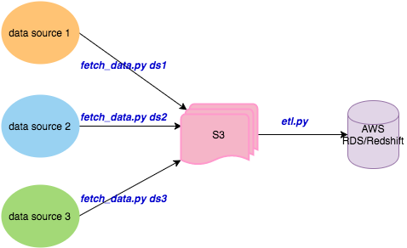
Data Pipeline Step 2 – Extract Transform Load
Notes:
Having collected daily segment data and asaved in S3, we now have an ETL process that processes each of the site daily data sets in turn and persists them to a cloud location say Amazon s3 bucket.

Slide 7
Data Pipeline Step 3 – Aggregate/Predict
Notes:
Here we can now perform some aggregations, calculations to find say top 10 most popular segments/routes in each state and write the results to a summary table in Redshift/RDS.

Slide 8
Data Pipeline Step 4 – Write Results
Notes:
Finally we have a process that creates a report or pre-canned reports for our web analytics site.

Slide 9
Naïve approach : separate cron tasks
Run the scripts in desired order as cron jobs and hope for the best: 0 8 * * * /home/ubuntu/bin/fetch_data.py ds1 0 8 * * * /home/ubuntu/bin/fetch_data.py ds2 0 8 * * * /home/ubuntu/bin/fetch_data.py ds3 30 8 * * * /home/ubuntu/bin/etl.py 0 9 * * * /home/ubuntu/bin/aggregate.py 0 10 * * * /home/ubuntu/bin/gen_report.py
Notes:
How do we implement the data pipeline outlined in the previous slide. So we start with the naïve approach and create separate cron tasks for each step in the pipeline:
Extremely problematic - any of the fetch data job could take much longer than expected to run and the etl job could start running on what is incomplete data. This brings us to the next less naïve approach - calling all tasks from generic wrapper script...

Slide 10
Less Naïve approach
Execute scripts in order in sequential order via single bash script : #!/usr/bin/bash dataset_loc1 = ... dataset_loc2 = ... dataset_loc3 = ... workdir = ... cd $workdir # retrieve data python fetch_data.py dataset_loc1 && python fetch_data.py dataset_loc2 \ && python fetch_data.py dataset_loc3 # Do ETL python run_etl.py s3_location # Do aggregation python aggregate.py # Generate results python gen_results.py
Notes:
The scripts are guaranteed to run in order without overlap but what happens in the case of errors in any intermediate step ?

Slide 11
Less Naïve approach with Error handling
Check the status of each task upon completion before running the next. # Retrieve data python fetch_data.py dataset_loc1 && python fetch_data.py dataset_loc2 \ && python fetch_data.py dataset_loc3 # Do ETL if [[ $? == 0 ]]; then python run_etl.py s3_location # Do aggregation else echo “error: $?” && exit -1 … if [[ $? == 0 ]]; then ...
Notes:
Well, we can add error handling as shown above… As you can see this approach can get tedious pretty fast as our pipeline becomes more complex.
So why don’t we take a step back and re-consider our approach

Slide 12


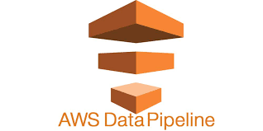
Solution: Use Workflow framework manager
Luigi | Airflow
AWS Data Pipeline
Notes:
One solution to our problem is to use one of the Python based workflow management tools and we shall consider 3 today shown in the slides.

Slide 13

Introduction to
Python package that helps build complex pipelines of batch jobs.
It provides dependency resolution, workflow management, visualization, handling failures, command line integration.
Created by folks at Spotify
Maintained by Erik Bernardson.
First open-source Python based workflow manager.
Named after the world’s 2nd most famous plumber
Notes:
First we start with Luigi. As Pythonistas we’ve all heard of Luigi.
Idea and name comes from Luigi the plumber character in Super Mario brothers. Purpose of Luigi is to address all the plumbing associated with data pipeline tasks.

Slide 14
Philosophy and Concepts
Similar to GNU Make where one can define tasks and tasks depend on other tasks
Dependency graph is specified in Python code.
Provides UI, can be run in server mode or with local-scheduler mode
Two main abstractions :
Task – Responsible for execution of a task. It is subclassed from the abstract class luigi.Task.
Target – Corresponds to a location for writing output data from a Task run. Examples : file on disk, file in S3/HDFS, checkpoint entry in database.
Notes:
A little bit about the philosophy and conceps in Luigi….

Slide 15
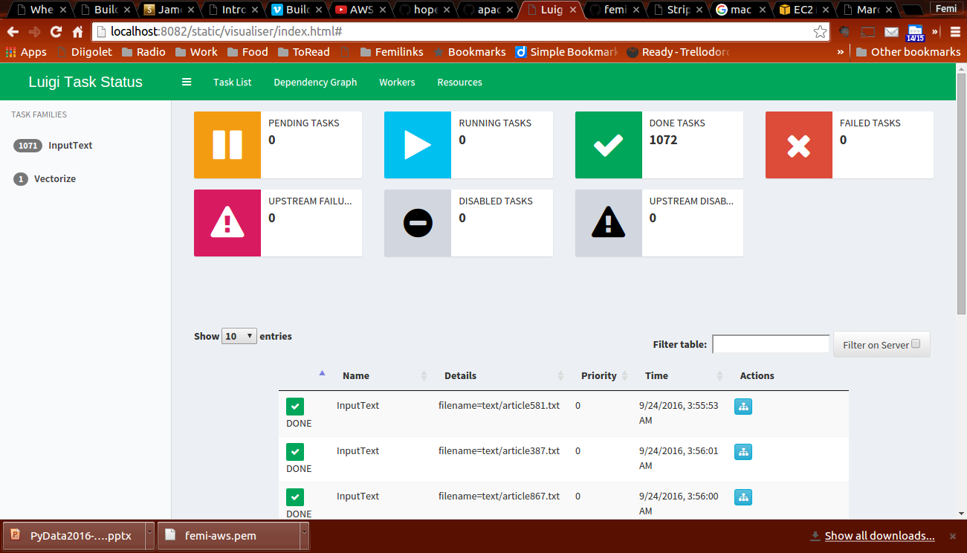
Luigi UI
Notes:
This is what the Luigi UI looks like. You can monitor the status of tasks, view the dependency graph

Slide 16
Task class Implementation
Implement a Task, subclass luigi.Task and implement the following 3 methods:
run() - contains the logic needed to achieve purpose of Task
output() - returns one or more Target objects.
requires() - specifies dependencies on a preceding Task object.
Notes:
This is how we implement a Task in luigi, by subclassing the luigi.task class

Slide 17
Task class Example
class ReportTask(luigi.Task): self.end_date= luigi.Parameter(end_date=‘latest’) def run(self): gen_report(end_date) def requires(self): return AggregateTask() def output(self): report_path = (“%s/%s.txt” %(bucket, end_date)) return luigi.s3.s3Target(report_path) if __name==“__main__”: luigi.run()
Notes:
Here is an example of how we could implement the ReportTask which is the final step in our data pipeline.

Slide 18
Examples of Target
MyTarget(luigi.Target)
luigi.s3Target
luigi.HDFSTarget
luigi.LocalTarget
Notes:
You can create your own target by inheriting from luigi.Target. Many other targets are specified in the documentation.

Slide 19
Advantages
Mature, been around the block
Platform agnostic – not limited to say just Hadoop like frameworks such as Oozie.
Native support for HDFS, S3, postgres, MySQL, Redshift, Spark, BigQuery etc luigi.postgres,
Decent visualization tool (UI) to track progress of job.
Decentralized dependencies.

Slide 20
Limitations
No built-in task triggering/scheduling. Reliant on cron or similar mechanism to trigger pipeline runs.
Focus is on batch processing so not as useful for real-time pipelines or stream processing.
Relatively small number of Tasks, because requires writing subclasses for unique tasks.
Requires writing to file at every stage - cannot write output from 1 stage to another via in-memory buffer.
Notes:
These limitations may also be in the eye of the beholder.

Slide 21
Introduction to Airflow
Workflow management and orchestration tool
Written in Python.
Created by folks at Airbnb
Maintained as an Apache Foundation project
Large set of features including UI, scheduler, command line interface
Notes:
We now move on to Airflow.

Slide 22
Airflow Design Principles
Core Abstraction : DAG (directed acyclic graph)
Pipelines are modeled as DAGs and tasks are nodes on the DAG while dependencies are paths connecting the nodes.
Cycles are not allowed (pipelines need to run to completion)
Can run tasks that are independent in parallel
Task failures in independent parts of the pipeline do not derail other parts.
Can re-run parts of workflow that have been affected by a failure
Notes:
Cycles- Airflow will raise exceptions when it finds cycles in your DAG or when a dependency is referenced more than once.

Slide 23
Airflow Components
Job definitions - stored in source control
Metadata DB - MySQL, Postgres used by Airflow to keep track of metadata such as task statuses.
Command line interface (CLI) – to test, run, backfill, describe and clear parts of pipeline definitions.
Rich Web interface – for viewing task dependencies, logs, statuses, and other metadata. Implemented as a Flask web app.
Scheduler – cron replacement that kicks off tasks that are scheduled to run.
Workers – array of processes that run tasks in a distributed fashion.
Notes:
Here is an outline of the architectural components of Airflow.

Slide 24
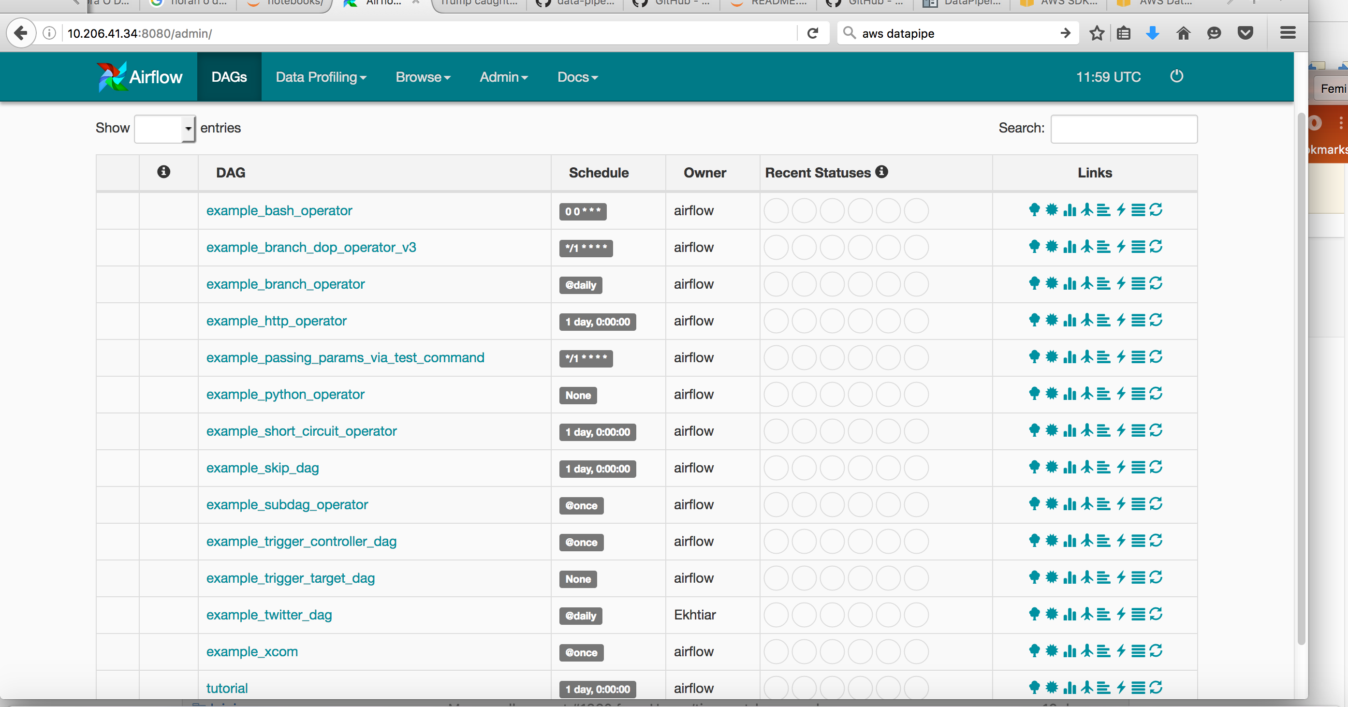
Airflow UI
Notes:
Screenshot of Airflow UI

Slide 25
Airflow Code – Concepts
Operators enable the creation of certain types of tasks. All operators derive from BaseOperator and inherit many attributes and methods.
Examples of Operators:
BashOperator, PythonOperator, EmailOperator
See link for more details: https://pythonhosted.org/airflow/code.html#operators
Executors are the mechanism by which tasks get run. All executors inherit from the BaseExecutor class.
Examples of Executors:
LocalExecutor, SequentialExecutor, CeleryExecutor
See link for more details: https://pythonhosted.org/airflow/code.html#executors
Notes:
BashOperator - bash tasks,
Python Operator - Python tasks,
EmailOperator,
CeleryExecutor - uses Celery task queue
- SequentialExecutor
- LocalExecutor - does tasks in parallel using Python multi-processing. Downside if is you want to restart the scheduler
- MesosExecutor

Slide 26
Airflow Code : Simple Task Creation
Here we create 2 tasks - Task_A, Task_B with Task_B dependent on Task_A :
import airflow.models as afm from airflow import DAG mydag = DAG(...) task_a = afm.PythonOperator(task_id = 'Task_A', python_callable = module.func_a, dag = mydag)
task_b = afm.PythonOperator(task_id = 'Task_B', python_callable = module.func_b, dag = mydag)
task_b.set_upstream(task_a)
Notes:
An example of creating a simple DAG in Airflow. DAG defintion file
People sometimes think of the DAG definition file as a place where they can do some actual data processing - that is not the case at all! The script’s purpose is to define a DAG object
To call Airflow:
python ~/airflow/dags/run_tasks.py – parse DAG airflow test Task_B param

Slide 27
Airflow Code : Dynamic Task Creation
for fname in files: task = afm.PythonOperator(task_id='proc_%s' % fname, python_callable = process, op_kwargs={'fname' : filename}, dag=DAG) task.set_upstream(task_a)
Notes:
Another DAG definition file showing how we can dynamically create Tasks based on a parameter.
Airflow leverages the power of Jinja Templating and provides the pipeline author with a set of built-in parameters and macros. Airflow also provides hooks for the pipeline author to define their own parameters, macros and templates.

Slide 28
Airflow Advantages
Comprehensive workflow management solution
Programmatic authoring of pipelines - all dependencies expressed in code rather than config files such as in Oozie (XML).
Extremely feature rich CLI and web UI.
Can express complex dependencies in pipelines - e.g. sub DAGs can be expressed within DAGs.

Slide 29
Airflow Disadvantages
Architectural complexity – lots of moving pieces – metadata DB, scheduler, queue
Code complexity – not as simple to use as say Luigi.

Slide 30
AWS Data Pipeline
Web-service based workflow manager for managing data pipelines created via Amazon Web Services AWS
Similar to SSIS rather than Python based workflow engine like Luigi, Airflow
Requires SNS endpoint
Basically ETL process hosted on Amazon's Cloud
Emphasis is more on UI based pipeline creation and management rather than a programmatic approach.

Slide 31
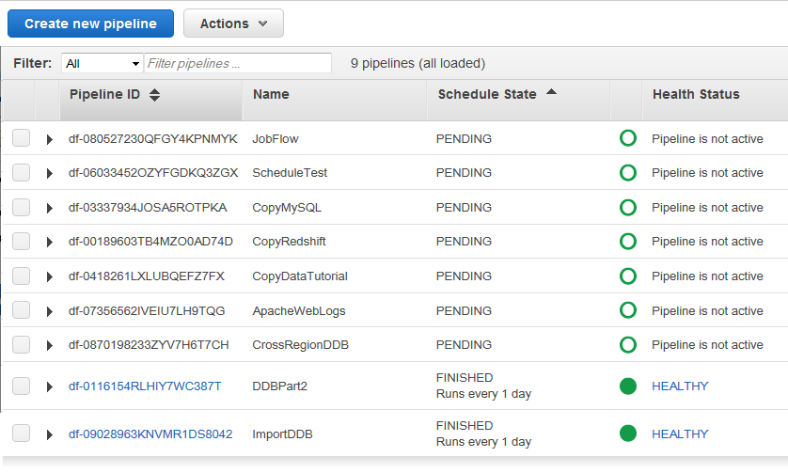
AWS Data Pipeline UI

Slide 32
AWS Data Pipeline Creation
Various ways to create a pipeline:
AWS Management Console - web interface to manage AWS Data Pipeline.
AWS Command Line Interface (AWS CLI) - with a pipeline definition file in JSON format.
AWS SDKs — Provides language-specific APIs. In Python's case you can use the boto3 module. See: https://boto3.readthedocs.io/en/latest/reference/services/datapipeline.html
Query API— Provides low-level APIs that you call using HTTPS requests. Using the Query API is the most direct way to access AWS Data Pipeline

Slide 33
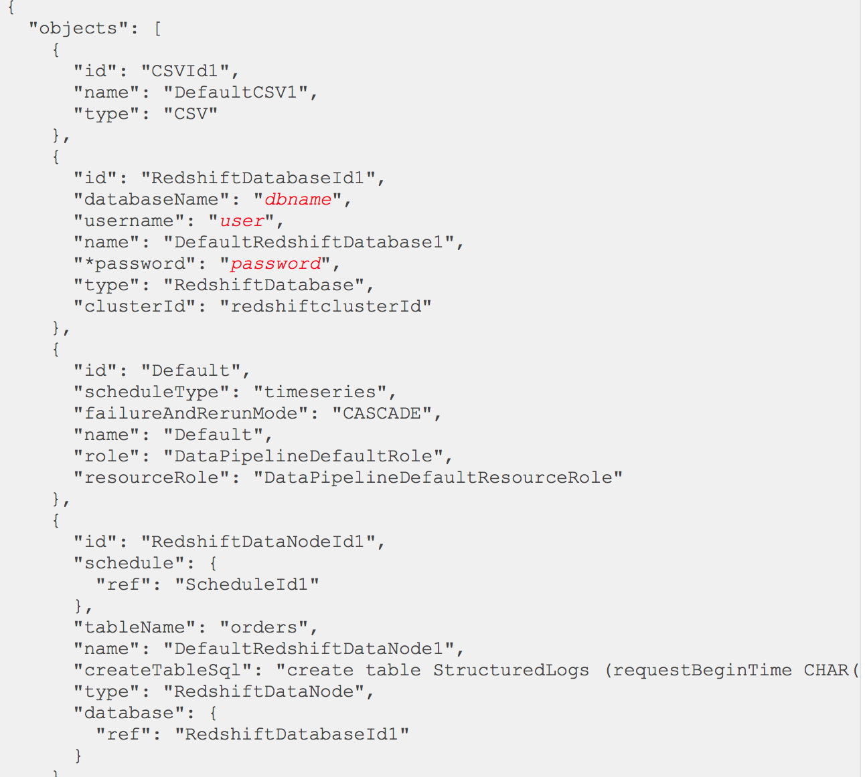
AWS Pipeline Definition

Slide 34
Advantages
Seamless integration with AWS Services - Amazon S3, Amazon RDS, HDFS (AWS EMR), Redshift
Easy to use web UI for creating and monitoring pipelines.
(To non-programmers) – emphasis is on configuration-based pipeline specification.
No need to install any additional software for use in the AWS cloud environment unlike tools like Luigi, Airflow.

Slide 35
Limitations
Very tight coupling with AWS Services. Essentially vendor lock-in.
Requires paying for services you may not want to use S3, Dynamo RDS etc.
Not very programmatic - more configuration file-based. Programmability via Python was limited. Cannot specify the dependencies in Python code like you do in Luigi/Airflow.
Notes:
Can use Simple Workflow as an alternative if you want more fine-grained programmatic customization over the control flow and patterns of your workflow logic.

Slide 36
Launching Pipelines in the cloud - AWS
For Luigi, Airflow :
Launch EC2 instance
Install Python – via Anaconda
pip install luigi
pip install airflow
For AWS Data Pipeline :

Slide 37
Luigi vs. Airflow vs. AWS Data Pipeline
Metric | Luigi | Airflow | AWS Data Pipeline
Ease of use | Easy | Moderate | It depends
Programmability | Medium | High | Low
Complexity | Low | Moderate | Moderate
Cloud provider coupling | None | None | High
Cost | Low | Low | Low
Developer learning curve | Low | Moderate | Moderate to High

Slide 38
Conclusions
Use Luigi if:
You have relatively simple workflows.
You want a minimalist workflow management solution which is programmatic.
You want a tried and tested mature solution which has a vast knowledge base of solutions.

Slide 39
Conclusions
Use Airflow if:
You would like an all in one solution.
You have complicated workflows with many dependencies.
You prefer encoding your task dependencies in code.

Slide 40
Conclusions
Use AWS if :
You plan on deploying all your workflows within only AWS.
You don't mind a configuration/UI based pipeline definition
You would like an all in one solution that seamlessly integrates with AWS services.

Slide 41
References
Luigi
https://luigi.readthedocs.io/en/latest/ - Read the docs
https://github.com/spotify/luigi - Github repo
Airflow
https://pythonhosted.org/airflow/start.html - Documentation
https://github.com/apache/incubator-airflow - Github repo
AWS Data Pipeline
https://aws.amazon.com/documentation/data-pipeline/ - Documentation
https://github.com/awslabs/data-pipeline-samples - Data Pipeline Samples

