Slide 1
Creating Data Pipelines in the Cloud
Femi Anthony

Slide 2
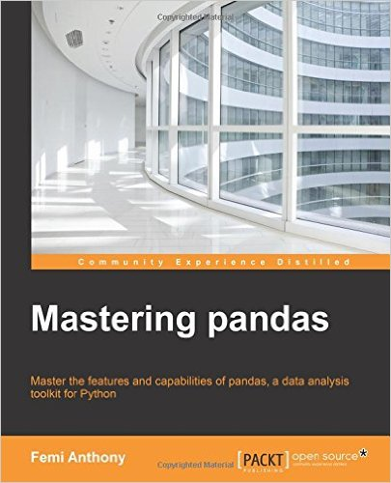
Nice to meet you
Femi Anthony
@dataphanatik
Data Engineer, Capital One
Book with PacktPub - Mastering Pandas

Slide 3
Overview
Definition and Rationale for Data Pipelines
Data Pipeline Tools - Luigi, Airflow, AWS Data Pipeline
Usage in the cloud

Slide 4
What is a data pipeline ?
A data pipeline consists of a series of software tasks that source and extract data from possibly disparate sources, move it to a centralized location, process and transform it in a logically consistent manner and produce a set of meaningful results that can be consumed by a client/end user.

Slide 5
Data Pipeline Step 1 – Data Retrieval

Slide 6
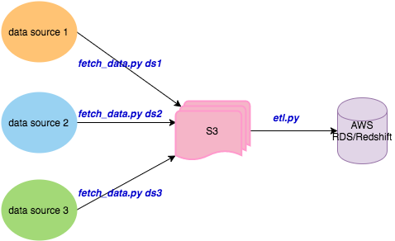
Data Pipeline Step 2 – Extract Transform Load

Slide 7
Data Pipeline Step 3 – Aggregate/Predict

Slide 8
Data Pipeline Step 4 – Write Results

Slide 9
Naïve approach : separate cron tasks
Run the scripts in desired order as cron jobs and hope for the best: 0 8 * * * /home/ubuntu/bin/fetch_data.py ds1 0 8 * * * /home/ubuntu/bin/fetch_data.py ds2 0 8 * * * /home/ubuntu/bin/fetch_data.py ds1 30 8 * * * /home/ubuntu/bin/etl.py 0 9 * * * /home/ubuntu/bin/aggregate.py 0 10 * * * /home/ubuntu/bin/gen_report.py

Slide 10
Less Naïve approach
Execute scripts in order in sequential order via single bash script : #!/usr/bin/bash dataset_loc1 = ... dataset_loc2 = ... dataset_loc3 = ... workdir = ... cd $workdir # retrieve data python fetch_data.py dataset_loc1 && python fetch_data.py dataset_loc2 \ && python fetch_data.py dataset_loc3 # Do ETL python run_etl.py s3_location # Do aggregation python aggregate.py # Generate results python gen_results.py

Slide 11
Less Naïve approach with Error handling
Check the status of each task upon completion before running the next. # Retrieve data python fetch_data.py dataset_loc1 && python fetch_data.py dataset_loc2 \ && python fetch_data.py dataset_loc3 # Do ETL if [[ $? == 0 ]]; then python run_etl.py s3_location # Do aggregation else echo “error: $?” && exit -1 … if [[ $? == 0 ]]; then ...

Slide 12


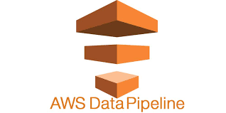
Solution: Use Workflow framework manager
Luigi | Airflow
AWS Data Pipeline

Slide 13
Introduction to
Python package that helps build complex pipelines of batch jobs.
It provides dependency resolution, workflow management, visualization, handling failures, command line integration.
Created by folks at Spotify
Maintained by Erik Bernardson.
First open-source Python based workflow manager.

Slide 14
Philosophy and Concepts
Similar to GNU Make where one can define tasks and tasks depend on other tasks
Dependency graph is specified in Python code.
Two main abstractions :
Task – Responsible for execution of a task. It is subclassed from the abstract class luigi.Task.
Target – Corresponds to a location for writing output data from a Task run. Examples : file on disk, file in S3/HDFS, checkpoint entry in database.

Slide 15
Task class Implementation
Implement a Task, subclass luigi.class and implement the following 3 methods:
run() - contains the logic needed to achieve purpose of Task
output() - returns one or more Target objects.
requires() - specifies dependencies on a preceding Task object.

Slide 16
Task class Example
class ReportTask(luigi.Task): self.end_date= luigi.Parameter(end_date=‘latest’) def run(self): gen_report(end_date) def requires(self): return ETLTask() def output(self): report_path = (“%s/%s.txt” %(bucket, end_date)) return luigi.s3.s3Target(report_path)

Slide 17
Examples of Target
MyTarget(luigi.Target)
luigi.s3Target
luigi.HDFSTarget
luigi.LocalTarget

Slide 18
Advantages
Mature, been around the block
Platform agnostic – not limited to say just Hadoop like frameworks such as Oozie.
Native support for HDFS, S3, postgres, MySQL, Redshift, Spark, BigQuery etc luigi.postgres,
Great visualization tools to track progress of job.
Decentralized dependencies.

Slide 19
Limitations
No built-in task triggering/scheduling. Reliant on cron or similar mechanism to trigger pipeline runs.
Focus is on batch processing so not as useful for real-time pipelines or stream processing.
Requires writing to file at every stage - cannot write output from 1 stage to another via in-memory buffer.

Slide 20
Introduction to Airflow
Workflow management and orchestration tool
Written in Python.
Created by folks at Airbnb
Maintained as an Apache Foundation project
Large set of features including UI, scheduler, command line interface

Slide 21
Airflow Design Principles
Core Abstraction : DAG (directed acyclic graph)
Pipelines are modeled as DAGs and tasks are nodes on the DAG while dependencies are paths connecting the nodes.
Cycles are not allowed (pipelines need to run to completion)
Can run tasks that are independent in parallel
Task failures in independent parts of the pipeline do not derail other parts.
Can re-run parts of workflow that have been affected by a failure

Slide 22
Airflow Components
Job definitions - stored in source control
Metadata DB - MySQL, Postgres used by Airflow to keep track of metadata such as task statuses.
Command line interface (CLI) – to test, run, backfill, describe and clear parts of pipeline definitions.
Rich Web interface – for viewing task dependencies, logs, statuses, and other metadata. Implemented as a Flask web app.
Scheduler – cron replacement that kicks off tasks that are scheduled to run.
Workers – array of processes that run tasks in a distributed fashion.

Slide 23
Airflow Code – Concepts
Operators enable the creation of certain types of tasks. All operators derive from BaseOperator and inherit many attributes and methods.
Examples of Operators:
BashOperator, PythonOperator, EmailOperator
See link for more details: https://pythonhosted.org/airflow/code.html#operators
Executors are the mechanism by which tasks get run. All executors inherit from the BaseExecutor class.
Examples of Executors:
LocalExecutor, SequentialExecutor, CeleryExecutor
See link for more details: https://pythonhosted.org/airflow/code.html#executors

Slide 24
Airflow Code : Simple Task Creation
Here we create 2 tasks - Task_A, Task_B with Task_B dependent on Task_A :
import airflow.models as afm from airflow import DAG task_a = afm.PythonOperator(task_id = 'Task_A', python_callable = module.func_a, dag = DAG)
task_b = afm.PythonOperator(task_id = 'Task_B', python_callable = module.func_b, dag = DAG)
task_b.set_upstream(task_a)

Slide 25
Airflow Code : Dynamic Task Creation
for fname in files: task = afm.PythonOperator(task_id='proc_%s' % fname, python_callable = process, op_kwargs={'fname' : filename}, dag=DAG) task.set_upstream(task_a)

Slide 26
Airflow Advantages
Comprehensive workflow management solution
Programmatic authoring of pipelines - all dependencies expressed in code rather than config files such as in Oozie (XML).
Extremely feature rich CLI and web UI.
Can express complex dependencies in pipelines - e.g. sub DAGs can be expressed within DAGs.

Slide 27
Airflow Disadvantages
Architectural complexity – lots of moving pieces – metadata DB, scheduler, queue
Code complexity – not as simple to use as say Luigi.

Slide 28
AWS Data Pipeline
Web-service based workflow manager for managing data pipelines created via Amazon Web Services AWS
Similar to SSIS rather than Python based workflow engine like Luigi, Airflow
Requires SNS endpoint
Basically ETL process hosted on Amazon's Cloud
Emphasis is more on UI based pipeline creation and management rather than a programmatic approach.

Slide 29
AWS Data Pipeline Creation
Various ways to create a pipeline:
AWS Management Console - web interface to manage AWS Data Pipeline.
AWS Command Line Interface (AWS CLI) - with a pipeline definition file in JSON format.
AWS SDKs — Provides language-specific APIs. In Python's case you can use the boto3 module. See: https://boto3.readthedocs.io/en/latest/reference/services/datapipeline.html
Query API— Provides low-level APIs that you call using HTTPS requests. Using the Query API is the most direct way to access AWS Data Pipeline

Slide 30
Advantages
Seamless integration with AWS Services - Amazon S3, Amazon RDS, HDFS (AWS EMR), Redshift
Easy to use web UI for creating and monitoring pipelines.
(To non-programmers) – emphasis is on configuration-based pipeline specification.
No need to install any additional software for use in the AWS cloud environment unlike tools like Luigi, Airflow.

Slide 31
Limitations
Very tight coupling with AWS Services. Essentially vendor lock-in.
Requires paying for services you may not want to use S3, Dynamo RDS etc.
Not very programmatic - more configuration file-based. Programmability via Python was limited. Cannot specify the dependencies in Python code like you do in Luigi/Airflow.

Slide 32
Launching Pipelines in the cloud - AWS
For Luigi, Airflow :
Launch EC2 instance
Install Python – via Anaconda
pip install luigi
pip install airflow
For AWS Data Pipeline :

Slide 33
Luigi vs. Airflow vs. AWS Data Pipeline
Metric | Luigi | Airflow | AWS Data Pipeline
Ease of use | Easy | Moderate | It depends
Programmability | Medium | High | Low
Complexity | Low | Moderate | Moderate
Cloud provider coupling | None | None | High
Cost | Low | Low | Low
Developer learning curve | Low | Moderate | Moderate to High

Slide 34
Conclusions
Use Luigi if:
You have relatively simple workflows.
You want a minimalist workflow management solution which is programmatic.
You want a tried and tested mature solution which has a vast knowledge base of solutions.

Slide 35
Conclusions
Use Airflow if:
You would like an all in one solution.
You have complicated workflows with many dependencies.
You prefer encoding your task dependencies in code.

Slide 36
Conclusions
Use AWS if :
You plan on deploying all your workflows within only AWS.
You don't mind a configuration/UI based pipeline definition
You would like an all in one solution that seamlessly integrates with AWS services.

Slide 37
References
Luigi
https://luigi.readthedocs.io/en/latest/ - Read the docs
https://github.com/spotify/luigi - Github repo
Airflow
https://pythonhosted.org/airflow/start.html - Documentation
https://github.com/apache/incubator-airflow - Github repo
AWS Data Pipeline
https://aws.amazon.com/documentation/data-pipeline/ - Documentation
https://github.com/awslabs/data-pipeline-samples - Data Pipeline Samples

