Slide 1
Pre-NOISE
May 11th 2021

Slide 2
Outline
Reflection

Slide 3
Reflection
I want to hear how would you summarize what each of you learned from Statistical Rethinking and Book of Why
What would you want to learn about next?

Slide 4
Reflection
Statistical Rethinking: Bayesian Statistics. Building models from “scratch”. Mechanics. DAGs. Downside: rethinking package not for research.
Book of Why: Causal Inference. Language of causation. Ladder: association, intervention, counterfactuals. Bayesian Networks. DAGs. Confounders. Front and Back-door adjustments. do-Calculus. Understanding mechanisms. Downside: not a how-to manual.

Slide 5
Next steps
Daniel Kahneman: Behavioral Economics. Decision making.
Nobel prize in Economics
Previous book: Thinking fast and slow

Slide 6
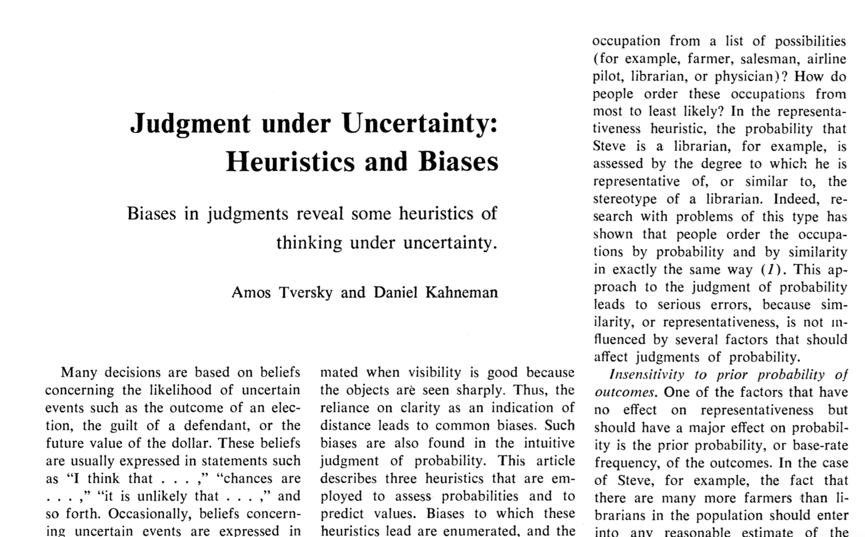

Slide 7
Judgment under Uncertainty: Heuristics and Biases
Paper published in Science, 1974
Authors: Amos Tversky and Daniel Kahneman
“Many decisions are based on beliefs concerning the likelihood of uncertain events…”
“…people rely on a limited number of heuristic principles which reduce the complex tasks of assessing probabilities and predicting values to simpler judgmental operations. In general, these heuristics are quite useful, but sometimes they lead to severe and systematic errors.”

Slide 8
My analogy to stats
We often assume normality in various forms in stats
Most of the time this works fine. And it is robust!
Sometimes it doesn’t and there are standard methods for dealing with this
Decision making assumes rationality
Most of the time this works fine. And it is robust (???)
Sometimes it doesn’t and there are standard methods for dealing with this (?????????)

Slide 9
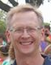
Example: Steve
“Steve is very shy and withdrawn, invariably helpful, but with little interest in people, or in the world of reality. A meek and tidy soul, he has a need for order and structure, and a passion for detail.”
Is Steve more likely to be a farmer or a librarian?

Slide 10
Example: Steve
“Steve is very shy and withdrawn, invariably helpful, but with little interest in people, or in the world of reality. A meek and tidy soul, he has a need for order and structure, and a passion for detail.”
Is Steve more likely to be a farmer or a librarian?
Let’s say that Steve lives in Iowa and there are about
100 farmers for every librarian.
We are ignoring the base-rate

Slide 11
Example: Steve
“Steve is very shy and withdrawn, invariably helpful, but with little interest in people, or in the world of reality. A meek and tidy soul, he has a need for order and structure, and a passion for detail.”
Is Steve more likely to be a farmer or a librarian?
Let’s say that Steve lives in Iowa and there are about
100 farmers for every librarian.

Slide 12
Example: babies are born…
A certain town is served by two hospitals. In the larger hospital about 45 babies are born each day, and in the smaller hospital about 15 babies are born each day. As you know, about 50 percent of all babies are boys. However, the exact percentage varies from day to day. Sometimes it may be higher than 50 percent, sometimes lower.
For a period of 1 year, each hospital recorded the days on which more than 60 percent of the babies born were boys.
Which hospital do you think recorded more such days?
- The larger hospital (A)
- The smaller hospital (B)
- About the same (that is, within 5 percent of each other) (C)

Slide 13
Example: babies are born…
A certain town is served by two hospitals. In the larger hospital about 45 babies are born each day, and in the smaller hospital about 15 babies are born each day. As you know, about 50 percent of all babies are boys. However, the exact percentage varies from day to day. Sometimes it may be higher than 50 percent, sometimes lower.
For a period of 1 year, each hospital recorded the days on which more than 60 percent of the babies born were boys.
Which hospital do you think recorded more such days?
- The larger hospital (21)
- The smaller hospital (21)
- About the same (that is, within 5 percent of each other) (53)

Slide 14
Example: Games of chance
Which sequence is more likely in a flip coin?
A) H-H-H-T-T-T
B) H-T-H-T-H-T
C) H-H-T-T-H-H

Slide 15
Example: Games of chance
Which sequence is more likely in a flip coin?
A) H-H-H-T-T-T
B) H-T-H-T-H-T
C) H-H-T-T-H-H
LAW OF SMALL NUMBERS (fallacy): even small samples are highly representative of the populations from which they are drawn
“As a consequence, researchers put too much faith in the results of small samples and grossly overestimate the replicability of such results” ( Ouch)

Slide 16
Representativeness
Bias 1: Insensitivity to prior probability of outcomes
Bias 2: Insensitivity to sample size
Bias 3: Misconceptions of chance
Bias 4: Insensitivity to predictability
Bias 5: The illusion of validity
Bias 6: Misconception of regression

Slide 17
Example: Driving skills
Do you think you are better, worse or average regarding your driving skills?

Slide 18
Example: People in Ames
Estimate: What percentage of people who live in Ames were born in Iowa?

Slide 19
Availability
Bias 1: retrievability of instance
Bias 2: effectiveness of a search set (ex: word search)
Bias 3: imaginability
Bias 4: Illusory (spurious) correlation

Slide 20
Example: Roulette anchoring in estimating percentages
People are asked to estimate a percentage about a quantity that they likely have absolutely no information about
Spinning a roulette (with numbers from 1-100) tends to anchor their answers closer to whatever the roulette comes up with

Slide 21
Adjustment and Anchoring
Bias 1: Insufficient adjustment
Bias 2: Overconfidence (assessment of subjective probability distributions)

Slide 22
Discussion
This article has been concerned with cognitive biases that stem from the reliance on judgmental heuristics. These biases are not attributable to motivational effects such as wishful thinking or distortion of judgments by payoff and penalties.
Indeed, several of the severe errors of judgment reported earlier occurred despite the fact that subjects were encouraged to be accurate and were rewarded for the correct answers

Slide 23
Summary
This article described three heuristics that are employed in making judgements under uncertainty: (i) representativeness, which is usually employed when people are asked to judge the probability that an object or event A belongs to class or process B; (ii) availability of instances or scenarios, which is often employed when people are asked to assess the frequency of a class or the plausibility of a particular development; and (iii) adjustment from an anchor, which is usually employed in numerical prediction when a relevant value is available. These heuristics are highly economical and usually effective, but they lead to systematic and predictable errors. A better understanding of these heuristics and of the biases to which they lead could improve judgements and decisions in situations of uncertainty.

