Slide 1

Before a golem is born…

Slide 2

Methods to distinguish between causal and association =
Directed Acyclic Graph
The point is to produce understanding. We need more than just prediction……we need causal understanding
It is needed to design the collection of data and the structure of our statistical model
Its validity relies on information outside the data
Successful prediction does not require correct causal identification
Association
Causal
Notes:
In the designing process……What the golem needs to do?? Causality or simple association???

Slide 3
Can we use LAI for as a selection trait for soybean seed protein concentrations?
Is there a relationship between LAI and Protein Concentration?
Is that relationship causal?

Slide 4
Why I am interested in the LAI- seed protein association?

Slide 5
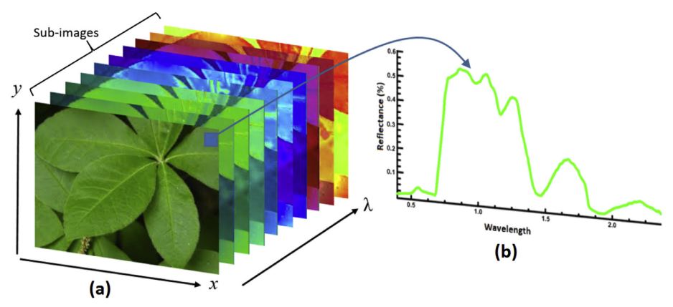
Predicting soybean crop variables using high-throughput
hyperspectral imaging
From a breeding perspective………HI allows phenotyping in extensive areas in a faster, non-destructive, and more cost-effective manner compared to direct measurements.

Slide 6
What crop variable we can best predict using the hyperspectral range
(350-2500 nm)?

Slide 7
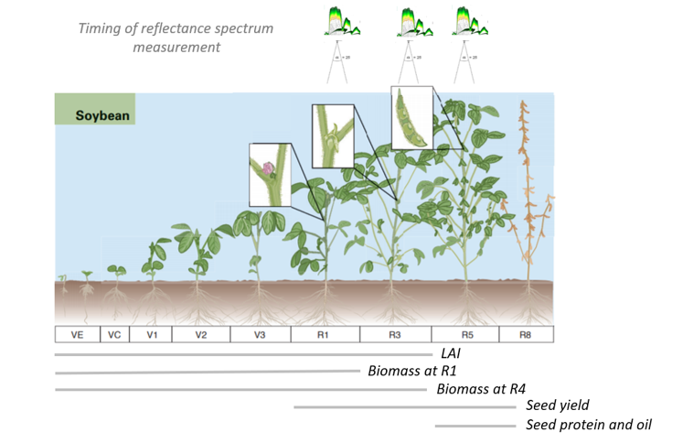
Predicting soybean crop variables using high-throughput
hyperspectral imaging
LAI (R2)
Biomass (R1)
Biomass (R4)
Yield
Seed protein
and oil
FieldSpec® 4 Hi-Res spectroradiometer
Experimental design
5 environments (yr./site)
32 genotypes
2 row-spacing (15 and 30 in)
3 reps
Data from Dr. Singh’s experiments

Slide 8
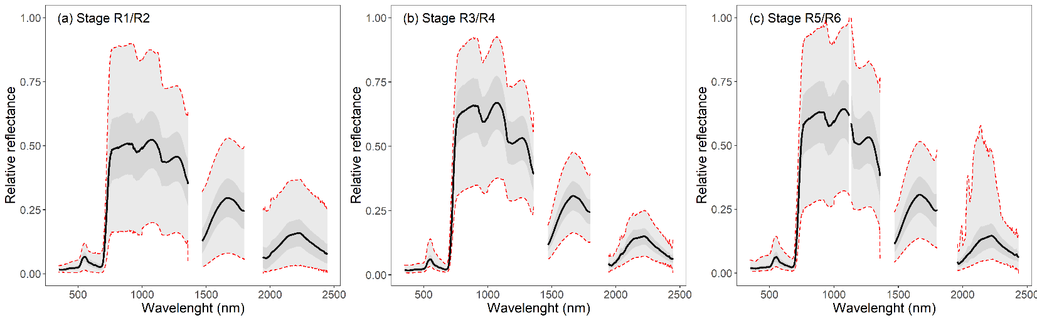
Predicting soybean crop variables using high-throughput
hyperspectral imaging
Predictors

Slide 9
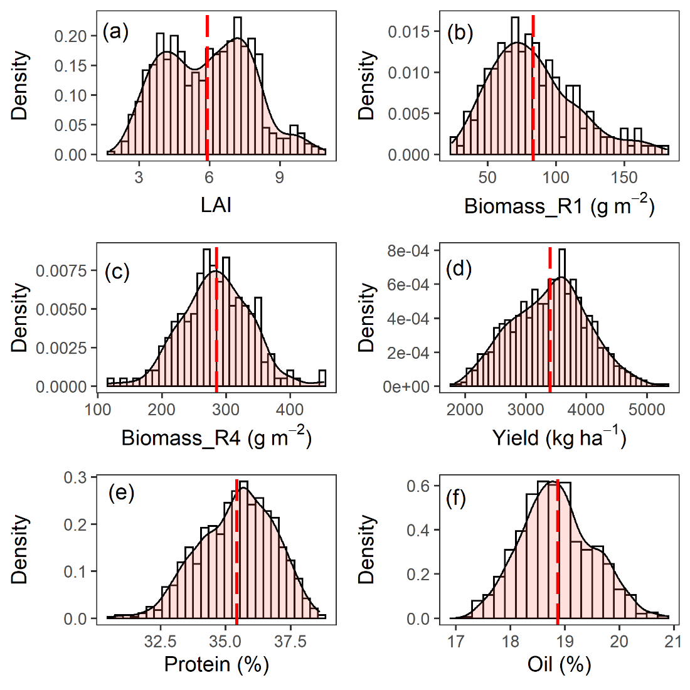
Predicting soybean crop variables using high-throughput
hyperspectral imaging
Predictors
Observed variables

Slide 10
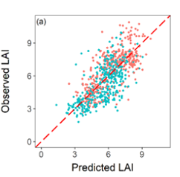
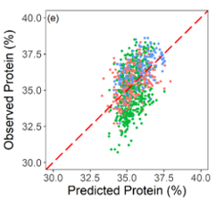
Predicting soybean crop variables using high-throughput
hyperspectral imaging
Predictors
Observed variables
Predicted vs Observed values
ME= 0.5
ME= 0.2

Slide 11
Why I am interested in the LAI- seed protein association?
Because…..LAI is the best variable we can extract from hyperspectral images and there is evidence of LAI and Protein % association

Slide 12
Studying the total causal effect of the LAI
on Protein concentration

Slide 13
Total causal effect of the LAI on
Protein concentration
A way of describing qualitative causal relations among variables:
DAGs = DIRECTED ACYCLIC GRAPH
DAGs in R…….
- dagitty: Graphical Analysis of Structural Causal Models
- ggdag: Analyze and Create Elegant Directed Acyclic Graphs
is built on top of 'dagitty', makes it easy to tidy and plot 'dagitty' objects using 'ggplot2' and 'ggraph'

Slide 14
Total causal effect of the LAI on
Protein concentration
What variables to include or not include in the DAG…….Here is the recipe:

Slide 15
Total causal effect of the LAI on
Protein concentration
What variables to include or not include in the DAG…….Here is the recipe:
List all the paths connecting LAI (the potential cause of interest) and seed protein concentration (the outcome).

Slide 16
Total causal effect of the LAI on
Protein concentration
What variables to include or not include in the DAG…….Here is the recipe:
List all the paths connecting LAI (the potential cause of interest) and seed protein concentration (the outcome).
Classify each path by whether is open or close. A path is open unless it contains a collider.

Slide 17
Total causal effect of the LAI on
Protein concentration
What variables to include or not include in the DAG…….Here is the recipe:
List all the paths connecting LAI (the potential cause of interest) and seed protein concentration (the outcome).
Classify each path by whether is open or close. A path is open unless it contains a collider.
Classify each path by whether it is a backdoor path. A backdoor path has an arrow entering LAI

Slide 18
Total causal effect of the LAI on
Protein concentration
What variables to include or not include in the DAG…….Here is the recipe:
List all the paths connecting LAI (the potential cause of interest) and seed protein concentration (the outcome).
Classify each path by whether is open or close. A path is open unless it contains a collider.
Classify each path by whether it is a backdoor path. A backdoor path has an arrow entering LAI
If there are any open backdoor paths, decide which variable(s) to condition on to close it (if possible)

Slide 19
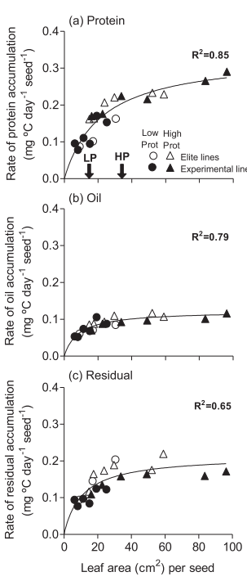
Total causal effect of the LAI on
Protein concentration
LAI per seed as a proxy for assimilates supply per seed.
Leaf area (cm²) per seed
Leaf area (cm²) per seed
Leaf area (cm²) per seed

Slide 20
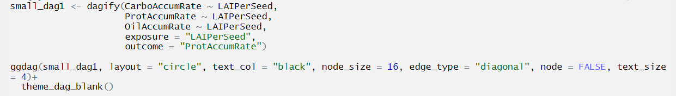
Total causal effect of the LAI on
Protein concentration
Leaf area (cm²) per seed
Leaf area (cm²) per seed
Leaf area (cm²) per seed
ggdag package

Slide 21
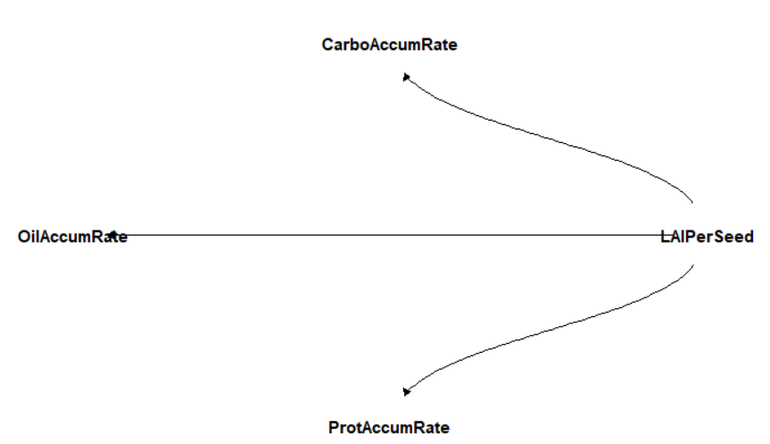
Total causal effect of the LAI on
Protein concentration
A fork is a classic confounder
Fork
LAIPerSeed is a common cause of three variables, generating a correlation between them. If we condition on LAIPerSeed, OilAccumRate tell us nothing more about ProtAccumRate.
Notes:
Conditioning on LAIPerSeed, block the path between the Oil-Prot-Carb Acumm. Rate (the three variables are now independent)

Slide 22
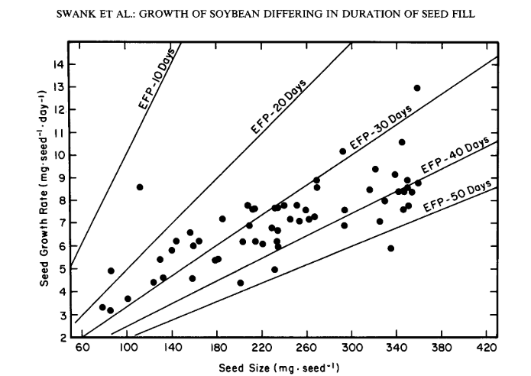
Total causal effect of the LAI on
Protein concentration
Content = rate x duration

Slide 23
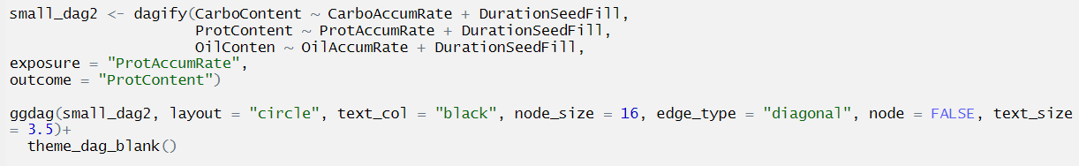
Total causal effect of the LAI on
Protein concentration
Content = rate x duration

Slide 24
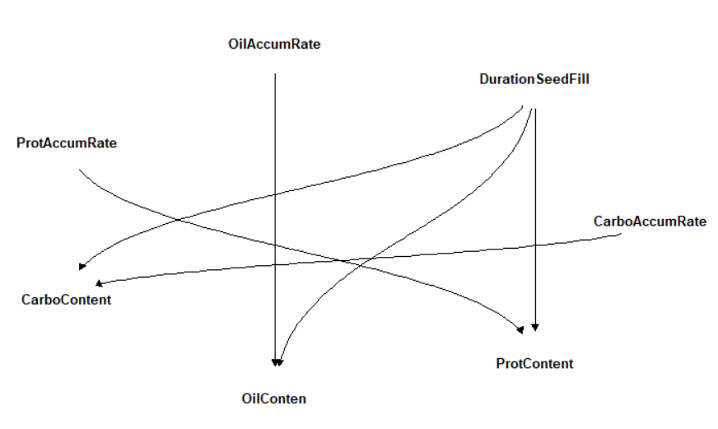
Total causal effect of the LAI on
Protein concentration
Content = rate x duration
Fork
There is no association between duration and Rate unless we condition on Content. A collider creates statistical associations between variables, not necessarily causal.
Collider
Collider
Collider

Slide 25
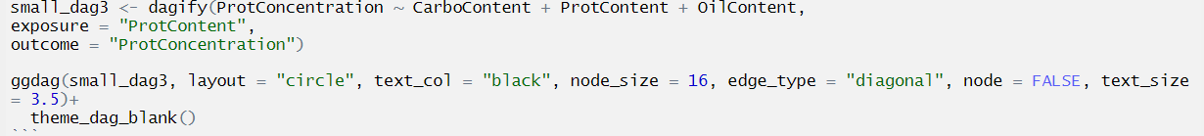
Total causal effect of the LAI on
Protein concentration
Concentration is a mathematical construct that relates the content of a particular component to the total weight of the seed (i.e. the sum of all components).
Protein Concentration (%) =
(mg protein/mg dry weight) * 100
mg of Protein + Oil + Carbohydrates

Slide 26
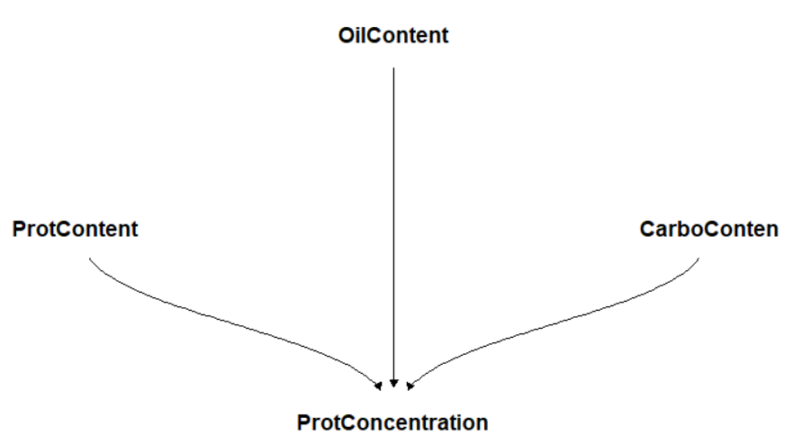
Total causal effect of the LAI on
Protein concentration
Knowing protein concentration, then learning about Protein Content also give you information about Oil and Carbo Content. The same works in reverse
Collider
This is the reason for a negative association between ProtContent and OilContent

Slide 27
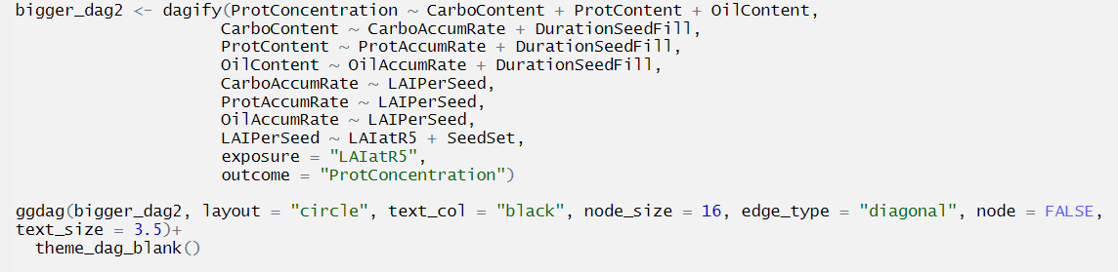
Total causal effect of the LAI on
Protein concentration
All paths together.....

Slide 28
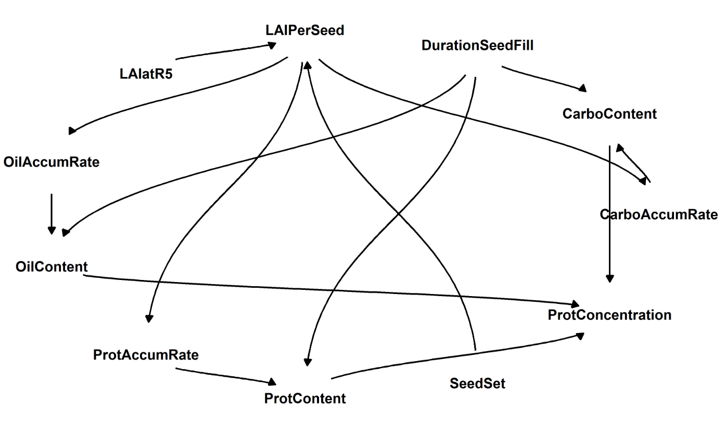
Total causal effect of the LAI on
Protein concentration

Slide 29
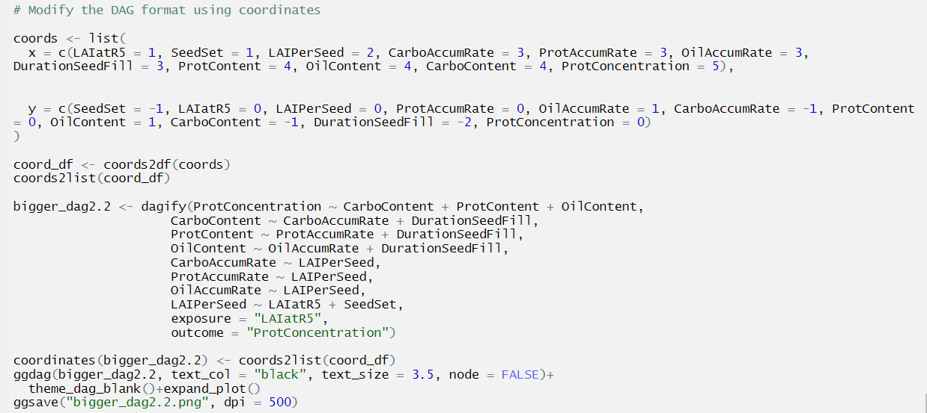
Total causal effect of the LAI on
Protein concentration

Slide 30
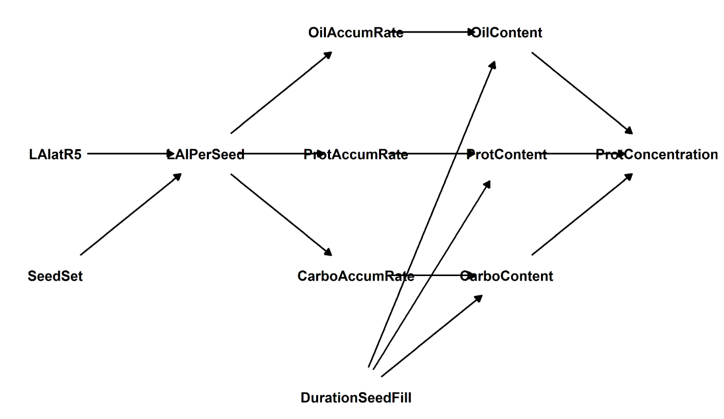
Total causal effect of the LAI on
Protein concentration

Slide 31
Total causal effect of the LAI on
Protein concentration
Many potential predictor variables, why don’t we add all of them?

Slide 32
Total causal effect of the LAI on
Protein concentration
Many potential predictor variables, why don’t we add all of them?
Multicollinearity = Strong association among predictor variables. None of the variables will be associated with the outcome. Ex = including both legs to predict height

Slide 33
Total causal effect of the LAI on
Protein concentration
Many potential predictor variables, why don’t we add all of them?
Multicollinearity = Strong association among predictor variables. None of the variables will be associated with the outcome. Ex = including both legs to predict height
Post-treatment bias = Included variables bias. Mistaken inference for including variables. Ex = including fungus and fungicide treatment to predict growth

Slide 34
Total causal effect of the LAI on
Protein concentration
Many potential predictor variables, why don’t we add all of them?
Multicollinearity = Strong association among predictor variables. None of the variables will be associated with the outcome. Ex = including both legs to predict height
Post-treatment bias = Included variables bias. Mistaken inference for including variables. Ex = including fungus and fungicide treatment to predict growth
Collider bias = When a variable is a common consequence of other variables. It generates statistical associations between the predictors. Ex = trustworthiness and newsworthiness influencing selection of proposals for funding.

Slide 35
Total causal effect of the LAI on
Protein concentration
Some variables are independent from others under certain conditions= Conditional Independencies
Which variables should be associated (or not) with one another?
Which variables become dis-associated when we condition on some other set of variables?

Slide 36
Total causal effect of the LAI on
Protein concentration
Some variables are independent from others under certain conditions= Conditional Independencies
Which variables should be associated (or not) with one another.
Which variables become dis-associated when we condition on some other set of variables.
Conditioning on a variable (Z) means learning its value and then asking if a variable X adds any additional information about Y.
If I know the value of Z, should I include X in the model to know Y??
Y || X|Z

Slide 37
Total causal effect of the LAI on
Protein concentration
Examples……

Slide 38
Total causal effect of the LAI on
Protein concentration
Examples……

Slide 39
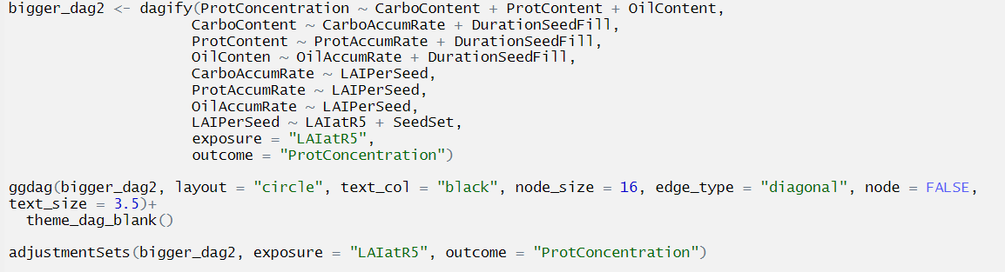
Total causal effect of the LAI on
Protein concentration
Shutting the backdoor: Blocking confounding paths between a predictor X and an outcome Y. We do not want spurious associations
Which path is open? All paths are open, unless they have a collider.
Analyze the graph and find the variables to control for in order to block the backdoor paths
No backdoor paths

Slide 40
Total causal effect of the LAI on
Protein concentration
What variables to include or not include in the DAG…….Here is the recipe:
List all the paths connecting LAI (the potential cause of interest) and seed protein concentration (the outcome).
Classify each path by whether is open or close. A path is open unless it contains a collider.
Classify each path by whether it is a backdoor path. A backdoor path has an arrow entering LAI

Slide 41
Total causal effect of the LAI on
Protein concentration

Slide 42
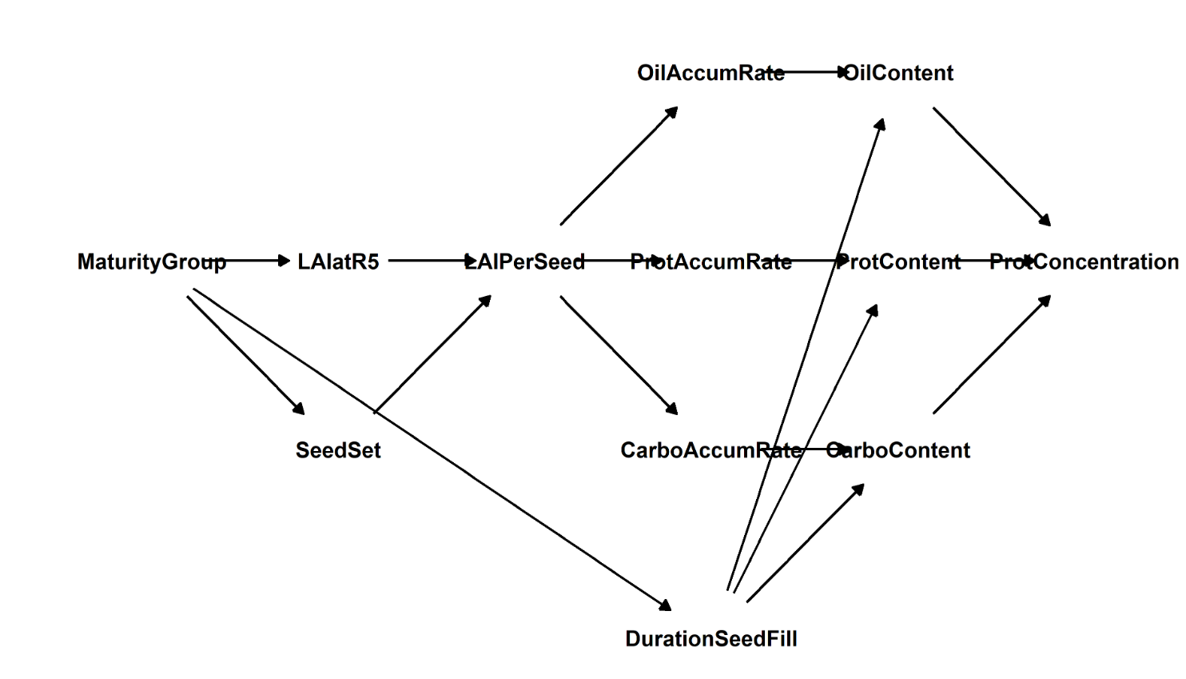
Total causal effect of the LAI on
Protein concentration
But, what if I include Maturity Group into the model…….

