Slide 1

STARMAN
By Olufemi Lowe

Slide 2
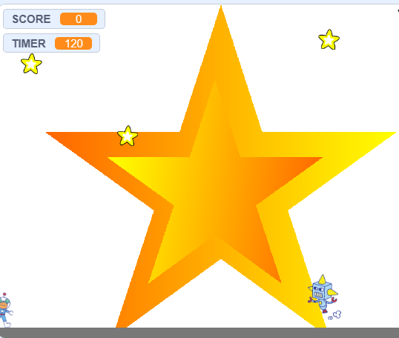
This is how the game starts.
The score is 0 and will increase when you collect stars or
diamonds or if the timer runs out.
The timer is 120 seconds and counts down to 0. At 0
the game ends and 50 points are added.
The aim of the game is to get as many points as
possible before the timer runs out while avoiding
the robot.

Slide 3
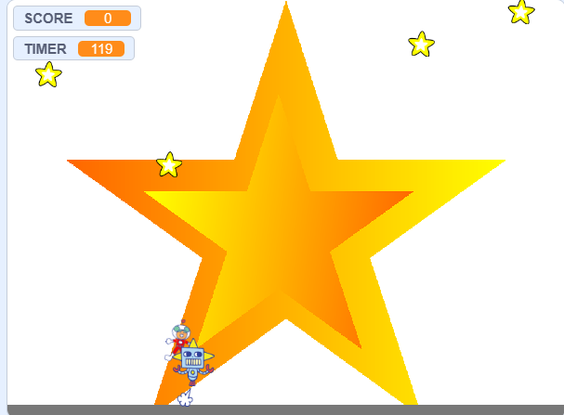
If you touch the robot then the game ends

Slide 4
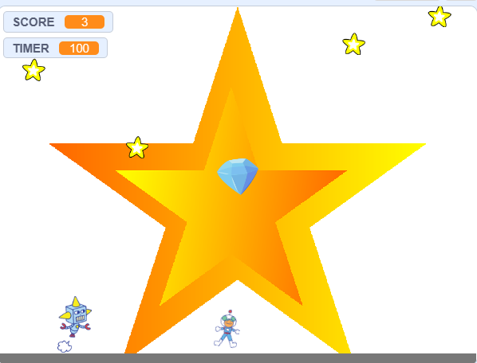
STARS when touched will add points to the score,
with more points for stars higher up. A noise will
play and it will disappear for 7 seconds.
A DIAMOND will appear at the top of the screen.
It will grow in size, so it appears to be moving
forward. It will then fall to the bottom of the
screen and disappear. It will repeat every 15
seconds. If touched by the astronaut it gives
10 points, it plays a sound, and then disappears.
The ROBOT will move from side to side until it
touches the astronaut or the timer runs out.
If it touches the astronaut a sound plays and the
game ends.
The FLOOR is a sprite. This is necessary for gravity to work.

Slide 5
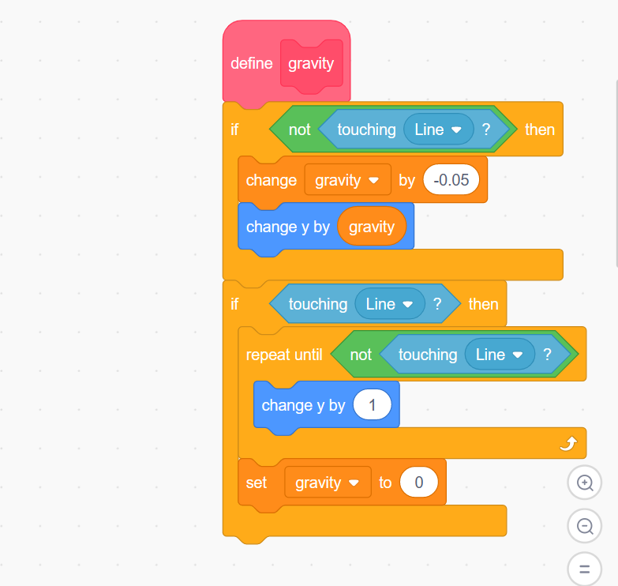
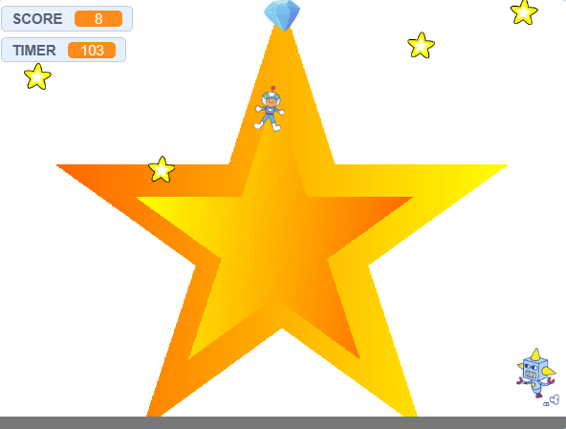
The gravity sequence allows the astronaut to have a floating effect when jumping. It affects how much the astronaut is pulled
towards the floor sprite when they jump.

