Slide 1
PES Exploration

Slide 2
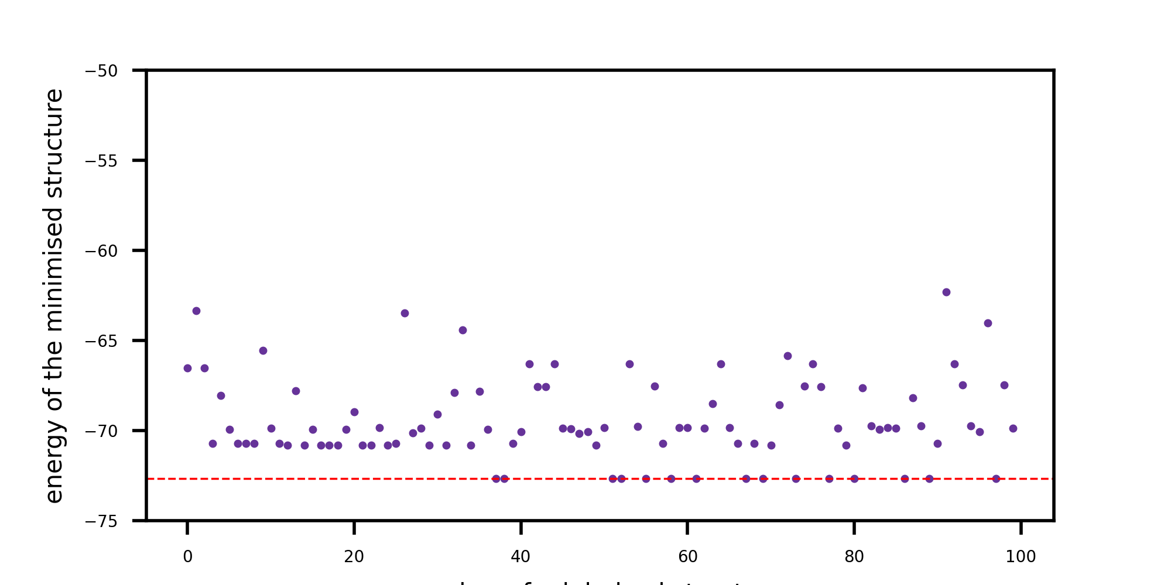
Wild
'wild' randomly selects one atom and moves it in a random direction by a random distance.
The distance is randomly distributed between 0.0 and the `magnitude` variable.
Number of iterations
Tested magnitude = 1, 2, 3, 4, 5, 6, 8, 12
Best-performing: magnitude = 8 (minimum found in 38 iterations).
At low magnitude, pertubations were insignificant and would stay at the same energy for many iterations.
However, at magnitude = 12, perturbation was too significant and the minima was never found

Slide 3
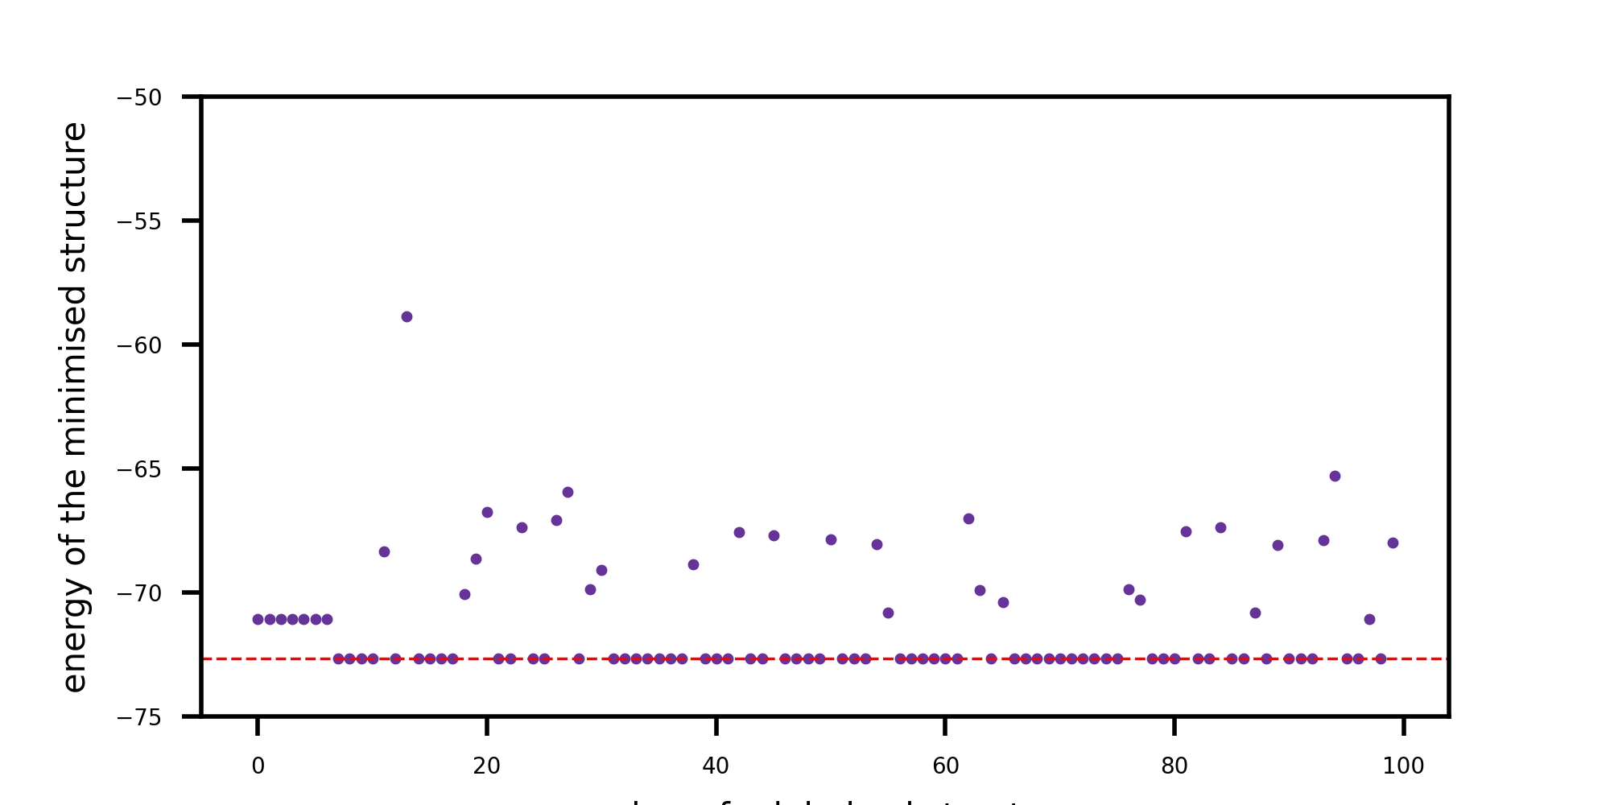
Stretch
'stretch' calculates the centroid of the cluster, then moves all the atoms away from that centroid.
Each of the atoms is moved by a random distance, randomly distributed between 0.0 and the `magnitude` variable
Number of iterations
Tested magnitude = 0.5, 1, 2, 3, 4, 6, 8, 12
Best-performing: magnitude = 0.5 (minimum found in 9 iterations), shown above
Generally increasing the magnitude perturbed the structure so much such that it would hop out of a lower energy basin into a higher energy basin.

Slide 4
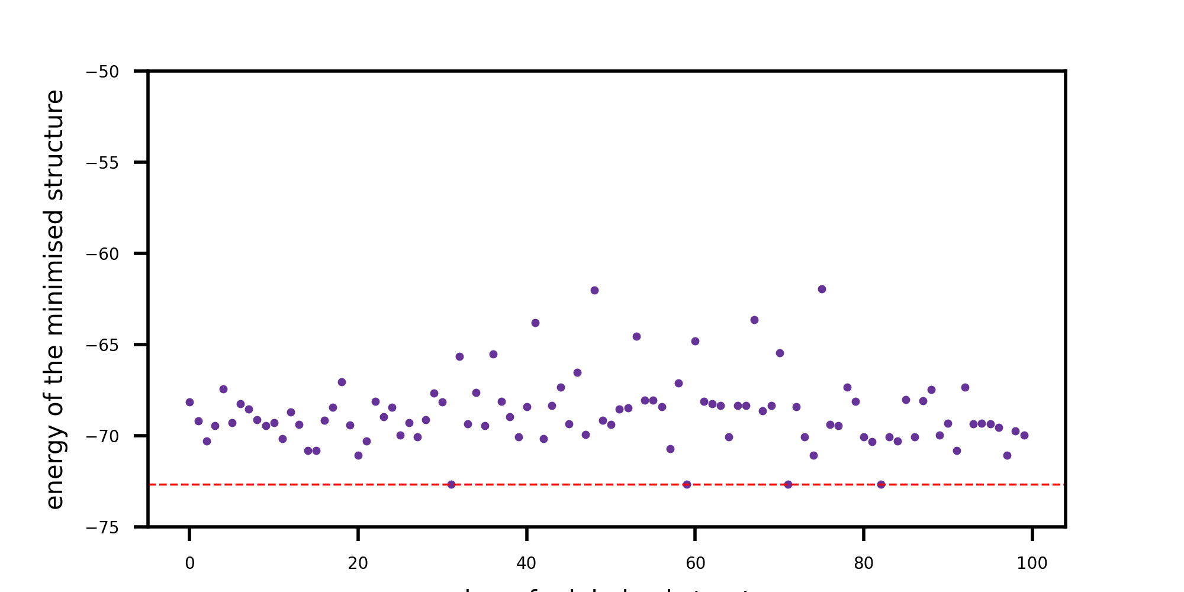
Sweep
'sweep' determines the k-furthest atoms from the cluster centroid, and moves each of these atoms in a random direction by a random distance, randomly distributed between 0.0 and the `magnitude` variable.
Based on the idea that the core of the cluster is likely stable, but the outermost atoms are those that need to be displaced.
Number of iterations
Tested magnitude = 1, 2, 3, 4, 5, 6, 8, 12
Best-performing: was magnitude = 6, minimising in 32 iterations.
Generally, low magnitude pertubations were too insignificant to escape basins of attraction, whilst, higher than mag = 6 resulted in poorer performance as perturbations consistently escaped to higher energy minima.
In future could explore different numbers of atoms to perturb (k)

Slide 5
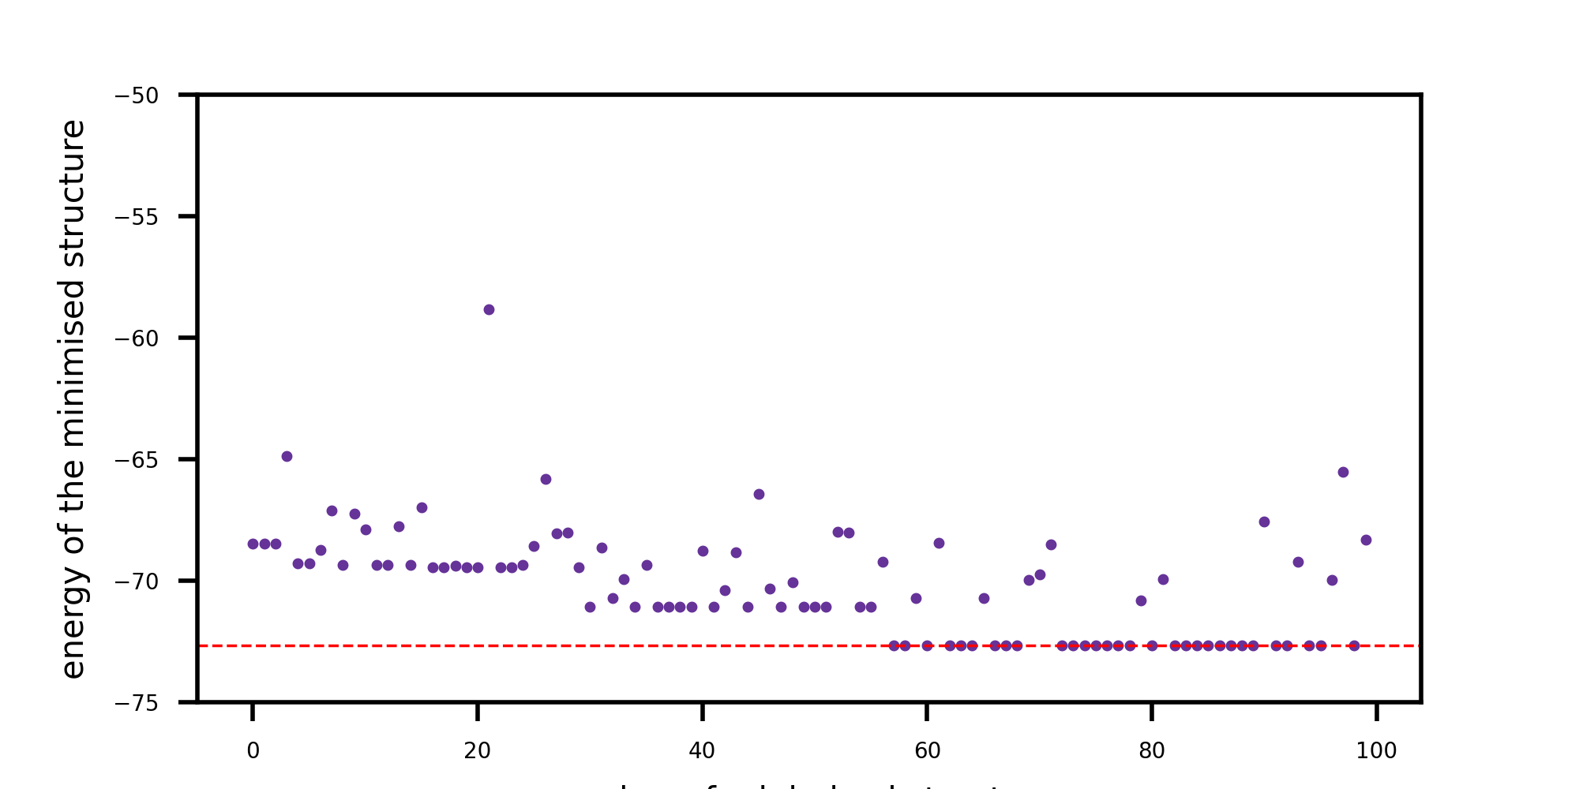
Swap
'swap' exchanges two random atoms coordinates, but only one component.
e.g. randomly swap the x coordinate of atom a with the z coordinate of atom b, or randomly swap the y coordinate of atom a with the y coordinate of atom b.
Number of iterations
No variable to modify, minimization achieved in 67 steps.

