Slide 1




Data Analyst Capstone Project: Stack Overflow Developer Survey Data
Vijay Asia
March 23, 2026
© IBM Corporation. All rights reserved.

Slide 2

OUTLINE
Executive Summary
Introduction
Methodology
Results
Visualization Charts
Dashboard Overview
Discussion
Key Findings and Implications
Conclusion
Appendix

Slide 3
EXECUTIVE SUMMARY
Framing Data and Objectives
Defines the dataset scope and key analysis goals.
Methodology Overview
Data collection methods
Analytical approach
Visualization techniques
Results Presentation
Displays findings using charts and trends.
Discussion of Findings
Interprets key results and their implications.
Conclusion
Summarizes insights and overall outcomes.

Slide 4
INTRODUCTION
The Stack Overflow Developer Survey captures insights from developers worldwide and provides a comprehensive view of the technologies currently being used and the tools and technologies developers aspire to adopt in the future.
The project aims to analyze global trends in the developer ecosystem, identify key patterns in technology preferences, and uncover potential correlations between developer demographics and their tool choices.
The dataset used has been filtered and pre-processed to ensure consistency and reliability..
The project combines data wrangling, exploratory analysis, and visualization techniques. to present actionable insights about the current and future state of technology adoption in the developer community.

Slide 5
METHODOLOGY
The Stack Overflow Developer Survey provides comprehensive insights into technologies currently used by developers worldwide, as well as the tools they aspire to adopt in the future.
This project aims to analyze global trends within the developer ecosystem, identify patterns in technology preferences, and explore potential relationships between developer demographics and their tool choices.
The dataset has been carefully filtered and pre-processed to ensure accuracy, consistency, and reliability of the analysis.
The study integrates data wrangling, exploratory data analysis, and visualization techniques to generate actionable insights into both current and emerging technology adoption trends within the developer community.

Slide 6
RESULTS
The analysis reveals clear trends in both current and future technology usage among developers. While widely used programming languages and tools remain dominant, there is a growing interest in modern, scalable, and cloud-based technologies.
The visualizations further highlight variations in preferences across different regions and experience levels, suggesting that demographic factors influence technology adoption. Overall, the results indicate a gradual shift toward emerging technologies within the developer ecosystem.
.

Slide 7
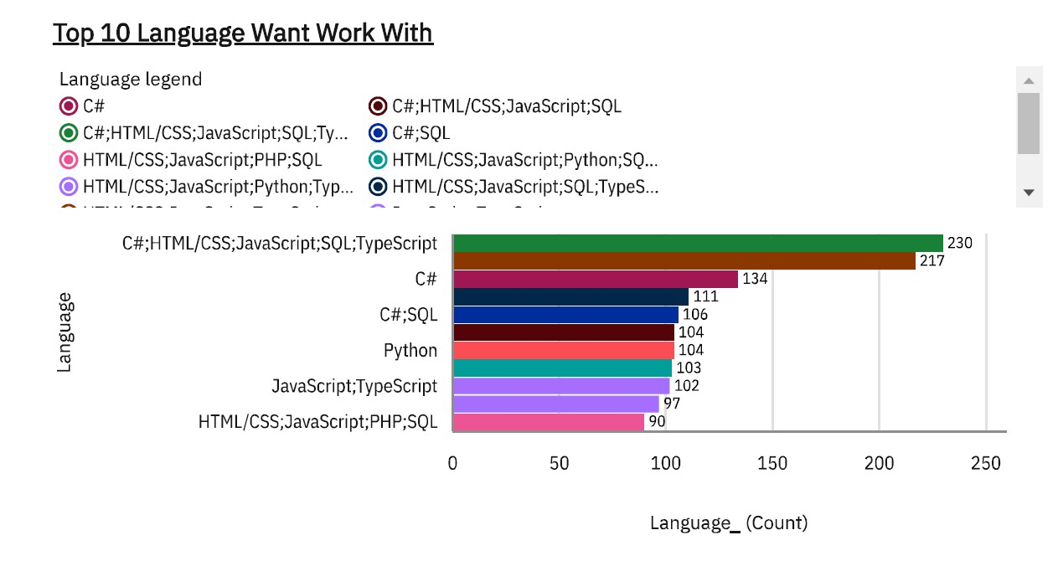
Programming Language Trends
Next Year

Slide 8
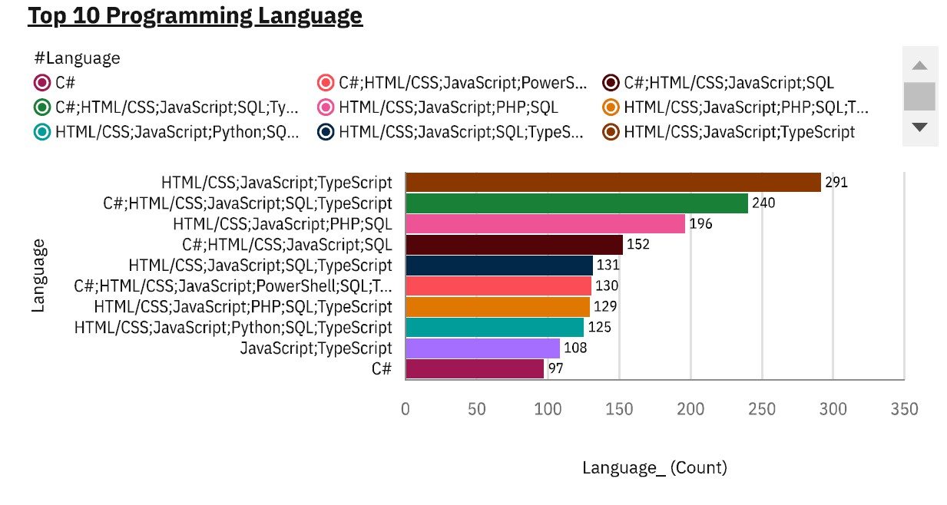
Programming Language Trends
Current Year

Slide 9
Programming Language Trends: Findings and Implications
Findings
JavaScript, HTML/CSS, and TypeScript remain the most dominant programming languages across both current and future usage.
C# shows a notable increase in preference, indicating growing developer interest for future adoption.
SQL and Python demonstrate consistent and stable demand across both periods.
Implications
Current trends show developers working with multiple languages simultaneously, whereas future preferences suggest a shift toward specializing in fewer, high-impact technologies.
Developers and students are encouraged to upskill in in-demand languages such as C# and SQL to enhance career opportunities

Slide 10
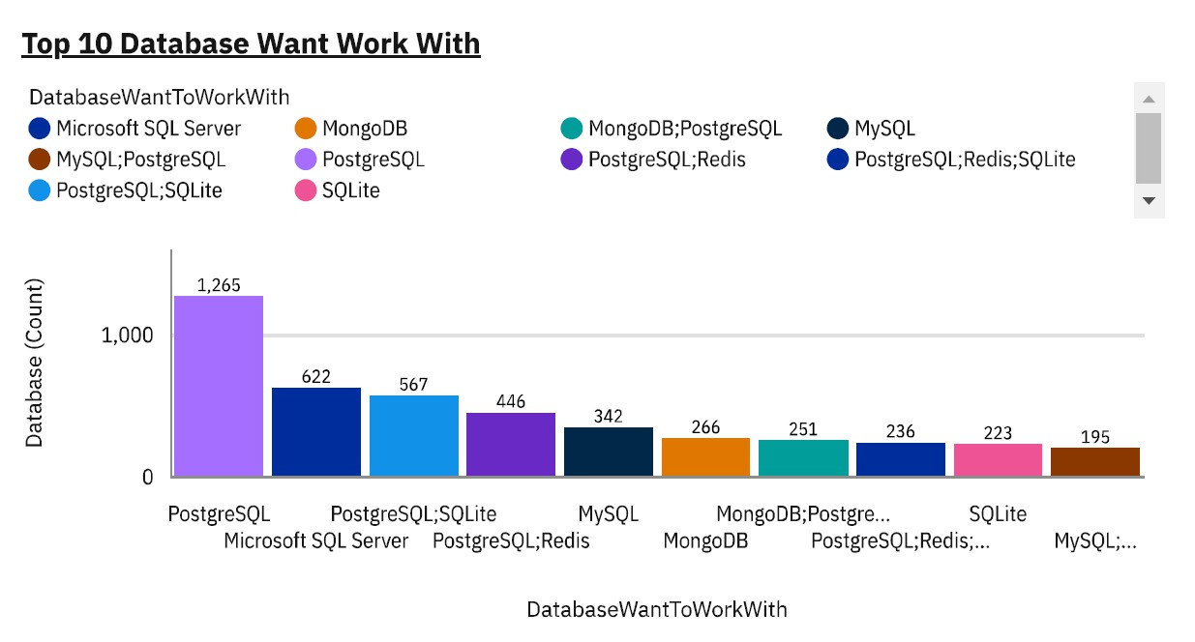
Database Trends
Next Year

Slide 11
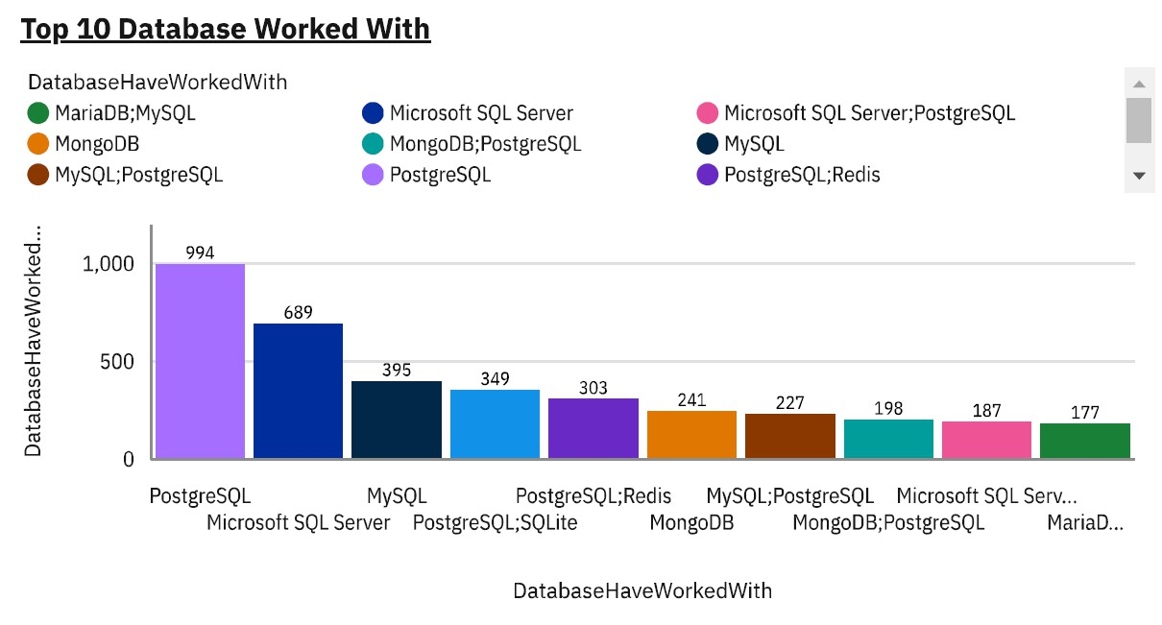
Database Trends
Current Year

Slide 12
Database Trends: Findings and Implications
Findings
PostgreSQL shows increased dominance, reflecting growing developer preference.
Microsoft SQL Server remains widely used but demonstrates only modest growth.
SQLite gains significant interest, emerging among the top databases for future use, which highlights demand for lightweight and embedded solutions.
MongoDB and other NoSQL databases, alongside tools like Redis, are gaining traction within the developer community.
Implications
The rising popularity of SQLite suggests increased development of mobile and lightweight applications.
The growing adoption of MongoDB and Redis indicates a shift toward NoSQL and hybrid database architectures.
Developers are increasingly favoring flexible and scalable database solutions, signaling continued integration of NoSQL technologies in modern application development.

Slide 13
OVERALL FINDINGS & IMPLICATIONS
Findings Implications
PostgreSQL is becoming the dominant database, with usage increasing significantly, while SQLite is also gaining traction for lightweight applications.
C# and SQL are growing in demand, while JavaScript remains strong but shows a slight decline in preference.
Cloud adoption is expanding beyond AWS, with Google Cloud and Digital Ocean gaining traction, although AWS remains the leader.
React, Spring Boot, and FastAPI are the most desired web frameworks, with FastAPI showing a surge in interest, indicating the rise of Python-based API development.
Developers should focus on PostgreSQL, C#, and
Python to align with market demand.
Businesses should invest in multi-cloud strategies (AWS, Azure, Google Cloud) to attract talent and stay competitive.
Companies shifting toward API-driven architectures should consider Python & FastAPI, as they are becoming essential in modern development.

Slide 14
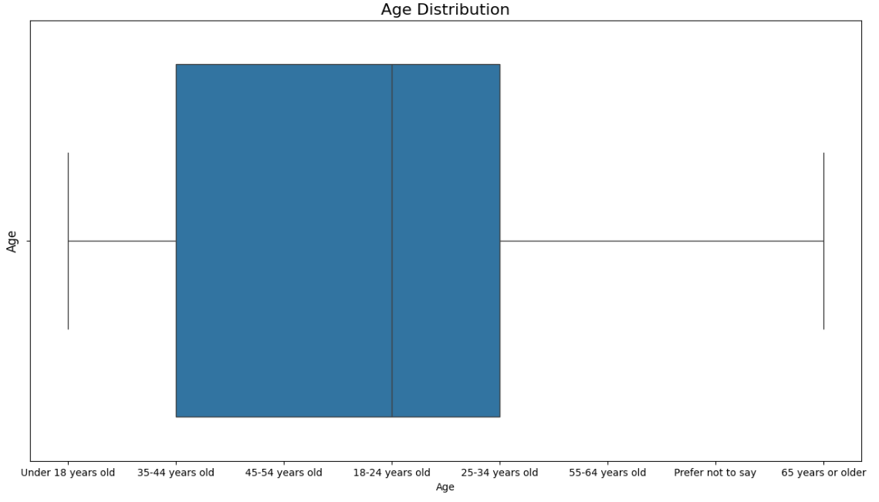
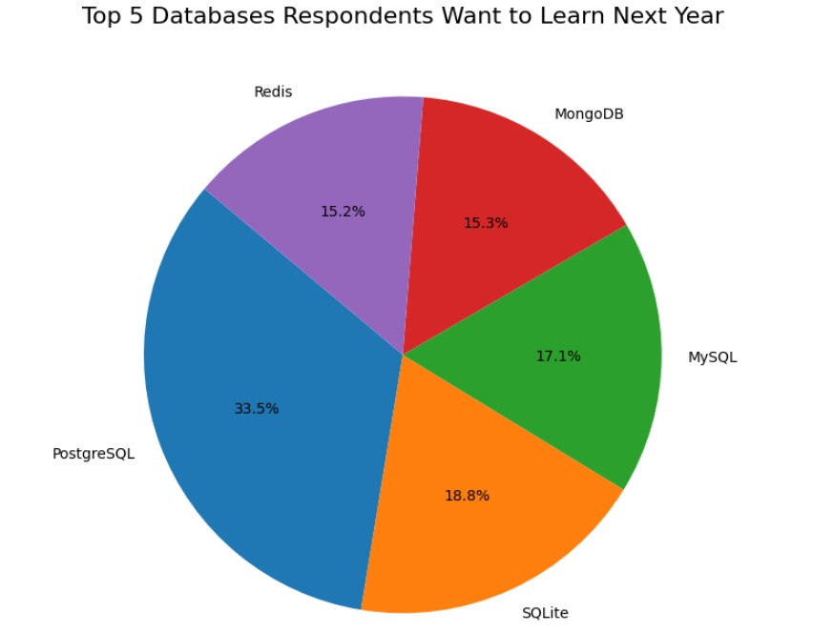
AGE/DATABASESE

Slide 15





JOB POSTINGS
Jobs Posting for Each Technology
C
13,498
Java
2,609
Python
1,173
Oracle
784
JavaScript
355
Technology
C#
333
C++
305
SQL Server
250
MongoDB
174
Scala 33
PostgreSQL 10
MySQL Server
0
0
2,000
4,000
6,000
8,000
Number of Jobs
10,000
12,000
14,000
16,000

Slide 16
POPULAR LANGUAGES
Popular Languages
Swift
130,801
Python
114,383
C++
113,865
Javascript
110,981
Language
Java
101,013
Go
94,082
R
92,037
C#
88,726
SQL
84,793
PHP
84,727
60,000 80,000
Average Annual Salary
0
20,000
40,000
100,000
120,000
140,000

Slide 17
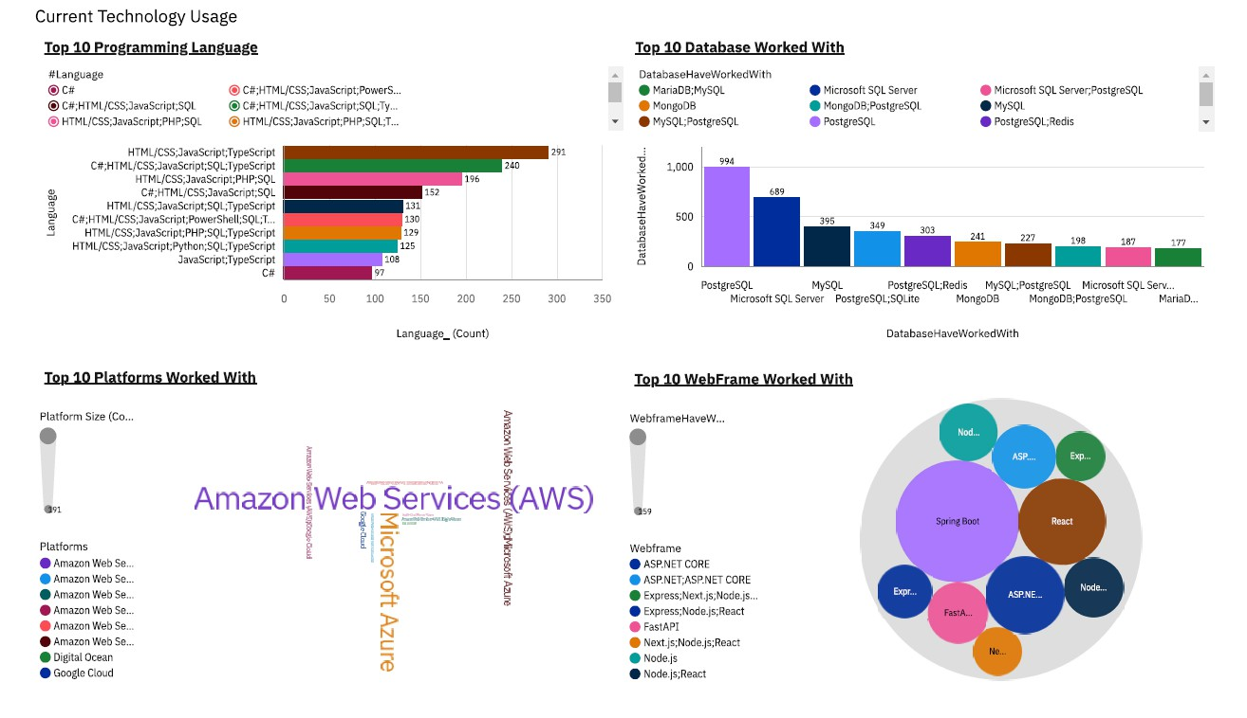
Tab 1

Slide 18
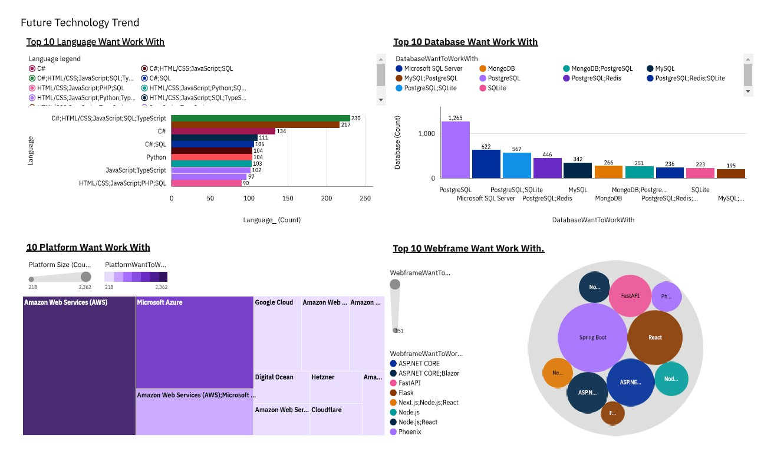
Tab 2

Slide 19
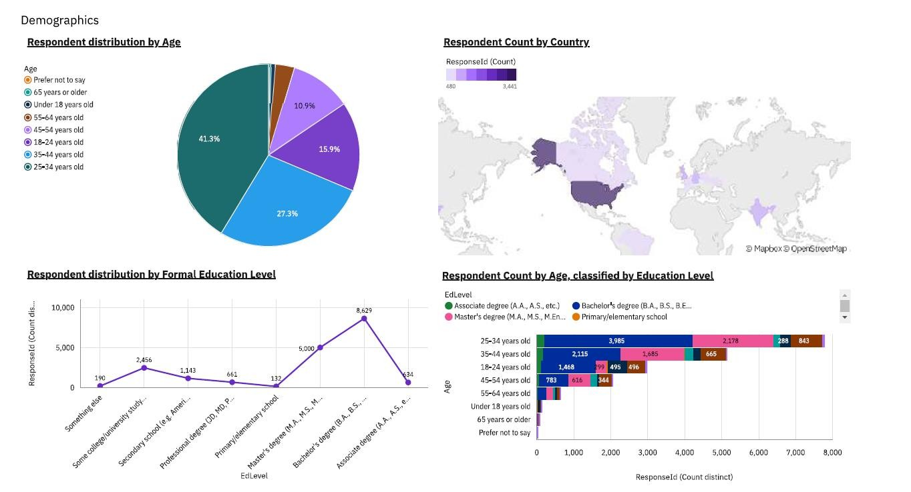
Tab 3

Slide 20
CONCLUSION
PostgreSQL remains the leading database, demonstrating strong growth, while SQLite is emerging as a key solution for lightweight and embedded applications.
C# and SQL are gaining momentum, reflecting a shift toward backend and enterprise-focused development, whereas JavaScript continues to be widely used despite a slight decline.
Cloud adoption is becoming more diverse, with platforms such as Google Cloud and DigitalOcean increasing in popularity, although AWS continues to dominate the market.
Frameworks such as React, Spring Boot, and FastAPI are shaping the future of web development, with FastAPI’s rapid adoption highlighting the growing importance of Python-based API development.

Slide 21
APPENDIX
This section provides supplementary materials that support the analysis and findings presented in this study. It includes additional datasets, visualizations, and supporting charts used during the exploratory and analytical phases of the project.
Additional Visualizations: Extended charts illustrating job postings by technology, popular programming languages, and salary distributions across different technologies.
Dataset Overview: The dataset is derived from the Stack Overflow Developer Survey and was pre-processed to ensure accuracy, consistency, and reliability before analysis.
Dashboard Tabs: Supporting dashboard components, including multiple tabs (Tab 1, Tab 2, Tab 3), showcasing different perspectives of the data such as technology usage, trends, and demographic insights.
Supporting Figures: Graphs such as “Jobs Posting for Each Technology” and “Popular Languages” used to validate trends and reinforce key findings discussed in the results section.

