Slide 1
Slide 1
GC Interference Reduction for Clouds
Elinor Tsen
Supervisor: Panos Patros

Slide 2

Slide 12
Garbage collection (GC)
Manages memory
Resource Intensive
Unpredictable
User can adjust GC before runtime or invoke GC during runtime

Slide 3

Slide 12
Garbage collection (GC) – IBM OpenJ9 JVM
GC Policies
OptThruPut
OptAvgPause
Balanced
GenCon

Slide 4
Slide 12
Problem
Meeting Service Level Objectives in multi-tenanted* environments with performance interference**
*Multi-tenancy – resource sharing by multiple users co-located in the same virtual machine / environment¹
**Performance interference – resource usage by one tenant affects resource usage of another tenant²
AlJahdali, H., Albatli, A., Garraghan, P., Townend, P., Lau, L., & Xu, J. (2014, April). Multi-tenancy in cloud computing. In 2014 IEEE 8th International Symposium on Service Oriented System Engineering (pp. 344-351). IEEE.
Pu, X., Liu, L., Mei, Y., Sivathanu, S., Koh, Y., & Pu, C. (2010, July). Understanding performance interference of i/o workload in virtualized cloud environments. In 2010 IEEE 3rd International Conference on Cloud Computing (pp. 51-58). IEEE.

Slide 5
Slide 12
Multi-tenancy
VM 2
VM 1
VM 1
Single tenant
Multitenant

Slide 6
Slide 13
Solutions suggested by literature
IMPROVING RESOURCE INTENSIVENESS OF PROCESSES
SCALING RESOURCES
IMPROVING MONITORING OF SLOS
OPTIMISING VIRTUAL MACHINES

Slide 7





Slide 3
Chosen Solution
CONTROL THEORY
SELF
ADAPTATION
GAME THEORY
A Cat On A Bed

Slide 8

Slide 7
A Cat On A Bed
VARIABLE 1
VARIABLE 2
VARIABLE 3
Heap size
Interval between local GC’s
Number of GC threads

Slide 9



Slide 7
A Cat On A Bed – Development phases
CatNap
Circling
Cat’s Meow
Naïve threshold based adjustments
PID controller
LQR controller

Slide 10


Slide 7
A Cat On A Bed – Testing methodology
4 CPU cores and 8 CPU cores
Repeated 16 time

Slide 11
Slide 12
CatNap - Development
I.E
If GC utilisation > 10%:
Decrease number of GC threads by 1 if possible
Else if GC utilisation < 5%
Increase number of GC threads by 1 if possible

Slide 12
Slide 12
Variables
CatNap – JVM versions
Decrease resource utilisation
Heap Size
Interval
Threads
`
JDKA
✓
JDKB
✓
JVM Names
JDKD
✓
JDKE
JDKF
JDKG
✓
✓
JDKI
✓
✓
JDKP
✓
✓
JDKR
✓
✓
✓

Slide 13
Slide 12
CatNap - Findings
Found no consistent relationship between variables and GC utilisation
Can cause out of memory errors
But, some improvements in GC utilisation

Slide 14
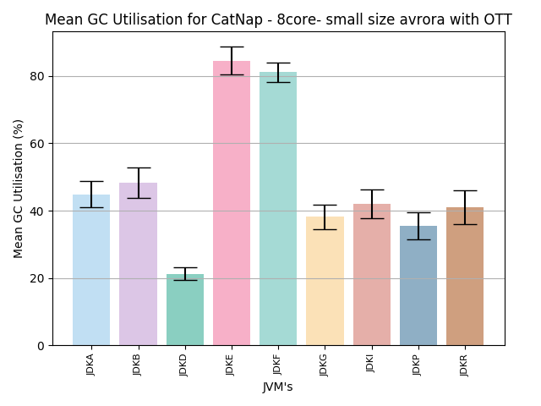
Slide 12
CatNap - Findings

Slide 15
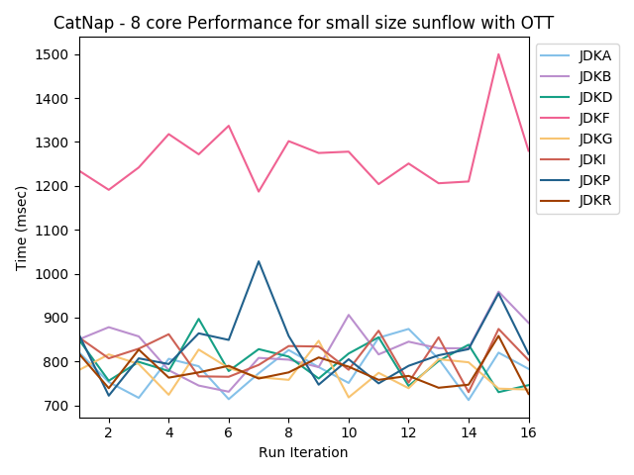
Slide 12
CatNap - Findings

Slide 16
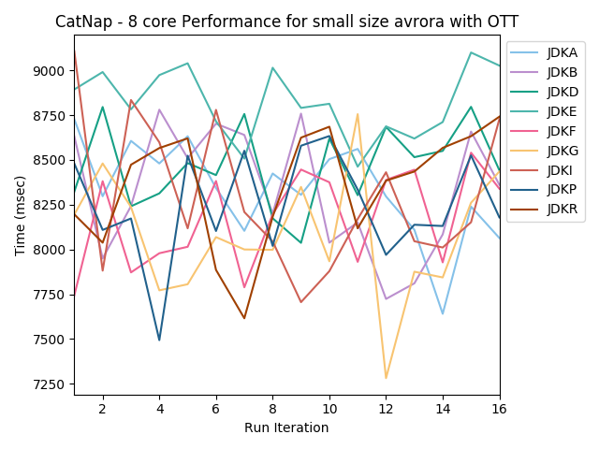
Slide 12
CatNap - Findings

Slide 17
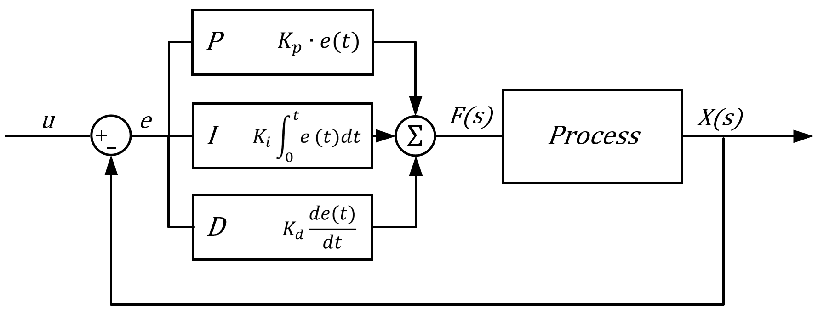
Slide 12
Circling - Development
Dewesoft Training. (n.d.). PID Control. Retrieved from https://dewesoft.pro/images/uploads/PIDfront.PNG
Notes:
Proportional tuning involves correcting a target proportional to the difference. Thus, the target value is never achieved because as the difference approaches zero, so too does the applied correction.
Integral tuning attempts to remedy this by effectively cumulating the error result from the "P" action to increase the correction factor. For example, if the oven remained below temperature, “I” would act to increase the head delivered. However, rather than stop heating when the target is reached, "I" attempts to drive the cumulative error to zero, resulting in an overshoot.
Derivative tuning attempts to minimize this overshoot by slowing the correction factor applied as the target is approached.

Slide 18
Slide 12
Circling - Development
I.E
If GC utilisation > 10%:
Decrease number of GC threads by 1 if possible
Else if GC utilisation < 5%
Increase number of GC threads by 1 if possible

Slide 19
Slide 12
Circling – JVM versions
I.E
K_{P}
K_{D}
JDK 0.5-0.5-1
K_{I}

Slide 20
Slide 12
Circling – JVM versions
JDK0.5-0.5-1
JDK0.5-1-0.5
JDK0.5-1-1
JDK0.5-1-1.5
JDK1.5-1-1.5
JDKE
JDK1-1-0.5
JDK1-1-1
JDKF
JDK1.5-1-0.5
JDK1.5-1-1

Slide 21
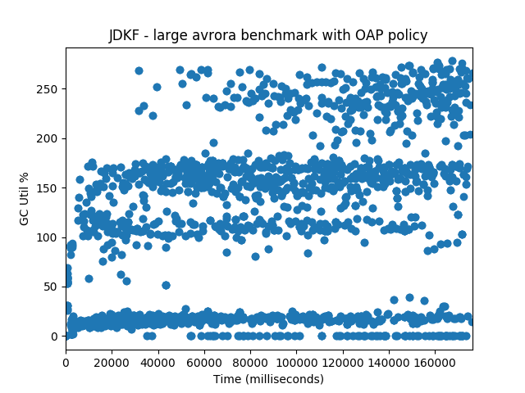
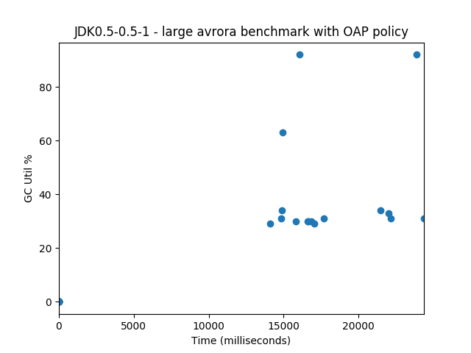
Slide 12
Circling - Findings

Slide 22
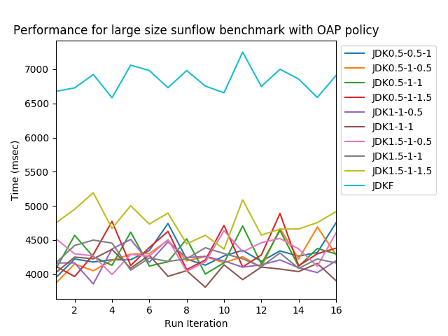
Slide 12
Circling - Findings

Slide 23
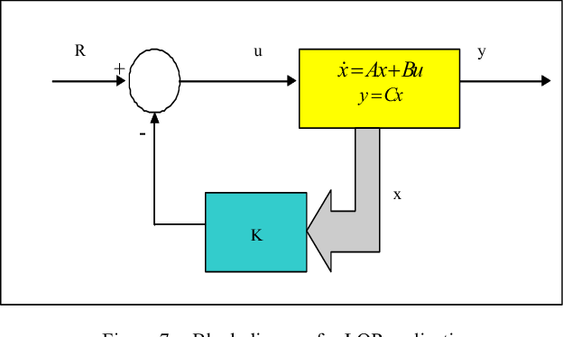
Slide 12
Cat’s Meow - Development
Ahmad, S. and Tokhi, M. (2011). Block diagram for LQR realisation. Retrieved from https://ai2-s2-public.s3.amazonaws.com/figures/2017-08-08/1e81356d35952fb0a2f963428d92f78690a5ffd9/5-Figure7-1.png
Notes:
automated way of finding an appropriate state-feedback controller

Slide 24
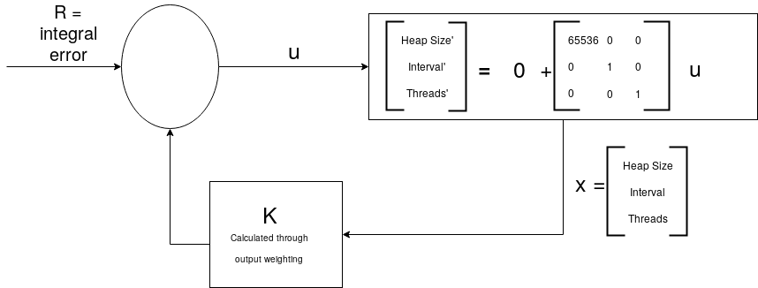
Slide 12
Cat’s Meow - Development
Notes:
automated way of finding an appropriate state-feedback controller

Slide 25
Slide 12
Cat’s Meow– JVM versions
I.E
K_{P}
K_{D}
JDK 8-9-9
K_{I}

Slide 26
Slide 12
Cat’s Meow – JVM versions
JDK1-1-3
JDK3-2-1
JDK8-9-9
JDK2-2-1
JDK3-2-3
JDKE
JDK2-3-2
JDK5-4-4
JDKF
JDK2-2-2
JDK5-6-7

Slide 27
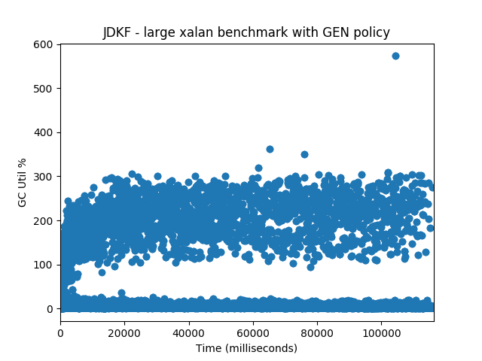
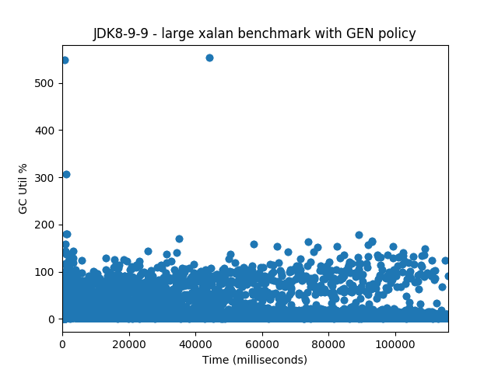
Slide 12
Cat’s Meow - Findings

Slide 28
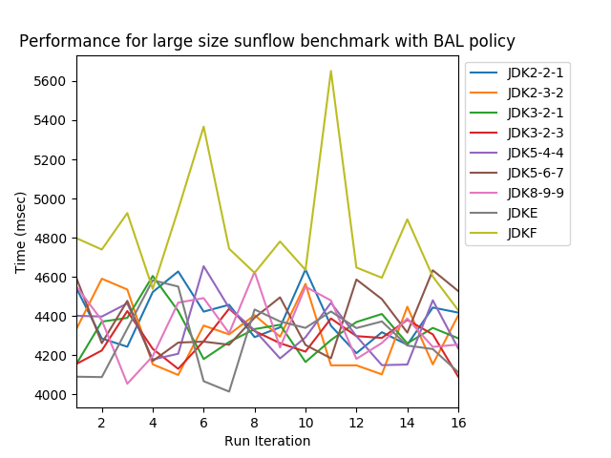
Slide 12
Cat’s Meow - Findings

Slide 29
Slide 12
Many Cats on a Bed – Game theory
Tenant 1
Increase resource utilisation
Decrease resource utilisation
Do nothing
`
Tenant 2
Increase resource utilisation
-5, -5
10, -5
-5, -2.5
Decrease resource utilisation
-5, 10
5, 5
-2.5, 2.5
Do nothing
-2.5, -5
2.5, -2.5
-2.5, -2.5

Slide 30
Slide 12
Many Cats on a Bed - Findings
Single VM testing: DaCapo benchmarks
Modified JVMs have better performance than original JVM for some benchmark
Notes:
Kubernetes
Game theory
Why graphs not on same axis, etc

Slide 31
Slide 7
A Cat On A Bed – final thoughts

Slide 32
Slide 15
ANY QUESTIONS?

