Slide 1
TUPLES, LISTS, ALIASING, MUTABILITY, CLONING
(download slides and .py files and follow along!)
COP1000 - LEC5

Slide 2
LAST TIME
functions
decomposition – create structure
abstraction – suppress details
from now on will be using functions a lot

Slide 3
TODAY
have seen variable types: int, float, bool,string
introduce new compound data types
tuples
lists
idea of aliasing
idea of mutability
idea of cloning

Slide 4
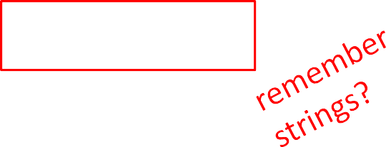

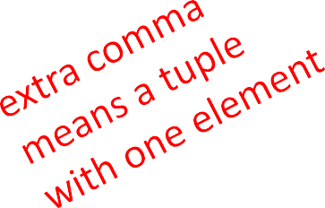
TUPLES
an ordered sequence of elements, can mix element types
cannot change element values, immutable
represented with parentheses
te = ()
t = (2,"mit",3) t[0]
(2,"mit",3) + (5,6)
→ evaluates to 2
→ evaluates to (2,"mit",3,5,6)
t[1:2]
t[1:3]
len(t)
→ slice tuple, evaluates to ("mit",)
→ slice tuple, evaluates to ("mit",3)
→ evaluates to 3
t[1] = 4 → gives error, can’t modify object

Slide 5

TUPLES
conveniently used to swap variable values
x = y
y = x
temp = x x = y
y = temp
(x, y) = (y, x)
used to return more than one value from a function
def quotient_and_remainder(x, y): q = x // y
r = x % y
return (q, r)
(quot, rem) = quotient_and_remainder(4,5)

Slide 6



MANIPULATING TUPLES
aTuple:(( ),( ),( ))
can iterate over tuples
nums( )
def get_data(aTuple):
words( ? ? ? )
if not already in words
i.e. unique strings from aTuple
nums = ()
words = ()
for t in aTuple: nums = nums +
(t[0],)
if t[1] not in words:
words = words + (t[1],)
min_n = min(nums) max_n = max(nums)
unique_words = len(words)
return (min_n, max_n, unique_words)

Slide 7
LISTS
ordered sequence of information, accessible by index
a list is denoted by square brackets, []
a list contains elements
usually homogeneous (ie, all integers)
can contain mixed types (not common)
list elements can be changed so a list is mutable

Slide 8

INDICES AND ORDERING
a_list =
[]
L = [2, 'a', 4, [1,2]]
len(L) | → | evaluates to 4
L[0] | → | evaluates to 2
L[2]+1 | → | evaluates to 5
L[3]
L[4]
i = 2 L[i-1]
→ evaluates to [1,2], another list!
→ gives an error
→ evaluates to ‘a’ since L[1]='a' above

Slide 9

CHANGING ELEMENTS
lists are mutable!
assigning to an element at an index changes the value
L = [2, 1, 3]
L[1] = 5
L is now [2, 5, 3], note this is the same object L
[2,5,3]
L

Slide 10
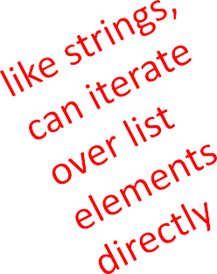
ITERATING OVER A LIST
compute the sum of elements of a list
common pattern, iterate over list elements
total = 0
for i in range(len(L)): total += L[i]
print total
notice
list elements are indexed 0
total = 0 for i in
L:
total += i print total
to len(L)-1
range(n) goes from 0 to n-1

Slide 11
OPERATIONS ON LISTS - ADD
add elements to end of list with L.append(element)
mutates the list!
L = [2,1,3]
L.append(5) → L is now [2,1,3,5]
what is the dot?
lists are Python objects, everything in Python is an object
objects have data
objects have methods and functions
access this information by object_name.do_something()
will learn more about these later

Slide 12
OPERATIONS ON LISTS - ADD
to combine lists together use concatenation, + operator, to give you a new list
mutate list with L.extend(some_list)
L1 | = | [2,1,3]
L2 | = | [4,5,6]
L3 | = | L1 + L2 | → | L3 is [2,1,3,4,5,6] L1, L2 unchanged
L1.extend([0,6])
→ mutated L1 to [2,1,3,0,6]

Slide 13
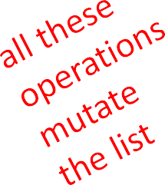
OPERATIONS ON LISTS - REMOVE
delete element at a specific index with del(L[index])
remove element at end of list with L.pop(), returns the removed element
remove a specific element with L.remove(element)
looks for the element and removes it
if element occurs multiple times, removes first occurrence
if element not in list, gives an error
L = [2,1,3,6,3,7,0] # do below in order L.remove(2) → mutates L = [1,3,6,3,7,0] L.remove(3) → mutates L = [1,6,3,7,0]
del(L[1])
L.pop()
→ mutates L = [1,3,7,0]
→ returns 0 and mutates L = [1,3,7]

Slide 14
CONVERT LISTS TO STRINGS AND BACK
convert string to list with list(s), returns a list with every character from s an element in L
can use s.split(), to split a string on a character parameter, splits on spaces if called without a parameter
use ''.join(L) to turn a list of characters into a string, can give a character in quotes to add char between every element
s = "I<3 cs" list(s) s.split('<')
L = ['a','b','c']
''.join(L)
'_'.join(L)
→ s is a string
→ returns ['I','<','3',' ','c','s']
→ returns ['I', '3 cs']
→ L is a list
→ returns "abc"
→ returns "a_b_c"

Slide 15
OTHER LIST OPERATIONS
sort() and sorted()
reverse()
and many more! https://docs.python.org/3/tutorial/datastructures.html
L=[9,6,0,3]
sorted(L) L.sort() L.reverse()
→ returns sorted list, does not mutate L
→ mutates L=[0,3,6,9]
→ mutates L=[9,6,3,0]

Slide 16
MUTATION, ALIASING, CLONING
IMPORTANT
and TRICKY!
Again, Python Tutor is your best friend to help sort this out!
http://www.pythontutor.com/

Slide 17
LISTS IN MEMORY
lists are mutable
behave differently than immutable types
is an object in memory
variable name points to object
any variable pointing to that object is affected
key phrase to keep in mind when working with lists is
side effects

Slide 18
AN ANALOGY
attributes of a person
singer, rich
he is known by many names
all nicknames point to the same person
add new attribute to one nickname …
Justin Bieber singer rich troublemaker
… all his nicknames refer to old attributes AND all new ones The Bieb singer rich troublemaker JBeebs singer rich troublemaker

Slide 19
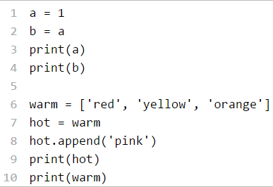
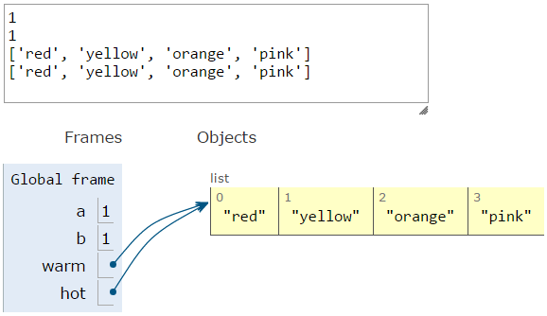
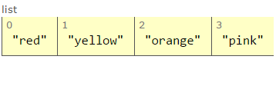
ALIASES
hot is an alias for warm – changing one changes the other!
append() has a side effect

Slide 20
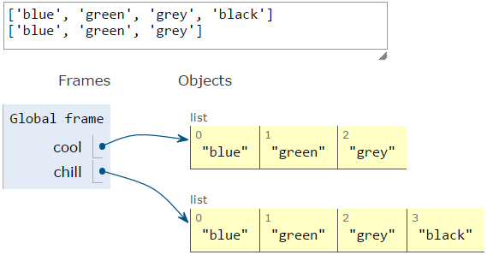
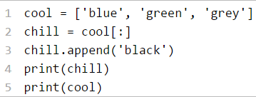
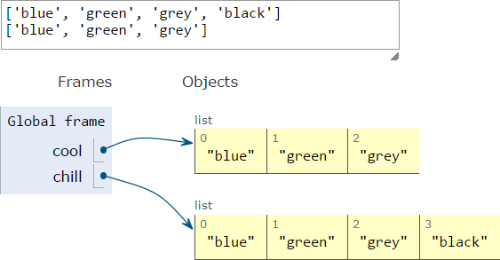
CLONING A LIST
create a new list and copy every element using
chill = cool[:]

Slide 21
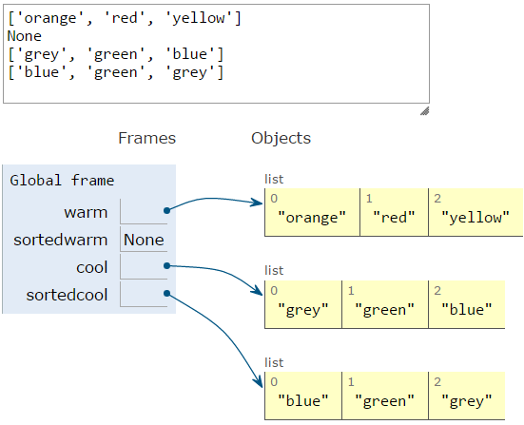
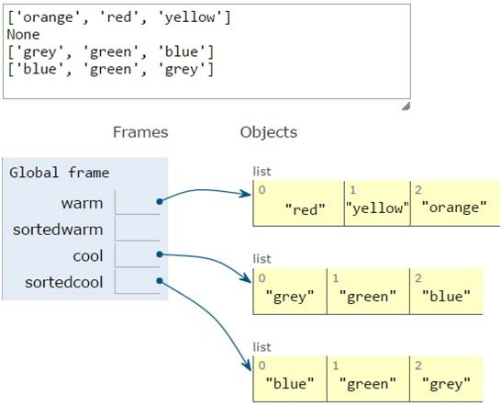
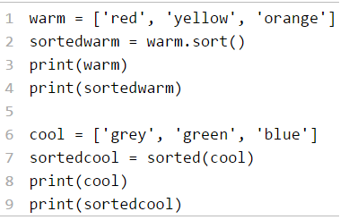
SORTING LISTS
calling sort() mutates the list, returns nothing
calling sorted() does not mutate list, must assign result to a variable

Slide 22
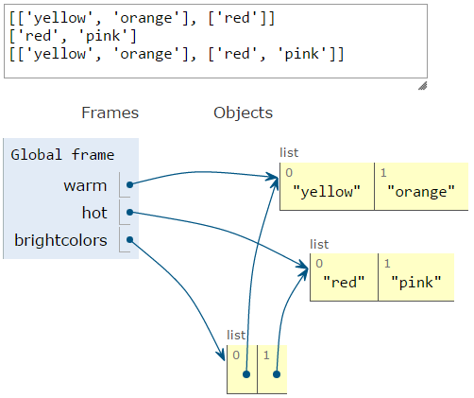
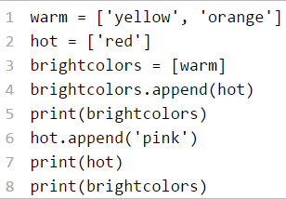
LISTS OF LISTS OF LISTS OF….
can have nested lists
side effects still possible after mutation

Slide 23
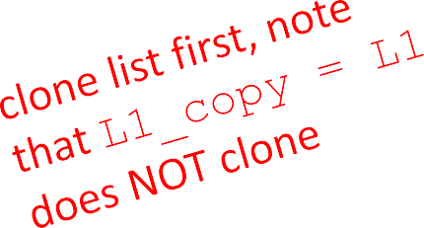
MUTATION AND ITERATION
Try this in Python Tutor!
avoid mutating a list as you are iterating over it
def remove_dups(L1, L2): for e in L1:
if e in L2:
L1.remove(e)
def remove_dups(L1, L2):
L1_copy = L1[:]
for e in L1_copy: if e in L2:
L1.remove(e)
L1 = [1, 2, 3, 4]
L2 = [1, 2, 5, 6]
remove_dups(L1, L2)
L1 is [2,3,4] not [3,4] Why?
Python uses an internal counter to keep track of index it is in the loop
mutating changes the list length but Python doesn’t update the counter
loop never sees element 2

