Slide 1


TESTING, DEBUGGING, EXCEPTIONS, ASSERTIONS
(download slides and .py files and follow along!)
COP1000 - LEC7
1

Slide 2




WE AIM FOR HIGH QUALITY – AN ANALOGY WITH SOUP
You are making soup but bugs keep falling in from the ceiling. What do you do?
check soup for bugs
testing
keep lid closed
defensive programming
clean kitchen
eliminate source of bugs
Analogy thanks to Prof Srini Devadas
2

Slide 3
DEFENSIVE PROGRAMMING
Write specifications for functions
Modularize programs
Check conditions on inputs/outputs (assertions)
TESTING/VALIDATION
Compare input/output pairs to specification
“It’s not working!”
“How can I break my program?”
DEBUGGING
Study events leading up to an error
“Why is it not working?”
“How can I fix my program?”
3

Slide 4
SET YOURSELF UP FOR EASY TESTING AND DEBUGGING
from the start, design code to ease this part
break program up into modules that can be tested and debugged individually
document constraints on modules
what do you expect the input to be?
what do you expect the output to be?
document assumptions behind code design
4

Slide 5
WHEN ARE YOU READY TO TEST?
ensure code runs
remove syntax errors
remove static semantic errors
Python interpreter can usually find these for you
have a set of expected results
an input set
for each input, the expected output
5

Slide 6
CLASSES OF TESTS
Unit testing
validate each piece of program
testing each function separately
Regression testing
add test for bugs as you find them
catch reintroduced errors that were previously fixed
Integration testing
does overall program work?
tend to rush to do this
6

Slide 7
TESTING APPROACHES
intuition about natural boundaries to the problem
def is_bigger(x, y):
""" Assumes x and y are ints
Returns True if y is less than x, else False """
can you come up with some natural partitions?
if no natural partitions, might do random testing
probability that code is correct increases with more tests
better options below
black box testing
explore paths through specification
glass box testing
explore paths through code
7

Slide 8
BLACK BOX TESTING
def sqrt(x, eps):
""" Assumes x, eps floats, x >= 0, eps > 0
Returns res such that x-eps <= res*res <= x+eps """
designed without looking at the code
can be done by someone other than the implementer to avoid some implementer biases
testing can be reused if implementation changes
paths through specification
build test cases in different natural space partitions
also consider boundary conditions (empty lists, singleton list, large numbers, small numbers)

Slide 9
BLACK BOX TESTING
def sqrt(x, eps):
""" Assumes x, eps floats, x >= 0, eps > 0
Returns res such that x-eps <= res*res <= x+eps """
CASE | x | eps
boundary | 0 | 0.0001
perfect square | 25 | 0.0001
less than 1 | 0.05 | 0.0001
irrational square root | 2 | 0.0001
extremes | 2 | 1.0/2.0**64.0
extremes | 1.0/2.0**64.0 | 1.0/2.0**64.0
extremes | 2.0**64.0 | 1.0/2.0**64.0
extremes | 1.0/2.0**64.0 | 2.0**64.0
extremes | 2.0**64.0 | 2.0**64.0

Slide 10
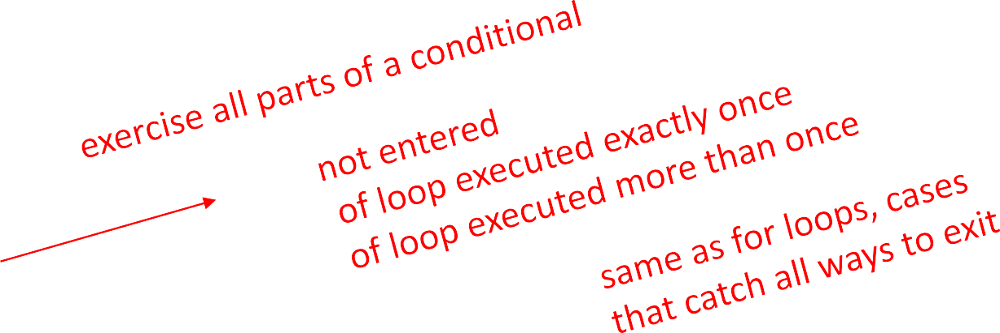
GLASS BOX TESTING
use code directly to guide design of test cases
called path-complete if every potential path through code is tested at least once
what are some drawbacks of this type of testing?
can go through loops arbitrarily many times
missing paths
guidelines
branches
for loops
while loops

Slide 11
GLASS BOX TESTING
def abs(x):
""" Assumes x is an int
Returns x if x>=0 and –x otherwise """ if x < -1:
return –x else:
return x
a path-complete test suite could miss a bug
path-complete test suite: 2 and -2
but abs(-1) incorrectly returns -1
should still test boundary cases

Slide 12
DEBUGGING
steep learning curve
goal is to have a bug-free program
tools
built in to IDLE and Anaconda
Python Tutor
print statement
use your brain, be systematic in your hunt

Slide 13
PRINT STATEMENTS
good way to test hypothesis
when to print
enter function
parameters
function results
use bisection method
put print halfway in code
decide where bug may be depending on values

Slide 14
DEBUGGING STEPS
study program code
don’t ask what is wrong
ask how did I get the unexpected result
is it part of a family?
scientific method
study available data
form hypothesis
repeatable experiments
pick simplest input to test with

Slide 15
ERROR MESSAGES – EASY
trying to access beyond the limits of a list
test = [1,2,3] then test[4] → IndexError
trying to convert an inappropriate type
int(test)
referencing a non-existent variable
a
→ TypeError
→ NameError
mixing data types without appropriate coercion
'3'/4 → TypeError
forgetting to close parenthesis, quotation, etc.
a = len([1,2,3]
print(a) → SyntaxError

Slide 16
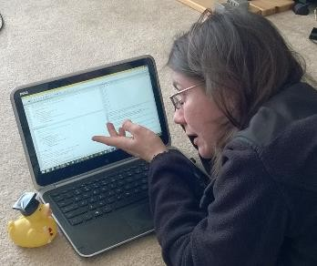
LOGIC ERRORS - HARD
think before writing new code
draw pictures, take a break
explain the code to
someone else
a rubber ducky

Slide 17


DON’T
DO
Write entire program
Test entire program
Debug entire program
Write a function
Test the function, debug the function
Write a function
Test the function, debug the function
*** Do integration testing ***
Change code
Remember where bug was
Test code
Forget where bug was or what change you made
Panic
Backup code
Change code
Write down potential bug in a comment
Test code
Compare new version with old version

Slide 18
EXCEPTIONS AND ASSERTIONS
what happens when procedure execution hits an
unexpected condition?
get an exception… to what was expected
trying to access beyond list limits
test = [1,7,4]
test[4]
trying to convert an inappropriate type
int(test)
referencing a non-existing variable
a
mixing data types without coercion
'a'/4
→ IndexError
→ TypeError
→ NameError
→ TypeError

Slide 19
OTHER TYPES OF EXCEPTIONS
already seen common error types:
SyntaxError: Python can’t parse program
NameError: local or global name not found
AttributeError: attribute reference fails
TypeError: operand doesn’t have correct type
ValueError: operand type okay, but value is illegal
IOError: IO system reports malfunction (e.g. file not found)

Slide 20
DEALING WITH EXCEPTIONS
Python code can provide handlers for exceptions
try:
a = int(input("Tell me one number:"))
b = int(input("Tell me another number:")) print(a/b)
except:
print("Bug in user input.")
exceptions raised by any statement in body of try are handled by the except statement and execution continues with the body of the except statement

Slide 21
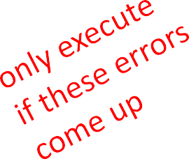
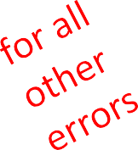
HANDLING SPECIFIC EXCEPTIONS
have separate except clauses to deal with a particular type of exception
try:
a = int(input("Tell me one number: "))
b = int(input("Tell me another number: ")) print("a/b = ", a/b)
print("a+b = ", a+b)
except
ValueError:
print("Could not convert to a number.")
except
ZeroDivisionError:
print("Can't divide by zero")
except:
print("Something went very wrong.")

Slide 22
OTHER EXCEPTIONS
else:
body of this is executed when execution of associated
try body completes with no exceptions
finally:
body of this is always executed after try, else and except clauses, even if they raised another error or executed a break, continue or return
useful for clean-up code that should be run no matter what else happened (e.g. close a file)

Slide 23
WHAT TO DO WITH EXCEPTIONS?
what to do when encounter an error?
fail silently:
substitute default values or just continue
bad idea! user gets no warning
return an “error” value
what value to choose?
complicates code having to check for a special value
stop execution, signal error condition
in Python: raise an exception
raise Exception("descriptive string")

Slide 24

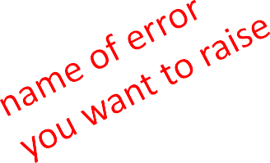
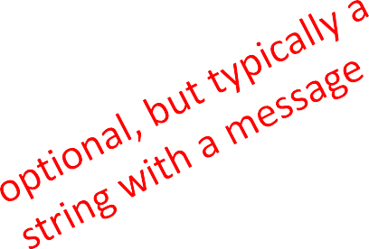
EXCEPTIONS AS CONTROL FLOW
don’t return special values when an error occurred and then check whether ‘error value’ was returned
instead, raise an exception when unable to produce a result consistent with function’s specification
raise <exceptionName>(<arguments>) raise ValueError("something is wrong")

Slide 25
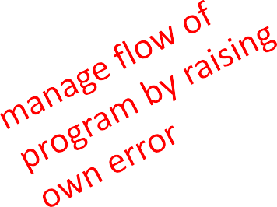
EXAMPLE: RAISING AN EXCEPTION
def get_ratios(L1, L2):
""" Assumes: L1 and L2 are lists of equal length of numbers Returns: a list containing L1[i]/L2[i] """
ratios = []
for index in range(len(L1)): try:
ratios.append(L1[index]/L2[index]) except ZeroDivisionError:
ratios.append(float('nan')) #nan = not a number except:
raise ValueError('get_ratios called with bad arg')
return ratios

Slide 26
EXAMPLE OF EXCEPTIONS
assume we are given a class list for a subject: each entry is a list of two parts
a list of first and last name for a student
a list of grades on assignments
test_grades = [[['peter', 'parker'], [80.0, 70.0, 85.0]],
[['bruce', 'wayne'], [100.0, 80.0, 74.0]]]
create a new class list, with name, grades, and an average
[[['peter', 'parker'], [80.0, 70.0, 85.0], 78.33333],
[['bruce', 'wayne'], [100.0, 80.0, 74.0], 84.666667]]]

Slide 27
EXAMPLE
CODE
[[['peter', 'parker'], [80.0, 70.0, 85.0]],
[['bruce', 'wayne'], [100.0, 80.0, 74.0]]]
def get_stats(class_list): new_stats = []
for elt in class_list:
new_stats.append([elt[0], elt[1], avg(elt[1])]) return new_stats
def avg(grades):
return sum(grades)/len(grades)

Slide 28
ERROR IF NO GRADE FOR A STUDENT
if one or more students don’t have any grades, get an error
test_grades = [[['peter', 'parker'], [10.0, 5.0, 85.0]],
[['bruce', 'wayne'], [10.0, 8.0, 74.0]],
[['captain', 'america'], [8.0,10.0,96.0]], [['deadpool'], []]]
get ZeroDivisionError: float division by zero
because try to
return sum(grades)/len(grades)

Slide 29

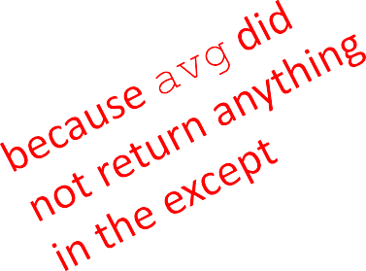
OPTION 1: FLAG THE ERROR BY PRINTING A MESSAGE
decide to notify that something went wrong with a msg
def avg(grades): try:
return sum(grades)/len(grades) except ZeroDivisionError:
print('warning: no grades data')
running on some test data gives
warning: no grades data
[[['peter', 'parker'], [10.0, 5.0, 85.0], 15.41666666],
[['bruce', 'wayne'], [10.0, 8.0, 74.0], 13.83333334],
[['captain', 'america'], [8.0, 10.0, 96.0], 17.5],
[['deadpool'], [],
None]]

Slide 30


OPTION 2: CHANGE THE POLICY
decide that a student with no grades gets a zero
def avg(grades): try:
return sum(grades)/len(grades) except ZeroDivisionError:
print('warning: no grades data') return 0.0
running on some test data gives
warning: no grades data
[[['peter', 'parker'], [10.0, 5.0, 85.0], 15.41666666],
[['bruce', 'wayne'], [10.0, 8.0, 74.0], 13.83333334],
[['captain', 'america'], [8.0, 10.0, 96.0], 17.5],
[['deadpool'], [], 0.0]]

Slide 31
ASSERTIONS
want to be sure that assumptions on state of computation are as expected
use an assert statement to raise an
AssertionError exception if assumptions not met
an example of good defensive programming

Slide 32
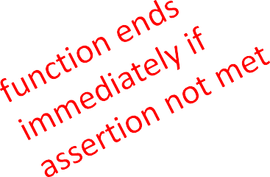
EXAMPLE
def avg(grades):
assert len(grades) != 0, 'no grades data'
return sum(grades)/len(grades)
raises an AssertionError if it is given an empty list for grades
otherwise runs ok

Slide 33
ASSERTIONS AS DEFENSIVE PROGRAMMING
assertions don’t allow a programmer to control response to unexpected conditions
ensure that execution halts whenever an expected condition is not met
typically used to check inputs to functions, but can be used anywhere
can be used to check outputs of a function to avoid propagating bad values
can make it easier to locate a source of a bug

Slide 34
WHERE TO USE ASSERTIONS?
goal is to spot bugs as soon as introduced and make clear where they happened
use as a supplement to testing
raise exceptions if users supplies bad data input
use assertions to
check types of arguments or values
check that invariants on data structures are met
check constraints on return values
check for violations of constraints on procedure (e.g. no duplicates in a list)

