Slide 1
WELCOME!
(download slides and .py files and follow along!)
COP1000 - LEC1

Slide 2
TODAY
course info
what is computation
python basics
mathematical operations
python variables and types
NOTE: slides and code files up before each lecture
o highly encourage you to download them before lecture
o take notes and run code files when I do
o bring computers to answer in-class practice exercises!

Slide 3
COURSE INFO
Grading
See Syllabus

Slide 4
COURSE POLICIES
Collaboration
may collaborate with anyone
required to write code independently and write names of all collaborators on submission
we will be running a code similarity program on all psets*
Extensions
no extensions
late days, see course D2L for details
drop and roll weight of max two psets in final exam grade
should be EMERGENCY use only

Slide 5
OFFICE HOURS
not mandatory
two flavors
Lecture review: review lecture material
if you missed lecture
if you need a different take on the same concepts
Problem solving: teach you how to solve programming problems
useful if you don’t know how to set up pseudocode from pset words
we show a couple of harder questions
walk you through how to approach solving the problem
brainstorm code solution along with the recitation instructor
will post solutions after

Slide 6
FAST PACED COURSE
Position yourself to succeed!
read psets when they come out and come back to them later
use late days in emergency situations
New to programming? PRACTICE. PRACTICE? PRACTICE!
can’t passively absorb programming as a skill
download code before lecture and follow along
do finger exercises
don’t be afraid to try out Python commands!

Slide 7
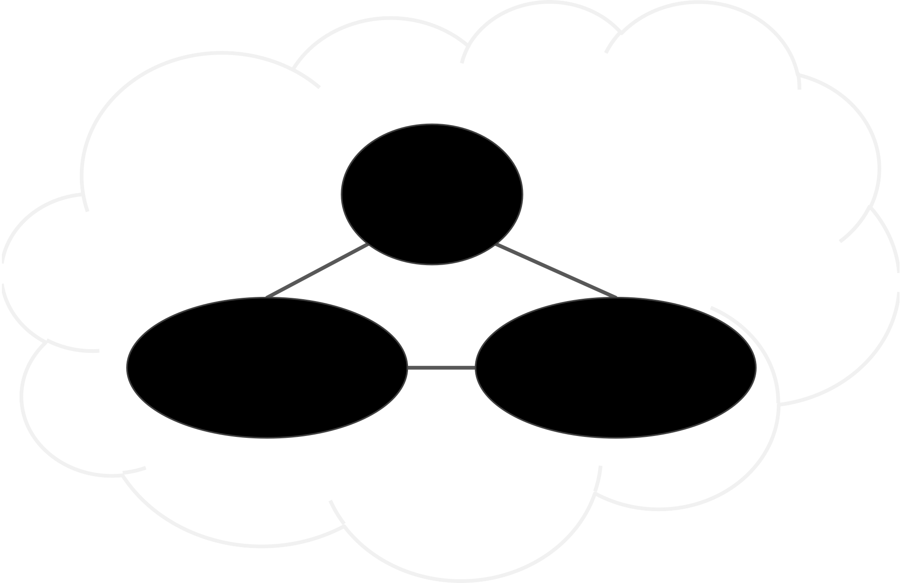
PROBLEM SOLVING
PRACTICE
KNOWLEDGE OF CONCEPTS
PROGRAMMING SKILL

Slide 8
TOPICS
represent knowledge with data structures
iteration and recursion as computational metaphors
abstraction of procedures and data types
organize and modularize systems using object classes and methods
different classes of algorithms, searching and sorting
complexity of algorithms

Slide 9
WHAT DOES A COMPUTER DO
Fundamentally:
performs calculations
a billion calculations per second!
remembers results
100s of gigabytes of storage!
What kinds of calculations?
built-in to the language
ones that you define as the programmer
computers only know what you tell them

Slide 10
TYPES OF KNOWLEDGE
declarative knowledge is statements of fact.
someone will win a Google Cardboard before class ends
imperative knowledge is a recipe or “how-to”.
Students sign up for raffle
Ana opens her IDE
Ana chooses a random number between 1st and n^{th} responder
Ana finds the number in the responders sheet. Winner!

Slide 11
A NUMERICAL EXAMPLE
square root of a number x is y such that y*y = x
recipe for deducing square root of a number x (16)
Start with a guess, g
If g*g is close enough to x, stop and say g
answer
is the
Otherwise make a new guess by averaging g and x/g
Using the new guess, repeat process until close enough
g | g*g | x/g | (g+x/g)/2
3 | 9 | 16/3 | 4.17
4.17 | 17.36 | 3.837 | 4.0035
4.0035 | 16.0277 | 3.997 | 4.000002

Slide 12
WHAT IS A RECIPE
sequence of simple steps
flow of control process that specifies when each step is executed
a means of determining when to stop
1+2+3 = an algorithm!

Slide 13
COMPUTERS ARE MACHINES
how to capture a recipe in a mechanical process
fixed program computer
calculator
stored program computer
machine stores and executes instructions

Slide 14

BASIC MACHINE ARCHITECTURE
MEMORY
CONTROL UNIT
ARITHMETIC LOGIC UNIT
program counter
do primitive ops
INPUT
OUTPUT

Slide 15
STORED PROGRAM COMPUTER
sequence of instructions stored inside computer
built from predefined set of primitive instructions
arithmetic and logic
simple tests
moving data
special program (interpreter) executes each instruction in order
use tests to change flow of control through sequence
stop when done

Slide 16
BASIC PRIMITIVES
Turing showed that you can compute anything using 6 primitives
modern programming languages have more convenient set of primitives
can abstract methods to create new primitives
anything computable in one language is computable in any other programming language

Slide 17
CREATING RECIPES
a programming language provides a set of primitive
operations
expressions are complex but legal combinations of primitives in a programming language
expressions and computations have values and meanings in a programming language

Slide 18
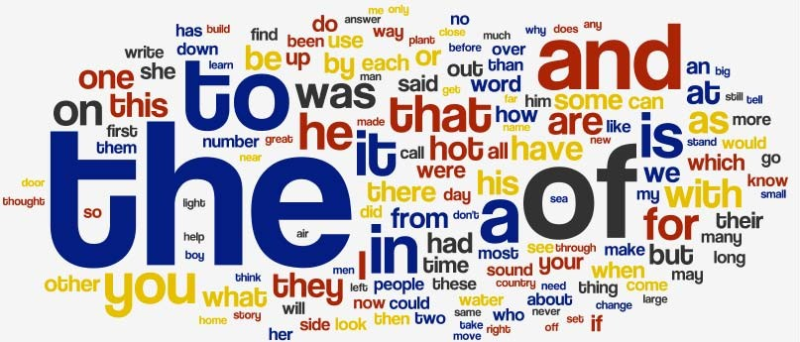
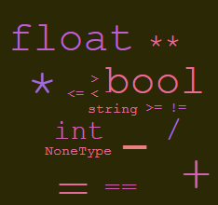
ASPECTS OF LANGUAGES
primitive constructs
English: words
programming language: numbers, strings, simple operators
Word Cloud copyright Michael Twardos, All Right Reserved. This content is excluded from our Creative Commons license. For more information, see https://ocw.mit.edu/help/faq-fair-use/.
Word Cloud copyright unknown, All Right Reserved. This content is excluded from our Creative Commons license. For more information, see https://ocw.mit.edu/help/faq-fair-use/.

Slide 19
ASPECTS OF LANGUAGES
syntax
English: "cat dog boy" → not syntactically valid
"cat hugs boy" → syntactically valid
programming language: "hi"5 → not syntactically valid
3.2*5 → syntactically valid

Slide 20
ASPECTS OF LANGUAGES
static semantics is which syntactically valid strings have meaning
English: "I are hungry" → syntactically valid
but static semantic error
programming language: 3.2*5 → syntactically valid
3+"hi" → static semantic error

Slide 21
ASPECTS OF LANGUAGES
semantics is the meaning associated with a syntactically correct string of symbols with no static semantic errors
English: can have many meanings "Flying planes can be dangerous"
programming languages: have only one meaning but may not be what programmer intended

Slide 22
WHERE THINGS GO WRONG
syntactic errors
common and easily caught
static semantic errors
some languages check for these before running program
can cause unpredictable behavior
no semantic errors but different meaning than what programmer intended
program crashes, stops running
program runs forever
program gives an answer but different than expected

Slide 23
PYTHON PROGRAMS
a program is a sequence of definitions and commands
definitions evaluated
commands executed by Python interpreter in a shell
commands (statements) instruct interpreter to do something
can be typed directly in a shell or stored in a file that is read into the shell and evaluated
Problem Set 0 will introduce you to these in Anaconda

Slide 24
OBJECTS
programs manipulate data objects
objects have a type that defines the kinds of things programs can do to them
Ana is a human so she can walk, speak English, etc.
Chewbacca is a wookie so he can walk, “mwaaarhrhh”, etc.
objects are
scalar (cannot be subdivided)
non-scalar (have internal structure that can be accessed)

Slide 25
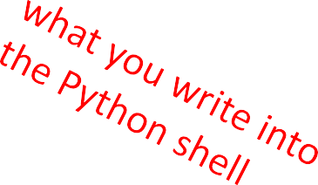
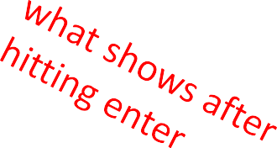
SCALAR OBJECTS
int – represent integers, ex. 5
float – represent real numbers, ex. 3.27
bool – represent Boolean values True and False
NoneType – special and has one value, None
can use type() to see the type of an object
>>> | type(5)
int
>>> type(3.0) float

Slide 26
TYPE CONVERSIONS (CAST)
can convert object of one type to another
float(3) converts integer 3 to float 3.0
int(3.9) truncates float 3.9 to integer 3

Slide 27
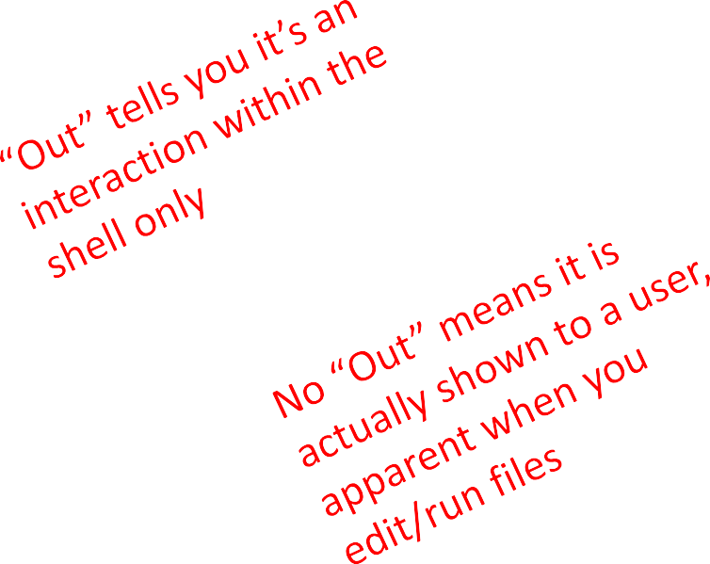
PRINTING TO CONSOLE
to show output from code to a user, use print
command
In [11]: 3+2
Out[11]: 5
In [12]: print(3+2)
5

Slide 28
EXPRESSIONS
combine objects and operators to form expressions
an expression has a value, which has a type
syntax for a simple expression
<object> <operator> <object>

Slide 29
OPERATORS ON ints and floats
i+j
i-j
i*j
i/j
→ the sum
→ the difference
→ the product
→ division
if both are ints, result is int
if either or both are floats, result is float
result is float
i%j → the remainder when i is divided by j
i**j → i to the power of j

Slide 30
SIMPLE OPERATIONS
parentheses used to tell Python to do these operations first
operator precedence without parentheses
**
*
/
◦ + and – executed left to right, as appear in expression

Slide 31

BINDING VARIABLES AND VALUES
equal sign is an assignment of a value to a variable name
pi
=
3.14159
pi_approx = 22/7
value stored in computer memory
an assignment binds name to value
retrieve value associated with name or variable by invoking the name, by typing pi

Slide 32
ABSTRACTING EXPRESSIONS
why give names to values of expressions?
to reuse names instead of values
easier to change code later
pi = 3.14159
radius = 2.2
area = pi*(radius**2)

Slide 33
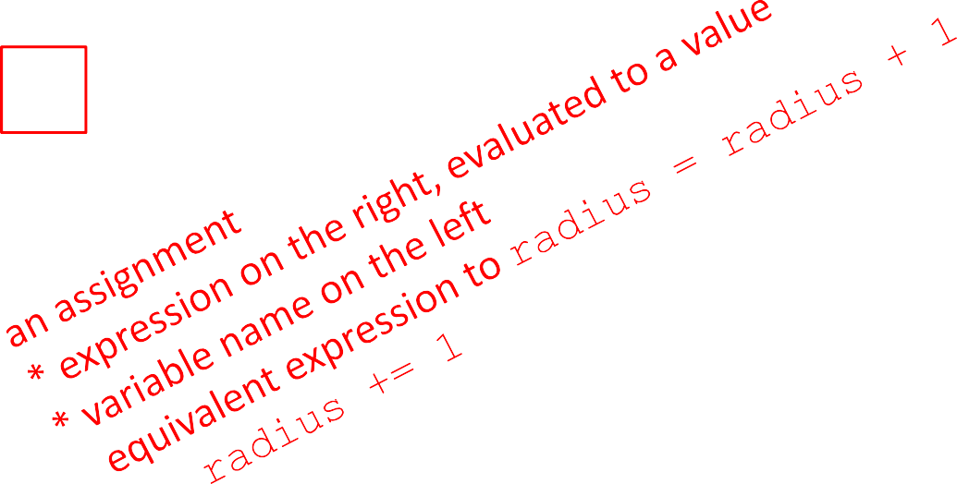
PROGRAMMING vs MATH
in programming, you do not “solve for x”
pi = 3.14159
radius = 2.2
# area of circle area = pi*(radius**2) radius = radius+1

Slide 34

CHANGING BINDINGS
can re-bind variable names using new assignment statements
previous value may still stored in memory but lost the handle for it
value for area does not change until you tell the computer to do the calculation again
3.14
pi = 3.14
radius = 2.2
area = pi*(radius**2) radius = radius+1
pi
radius area
2.2
3.2
15.1976

