Slide 1
BRANCHING, ITERATION
(download slides and .py files ĂŶĚ follow along!) COP1000 - LEC2

Slide 2
LAST TIME
syntax and semantics
scalar objects
simple operations
expressions, variables and values

Slide 3
TODAY
string object type
branching and conditionals
indentation
iteration and loops

Slide 4
STRINGS
letters, special characters, spaces, digits
enclose in quotation marks or single quotes
hi = "hello there"
concatenate strings
name = "ana"
greet = hi + name
greeting = hi + " " + name
do some operations on a string as defined in Python docs
silly = hi + " " + name * 3

Slide 5
INPUT/OUTPUT: print
used to output stuff to console
keyword is print
x = 1
print(x)
x_str = str(x)
print("my fav num is", | x, ".", | "x =", x)
print("my fav num is " | + x_str | + ". " + "x = " + x_str)

Slide 6
INPUT/OUTPUT: input("")
prints whatever is in the quotes
user types in something and hits enter
binds that value to a variable
text = input("Type anything... ") print(5*text)
input gives you a string so must cast if working with numbers
num = int(input("Type a number... ")) print(5*num)

Slide 7
COMPARISON OPERATORS ON
int, float, string
i and j are variable names
comparisons below evaluate to a Boolean
i > j i >= j i < j
i <= j
i == j → equality test, True if i is the same as j
i != j → inequality test, True if i not the same as j

Slide 8
LOGIC OPERATORS ON bools
a and b are variable names (with Boolean values)
not a →
a and b →
a or b →
True if a is False False if a is True
True if both are True
True if either or both are True
A | B | A and B | A or B
True | True | True | True
True | False | False | True
False | True | False | True
False | False | False | False

Slide 9
COMPARISON EXAMPLE
pset_time = 15
sleep_time = 8
print(sleep_time derive = True drink = False
> pset_time)
both = drink and derive print(both)

Slide 10
If right blocked, go forward
If right clear, go right
If right and front blocked,
go left
If right , front, left blocked,
go back

Slide 11
CONTROL FLOW - BRANCHING
if <condition>:
<expression>
<expression>
...
if <condition>:
<expression>
<expression>
...
elif <condition>:
<expression>
<expression>
...
else:
<expression>
<expression>
...
if <condition>:
<expression>
<expression>
...
else:
<expression>
<expression>
...
<condition> has a value True or False
evaluate expressions in that block if <condition> is True

Slide 12
INDENTATION
matters in Python
how you denote blocks of code
x = float(input("Enter a number for x: ")) y = float(input("Enter a number for y: ")) if x == y:
print("x and y are equal"
if y != 0
print("x
and y are
equal"
)
if y != 0
:
print("therefore, x / y is", x/y
print("therefore
, x / y is",
x/y
)
elif x < y:
print("x s smaller"
print("x
is
smaller"
)
else:
print("y s smaller"
print("y
is
smaller"
)
print("thanks!")

Slide 13
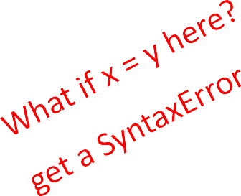
= vs ==
x = float(input("Enter a number for x: ")) y = float(input("Enter a number for y: ")) if x == y:
print("x and y are equal") if y != 0:
print("therefore, x / y is", x/y) elif x < y:
print("x is smaller") else:
print("y is smaller") print("thanks!")

Slide 14
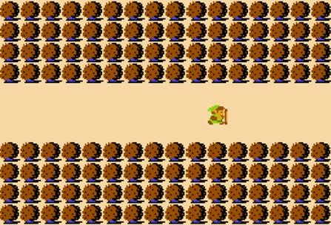
Legend of Zelda – Lost Woods
keep going right, takes you back to this same screen, stuck in a loop
Image Courtesy Nintendo, All Rights Reserved. This content is excluded from our Creative Commons license. For more information, see http://ocw.mit.edu/help/faq-fair-use/.
if <exit right>:
<set background to woods_background
if <exit right>
<set background to
woods_background
>
if <exit right>
:
<set background to woods_background
f <exit right>
<set background to
woods_background
>
if
<exit right>
:
set background to woods_background
nd so on and on and on..
<
set background to
woods_background
>
and so on and on and on..
.
else
:
ls
set background to exit_background
<
set background to
exit_background
>
else
:
lse
<set background to exit_background
<set background to
exit_background
>
else:
<set background to exit_background
<set background to
exit_background
>

Slide 15
Legend of Zelda – Lost Woods
keep going right, takes you back to this same screen, stuck in a loop
Word Cloud copyright unknown, All Right Reserved. This content is excluded from our Creative Commons license. For more information, see http://ocw.mit.edu/help/faq-fair-use/.
while <exit right>:
<set background to woods_background
<set background to
woods_background
>
<set background to exit_background>

Slide 16
CONTROL FLOW:
while LOOPS
while <condition>:
<expression>
<expression>
...
<condition> evaluates to a Boolean
if <condition> is True, do all the steps inside the while code block
check <condition> again
repeat until <condition> is False

Slide 17
while LOOP EXAMPLE
You are in the Lost Forest.
************
************
☺
************
************
Go left or right?
PROGRAM:
n = input("You're in the Lost Forest. Go left or right? ")
while n == "right":
n = input("You're in the Lost Forest. Go left or right? ") print("You got out of the Lost Forest!")

Slide 18
CONTROL FLOW:
while and for LOOPS
iterate through numbers in a sequence
# more complicated with while loop n = 0
while n < 5:
print(n) n = n+1
# shortcut with for loop for n in range(5):
print(n)

Slide 19
CONTROL FLOW: for LOOPS
for <variable> in range(<some_num>):
<expression>
<expression>
...
each time through the loop, <variable> takes a value
first time, <variable> starts at the smallest value
next time, <variable> gets the prev value + 1
etc.

Slide 20
range(start,stop,step)
default values are start = 0 and step = 1 and optional
loop until value is stop - 1
mysum = 0
for i in range(7, 10): mysum += i
print(mysum)
mysum = 0
for i in range(5, 11, 2): mysum += i
print(mysum)

Slide 21
break STATEMENT
immediately exits whatever loop it is in
skips remaining expressions in code block
exits only innermost loop!
while <condition_1>: while <condition_2>:
<expression_a> break
<expression_b>
<expression_c>

Slide 22
break STATEMENT
mysum = 0
for i in range(5, 11, 2):
mysum
f mysum == 5
mysum
+=
i
if
mysum
== 5
:
break
break
mysum += 1 print(mysum)
what happens in this program?

Slide 23
for
VS while LOOPS
for loops
know number of iterations
can end early via
break
uses a counter
while loops
unbounded number of iterations
can end early via break
can use a counter but must initialize before loop and increment it inside loop
may not be able to rewrite a while loop using a for loop
can rewrite a for
loop
using a while loop

