Slide 1
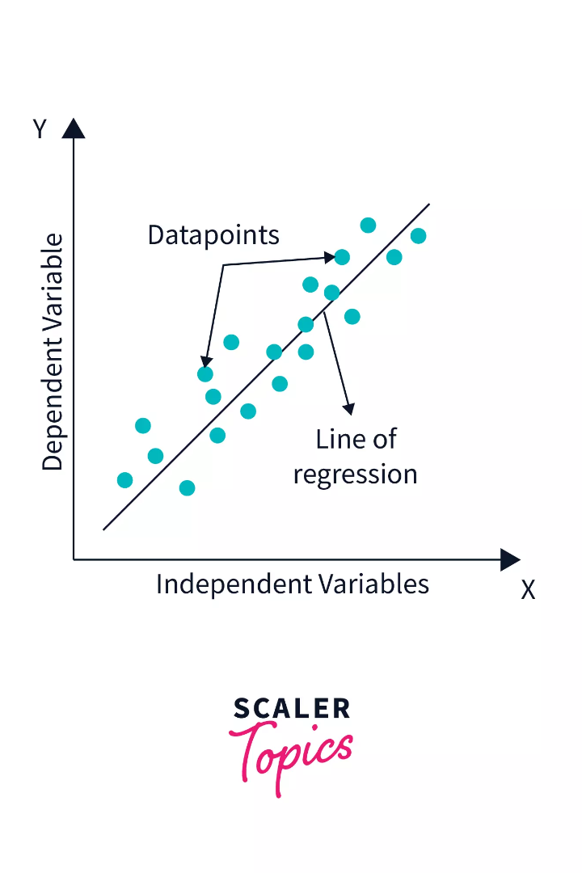

Explaining Linear Regression with Real World Examples and Code
If you want to know how to build a model for predicting numerical values, you’ve come to the right place. Linear regression is a basic yet powerful tool in statistical learning. In this presentation, we will define what linear regression is, give real-world examples of how it’s used, and explain the key libraries for running it in Python.
by Immanuel Kant

Slide 2

What is Linear Regression?
1
The Basics 📊
2
Formula 🔢
Linear regression is a statistical approach that helps to describe the relationship between two continuous variables, by fitting a line to the data points.
The formula is Y = a*X + b, where Y is the dependent variable, X is the independent variable, a is the slope of the line, and b is the intercept.
3
Applications 🎯
Linear Regression is used in many areas of business and science. It’s unsuitable for categorical variables and requires the relationship between variables to be linear.

Slide 3

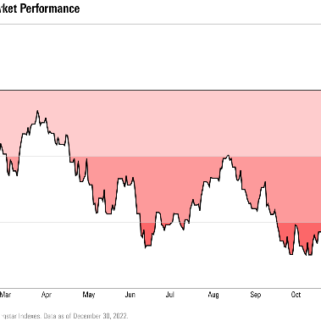

Real world examples of Linear Regression 🏠📈💰
Predicting house prices
Predicting stock prices
Explaining advertising spend impact on sales
We use Linear Regression to predict the selling prices of houses based on their characteristics, such as age, square footage, and location.
We use Linear Regression to predict future prices of stocks based on their past prices and other financial variables.
We use Linear Regression to study the relationship between advertising expenditure (independent variable) and sales (dependent variable).

Slide 4
Steps involved in building a linear regression model 🚀
1
Data Preparation
Choose your data and clean it.
Model Building
2
Select the variables, train your model, and choose your algorithm.
3
Model Testing
Assess the accuracy of your model and refine your algorithm.
Model Interpretation
4
Draw conclusions supported by statistical tests.

Slide 5
Key Python Libraries for Linear Regression 🐍
Pandas 🐼
Numpy 📈
Matplotlib 📊
Used for data wrangling.
Used for numerical computing (mathematical and logical operations)
Used for plotting.
Scikit-learn 🤖
Sklearn is an open-source Python library used for machine learning. It also includes several linear regression models.

Slide 6

How to interpret the regression output 🤔
The regression output shows the slope of the line (i.e., how much Y changes when X increases by 1 unit) and the y-intercept (i.e., the value of Y when X equals zero). Other measurements of the model's accuracy, like R-squared and p-values, can also help interpret the regression output.

Slide 7

Assumptions of Linear Regression 🧐
1
Linearity
2
Independence
The relationship between dependent and independent variables is linear
The observations are independent of one another
3
Homoscedasticity
4
Normality🔍
There is a constant variance in the errors.
The error distribution of residuals is Normal.

Slide 8

Common errors/mistakes in interpreting Linear Regression results 🙅‍♀️
Some people assume correlation implies causation, which isn't always the case. A higher R-squared value does not necessarily mean that the model is a good fit for the data as other factors come into play while building a Linear Regression model.

