Slide 1
Visual Modeling Concepts
Notes:
Hey everyone, welcome to Visual Modeling Concepts.
In this lecture, we're gonna talk about the basics
of visual modeling and give you an understanding
of what I mean when I say visual modeling
and the benefits of using visual models
within the the analyzing requirements.

Slide 2


What is Visual Modeling?
Visual Modeling is…
Graphical representation using a modeling language that takes something complex and makes it easier to understand.
Notes:
So first off what is visual modeling?
Well, the actual definition
is a graphical representation using a modeling language
that takes something complex and makes
it easier to understand.
Overall that that definition is pretty complex
or a little bit overly confusing so let's go ahead
and break that down.

Slide 3


What is Visual Modeling?
Visual Modeling is…
Graphical representation using a modeling language that takes something complex and makes it easier to understand.
Notes:
So the first thing is, visual modeling
is a graphical representation.
Pictures are a lot easier to understand than a block
of text and so modeling what it does is it takes that block
of text and it breaks it up, it could break
it up into full picture format, it could break
it up into smaller words that kind of flow
through in like a process flow, it could break
it up into a matrix which is basically like imagine
an Excel spreadsheet with different cells and rows
and columns and so a graphical representation
is a way to be able to display it rather
than just displaying text.
The next thing is using a modeling language,
what we're gonna talk about in the next lecture
is the different modeling techniques that can be utilized.
Well over time, different languages have been created
and evolved to meet different needs and usually
it comes from different professions or industries
and so the different languages are out there,
we're not gonna talk too much about the languages,
we're not gonna worry about that in this particular course
because we're staying at a higher level,
I just want to give you the concepts
of what those different modeling languages
are or what the different modeling techniques are.
We're not gonna dive into the specifics
of the particular modeling languages
but the different graphical representations
can use different modeling languages and what
it does is it takes something complex and makes
it easier to understand.
So take something that would be really long
and convoluted if you wrote it out but when you put
it into a picture into a model, a visual model,
it kind of speaks for itself and it helps to break
that down and make it easier to understand.

Slide 4



What is Visual Modeling?
Visual Modeling is…
Graphical representation using a modeling language that takes something complex and makes it easier to understand.

Slide 5




What is Visual Modeling?
Visual Modeling is…
Graphical representation using a modeling language that takes something complex and makes it easier to understand.

Slide 6







Benefits of Visual Modeling
Easily understand complex information
Gets all stakeholders involved
Receive requirements efficiently
Identify the underlying problem
Analyze ‘what if’ scenarios
Allows remove of irrelevant information

Slide 7






What Gets Modeled?
Current state, “as-is”
Future state, “to-be”
Requirements fill the gap

Slide 8


Business Models

Slide 9











Organizational Chart
CEO
Executive x5555
Homer Owner
Service Manager Service Dept x6669
Sales Manager Sales Dept x6666
Lisa Manager
Marge Manager
Service Rep Service Dept x6670
Sales Rep Sales Dept x6668
Bart Service
Apu Sales
Service Rep Service Dept x6671
Sales Rep Sales Dept x6667
Maggie Service
Ned Sales

Slide 10

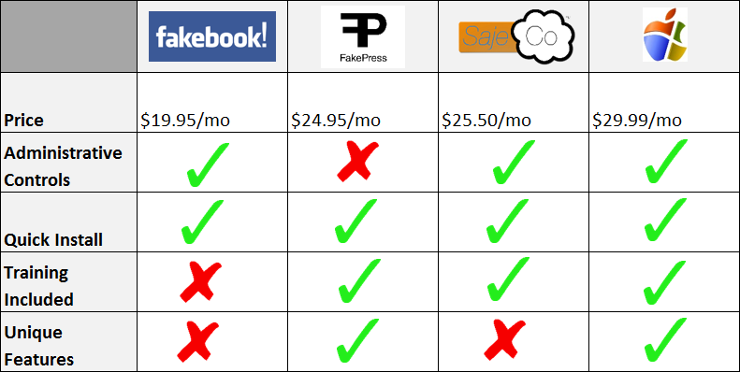

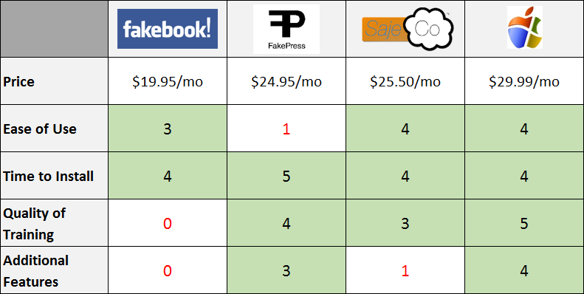
Competitive Comparison Matrix

Slide 11









Stakeholder Map
President
Dough-C-Dough
Vice President
Executive Management
Suppliers
Bake Goods R Us
Head of Operations
Dough-Licious System
Order Placer
Cashier
Customers
Employees
Goods Consumer
Baker
Shopper
Store Management

Slide 12

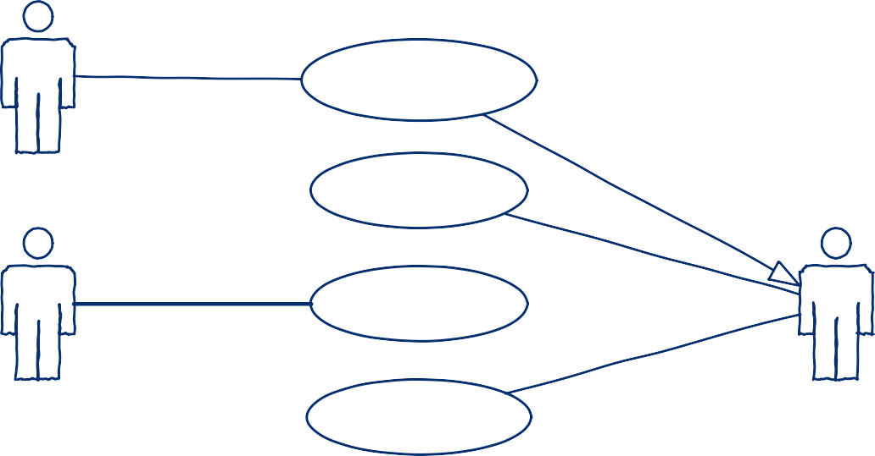


Use Case Diagram
System
Enter Order
Cashier
Process Order
Actor
Prepare Order
Use Case
Baker
Inventory System
Update Inventory
Association
Buy Inventory
Generalization
Shopper

Slide 13

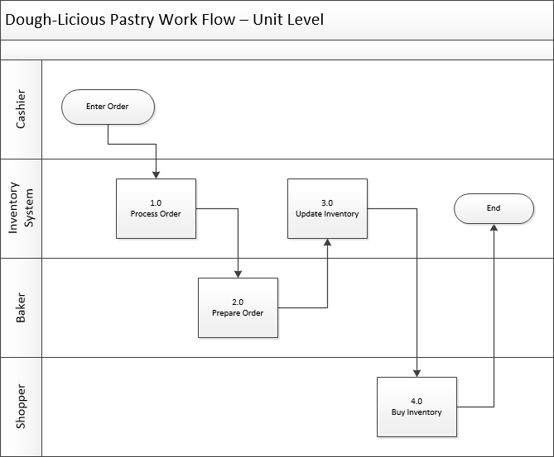






Process Flow Diagram
Start/End
Process
Decision

Slide 14

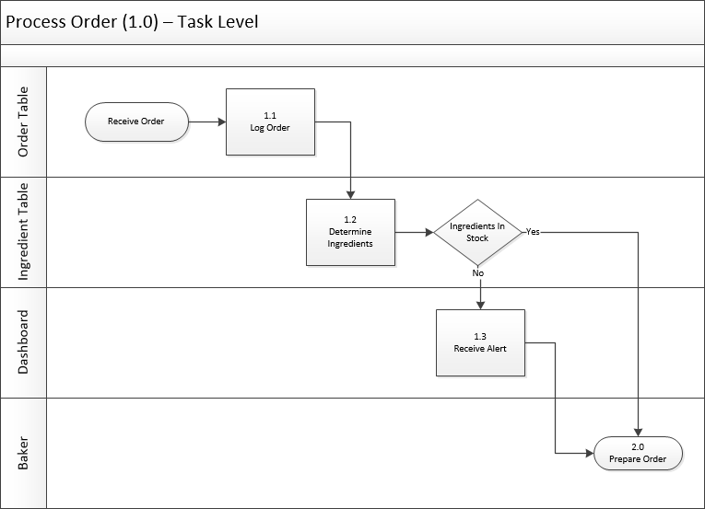



Process Flow Diagram
Start/End
Process
Decision

Slide 15
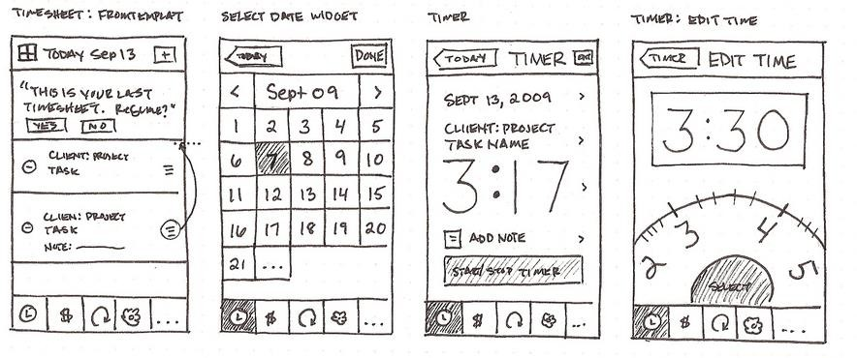
User Interface Wireframe
Credit to Anthony Armendariz for the Interface Wireframe example https://www.flickr.com/photos/anthonyarmendariz

Slide 16
Technical Models

Slide 17


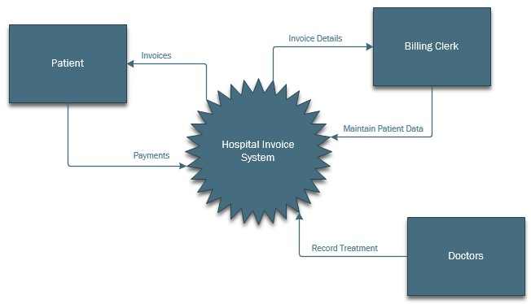

System Context Diagram
Main System
Actor / Other System
Data Flow

Slide 18


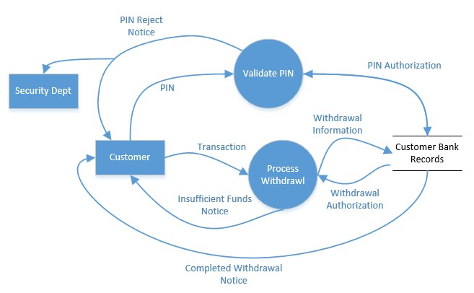

Data Flow Diagram
Process
External Entity
Database
Data Flow

Slide 19

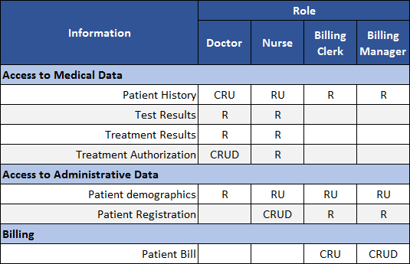








CRUD Matrix
Create Read Update Delete

Slide 20

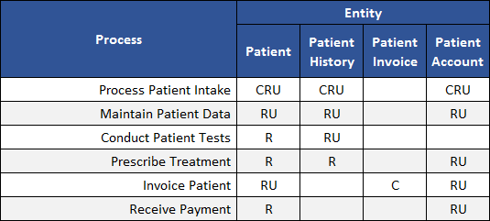








CRUD Matrix
Create Read Update Delete

Slide 21

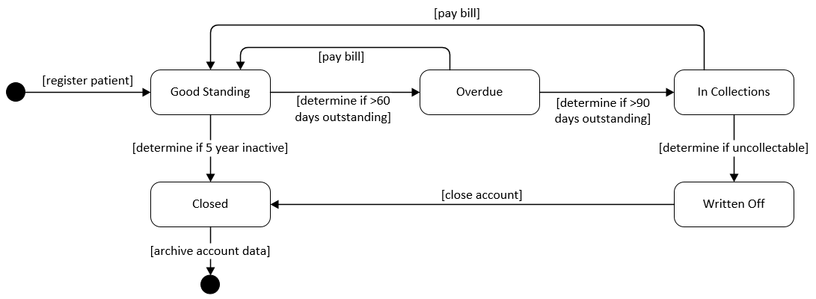

State Diagram
Start / End
Status
Transition

Slide 22

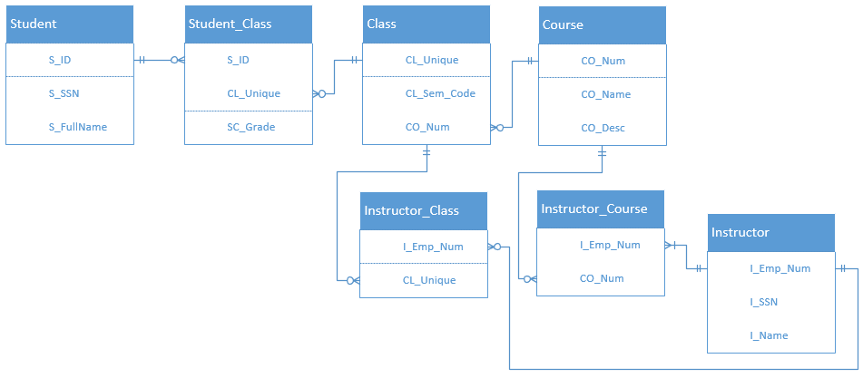

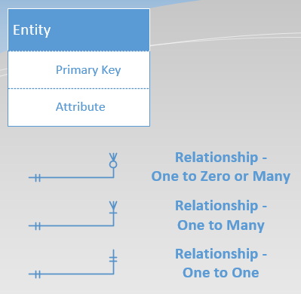
Entity Relationship Diagram (ERD)

Slide 23



BPMN vs UML
Business Process Modeling Notation
vs
Unified Modeling Language

Slide 24













BPMN vs UML: Common Parts
Activity – Activity within a process, triggered by an event
Event – Manual or automated action, or delay in time that triggers an action
Gateway – Split of pathways, where multiple paths can be taken or decision on a path must be made per a condition
Flow – Direction of the sequence or order of events and actions
Swimlanes – Visual distinction of who is doing what within a process

Slide 25

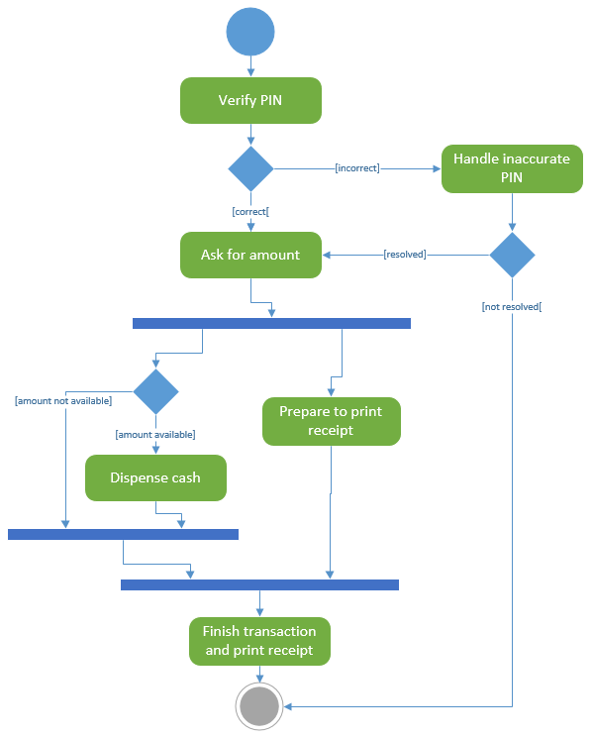
UML Activity Diagram

Slide 26
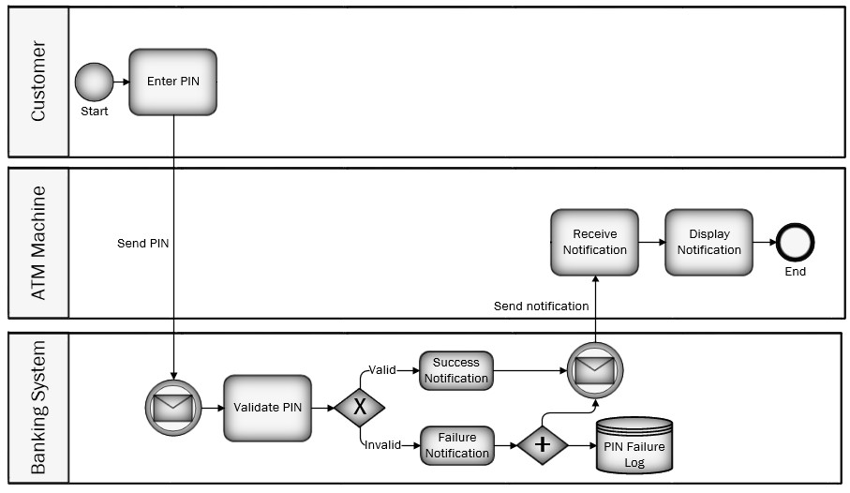
Business Process Modeling (BPMN)

Slide 27


