Slide 1


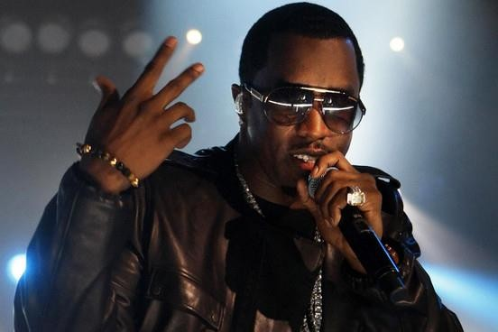
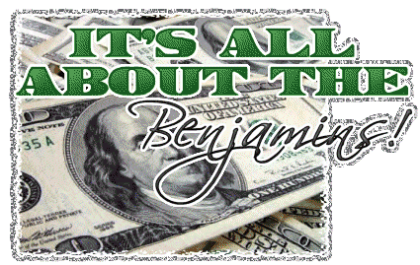

It’s All About the Requirements …Baby

Slide 2
Why Do I Need Requirements?
Guides the design of the eventual solution
Without correct requirements, you cannot design or build the
correct product
60% of project failures originate with the requirements

Slide 3
What is a Requirement?
Something a product must do or a quality it must have

Slide 4
Categories of Requirements
Functional Requirements
Non-Functional Requirements Constraints

Slide 5
Categories of Requirements
Functional Requirements
Non-Functional Requirements Constraints
Things the product must do
Action the product must take

Slide 6
Categories of Requirements
Functional Requirements
Non-Functional Requirements Constraints
Properties or qualities the product
must have
How the product will behave

Slide 7
Categories of Requirements
Functional Requirements
Non-Functional Requirements Product Constraints
Global requirements
Purpose of the project
Users of a product

Slide 8
Product Constraints
Purpose of the Product – reason for building the product
Client, Customer, and Stakeholders – people that interact with the product
Users of the Product – intended end-users and how they affect product usability
Requirements Constraints – limitations of the project and restrictions on design
Naming Conventions and Definitions – vocabulary of the product
Relevant Facts – outside influences that make a difference to this product
Assumptions – assumptions developers are making

Slide 9
Product Constraint Examples
The product budget must not exceed $50,000
The product shall run on the company’s existing machines
Implementation of the product cannot interrupt daily business
The last 5 years of historical data needs to be made available in the product

Slide 10
Functional Requirements
Scope of the Product – defines the boundaries and connections to other products
Functional and Data Requirements – Things the product must do and data
manipulated by the functions

Slide 11
Functional Requirement Examples
The product must track recipes down the ingredient and quantity level
The recipes must be editable by an administrator
The product must display the orders that need to be completed
The product must display the recipes to make the orders
The product must track ingredients including their cost, vendors, and quantity in inventory
The product must interact with the current Point of Sale system

Slide 12
Non-Functional Requirements
Look and Feel Requirements – intended appearance
Usability Requirements – based on the intended users
Performance Requirements – how fast, big, accurate, safe, reliable, etc.
Operational Requirements – product’s intended operating environment
Maintainability and Portability Requirements – how changeable product must be
Security Requirements – security, confidentiality, and integrity of the product
Cultural and Political Requirements – human factors
Legal Requirements – conformance to applicable laws

Slide 13
Non-Functional Requirement Examples
The product shall use the company colors and logos
The product shall be intuitive, even to first time users
The product shall only allow bakers and administrators to view recipes
The product shall be easily upgraded for future business needs
The product shall be scalable to multiple bakery locations

Slide 14
What Makes a Good Requirement?
Understandable
Allocatable
Measurable
Correct
Necessary
Testable
Design-independent
Attainable
Unambiguous
Concise
Modifiable
Consistent
Feasible
Complete
Prioritized
Organized
Traceable

Slide 15










SMART Requirements
Specific
Measurable Attainable Reasonable Traceable

Slide 16


SMART Requirements
Specific
Overall
Clear, no ambiguity
Consistent, same terminology throughout
Simple
Questions to Ask
What?
Why?
Who?
Where?
Guidelines
Avoid “some”, “several”, “many”
State pronouns clearly “A calls B, it is updated”
Specify units all with numbers
Use pictures to clarify understanding
Provide explanations for terms like “transmitted”, “sent”, “downloaded”, and “processed”

Slide 17


SMART Requirements
Measurable
Overall
Measure progress towards goal
Indicators should be quantifiable
Questions to Ask
How much?
How many?
How will I know when it is accomplished?
Guidelines
Ensure measurable during requirement elicitation
Validate unequivocal success can be proven
with that requirement
Determine tests that will need to be used to verify the requirement was met

Slide 18


SMART Requirements
Attainable
Overall
Validate requirement is feasible
Within technical expertise
Within scope of project
Within budget
Questions to Ask
Is there a theoretical solution to the
problem?
Has it been done before?
Are there any known constraints (environmental, physical, etc.)?
Guidelines
Determine who has responsibility for satisfying the requirement and validate they can deliver
Ensure sufficient time, resources, and budget
Reuse pieces from previous projects

Slide 19


SMART Requirements
Reasonable
Overall
Validate the effort is worth the requirement
Questions to Ask
Is this worthwhile?
Is the timing right?
Does this match our other
efforts/needs?
Guidelines
Run all requirements through a ‘sanity check’
Ensure the requirement makes sense in context

Slide 20


SMART Requirements
Traceable
Overall
Trace requirement through design, implementation, and testing
Questions to Ask
Can I ensure this requirement has been met in the design solution?
Can I ensure this requirement has been met in the implementation?
Can I ensure this requirement has been met during testing?
Guidelines
Requirements should include
Originators
Assumptions
Business justifications
Dependencies on other requirements
Importance

Slide 21
Tips for Producing Valid Requirements
Should use the word shall
Only one shall per requirement
Written in short, simple sentences
Consistent terminology
Stated positively
Accompanied by notes and comments to support and clarify
Stated imperatively
Don’t use will and should

Slide 22
Translations for Requirement Verbiage
Or – Select one of the options
Can, should – Expresses desire or suggestion instead of requirement
Must – 100% reliability
Are, is, will – Descriptive part to lead into the requirement
Support, and/or – Confusing
But not limited to, etc – Incomplete requirement/thought
Shall – dictates specification and functional capability

Slide 23
Terms to Avoid
Adequate
Approximately
Better than
Comparison
Easy
Maintainable
Maximize
Minimize
Normally
Optimize
Quality product
Quick
Rapid
Substantial
Sufficient
Timely

Slide 24
Introduction to Requirement Analysis

Slide 25
Phases of the Requirements Process
Requirement Elicitation
Requirement Analysis
Requirement Specification
Requirements Approval

Slide 26
Business Rules

Slide 27
Business Rules
What are Business Rules?
Business Rules vs Business Requirements
Best Practices

Slide 28
Business Rules Explained

Slide 29
Business Rules Explained
Definition:
A business rule is a rule that defines or constrains some aspect of business and always resolves to either true or false.
Purpose:
Business rules are intended to assert business structure or to control or influence the behavior of the business.

Slide 30
Business Rules Explained
Definition:
A business rule is a rule that defines or constrains some aspect of business and always resolves to either true or false.
Purpose:
Business rules are intended to assert business structure or to control or influence the behavior of the business.

Slide 31
Business Rules Explained
Definition:
A business rule is a rule that defines or constrains some aspect of business and always resolves to either true or false.
Purpose:
Business rules are intended to assert business structure or to control or influence the behavior of the business.

Slide 32
Business Rules Explained
Definition:
A business rule is a rule that defines or constrains some aspect of business and always resolves to either true or false.
Purpose:
Business rules are intended to assert business structure or to control or influence the behavior of the business.

Slide 33
Business Rules Examples
Entered email addresses must appear valid (contain @ and .)
Each class must have at least one instructor
Customers must have a valid driver’s license to rent a vehicle
A quote must be completed prior to an invoice being generated

Slide 34
Business Rules vs Business Requirements
Rule:
Entered email addresses must appear valid (contain @, then later .)
Possible Requirements:
Capability to enter email address
Alert agent when the email doesn’t appear to be valid
Allow for correction of email if invalid email format is entered

Slide 35
Business Rules vs Business Requirements
Rule:
Each course must have at least one instructor
Possible Requirements:
Capability for Dean to assign instructor to course
Course registration cannot be opened until an instructor is assigned

Slide 36
Business Rules vs Business Requirements
Rule:
Customers must have a valid driver’s license to rent a vehicle
Possible Requirements:
Employee to inspect driver’s license
Ability for employee to validate driver’s license

Slide 37
Business Rules vs Business Requirements
Rule:
A quote must be completed prior to an invoice being generated
Possible Requirements:
Capability to enter a quote
Details from quote must automatically flow to the invoice
Ability to tie the quote and invoices together for reporting

Slide 38
Business Rules Best Practices
When documenting business rules, keep it simple
Business requirements are used to comply with business rules
Each business rule may need multiple requirements
Business rules should not be changed
Changes can cause major constraints down the road

