Slide 1
Chapter 1 - Introduction to Continuous Integration, Continuous Delivery and Jenkins-CI
Objectives
Key objectives of this chapter
Agile Development
Continuous Integration
Continuous Delivery
History of Jenkins

Slide 2
Chapter 1 - Introduction to Continuous Integration, Continuous Delivery and Jenkins-CI
1.1 Foundation of Agile AppDev
Agile Development begins with Extreme Programming (XP)
Invented/Promoted by Kent Beck and associates
Beck describes XP as:
A philosophy of software development based on the values of communication, feedback, simplicity, courage, and respect
A body of practices proven useful in improving software development.
A set of complementary principles, intellectual techniques for translating the values into practice, useful when there isn't a practice handy for your problem.
A community that shares these values and many of the same practices.

Slide 3
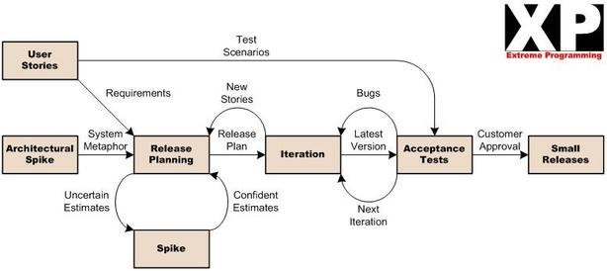
Chapter 1 - Introduction to Continuous Integration, Continuous Delivery and Jenkins-CI
1.2 XP Flow

Slide 4
Chapter 1 - Introduction to Continuous Integration, Continuous Delivery and Jenkins-CI
1.3 Extreme Programming
As time went on, people took inspiration from XP and developed other approaches with much the same goals
Speed
Include the Customer Early
Don't wait until you understand the entire problem - you'll understand it while you fix it
Deliver usable value at every iteration
Make reasonable use of modeling and development tools

Slide 5
Chapter 1 - Introduction to Continuous Integration, Continuous Delivery and Jenkins-CI
1.4 Agile Development
Two themes emerge from XP and Agile Development
Trust
Vendor, customer, managers, developers all need to trust each other
Automation
If we're going to go fast, we need tools that make it easy to produce software
Trust is a social problem – solution is all about different approaches to process, requirements gathering, project management, etc.
Automation is about tools – and Continuous Integration is a primary tool of Agile Development

Slide 6
Chapter 1 - Introduction to Continuous Integration, Continuous Delivery and Jenkins-CI
1.5 What is Continuous Integration
“Integrate and test changes after no more than a couple of hours.”
Beck & Andres “Extreme Programming Explained”
Integrate and build the complete product, atomic build product
If a website, build the website packaging, e.g. .NET, J2EE EAR
If a Javascript development, package the scripts and any configuration files

Slide 7
Chapter 1 - Introduction to Continuous Integration, Continuous Delivery and Jenkins-CI
1.6 What is Continuous Integration (cont'd)
Purposes
You find out quickly about integration problems
Immediately evident if a code change “breaks the build”
Prevents a long drawn-out integration step at the end of code changes
Should be complete enough that eventual first deployment of the system is “no big deal”.

Slide 8
Chapter 1 - Introduction to Continuous Integration, Continuous Delivery and Jenkins-CI
1.7 What is Continuous Integration (cont'd)
Usually, CI goes along with Test-First design and automated QA
Run the unit-test suite and smoke testing to ensure the build isn’t broken
Clearly, automatic build is a prerequisite
So we need a build system – Maven for instance
Can be synchronous or asynchronous
Asynchronous – Integration happens automatically on code committal
Synchronous – Trigger the build manually after a development session

Slide 9
Chapter 1 - Introduction to Continuous Integration, Continuous Delivery and Jenkins-CI
1.8 What is Continuous Integration (cont'd)
Side Effects
Generate development reports
Install to QA, User Test, etc
Always have an install-able artifact
It’s a great time to generate development metrics
E.g. Code Coverage, Standards Compliance, Static Analysis

Slide 10
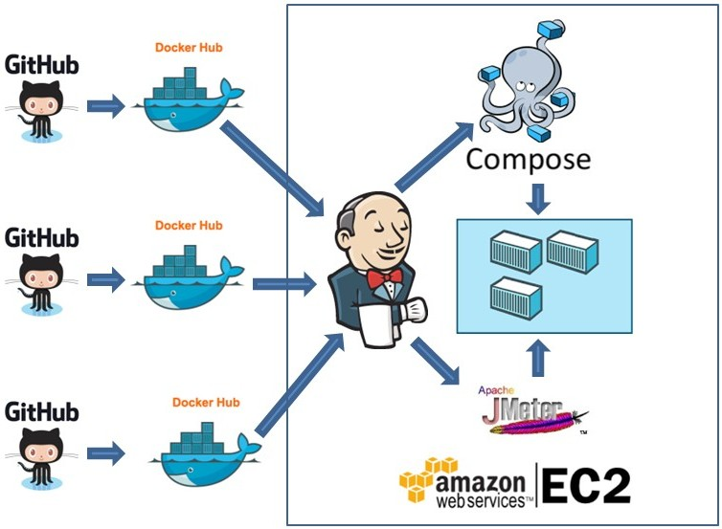
Chapter 1 - Introduction to Continuous Integration, Continuous Delivery and Jenkins-CI
1.9 Typical Setup for Continuous Integration

Slide 11
Chapter 1 - Introduction to Continuous Integration, Continuous Delivery and Jenkins-CI
1.10 Setup Notes for Continuous Integration
Notes:
CI system gets the code directly from version control
Build is independent of any local artifacts that are on the developer’s machine
Controlled links to corporate repository and Maven Central
Goal is to ensure that the package can be built from the corporate repository
Jenkins can have connections to a deployment environment
Production Staging
User Acceptance Testing
QA
Load Test
Etc…
It turns out that if we use Maven, we ABSOLUTELY NEED a local repository manager
More info to follow…

Slide 12
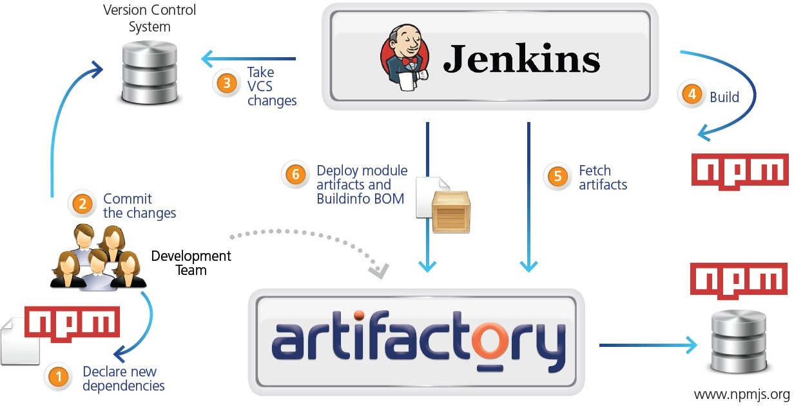
Chapter 1 - Introduction to Continuous Integration, Continuous Delivery and Jenkins-CI
1.11 CI with Artifact Management

Slide 13
Chapter 1 - Introduction to Continuous Integration, Continuous Delivery and Jenkins-CI
1.12 What is Continuous Delivery?
Using the definition from DevOps thought leader Martin Fowler
Continuous Delivery is a software development discipline where you build software in such a way that the software can be released to production at any time.
You’re doing continuous delivery when:
Your software is deployable throughout its lifecycle
Your team prioritizes keeping the software deployable over working on new features
Anybody can get fast, automated feedback on the production readiness of their systems any time somebody makes a change to them

Slide 14
Chapter 1 - Introduction to Continuous Integration, Continuous Delivery and Jenkins-CI
1.13 Why Continuous Delivery?
CD extends CI into readiness for deployment and operations
Agile/XP speeds up the development process
Include the Customer or Voice of the Customer
Ensure releasable artifact after every iteration
Nonetheless, Agile/XP releases fit into the standard Software Development Life Cycle
A release engineering and deployment process follows the development process.
Reflects traditional split between development and operations

Slide 15
Chapter 1 - Introduction to Continuous Integration, Continuous Delivery and Jenkins-CI
1.14 DevOps and Continuous Delivery
Managing deployments and development across horizontally-scaled environments is complex
We have to deploy more than one server/image/container
Requires tight control of the process
Requires automation of development, deployment and monitoring
Along with the technologies of virtualization, cloud, etc.
This is the central theme of DevOps - Integrated provision of services using appropriate technology and processes
Deploy software as fast as we create it, while maintaining quality, traceability and accountability
25

Slide 16
Chapter 1 - Introduction to Continuous Integration, Continuous Delivery and Jenkins-CI
1.15 Continuous Delivery Challenges
More than one department/group involved, not just Developers
QA, Compliance, Business Customers, etc
CI job takes a few minutes, CD process could extend over days
Could also include human input, manual tests, acceptance tests, etc
Extended cycle means we have multiple process instances "in flight"
"Version 6" part-way through User Acceptance Testing, while work continues on "Version 7"
Multiple resources and test/deployment environments involved
"Version 6" goes on to Performance Validation
"Version 7" moves into User Acceptance Testing
Meanwhile, development gets going on "Version 8"
27

Slide 17
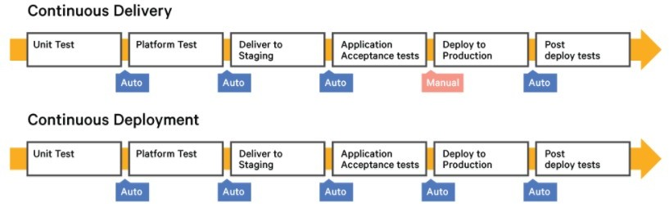
Chapter 1 - Introduction to Continuous Integration, Continuous Delivery and Jenkins-CI
1.16 Continuous Delivery vs Continuous Deployment

Slide 18
Chapter 1 - Introduction to Continuous Integration, Continuous Delivery and Jenkins-CI
1.17 Jenkins Continuous Integration
Originally developed at Sun by Kohsuke Kawaguchi
Originally “Hudson” on java.net circa 2005
Jenkins forked in November 2010
Hudson is still live, part of Eclipse Foundation
But Jenkins seems to be far more active

Slide 19
Chapter 1 - Introduction to Continuous Integration, Continuous Delivery and Jenkins-CI
1.18 Jenkins Features
Executes jobs based on a number of triggers
Change in a version control system
Time
Manual Trigger
A Job consists of some instructions
Run a script
Execute a Maven project or Ant File
Run an operating system command
User Interface can gather reports
Each job has a dashboard showing recent executions
Jenkins 2 adds the "Pipeline"
Orchestrate Continuous Delivery processes more easily

Slide 20
Chapter 1 - Introduction to Continuous Integration, Continuous Delivery and Jenkins-CI
1.19 Running Jenkins
You can run Jenkins Standalone or inside a web container
You can setup distributed instances that cooperate on building software
Can setup jobs in place of what might have been script commands.

Slide 21
Chapter 1 - Introduction to Continuous Integration, Continuous Delivery and Jenkins-CI
1.20 Summary
Continuous Integration is a powerful tool for agile software development
Jenkins is currently the dominant Continuous Integration tool

Slide 22
Chapter 2 - Installing and Running Jenkins
Objectives
Key objectives of this chapter
Downloading and Installing Jenkins.
Running Jenkins as a Stand-Alone Application.
Running Jenkins on an Application Server.
Installing Jenkins as a Windows Service.
Build Steps
Reporting on Test Results
Working with Maven Build Jobs

Slide 23
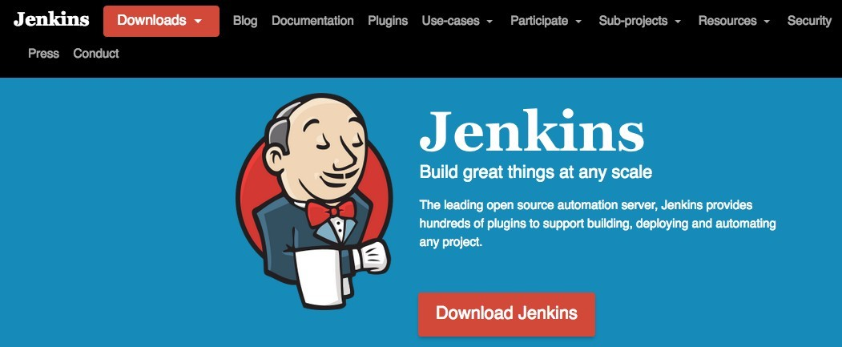
Chapter 2 - Installing and Running Jenkins
2.1 Downloading and Installing Jenkins
Download Jenkins from the Jenkins website (http://jenkins.io)
Jenkins is a dynamic project, and new releases come out at a regular rate.
Jenkins distribution is bundled in Java web application (a WAR file).
For Windows users, there is a graphical Windows installation MSI package
There are also native installers for several *nix variations (Ubuntu, Red Hat, FreeBSD, Mac OSX, etc), as well as Docker images

Slide 24

Chapter 2 - Installing and Running Jenkins
2.2 Running Jenkins as a Stand-Alone Application
Jenkins comes bundled as a WAR file that you can run directly with 'java -jar'.
Jenkins uses a lightweight, embedded Servlet engine to allow you to run the server out of the box.
Flexible to install plug-ins and upgrades on the fly.
To run Jenkins using the embedded Servlet container, just go to the command line and type the following:
The Jenkins web application will now be available on port 8080.
Jenkins can be accessed directly using the server URL (http://localhost:8080).
To stop Jenkins, just press Ctrl-C.
Note: Requires a Java run-time environment - JDK 7 or higher, JDK 8 recommended.
Note - some Linux distributions ship with GCJ, which doesn't work with Jenkins. Install OpenJDK or an Oracle JDK instead.

Slide 25
Chapter 2 - Installing and Running Jenkins
2.3 Running Jenkins as a Stand-Alone Application (cont'd)
Useful Options:
--httpPort
By default, Jenkins will run on the 8080 port.
Jenkins can be start on different port using the --httpPort option:
java -jar jenkins.war –httpPort=8081
--logfile
By default, Jenkins writes its logfile into the current directory.
Option to redirect your messages to other file:
java -jar jenkins.war --logfile=C:/Software/log/jenkins.log
These options can also be set at JENKINS_HOME/jenkins.xml config file.

Slide 26
Chapter 2 - Installing and Running Jenkins
2.4 Running Jenkins on an Application Server
Jenkins distribution WAR file can be easily deploy to standard Java application server such as Apache Tomcat, Jetty, or GlassFish.
Jenkins will be executed in its own web application context (typically “jenkins”).
URL : http://localhost:8080/jenkins.

Slide 27
Chapter 2 - Installing and Running Jenkins
2.5 The Jenkins Home Folder
When run either as stand-alone or in an application server, Jenkins will create a "home" folder called '.jenkins'
On Unix/Linux, this will be under the user that runs either Jenkins or the server
e.g. if Bob Smith runs Jenkins on his Mac,
/Users/smithb/.jenkins
e.g. Claire Jones runs Jenkins on Windows 8
C:\Users\claire\.jenkins

Slide 28
Chapter 2 - Installing and Running Jenkins
2.6 Installing Jenkins as a Windows Service
In production, we want Jenkins to run as a Windows Service
Jenkins will automatically start whenever the server reboots
Can be managed using the standard Windows administration tools.
Recent versions of Jenkins ship with an 'MSI'-style installer for Windows
Oddly, it's packed in a '.zip' file. Unpack the zip file to get the installer.
The installation includes a bundled Java Runtime Environment
Typically installs to 'C:\Program Files (x86)\Jenkins', but you can override it.
The same folder is used as the 'Jenkins Home' folder.
Start/Stop the service through the service control panel.
URL: http://localhost:8080
This can be configured in 'jenkins.xml' in the installation folder

Slide 29
Chapter 2 - Installing and Running Jenkins
2.7 Initial Configuration
When you first run Jenkins, it runs an installation wizard that forces you to:
Select a set of plugins
Setup an administrative user

Slide 30
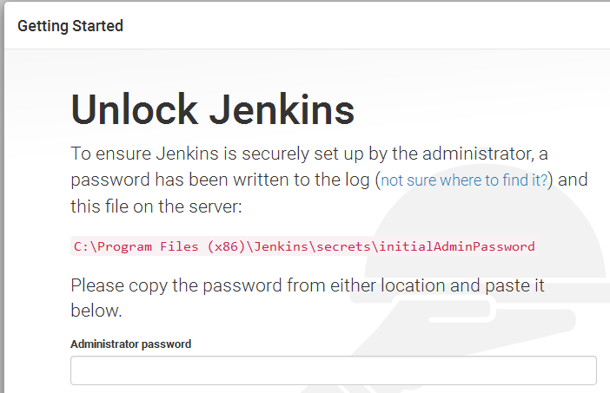
Chapter 2 - Installing and Running Jenkins
2.8 Configuration Wizard
When you access through 'http://localhost;8080' (I.e. Windows installer or embedded mode)
It will ask for a one-time password, which you can get from the server console or the file indicated

Slide 31
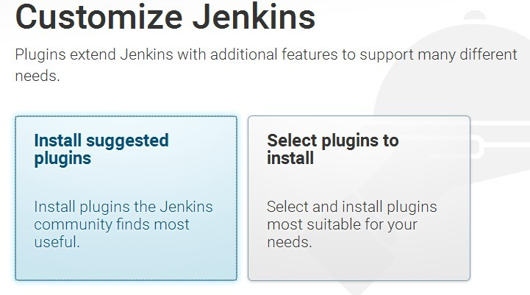
Chapter 2 - Installing and Running Jenkins
2.9 Configuration Wizard (cont'd)
Click on either "Install suggested Plugins" or "Select plugins to install"
Usually OK to start with the suggested plugins, unless you know your configuration needs customization

Slide 32
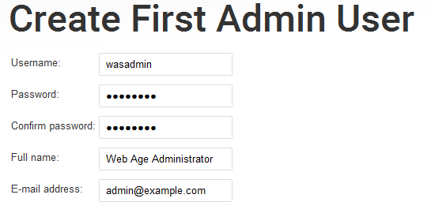
Chapter 2 - Installing and Running Jenkins
2.10 Configuration Wizard (cont'd)
As of Jenkins 2, Jenkins defaults to secure mode.
Create an Administrative user
That user can then do further configuration through the web interface
We'll cover security setup and secure-http in a later module.

Slide 33
Chapter 2 - Installing and Running Jenkins
2.11 Configuring Tools
Jenkins doesn't actually "build" anything - it uses tools
e.g. Java, Maven, Ant, gulp, grunt, etc
We might have multiple versions installed
A given job might only work with a particular version of Maven for instance
You might want to build/test against more than one version of Java
etc...
Install locations can vary across different hosts
Add tools through the web interface:
Manage Jenkins --> Global Tool Configuration
In general, need to supply the install location for each tool, along with an identifier

Slide 34
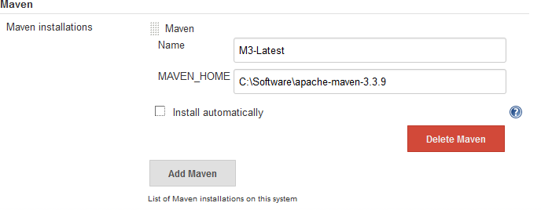
Chapter 2 - Installing and Running Jenkins
2.12 Configuring Tools - Best Practices
Provide a tool identifier for general use
e.g. 'M3-Default' or 'M3-Latest'
Keep this one updated - most jobs should use it
If you have jobs that need specific versions, then add the specific version

Slide 35
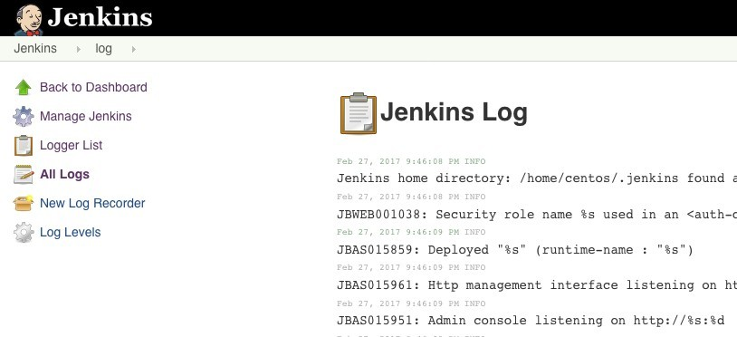
Chapter 2 - Installing and Running Jenkins
2.13 Logging in Jenkins
Jenkins uses the 'java.util.logging' package
Look in the web server's logging system
Jenkins also sets up its own logger and keeps the data in memory
Access the logs through Manage Jenkins → System Log
For build job problems, read through the build's console output

Slide 36
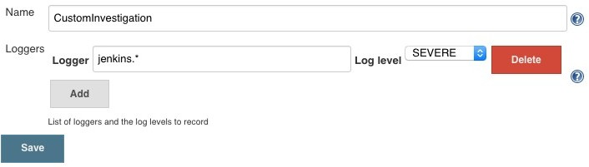
Chapter 2 - Installing and Running Jenkins
2.14 Custom Log Recorders
The system log records log messages to a memory-based ring buffer
Default is to log everything
You can create your own log recorders

Slide 37
Chapter 2 - Installing and Running Jenkins
2.15 Summary
Jenkins is a JEE Web Application
Can run as an embedded web server, in a web server installation, or as a Windows Service
Defaults to secure mode - some initial setup is required.
You need to setup tools - Java, Maven, Ant, etc.

Slide 38
Chapter 3 - Job Types in Jenkins
Objectives
Key objectives of this chapter
Different types of Jenkins job.
Configuring Source Code Management.
Working with Subversion
Build Triggers.
Schedule Build Jobs.
Maven Build Steps

Slide 39
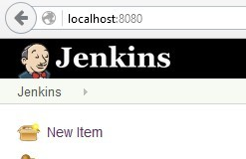
Chapter 3 - Job Types in Jenkins
3.1 Introduction
Traditional Continuous Integration tasks are called "Jobs"
More complicated tasks can be defined with the Pipeline, which we'll see later.
Create a new job by clicking 'New Item' from the main menu

Slide 40
Chapter 3 - Job Types in Jenkins
3.2 Different types of Jenkins Items
Jenkins supports several different types of items at the top level
Freestyle software project:
Freestyle projects are general purpose and allow to configure any sort of build job.
Highly flexible and very configurable.
Maven project:
Installed as a plugin
Jenkins understands Maven pom files and project structures.
Reduce the work needed to do to set up the project.
Monitor an external job:
Monitoring the non-interactive execution of processes, such as cron jobs.

Slide 41
Chapter 3 - Job Types in Jenkins
3.3 Different types of Jenkins Items (cont'd)
Multi-configuration job:
Run same build job in many different configurations.
Powerful feature, useful for testing an application in many different environments.
Folder:
aka the CloudBees Folders Plugin
Lets you group jobs in folders
Creates separate namespaces for jobs
Pipeline
Runs an orchestration script that can have multiple steps and span restarts
Multibranch Pipeline
Creates a pipeline for more than one branch in an SCM repository

Slide 42
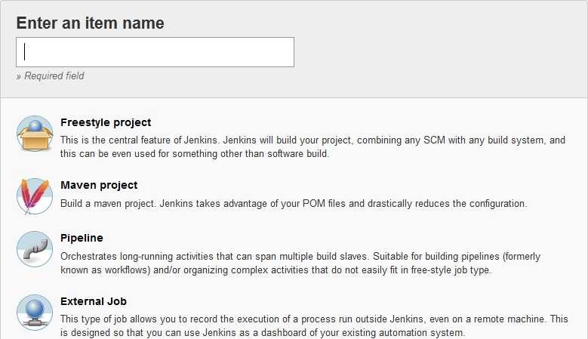
Chapter 3 - Job Types in Jenkins
3.4 Different types of Jenkins Items (cont'd)

Slide 43
Chapter 3 - Job Types in Jenkins
3.5 Configuring Source Code Management(SCM)
Monitors version control system, and checks out the latest changes as they occur.
Compiles and tests the most recent version of the code.
Simply check out and build the latest version of the source code on a regular basis.
SCM configuration options in Jenkins are identical across all sorts of build jobs.
Jenkins supports Git and Subversion out of the box (default plugins)
Integrates with a large number of other version control systems via plugins.

Slide 44
Chapter 3 - Job Types in Jenkins
3.6 Working with Subversion
Simply provide the corresponding Subversion URL
Supported protocols http, svn, or file.
Jenkins will check that the URL is valid as soon as you enter it.
If authentication needed, Jenkins will prompt you for the corresponding credentials automatically, and store them for any other build jobs that access this repository.
Fine-tune Jenkins to obtain the latest source code from your Subversion repository by selecting an appropriate value in the Check-out Strategy drop-down list.
Choose check-out Strategy as “Use ‘svn update’ as much as possible, with ‘svn revert’ before update”
No local files are modified, though it will not remove any new files that have been created during the build process.
You might want other options, depending on the load on your svn server.

Slide 45
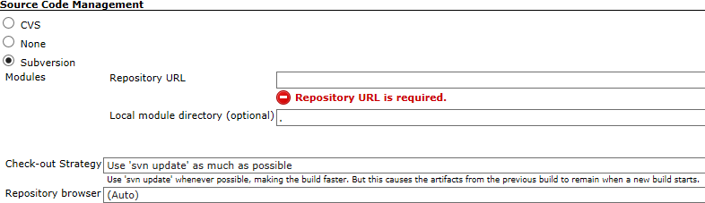
Chapter 3 - Job Types in Jenkins
3.7 Working with Subversion (cont'd)
◊

Slide 46
Chapter 3 - Job Types in Jenkins
3.8 Working with Git
Git support is in a plugin, but is installed by default if you select "Install suggested plugins" at initial setup.
Any type of remote repository can be used:
Could be https, ssh, or local
Jenkins will check that the URL is valid as soon as you enter it.
You can store ssh credentials or http credentials
There are a wide variety of other "Additional Checkout Behaviors" that are possible

Slide 47
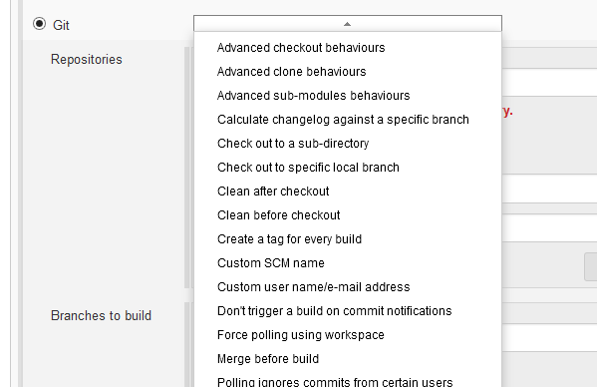
Chapter 3 - Job Types in Jenkins

Slide 48

Chapter 3 - Job Types in Jenkins
3.9 Storing Credentials
Usually, SCM systems require login
The values we use for login are called "Credentials" and can be managed centrally
As a convenience, you can add them directly from the job configuration screen
Click 'Add' and then select 'Jenkins Credential Provider'

Slide 49
Chapter 3 - Job Types in Jenkins
3.10 Service Accounts
As a general rule, you don't want users to put their own credentials into Jenkins jobs or other setups
The correct thing to do is create accounts for Jenkins
i.e. "Service Accounts"
Jenkins then has an identity that it uses to access things
Administration personnel maintain the credentials in Jenkins for the service account
No users can see or download the stored credentials

Slide 50
Chapter 3 - Job Types in Jenkins
3.11 Storing Credentials (cont'd)
You can store several types of credentials
User name/Password
SSH Key
Secret file
Secret text
X.509 Certificate
Other plugins are available

Slide 51
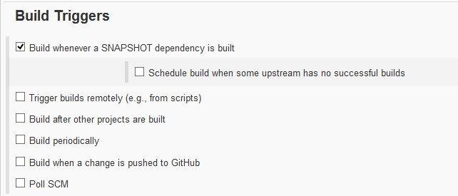
Chapter 3 - Job Types in Jenkins
3.12 Build Triggers
In a Freestyle build, there are three basic ways a build job can be triggered
Start a build job once another build job has completed
Kick off builds at periodic intervals
Poll the SCM for changes

Slide 52
Chapter 3 - Job Types in Jenkins
3.13 Schedule Build Jobs
Build job at regular intervals.
For all scheduling tasks, Jenkins uses a cron-style syntax, consisting of five fields separated by white space in the following format:
MINUTE : Minutes within the hour (0–59)
HOUR : The hour of the day (0–23) DOM
DOM : The day of the month (1–31)
MONTH : The month (1–12)
DOW : The day of the week (0–7) where 0 and 7 are Sunday.
There are also a few short-cuts:
“*” represents all possible values for a field. For example, “* * * * *” means “once a minute.”
You can define ranges using the “M–N” notation. For example “1-5” in the DOW field would mean “Monday to Friday.”
You can use the slash notation to defined skips through a range. For example, “*/5” in the MINUTE field would mean “every five minutes.”
A comma-separated list indicates a list of valid values. For example, “15,45” in the MINUTE field would mean “at 15 and 45 minutes past every hour.”

Slide 53
Chapter 3 - Job Types in Jenkins

Slide 54
Chapter 3 - Job Types in Jenkins
3.14 Polling the SCM
Poll SVN or Git server at regular intervals if any changes have been committed.
The more frequent the polling is, the faster the build jobs will start, and the more accurate.
But, there's more load on the SCM server
In Jenkins, SCM polling is easy to configure, and uses the same cron syntax we discussed previously.

Slide 55
Chapter 3 - Job Types in Jenkins
3.15 Polling vs Triggers
Many SCMs can have "hooks" added
For instance a script can be run when changes are pushed to a repository
You could use a hook to trigger a build
Typical way is to use "curl" to initiate a build
In the project configuration, enable "Trigger builds remotely"
Jenkins will show you a URL that triggers the build
Triggering may be more work to setup
Polling may be more overhead on the SCM repository
Especially if you have a large number of Jenkins jobs
You probably need to experiment!

Slide 56
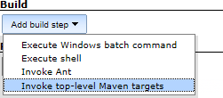
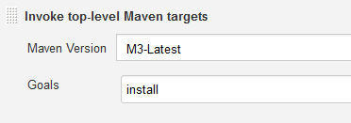
Chapter 3 - Job Types in Jenkins
3.16 Maven Build Steps
Jenkins has excellent Maven support, and Maven build steps are easy to configure and very flexible.
Select “Invoke top-level Maven targets” from the build step lists.
Select a version of Maven to run (if you have multiple versions installed)
Enter the Maven goals you want to run. Jenkins freestyle build jobs work fine with both Maven 2 and Maven 3.
The optional POM field lets you override the default location of the Maven pom.xml file.

Slide 57
Chapter 3 - Job Types in Jenkins
3.17 Summary
Learned how Jenkins checks out the source code of a project.
How to set-up and schedule a job.
Setup build for Maven project.

Slide 58
Chapter 4 - Advanced Jobs
Objectives
Key objectives of this chapter
Parameterized Jobs
Configuration Matrix
Monitoring External Jobs

Slide 59
Chapter 4 - Advanced Jobs
4.1 Parameterized Jobs
With a parameterized job, we can define parameters, and then supply values for those parameters when we run the job
When we hit "build now", the page asks for parameter values
You can also provide parameters when starting the job using http.

Slide 60
Chapter 4 - Advanced Jobs
4.2 Built-in Environment Variables
All of our values in the configuration can be constructed using 'environment variables'
Any parameters we set on the job are also accessible
Several environment variables are built-in
BUILD_NUMBER
BUILD_ID
BUILD_UR
NODE_NAME
JOB_NAME
BUILD_TAG (JOB_NAME – BUILD_NUMBER)
JENKINS_URL
EXECUTOR_NUMBER JAVA_HOME
WORKSPACE
SVN_REVISION
CVS_BRANCH

Slide 61
Chapter 4 - Advanced Jobs
GIT_COMMIT
GIT_URL
GIT_BRANCH

Slide 62
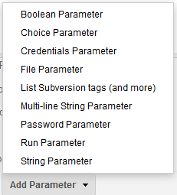
Chapter 4 - Advanced Jobs
4.3 Parameter Types
Jenkins has the following types of parameters:
Some of these define values that you can enter
Boolean, String, Password, Choice
Others give you choices from the Jenkins environment
Credentials, Run, Subversion tags
File parameter lets the user upload a file

Slide 63
Chapter 4 - Advanced Jobs
4.4 Defining Parameters
Define parameters for the job by selecting "This build is parameterized" in the job configuration
Select the parameter type

Slide 64
Chapter 4 - Advanced Jobs
4.5 Using Parameters / Environment Variables
The parameters are available as environment variables
How you use them depends on where you're using them
Shell: $FOO
Windows batch command: %FOO%
Ant or Maven properties: ${env.FOO}
As values in the Jenkins job configuration: ${FOO}
But whether they're recognized depends on the plugin that's running that step

Slide 65
Chapter 4 - Advanced Jobs
4.6 Parameters in the config.xml File
When parameters are defined in a job, they are available in the job's config.xml file
You can access the config.xml at:
http://<jenkins-host>/job/<job-name>/config.xml
e.g. http://localhost:8080/job/ParameterSample/config.xml

Slide 66
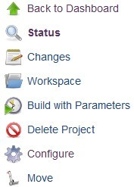
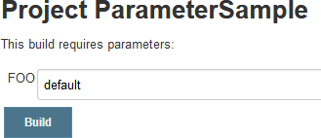
Chapter 4 - Advanced Jobs
4.7 Launching a Build with Parameters
Build with Parameters
Start a build by POSTing to the following URL
http://server/job/myjob/buildWithParameters?PARAMETER=Value

Slide 67
Chapter 4 - Advanced Jobs
4.8 Configuration Matrix
Aka. Multi-configuration Project
It is useful for instances where your builds will use many similar build steps
for instance, building on many different agent nodes
or using different build configurations
By using matrix configuration, you avoid duplicating steps or jobs
Don't Repeat Yourself!
Configuration Matrix allows you to run the job with a variety of different, but pre-set parameters

Slide 68
Chapter 4 - Advanced Jobs
4.9 Configuration Matrix – Example
Imagine you have a build that you want to create for several different environments (dev, test, prod), and you want to produce both debug and release outputs.
With freestyle job, you would have the following Ant build steps
Ant: set-target-dev debug compile Ant: set-target-test debug compile Ant: set-target-prod debug compile Ant: set-target-dev release compile Ant: set-target-test release compile Ant: set-target-prod release compile
It can be reduced to one build step using variables
Ant: $target $releasetype compile
The above would require adding two User Defined Axes in the Configuration Matrix, it would be defined like this:

Slide 69
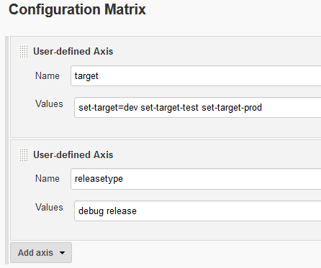
Chapter 4 - Advanced Jobs
The Name target and releasetype are exposed to the build steps as environment variables. The Value is a space delimited list of points to iterate through for each axis.

Slide 70
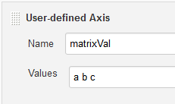

Chapter 4 - Advanced Jobs
4.10 Defining Configuration Matrix
User-defined Axis
Now you'll see three configurations:

Slide 71
Chapter 4 - Advanced Jobs
4.11 Monitoring External Jobs
A remote job can be monitored by a Jenkins instance
Create a job using "Monitor an external job"
Java must be installed on the machine where the external job is running.
Install Jenkins JAR files on the machine where the external job is running
For Debian / Ubuntu
sudo apt-get install jenkins-external-job-monitor
export JENKINS_HOME=http://@localhost:8080/
java -jar /usr/share/jenkins/external-job-monitor/java/jenkins-core-*.jar "external- build-job-name" command-to-run
On Windows
Copy following JAR files by extracting jenkins.war file
jenkins-core-*.jar remoting-*.jar ant-1.7.0.jar commons-io-1.4jar
commons-lang-2.4.jar
jna-posix-*.jar xstream-*.jar
set JENKINS_HOME=http://user:pw@myserver.acme.org/path/to/jenkins/

Slide 72
Chapter 4 - Advanced Jobs
java -jar \path\to\WEB-INF\lib\jenkins-core-*.jar "job name" cmd.exe /c <program arg1 arg2...>

Slide 73
Chapter 4 - Advanced Jobs
4.12 Summary
Parameterized builds allows you to create flexible Jenkins jobs
Configuration Matrix reduces the effort required to run multiple builds with similar steps
Jenkins "Monitor an external job" can be used to monitor external jobs.

Slide 74
Chapter 5 - Non-Java Jenkins Jobs
Objectives
Key objectives of this chapter
Understanding Jenkins Jobs
Building and Executing .NET based Jenkins Jobs
Building and Executing C++ based Jenkins Jobs
Building and Executing Node.js based Jenkins Jobs
Executing PowerShell based Jenkins Jobs

Slide 75
Chapter 5 - Non-Java Jenkins Jobs
5.1 Jenkins Jobs
In Jenkins the definition of a build process is called a Job
Jobs are created using the main menu on the Jenkins home page.
A job can be composed of multiple steps.
Examples of steps include connecting to source code repository, executing shell / batch scripts, and sending emails.
More types of steps can be added by installing plugins in Jenkins.

Slide 76
Chapter 5 - Non-Java Jenkins Jobs
5.2 Non-Java Jobs
Source Code repository
Git
SVN
TFVC
...
.NET Project
MSBuild
MSTest
…
Node.js
node.exe
npm.exe
PowerShell
C++

Slide 77
Chapter 5 - Non-Java Jenkins Jobs
5.3 Building .NET Projects with Jenkins
Install MSTest plugin in Jenkins
Configure the MSBuild plugin
Install MSTestRunner plugin in Jenkins
Configure the MSTestRunner plugin
Create a Jenkins Job to build and test the .NET project
Deploy the project
Run the Job

Slide 78
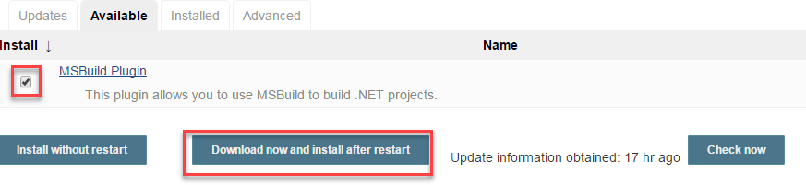
Chapter 5 - Non-Java Jenkins Jobs
5.4 Installing MSTest Plugin in Jenkins
Install MSTest plugin in Jenkins

Slide 79
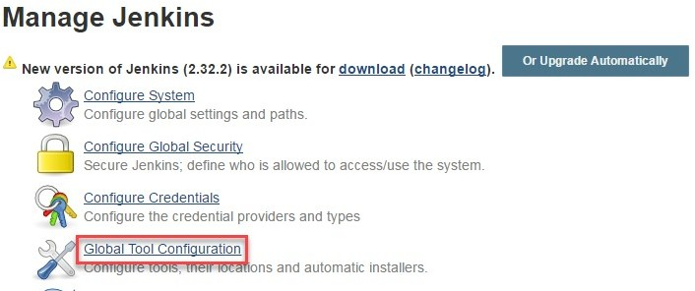
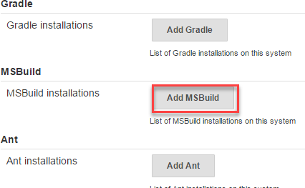
Chapter 5 - Non-Java Jenkins Jobs
5.5 Configuring the MSBuild Plugin
Manage Jenkins > Global Tool Configuration
Configure MSBuild
Add path to msbuild.exe

Slide 80
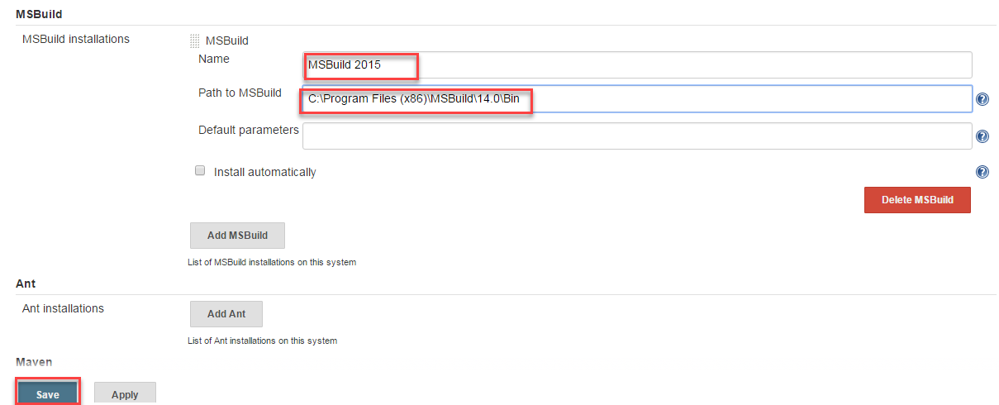
Chapter 5 - Non-Java Jenkins Jobs

Slide 81
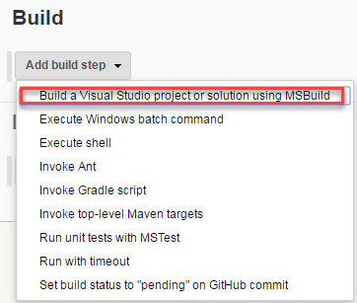
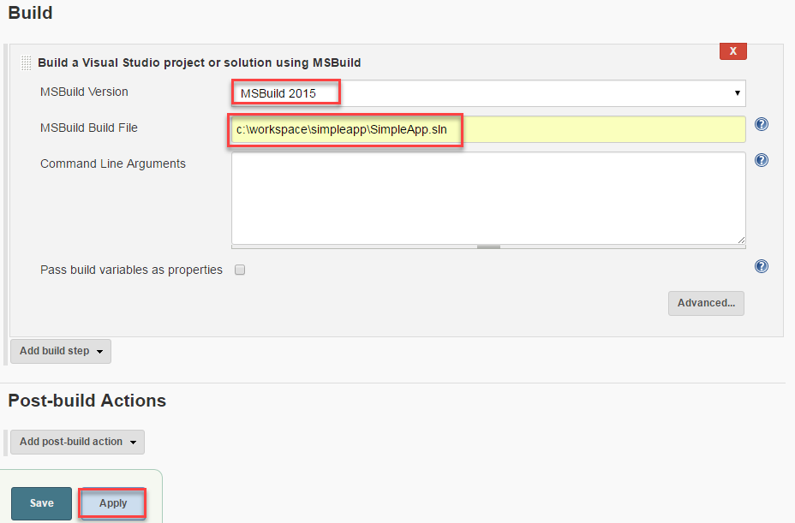
Chapter 5 - Non-Java Jenkins Jobs
5.6 Creating a Jenkins Job and Specify a Build Step
Add a build step
Specify solution (.sln) file

Slide 82
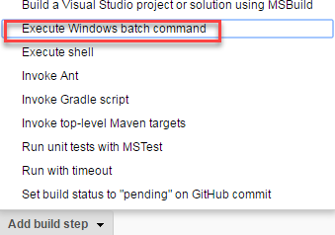
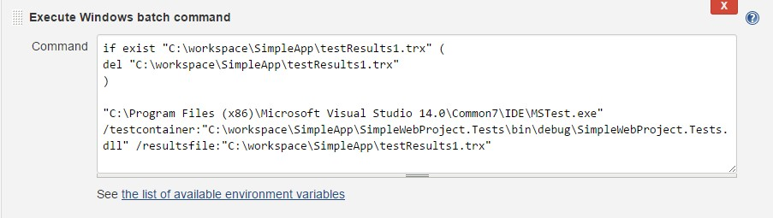
Chapter 5 - Non-Java Jenkins Jobs
5.7 Specifying a Step for Running Unit Tests
You can define a step for running unit tests in various ways
MSTestRunner plugin
Execute Windows batch command
Define a Windows batch command

Slide 83
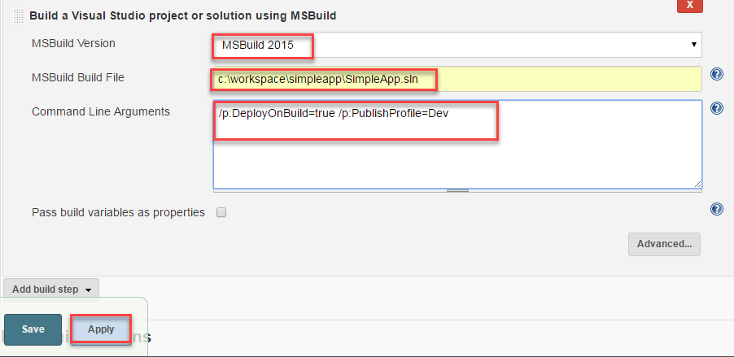
Chapter 5 - Non-Java Jenkins Jobs
5.8 Adding a Step for Deploying the .NET Project
Configure MSBuild Build File and Command Line Arguments.

Slide 84

Chapter 5 - Non-Java Jenkins Jobs
5.9 Building a Node.js Application with Jenkins
Execute Windows batch command
npm install
Running unit tests with Mocha
Publish test results with post-build action

Slide 85
Chapter 5 - Non-Java Jenkins Jobs
5.10 Node.js Plugin
Running Node projects from a shell script will be fine for many projects
There is also a Node.js plugin
It only runs on Linux
Provides auto-installers
Lets you create multiple Node environments
Different versions
Different sets of global modules

Slide 86
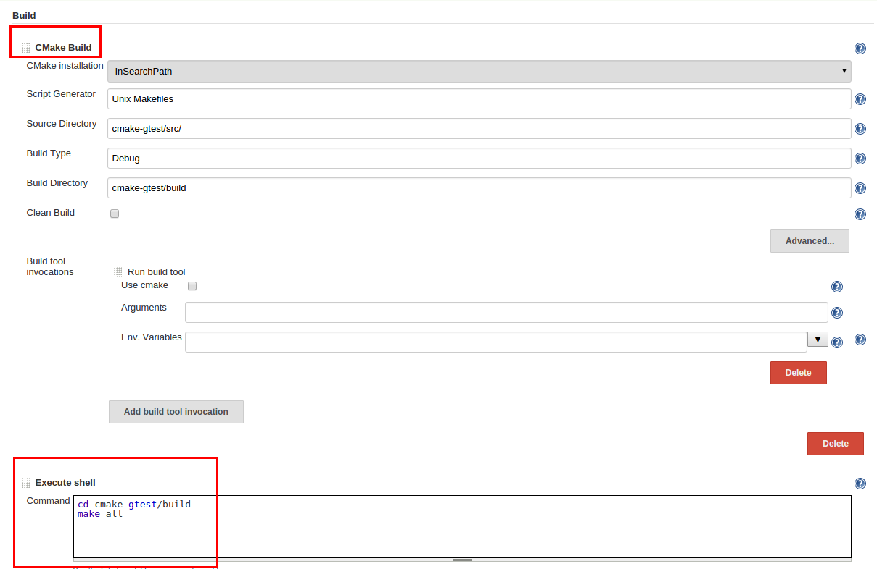
Chapter 5 - Non-Java Jenkins Jobs
5.11 Provides direct Pipeline supportBuilding a C++ Project with Jenkins
Install CMake plugin in Jenkins
CMake is used for generating a MakeFile
The CMake plugin is useful if you want Jenkins to use a specific version of CMake
Add a CMake build step
Run "make all" from the build directory
s

Slide 87
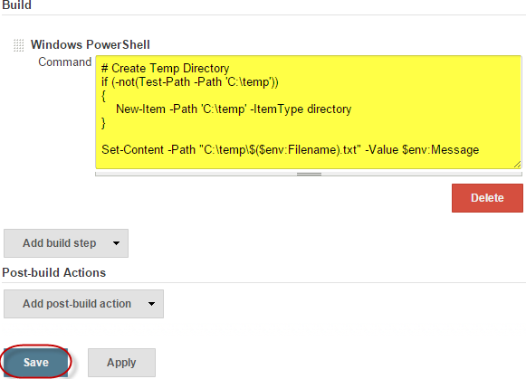
Chapter 5 - Non-Java Jenkins Jobs
5.12 Executing PowerShell Scripts with Jenkins
Install PowerShell plugin in Jenkins
Manage Jenkins > Manage Plugins
Add a PowerShell build step
Run the Jenkins job

Slide 88
Chapter 5 - Non-Java Jenkins Jobs
5.13 Summary
Jenkins has various plugins for building / executing non-Java projects, such as .NET, Node.js, C++, PowerShell etc.

Slide 89
Chapter 6 - Template Jobs
Objectives
Key objectives of this chapter
Multiple SCMs Plugin
The Template Project Plugin
Plugins configuration in config.xml

Slide 90
Chapter 6 - Template Jobs
6.1 Template Jobs
Template job allows creating a job based on some existing job
It allows multiple jobs to follow the same basic set of steps
Requires "Template Project" plugin

Slide 91
Chapter 6 - Template Jobs
6.2 Template Jobs (Contd.)
The Templates plugin brings meta-programming to Jenkins
It shields Jenkins configuration from end users. Administrators can allow end users to modify the domain specific features of the job, yet not expose the entire job configuration to them.
It captures the "sameness" of configuration across environments. It's useful when organizations have a large number of jobs that differ by only a few things.
e.g. a job that pulls from a different Git repository branch for every developer

Slide 92
Chapter 6 - Template Jobs
6.3 Template Jobs (Contd.)
The Templates plugin has a notion of reusable components.
Think of them as an equivalent of class, attributes, and instance from the object oriented programming paradigm
These components are the building blocks that can be used to build other components or can be instantiated in standalone manner.
One huge advantage of using the Templates plugin is that if the template definition changes, then it is reflected in all jobs using that template, thus simplifying management of large numbers of jobs

Slide 93
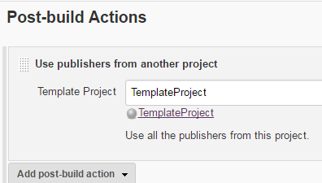
Chapter 6 - Template Jobs
6.4 Template Jobs Plugin
Installation
Manage Plugins > Available Tab
Template Job Plugin
Using Template Job Plugin as Post-build step
Use publishers from another project

Slide 94

Chapter 6 - Template Jobs
6.5 Template Jobs Plugin - config.xml
When Template Jobs Plugin is used by a job as a build / post-build step, it's reflected by the config.xml

Slide 95
Chapter 6 - Template Jobs
6.6 Summary
Build / Post-build steps can be reused from a job by using the Templates Plugin
When you reuse build steps, it's reflected by the job's config.xml file

Slide 96
Chapter 7 - Continuous Delivery and the Jenkins Pipeline
Objectives
Key objectives of this chapter
Continuous Delivery
The Jenkins Pipeline
A Brief Introduction to Groovy
The JenkinsFile
Pipeline Jobs

Slide 97
Chapter 7 - Continuous Delivery and the Jenkins Pipeline

Slide 98
Chapter 7 - Continuous Delivery and the Jenkins Pipeline
7.1 Continuous Delivery
CD extends CI into deployment and operations
Agile/XP speeds up the development process
Include the Customer or Voice of the Customer
Ensure releasable artifact after every iteration
Nonetheless, Agile/XP releases fit into the standard Software Development Life Cycle
A release engineering and deployment process follows the development process.
Reflects traditional split between development and operations

Slide 99
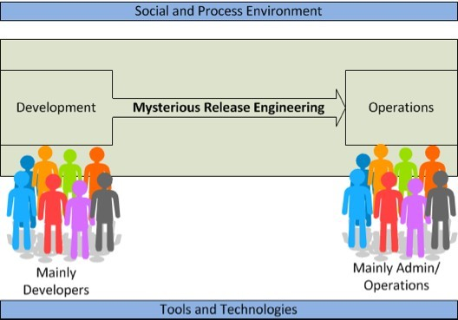
Chapter 7 - Continuous Delivery and the Jenkins Pipeline
7.2 Continuous Delivery (cont'd)
113

Slide 100
Chapter 7 - Continuous Delivery and the Jenkins Pipeline
7.3 DevOps and Continuous Delivery
Managing deployments and development across horizontally-scaled environments is difficult
Requires tight control of the process
Requires automation of development, deployment and monitoring
Along with the technologies of virtualization, cloud, etc.
This is the central theme of DevOps - Integrated provision of services using appropriate technology and processes
Deploy software as fast as we create it, while maintaining quality, trace-ability and accountability
115

Slide 101
Chapter 7 - Continuous Delivery and the Jenkins Pipeline
7.4 Continuous Delivery Challenges
More than one department/group involved, not just Developers
QA, Compliance, Business Customers, etc
CI job takes a few minutes, CD process could extend over days
Could also include human input, manual tests, acceptance tests, etc
Extended cycle means we have multiple process instances "in flight"
"Version 6" part-way through User Acceptance Testing, while work continues on "Version 7"
Multiple resources and test/deployment environments involved
"Version 6" goes on to Performance Validation
"Version 7" moves into User Acceptance Testing
Meanwhile, development gets going on "Version 8"
117

Slide 102
Chapter 7 - Continuous Delivery and the Jenkins Pipeline
7.5 Continuous Delivery with Jenkins
Jenkins has always been useful for this
A job completed successfully can trigger another job
Jobs can be run on different machines
Parameterized jobs can gather information from users
Plugins can manage deployment
Workflow processing has been difficult though
Builds in-process don't persist across restart
No logic in linking jobs
No unified user interface
Job definitions are not in Version Control
Solution: The Pipeline Plugin
119

Slide 103
Chapter 7 - Continuous Delivery and the Jenkins Pipeline
7.6 The Pipeline Plugin
Represents a workflow
More like a business process in SOA
whereas a "Job" is more like a "Service Operation"
Define a process and then execute an "instance"
Completion of the process can span more than one machine
Process has "State"
"where are we in the process"
Process variables
State is stored persistently
Also distributed when the build uses a different machine

Slide 104
Chapter 7 - Continuous Delivery and the Jenkins Pipeline
7.7 The Pipeline Plugin (cont'd)
Steps can be executed conditionally
Can have explicit parallelism
And can span machines
Definition of Pipeline can be stored in Version Control
Including all the steps that would make traditional "jobs"
User Interface
lets us see multiple instances
See processes that span distributed installations
Interact with the process (input and output)

Slide 105
Chapter 7 - Continuous Delivery and the Jenkins Pipeline
7.8 Defining a Pipeline
The pipeline is defined by a script written in the Groovy programming language
http://groovy-lang.org
The script defines "steps" that the Pipeline plugin executes
Steps:
built-in steps like "checkout" , "sh" or "bat"
Calls to plugins
Calls to existing jobs

Slide 106
Chapter 7 - Continuous Delivery and the Jenkins Pipeline
7.9 A Pipeline Example
node {
stage 'Checkout' checkout scm
stage 'Build'
bat 'nuget restore SolutionName.sln'
bat "\"${tool 'MSBuild'}\" SolutionName.sln"
stage 'Archive'
archive 'ProjectName/bin/Release/**'
}

Slide 107
Chapter 7 - Continuous Delivery and the Jenkins Pipeline
7.10 Pipeline Example (cont'd)
'node' indicates a section that should be run on an Agent machine
'stage' defines a pipeline stage
for presentation in the UI
'checkout' invokes the SCM plugin to checkout a copy of the project on the node in question
Note: this file would be stored in version control and checked-out by the Jenkins master. 'checkout' is checking out the same project on the execution node
'bat' runs a Windows batch file
'archive' stores the build results

Slide 108
Chapter 7 - Continuous Delivery and the Jenkins Pipeline
7.11 Parallel Execution
Sections of the pipeline can be executed in parallel
def labels = ['precise', 'trusty'] // labels for Jenkins node types we will build on
def builders = [:]
for (x in labels) {
def label = x // Need to bind the label variable before the closure - can't do 'for (label in labels)'
// Create a map to pass in to the 'parallel' step so we can fire all the builds at once
builders[label] = { node(label) {
// build steps that should happen on all nodes go here
}
}
}
parallel builders

Slide 109
Chapter 7 - Continuous Delivery and the Jenkins Pipeline
7.12 Creating a Pipeline
Various ways
From the UI, like a Job
Enter pipeline script into the web interface
This is nice because of syntax help available
In a "Jenkinsfile"
Stored in version control
Could be in the same repository as a project, or in its own repository
Commonly-used scripts and functions can be stored in a "Global Library"
Jenkins runs an instance of 'Git' to let you push global libraries that are then available to all Pipeline scripts.
Libraries can be stored in the project and loaded as needed.

Slide 110
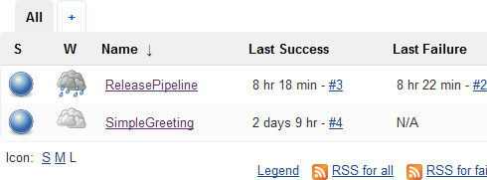
Chapter 7 - Continuous Delivery and the Jenkins Pipeline
7.13 Invoking the Pipeline
The pipeline shows up just like a regular Jenkins job
It can be invoked manually, at a predefined interval, or based on SCM polling
Just like a regular job

Slide 111
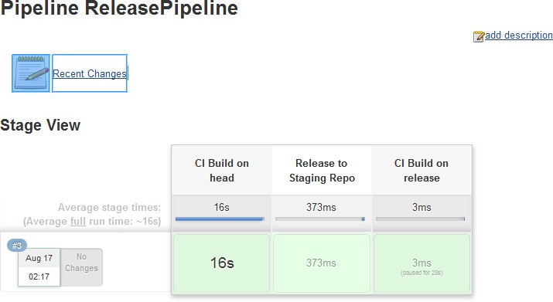
Chapter 7 - Continuous Delivery and the Jenkins Pipeline
7.14 Interacting with the Pipeline
Stages in the pipeline appear on the user interface
In case of input required or output, these appear on the UI

Slide 112
Chapter 7 - Continuous Delivery and the Jenkins Pipeline
7.15 Pipeline vs Traditional Jobs
In the long term, we expect that use of traditional (config.xml) jobs will be replaced by Pipeline jobs
'config.xml' is not stored in version control
It is possible to manually store it, but Jenkins doesn't know anything about versioning the config.xml
Libraries allow the same process to be applied to multiple jobs
Plugins like the "BitBucket Branch Source Plugin" and the "GitHub Branch Source Plugin" let administrators basically apply the same job setup to all the repositories in a given organization
Under this practice, you get a CI job/jobs automatically when the repository is created

Slide 113
Chapter 7 - Continuous Delivery and the Jenkins Pipeline
7.16 Conclusion
The Pipeline plugin turns Jenkins into an Orchestration system
Continuous Delivery processes may span extended time periods
Pipeline definition is in the form of a Groovy script
The Jenkins UI lets you interact with the Pipeline

Slide 114
Chapter 8 - Groovy DSL
Objectives
Key objectives of this chapter
Basic Groovy Syntax
Defining Functions
Defining Classes
Classes vs Scripts
Defining Shared Libraries
Using Shared Libraries

Slide 115
Chapter 8 - Groovy DSL
8.1 What is Groovy
Groovy is an object oriented language
It is based on Java platform.
First released in 2007.
It is distributed via the Apache License.

Slide 116
Chapter 8 - Groovy DSL
8.2 Groovy in Jenkins
Groovy can be executed in Jenkins in various ways
Script Console (http://localhost:8080/script)
Execute system groovy script (Build step)
Runs in Jenkins' JVM.
Jenkins' system is available to the scripts
Execute groovy script (Build step)
Runs outside Jenkins' JVM.
Jenkins' system isn't available to scripts
Groovy PostBuild Plugin
Pipeline Job Command

Slide 117
Chapter 8 - Groovy DSL
8.3 Comments in Groovy
Single-line comment
//
Multi-line comment
/*
*/

Slide 118
Chapter 8 - Groovy DSL
8.4 Data Types
Built-in types
byte
short
int
long
float
double
char
Boolean
String
Object types
java.lang.Byte
java.lang.Short
java.lang.Long
java.lang.Float

Slide 119
Chapter 8 - Groovy DSL
java.lang.Double
java.math.BigInteger
java.math.BigDecimal

Slide 120
Chapter 8 - Groovy DSL
8.5 Identifiers
Identifiers are used to define variables, functions, or other user defined objects.
Identifiers start with a letter, a dollar, or an underscore.
They cannot start with a number.
e.g.
customer123name, _customer123Name, customer_name123

Slide 121
Chapter 8 - Groovy DSL
8.6 Variables
Case-sensitive
Variable declarations
String message = "Hello World";
int a = 5;
Printing variables
println message;
println(message);
print message;
print(message);

Slide 122
Chapter 8 - Groovy DSL
8.7 def
def keyword can be used to define an identifier
When using def, the actual type holder is Object (so you can assign any object to variables defined with def, and return any kind of object if a method is declared returning def)
e.g.
def x = 5;

Slide 123
Chapter 8 - Groovy DSL
8.8 String Interpolation
String interpolation requires double quotes.
String name = "Bob";
String message = "Hi, ${name}";

Slide 124
Chapter 8 - Groovy DSL
8.9 Operators
Arithmetic
◊ +, -, *, /, %, ++, --
Relational
◊ ==, !=, <, <=, >, >=
Logical
&&, ||, !
Bitwise
&, |, ^, ~
Assignment
◊ +=, -=, *=, /=, %=
Range
..
e.g. def range = 5..10
println(range); //prints [5,6,7,8,9,10]
println(range.get(2); //prints 7

Slide 125
Chapter 8 - Groovy DSL
8.10 Ranges
Range examples
1..5 (inclusive range)
1..<5 (exclusive range)
5..1 (descending order)
'a'..'f' (character range)
'f'..'a' (descending order)
Methods
contains(val)
get(pos)
size()
subList(fromIndex, toIndex)

Slide 126
Chapter 8 - Groovy DSL
8.11 Conditional Statements
if
if (a < 5) {
println("A is less than 5");
}
if / else
if(a < 5) {
println("A is less than 5");
}
else if(a == 5) {
println("A is equal to 5");
}
else {
println("A is greater than 5");
}
switch
switch(a) {
case 1:
println("A is 1"); break;
case 2:

Slide 127
Chapter 8 - Groovy DSL
println("A is 2"); break;
default:
println("Unknown"); break;
}

Slide 128
Chapter 8 - Groovy DSL
8.12 Loops
for
for(int a = 0; a < 10; a++) { println(a);
}
for-in
String[] teams = ["Flames", "Maples", "Oilers" ]; for(String team in teams) {
println(team);
}
while
while(a < 5) {
println(a); a++;
}
Additional keywords
break
while(a < 5) {
println(a); a++;

Slide 129
Chapter 8 - Groovy DSL
if(a == 3) {
break;
}
}
continue
while(a < 5) {
println(a); a++;
if(a == 3) {
continue;
}
}

Slide 130
Chapter 8 - Groovy DSL
8.13 Lists
List examples
[] // an empty list
[1, 2, 3, 4, 5]
[1, 2, [3, 4], 5] // a nested list
['apple', 'banana', 'cherry'] // a list of strings
[1, 'apple', 2, 'banana'] // heterogeneous list
Methods
list.add(val);
list.remove(val);
list.contains(val);
list.get(3);
list.isEmpty();
list.minus(anotherList);
list.plus(anotherList);
list.pop();

Slide 131
Chapter 8 - Groovy DSL
list.reverse();
list.size();
list.sort();

Slide 132
Chapter 8 - Groovy DSL
8.14 Maps
Dictionary / table / hash
Unordered collection of object references
key / value pair
e.g.
[ : ] // an empty map
teams = ['Calgary': 'Flames', 'Toronto': 'Maples']
Processing all items in a map
for(team in teams) { println(team);
}
Methods
map.containsKey(key);
map.get(key);
map.put(key, value);
map.size();

Slide 133
Chapter 8 - Groovy DSL
8.15 Exception Handling
try .. catch .. finally
try {
def arr = [1,2,3]; def item = arr[7]; println(item);
}
catch(ArrayIndexOutOfBoundsException ex) { println(ex.getMessage());
}
catch(Exception ex) {
println ("Some other exception");
}
finally {
println("always executed");
}

Slide 134
Chapter 8 - Groovy DSL
8.16 Methods
A method is defined with a return type or with the def keyword.
e.g.
def sum(def a, def b) { return a + b;
}
def result = sum(5,6);
Default parameters
def sum(def a = 5, def b = 6) { return a + b;
}
def result1 = sum(5); def result2 = sum();
Return keyword and semi-colon are optional, but recommended
def sum(def a, def b) { a + b
}

Slide 135
Chapter 8 - Groovy DSL
8.17 Closures
e.g.
def closure = {println "Hello world"}; closure.call();
Parameters in closure
def closure = {param -> println "Hello ${param}"}; closure.call("World");
Multiple parameters in closure
def sumClosure = {num1, num2 -> return num1 + num2}; closure.call(5,6);

Slide 136
Chapter 8 - Groovy DSL
8.18 this Keyword
Used for accessing instance-level variable.
class Customer { String name;
public void SetName(String value) {
this.name = value;
}
public String GetName() { return this.name;
}

Slide 137
Chapter 8 - Groovy DSL
8.19 Classes
A Groovy class is a collection of data and the methods that operate on that data
A class declares the state (data) and the behavior (methods) of objects defined by that class.
Getter and setter methods are used to implement encapsulation
e.g.
class Customer {
String name;
public void SetName(String value) { this.name = value;
}
public String GetName() { return this.name;
}
}
Instance creation
def cus1 = new Customer();

Slide 138
Chapter 8 - Groovy DSL
8.20 Static Methods
Class level methods
e.g.
class MyClass {
static def MyMethod() { println("Static method");
}
}

Slide 139
Chapter 8 - Groovy DSL
8.21 Inheritance
extends keyword is used to inherit the properties of a class.
class Person {
String name; public Person() {
this.name = "";
}
public void SetName(String value) { this.name = value;
}
public String GetName() { return this.name;
}
}
public class Student extends Person { public Student() {
super();
}
}

Slide 140
Chapter 8 - Groovy DSL
8.22 Abstract Classes
Abstract classes represent generic concepts
They cannot be instantiated
They must be sub-classed
e.g.
abstract class Person { public String name;
abstract void DisplayDetails();
}
public class Customer extends Person { public Customer() {
super();
}
void DisplayDetails() { println "Details…";
}
}

Slide 141
Chapter 8 - Groovy DSL
8.23 Interfaces
Defines a contract that a class needs to conform to.
interface Vehicle {
void Start();
}
class Car implements Vehicle { void Start() {
println("Car.Start()");
}
}

Slide 142
Chapter 8 - Groovy DSL
8.24 Generics
Generalized classes
Generic for Collections
def list = new ArrayList<String(); list.add("A");
Generalized Classes
public class MyClass<T> { private T localVariable; public T getVariable() {
return this.localVariable;
}
public void set(T value) { this.localVariable = value;
}
}

Slide 143
Chapter 8 - Groovy DSL
8.25 Jenkins Script Console
Manage Jenkins > Script Console
Allows execution of adhoc scripts.
Sample script:
def printFile(location) {
pub = new File(location) if (pub.exists()){
println "Location ${location}" pub.eachLine{line-> println line}
}
else{
println "${location} does not exist"
}
}
printFile("C:/Windows/System32/drivers/etc/hosts")

Slide 144
Chapter 8 - Groovy DSL
8.26 Extending with Shared Libraries
Parts of Pipelines can be shared between various projects to reduce redundancies and keep code DRY (Don't Repeat Yourself).
A Shared Library is defined with a name, a source code retrieval method such as by SCM, and optionally a default version.
Version can be anything understood by the SCM, e.g. branches, tags, and commit hashes.
Library can be loaded implicitly or explicitly

Slide 145
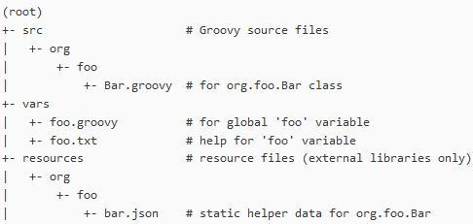
Chapter 8 - Groovy DSL
8.27 Directory Structure
Can be defined at various levels
src directory should look like standard Java source directory structure. This directory is added to the classpath when executing Pipelines.
The vars directory hosts scripts that define global variables accessible from Pipeline. The basename of each *.groovy file should be a Groovy identifier, conventionally camelCased. The matching *.txt can contain documentation.
The resources directory allows usage from an external library to load associated non- Groovy files.

Slide 146
Chapter 8 - Groovy DSL
8.28 Sample Groovy Code
package com.abcinc;
def checkout() { node {
stage 'Checkout'
git url: 'C:\\Software\\repos\\SimpleGreeting.git'
}
}

Slide 147
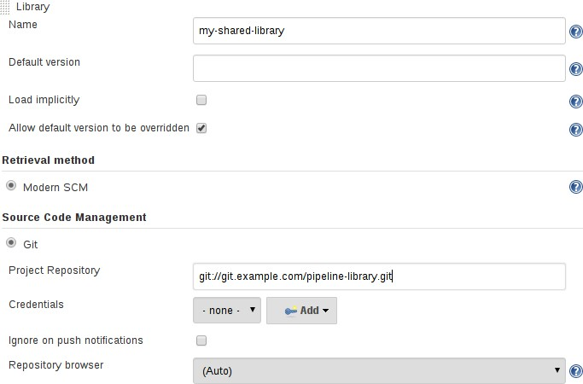
Chapter 8 - Groovy DSL
8.29 Defining Shared Libraries
Shared libraries can be defined at various levels:
Global Shared Libraries
Manage Jenkins > Configure System > Global Pipeline Libraries
Folder-level Shared Libraries
Automatic Shared Libraries
e.g. GitHub Organization Folder

Slide 148
Chapter 8 - Groovy DSL
8.30 Using Shared Libraries
Shared libraries can be utilized in various places
Pipeline
Execute system Groovy script
Execute Groovy script
Execute PostBuild script
Loading libraries explicitly
@Library('my-shared-lib') _ @Library('my-shared-lib@master') _
@Library(['my-shared-lib', 'another-shared-lib']) _
Conventionally the annotation goes on an import statement
@Library('my-shared-lib') import com.abcinc.utils;

Slide 149
Chapter 8 - Groovy DSL
8.31 Same Shared Library Usage Code
@Library('my-shared-lib') import com.abcinc.utils;
def u = new utils(); u.checkout();

Slide 150
Chapter 8 - Groovy DSL
8.32 Defining Global Variables
// vars/acme.groovy def setName(value) { name = value;
}
def getName() { return name;
}
// src/com/abcinc/sample.groovy def myFunction() {
name = "Bob";
}

Slide 151
Chapter 8 - Groovy DSL
8.33 Summary
Groovy's syntax is similar to Java
Semi-colon is optional in end of statement
return keyword is optional in a method
def keyword can be used to declare variables, as method return type, and for method input parameters.
Groovy is used to define shared libraries
In Jenkins shared libraries can be defined at various levels
Shared libraries can be loaded implicitly or explicitly using @Library annotation.

Slide 152
Chapter 9 - Securing Jenkins
Objectives
Key objectives of this chapter
Overall view of Jenkins Security
Authentication Options
Authorization

Slide 153
Chapter 9 - Securing Jenkins
9.1 Jenkins Security - Overview
Jenkins is used to build software
Source code is available in the workspace
Code built with Jenkins is frequently “unreleased” development or test builds
Need to make sure only authorized users can access this software
Jenkins can be used to execute admin jobs
Prevent access to prevent breaches and denial-of-service
Jenkins is highly configurable
So we need to prevent accidental configuration changes
171

Slide 154
Chapter 9 - Securing Jenkins
9.2 Jenkins Security
Security breaks down into separate issues:
Authentication
Authorization
Confidentiality
173

Slide 155
Chapter 9 - Securing Jenkins
9.3 Authentication
The task of identifying a user
Authentication happens against a user registry
Jenkins can use LDAP, operating system, servlet container, or internal registry
175

Slide 156
Chapter 9 - Securing Jenkins
9.4 Authorization
Authorization is the task of deciding what operations a user can perform, once they are authenticated
Jenkins allows a few different options for authentication
Anyone can do anything
Authorized Users can do anything
Permissions Matrix
Project-Based Permissions Matrix
177

Slide 157
Chapter 9 - Securing Jenkins
9.5 Confidentiality
Making sure that unauthorized parties don't get information they shouldn't have
Two aspects in Jenkins
Control access to projects (really authentication)
Web confidentiality
Use secure http
Handled by the servlet container or httpd
179

Slide 158

Chapter 9 - Securing Jenkins
9.6 Activating Security
Manage Jenkins --> Configure Global Security
Click the “Enable Security” checkbox
Jenkins will then display other options
181

Slide 159
Chapter 9 - Securing Jenkins
9.7 Configure Authentication
Authentication is performed within a “realm”
Possibilities
Use the servlet container's authentication
Different containers can be setup for different authentication techniques
Jenkins' own User Database
LDAP
Unix User/Group Database
Using Pluggable Authentication Module (PAM)
183

Slide 160
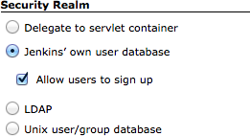
Chapter 9 - Securing Jenkins
9.8 Using Jenkins's Internal User Database
In the “Configure Global Security” screen, select “Jenkins own user database”
Choose whether users can “sign up” for a user id
Otherwise, administrator needs to create users
186

Slide 161
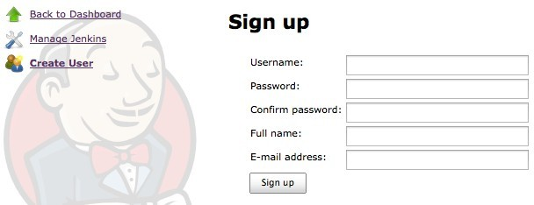
Chapter 9 - Securing Jenkins
9.9 Creating Users
Manage Jenkins -> Manage Users -> Create User
188

Slide 162
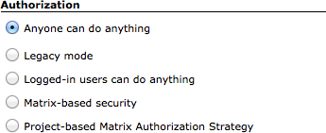
Chapter 9 - Securing Jenkins
9.10 Authorization
Five options
190

Slide 163
Chapter 9 - Securing Jenkins
9.11 Authorization
Typically we want “Matrix-based security” or “Project-based Matrix Authorization Strategy”
Authorization is separate from the authentication system
Need to enter userid or group entries separately from the users
192

Slide 164
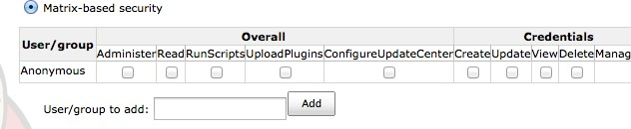
Chapter 9 - Securing Jenkins
9.12 Matrix-Based Security
Each user is granted a set of permissions that apply to various operations
Add an entry for the user id, then select the appropriate check boxes
194

Slide 165
Chapter 9 - Securing Jenkins
9.13 Note – Create the Administrative User
Create an administrative user at the same time you turn on security
Grant full permissions to this user
If there's no admin user, but you've turned on matrix permissions, then no-one has permissions
You're locked out!
See notes for recovery from lock-out
196

Slide 166
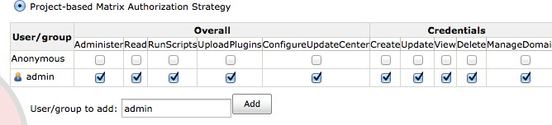
Chapter 9 - Securing Jenkins
9.14 Project-based Matrix Authorization
Same global user/permission grid
You still need an administrative user
Grant full permissions to the admin user
Additionally, you can set permissions by project
198

Slide 167
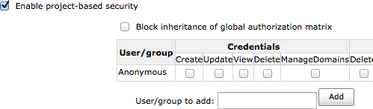
Chapter 9 - Securing Jenkins
9.15 Project-Based Authentication
You will now have an option in each job's configuration to enable project-based security
Add users to this permission list, for the project
Permissions are additive
Users with global permissions still have those permissions for the project
200

Slide 168
Chapter 9 - Securing Jenkins
9.16 Role Based Access Control
The Role Based Access Control plugin allows administrators to define roles and then map users to roles
Mappings can be applied to specific resources
So, for instance, only certain groups could be allowed to access a given folder
As a user, what you'll see depends on the role that you're in

Slide 169
Chapter 9 - Securing Jenkins
9.17 Conclusion
Configure security through the “Configure Global Security” screen
There are a variety of authentication and authorization options available.

Slide 170
Chapter 10 - Jenkins Plugins
Objectives
Key objectives of this chapter
Introduction
Jenkins Plugins – SCM
Jenkins Plugins – Build and Test
Jenkins Plugins – Analyzers
Jenkins for Teams
Installing Jenkins Plugins

Slide 171
Chapter 10 - Jenkins Plugins
10.1 Introduction
Jenkins has over 300 plugins.
Software Configuration Management(SCM).
Test Frameworks
Notifiers
Static Analyzer
Builders

Slide 172
Chapter 10 - Jenkins Plugins
10.2 Jenkins Plugins - SCM
Version Control Systems:
Git
Subversion
ClearCase

Slide 173
Chapter 10 - Jenkins Plugins
10.3 Jenkins Plugins – Build and Test
Build Tools:
Ant
Maven
Test Frameworks:
Junit
Selenium

Slide 174
Chapter 10 - Jenkins Plugins
10.4 Jenkins Plugins – Analyzers
Static Analyzers:
FindBugs
PMD
Sonar
Fortified
CodeScanner
Code Coverage:
Emma
Cobertura
Clover

Slide 175
Chapter 10 - Jenkins Plugins
10.5 Jenkins for Teams
Multi Configuration jobs.
Multi Stage Jobs.
Replaced by the Pipeline plugin
Folders Plugin
GitHub Organization Plugin

Slide 176
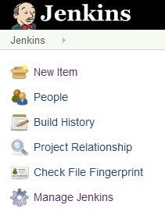

Chapter 10 - Jenkins Plugins
10.6 Installing Jenkins Plugins
For example, installing the Jenkins Emma plugin for code coverage.
Click Manage Jenkins
Then on click the Manage Plugins link:

Slide 177

Chapter 10 - Jenkins Plugins
Select the Available tab:
For quick access, enter plugin name on the filter input box, located at right top corner.
Scroll down the list of plugins to find the Emma Plugin.
Select the check box next to Emma Plugin.
Click Download now and install after restart

Slide 178
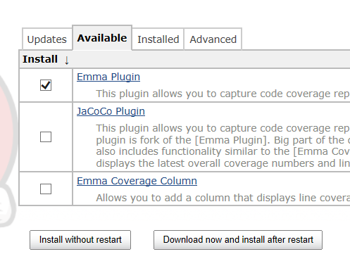
Chapter 10 - Jenkins Plugins
This will download the Emma plugin for Jenkins. The download may take some time to finish. Once the installation is complete, you will get the following:

Slide 179
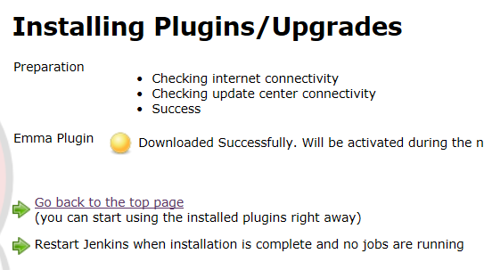
Chapter 10 - Jenkins Plugins
Select the Restart Jenkins when installation is complete and no jobs are running.
You have done the installation
Note that quite often, the "Install without restart" option works too

Slide 180
Chapter 10 - Jenkins Plugins
10.7 Summary
Jenkins Plugins are where most features of Jenkins are actually implemented
Different Categories of Plugins are available
Plugins are installed through the "Manage Jenkins" menu
.

Slide 181
Chapter 11 - Distributed Builds with Jenkins
Objectives
Key objectives of this chapter
Setting up Distributed Builds

Slide 182
Chapter 11 - Distributed Builds with Jenkins
11.1 Distributed Builds - Overview
Jenkins can act as master/agent setup to distribute builds over multiple machines
Why?
Additional Capacity
Different build/runtime environments
Integration Test
Managing Machines

Slide 183
Chapter 11 - Distributed Builds with Jenkins
11.2 Distributed Builds – How?
Have another machine
Make sure all the required software is installed
Version control system
Java Development Kit
SSH
Configure the Jenkins Master
If necessary, configure projects

Slide 184
Chapter 11 - Distributed Builds with Jenkins
11.3 Agent Machines
For *nix, Master contacts agents by SSH
Need user created on agent machine
Keys/credentials if necessary
For Windows, usually just install agent as a Windows Service
Needs to have local copies of anything that Jenkins needs
Git, SVN, Mercurial, etc
Maven
Java
Jenkins can install some of these automatically

Slide 185
Chapter 11 - Distributed Builds with Jenkins
11.4 Configure Jenkins Master
Create a Node
Configure Node for # executors, tool locations, etc

Slide 186
Chapter 11 - Distributed Builds with Jenkins
11.5 Configure Projects
If desired, you can restrict where a project runs
Each agent has one or more tags
Project can call out a tag
Project will only run on agents where the tags match
No other config required

Slide 187
Chapter 11 - Distributed Builds with Jenkins
11.6 Conclusion
Distributed builds are readily supported in Jenkins

Slide 188
Chapter 12 - Containerized Builds
Objectives
Key objectives of this chapter
Introduction to Docker
Installing and Configuring Docker
Installing Jenkins in a Docker Container
Using Docker for Builds
Jenkins Docker Build-step Plugin

Slide 189
Chapter 12 - Containerized Builds
12.1 Introduction to Docker
Docker is used to create containers
By using containers, everything required to make a piece of software run is packaged into isolated containers
Unlike VMs, containers do not bundle a full operating system – only libraries and settings required to make the software work are needed.
This makes for efficient, lightweight, self-contained systems and guarantees that software will always run the same, regardless where it's deployed.
It's available for both Linux and Windows based apps.
Containers isolate software from its surroundings, for example differences between development and staging environments and help reduce conflict between teams running different software on the same infrastructure.

Slide 190
Chapter 12 - Containerized Builds
12.2 Docker – Benefits
Docker containers running on a single machine share that machine's operating system kernel.
Docker containers start instantly and use less resources.
Images are constructed from filesystem and share common files. This minimizes disk usage and image downloads are much faster.
Docker containers are based on open standards and run on all major Linux distributions, Microsoft Windows, and on any infrastructure including VMs, bare-metal and in the cloud.
Docker containers isolate applications from one another and from the underlying infrastructure.
Docker provides the strongest default isolation to limit app issues to a single container instead of the entire machine.

Slide 191
Chapter 12 - Containerized Builds
12.3 Containers vs. Virtual Machines
!Containers are an abstraction at the app layer that packages code and dependencies together. Multiple containers can run on the same machine and share the OS kernel with other containers, each running as isolated processes in user space. Containers take up less space than VMs (container images are typically tens of MBs in size) and start almost instantly.
Virtual machines are an abstraction of physical hardware, turning one server into many servers. The hypervisor allows multiple VMs to run on a single machine. Each VM includes a full copy of an operating system, one or more apps, necessary binaries and libraries – taking up tens of GBs. VMs can also be slow to boot.

Slide 192
Chapter 12 - Containerized Builds
12.4 Running Jenkins in a Docker Container
Pull Jenkins image
docker search jenkins docker pull jenkins:2.7.2
Create a Docker container and run Jenkins in it
docker run –name=jenkins-master -p 8080:8080 -d jenkins:2.7.2
Obtain IP Address required to connect to the Docker container
docker-machine ip default
Connect to Jenkins
http://<docker_container_ip_address>:8080
Obtaining Jenkins default administrator password
docker logs -f jenkins-master

Slide 193
Chapter 12 - Containerized Builds
12.5 Delete Jenkins Container and Image
Obtain active container list
docker ps
Stop container
docker stop jenkins-master
Remove Jenkins container
docker rm jenkins-master
Obtain image list
docker images
Remove Jenkins image
docker rmi jenkins:2.7.2

Slide 194
Chapter 12 - Containerized Builds
12.6 Configuring Command Prompt to Connect to Docker
By default, Docker Quickstart Terminal can connect to Docker, but not the command prompt.
To allow command prompt to connect to Docker, following steps have to be performed:
Add docker.exe path to the Path environment variable
Obtain additional environment variable list by running following command:
docker-machine env default
Create the above environment variables. Usually, they involve: DOCKER_TLS, DOCKER_HOST, DOCKER_CERT_PATH, DOCKER_MACHINE_NAME, COMPOSE_CONVERT_WINDOWS_PATHS

Slide 195
Chapter 12 - Containerized Builds
12.7 Creating Docker Container from Jenkins Job
Download image. e.g.
docker pull ubuntu:12.04
Create Dockerfile. e.g.
# lets use ubuntu docker image FROM ubuntu:12.04
RUN apt-get update -y
RUN apt-get install openjdk-7-jdk -y
# deploy the jar file to the container
COPY target/SimpleGreeting-1.0-SNAPSHOT.jar /root/SimpleGreeting-1.0-SNAPSHOT.jar
Create a Jenkins job and add Execute Windows batch command with following command to create a custom image
docker build -t dev-ubuntu:v1.0

Slide 196
Chapter 12 - Containerized Builds
12.8 Test Custom Image Created by a Jenkins Job
Create a container based on the custom image generated by the Jenkins job
docker run –name dev –hostname dev -it dev-ubuntu:v1.0 /bin/bash
Exit out from the container
exit

Slide 197
Chapter 12 - Containerized Builds
12.9 The Jenkins Docker Build Step Plugin
Install Docker build step plugin
The plugin supports following commands
commit changes in specified container
create new container from image
create image from Dockerfile
create exec command
kill container(s)
pull image from a repository
push image to a repository
remove container(s)
remove all containers
restart container(s)
start container(s)
stop container(s)
stop all containers

Slide 198
Chapter 12 - Containerized Builds
start/stop all containers created from specified image
start exec command

Slide 199
Chapter 12 - Containerized Builds
12.10 Ephemeral Build Agents
Recall that one of the goals of CI is to make sure we're building in a clean environment
What could be cleaner than a brand-new Docker container?
The "Docker Plugin" lets you setup a "cloud" configuration
Docker containers will be launched on demand, when needed to run a build
Administrators can specify one or more "Docker Templates" to use for a build
e.g., one template for Node jobs, another one for Java jobs
The containers are typically discarded after the build - no changes are saved

Slide 200
Chapter 12 - Containerized Builds
12.11 Summary
Docker containers are lightweight, fast, and have smaller footprint compared to Virtual Machines
Jenkins can be installed in a Docker container.
Jenkins can be used to create custom Docker images and deploy software in it.
Jenkins can use a Docker image to create an "Ephemeral Build Agent" to run a build on

Slide 201
Chapter 13 - The Jenkins API
Objectives
Key objectives of this chapter
Remote Access API
What you can do with Jenkins Remote API
Remote API and CSRF Protection – API Token
Remote API and CSRF Protection – Crumb
Configure Jobs to Support the Jenkins Remote API
Making Remote API Calls
Example – Advanced REST Client
Example – cURL
Jenkins CLI
Configure Jenkins to Use CLI
Download and Use Jenkins CLI

Slide 202
Chapter 13 - The Jenkins API
13.1 Remote Access API
Jenkins provides remote access API to its functionalities
The Remote Access API comes in 3 flavors:
XML
JSON (covered in this chapter)
Python
Remote Access API is offered in REST-like style
Due to REST-like style, there is no single entry point for all features, and instead they are available under the "…/api/" URL where "…"
e.g.
Visiting http://localhost:8080/api will show just the top-level API features available – primarily a listing of the configured jobs for the Jenkins instance
Visiting http://localhost:8080/job/<job_name>/api will show list of functionalities for that job
Visiting http://localhost:8080/job/<job_name>/lastSuccessfulBuild/api will sow list of functionalities for that build

Slide 203
Chapter 13 - The Jenkins API
13.2 What you can do with the Jenkins Remote API
Remote API can be used to do various things, such as
retrieve information from Jenkins for programmatic consumption
trigger a new build
enable / disable a job
...

Slide 204

Chapter 13 - The Jenkins API
13.3 Remote API and CSRF Protection – API Token
If Jenkins uses the "Prevent Cross Site Request Forgery exploits" security option, when you make POST request, you have to send a CSRF protection token as an HTTP request header
The CSRF protection token can be obtained like this:
Jenkins > Configure
Under API Token, click Show API Token…
◊

Slide 205
Chapter 13 - The Jenkins API
13.4 Remote API and CSRF Protection – Crumb
In addition to the API token, a "crumb" is also required
A CrumbIssuer represents an algorithm to generate a crumb.
Crumbs are typically hashes incorporating information that uniquely identifies an agent that sends a request, along with a guarded secret so that the crumb value cannot be forged by a third party.
Crumb can be obtained in various ways:
URL
http://<user>:<password>@localhost:8080/crumbIssuer/api/xml? xpath=concat(//crumbRequestField,":",//crumb)
cURL
curl "http://<user>:<password>/crumbIssuer/api/xml?xpath=concat(//crumbRequestField,%22:%22,//crumb)"
A typical crumb value looks like this: (Note: The actual value may vary)
Jenkins-Crumb:eb7e766ce503b1a07cea634c5f8e6b3b

Slide 206

Chapter 13 - The Jenkins API
13.5 Configure Jobs to Support the Jenkins Remote API
By default, Jenkins jobs don't support the Jenkins Remote API
Jenkins job can be configured to support the Jenkins Remote API
<JOB> > Configure
Under Build Triggers section

Slide 207
Chapter 13 - The Jenkins API
13.6 Making Remote API Calls
Remote API calls can be made in various ways:
Advanced REST Client - Chrome Plugin
cURL
Programmatically
JavaScript, Java, ...

Slide 208
Chapter 13 - The Jenkins API
13.7 Example - Advanced REST Client
This example starts a new build
URL:
without parameters
http://<user id>:<API token>@localhost:8080/job/<job_name>/build
with parameters
http://<user id>:<API token>@localhost:8080/job/<job_name>/buildWithParameters?PARAM1=VALUE&PARAM2=VALUE
POST
Send Raw Header
Jenkins-Crumb: <crumb_value> Content-Type: text/plain

Slide 209
Chapter 13 - The Jenkins API
13.8 Example – cURL
This example starts a new build without parameters
curl -X POST -u <user>:<password> http://localhost:8080/job/<job_name>/build
This example starts a new build with parameters
curl -X POST -u <user>:<password> http://localhost:8080/job/<job_name>/buildWithParameters? PARAM1=VALUE&PARAM2=VALUE

Slide 210
Chapter 13 - The Jenkins API
13.9 Jenkins CLI
Jenkins CLI is a built-in command line interface that allows users and administrators to access Jenkins from a script or shell-environment.
This can be convenient for scripting of routing tasks, bulk updates, and more
The command line interface can be accessed over SSH or with the Jenkins CLI client, a
.jar file distributed with Jenkins.

Slide 211

Chapter 13 - The Jenkins API
13.10 Configure Jenkins to use CLI
Requires SSH key pair.
Generate SSH key pair
ssh-keygen -t rsa -b 4096 -C "<user>"
Default location is /c/Users/<user>/.ssh/id_rsa
Add SSH key to the SSH Agent
ssh-add /c/users/<user>/.ssh/id_rsa
Add SSH public key to Jenkins
Obtain public key located under /c/users/<user>/.ssh, named id_rsa.pub
Jenkins > Configure
SSH Public Keys section
Configure TCP port to fixed
Manage > Configure Global Security
Change "TCP port" to fixed and enter a value
◊

Slide 212
Chapter 13 - The Jenkins API
13.11 Download and Use Jenkins CLI
Download Jenkins CLI
http://localhost:8080/cli
Download jenkins-cli.jar
Use Jenkins CLI
java -jar jenkins-cli.jar -s http://localhost:8080 <command>
Commands
help
version
login
build
console
delete-build
disable-job
enable-job
...

Slide 213
Chapter 13 - The Jenkins API
13.12 Summary
Jenkins can be accessed using REST-based Remote Access API and the Command-Line Interface
Both the Remote Access API and CLI allows Jenkins to be accessed programmatically or via scripts.
They can be used by users or administrators for bulk execution of Jenkins functionalities.

Slide 214
Chapter 14 - Scripting
Objectives
Key objectives of this chapter
Introduction to Scripting
Benefits of Scripting
The Jenkins Script Console
Calling Scripts using cURL
Sample Scripts
Calling Groovy Scripts from a Jenkins Job
Jenkins API

Slide 215
Chapter 14 - Scripting
14.1 Introduction to Scripting
Usually you create a Jenkins job and define the steps (build, post, etc.) via the GUI
The GUI is available either OOB or provided by plugins
Optionally, Groovy scripting can be utilized to create jobs, such as a Pipeline
Groovy scripting can also be defined as a step (build, post etc.)

Slide 216
Chapter 14 - Scripting
14.2 Benefits of Scripting
There are several benefits of scripting
Scripts are reusable
Scripts can be versioned
Scripts can be used for performing complex functions, such as automatic deletion of previous builds etc.

Slide 217
Chapter 14 - Scripting
14.3 The Jenkins Script Console
Jenkins features a Groovy script console
The script console allows to run arbitrary scripts on the Jenkins server or on slave nodes.
This feature can be accessed in two ways:
Manage Jenkins
http://server/jenkins/script
It is a web-based Groovy shell into the Jenkins runtime.
Groovy is a very powerful language which offers the ability to do practically anything Java can do

Slide 218
Chapter 14 - Scripting
14.4 Calling Scripts using cURL
User can execute Groovy scripts remotely sending POST request to /script url
e.g.
curl -d "script=<your_script>" http://server/script
or
curl --data-urlencode "script=$(<./scomscript.groovy>)" http://server/script
If security is configured in Jenkins, then curl can be provided options to authenticate using the curl --user option
curl --user 'username:password' -d "script=<your_script>" http://server/script

Slide 219
Chapter 14 - Scripting
14.5 Sample Scripts
Display a simple message
PI = 3.14;
message = "Hello, World!";
println("The value of PI is: ${PI}, and the message is: $
{message}");
Get job list
j = jenkins.model.Jenkins.instance; for(item in j.getAllItems()) {
name = item.name; url = item.getUrl();
println("Job name: ${name}, URL: ${url}");
}
Get successful build list
println "Jobs with successful builds\n--------------------" activeJobs = hudson.model.Hudson.instance.items.findAll{job -> job.isBuildable()}
successfulRuns = activeJobs.findAll{job -> job.lastBuild != null && job.lastBuild.result == hudson.model.Result.SUCCESS}

Slide 220
Chapter 14 - Scripting
successfulRuns.each{run -> println "Successful Job Name: $
{run.name}"}
Various useful scripts are available on following site
https://github.com/jenkinsci/jenkins-scripts/tree/master/scriptler

Slide 221
Chapter 14 - Scripting
14.6 Calling Groovy Scripts from a Jenkins Job
Groovy scripts can be called from a Jenkins job in two ways
Build step
Requires Groovy plugin
Add Build Step > Execute system Groovy script
Post-build step
Requires Groovy Postbuilt plugin
Add post-build action > Groovy Postbuild

Slide 222
Chapter 14 - Scripting
14.7 Jenkins API
Importing Jenkins classes
import jenkins.model.*;
Obtaining Jenkins instance
ji = Jenkins.instance;
Obtaining a job by name
job = ji.getItemByFullName('<job_name>');
Additional useful functions
getJobNames()
restart()
doWipeOutWorkspace()
getBuilds()
API documentation is available on following site: http://javadoc.jenkins-ci.org/

Slide 223
Chapter 14 - Scripting
14.8 Summary
Scripting allows a powerful way of executing operations in Jenkins that aren't available when using the GUI
Scripts can be written in the Jenkins Script Console or defined as part of a Jenkins job.

Slide 224
Chapter 15 - User Interface Options
Objectives
Key objectives of this chapter
User Interface Options
User Content
Writing Plugins
Blue Ocean Plugin

Slide 225
Chapter 15 - User Interface Options
15.1 User Interface Options
Many ways to customize the Jenkins User Interface
OOB css and images directories
User Content
Plugins
The Blue Ocean Plugin

Slide 226
Chapter 15 - User Interface Options
15.2 Customizing the UI with CSS
Jenkins contains following two directories for branding
<JENKINS_HOME>\war\css
<JENKINS_HOME>\war\images
Reference: https://devopscube.com/setup-custom-materialized-ui-theme-jenkins/

Slide 227
Chapter 15 - User Interface Options
15.3 The User Content Folder
<JENKINS_HOME>\userContent can be used for storing custom style sheets and images. This way you don't mess up with OOB style.css file.
The userContent directory can be accessed by using following url:
http://localhost:8080/jenkins/userContent
The above URL can be accessed by plugins, such as Simple Theme Plugin.

Slide 228
Chapter 15 - User Interface Options
15.4 Using the User Content Folder and Simple Theme Plugin
Install "Simple Theme Plugin"
Go to <JENKINS_HOME>\userContent directory
Create "layout" directory
Create style.css file into the above directory
Copy custom images into the above directory (logo should be 40px in height)
Go to Simple Theme Plugin configuration and enter following:
URL of theme CSS: http://localhost:8080/jenkins/userContent/layout/style.css
Sample style.css
/* Custom style for CloudBees Jenkins Platform */
.logo img { content:url("http://localhost:8080/jenkins/userContent/layout/logo.p
ng");
}
.logo span { display: none;
}

Slide 229
Chapter 15 - User Interface Options
.logo:after {
content: 'Jenkins. My instance'; font-weight: bold;
font-size: 20px; margin-left: 6px;
margin-right: 12px; color: white;
}

Slide 230
Chapter 15 - User Interface Options
15.5 Writing a Jenkins Plugin
Custom plugins can be generated by using Maven
Modify settings.xml under c:\users\<user>\.m2 to include the Jenkins.
Generate boilerplate code using Maven
Modify pom.xml to customize custom plugin details (e.g. name, description, …)
Update src\main\java\org\jenkinsci\plugins\<plugin>\<plugin>Builder.java
Package the plugin (generate .hpi file)
Install the plugin (install into the local repository)
Deploy the plugin (upload it to Jenkins)

Slide 231
Chapter 15 - User Interface Options
15.6 Modify settings.xml
<settings>
<pluginGroups>
<pluginGroup>org.jenkins-ci.tools</pluginGroup>
</pluginGroups>
<profiles>
<!-- Give access to Jenkins plugins -->
<profile>
<id>jenkins</id>
<activation>
<activeByDefault>true</activeByDefault> <!-- change this to false, if you don't like to have it on per default -->
</activation>
<repositories>
<repository>
<id>repo.jenkins-ci.org</id>
<url>https://repo.jenkins-ci.org/public/</url>
</repository>
</repositories>
<pluginRepositories>
<pluginRepository>

Slide 232
Chapter 15 - User Interface Options
<id>repo.jenkins-ci.org</id>
<url>https://repo.jenkins-ci.org/public/</url>
</pluginRepository>
</pluginRepositories>
</profile>
</profiles>
<mirrors>
<mirror>
<id>repo.jenkins-ci.org</id>
<url>https://repo.jenkins-ci.org/public/</url>
<mirrorOf>m.g.o-public</mirrorOf>
</mirror>
</mirrors>
</settings>

Slide 233
Chapter 15 - User Interface Options
15.7 Generate Boilerplate Code for Custom Jenkins Plugin
Generate boilerplate code
mvn hpi:create -Pjenkins
Enter following values:
groupId
artifactId – this is the custom plugin name

Slide 234
Chapter 15 - User Interface Options
15.8 Modify pom.xml
Name and description should be updated
<name>PLUGIN_NAME</name>
<description>PLUGIN_DESCRIPTION</description>

Slide 235
Chapter 15 - User Interface Options
15.9 Package and Deploy the Plugin
Package the plugin – compiles, generates .hpi file in the target directory
mvn package
Install the plugin – compiles, packages, and installs the plugin in Maven's local repository
mvn install
Deploy the plugin
Manage Jenkins > Manage Plugins > Advanced
Upload Plugin
Once the plugin has been deployed, it will become available under Installed tab.
The plugin also becomes available under <JENKINS_HOME>\plugins
Use the plugin
A custom build-step would become available in a Jenkins job.

Slide 236
Chapter 15 - User Interface Options
15.10 The Blue Ocean Plugin
Blue Ocean is a project that rethinks the user experience of Jenkins
It models and presents the process of software delivery by surfacing information that's important to development teams with as few clicks as possible
It rethinks Jenkins while still staying true to the extensibility that is core to Jenkins.
Jenkins users can install Blue Ocean side-by-side with the Jenkins Classic UI via a plugin

Slide 237
Chapter 15 - User Interface Options
15.11 Blue Ocean Plugin Features
New modern user experience
Advanced Pipeline visualizations with built-in failure diagnosis
Branch and Pull Request awareness
Personalized View

Slide 238
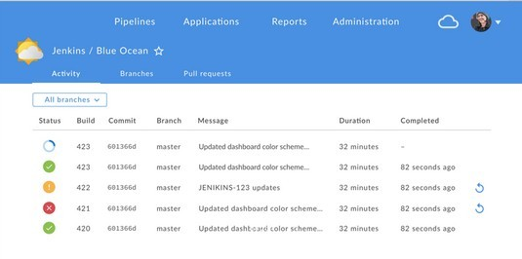
Chapter 15 - User Interface Options
15.12 New modern user experience
The UI aims to improve clarity, reduce clutter and navigational depth to make the user experience very concise.
A modern visual design gives developers much needed relief throughout their daily usage and screens respond instantly to changes on the server without requiring manual page refreshes.

Slide 239

Chapter 15 - User Interface Options
15.13 Advanced Pipeline visualizations with built-in failure diagnosis
Pipelines are visualized on screen along with the steps and logs to allow simplified comprehension of the continuous delivery pipeline – from the simple to the most sophisticated scenarios.

Slide 240

Chapter 15 - User Interface Options
15.14 Branch and Pull Request awareness
Modern pipelines make use of multiple Git branches, and Blue Ocean is designed with this in mind.
When Jenkinsfile defining a pipeline is dropped into a Git repository, it automatically discovers and starts automating any branches and validating pull requests.

Slide 241

Chapter 15 - User Interface Options
15.15 Personalized View
Blue Ocean offers a dashboard.
Jobs that need user attention, such as Pipeline awaiting approval or a failing job, appear on the top of the dashboard.

Slide 242
Chapter 15 - User Interface Options
15.16 Summary
Jenkins offers various ways for customizing the look-and-feel.
Custom plugins can be written to add custom build steps to a Jenkins job
Blue Ocean enhances Jenkins by adding making Jenkins UI easier and more useful.

Slide 243
Chapter 16 - Best Practices for Jenkins
Objectives
Key objectives of this chapter
Best Practices.

Slide 244
Chapter 16 - Best Practices for Jenkins
16.1 Best Practices - Secure Jenkins
Always secure Jenkins.
Without security, the Jenkins dashboard makes your source code available to anyone
Also, pre-release artifacts
Even if most of your users are trusted, the setup of projects is sometimes complicated
Securing those projects helps prevent accidents
See the security chapter

Slide 245
Chapter 16 - Best Practices for Jenkins
16.2 Best Practices - Users
Jenkins will need to have user credentials on other systems
e.g. to read from SCM, deploy software, etc
Don't let users put their real credentials into jobs or pipelines!
Create a user account for Jenkins itself
Don't publish the login credentials for this "server account"
Use the credentials system in Jenkins
You can grant usage of the credentials through Jenkins security subsystem

Slide 246
Chapter 16 - Best Practices for Jenkins
16.3 Best Practices - Backups
Everything of any interest is stored in the Jenkins Home directory
Back it up regularly
JENKINS_HOME/jobs
contains all the job information
You can copy jobs from one Jenkins installation to another
JENKINS_HOME/workspace
is where the checkouts from version control go to
Could be skipped in backups if space is a problem
Archive unused jobs before removing them.
Store a copy of the project's folder under JENKINS_HOME/jobs
If you need to restore, copy the archived folder back into 'jobs', then 'Manage Jenkins
--> Reload config from disk'
Can be done while Jenkins is running

Slide 247
Chapter 16 - Best Practices for Jenkins
16.4 Best Practices - Reproducible Builds
Ensure a build is reproducible, the build must be a clean build, which is built fully from Source Code Control, plus authorized binaries
All code including build scripts, release notes, etc. must be checked into Source Code Control.
If it isn't in Version Control, it didn't happen!
Dependencies in Version Control?
This is a contentious issue
Old-school says "put the dependency jars in version control"
Modern approaches usually use binary repository like Nexus, Artifactory, or Apache Archiva for dependencies
Discuss, set policy and follow it
Repeatable build is always the goal!

Slide 248
Chapter 16 - Best Practices for Jenkins
16.5 Best Practices - Testing and Reports
Always configure your job to generate trend reports and automated testing when running a Java build
Make your build self-testing
Run tests as part of the build process
Provide rapid feedback
define a test pipeline with distinct test phases
Take steps to ensure failures are reported as soon as possible.
For example, it may be appropriate to run a limited set of "sniff tests" before the full suite.
Integrate with your issue management system as much as possible
Set up email notifications mapping to ALL developers in the project, so that everyone on the team has his or her pulse on the project's current status.
Tag, label, or baseline the code-base after a successful build.

Slide 249
Chapter 16 - Best Practices for Jenkins
16.6 Best Practices - Large Systems
For integration tests, and multiple jobs, allocate a different port for parallel project builds and avoid scheduling all jobs to start at the same time
If builds conflict, look into the "Locks and Latches" plugin, or the "Throttle Concurrent Builds" plugin
Multiple jobs running at the same time can cause resource overload.
Try to avoid scheduling all jobs to start at the same time.
e.g. Use 'H/5' rather than '*/5' in the schedule entries.
Spreads out the start time
Write jobs for your maintenance tasks, such as cleanup operations to avoid full disk problems.

Slide 250
Chapter 16 - Best Practices for Jenkins
16.7 Best Practices - Distributed Jenkins
In larger systems, use distributed builds and disallow build on the master machine. This ensures that the Jenkins master can scale to support many more jobs than if it had to process build jobs directly as well.
Be aware that Jenkins may use a lot of disk space!
Make sure your installation process for Jenkins Master and Agents are documented and automated
Either use a configuration management system (Ansible, Puppet, Chef, etc)
Or use a containerized agent (Docker)

Slide 251
Chapter 16 - Best Practices for Jenkins
16.8 Best Practices - Summary
Backup!
Repeatable builds!
Communicate!
Use Jenkins' features
Testing and Reporting
Distributed Jenkins

