Slide 1
Accessing an Oracle Database

Slide 2
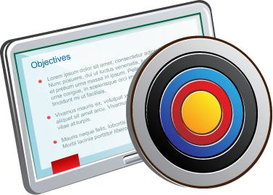
Objectives
After completing this lesson, you should be able to:
Connect to an Oracle Database
Describe the tools used to access an Oracle Database
Describe the Oracle-supplied user accounts for Oracle Database
Query the data dictionary in an Oracle Database

Slide 3
Connecting to an Oracle Database Instance
You connect client applications to an Oracle Database by connecting to its database instance, not its database.
A user session is a logical entity that represents the state of the current user login to the database instance.
Examples of connecting to an Oracle Database instance:
By using operating system authentication
By using Easy Connect Syntax
$ sqlplus / as sysdba
SQL> connect hr/hr@host1.example.com:1521/db.example.com
Notes:
Connections Compared With Sessions
You connect client applications to database instances (not databases).
A connection is the physical communication pathway between a client process and a database instance.
A user session is a logical entity that represents the state of the current user login to the database instance. A session lasts from the time the user is authenticated by the database instance until the time the user disconnects or exits the client application.
Connecting to CDBs by Using Operating System Authentication
As a database administrator, you can quickly start SQL*Plus and connect to a root container without a password by using the $ sqlplus / as sysdba command. This command enables you to connect to the database as the SYS user with the SYSDBA privilege. There are some rules: You must be on the same machine as the database instance, and the current operating system user must be a member of the privileged OSDBA group.
Connecting to PDBs by Using the Easy Connect Syntax
There are many ways to connect to a PDB; however, using the Easy Connect syntax in SQL*Plus is the easiest because it's already enabled on the database server by default and doesn't require any client-side configuration. This syntax supports TCP protocol only (no SSL). It offers no support for advanced connection options such as connect-time failover, source routing, and load balancing.

Slide 4
Notes:
Easy Connect connection strings take the following form:
SQL> CONNECT <username>/<password>@<listener hostname>:<listener port>/<service name>
For example, the SYSTEM user requests a connection to the database service named db.example.com. The listener is located on a machine named host01.example.com and listens on port 1521.
SQL> CONNECT hr/hr@host1.example.com:1521/db.example.com
If you're starting from a command prompt, you can start SQL*Plus and log in at the same time:
$ sqlplus hr/hr@host1.example.com:1521/db.example.com
The listener port and service name are optional. If the listener port is not provided, Oracle Net assumes that the default port of 1521 is being used. If the service name is not provided, Oracle Net assumes that the database service name and host name provided in the connect string are identical. For example, assuming that the listener uses TCP to listen on port 1521, the connection string above can be shortened.
For example, a connection string like this:
SQL> CONNECT hr/hr@db.example.com:1521/db.example.com
...can be shortened to:
SQL> CONNECT hr/hr@ db.example.com
Disconnecting from the Database Instance
Use the EXIT command to exit SQL*Plus, disconnect from the database instance, and end all sessions in the database instance memory.

Slide 5
Oracle Database Tools
Oracle Database tools each have their own purpose, and some operations can be performed in more than one tool.
Finding the right tool for the job often comes down to preference (for example, whether you prefer to work with code or use a graphical user interface).
Tools include:
SQL*Plus
SQL Developer
SQL Developer Command Line (SQLcl)
Database Configuration Assistant (DBCA)
Oracle Enterprise Manager Database Express (EM Express)
Oracle Enterprise Manager Cloud Control
Others such as Listener Control, Oracle Net Configuration Assistant, Oracle Net Manager, ADR Command Interpreter, SQL*Loader, Oracle Data Pump Import, and Oracle Data Pump Export
Notes:
Oracle Database includes the following tools:
SQL*Plus: Use this command-line tool to access a database.
SQL Developer: Use this graphical user interface (GUI) tool to access a database and perform DBA actions.
SQL Developer Command Line (SQLcl): Use this tool to access a database.
Database Configuration Assistant (DBCA): Use this GUI tool to create databases. To use DBCA, you must be on the server to launch the tool from the operating system that houses the CDB.
Oracle Enterprise Manager Database Express (EM Express): Use this GUI tool to perform database administration tasks on one database instance at a time.
Oracle Enterprise Manager Cloud Control (EM Cloud Control): Use this GUI tool to perform database administration tasks on several targets (database instances, listeners, and so on) at the same time.
Others: Many specialized utilities are used to assist with database administration. The ones used in this course may include Listener Control (lsnrctl), Oracle Net Configuration Assistant (netca), Oracle Net Manager (netmgr), ADR Command Interpreter (adcri), SQL*Loader (sqlldr), Oracle Data Pump Import (impdp), and Oracle Data Pump Export (expdp). This list does not cover all the utilities available.

Slide 6
Database Tool Choices
Topic | SQL*Plus | SQL Developer | SQLcl | DBCA | EM Database Express | EM Cloud Control | Oracle Universal Installer
Create a CDB or PDB | Yes | Yes (PDB only) | Yes | Yes | Yes (PDB only) | Yes (PDB only) | Yes
Explore CDB instance, architecture, and PDBs | Yes | Yes | Yes | No | Yes | Yes | No
Notes:
The table shows you at a glance which tool can be used to perform which tasks.

Slide 7
SQL*Plus
Example 1: From a command line, you can start SQL*Plus, log in, and show the user that you're logged in as:
$ sqlplus / as sysdba
...
SQL> show user
USER is "SYS"
Example 2: Call a SQL script from the command line:
$ sqlplus hr/hr@HRPDB @script.sql
File name
Username and password
Connect identifier
Notes:
SQL*Plus
SQL*Plus is a command-line program that you use to submit SQL and PL/SQL statements to an Oracle database. SQL*Plus is installed with Oracle Database and is located in the $ORACLE_HOME/bin directory. You can start SQL*Plus from the command line or from the Start menu on a Windows client. Use the SQL*Plus command-line interface to execute SQL*Plus, SQL, and PL/SQL commands to perform the following:
Enter, edit, run, store, retrieve, and save SQL commands and PL/SQL blocks
Format, calculate, store, and print query results
List column definitions for any table
Send messages to and accept responses from an end user
Perform database administration
Calling a SQL Script from SQL*Plus
When calling a SQL script file from within SQL*Plus, you have the following options:
Option 1: Call the script from the command line when you first invoke SQL*Plus:
$ sqlplus hr/hr@HRPDB @script.sql
Option 2: Call the script from inside a SQL*Plus session simply by using the “@” operator:
SQL> @script.sql
When a script is saved from SQL*Plus by using the SAVE command, the .sql extension is automatically supplied. You can then execute the script without supplying the extension at execution time, for example:
SQL> @script

Slide 8
Notes:
Calling SQL*Plus from a Shell Script
You can call SQL*Plus from a shell script or BAT file by invoking sqlplus and using the operating system scripting syntax for passing parameters. For example, suppose you have the following shell script:
# Name of this file: batch_sqlplus.sh
# Count employees and give raise.
sqlplus hr/hr <<EOF
select count(*) from employees;
update employees set salary = salary*1.10;
commit;
quit
EOF
You can call that shell script from the command line:
$ ./batch_sqlplus.sh
For More Information
To learn how to start SQL*Plus, see “Starting SQL Plus” in SQL*Plus Users Guide and Reference.

Slide 9
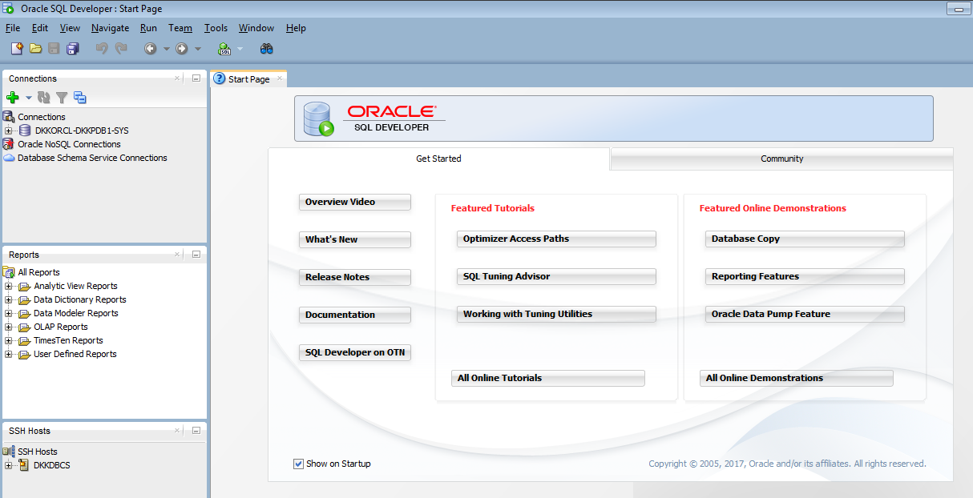
Oracle SQL Developer
Notes:
Oracle SQL Developer (SQL Developer) is a graphical tool for database developers and DBAs and gets installed with Oracle Database. You can choose to display several different panes in the SQL Developer interface, such as a Connections and DBA pane. You use the former to define connections to databases and use the latter to perform DBA operations. You should add connections only for which the associated database user has DBA privileges or at least privileges for the desired DBA navigator operations on the specified database.
Some developer-type operations that you can perform with SQL Developer include:
Develop scripts in both the SQL and PL/SQL languages
Browse database objects
Run SQL statements and SQL scripts
Edit and debug PL/SQL statements

Slide 10
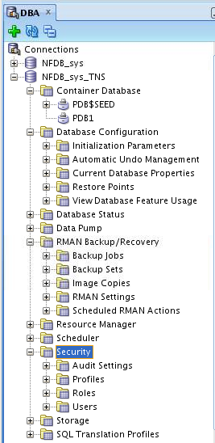
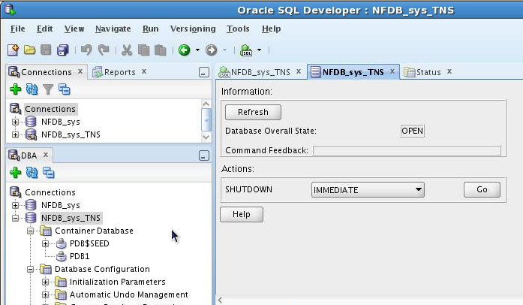
Oracle SQL Developer: DBA Actions
Using DBA features through DBA navigator
Performing DBA actions
Notes:
Some DBA-type operations that you can perform with SQL Developer include:
Start and shut down PDBs
Configure databases (for example, configure initialization parameters)
View the status of databases
Export databases by using Data Pump and import jobs
Back up and recover data by using Oracle Recovery Manager (RMAN)
Configure Oracle Database Resource Manager (the Resource Manager), which enables you to manage multiple workloads within a database that are contending for system and database resources
Schedule jobs (for example, loading data)
Configure security by using audit settings, profiles, roles, and users
Configure storage for archive logs, control files, data files, redo log groups, tablespaces, and temporary tablespace groups
Run any number of provided reports, as well as create new ones

Slide 11
SQL Developer Command Line (SQLcl)
SQLcl:
Is a tool that can access Oracle databases
Is a cross between SQL*Plus and SQL Developer
Incorporates Linux-like and IDE features, and color
Example query with formatting to fit the screen:
SQL> SELECT first_name, last_name, salary, hire_date FROM hr.employees;
FIRST_NAME LAST_NAME SALARY HIRE_DATE
Steven King 24000 17-JUN-03
Neena Kochhar 17000 21-SEP-05
...
Notes:
SQL Command Line (SQLcl) is another tool that you can use to access an Oracle Database. SQLcl is a cross between SQL Developer and SQL*Plus. It can do everything that SQL*Plus can do, plus more. It has improvements in command-line interaction, incorporating Linux-like and IDE features, and it includes color.
You can download SQLcl from the Oracle SQL Developer product page on the Oracle Technology Network at http://www.oracle.com/technetwork/developer-tools/sql-developer/overview/index.html
Note: For SQLcl to run on Windows or Linux operating systems, you need a Java Runtime Environment (JRE) of version 1.7 or higher.
See Oracle SQL Developer Command Line Quick Reference for details.

Slide 12
Database Configuration Assistant (DBCA)
DBCA is a tool for creating and configuring an Oracle database
DBCA has two modes:
Interactive: Provides a graphical interface and guided workflow
Noninteractive/silent: Uses command-line arguments, a response file, or both
DBCA can be launched by the Oracle Universal Installer or invoked after the software is installed.
Notes:
Database Configuration Assistant (DBCA) is a tool that you can use to do the following:
Create databases (CDBs and non-CDBs)
Configure existing databases
Delete databases
Manage templates
Manage pluggable databases
Manage Oracle RAC database instances
DBCA can be launched by the Oracle Universal Installer (OUI), depending upon the type of install that you select. You can also launch DBCA as a standalone tool at any time after Oracle Database installation.
See Oracle Database Administrator’s Guide and Oracle Database 2 Day DBA for detailed information.

Slide 13

Oracle Enterprise Manager Database Express
Console
Listener
Dispatcher
Shared
Server
Get Report
Common
Reporting
Framework
Request
Oracle Web Server
EM Express Servlet
Authentication
Session Management
Compression
Caching
Oracle Database
Instance
File
Manager
Get shell files
Notes:
Oracle Enterprise Manager Database Express
Oracle Enterprise Manager Database Express (EM Express) is a lightweight tool that you can use to manage a CDB and all its PDBs (except the seed PDB). It provides an out-of-the-box browser-based management solution, performance monitoring, configuration management, administration, diagnostics, and tuning.
Architecture
EM Express uses a web-based console, communicating with the built-in web server available in XML DB.
As requests from the console are processed, the EM Express servlet handles the requests, including authentication, session management, compression, and caching. The servlet passes requests for reports to the Common Reporting Framework and actions requiring shell files to the File Manager. This architecture is illustrated in the slide.
EM Express is available only when the database is open. This means that Enterprise Manager Database Express cannot be used to start the database. Other operations that require that the database change state, such as enable or disable ARCHIVELOG mode, are also not available in EM Express.
EM Express is configurable with a single click in Database Configuration Assistant (DBCA).
EM Express is a servlet built on top of Oracle XML DB. The Oracle XML DB default wallet has a self-signed certificate, and some existing browsers consider self-signed certificates as untrusted because they are not signed by a trusted CA (certificate authority). However, the self-signed certificate is still secure, as it ensures that the traffic is encrypted between the Oracle XML DB server and the client (browser). Therefore, enter a security exception for the EM Express URL in your web browser.

Slide 14
Notes:
Requirements
The following are required for EM Express:
XMLDB components must be installed on the Oracle Database server. All Oracle Databases of version 12.1.0 or higher have XMLDB installed.
The web browser must have the Flash plug-in installed because EM Express uses Shockwave Flash (SWF) files.
Starting EM Express for CDBs and PDBs
EM Express uses a global HTTPS port to connect to and manage non-CDBs, CDBs, and PDBs. With Oracle Database 12c Release 1, Enterprise Manager Database Express uses a different port for each PDB. Starting with Oracle Database 12c Release 2, you can set a global port that enables Enterprise Manager Database Express access to the CDB and all PDBs on that single port.

Slide 15
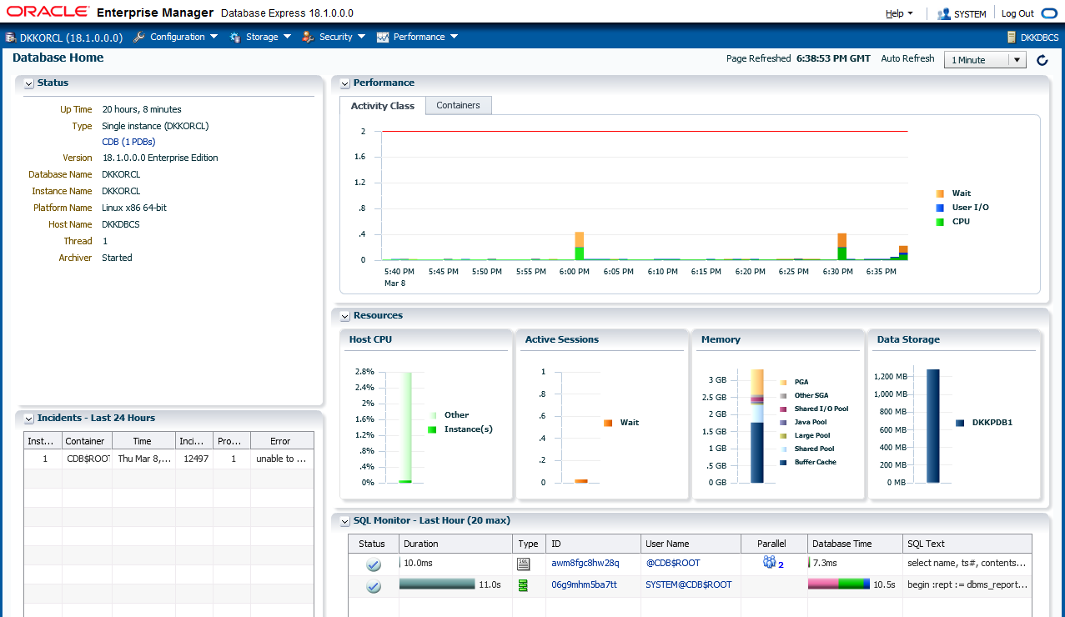
Using the Database Home Page
Notes:
The Enterprise Manager Database Express home page presents an overall view of the database instance status and activity.

Slide 16

Enterprise Manager Cloud Control 13c Features
Enterprise-Ready Framework
Applications Management
Unified Cloud Management: Hybrid Cloud
Middleware Management
Chargeback and Capacity Planning
Database Management
Exadata and Exalogic Management
Application Quality Management
Configuration Management
Provisioning and Patching
Notes:
Oracle Enterprise Manager Cloud Control (EM Cloud Control) is Oracle’s on-premises management platform, providing a single location for managing all your Oracle deployments, whether they be in your data centers or in Oracle Cloud. Through deep integration with Oracle’s product stack, EM Cloud Control provides management and automation support for Oracle applications, databases, middleware, hardware, and engineered systems.
Key objectives in the design of Enterprise Manager Cloud Control 13c include:
Providing a complete integrated cloud management solution for a combination of on-premises cloud configurations and Oracle Cloud Services solutions (Hybrid Cloud)
Delivering enhanced engineered systems management
Enhancing middleware and database management
Maintaining a robust, cloud-scale platform
Enterprise Manager Cloud Control 13c includes the following features:
Enterprise-Ready Framework: Provides modular and extensible architecture, self-updateable entities, centralized incident management, in-context diagnostics management, as well as flexible job scheduling and security sub-systems
Cloud Management: Provides complete cloud life cycle management for both on-premises clouds and PaaS services on Oracle Cloud
Chargeback and Capacity Planning: Provides chargeback based on target types and uses Automatic Workload Repository (AWR) Warehouse to consolidate AWR reports from multiple databases across the enterprise

Slide 17
Notes:
Exadata and Exalogic Management: Provides an integrated view of the hardware and software in an Exadata machine and complete life cycle management for Exalogic systems
Configuration and Management: Provides an integrated set of tools, agent-less discovery, integration with My Oracle Support, and custom configuration capabilities
Provisioning and Patching: Provides profiles for provisioning known configurations, user-defined deployment procedures, and a Software Library integrated with self-updating capabilities
Application and Quality Management: Provides Database Replay, Application Server Replay, Real Application Testing integrated with Data Masking, and test database management that includes Application Data Model
Database Management: Provides management of Oracle Database systems, including performance management and change life cycle management
Middleware Management: Provides complete management of Middleware systems
Applications Management: Provides management of Fusion Applications

Slide 18



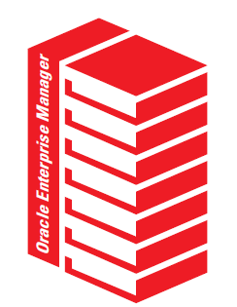
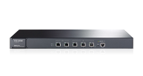




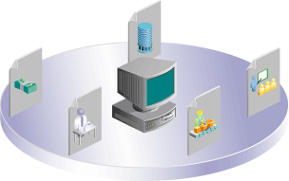
Single Pane of Glass for Enterprise Management
Common Cloud management practices
Quality of Service management
Lifecycle & Cloud management
Data governance & compliance controls
Backup to the cloud
Workload portability and secure, bidirectional cloning
Unified self-service catalog
Network
Storage
VMs/Servers
Databases
Middleware
Applications
Notes:
One Management Tool to Oversee Them All
Enterprise Manager Cloud Control 13c has capabilities to intelligently manage traditional and cloud-based services, mitigating the need to use multiple management and monitoring tools for what were previously two disparate environments.
Complete solution for management of the Oracle stack, including engineered systems, with real-time integration of Oracle’s knowledge base with customer environments
End-to-end performance management and automation
Integrated Ops Center functionality to monitor and manage both hardware and software from a single interface
Common management practices applicable to on-premises targets and Oracle Cloud targets
Quality of Service (QoS) management to ensure delivery of the best service possible to internal and external customers
Lifecycle and cloud management for simplified provisioning and patching of applications and platforms
Data governance and compliance controls for conforming with internal and external standards and requirements
Ability to back up to the cloud to leverage the Oracle Cloud capacity
Hybrid cloud option to move workloads and clone targets between on-premises and Oracle Cloud

Slide 19






Oracle Database Cloud Service Tools
Oracle Database Cloud Service includes:
Oracle Database tools such as SQL*Plus and Enterprise Manager Database Express
Cloud tooling that simplifies backup, recovery, patching, and upgrade operations
Automated Backups
Automated Patching
Notes:
In addition to standard Oracle Database tools such as SQL*Plus, Oracle Database Cloud Service includes cloud tooling that simplifies backup, recovery, patching, and upgrade operations.

Slide 20
Cloud Tooling
Feature | Description | Tools
Simple Automated Backups | Perform on-demand backups Change automatic backup configuration | bkup_api utility raccli utility
Simple Automated Recovery | Restore from backups and recover the database | orec subcommand of the dbaascli utility raccli utility
Simple Automated Patching | Apply patches | dbpatchm subcommand of the dbaascli utility dbpatchmdg utility raccli utility
Notes:
Database Cloud Service offers the following tools on the compute nodes associated with the database deployment:
Simple Automated Backups: Use the bkup_api utility on a single-instance database or the raccli utility on deployments that use Oracle Real Application Clusters (RAC) to perform on-demand backups and change how automatic backups are configured.
Simple Automated Recovery: Use the orec subcommand of the dbaascli utility on single-instance databases or the raccli utility on deployments that use Oracle RAC to restore from backups and recover the database.
Simple Automated Patching: Use the dbpatchm subcommand of the dbaascli utility for single-instance databases, raccli on deployments that use Oracle RAC, and the dbpatchmdg utility on Oracle Data Guard configurations to apply patches.

Slide 21
Accessing Tools and Features from the DBCS Console
From the database deployment menu, you can select the following to access consoles and perform other actions:
Application Express Console
DBaaS Monitor Console
EM Console
SSH Access
Access Rules
Delete
Notes:
The Oracle Database Cloud Service console enables you to manage your database deployment through the following consoles and features:
Application Express: Oracle Application Express enables you to design, develop, and deploy responsive database-driven applications by using only your web browser.
DBaaS Monitor: Database deployments include Oracle DBaaS Monitor Console, a built-in monitor that provides a wide spectrum of information about Oracle Database status and resource usage.
EM: To monitor and manage the Oracle database deployed on Database Cloud Service, you can use the standard management tool provided with the version of the database:
Enterprise Manager 11g Database Control for Oracle Database 11g
Enterprise Manager Database Express 12c for Oracle Database 12c
Enterprise Manager Database Express 19c for Oracle Database 19c
SSH Access: Should the need arise, you can add SSH public keys for the opc and oracle users to the compute nodes associated with a database deployment.
Access Rules: Oracle Database Cloud Service relies on Oracle Compute Cloud Service to provide secure network access to database deployments. You can use the Oracle Database Cloud Service console to perform network access operations such as enabling access to a port on a compute node or creating new security rules.
Delete: When you no longer require a database deployment on Database as a Service, you can delete it. After it is deleted, the entry is removed from the list of database deployments displayed on the Database Cloud Service Console.
See Administering Oracle Database Cloud Service for details.

Slide 22






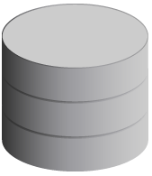
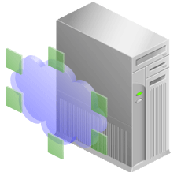

Using Enterprise Manager Cloud Control
You can monitor and manage DBCS with on-premises Enterprise Manager Cloud Control.
On-premises server
Oracle Cloud host
3872
HTTPS
Agent
1748
OMS
Plug-ins
3872
HTTPS
4900
Proxy process
22
Targets
Gateway Agent
SSH
See Using Oracle Enterprise Manager Cloud Control with Database Cloud Service in Using Oracle Database Cloud Service
Notes:
You can use Enterprise Manager Cloud Control 13c to manage and monitor your cloud services and deployments, just as you do the hosts and applications in your own data centers. Cloud Control agents can be deployed to the compute nodes that underpin the Oracle Cloud services. The same plug-ins that manage and monitor your local targets can be used with targets running on the compute nodes. You can install the Enterprise Manager Cloud Control management agent, referred to as the Hybrid Cloud Agent, on the compute node that is deployed for you as part of DBCS.
In order for an Oracle Management Service (OMS) to manage and monitor a host and its targets on the other side of a firewall, directional holes corresponding to the communications between OMS and targets need to be opened in the firewall to allow full functionality. Depending upon the targets being monitored, this can result in a large number of holes in the firewall, and such a topology is anathema to basic security principles and the purpose of firewalls.
The Hybrid Cloud Agent resolves this topological dilemma for hosts in the Oracle Cloud in several ways by using one tunnel for all traffic:
A Secure Shell (SSH) tunnel is configured in the OMS by providing named SSH credentials for the Oracle Cloud
When the OMS initiates communication with the agent in Oracle Cloud, it does so via the SSH tunnel by using an EMCTL dispatcher on the Oracle Cloud host
When the Agent initiates communication with the OMS, it does so via a proxy process that, in turn, communicates via the SSH tunnel with an on-premises agent configured as a gateway agent
When the OMS initiates direct communication with any of the targets on the Oracle Cloud managed host, such as a database, it does so via the SSH tunnel

Slide 23

Summary
In this lesson, you should have learned how to:
Connect to an Oracle Database
Describe the tools used to access an Oracle Database
Describe the Oracle-supplied user accounts for Oracle Database
Query the data dictionary in an Oracle Database

Slide 24
Practice 5: Overview
5-1: Viewing Database Deployment Information and Menus
5-2: Connecting to the Database Deployment Compute Node
5-3: Exploring a CDB by Using SQL*Plus
5-4: Exploring a PDB by Using SQL*Plus
5-5: Installing the HR Sample Schema
5-6: Copying Course Practice Files

