Slide 1
Managing Database Instances

Slide 2

Objectives
After completing this lesson, you should be able to:
Describe initialization parameter files and initialization parameters
View and modify initialization parameters in SQL*Plus
Start up and shut down Oracle databases
Open and close PDBs
Work with the Automatic Diagnostic Repository (ADR)
Query dynamic performance views

Slide 3
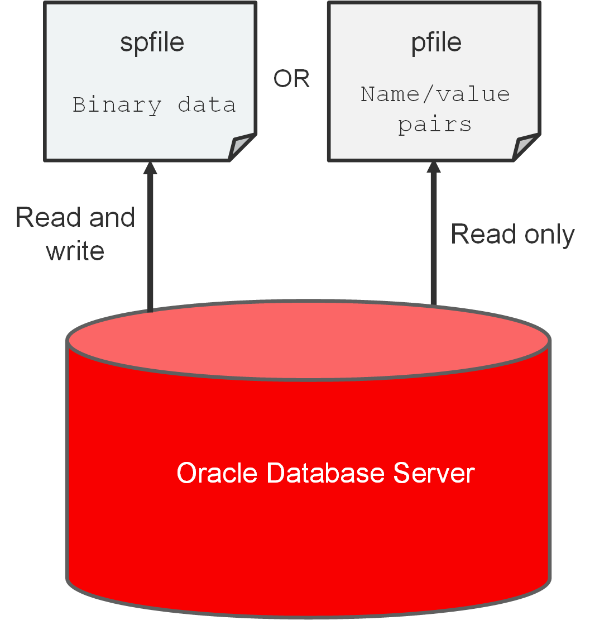
Working with Initialization Parameters
Notes:
Initialization Parameter Files
When you start a database instance, it reads instance configuration parameters (initialization parameters) from an initialization parameter file (parameter file). On most platforms, parameter files are stored in the $ORACLE_HOME/dbs directory by default.
You can use one of the following types of parameter files to start your database instance, as illustrated in the slide:
Server parameter file (SPFILE): An SPFILE is a binary file that is written to and read by the database server. You can't edit it manually. An SPFILE is preferred over a PFILE because you can change initialization parameters with ALTER SYSTEM commands in SQL*Plus, and the changes persist when you shut down and start up the database instance. It also provides a basis for self-tuning by Oracle Database. An SPFILE is automatically created for you by Database Configuration Assistant (DBCA) when you create a CDB. It resides on the server on which the Oracle instance is running. The default name of the SPFILE, which is automatically sought at startup, is SPFILE<SID>.ora.
Text initialization parameter file (PFILE): A PFILE is a text file containing parameter values in name/value pairs, which the database server can read to start the database instance. Unlike an SPFILE, the database server cannot write to and alter a PFILE. Therefore, to change parameter values in a PFILE and make them persist during shutdown and startup, you must manually edit the PFILE in a text editor and restart the database instance to refresh the parameter values. Your installation includes a sample PFILE named init.ora in the default directory for parameter files. You can use this file as a starting point for a PFILE, or you can create a PFILE from the SPFILE. If you save your PFILE as init<SID>.ora in the default directory, the database server will automatically use it if an SPFILE is not available. If you save the PFILE under a different name, you'll need to specify it during startup.

Slide 4
Notes:
Search Order for a Parameter File
The database server locates your parameter file by examining file names in the $ORACLE_HOME/dbs directory in the following order:
SPFILE<SID>.ora, where SID is the system ID and identifies the instance name (for example, ORCL)
SPFILE.ora
init<SID>.ora (PFILE)

Slide 5
Initialization Parameters
Initialization parameters (parameters):
Set database limits
Set database-wide defaults
Specify files and directories
Affect performance
Parameters can be of two types: basic or advanced.
Tune around 30 basic parameters to get reasonable database performance.
Example of a basic parameter: SGA_TARGET
Example of an advanced parameter: DB_CACHE_SIZE
Derived parameters calculate their values from the values of other parameters.
Example: SESSIONS is derived from PROCESSES.
Some parameter values or value ranges depend on the host operating system.
Example: DB_BLOCK_SIZE
Notes:
Initialization parameters (parameters) set database limits, set databasewide defaults, specify files and directories, and affect performance. The parameter file must, at a minimum, specify the DB_NAME parameter. All other parameters have default values.
Types of Initialization Parameters
Parameters can be of two types: basic or advanced. In the majority of cases, you'll need to set and tune only the 30 or so basic parameters to get reasonable performance from the database. In rare situations, you'll need to modify one or more of the 300 or so advanced parameters to achieve optimal performance. An example of a basic parameter is SGA_TARGET, which specifies the total memory size of all SGA components. And example of an advanced parameter is DB_CACHE_SIZE, which specifies the size of the default buffer pool.
Derived Parameters
Some parameters are derived, meaning their values are calculated from the values of other parameters. Normally, you shouldn't alter values for derived parameters. But if you do, the value that you specify overrides the calculated value. For example, the default value of the SESSIONS parameter is derived from the value of the PROCESSES parameter. If the value of PROCESSES changes, the default value of SESSIONS changes as well, unless you override it with a specified value.
Parameter Values That Depend on the OS
Some parameter values or value ranges depend on the host operating system. For example, the DB_FILE_MULTIBLOCK_READ_COUNT parameter specifies the maximum number of blocks that are read in one I/O operation during a sequential scan; this parameter is platform dependent. The size of those blocks, which is set by DB_BLOCK_SIZE, has a default value that depends on the operating system.

Slide 6
Notes:
View
Review the information about the CONTROL_FILES parameter. Oracle Database Reference is a good source of information about parameters. In this example, you'll learn the parameter's data type (string), syntax (CONTROL_FILES = file name, [, file name]...), default value (operating system-dependent), whether its modifiable (no), whether you can modify its value in a PDB (no), its range of values (1 to 8 file names), whether it is a basic parameter (yes), and details for Oracle Real Application Clusters (multiple instances must have the same value).

Slide 7
Modifying Initialization Parameters
Modify parameters to set capacity limits or improve performance.
Use EM Express or SQL*Plus (ALTER SESSION or ALTER SYSTEM).
Query V$PARAMETER for an initialization parameter to learn whether you can make:
Session-level changes (ISSES_MODIFIABLE column)
System-level changes (ISSYS_MODIFIABLE column)
PDB-level changes (ISPDB_MODIFIABLE column)
Use the SCOPE clause with the ALTER SYSTEM command to tell the system where to update the system-level parameter:
MEMORY
SPFILE
BOTH
Use the DEFERRED keyword to set or modify the value of the parameter for future sessions that connect to the database.
Notes:
Using ALTER SESSION or ALTER SYSTEM Commands
You modify parameters because you want to set capacity limits or improve performance. You can use the ALTER SESSION or ALTER SYSTEM commands in SQL*Plus to modify parameters. In your own environment, you'll likely only modify the basic initialization parameters to keep your database running with good performance. You can also use EM Express to modify parameters.
Increasing the values of parameters may improve your system’s performance, but increasing most parameters also increases the SGA size. A larger SGA can improve database performance up to a point. An SGA that is too large can degrade performance if it is swapped in and out of memory. You should set operating system parameters that control virtual memory working areas with the SGA size in mind. The operating system configuration can also limit the maximum size of the SGA.
Before modifying a parameter, you should query the V$PARAMETER view to learn about how you can modify a parameter.
The ISSES_MODIFIABLE column value tells you whether you can change the parameter for your current session (TRUE) or not (FALSE) by using the ALTER SESSION command. You can change some parameters at the session level, but not all. Changes are applied to your current session immediately (dynamically) and expire when you end your session. Parameters with a value of TRUE are referred to as session-level parameters.
Example: SQL> ALTER SESSION SET NLS_DATE_FORMAT ='mon dd yyyy';

Slide 8
Notes:
The ISSYS_MODIFIABLE column value tells you when a system-level change to the parameter, made by using the ALTER SYSTEM command, takes effect.
IMMEDIATE means the change will take effect immediately and be applied to all current sessions.
DEFFERED means the change will take effect in subsequent sessions.
FALSE means the change will take effect in subsequent instances.
You can change all parameters at the system level by using the ALTER SYSTEM command, and the change is applied to all sessions.
Parameters with a value of FALSE are referred to as static parameters. For static parameters, you need to shut down and restart the database instance to implement the change. Also, the database instance must have been started with an SPFILE.
Example: SQL> ALTER SYSTEM SET SEC_MAX_FAILED_LOGIN_ATTEMPTS=2 SCOPE=SPFILE;
The ISPDB_MODIFIABLE column value tells you whether you can (TRUE) or can't (FALSE) modify the parameter inside a PDB. In a non-CDB, the value of this column is NULL.
Setting the Scope in the ALTER SYSTEM Command
Use the SCOPE clause with the ALTER SYSTEM command to tell the system where to update the system-level parameter. This location dictates how long the change will stay in effect. Scope also depends on whether you started the database instance by using a PFILE or an SPFILE. Scope can have the following values:
MEMORY: This value tells the system to make the parameter change in memory only. The change will take effect immediately, but not persist in subsequent sessions. If you started the database instance by using a PFILE, then this is the only scope you can specify. This specification is not allowed for static parameters.
SPFILE: This value tells the system to make the parameter change in the SPFILE only. The change will take effect immediately and persist after you restart the database instance. This is the only scope allowed for static parameters.
BOTH: This value tells the system to make the parameter change in both memory and in the SPFILE. The change will take effect immediately and persist after you restart the database instance. If you started the database instance by using an SPFILE, then BOTH is the default.
Using the DEFERRED Keyword
The DEFFERED keyword tells the system to make the parameter change effective only for future sessions. You must specify DEFERRED in the ALTER SYSTEM command if the value of the ISSYS_MODIFIABLE column is DEFERRED. If the value of that column is IMMEDIATE, then the DEFERRED keyword is optional. If the value of that column is FALSE, then you cannot specify DEFERRED in the ALTER SYSTEM statement.

Slide 9
Viewing Initialization Parameters
Ways to view initialization parameters in SQL*Plus:
Issue the SHOW PARAMETER command.
Example: Find out about all the parameters whose names contain the word “para.”
Query the following views:
V$PARAMETER
V$PARAMETER2
V$SPPARAMETER
V$SYSTEM_PARAMETER
V$SYSTEM_PARAMETER2
SQL> SHOW PARAMETER para
Notes:
Issuing the SHOW PARAMETER Command
You can issue the SHOW PARAMETER command in SQL*Plus to view information about an initialization parameter (for example, view a parameter's data type and default value). For instance, the following SHOW PARAMETER command returns information about parameters whose names contain the word “para.”
SQL> SHOW PARAMETER para
NAME TYPE VALUE
------------------------------------ ----------- ---------------------
cell_offload_parameters string
fast_start_parallel_rollback string LOW
parallel_adaptive_multi_user boolean TRUE
parallel_automatic_tuning boolean FALSE
Querying Views
You can also query the V$PARAMETER view in SQL*Plus to view information about an initialization parameter. For example, the following query against the V$PARAMETER view returns information about parameters whose names contain the word “pool.”

Slide 10
Notes:
SQL> SELECT name, value FROM v$parameter WHERE name LIKE '%pool%';
NAME VALUE
------------------------- ----------
shared_pool_size 0
large_pool_size 0
java_pool_size 0
streams_pool_size 0
shared_pool_reserved_size 15728640
…
9 rows selected.
Other views that contain parameter information include:
V$SPPARAMETER: Displays information about the contents of the SPFILE. If you didn't use an SPFILE to start the database instance, each row of the view will contain FALSE in the ISSPECIFIED column.
V$PARAMETER2: Displays information about the parameters that are currently in effect for the session, with each parameter value appearing as a row in the view. A new session inherits parameter values from the database instance-wide values displayed in the V$SYSTEM_PARAMETER2 view.
V$SYSTEM_PARAMETER: Displays information about the parameters that are currently in effect for the database instance.
V$SYSTEM_PARAMETER2: Displays information about the initialization parameters that are currently in effect for the instance, with each list parameter value appearing as a row in the view.

Slide 11
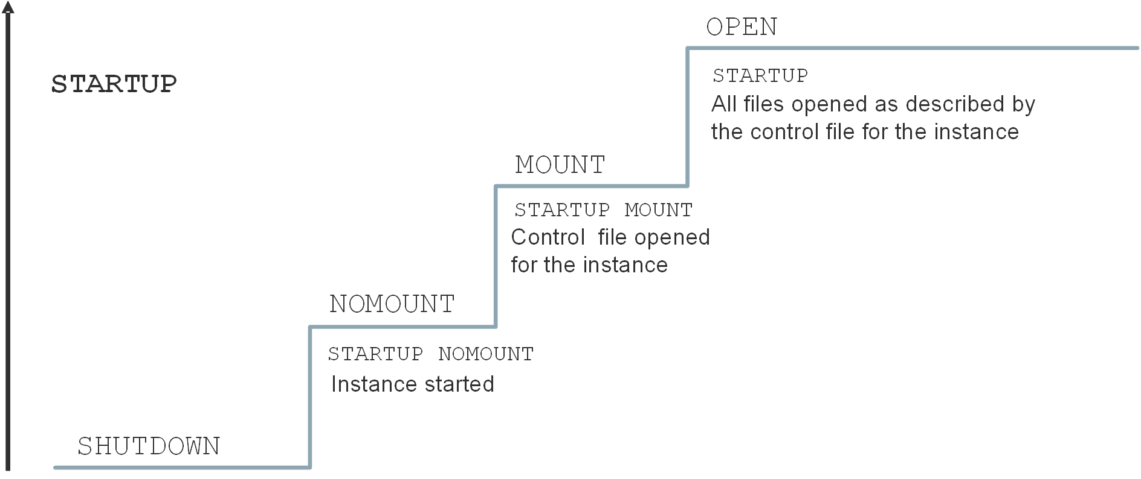
Starting the Oracle Database Instance
Notes:
Before users can connect to a database instance, a database administrator must start the database instance. The database instance and database go through stages as the database is made available for access by users. The database instance is started, the database is mounted, and then the database is opened, as shown in the slide.
You can use the STARTUP command in SQL*Plus with the options shown in the slide for each stage. The default option is OPEN.
NOMOUNT: During this stage, the Oracle software reads an initialization parameter file, starts background processes, allocates memory to the SGA, and opens the alert log and trace files. An instance is typically started only in NOMOUNT mode during database creation, during re-creation of control files, or in certain backup and recovery scenarios.
MOUNT: During this stage, the Oracle software associates the database (CDB) with the previously started database instance, opens and reads the control files that are specified in the initialization parameter file, and obtains the names and statuses of the data files and online redo log files. No checks, however, are performed to verify the existence of the data files and online redo log files at this time. Start in MOUNT mode to perform some maintenance operations, such as renaming data files and performing full database recoveries.
OPEN: The Oracle software opens the redo log files and data files according to the list registered in the control files. Start up in OPEN mode to enable users to connect to the database instance. PDBs are not, by default, started when you open the database.

Slide 12
Shutting Down an Oracle Database Instance
Sometimes you need to shut down the database instance (for example, to change a static parameter or patch the database server).
Use the SHUTDOWN command to shut down the database instance in various modes: ABORT, IMMEDIATE, TRANSACTIONAL, and NORMAL.
 | ABORT | IMMEDIATE | TRANSACTIONAL | NORMAL
Allows new connections | No | No | No | No
Waits until current sessions end | No | No | No | Yes
Waits until current transactions end | No | No | Yes | Yes
Forces a checkpoint and closes files | No | Yes | Yes | Yes
Notes:
IMMEDIATE Mode: A shutdown in IMMEDIATE mode is the most typically used option.
Current SQL statements being processed by the database instance are not completed.
The database server does not wait for the users who are currently connected to the database instance to disconnect.
The database server rolls back active transactions and disconnects all connected users.
The database server closes and dismounts the database before shutting down the database instance.
TRANSACTIONAL Mode: A shutdown in TRANSACTIONAL mode prevents clients from losing data, including results from their current activity.
No client can start a new transaction on this particular instance.
A client is disconnected when the client ends the transaction that is in progress.
When all transactions have been completed, a shutdown occurs immediately.
NORMAL Mode: NORMAL is the default shutdown mode if no mode is specified with the SHUTDOWN command.
No new connections can be made.
The Oracle server waits for all users to disconnect before completing the shutdown.
Database and redo buffers are written to disk.
Background processes are terminated, and the SGA is removed from memory.
The Oracle server closes and dismounts the database before shutting down the instance.

Slide 13
Notes:
ABORT Mode: If the other shutdown modes don't work, you can use ABORT mode. ABORT mode performs the least amount of work before shutting down. Because this mode puts the database in an inconsistent state and requires recovery before startup, use it only when necessary. It's not advisable to back up the database in this state. It's typically used when no other form of shutdown works, when there are problems with starting the database instance, or when you need to shut down immediately because of an impending situation (such as notice of a power outage within seconds). ABORT mode is usually the fastest shutdown mode and NORMAL mode is the slowest. NORMAL and TRANSACTIONAL modes can take a long time depending on the number of sessions and transactions.
The following happens during a shutdown in ABORT mode, an instance failure, or a database instance startup in FORCE mode:
Current SQL statements being processed by the Oracle server are immediately terminated.
The Oracle server does not wait for users who are currently connected to the database to disconnect.
Database and redo buffers are not written to disk.
Uncommitted transactions are not rolled back.
The instance is terminated without closing the files.
The database is not closed or dismounted.
The next startup requires instance recovery, which occurs automatically.

Slide 14
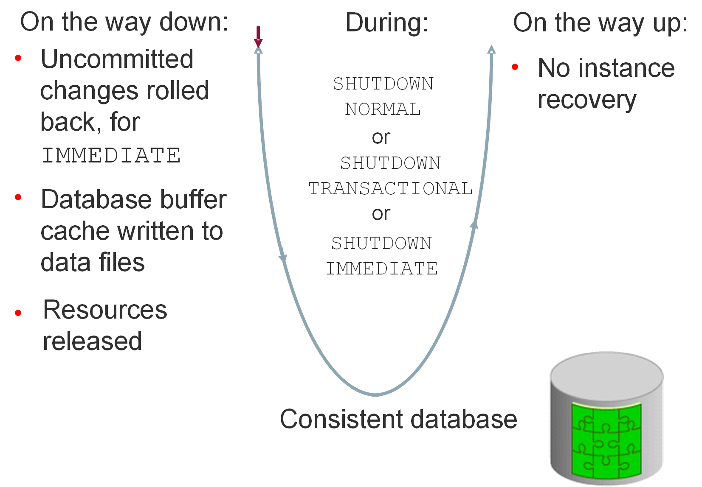
Comparing SHUTDOWN Modes
Notes:
The diagram in this slide shows the IMMEDIATE, TRANSACTIONAL, and NORMAL shutdown modes. The diagram in the next slide shows ABORT shutdown mode (and instance failure or STARTUP FORCE mode). Notice that the database becomes inconsistent when you perform an ABORT shutdown, whereas it stays consistent during the other shutdown modes. Also note that you need to recover the database instance after you perform an ABORT shutdown; whereas with the other shutdown modes, you don't need to do so.

Slide 15
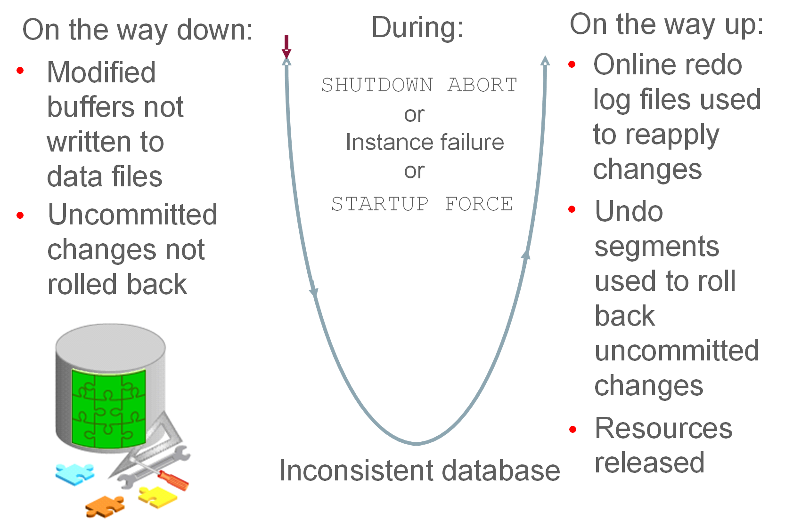
Comparing SHUTDOWN Modes
Notes:
Notice that the database becomes inconsistent when you perform an ABORT shutdown, whereas it stays consistent during the other shutdown modes. Also note that you need to recover the database instance after you perform an ABORT shutdown; whereas with the other shutdown modes, you don't need to do so.

Slide 16
Opening and Closing PDBs
Open/close a PDB to open/close its data files.
A PDB has four open modes:
READ WRITE (the PDB is fully started/opened)
READ ONLY
MIGRATE
MOUNTED (the PDB is shut down/closed)
Use the ALTER PLUGGABLE DATABASE command or STARTUP and SHUTDOWN commands to open and close PDBs.
Example: SQL> ALTER PLUGGABLE DATABASE PDB1 OPEN;
The ALTER PLUGGABLE DATABASE command lets you change from any open mode to another.
To use the STARTUP command, the PDB must be in MOUNTED mode.
Notes:
Open Modes
Starting up a PDB and opening a PDB mean the same thing, and you'll find both phrases used in documentation and online resources. When you open a PDB, the database server opens the data files for that PDB. Similar to a CDB, a PDB has four levels of being open, and these levels are referred to as open modes. The open modes are READ WRITE (the PDB is fully started/opened), READ ONLY, MIGRATE, and MOUNTED (the PDB is shut down/closed).
Commands to Open and Close PDBs
You can use the ALTER PLUGGABLE DATABASE command to open and close a PDB from either the root container or within the PDB itself. You can also use STARTUP and SHUTDOWN commands. The ALTER PLUGGABLE DATABASE command lets you change from any open mode to another for a PDB. To use the STARTUP command, the PDB must first be in MOUNTED mode. Either command requires you to be connected to the root container or PDB with one of the following system privileges: AS SYSBACKUP, AS SYSDBA, AS SYSDG, or AS SYSOPER.
Examples
In this example, PDB1 is started up (opened). Its open mode is changed from MOUNT to READ WRITE.
SQL> ALTER PLUGGABLE DATABASE PDB1 OPEN;
In this example, PDB1 is shut down (closed). Its open mode is changed to MOUNT.
SQL> ALTER PLUGGABLE DATABASE PDB1 CLOSE;

Slide 17
Working with the Automatic Diagnostic Repository
The Automatic Diagnostic Repository (ADR):
Is a file-based repository outside the database
Is a system-wide central tracing and logging repository
Stores database diagnostic data such as:
Traces
Alert log
Health monitor reports
Notes:
Automatic Diagnostic Repository
The Automatic Diagnostic Repository (ADR) is a system-wide tracing and logging central repository for database diagnostic data such as traces, the alert log, health monitor reports, and more.
The ADR root directory is known as the ADR base. Its location is set by the DIAGNOSTIC_DEST initialization parameter (for example, /u01/app/oracle).
The location of an ADR home is given by the following path, which starts at the ADR base directory:
<ADR Base>/diag/product_type/db_id/instance_id
For example:
/u01/app/oracle/diag/rdbms/orcl/ORCL

Slide 18

Automatic Diagnostic Repository
DIAGNOSTIC_DEST
$ORACLE_BASE
$ORACLE_HOME/log
ADR Base
Support Workbench
diag
rdbms
DB Name
Core dumps
ADR Home
SID
metadata
Foreground and background process traces, and alert log data
Alert log data
alert
cdump
incpkg
incident
hm
trace
(others)
incdir_1
…
incdir_n
ADRCI
log.xml
Incident dumps
alert_SID.log
V$DIAG_INFO
Notes:
ADR is a file-based repository for database diagnostic data such as traces, incident dumps and packages, the alert log, Health Monitor reports, core dumps, and more. It has a unified directory structure across multiple instances and multiple products—stored outside of any database. It is, therefore, available for problem diagnosis when the database is down.
The Oracle Database server, Automatic Storage Management (ASM), Cluster Ready Services (CRS), and other Oracle products or components store all diagnostic data in the ADR. Each instance of each product stores diagnostic data underneath its own ADR home directory. For example, in a Real Application Clusters environment with shared storage and ASM, each database instance and each ASM instance have a home directory within the ADR. ADR’s unified directory structure, consistent diagnostic data formats across products and instances, and a unified set of tools enable customers and Oracle Support to correlate and analyze diagnostic data across multiple instances.
The ADR root directory is known as the ADR base. Its location is set by the DIAGNOSTIC_DEST initialization parameter. If this parameter is omitted or left null, the database sets DIAGNOSTIC_DEST upon startup as follows: If environment variable ORACLE_BASE is set, DIAGNOSTIC_DEST is set to $ORACLE_BASE. If environment variable ORACLE_BASE is not set, DIAGNOSTIC_DEST is set to $ORACLE_HOME/log.

Slide 19
Viewing the Alert Log
The alert log file is a chronological log of messages about the database instance and database, such as:
Any nondefault initialization parameters used at startup
All internal errors (ORA-600), block corruption errors (ORA-1578), and deadlock errors (ORA-60) that occurred
Administrative operations, such as the SQL statements CREATE, ALTER, DROP DATABASE, and TABLESPACE, and the Enterprise Manager or SQL*Plus statements STARTUP, SHUTDOWN, ARCHIVE LOG, and RECOVER
Several messages and errors relating to the functions of shared server and dispatcher processes
Errors during the automatic refresh of a materialized view
Query V$DIAG_INFO to find the location of the alert log.
The path to alert_SID.log corresponds to the Diag Trace entry.
The path to log.xml corresponds to the Diag Alert entry.
You can view the alert log in a text editor or in ADRCI.
Notes:
Each database instance has an alert_SID.log file. The file is on the server with the database and is stored in $ORACLE_BASE/diag/rdbms/<db_name>/<SID>/trace by default if $ORACLE_BASE is set.
Oracle Database uses the alert log to keep a record of these events as an alternative to displaying the information on an operator’s console. Many systems also display this information on the console. If an administrative operation is successful, a message is written in the alert log as “completed” along with a time stamp.
Enterprise Manager Cloud Control monitors the alert log file and notifies you of critical errors. You can also view the log to see noncritical error and information messages. Because the file can grow to an unmanageable size, you can periodically back up the alert file and delete the current alert file. When the database attempts to write to the alert file again, it creates a new one.
Note: There is an XML version of the alert log in the $ORACLE_BASE/diag/rdbms/<db_name>/<SID>/alert directory.
ADRCI is an Oracle command-line utility that enables you to investigate problems, view health check reports, and package and upload first-failure data to Oracle Support. You can also use the utility to view the names of the trace files in the Automatic Diagnostic Repository (ADR) and the alert log. ADRCI has a rich command set that you can use interactively or in scripts.

Slide 20
Using Trace Files
Trace files contain:
Error information (contact Oracle Support Services if an internal error occurs)
Information that can provide guidance for tuning applications or an instance
Each server and background process can write to an associated trace file.
Trace file names for background processes are named after their processes.
Exception: Trace files generated by job queue processes
Oracle Database includes an advanced fault diagnosability infrastructure for preventing, detecting, diagnosing, and resolving problems.
When a critical error occurs:
An incident number is assigned to the error
Diagnostic data for the error (such as trace files) is immediately captured and tagged with the incident number
Data is stored in the ADR
ADR files can be automatically purged by setting retention policy parameters.
Notes:
Trace Files
Each server and background process can write to an associated trace file. When a process detects an internal error, it dumps information about the error to its trace file. If an internal error occurs and information is written to a trace file, the administrator should contact Oracle Support Services.
All file names of trace files associated with a background process contain the name of the process that generated the trace file. The one exception to this is trace files that are generated by job queue processes (Jnnn).
Additional information in trace files can provide guidance for tuning applications or an instance. Background processes always write this information to a trace file when appropriate.
Oracle Database includes an advanced fault diagnosability infrastructure for preventing, detecting, diagnosing, and resolving problems. In particular, problems that are targeted include critical errors such as those caused by database code bugs, metadata corruption, and customer data corruption.
When a critical error occurs, an incident number is assigned to it; diagnostic data for the error (such as trace files) is immediately captured and tagged with this number. The data is then stored in the Automatic Diagnostic Repository (ADR)—a file-based repository outside the database—where it can later be retrieved by incident number and analyzed.

Slide 21
Notes:
Purging Mechanism
The purging mechanism allows you to specify a retention policy stating:
How old ADR contents should be before they are automatically deleted.
The long retention period is used for the relatively higher-value diagnostic data, such as incidents and alert log (default value is 365 days).
The short retention period is used for traces and core dumps (default value is 30 days).
Older items are deleted first. The long retention period items are typically older than any of the items in the short retention period. So a mechanism is used in which the time periods are “scaled” so that roughly the same percentage of each gets deleted. Some components use these periods in slightly different ways. For instance, IPS, the packaging facility, uses the short retention period to determine when to purge packaging metadata and the staging directory contents. However, the age of the data is based on when the package was completed, not when it was originally created.
The size-based retention to specify a target size for an ADR home. When purging, the old data, determined by the time-based retention periods, is deleted first. If the size of the ADR home is still greater than the target size, diagnostics are automatically deleted until the target size is no longer exceeded.

Slide 22
Administering the DDL Log File
Enable the capture of certain DDL statements to a DDL log file by setting ENABLE_DDL_LOGGING to TRUE.
The DDL log contains one log record for each DDL statement.
Two DDL logs containing the same information:
XML DDL log: log.xml written to $ORACLE_BASE/diag/rdbms/<dbname>/<SID>/log/ddl
Text DDL: ddl_<sid>.log written to $ORACLE_BASE/diag/rdbms/<dbname>/<SID>/log
Example:
$ more ddl_orcl.log
Thu Nov 15 08:35:47 2016
diag_adl:drop user app_user
Notes:
The DDL log is created only if the ENABLE_DDL_LOGGING initialization parameter is set to TRUE. When this parameter is set to FALSE, DDL statements are not included in any log. A subset of executed DDL statements is written to the DDL log.
There are two DDL logs that contain the same information. One is an XML file, and the other is a text file. The DDL log is stored in the log/ddl subdirectory of the ADR home.
Important: You must have a license for Oracle Database Lifecycle Management Pack to enable DDL logging.

Slide 23
Querying Dynamic Performance Views
Dynamic performance views provide access to information about the changing states of instance memory structures:
Sessions, file states, and locks
Progress of jobs and tasks
Backup status, memory usage, and allocation
System and session parameters
SQL execution
Statistics and metrics
Dynamic performance views start with the prefix V$.
Example query: Which current sessions have logged in from the EDXX9P1 computer on the last day?
SQL> SELECT * FROM V$SESSION
2 WHERE machine = 'EDXX9P1'
3 AND logon_time > SYSDATE - 1;
Notes:
The Oracle Database server maintains a dynamic set of data about the operation and performance of the database instance. The dynamic performance views are based on virtual tables that are built from memory structures inside the database server. They are not conventional tables that reside in a database. This is the reason that some of them are available before a database is mounted or open.
Note: The DICT and DICT_COLUMNS views also contain the names of these dynamic performance views.
You can use dynamic performance views to answer questions such as the following:
For which SQL statements (and their associated numbers of executions) is the CPU time consumed greater than 200,000 microseconds?
SQL> SELECT sql_text, executions FROM V$SQL WHERE cpu_time > 200000;
What are the session IDs of those sessions that are currently holding a lock that is blocking another user, and how long have those locks been held?
SQL> SELECT sid, ctime FROM v$lock WHERE block > 0;

Slide 24
Considerations for Dynamic Performance Views
These views are owned by the SYS user.
Views provide information depending on the stage (NOMOUNT, MOUNT, or OPEN).
You can query V$FIXED_TABLE to see all the view names.
These views are often referred to as “v-dollar views.”
Read consistency is not guaranteed on these views because the data is dynamic.
Notes:
Some dynamic views provide information that is not applicable to all states of an instance or database. For example, if an instance has just been started but no database is mounted, you can query V$BGPROCESS to see the list of background processes that are running. But querying V$DATAFILE to see the status of database data files would return no rows. The database must be mounted or opened for V$DATAFILE to provide meaningful information. It is when the database is mounted that the control file is read to obtain information about the data files associated with a database.
Some V$ views contain information that is similar to information in the corresponding DBA_ views. For example, V$DATAFILE is similar to DBA_DATA_FILES. Note also that V$ view names are generally singular and DBA_ view names are plural.

Slide 25

Data Dictionary: Overview
Tables
Indexes
SYSTEM Tablespace
Views
Users
Schemas
Metadata
Procedures
…and so on
SELECT * FROM dictionary;
Notes:
The Oracle data dictionary is the metadata of the database and contains the names and attributes of all objects in the database. The creation or modification of any object causes an update to the data dictionary that reflects those changes. This information is stored in the base tables that are maintained by the Oracle Database server, but you access these tables by using predefined views rather than by reading the tables directly.
The data dictionary:
Is used by the Oracle Database server to find information about users, objects, constraints, and storage
Is maintained by the Oracle Database server when object structures or definitions are modified
Is available for use by any user to query information about the database
Is owned by the SYS user
Should never be modified directly by using SQL
Note: The DICTIONARY data dictionary view (or the DICT synonym for this) contains the names and descriptions of data dictionary tables and views. Use the DICT_COLUMNS view to see the view columns and their definitions. For complete definitions of each view, see the Oracle Database Reference. There are over 1000 views that reference hundreds of base tables.

Slide 26
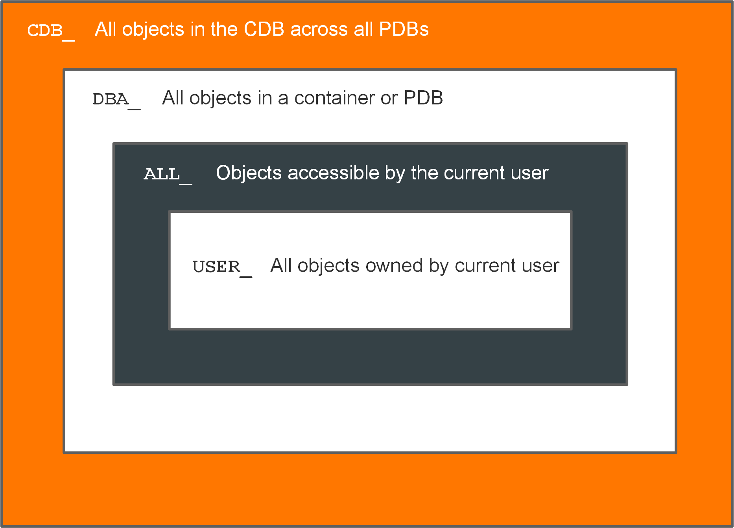
Querying the Oracle Data Dictionary
Notes:
CDB_, DBA_, ALL_, and USER_ Views
The view prefixes, as shown in the slide, indicate the data (and how much of that data) a given user can see.
CDB_ views display metadata for all objects in a CDB across all PDBs.
DBA_ views display metadata for all objects in a container or PDB.
ALL_views display metadata for objects that the current user is privileged to see, whether the user owns them or not. For example, if USER_A has been granted access to a table owned by USER_B, then USER_A sees that table listed in any ALL_ view dealing with table names.
USER_ views display metadata for all objects owned by the current user; that is, objects that are present in the user's own schema.
Only USER_ and ALL_ views are available to any user. The CDB_ and DBA_ views are restricted to DBA accounts.
Generally, each view set is a subset of the higher-privileged view set, row-wise and column-wise. Not all views in a given view set have a corresponding view in the other view sets. It depends on the nature of the information in the view. For example, there is a DBA_LOCK view, but no ALL_LOCK view, because only a DBA would have interest in data about locks. Be sure to choose the appropriate view set to meet the need that you have. If you have the privilege to access the DBA views, you still may want to query only the USER_ version of the view because the results show information on objects that you own and you may not want other objects to be added to your result set.
The CDB_ and DBA_ views can be queried only by users with the SYSDBA or SELECT ANY DICTIONARY privilege, or SELECT_CATALOG_ROLE role, or by users with direct privileges granted to them.

Slide 27
Notes:
When a user connected to the root queries a CDB_* view, the query results will depend on the CONTAINER_DATA attribute for the user. The CONTAINER_DATA clause of the SQL ALTER USER statement is used to set and modify the users' CONTAINER_DATA attribute. In a PDB, the CDB_* views only show objects visible through a corresponding DBA_* view.

Slide 28

Summary
In this lesson, you should have learned how to:
Describe initialization parameter files and initialization parameters
View and modify initialization parameters in SQL*Plus
Start up and shut down Oracle databases
Open and close PDBs
Work with the Automatic Diagnostic Repository (ADR)
Query dynamic performance views

Slide 29
Practice 7: Overview
7-1: Investigating Initialization Parameter Files
7-2: Viewing Initialization Parameters by Using SQL*Plus
7-3: Modifying Initialization Parameters by Using SQL*Plus
7-4: Modifying an Initialization Parameter by Using Enterprise Manager Database Express
7-5: Shutting Down and Starting Up the Oracle Database
7-6: Viewing Diagnostic Information

