Slide 1
Administering User Security

Slide 2
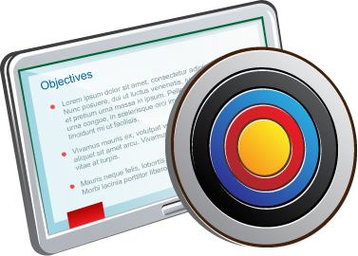
Objectives
After completing this lesson, you should be able to:
Create database users
Grant privileges to database users
Create and grant roles to users or other roles
Revoke privileges and roles from users and other roles
Create and assign profiles to users
Explain the various authentication options for users
Assign quota to users
Apply the principle of least privilege

Slide 3



Oracle Cloud User Roles and Privileges
ACCOUNT ADMINISTRATORS
Manage the service account
Request trial subscriptions
Activate services
SERVICE ADMINISTRATORS
Manage service operations
Administer cloud services
Assign roles to users
Provide sign-in credentials and URLs to users
IDENTITY DOMAIN ADMINISTRATORS
Manage users and roles
Create user accounts
Assign roles
Reset passwords
USERS IN A CLOUD SERVICE
See Oracle Cloud User Roles and Privileges in Getting Started with Oracle Cloud for additional information.
Notes:
If you have subscribed to an entitlement to create instances of an Oracle Cloud Service, then you can create multiple service instances based on your business needs.
You have identity domain administrator privileges to create a user and assign the service entitlement administrator role to the user, who will create service instances. The actual name of this role depends on the Oracle Cloud service that you have subscribed to.
Identity domain administrators can assign and remove roles only for the users in the identity domains that they manage.
Service administrators (or the DBCS database administrator) can assign and remove roles only for the users of the services that they manage. Because service administrators cannot add users or roles, the users and roles must already be in the system before service administrators can assign a specific role to a user.

Slide 4
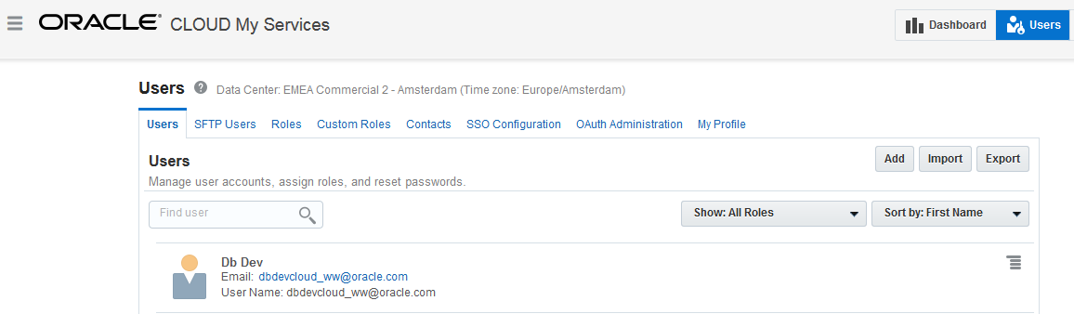
Administering Oracle Cloud Users, Roles, and Privileges
Administer Cloud Services users by accessing the Users page.
Cloud Services users are different from Oracle Database users.
See Creating a User and Assigning a Role in Getting Started with Oracle Cloud for details.
Notes:
The Users page may be selected from various consoles. On the Users page, you can add individual users and configure the roles (privileges) for each user.
User privileges are controlled through assigned roles. The roles assign privileges in a granular fashion, and each role has specific privileges.
The Import button allows you to import a list of users as a CSV file (comma delimited).
The Users page provides administration for:
SFTP users for file transfers: Predefined users with specific uses
Roles: Predefined roles for managing cloud services; roles are assigned to individual users, or a single role can be assigned to a list of users in a CSV file
Custom Roles: Created and deleted by identity domain administrators and then used by application developers to secure applications
SSO Configuration: Used to configure Single Sign-On so your users can use their company credentials to log in to all applications, including Oracle Cloud applications
OAuth Administration: Used to manage client access to Oracle Cloud APIs using the OAuth 2.0 protocol
My Profile: Each user can modify basic user information, reset the password, change the roles, and remove the user.
For each user, there is also a menu icon that can be used to modify basic user information, reset the password, change the roles, and remove the user.

Slide 5
Managing Oracle Cloud Compute Node Users
When a database deployment is created, three Linux users are created.
OS User | Authorization
opc | Authorized to log in to the compute node Authorized to run root commands Can use sudo –s
oracle | Authorized to log in to the compute node Not authorized to run root commands
root | Not authorized to log in to the compute node
Notes:
When a database deployment is created, three Linux users are created:
opc: The opc user is authorized to run root commands. Certain operations such as database backup and recovery or compute node reboot require the use of the sudo command. Connect as opc to perform these operations.
oracle: The oracle user is the administrator account you use to access the system and perform operations on the compute node. A home directory, /home/oracle, is created for this user. This user cannot use the sudo command to perform operations that require root-user access.
root: The root administrator for the system exists, but you do not have a direct connection to this account. To perform operations that require root-user access, connect as the opc user and use the sudo command.

Slide 6
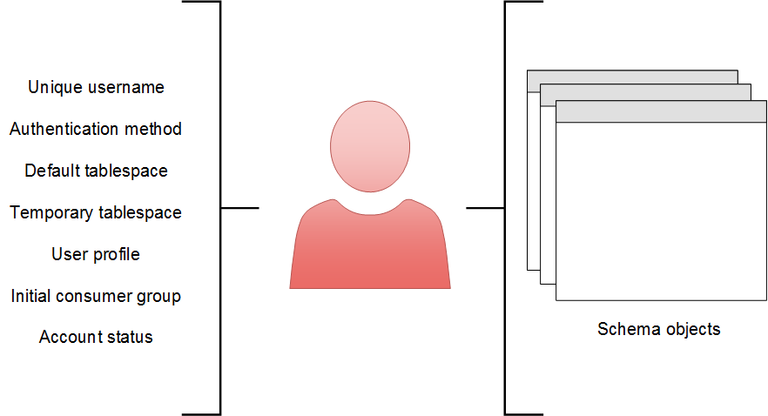
Database User Accounts
Notes:
User Account Components
To access the database, a user must specify a valid database user account and successfully authenticate as required by that user account. Each database user has a unique database account. Oracle recommends this to avoid potential security holes and provide meaningful data for certain audit activities. However, users may sometimes share a common database account. In these rare cases, the operating system and applications must provide adequate security for the database.
Each user account has the following, as illustrated in the slide:
Unique username: Usernames cannot exceed 30 bytes, cannot contain special characters, and must start with a letter.
Authentication method: The most common authentication method is a password.
Default tablespace: This is a place where a user creates objects if the user does not specify some other tablespace.
Having a default tablespace does not imply that the user has the privilege of creating objects, nor does the user have a quota of space in that tablespace in which to create objects. Both of these privileges are granted separately.
If a user does not specify a tablespace when creating an object, the object will be created in the default tablespace assigned to the object owner. This enables you to control where the user's objects are created.
If an administrator does not define a default tablespace, the system-defined default permanent tablespace is used.

Slide 7
Notes:
Quota for a specific tablespace is not granted through a privilege. It's done by using the ALTER USER command, which changes the attributes for a user. However, if a DBA grants the UNLIMITED TABLESPACE system privilege to a user, then that user can use all the space in any tablespace.
Temporary tablespace: This is a place where temporary objects, such as sorts and temporary tables, are created on behalf of the user by the instance. No quota is applied to temporary tablespaces. If an administrator does not define a temporary tablespace for a user, the system-defined temporary tablespace is used when the user creates objects.
User profile: This is a set of resource and password restrictions assigned to the user.
Initial consumer group: This is used by the Resource Manager.
Account status: Users can access only “open” accounts. The account status may be “locked” and/or “expired.”
Note: A database user is not necessarily a person. It is a common practice to create a user that owns the database objects of a particular application, such as HR. The database user can be a device, an application, or just a way to group database objects for security purposes. The personal identifying information of a person is not needed for a database user.
Schemas
A schema is a collection of database objects that are owned by a database user. Schema objects are the logical structures that directly refer to the database’s data. Schema objects include such structures as tables, views, sequences, stored procedures, synonyms, indexes, clusters, and database links. In general, schema objects include everything that your application creates in the database.

Slide 8
Oracle-Supplied Administrator Accounts
Account | Description
SYS | Super user. Owns the data dictionary and the Automatic Workload Repository (AWR). Used for starting up and shutting down the database instance.
SYSTEM | Owns additional administrative tables and views
SYSBACKUP | Facilitates Oracle Recovery Manager (RMAN) backup and recovery operations
SYSDG | Facilitates Oracle Data Guard operations
SYSKM | Facilitates Transparent Data Encryption wallet operations
SYSRAC | For Oracle Real Application Clusters (RAC) database administration tasks
SYSMAN | For Oracle Enterprise Manager database administration tasks
DBSNMP | Used by the Management Agent component of Oracle Enterprise Manager to monitor and manage the database
Notes:
The SYS and SYSTEM accounts are required accounts in the database and cannot be deleted. You supply their passwords when you create the database instance and database in DBCA.
During installation and database creation, you can unlock and reset many of the Oracle-supplied database user accounts.

Slide 9
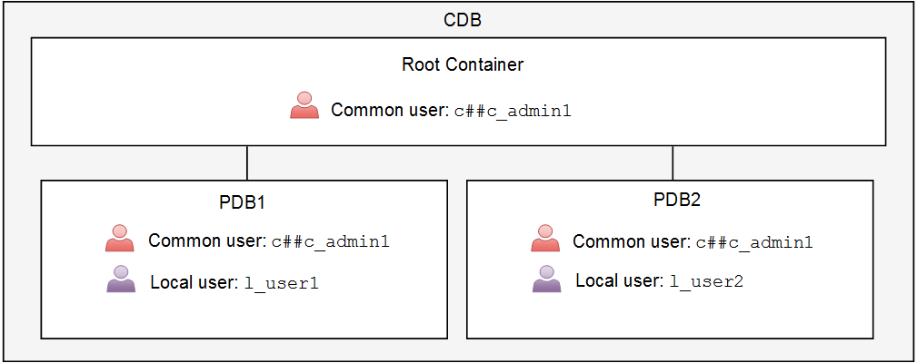
Creating Oracle Database Users in a Multitenant Environment
Notes:
Comparing Common and Local Users
A multitenant environment has two types of database users that you can create:
Common user: The user is replicated in all existing and future containers. Oracle supplies several common user accounts for database administrators to use. A common user that you create, by default, must be given a name that starts with C## or c## (for example, c##c_admin1). The COMMON_USER_PREFIX parameter specifies a prefix for common users, roles, and profiles in a container database. To create a common user, log in to the root container, issue the CREATE USER command, and include the CONTAINER=ALL clause. For example:
SQL> CONNECT / AS SYSDBA
SQL> CREATE USER c##c_admin1 IDENTIFIED BY x CONTAINER=ALL;
Local user: The user is created in a single PDB only. Local users cannot be created in a root container or in an application root container. A local user cannot create a common user. To create a local user, log in to the PDB where you want to create the local user and issue the CREATE USER command. For example:
SQL> CONNECT SYS@PDB1 AS SYSDBA
SQL> CREATE USER l_user1 … ;
In the illustration in the slide, the common user c##c_admin1 exists in the root container and all PDBs, while local user l_user1 only exists in PDB1 and local user l_user2 only exists in PDB2.
You can use tools such as SQL*Plus and Enterprise Manager Database Express to create user accounts in the Oracle database.

Slide 10
Schema-Only Account
Ensure that a user cannot log in to the instance:
Enforce data access through the application.
Secure schema objects.
Prevent objects from being dropped by the connected schema.
Use the NO AUTHENTICATION clause.
Can be replaced by IDENTIFIED BY VALUES
A schema-only account cannot be:
Granted system administrative privileges
Used in database links
DBA_USERS
AUTHENTICATION_TYPE = NONE | PASSWORD
Notes:
Application designers may want to create accounts that contain the application data dictionary, but are not allowed to log in to the instance. This can be used to enforce data access through the application, separation of duties at the application level, and other security mechanisms.
In addition, utility accounts can be created but remain inaccessible by denying the ability to log in except under controlled situations.
Until Oracle Database 12c, DBAs create accounts that do not need to log in to the instance or maybe rarely log in to the instance. Nevertheless, for all these accounts, there are default passwords and requirements to rotate the passwords.
In Oracle Database 19c, an account can be created with the NO AUTHENTICATION clause to ensure that the account is not permitted to log in to the instance. Removing the password and the ability to log in essentially just leaves a schema. The schema account can be altered to allow login, but can then have the password removed. The ALTER USER statement can be used to disable or re-enable the login capability.
The DBA_USERS view has a new column, AUTHENTICATION_TYPE, which displays NONE when NO AUTHENTICATION is set, and PASSWORD when a password is set.

Slide 11
Authenticating Users
Every user, including administrators, must be authenticated when connecting to a database instance.
Authentication verifies that the user is a valid database user and establishes a trust relationship for further interactions.
Authentication also enables accountability by making it possible to link access and actions to specific identities.
The following authentication methods are possible:
Password (usually for database users)
Operating system (OS) authentication
Password file (for system administrative privileged users only)
Strong authentication with Kerberos, SSL, or directory authentication
A system administrative privileged user must use OS authentication, password file authentication, or strong authentication. These methods can authenticate when the database is available or unavailable (not started).
Notes:
Your choice of authentication is influenced by whether you intend to administer your database locally on the same system where the database resides or whether you intend to administer many different databases from a single remote client.

Slide 12
Password Authentication
Password authentication is also referred to as "authentication" by the Oracle Database server.
Create each user with an associated password that must be supplied when the user attempts to establish a connection.
When setting up a password, you can expire the password immediately, which forces the user to change the password after first logging in.
If you decide on expiring user passwords, make sure that users have the ability to change the password. Some applications do not have this functionality.
All passwords created in Oracle Database are case-sensitive by default.
Passwords may contain multibyte characters and are limited to 30 bytes.
Passwords are always automatically and transparently encrypted by using the Advanced Encryption Standard (AES) algorithm during network (client/server and server/server) connections before sending them across the network.

Slide 13
Password File Authentication
You can use password file authentication for an Oracle database instance and for an Oracle Automatic Storage Management (Oracle ASM) instance.
If authentication succeeds, the connection is logged with the SYS user.
A password file stores database usernames and case-sensitive passwords for administrator users (common and local administrators).
DBCA creates a password file during installation.
To prepare for password file authentication, you must:
Create the password file.
Set the REMOTE_LOGIN_PASSWORDFILE initialization parameter.
Grant system administrative privileges (for example, GRANT SYSDBA TO mydba).
Use the CONNECT command in SQL*Plus to connect. For example:
SQL> CONNECT mydba AS SYSDBA
Notes:
For more information, see the following sources in Oracle Database Administrator's Guide:
Preparing to Use Password File Authentication
Connecting Using Password File Authentication
On UNIX and Linux, the password file is called orapwORACLE_SID and is stored in $ORACLE_HOME/dbs. On Windows, the file is called PWDORACLE_SID.ora and is stored in $ORACLE_HOME\database.
If your concern is that the password file might be vulnerable or that the maintenance of many password files is a burden, strong authentication can be implemented. You can query V$PWFILE_USERS to view information in the password file.

Slide 14
OS Authentication
Oracle Universal Installer creates operating system groups, assigns them specific names, and maps each group to a specific system privilege.
Example: Members of the dba group are granted SYSDBA
As a group member, you can be authenticated, enabled as an administrative user, and connected to a local database:
SQL> CONNECT / AS SYSDBA
SQL> CONNECT / AS SYSOPER
SQL> CONNECT / AS SYSBACKUP
SQL> CONNECT / AS SYSDG
SQL> CONNECT / AS SYSKM
SQL> CONNECT / AS SYSRAC
If you are not a member of one of these OS groups, you will not be able to connect as an administrative user via OS authentication.
Notes:
OS Authentication for Privileged Users
Oracle Universal Installer creates operating system groups, assigns them specific names, and maps each group to a specific system privilege. The table in the next slide shows this mapping for a UNIX or Linux environment. Membership in one of these operating system groups enables a database administrator to authenticate to the database instance through the operating system rather than with a database username and password. This is known as operating system authentication.
Example
The special system privileges are not exercised unless you include them in your CONNECT clause. For example, assume that the HR user is granted the SYSDBA privilege and connects with that privilege. Notice that the current user becomes SYS:
SQL> CONNECT hr/hr@PDB1 AS SYSDBA
Connected.
SQL> SHOW USER
USER is "SYS"
However, if the HR user logs in to PDB1 without including the AS SYSDBA clause, the current user is HR and the user does not have the SYSDBA privilege.
SQL> CONNECT hr/hr@PDB1
Connected.
SQL> SHOW USER
USER is "HR"

Slide 15
Notes:
OS Authentication for Users
If your operating system permits, you can have it authenticate users. They will not need to provide a username or password when connecting to the database instance.
If you use operating system authentication, set the OS_AUTHENT_PREFIX initialization parameter and use this prefix in Oracle usernames. The OS_AUTHENT_PREFIX parameter defines a prefix that the Oracle database adds to the beginning of each user’s operating system account name. The default value of this parameter is OPS$ for backward compatibility with the previous versions of the Oracle software. The Oracle database compares the prefixed username with the Oracle usernames in the database when a user attempts to connect. For example, assume that OS_AUTHENT_PREFIX is set as follows:
OS_AUTHENT_PREFIX=OPS$
If a user with an operating system account named tsmith needs to connect to an Oracle database and be authenticated by the operating system, the Oracle database checks whether there is a corresponding database user OPS$tsmith and, if so, allows the user to connect. All references to a user who is authenticated by the operating system must include the prefix, as seen in OPS$tsmith. The text of the OS_AUTHENT_PREFIX initialization parameter is case-sensitive on some operating systems.

Slide 16
OS Authentication for Privileged Users
OS Group | UNIX or Linux User Group | Special System Privilege Granted to Members
Oracle Software Group (top level group) | oinstall | Allowed to create and delete database files on the OS. All database administrators belong to this group.
Database Administrator Group (OSDBA) | dba | SYSDBA (Connects you as the SYS user)
Database Operator Group (OSOPER) – optional | oper | SYSOPER (Connects you as the PUBLIC user)
Database Backup and Recovery Group (OSBACKUPDBA) | backupdba | SYSBACKUP
Data Guard Administrative Group (OSDGDBA) | dgdba | SYSDG
Encryption Key Management Administrative Group (OSKMDBA) | kmdba | SYSKM
Real Application Cluster Administrative Group (OSRACDBA) | rac | SYSRAC
Notes:
If you are not a member of one of the OS groups listed in the slide, you will not be able to connect as an administrative user via OS authentication. That is, CONNECT / AS SYSDBA will fail. However, you can still connect using other authentication methods (for example, network, password, or directory-based authentication).

Slide 17

Privileges
There are two types of user privileges:
System: Enables users to perform particular actions in the database
Object: Enables users to access and manipulate a specific object
HR_DBA
Object privilege:
Update employees
System privilege:
Create session
Notes:
A privilege is a right to execute a particular type of SQL statement or to access another user’s object.
Privileges are divided into two categories:
System privileges: Each system privilege allows a user to perform a particular database operation or class of database operations. For example, the privilege to create tablespaces is a system privilege. System privileges can be granted by the administrator or by someone who has been given explicit permission to administer the privilege. There are more than 170 distinct system privileges. Many system privileges contain the ANY clause.
Object privileges: Object privileges allow a user to perform a particular action on a specific object, such as a table, view, sequence, procedure, function, or package. Without specific permission, users can access only their own objects. Object privileges can be granted by the owner of an object, by the administrator, or by someone who has been explicitly given permission to grant privileges on the object.

Slide 18
System Privileges
Each system privilege allows a user to perform a particular database operation or class of database operations.
Administrators have special system privileges.
A system privilege with the ANY clause means the privilege applies to all schemas, not just your own.
If you grant a system privilege with the ADMIN OPTION enabled, you enable the grantee to administer the system privilege and grant it to other users.
Notes:
System Privileges
Each system privilege allows a user to perform a particular database operation or class of database operations. System privileges can be granted by the administrator or by someone who has been given explicit permission to administer the privilege. You can administer system privileges when you create a user or at a later time. Carefully consider security requirements before granting system permissions.
There are more than 170 distinct system privileges. A few are listed here:
CREATE SESSION: Enables a user to connect to a database instance
DROP ANY OBJECT
CREATE TABLESPACE
DROP TABLESPACE
ALTER TABLESPACE
CREATE LIBRARY
CREATE ANY DIRECTORY
GRANT ANY OBJECT PRIVILEGE
ALTER DATABASE
ALTER SYSTEM

Slide 19
Notes:
ANY Clause
Many system privileges contain an ANY clause, which means the privilege applies to all schemas, not just your own. For example, the SELECT ANY TABLE system privilege allows you to retrieve data from all tables and views, including those from schemas owned by other users. The SYS user and users with the DBA role are granted all the ANY privileges; therefore, they can do anything to any data object. You can control the scope of all system privileges, including those with the ANY clause, by using Oracle Database Vault.
ADMIN OPTION
If you grant a system privilege with ADMIN OPTION enabled, you enable the grantee to administer the system privilege and grant it to other users. The SQL syntax for granting system privileges is:
SQL> GRANT <system_privilege> TO <grantee clause> [WITH ADMIN OPTION]

Slide 20
System Privileges for Administrators
Privilege | Description
SYSDBA | Perform all administrative tasks in the database, including create and drop a database, open and mount a database, start up and shut down an Oracle database, create an SPFILE, put a database in or remove a database from ARCHIVELOG mode, perform incomplete recovery operations, patch, and migrate. This privilege enables you to connect as the SYS user.
SYSOPER | Perform similar administration tasks as the SYSDBA privilege, but without the ability to look at user data. For example, you can start up and shut down the database, create an SPFILE, and perform complete recovery operations (not incomplete recovery operations).
SYSASM | Start up, shut down, and administer an Automatic Storage Management instance.
SYSBACKUP | Perform backup and recovery operations by using RMAN or SQL*Plus.
SYSDG | Perform Data Guard operations by using the Data Guard Broker or the DGMGRL command-line interface.
SYSKM | Manage Transparent Data Encryption wallet operations.
SYSRAC | Perform day-to-day administration tasks on an Oracle Real Application Clusters (RAC) cluster.
Notes:
There are seven special system privileges that are usually granted only to administrators. Anyone who is granted one of these privileges is referred to as a system administrative privileged user (privileged user, for short).
Only users who are granted the SYSDBA, SYSOPER, SYSASM, and SYSRAC privileges are allowed to start up and shut down the Oracle database.
The SYSBACKUP, SYSDG, and SYSKM privileges enable you to connect to the database even if the database is not open.
The SELECT ANY DICTIONARY system privilege does not permit access to sensitive data dictionary tables, which are owned by the SYS schema.

Slide 21
Object Privileges
Object privileges allow a user to perform a particular action on a specific object, such as a table, view, sequence, procedure, function, or package.
Without specific permission, users can access only their own objects.
Object privileges can be granted by the owner of an object, by the administrator, or by someone who has been explicitly given permission to grant privileges on the object.
The SQL syntax for granting object privileges is:
GRANT <object_privilege> ON <object> TO <grantee clause>
[WITH GRANT OPTION]

Slide 22
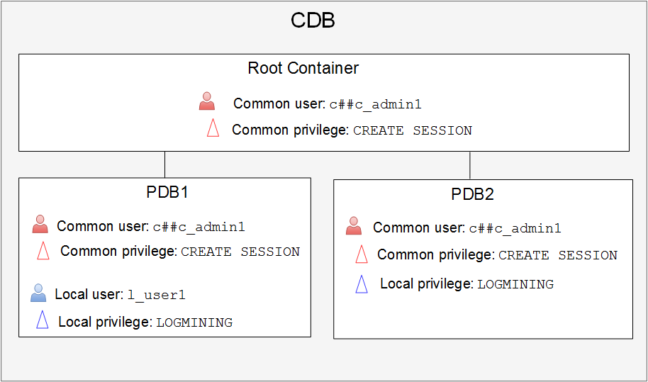
Granting Privileges in a Multitenant Environment
Notes:
Comparing Common and Local Privileges
A privilege is a right to execute operations that create, modify, or delete structures in an instance or a database or a right to execute operations that manipulate users’ objects. Oracle Database has predefined system and object privileges. You do not create them. It is best to grant a privilege only to a user who requires that privilege to accomplish the necessary work. Excessive granting of unnecessary privileges can compromise security.
In a multitenant environment, you can grant a privilege to a user in two ways:
Commonly: You grant the user the privilege in all containers of a CDB. In an application container, a common privilege is granted to a grantee in the application root and application PDBs. To grant a privilege commonly, you must log in to the root container and issue the GRANT command with the CONTAINER=ALL clause. For example:
SQL> CONNECT / AS SYSDBA
SQL> GRANT create session TO c##c_admin1 CONTAINER=ALL;
Locally: You grant the user the privilege in a single PDB only. To grant a privilege locally, log in to the PDB and issue the GRANT command. For example:
SQL> CONNECT SYS@PDB1 AS SYSDBA
SQL> GRANT logmining TO l_user1;

Slide 23
Notes:
To switch to a different container, a common user must have the SET CONTAINER privilege in the current container. Alternatively, a common user can start a new database session whose initial current container is the container the user wants, relying on the CREATE SESSION privilege in that PDB. Be aware that commonly granted privileges that have been made to common users may interfere with the security configured for individual PDBs.
The diagram in the slide illustrates the following:
The c##c_admin1 common user is granted the CREATE SESSION privilege commonly, which applies the privilege to that user in all containers. In PDB2, c##c_admin1 is also granted the LOGMINING privilege locally. c##c_admin1 does not have the LOGMINING privilege in any other container.
The local user l_user1 exists in PDB1 only and is granted the LOGMINING privilege. If the same user existed in another PDB (as a totally separate user), the LOGMINING privilege would not be applied.
Remember
Step 1: Create a common user when the same user has to perform the same actions in all PDBs in the CDB. Otherwise, create the user as a local user in a PDB.
Step 2: Ask yourself, do you want the common user who exists in each PDB to have the same privilege(s) in the PDBs?
If yes, then you commonly grant the privilege(s) to the common user. Connect to the CDB as a user who is privileged enough to do it and grant privilege1, privilege2, and so on to the common user by using the CONTAINER=ALL clause.
If no, then you locally grant the privilege(s) to the common user. Connect to the PDB as a user who is privileged enough to do it and grant privilege1, privilege2, and so on to the common user.

Slide 24
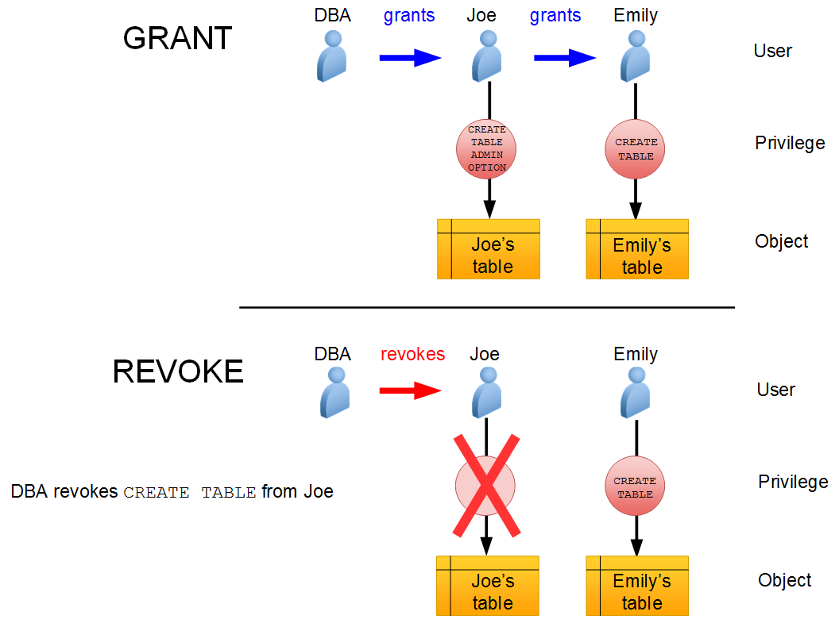
Granting and Revoking System Privileges
Notes:
System privileges that have been granted directly with a GRANT command can be revoked by using the REVOKE command in SQL*Plus. Users with the ADMIN OPTION for a system privilege can revoke the privilege from any other database user. The revoker does not have to be the same user who originally granted the privilege.
There are no cascading effects when a system privilege is revoked, regardless of whether it is given the ADMIN OPTION.
The SQL syntax for revoking system privileges is:
SQL> REVOKE <system_privilege> FROM <grantee clause>
The diagram in the slide illustrates the following events:
The DBA grants the CREATE TABLE system privilege to the user Joe with ADMIN OPTION.
Joe creates a table.
Joe grants the CREATE TABLE system privilege to the user Emily.
Emily creates a table.
The DBA revokes the CREATE TABLE system privilege from Joe.
The result is that Joe’s table still exists and he can still access it, but he can't create new tables. Emily’s table still exists, and she still has the CREATE TABLE system privilege.

Slide 25
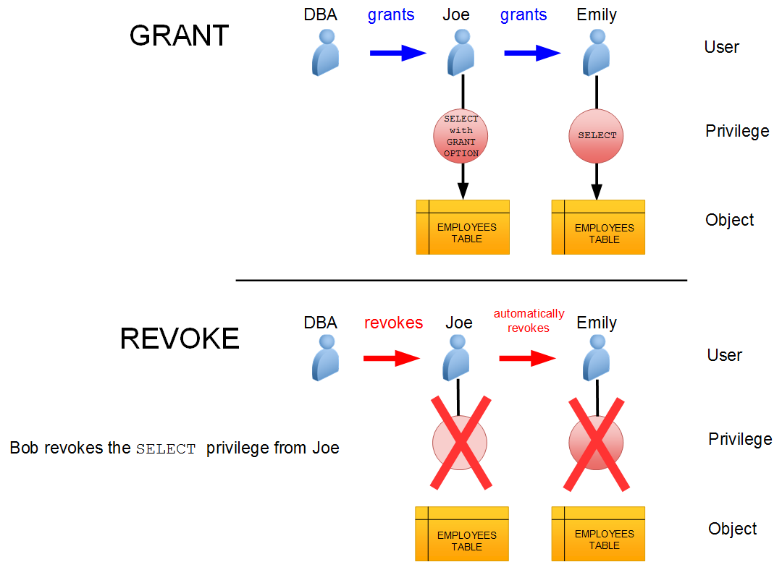
Granting and Revoking Object Privileges
Notes:
Cascading effects can be observed when revoking a system privilege that is related to a data manipulation language (DML) operation. For example, if the SELECT ANY TABLE privilege is granted to a user, and if that user has created procedures that use the table, all procedures that are contained in the user’s schema must be recompiled before they can be used again.
Revoking object privileges also cascades when given with GRANT OPTION. As a user, you can revoke only those privileges that you have granted. For example, Bob cannot revoke the object privilege that Joe granted to Emily. Only the grantee or a user with the privilege called GRANT ANY OBJECT PRIVILEGE can revoke object privileges.
The diagram in the slide illustrates object privileges being revoked. Assume that the following events occur:
A DBA grants Joe the SELECT object privilege on the EMPLOYEES table with the GRANT OPTION.
Joe grants the SELECT privilege on the EMPLOYEES table to Emily.
The DBA revokes the SELECT privilege from Joe.
The result is that the revoke takes away Joe's ability to access the EMPLOYEES table, and the revoke is cascaded to Emily as well.

Slide 26
Using Roles to Manage Privileges
Roles:
Used to group together privileges and roles
Facilitate granting of multiple privileges or roles to users
Benefits of roles:
Easier privilege management
Dynamic privilege management
Selective availability of privileges
Notes:
A role is a named group of related privileges that are granted to users or to other roles.
You can use roles to administer database privileges. You can add privileges to a role and grant the role to a user. The user can then enable the role and exercise the privileges granted by the role. A role contains all privileges that are granted to that role and all privileges of other roles that are granted to it.
Roles provide the following benefits with respect to managing privileges:
Easier privilege management: Use roles to simplify privilege management. Rather than granting the same set of privileges to several users, you can grant the privileges to a role and then grant that role to each user.
Dynamic privilege management: If the privileges associated with a role are modified, all users who are granted the role acquire the modified privileges automatically and immediately.
Selective availability of privileges: Roles can be enabled and disabled to turn privileges on and off temporarily. This allows the privileges of the user to be controlled in a given situation.

Slide 27

Assigning Privileges to Roles and Assigning Roles to Users
Users
Jenny
David
Rachel
Roles
HR_MGR
HR_CLERK
Delete
employees
Create
job
Update
employees
Privileges
Insert
employees
Select
employees
Notes:
In most systems, it is time-consuming and error-prone to grant necessary privileges to each user individually. Oracle software provides for easy and controlled privilege management through roles. Roles are named groups of related privileges that are granted to users or to other roles. Roles are designed to ease the administration of privileges in the database and, therefore, improve security.
Role Characteristics
Privileges are granted to and revoked from roles as though the role were a user.
Roles are granted to and revoked from users or other roles as though they were system privileges.
A role can consist of both system and object privileges.
A role can be enabled or disabled for each user who is granted the role.
A role can require a password to be enabled.
Roles are not owned by anyone, and they are not in any schema.
In the example in the slide, the SELECT and UPDATE privileges on the employees table and the CREATE JOB system privilege are granted to the HR_CLERK role. DELETE and INSERT privileges on the employees table and the HR_CLERK role are granted to the HR_MGR role. The manager is granted the HR_MGR role and can now select, delete, insert, and update the employees table.

Slide 28
Oracle-Supplied Roles
Account | Description
DBA | Includes most system privileges and several other roles. Do not grant this role to nonadministrators. Users with this role can connect to the CDB or PDB only when it is open.
RESOURCE | CREATE CLUSTER, CREATE INDEXTYPE, CREATE OPERATOR, CREATE PROCEDURE, CREATE SEQUENCE, CREATE TABLE, CREATE TRIGGER, CREATE TYPE
SCHEDULER_ADMIN | CREATE ANY JOB, CREATE EXTERNAL JOB, CREATE JOB, EXECUTE ANY CLASS, EXECUTE ANY PROGRAM, MANAGE SCHEDULER
SELECT_CATALOG_ROLE | SELECT privileges on data dictionary objects
Notes:
The table in the slide lists some commonly used predefined roles in Oracle Database.
You must not alter the privileges granted to Oracle-supplied roles without the assistance of Oracle Support because you may inadvertently disable the needed functionality. The SYS and SYSTEM accounts have the DBA role granted to them by default. In addition, SYSTEM is also granted the AQ_ADMINISTRATOR_ROLE and MGMT_USER roles.

Slide 29
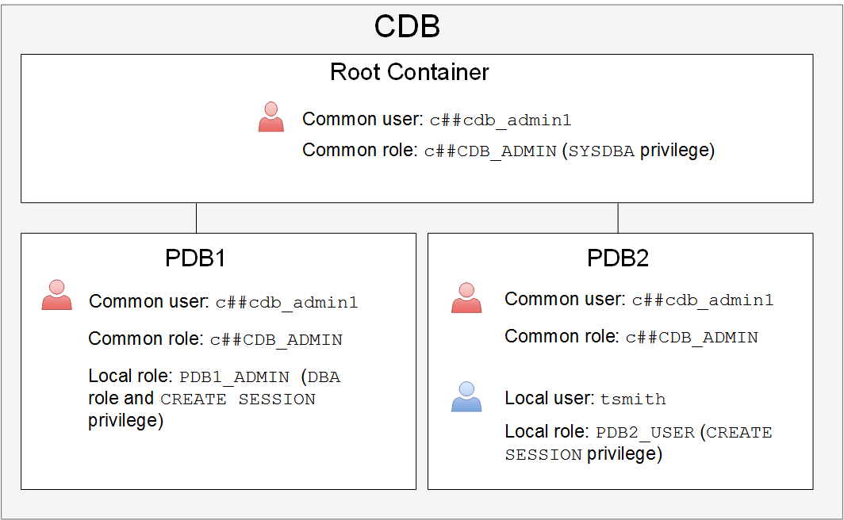
Creating and Granting Roles
Notes:
Creating Roles
A role is a group of privileges and/or other roles and is granted to a user or a role. Roles are usually created by administrators; however, there are several Oracle-supplied roles. You can use several tools, including SQL*Plus and Enterprise Manager Express, to create and grant roles.
Roles provide the following benefits with respect to managing privileges:
Easier privilege management: Use roles to simplify privilege management. Rather than granting the same set of privileges to several users, you can grant the privileges to a role and then grant that role to each user.
Dynamic privilege management: If the privileges associated with a role are modified, all users who are granted the role acquire the modified privileges automatically and immediately.
Selective availability of privileges: Roles can be enabled and disabled to turn privileges on and off temporarily. This allows the privileges of the user to be controlled in a given situation.
In a multitenant environment, you can create two types of roles:
Common role: The role is replicated in all current and future containers. All Oracle-supplied predefined roles are common roles. To create a common role, connect to the root container and issue the CREATE ROLE command with the CONTAINER=ALL clause appended to the end. Local users cannot create common roles. For example:
SQL> CONNECT / AS SYSDBA
SQL> CREATE ROLE c##c_role1 CONTAINER=ALL;

Slide 30
Notes:
Local role: The role is created in a single PDB and can be used within that PDB only. It does not have any commonly granted privileges. To create a local role, you must connect to the container and issue the CREATE ROLE command. For example:
SQL> CONNECT SYS@PDB1 AS SYSDBA
SQL> CREATE ROLE l_role1;
The diagram on the slide illustrates:
A common role named c##CDB_ADMIN is created in all containers. This role consists of the SYSDBA privilege and is created for users who need to perform maintenance operations on the entire CDB. The common user c##c_admin1, who exists in every container, is granted the c##CDB_ADMIN role commonly; meaning, c##c_admin1 is granted that role in every container.
A local role named PDB1_ADMIN is created and available in PDB1 only. This role consists of the DBA role and the CREATE SESSION privilege and is created for users who manage PDB1. The common user named c##c_admin1 is granted this role only in PDB1.
A local role named PDB2_USER is created and available in PDB2 only. The local user named tsmith, who exists only PDB2, is granted the PDB2_USER role.
Role Characteristics
Privileges are granted to and revoked from roles as though the role were a user.
Roles are granted to and revoked from users or other roles as though they were system privileges.
A role can consist of both system and object privileges.
A role can be enabled or disabled for each user who is granted the role.
A role can require a password to be enabled.
Roles are not owned by anyone, and they are not in any schema.
The SYSDBA privilege is not granted in any role, so you grant it (either commonly or locally) to a user or role.

Slide 31
Assigning Roles
To assign (grant) a role to a user or another role by using SQL*Plus, use the GRANT command.
There are two ways to grant a role in a multitenant architecture:
Commonly: Grant the role to the user (or role) in all containers.
Locally: Grant the role to a user (or role) in one PDB only.
SQL> CONNECT / AS SYSDBA
SQL> GRANT <common role> TO <common user or role> CONTAINER=ALL;
SQL> CONNECT SYS@PDB1 AS SYSDBA
SQL> GRANT <common or local role> TO <common or local user>;
Notes:
Comparing Granting Roles Commonly and Locally in a Multitenant Architecture
There are two ways to grant a role in a multitenant architecture:
Commonly: You grant the role to the user (or role) in all containers. Do this if the user needs to perform the same operation in all containers. To grant a role commonly, log in to the root container and issue the GRANT command to a common user (or common role) with the CONTAINER=ALL clause. The role that you grant must be a common role before you can grant it commonly. For example:
SQL> CONNECT / AS SYSDBA
SQL> GRANT <common role> TO <common user or role> CONTAINER=ALL;
Locally: You grant the role to a user (or role) in one PDB only. To grant a role locally, log in to the PDB where the user exists and issue the GRANT command without the CONTAINER=ALL clause. The role that you grant can be a common or local role. For example:
SQL> CONNECT SYS@PDB1 AS SYSDBA
SQL> GRANT <common or local role> TO <common or local user>;

Slide 32
Making Roles More Secure
Roles are usually enabled by default, which means that if a role is granted to a user, then that user can exercise the privileges given to the role immediately.
Default roles are assigned to the user at connect time.
Use the following security measures to make roles more secure:
Make a role nondefault.
Use role authentication.
Create application roles.
Notes:
You can use the following security measures to make roles more secure:
Make a role nondefault. Not all privileges and roles granted to a user need to be available to that user at logon. You can configure specific roles to be enabled by default and set the other roles to be nondefault (disabled). The user can enable the nondefault roles when needed by using the SET ROLE command. For example, a user tsmith is granted both the HRCLERK and HRMANAGER roles. The HRMANAGER role has more privileges and contains the HRCLERK role. You configure tsmith's default role to be HRCLERK, so when tsmith logs on to the PDB, she automatically is granted the HRCLERK role. When she needs to operate as the manager, she enables the HRMANAGER role.
To configure default roles for a user, use the ALTER USER command with the DEFAULT ROLE clause. In the DEFAULT ROLE clause, you cannot specify a role that is a member of another role (that is, a subrole).
Note that the SET ROLE command disables roles you don't specify in the command.
Use role authentication. Have a role require additional authentication by using the IDENTIFIED clause to indicate that a user must be authorized by a specified method before the role is enabled with the SET ROLE statement. The default authentication for a role is None. You can define role authentication in Enterprise Manager Cloud Control, but not in Enterprise Manager Database Express.
Create application roles. Create secure application roles that a user must enable by executing a PL/SQL procedure successfully. The PL/SQL procedure can check things, such as the user’s network address, the program that the user is running, the time of day, and other elements needed, to properly secure a group of permissions.
CREATE ROLE secure_application_role IDENTIFIED USING <security_procedure_name>

Slide 33
Notes:
Note: Oracle Database Vault also includes secure application roles, which are different from the secure application roles described in this course. See Oracle Database Vault Administrator’s Guide for details on secure application roles in Oracle Database Vault.

Slide 34
Revoking Roles and Privileges
You can use the REVOKE statement to:
Revoke system privileges from users and roles
Revoke roles from users, roles, and program units
Revoke object privileges for a particular object from users and roles

Slide 35
Profiles and Users
Users are assigned only one profile at a time.
Profiles:
Control resource consumption
Manage account status and password expiration
RESOURCE_LIMIT must be set to TRUE before profiles can impose resource limitations.
Notes:
Profiles impose a named set of resource limits on database usage and instance resources. Profiles also manage the account status and place limitations on users’ passwords (length, expiration time, and so on). Every user is assigned a profile and may belong to only one profile at any given time. If users have already logged in when you change their profile, the change does not take effect until their next login.
The DEFAULT profile serves as the basis for all other profiles. Limitations for a profile can be implicitly specified (as in CPU/Session), can be unlimited (as in CPU/Call), or can reference whatever setting is in the DEFAULT profile (as in Connect Time).
Profiles cannot impose resource limitations on users unless the RESOURCE_LIMIT initialization parameter is set to TRUE. With RESOURCE_LIMIT at its default value of FALSE, profile resource limitations are ignored. Profile password settings are always enforced.

Slide 36
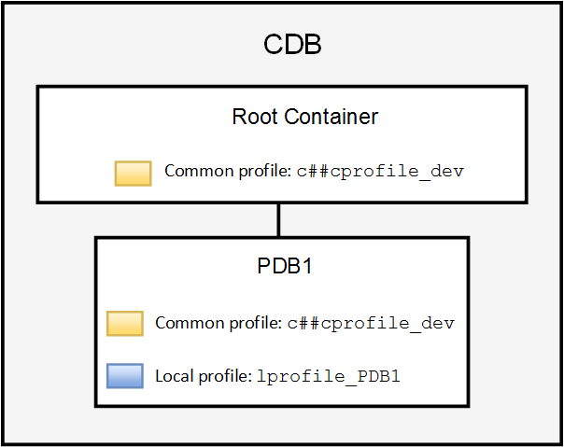
Creating Profiles in a Multitenant Architecture
Common profile:
Local profile:
SQL> CREATE PROFILE c##cprofile_dev
2 limit … CONTAINER=ALL;
SQL> CREATE PROFILE lprofile_PDB1
2 limit … ;
Notes:
Creating Profiles
Oracle recommends that you use profiles to create and manage password security (you can use the CREATE PROFILE command) and use Database Resource Manager to manage machine resources because it offers a more flexible means of managing and tracking resource use.
In a multitenant environment, you can create two types of profiles:
Common profile: The profile is replicated in all current and future containers. To create a common profile by using SQL*Plus, log in to the root container and issue the CREATE PROFILE command with the CONTAINER=ALL clause. For example:
SQL> CONNECT / AS SYSDBA
SQL> CREATE PROFILE c##cprofile_dev limit … CONTAINER=ALL;
Local profile: The profile is created in a single PDB and can be used within that PDB only. To create a local profile by using SQL*Plus, log in to the PDB and issue the CREATE PROFILE command without the CONTAINER=ALL clause. For example:
SQL> CONNECT SYS@PDB1 AS SYSDBA
SQL> CREATE PROFILE lprofile_PDB1 limit … ;
In the diagram in the slide, the common profile named c##cprofile_dev is created commonly at the CDB level. The CREATE operation is replicated in all containers, including the root container where it was initially created. Consequently, the same profile c##cprofile_dev is created in PDB1. The profile named lprofile_PDB1 is created locally in PDB1 and exists only in PDB1.

Slide 37
Notes:
Dropping or Changing Profiles
In Enterprise Manager Database Express, you cannot drop a profile that is used by users. However, if you drop a profile with the CASCADE option (for example, in SQL*Plus), all users who have that profile are automatically assigned the DEFAULT profile.
If users have already logged in when you change their profile, the change does not take effect until their next login.

Slide 38
Profile Parameters: Resources
In a profile, you can control:
CPU resources: May be limited to a per-session or per-call basis
Network and memory resources (Connect time, Idle time, Concurrent sessions, Private SGA)
Disk I/O resources: Limit the amount of data a user can read at the per-session level or per-call level.
Profiles cannot impose resource limitations on users unless the RESOURCE_LIMIT initialization parameter is set to TRUE. With RESOURCE_LIMIT at its default value of FALSE, profile resource limitations are ignored.
Profiles also allow composite limits, which are based on weighted combinations of CPU/session, reads/session, connect time, and private SGA.
Notes:
CPU Resources
CPU resources may be limited on a per-session or per-call basis. A CPU/Session limitation of 1,000 means that if any individual session that uses this profile consumes more than 10 seconds of CPU time (CPU time limitations are in hundredths of a second), that session receives the following error message and is logged off:
ORA-02392: exceeded session limit on CPU usage, you are being logged off.
A per-call limitation does the same thing, but instead of limiting the user’s overall session, it prevents any single command from consuming too much CPU. If CPU/Call is limited and the user exceeds the limitation, the command aborts. The user receives an error message, such as:
ORA-02393: exceeded call limit on CPU usage
Network and Memory Resources
Each database session consumes system memory resources and (if the session is from a user who is not local to the server) network resources. You can specify the following:
Connect Time: Indicates for how many minutes a user can be connected before being automatically logged off.
Idle Time: Indicates for how many minutes a user’s session can remain idle before being automatically logged off. Idle time is calculated for the server process only. It does not take into account application activity. The IDLE_TIME limit is not affected by long-running queries and other operations.
Concurrent Sessions: Indicates how many concurrent sessions can be created by using a database user account.

Slide 39
Notes:
Private SGA: Limits the amount of space consumed in the System Global Area (SGA) for sorting, merging bitmaps, and so on. This restriction takes effect only if the session uses a shared server configuration.
Disk I/O Resources
Disk I/O resources limit the amount of data a user can read at the per-session level or per-call level. Reads/Session and Reads/Call place a limitation on the total number of reads from both memory and the disk. This can be done to ensure that no I/O-intensive statements overuse memory and disks.

Slide 40
Profile Parameters: Locking and Passwords
In a profile, specific parameters control account locking, password aging and expiration, and password history.
Profile password settings are always enforced.
Account locking enables automatic locking of accounts for a set duration when users fail to log in to the system in the specified number of attempts or when accounts sit inactive for a predefined number of days (users have not attempted to log in to their accounts).
Password aging and expiration enables user passwords to have a lifetime, after which the passwords expire and must be changed.
Password history checks the new password to ensure that the password is not reused for a specified amount of time or a specified number of password changes.
Password complexity verification makes a complexity check on the password to verify that it meets certain rules.
Notes:
Account Locking
Account locking enables automatic locking of accounts for a set duration when users fail to log in to the system in the specified number of attempts or when accounts sit inactive for a predefined number of days (users have not attempted to log in to their accounts). Configure the following profile parameters:
FAILED_LOGIN_ATTEMPTS specifies the number of failed login attempts before the lockout of the account.
PASSWORD_LOCK_TIME specifies the number of days for which the account is locked after the specified number of failed login attempts.
INACTIVE_ACCOUNT_TIME specifies the number of days an account can be inactive before it is locked.
Password Aging and Expiration
Password aging and expiration enables user passwords to have a lifetime, after which the passwords expire and must be changed. Configure the following profile parameters:
PASSWORD_LIFE_TIME determines the lifetime of the password in days, after which the password expires.
PASSWORD_GRACE_TIME specifies a grace period in days for changing the password after the first successful login after the password has expired.
Expiring passwords and locking the SYS, SYSMAN, and DBSNMP accounts prevent Enterprise Manager from functioning properly. The applications must catch the “password expired” warning message and handle the password change; otherwise, the grace period expires and the user is locked out without knowing the reason.

Slide 41
Notes:
Password History
Password history checks the new password to ensure that the password is not reused for a specified amount of time or a specified number of password changes. Configure one of the following parameters:
PASSWORD_REUSE_TIME specifies that a user cannot reuse a password for a given number of days.
PASSWORD_REUSE_MAX specifies the number of password changes that are required before the current password can be reused.
PASSWORD_VERIFY_FUNCTION checks for password complexity for the SYS user.
Recall that the values of the profile parameters are either set or inherited from the DEFAULT profile.
If both password history parameters have a value of UNLIMITED, Oracle Database ignores both. The user can reuse any password at any time, which is not a good security practice. If both parameters are set, password reuse is allowed, but only after meeting both conditions. The user must have changed the password the specified number of times, and the specified number of days must have passed since the old password was last used. For example, the profile of user ALFRED has PASSWORD_REUSE_MAX set to 10 and PASSWORD_REUSE_TIME set to 30. User ALFRED cannot reuse a password until he has reset the password 10 times and until 30 days have passed since the password was last used. If one parameter is set to a number and the other parameter is specified as UNLIMITED, then the user can never reuse a password.
Password Complexity Verification
Password complexity verification makes a complexity check on the password to verify that it meets certain rules. The check must ensure that the password is complex enough to provide protection against intruders who may try to break into the system by guessing the password.
The PASSWORD_VERIFY_FUNCTION parameter names a PL/SQL function that performs a password complexity check before a password is assigned. Password verification functions must be owned by the SYS user and return a Boolean value (TRUE or FALSE). A model password verification function is provided in the utlpwdmg.sql script found in the following directories:
UNIX and Linux platforms: $ORACLE_HOME/rdbms/admin
Windows platforms: %ORACLE_HOME%\rdbms\admin
You can create complexity functions and run the utlpwdmg.sql script to create the VERIFY_FUNCTION_11g, ORA12c_VERIFY_FUNCTION, and ORA12c_STRONG_VERIFY_FUNCTION prebuilt complexity functions.

Slide 42
Oracle-Supplied Password Verification Functions
Complexity verification checks that each password is complex enough to provide reasonable protection against intruders who try to break into the system by guessing passwords.
You can create your own password verification functions.
Oracle Database provides the following functions that you can create by executing the utlpwdmg.sql script:
ORA12c_VERIFY_FUNCTION
ORA12c_STRONG_VERIFY_FUNCTION
VERIFY_FUNCTION_11g
These functions must be owned by the SYS user.
Password complexity checking is not enforced for the SYS user.
Notes:
Complexity Verification
Complexity verification checks that each password is complex enough to provide reasonable protection against intruders who try to break into the system by guessing passwords. Using a complexity verification function forces users to create strong, secure passwords for database user accounts. You must ensure that the passwords for your users are complex enough to provide reasonable protection against intruders who try to break into the system by guessing passwords.
Oracle-Supplied Functions
You can create your own password verification functions; however, Oracle Database provides the following functions that you can create by executing the utlpwdmg.sql script, located in $ORACLE_HOME/rdbms/admin:
ORA12c_VERIFY_FUNCTION: This function performs the minimum complexity checks such as checking for a minimum password length and that the password is not the same as the username.
ORA12c_STRONG_VERIFY_FUNCTION: This function provides a stronger password complexity function that takes into consideration recommendations from the US Department of Defense Database Security Technical Implementation Guide.
VERIFY_FUNCTION_11g: This function performs minimum complexity checks such as checking for a minimum password length and that the password is not the same as the username. This function was provided with Oracle Database 11g.

Slide 43
Notes:
In addition to creating the functions, the utlpwdmg.sql script also changes the DEFAULT profile with the following ALTER PROFILE command:
ALTER PROFILE default LIMIT
PASSWORD_LIFE_TIME 180
PASSWORD_GRACE_TIME 7
PASSWORD_REUSE_TIME UNLIMITED
PASSWORD_REUSE_MAX UNLIMITED
FAILED_LOGIN_ATTEMPTS 10
PASSWORD_LOCK_TIME 1
PASSWORD_VERIFY_FUNCTION ora12c_verify_function;

Slide 44
Assigning Profiles
There are two ways to assign a profile:
Commonly: The profile assignment is replicated in all current and future containers.
SQL> CONNECT / AS SYSDBA
SQL> ALTER USER <common user> PROFILE <common profile> CONTAINER=ALL;
Locally: The profile assignment occurs in one PDB (stand-alone or application container) only.
SQL> CONNECT SYS@PDB1 AS SYSDBA
SQL> ALTER USER <common or local user> PROFILE <common or local profile>;
Notes:
There are two ways to assign a profile to a user:
Commonly: The profile assignment is replicated in all current and future containers. The user must be a common user and the profile must be a common profile. Do this if the user needs the same profile in all containers. To assign a profile commonly, log in to the root container and issue the ALTER USER command with the PROFILE and CONTAINER=ALL clauses.
Locally: The profile assignment occurs in one PDB (stand-alone or application container) only. The user can be common or local, and the profile can be common or local. To assign a profile locally, log in to the PDB where the user exists and issue the ALTER USER command with the PROFILE clause. Exclude the CONTAINER=ALL clause.

Slide 45
Assigning Quotas
A quota is a space allowance in a given tablespace.
By default, a user has no quota on any of the tablespaces.
Database accounts that need quota are those that own database objects (for example, accounts for applications).
Only those activities that use space in a tablespace count against quota.
Oracle server checks quota when you create or extend a segment.
Activities that don't use space don't impact quota (example: CREATE VIEW).
You can be granted permission to use objects without needing any quota.
Quota is not needed for assigned temporary tablespaces or undo tablespaces.
A user's quota is replenished when he drops objects (with the PURGE clause) or purges his objects in the recycle bin.

Slide 46
Assigning Quotas
You have three options for providing quota for a user on a tablespace:
UNLIMITED
Value
UNLIMITED TABLESPACE system privilege
Notes:
You have three options for providing a quota for a user on a tablespace:
UNLIMITED: Allows the user to use as much space as is available in the tablespace
Value: Number of kilobytes or megabytes that the user can use. This does not guarantee that the space is set aside for the user. This value can be larger or smaller than the current space that is available in the tablespace.
UNLIMITED TABLESPACE system privilege: Overrides all individual tablespace quotas and gives the user unlimited quota on all tablespaces, including SYSTEM and SYSAUX. This privilege must be granted with caution.
You must not provide a quota to users on the SYSTEM or SYSAUX tablespaces. Typically, only the SYS and SYSTEM users are able to create objects in the SYSTEM or SYSAUX tablespaces.

Slide 47
Applying the Principle of Least Privilege
The principle of least privilege means that a user must be given only those privileges that are required to efficiently complete a task.
This reduces the chances of users modifying or viewing data (either accidentally or maliciously) that they do not have the privilege to modify or view.
Ways to apply the principle of least privilege:
Protect the data dictionary
Revoke unnecessary privileges from PUBLIC
Use access control lists (ACLs) to control network access
Restrict access to OS directories
Limit users with administrative privileges
Restrict remote database authentication
Enable unified auditing
Notes:
The following are ways that you can apply the principle of least privilege.
Protect the data dictionary: The O7_DICTIONARY_ACCESSIBILITY parameter is set by default to FALSE. You must not allow this to be changed without a very good reason because it prevents users with the ANY TABLE system privileges from accessing the data dictionary base tables. It also ensures that the SYS user can log in only as SYSDBA.
Revoke unnecessary privileges from PUBLIC: Several packages are extremely useful to applications that need them, but require proper configuration to be used securely. PUBLIC is granted execute privilege on the following packages: UTL_SMTP, UTL_TCP, UTL_HTTP, and UTL_FILE.
Use access control lists (ACLs) to control network access: In Oracle Database, network access is controlled by an ACL that may be configured to allow certain users access to specific network services. Network access is denied by default. An ACL must be created to allow network access. File access through UTL_FILE is controlled at two levels:
At the OS level with permissions on files and directories
In the database by DIRECTORY objects that allow access to specific file system directories. The DIRECTORY object may be granted to a user for read or for read and write. Execute privileges on other PL/SQL packages should be carefully controlled.
The more powerful packages that may potentially be misused include:
UTL_SMTP: Permits arbitrary email messages to be sent by using the database as a Simple Mail Transfer Protocol (SMTP) mail server. Use the ACL to control which machines may be accessed by which users.

Slide 48
Notes:
UTL_TCP: Permits outgoing network connections to be established by the database server to any receiving or waiting network service. Thus, arbitrary data can be sent between the database server and any waiting network service. Use the ACL to control access.
UTL_HTTP: Allows the database server to request and retrieve data via HTTP. Granting this package to a user may permit data to be sent via HTML forms to a malicious website. Limit access by using the ACL.
UTL_FILE: If configured improperly, allows text-level access to any file on the host operating system. When properly configured, this package limits user access to specific directory locations.
Restrict access to OS directories: The DIRECTORY object inside the database enables DBAs to map directories to OS paths and to grant privileges on those directories to individual users.
Limit users with administrative privileges: Do not provide database users more privileges than necessary. Nonadministrators must not be granted the DBA role. To implement least privilege, restrict the following types of privileges:
Grants of system and object privileges
SYS-privileged connections to the database, such as SYSDBA and SYSOPER
Other DBA-type privileges, such as DROP ANY TABLE
Restrict remote database authentication: The REMOTE_OS_AUTHENT parameter is set to FALSE by default. It must not be changed unless all clients can be trusted to authenticate users appropriately. In the remote authentication process:
The database user is authenticated externally
The remote system authenticates the user
The user logs in to the database without further authentication
Note: Always test your applications thoroughly if you have revoked privileges.
After applying the principle of least privilege, you can track changes that users make in the database.
Unified auditing:
Auditing is the monitoring and recording of configured database actions from both database users.
Unified Auditing centralizes all audit records in one place.
You can configure auditing for both successful and failed activities and include or exclude specific users from the audit.
In a multitenant environment, you can audit individual actions of PDBs or individual actions in the entire CDB.
Auditing is enabled by default for the SYS user (instance parameter AUDIT_SYS_OPERATIONS = TRUE).
All audit records are written to the unified audit trail in a uniform format and are made available through the UNIFIED_AUDIT_TRAIL view.

Slide 49





Privilege Analysis
Analyze used privileges to revoke unnecessary privileges.
Use the DBMS_PRIVILEGE_CAPTURE package.
2. Start analyzing
used privileges.
3. Stop analyzing.
4. Generate report. 5. Compare with unused privileges.
6. Revoke unused privileges.
1. Create analysis.
INSERT on HR.EMP
DELETE on HR.DEPT
EXECUTE on SALES.PROC1
UNLIMITED TABLESPACE
SELECT ANY TABLE
EXECUTE ANY PROCEDURE
APPS
PUBLIC
role
SELECT ANY TABLE
Sales
module
Used privileges
Unused privileges
Notes:
A major concern in many databases is that existing database and application users have excessive privileges. Excessive privileges violate the principle of least privilege. To achieve the least privilege principle, unused privileges need to be identified.
The DBMS_PRIVILEGE_CAPTURE package can be used to analyze used privileges.
You can use a privilege analysis policy to identify object and system privileges used to run an application module or to execute certain SQL statements or privileges used by defined roles. You can generate reports of used and unused privileges during the analysis period. The report helps the security officer revoke unnecessary privileges by comparing the used and unused granted privilege lists.

Slide 50
Privilege Analysis Flow
Define types of analysis.
1
Define conditions of analysis.
Database
Role
Context
Role and Context
No condition: All privileges
Roles: MGR_SALES, PUBLIC
Condition:
Users = HR, SCOTT, OE
Modules = sales
Requires the
CAPTURE_ADMIN
role
DBMS_PRIVILEGE_CAPTURE.CREATE_CAPTURE
2
Start/stop analyzing used privileges.
DBMS_PRIVILEGE_CAPTURE.ENABLE_CAPTURE
DBMS_PRIVILEGE_CAPTURE.DISABLE_CAPTURE
3
Report used privileges.
DBMS_PRIVILEGE_CAPTURE.GENERATE_RESULT
DBA_USED_PUBPRIVS
DBA_USED_OBJPRIVS
DBA_USED_SYSPRIVS
DBA_USED_PRIVS
DBA_USED_OBJPRIVS_PATH
DBA_USED_SYSPRIVS_PATH
DBA_UNUSED_OBJPRIVS
DBA_UNUSED_SYSPRIVS
DBA_UNUSED_PRIVS
DBA_UNUSED_OBJPRIVS_PATH
DBA_UNUSED_SYSPRIVS_PATH
Notes:
When creating an analysis, you first define the targeted objects to be analyzed in used privileges. You do that by setting the type of analysis:
Database analysis: If no condition is given, it analyzes the used privileges (except privileges used by administrative users) within the whole database.
Role analysis: If roles are defined, it analyzes the privileges exercised through any given role. For example, if you create a privilege analysis policy to analyze on PUBLIC, the privileges that are directly and indirectly granted to PUBLIC are analyzed when they are used.
Context-specific analysis: If the contexts are defined, it analyzes the privileges that are used through a given application module or specified contexts.
Different conditions can be combined with “AND” and/or “OR” Boolean operators.
Because the created policy is not enabled by default, your next step is to enable the policy to start analyzing used privileges. After a certain time, you stop analyzing.
Your third step is to generate a report. Reporting includes two types of results:
Used privileges visible in DBA_USED_xxx and DBA_USED_xxx_PATH views
Unused privileges visible in DBA_UNUSED_xxx and DBA_UNUSED_xxx_PATH views

Slide 51
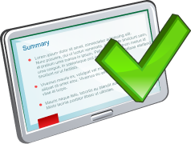
Summary
In this lesson, you should have learned how to:
Create database users
Grant privileges to database users
Create and grant roles to users or other roles
Revoke privileges and roles from users and other roles
Create and assign profiles to users
Explain the various authentication options for users
Assign quota to users
Apply the principle of least privilege

Slide 52
Practice 9: Overview
9-1: Creating Common and Local Users
9-2: Creating a Local User for an Application
9-3: Granting a Local Role (DBA) to PDBADMIN
9-4: Using EM Express to Create a Local Profile
9-5: Using EM Express to Create Local Roles
9-6: Using EM Express to Create Local Users
9-7: Configuring a Default Role for a User
9-8: Exploring OS and Password File Authentication

