Slide 1
Moving Data

Slide 2

Objectives
After completing this lesson, you should be able to:
Describe ways to move data
Explain the general architecture of Oracle Data Pump
Use Data Pump Export and Import to move data between Oracle databases
Use SQL*Loader to load data from a non-Oracle database (or user files)
Use external tables to move data via platform-independent files
Describe methods that can be used to migrate databases to Oracle Database Cloud Service

Slide 3
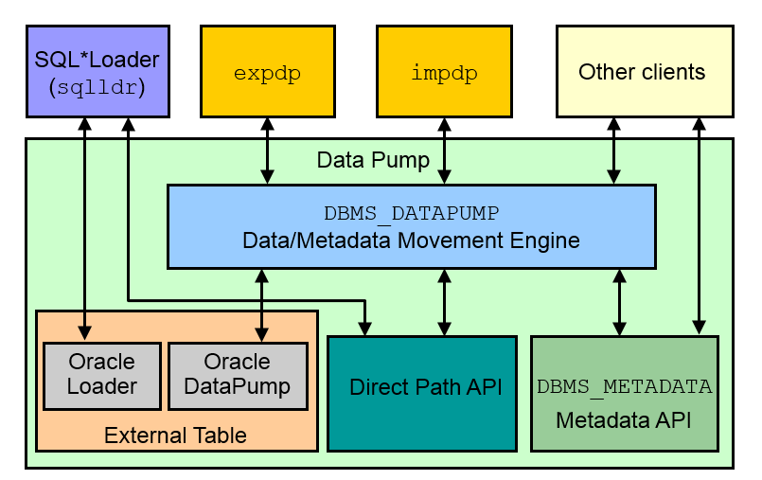
Moving Data: General Architecture
Notes:
Major functional components include:
DBMS_DATAPUMP: It contains the API for high-speed export and import utilities for bulk data and metadata movement.
Direct Path API (DPAPI): Oracle Database supports a Direct Path API interface that minimizes data conversion and parsing at both unload and load time.
DBMS_METADATA: Used by worker processes for all metadata unloading and loading. Database object definitions are stored by using XML rather than SQL.
External Table: With the ORACLE_DATAPUMP and ORACLE_LOADER access drivers, you can store data in external tables (that is, in platform-independent files). The SELECT statement reads external tables as though they were stored in an Oracle database.
SQL*Loader: It has been integrated with external tables, providing automatic migration of loader control files to external table access parameters.
expdp and impdp: They are thin layers that make calls to the DBMS_DATAPUMP package to initiate and monitor Data Pump operations.
Other clients: Applications (such as replication, transportable tablespaces, and user applications) that benefit from this infrastructure. SQL*Plus may also be used as a client of DBMS_DATAPUMP for simple status queries against ongoing operations.

Slide 4
Oracle Data Pump: Overview
As a server-based facility for high-speed data and metadata movement, Oracle Data Pump:
Is callable via DBMS_DATAPUMP
Provides the following tools:
expdp and impdp
GUI interface in Enterprise Manager Cloud Control
Provides several data movement methods:
Conventional path load
Direct path
External tables
Transportable tablespace
Network link support
Detaches from and reattaches to long-running jobs
Restarts Data Pump jobs
Notes:
Oracle Data Pump enables very high-speed data and metadata loading and unloading of Oracle databases. The Data Pump infrastructure is callable via the DBMS_DATAPUMP PL/SQL package. Thus, custom data movement utilities can be built by using Data Pump.
Oracle Database provides the following tools:
Command-line export and import clients called expdp and impdp, respectively
An export and import interface in Enterprise Manager Cloud Control
Data Pump automatically decides the data access methods to use; these can be either direct path or external tables. Data Pump uses direct path load and unload when a table’s structure allows it and when maximum single-stream performance is desired. However, if there are clustered tables, encrypted columns, or several other items, Data Pump uses external tables rather than direct path to move the data.
Conventional Path Load is used when Data Pump is not able to load data into a table by using either direct path or external tables. The ability to detach from and reattach to long-running jobs without affecting the job itself enables you to monitor jobs from multiple locations while they are running. All stopped Data Pump jobs can be restarted without loss of data as long as the metadata remains undisturbed. It does not matter whether the job is stopped voluntarily or involuntarily due to a crash.

Slide 5
Oracle Data Pump: Benefits
Data Pump offers many benefits and features, such as:
Fine-grained object and data selection
Explicit specification of database version
Parallel execution
Network mode in a distributed environment
Remapping capabilities
Data sampling and metadata compression
Compression of data during a Data Pump export
Security through encryption
Ability to export XMLType data as CLOBs
Notes:
The EXCLUDE, INCLUDE, and CONTENT parameters are used for fine-grained object and data selection.
You can specify the database version for objects to be moved (using the VERSION parameter) to create a dump file set that is compatible with a previous release of Oracle Database that supports Data Pump.
You can use the PARALLEL parameter to specify the maximum number of threads of active execution servers operating on behalf of the export job.
Network mode enables you to export from a remote database directly to a dump file set. This can be done by using a database link to the source system.
During import, you can change the target data file names, schemas, and tablespaces:
Rename tables during an import operation.
Remap data as it is being imported into a new database.
In addition, you can specify a percentage of data to be sampled and unloaded from the source database when performing a Data Pump export. This can be done by specifying the SAMPLE parameter.
You can use the COMPRESSION parameter to indicate whether the metadata should be compressed in the export dump file so that it consumes less disk space. If you compress the metadata, it is automatically uncompressed during import. You can choose to compress both data and metadata, only data, only metadata, or no data during an export. This feature requires the Oracle Advanced Compression option.

Slide 6
Notes:
You can also specify encryption options to encrypt. Encryption requires the Oracle Advanced Security option:
Both data and metadata, only data, only metadata, no data, or only encrypted columns during an export
With a particular encryption algorithm to use during an export
Using the type of security to use for performing encryption and decryption during an export. For example, perhaps the dump file set will be imported into a different or remote database and must remain secure in transit. Or perhaps the dump file set will be imported on-site using the Oracle Encryption Wallet, but it may also need to be imported off-site where the Oracle Encryption Wallet is not available.
You can also define that XMLType columns are to be exported in uncompressed CLOB format regardless of the XMLType storage format that was defined for them.

Slide 7
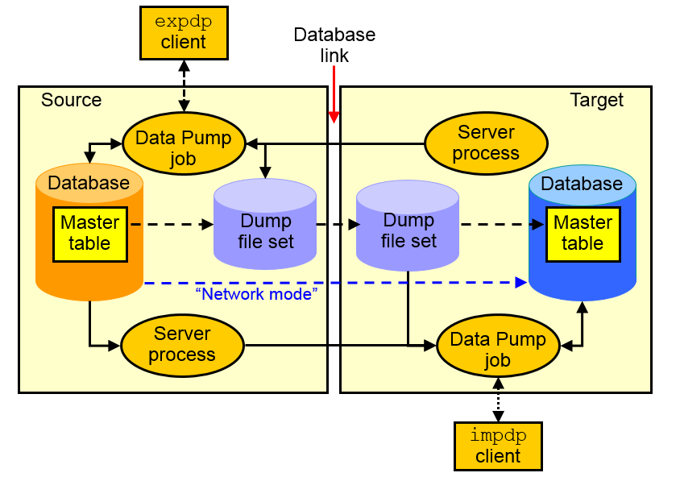
Data Pump Export and Import Clients
Notes:
Data Pump Export is a utility for unloading data and metadata into a set of operating system files called dump file sets. Data Pump Import is used to load metadata and data stored in an export dump file set into a target system.
The Data Pump API accesses its files on the server rather than on the client.
These utilities can also be used to export from a remote database directly to a dump file set or to load the target database directly from a source database with no intervening files. This is known as network mode. This mode is particularly useful to export data from a read-only source database.
At the center of every Data Pump operation is the master table, which is a table created in the schema of the user running the Data Pump job. The master table maintains all aspects of the job. The master table is built during a file-based export job and is written to the dump file set as the last step. Conversely, loading the master table into the current user’s schema is the first step of a file-based import operation and is used to sequence the creation of all objects imported.
Note: The master table is the key to Data Pump’s restart capability in the event of a planned or unplanned stopping of the job. The master table is dropped when the Data Pump job finishes normally.

Slide 8
Data Pump Interfaces and Modes
Data Pump Export and Import interfaces:
Command line
Parameter file
Interactive command line
Enterprise Manager Cloud Control
Data Pump Export and Import modes:
Full
Schema
Table
Tablespace
Transportable tablespace
Transportable database
Notes:
You can interact with Data Pump Export and Import by using one of the following interfaces:
Command-line interface: Enables you to specify most of the export parameters directly on the command line.
Parameter file interface: Enables you to specify all command-line parameters in a parameter file. The only exception is the PARFILE parameter.
Interactive-command interface: Stops logging in to the terminal and displays the export or import prompts, where you can enter various commands. This mode is enabled by pressing Ctrl + C during an export operation that is started with the command-line interface or the parameter file interface. Interactive-command mode is also enabled when you attach to an executing or stopped job.
Oracle Enterprise Manager Cloud Control: Select Schema > Database Export/Import. In the menu, select the export or import operation you want to execute.
Data Pump Export and Import provide different modes for unloading and loading different portions of the database. The mode is specified on the command line by using the appropriate parameter. The available modes are also listed in the diagram in the slide.
FULL=YES: All data and metadata of the CDB are to be exported. To perform a full export, you must have the DATAPUMP_EXP_FULL_DATABASE role.
SCHEMAS=hr,oe: All data and metadata of the schemas are to be exported. This is the default mode for Export. By default, if you do not have the DATAPUMP_EXP_FULL_DATABASE role, then only your own schema gets exported. If you have the DATAPUMP_EXP_FULL_DATABASE role, then you can specify a list of schemas.

Slide 9
Notes:
TABLES=hr.employees, oe.sales: Only the specified set of tables, partitions, and their dependent objects are unloaded.
TABLESPACES=tbs_app, tbs2: Only the tables contained in a specified set of tablespaces are unloaded. If a table is unloaded, then its dependent objects are also unloaded. Both object metadata and data are unloaded.
TRANSPORT_TABLESPACES=tbs_app, tbs2: Only object metadata contained in the tablespaces will be exported from the source database into the target database. The data is stored in data files. Because the data files do not get transported with the dump file, they should be copied to the target database before starting the import.
TRANSPORTABLE=ALWAYS and FULL=YES: Both modes used together export all objects and data necessary to create a complete copy of the database. To import the full transportable database, use the TRANSPORT_DATAFILES='datafile1','datafile2' parameter to tell import that it is a transportable-mode import and from which data files to get the actual data.

Slide 10
Data Pump Import Transformations
You can remap:
Data files by using REMAP_DATAFILE
Tablespaces by using REMAP_TABLESPACE
Schemas by using REMAP_SCHEMA
Tables by using REMAP_TABLE
Data by using REMAP_DATA
Directory by using REMAP_DIRECTORY
Notes:
Because object metadata is stored as XML in the dump file set, it is easy to apply transformations when DDL is being formed during import. Data Pump Import supports several transformations:
REMAP_DATAFILE is useful when moving databases across platforms that have different file-system semantics. It changes the name of the source data file to the target data file name in all SQL statements where the source data file is referenced: CREATE TABLESPACE, CREATE LIBRARY, and CREATE DIRECTORY.
REMAP_TABLESPACE enables objects to be moved from one tablespace to another.
REMAP_SCHEMA provides the capability to change object ownership.
REMAP_TABLE provides the ability to rename entire tables.
REMAP_DATA provides the ability to remap data as it is being inserted.
REMAP_DIRECTORY provides the ability to remap directories when you move databases between platforms.

Slide 11
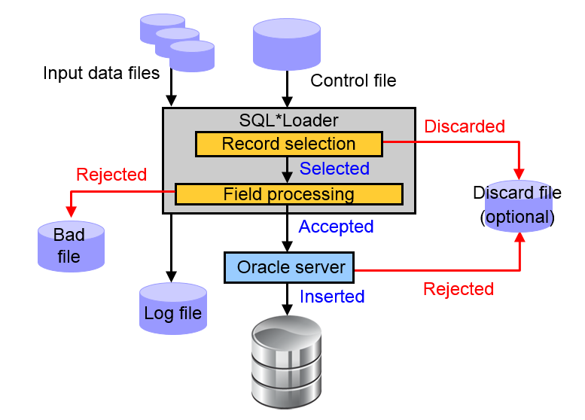
SQL Loader: Overview
Notes:
SQL*Loader loads data from external files into the tables of an Oracle database. It has a powerful data parsing engine that puts little limitation on the format of the data in the data file.
SQL*Loader uses the following files:
Input data files: SQL*Loader reads data from one or more files (or operating system equivalents of files) that are specified in the control file. From SQL*Loader’s perspective, the data in the data file is organized as records. A particular data file can be in fixed record format, variable record format, or stream record format. The record format can be specified in the control file with the INFILE parameter. If no record format is specified, the default is stream record format.
A control file: The control file is a text file that is written in a language that SQL*Loader understands. The control file indicates to SQL*Loader where to find the data, how to parse and interpret the data, where to insert the data, and so on. Although not precisely defined, a control file can be said to have three sections.
The first section contains such session-wide information as the following:
Global options, such as the input data file name and records to be skipped
INFILE clauses to specify where the input data is located
Data to be loaded
The second section consists of one or more INTO TABLE blocks. Each of these blocks contains information about the table (such as the table name and the columns of the table) into which the data is to be loaded.
The third section is optional and, if present, contains input data.

Slide 12
Notes:
A log file: When SQL*Loader begins execution, it creates a log file. If it cannot create a log file, execution terminates. The log file contains a detailed summary of the load, including a description of any errors that occurred during the load.
A discard file: This file is created only when it is needed and only if you have specified that a discard file should be enabled. The discard file contains records that are filtered out of the load because they do not match any record-selection criteria specified in the control file.
A bad file: The bad file contains records that are rejected, either by SQL*Loader or by the Oracle database. Data file records are rejected by SQL*Loader when the input format is invalid. After a data file record is accepted for processing by SQL*Loader, it is sent to the Oracle database for insertion into a table as a row. If the Oracle database determines that the row is valid, the row is inserted into the table. If the row is determined to be invalid, the record is rejected, and SQL*Loader puts it in the bad file.
For more information about SQL*Loader, see the Oracle Database Utilities guide.

Slide 13
Comparing Loading Methods
Conventional Load | Direct Path Load
Uses COMMIT | Uses data saves (faster operation)
Always generates redo entries | Generates redo only under specific conditions
Enforces all constraints | Enforces only PRIMARY KEY, UNIQUE, and NOT NULL constraints
Fires INSERT triggers | Does not fire INSERT triggers
Can load into clustered tables | Does not load into clusters
Allows other users to modify tables during load operation | Prevents other users from making changes to tables during load operation
Maintains index entries on each insert | Merges new index entries at the end of the load
Notes:
A conventional path load executes SQL INSERT statements to populate tables in an Oracle database. Conventional path loads use SQL processing and a database COMMIT operation for saving data. The insertion of an array of records is followed by a COMMIT operation. Each data load may involve several transactions.
Direct path loads use data saves to format data blocks and write them directly to the data files bypassing the cache layer. This is why the direct path loads are faster than the conventional ones.

Slide 14
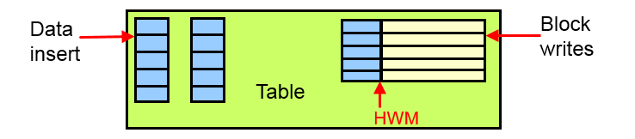
Data Save Feature
Notes:
The following features differentiate a data save from COMMIT:
During a data save, only full database blocks are written to the database.
The blocks are written after the high-water mark (HWM) of the table, as shown in the diagram in the slide.
After a data save, the HWM is moved.
Internal resources are not released after a data save.
A data save does not end the transaction.
If the ROWS parameter is specified, then SQL Loader issues a data save after that many rows are loaded.
Indexes are not updated at each data save. At the beginning of a direct path load, all indexes on the table are marked unusable. The indexes are updated at the end of the load. If the load is aborted after the indexes were marked unusable, then they will remain unusable.
The control file option that lets the direct path API handle check constraints is EVALUATE CHECK CONSTRAINTS.

Slide 15
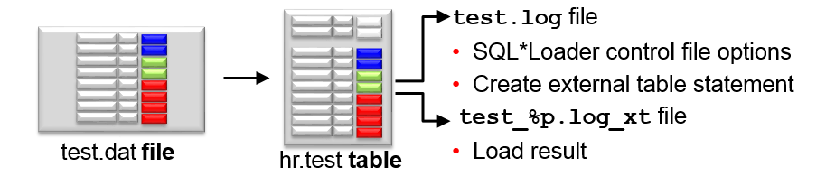
Express Mode
Specify a table name to initiate an Express Mode load.
Table columns must be scalar data types (character, number, or datetime).
A data file can contain only delimited character data.
SQL*Loader uses table column definitions to determine input data types.
There is no need to create a control file.
Notes:
If you activate SQL*Loader Express Mode, specifying only the username and the TABLE parameter, it uses default settings for several other parameters. You can override most of the defaults by specifying additional parameters on the command line.
The TERMINATED_BY parameter, which specifies a field terminator
The ENCLOSED_BY parameter, which specifies a field enclosure character
The OPTIONALLY_ENCLOSED_BY parameter, which specifies an optional field enclosure character
The three delimiters can be a multicharacter string.
SQL*Loader Express Mode generates two files. The names of the log files come from the name of the table (by default).
A log file includes:
The control file output
A SQL script for creating the external table and performing the load by using a SQL INSERT /*+ APPEND */ AS SELECT statement
Neither the control file nor the SQL script are used by SQL*Loader Express Mode. They are made available to you in case you want to use them as a starting point to perform operations using regular SQL*Loader or stand-alone external tables.
You can specify that direct path load be used instead of external tables with the DIRECT=YES parameter. You can also specify that conventional path be used instead of external tables with DIRECT=NO.
A log file similar to a SQL*Loader log file that describes the result of the operation. “%p” represents the process ID of the SQL*Loader process.

Slide 16
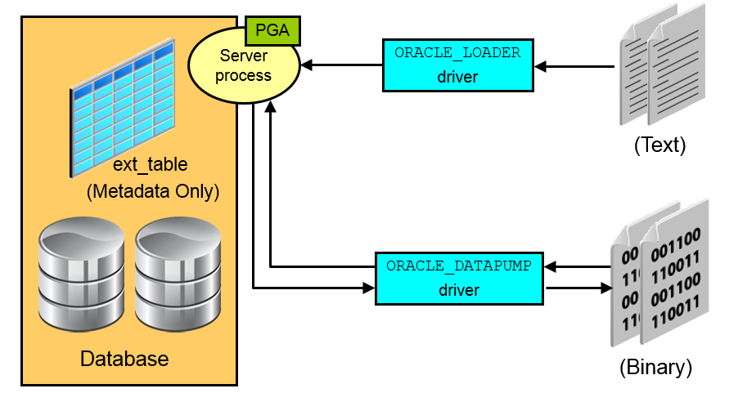
External Tables
Notes:
External tables access data in external sources as if it were in a table in the database. You can connect to the database and create metadata for the external table by using DDL. The DDL for an external table consists of two parts:
One part that describes the Oracle Database column types
Another part that describes the mapping of the external data to the Oracle Database data columns
An external table does not describe any data that is stored in the database, nor does it describe how data is stored in the external source. Instead, it describes how the external table layer must present the data to the server. It is the responsibility of the access driver and the external table layer to do the necessary transformations required on the data in the external file so that it matches the external table definition. External tables are read-only; therefore, no DML operations are possible.
There are two access drivers used with external tables.
The ORACLE_LOADER access driver can be used only to read table data from an external table and load it into the database. It uses text files as the data source.
The ORACLE_DATAPUMP access driver can both load table data from an external file into the database and also unload data from the database into an external file. It uses binary files as the external files.
As of Oracle Database 12c Release 2 (12.2.0.1), you can partition data contained in external tables, which allows you to take advantage of the same performance improvements provided when you partition tables stored in a database.

Slide 17
External Table Benefits
Data can be used directly from the external file or loaded into another database.
External data can be queried and joined directly in parallel with tables residing in the database, without requiring it to be loaded first.
The results of a complex query can be unloaded to an external file.
You can combine generated files from different sources for loading purposes.
Notes:
The data files created for the external table can be moved and used as the data files for another external table in the same database or a different database.
External data can be queried and joined directly in parallel to tables residing in the database, without requiring the data to be loaded first. You can choose to have your applications directly access external tables with the SELECT command, or you can choose to have data loaded first into a target database.
The results of a complex query can be unloaded to an external file by using the ORACLE_DATAPUMP access driver.
Data files that are populated by different external tables can all be specified in the LOCATION clause of another external table. This provides an easy way of aggregating data from multiple sources. The only restriction is that the metadata for all the external tables must be exactly the same.

Slide 18


Migrating to Oracle Database Cloud Service: Considerations
Some of the characteristics and factors to consider when choosing a migration method are:
On-premises database version
Oracle Database Cloud database version
On-premises host operating system and version
On-premises database character set
Quantity of data, including indexes
Data types used in the on-premises database
Storage for data staging
Acceptable length of system outage
Network bandwidth
Notes:
Attend the Migrating Your Oracle Database to the Oracle Cloud course to learn more about migrating to Oracle Database Cloud Service.

Slide 19

Migrating to Oracle Database Cloud Service: Information Gathering
To determine which migration methods are applicable to your migration scenario, gather the following information:
Database version of your on-premises database
For on-premises Oracle Database 12c databases, the architecture of the database (multitenant or non-CDB)
Endian format (byte ordering) of your on-premises database’s host platform
Database character set of your on-premises database and your Database Cloud Service database
Database version of your Database Cloud Service database
See Choosing a Migration Method in Using Oracle Database Cloud Service for additional information.

Slide 20

Applicable Migration Methods
Method | On-premises 11g database to Cloud 11g database | On-premises 11g database to Cloud 12c PDB | On-premises 12c non-CDB to Cloud 12c PDB | On-premises 12c PDB to Cloud 12c PDB
Data Pump Conventional Export/Import | Y | Y | Y | Y
Data Pump Transportable Tablespace | Y | Y | Y | Y
Data Pump Full Transportable | N | Y | Y | Y
RMAN Transportable Tablespace with Data Pump | Y | Y | Y | Y
RMAN CONVERT Transportable Tablespace with Data Pump | Y | Y | Y | Y
RMAN Cross-Platform Transportable Tablespace Backup Sets | N | N | Y | Y
RMAN Cross-Platform Transportable PDB | N | N | N | Y
Notes:
The methods shown in the table are applicable when migrating an Oracle Database 11g or 12c on-premises databases to an Oracle Database 11g or 12c database in the cloud.

Slide 21
Applicable Migration Methods
Method | On-premises 11g database to Cloud 11g database | On-premises 11g database to Cloud 12c PDB | On-premises 12c non-CDB to Cloud 12c PDB | On-premises 12c PDB to Cloud 12c PDB
Unplugging/Plugging | N | N | Y | Y
Remote Cloning | N | N | Y | Y
SQL Developer and SQL*Loader to Migrate Selected Objects | N | N | Y | Y
SQL Developer and INSERT Statements to Migrate Selected Objects | N | N | Y | Y
Notes:
The methods shown in the table are applicable when migrating an Oracle Database 11g or 12c on-premises databases to an Oracle Database 11g or 12c database in the cloud.

Slide 22

Summary
In this lesson, you should have learned how to:
Describe ways to move data
Explain the general architecture of Oracle Data Pump
Use Data Pump Export and Import to move data between Oracle databases
Use SQL*Loader to load data from a non-Oracle database (or user files)
Use external tables to move data via platform-independent files
Describe methods that can be used to migrate databases to Oracle Database Cloud Service

Slide 23
Practice 15: Overview
15-1: Moving Data from One PDB to Another
15-2: Loading Data into a PDB from an External File

