Slide 1
Creating PDBs

Slide 2
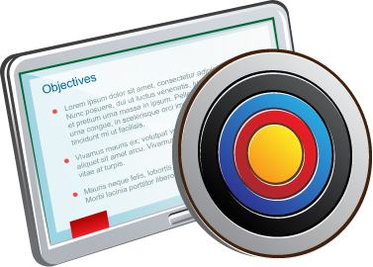
Objectives
After completing this lesson, you should be able to:
Describe the methods and tools used to create PDBs
Create PDBs from seed by using SQL*Plus
Clone PDBs by using SQL*Plus
Unplug and plug in PDBs by using SQL*Plus
Drop PDBs by using SQL*Plus
Notes:
When working with a multitenant Oracle database, you have the opportunity to spread things out. This means that each application can have its own PDB. You don't have to put all your data from all applications into one PDB. So, part of your planning process as a database administrator is to determine how many PDBs you think you'll need. This lesson will show you some fundamental ways to create PDBs and how to move them around between CDBs by unplugging and plugging them.

Slide 3
Methods and Tools to Create PDBs
Methods to create PDBs:
Create a PDB by using the seed
Create a PDB from a non-CDB
Clone an existing PDB or non-CDB
Plug an unplugged PDB into a different CDB
Relocate a PDB to a different CDB
Create a PDB as a proxy PDB
Tools to create PDBs:
SQL*Plus
SQL Developer
Enterprise Manager Cloud Control
DBCA—Create a PDB from seed or by using the unplug/plug method.
Notes:
You can use the following methods to create a PDB:
Create a PDB by using the seed: Create a PDB in a CDB by using the files of the CDB seed or application seed. This technique copies the files associated with the seed to a new location and associates the copied files with the new PDB.
Create a PDB from a non-CDB: Create a PDB by adopting a non-CDB into a PDB. You can use the DBMS_PDB package to create an unplugged PDB from an Oracle Database 12c non-CDB. You can then plug the unplugged PDB into the CDB.
Clone an existing PDB or non-CDB: Create a PDB by cloning a source PDB or non-CDB. A source can be a PDB in the local CDB, a PDB in a remote CDB, a PDB in a local or remote application container, or a non-CDB. This technique copies the files associated with the source to a new location and associates the copied files with the new PDB.
Plug an unplugged PDB into a CDB: Create a PDB by using the XML metadata file that describes the PDB and the files associated with the PDB to plug it into the CDB.
Relocate a PDB to a different CDB: Create a PDB by relocating it from one CDB to another. This technique moves the files associated with the PDB to a new location.
Create a PDB as a proxy PDB: Create a PDB as a proxy PDB by referencing a different PDB with a database link. The referenced PDB can be in the same CDB as the proxy PDB, or it can be in a different CDB.
Note: This course focuses on how to use SQL*Plus to create a PDB from seed and clone a PDB.

Slide 4
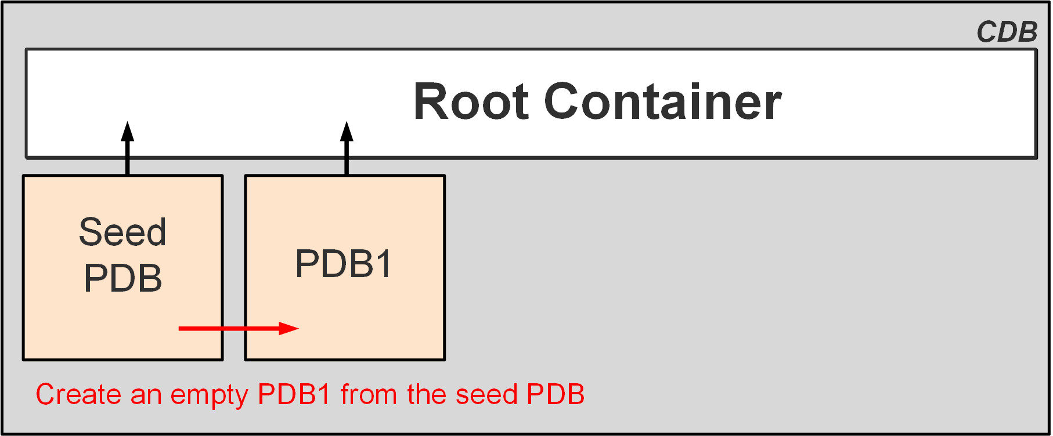
Creating PDBs from Seed
You can create a new empty PDB by using the seed PDB as a template.
Every CDB has a seed PDB.
To create a PDB from seed with SQL*Plus, use the CREATE PLUGGABLE DATABASE statement.
Notes:
To create a PDB from seed with SQL*Plus, you use the CREATE PLUGGABLE DATABASE statement. The creation of a new PDB from the seed is nearly instantaneous. This action copies the data files from the READ-ONLY seed PDB to the target directory defined in the CREATE PLUGGABLE DATABASE statement. It creates tablespaces such as SYSTEM to store a full catalog, including metadata pointing to Oracle-supplied objects, and SYSAUX for local auxiliary data. It creates default schemas and common users that exist in seed PDB, SYS who continues to have all super user privileges, and SYSTEM who can administer the PDB. A new default service is created for the PDB.
Prerequisites for using the CREATE PLUGGABLE DATABASE statement include:
You must be connected to a CDB and the current container must be the root.
You must have the CREATE PLUGGABLE DATABASE system privilege.
The CDB in which the PDB is being created must be in READ WRITE mode.

Slide 5
Creating a New PDB from PDB$SEED
Copies the data files from PDB$SEED data files
Creates the SYSTEM, SYSAUX, and UNDO tablespaces
Creates a full catalog including metadata pointing to Oracle-supplied objects
Creates common users:
SYS
SYSTEM
Creates a local user (PDBA), granted local PDB_DBA role
Creates a new default service
CDB1
Data files/Temp files
CDB root
Control
files
Redo log
files
SYSTEM
UNDO
SYSAUX
USERS
TEMP
PDB$SEED
Data files
SYSTEM
SYSAUX
UNDO
Create
PDB1
from
PDB$SEED
PDB1
Data files
SYSTEM
UNDO
SYSAUX
Notes:
The creation of a new PDB from the CDB seed is nearly instantaneous. The operation copies the data files from the READ-ONLY seed PDB to the target directory defined in the CREATE PLUGGABLE DATABASE statement.
It creates tablespaces such as SYSTEM to store a full catalog, including metadata pointing to Oracle-supplied objects, SYSAUX for local auxiliary data, and UNDO for local undo segments.
It creates default schemas and common users that exist in the CDB seed, SYS who continues to have all superuser privileges, and SYSTEM who can administer the PDB.
It creates a local user (the PDBA), who is granted a local PDB_DBA role. Until the PDB SYS user grants privileges to the local PDB_DBA role, the new PDBA cannot perform any other operation than connecting to the PDB.
A new default service is also created for the PDB.

Slide 6
Examples: Creating a PDB from Seed
Create a new PDB from the seed by using FILE_NAME_CONVERT:
Set the PDB_FILE_NAME_CONVERT initialization parameter and then create the PDB:
SQL> CREATE PLUGGABLE DATABASE pdb1
ADMIN USER admin1 IDENTIFIED BY p1 ROLES=(CONNECT)
FILE_NAME_CONVERT = ('PDB$SEEDdir', 'PDB1dir');
SQL> CREATE PLUGGABLE DATABASE pdb1
ADMIN USER pdb1_admin IDENTIFIED BY p1 ROLES=(CONNECT);
Notes:
If you do not use Oracle Managed Files (OMF), connect to the CDB root as a common user with the CREATE PLUGGABLE DATABASE system privilege and execute the CREATE PLUGGABLE DATABASE statement as shown in the slide. The ADMIN USER clause defines the PDBA user created in the new PDB with the CONNECT and PDB_DBA roles (empty role). The FILE_NAME_CONVERT clause first designates the source directory of the CDB seed data files and then the destination directory for the new PDB data files.
You can also set the PDB_FILE_NAME_CONVERT initialization parameter to both the source directory of the CDB seed data files and the target directory for the new PDB data files.
If you are using OMF, set the DB_CREATE_FILE_DEST initialization parameter to a target directory for the data files of the new PDB.
When the statement completes, use views to verify that the PDB is correctly created. The CDB_PDBS view displays the list of the PDBs, and the CDB_TABLESPACES view displays the list of the tablespaces of the new PDB (SYSTEM, SYSAUX, UNDO).
The CDB_PDBS view shows the STATUS of the new PDB: it is NEW. The PDB has never been opened. It must be opened in READ WRITE or RESTRICTED mode for Oracle to perform the processing needed to complete the integration of the PDB into the CDB and mark it NORMAL. An error will be returned if an attempt is made to open the PDB read-only.

Slide 7
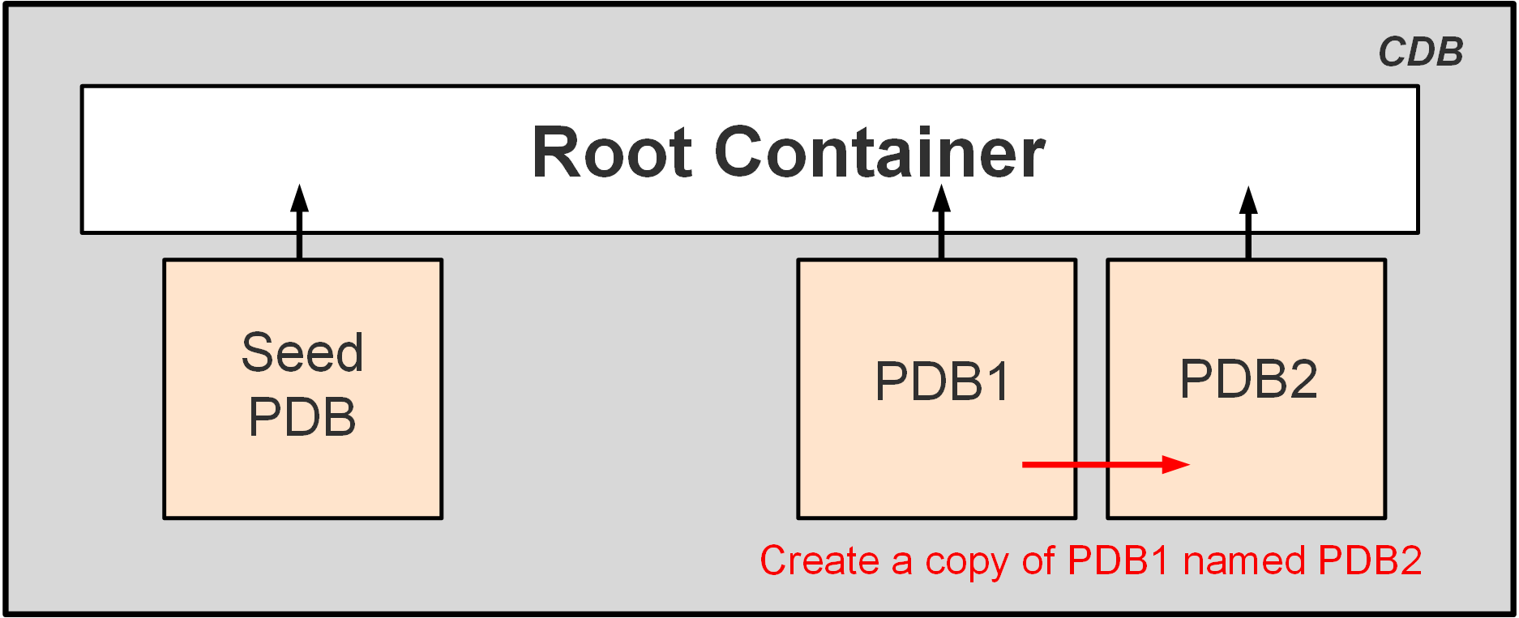
Cloning PDBs
Cloning is copying a source PDB from a CDB and plugging the copy into the same CDB or another CDB.
Example: PDB1 is cloned as PDB2 in the same CDB. The seed PDB, while present in the CDB, is not used.
Notes:
Cloning is suitable for the following situations:
You want to test the application patch of your production PDB. You first clone your production application in a cloned PDB, patch the cloned PDB, and test it.
You want to diagnose performance issues or perform performance regression tests on your application. Because you cannot perform this operation in parallel with the production in the same database, you clone the PDB into another CDB.
To clone a PDB with SQL*Plus, you use the CREATE PLUGGABLE DATABASE statement.
Prerequisites for using the CREATE PLUGGABLE DATABASE statement to clone a PDB include:
You must be connected to a CDB and the current container must be the root.
You must have the CREATE PLUGGABLE DATABASE system privilege.
The CDB in which the PDB is being created must be in READ/WRITE mode.
You must put the PDB being cloned into READ-ONLY mode before you can clone it.

Slide 8

Cloning Regular PDBs
CDB1
Define how Oracle will find the location of the data files:
In init.ora, set DB_CREATE_FILE_DEST= 'PDB3dir'
In init.ora, set PDB_FILE_NAME_CONVERT='PDB1dir', 'PDB3dir'
Using the CREATE_FILE_DEST= 'PDB3dir' clause
Connect to the CDB root to close PDB1.
Clone PDB3 from PDB1.
Open PDB3 in read/write mode.
Note: Cloning metadata only with NO DATA
CDB root
Data files/
Temp files
Control
files
Redo Log
files
PDB$SEED
Data files/Temp files
PDB1
Data files/Temp files
Create
PDB3
from
PDB1
Data files/Temp files
PDB3
SQL> CREATE PLUGGABLE DATABASE pdb3 FROM pdb1
CREATE_FILE_DEST = 'PDB3dir';
PDB3 owns:
SYSTEM, SYSAUX, UNDO tablespaces
Full catalog
SYS, SYSTEM common users
Same local administrator name
New service name
SQL> ALTER PLUGGABLE DATABASE pdb3 OPEN;
Notes:
This technique copies a source PDB from a CDB and plugs the copy into a CDB. The source PDB is in the local CDB.
The steps to clone a PDB within the same CDB are:
Define the location for the data files of the new PDB:
In init.ora, set DB_CREATE_FILE_DEST= 'PDB3dir' (OMF) or PDB_FILE_NAME_CONVERT= 'PDB1dir', 'PDB3dir' (non-OMF).
Use the CREATE_FILE_DEST clause during the CREATE PLUGGABLE DATABASE statement (OMF).
Use the FILE_NAME_CONVERT=(’pdb1dir’,’ pdb3dir’) clause to define the directory of the source files to copy from PDB1 and the target directory for the new files of PDB3 (non-OMF).
Connect to the CDB root as a common user with the CREATE PLUGGABLE DATABASE privilege.
Use the CREATE PLUGGABLE DATABASE command to clone the PDB PDB3 from PDB1.
Then open the new PDB3 with the command ALTER PLUGGABLE DATABASE OPEN.
Note: NO DATA allows PDB metadata cloning, which is an option that can be used for cloning an empty PDB and later importing data for testing.

Slide 9
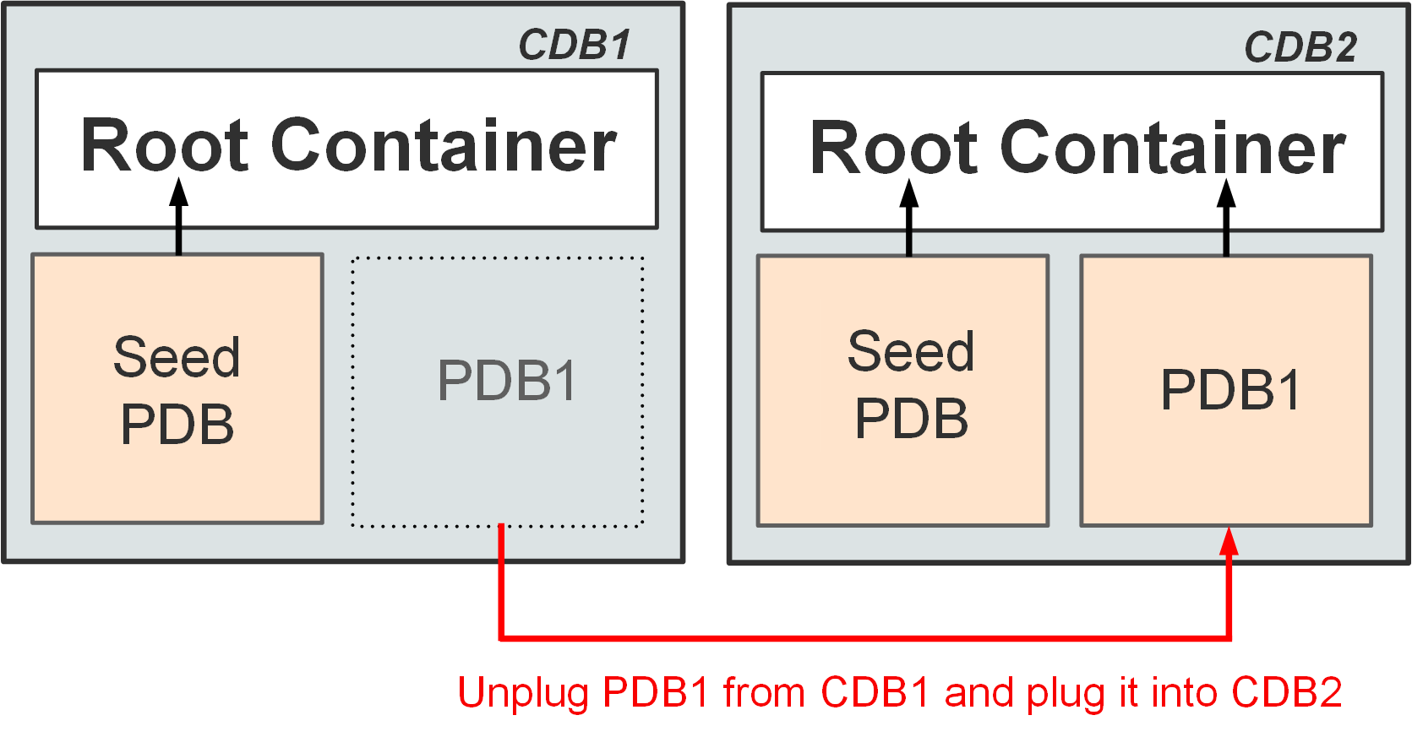
Unplugging and Plugging in PDBs
Unplugging a PDB is disassociating the PDB from its CDB.
Plugging in a PDB is associating a PDB with a CDB.
You can plug a PDB into the same or another CDB.
Example: PDB1 is unplugged from CDB1 and plugged into CDB2.
Notes:
Unplugging and plugging is suitable for the following situations:
You have to upgrade a PDB to the latest Oracle version, but you do not want to apply it on all PDBs. Instead of upgrading a CDB from one release to another, you can unplug a PDB from one Oracle Database release and then plug it into a newly created CDB from a later release.
You want to test the performance of the CDB without a particular PDB. You unplug the PDB, test the performance without the PDB, and, if necessary, replug the PDB into the CDB.
You want to maintain a collection of PDB “gold images” as unplugged PDBs.
You use the ALTER PLUGGABLE DATABASE statement to unplug a PDB from a CDB. To unplug a PDB, you must first close it and then generate an XML manifest file. The XML file contains the names and full paths of the tablespaces and data files of the unplugged PDB. That information is then used by the plugging operation. You use the CREATE PLUGGABLE DATABASE statement to plug a PDB into a CDB.

Slide 10
Plugging an Unplugged Regular PDB into a CDB
CDB1
Unplug PDB1 from CDB1:
Connect to CDB1 as a common user.
Verify that PDB1 is closed.
Drop PDB1 from CDB1 .
Plug PDB1 into CDB2:
Connect to CDB2 as a common user.
Use the DBMS_PDB package to check the compatibility of PDB1 with CDB2.
Open PDB1 in read/write mode.
CDB root
PDB$SEED
PDB1
Data files
SYSTEM
USERS
SQL> ALTER PLUGGABLE DATABASE pdb1
UNPLUG INTO 'xmlfile1';
SYSAUX
UNDO
Unplug PDB1
XML file
Plug PDB1
CDB2
CDB root
PDB$SEED
SQL> CREATE PLUGGABLE DATABASE pdb1
USING 'xmlfile1' NOCOPY;
PDB1
Data files
SYSTEM
SYSAUX
USERS
UNDO
Notes:
You can create a PDB in a CDB by using the unplugging/plugging method.
Unplugging a PDB disassociates the PDB from a CDB. You unplug a PDB when you want to move the PDB to a different CDB or when you no longer want the PDB to be available.
The first step is to unplug PDB1 from CDB1. The second step is to plug PDB1 into CDB2.
To unplug PDB1 from CDB1, first connect to the source CDB root and check that the PDB is closed by using the V$PDBS view. Then use ALTER PLUGGABLE DATABASE with the UNPLUG clause to specify the database to unplug and the XML file to unplug it into. The STATUS in CDB_PDBS of the unplugged PDB is UNPLUGGED. A PDB must be dropped from the CDB before it can be plugged back into the same CDB. If the PDB is plugged into another CDB, the PDB does not need to be dropped if the data files are copied.
Before plugging PDB1 into CDB2, you can optionally check whether the unplugged PDB is compatible with CDB2 with the DBMS_PDB.CHECK_PLUG_COMPATIBILITY function.
To plug PDB1 into CDB2, connect to CDB2 root and use CREATE PLUGGABLE DATABASE pdb1 USING ’xmlfile1.xml’. The last step is to open the PDB.

Slide 11
Plugging Using an Archive File
Unplugging a PDB into a single archive file includes:
XML file
Data files
Plugging the PDB requires only the archive file.
CDB_SOURCE
PDB1
SQL> ALTER PLUGGABLE DATABASE pdb1
UNPLUG INTO '/tmp/pdb1.pdb';
Data files
Archive file
pdb1.pdb
CDB_TARGET
PDB_NEW
SQL> CREATE PLUGGABLE DATABASE pdb_new USING '/tmp/pdb1.pdb';
Data files
Notes:
When a PDB is unplugged, all the data files associated with the PDB along with the PDB manifest must be copied or moved individually over to the remote server where it will be plugged into another CDB. You can choose to create a single PDB archive file, a compressed file with the .pdb extension, which contains the PDB manifest and all the data files when unplugging a PDB. When plugging in a PDB, the presence of a .pdb file is interpreted, and the PDB is plugged into the CDB. You can choose to run the PDB plug-in compatibility test directly on the PDB archive without extracting the PDB manifest file from the archive.
This feature provides ease of managing the unplugging and plugging of PDBs across CDBs.

Slide 12
Dropping PDBs
When you drop a PDB, you remove all references to it and its data files in the control file of the CDB.
Archived logs and backups associated with the dropped PDB are not deleted in case you later want to recover the PDB.
You can also use Oracle Recovery Manager (RMAN) to delete archived logs and backups.
You use the DROP PLUGGABLE DATABASE statement to drop a pluggable database (PDB).
Example:
SQL> DROP PLUGGABLE DATABASE SALESPDB INCLUDING DATAFILES;
Notes:
You use the DROP PLUGGABLE DATABASE statement to drop a pluggable database (PDB).
Specify KEEP DATAFILES to retain the data files associated with the PDB after the PDB is dropped. The temp file for the PDB is deleted because it is no longer needed. This is the default. Keeping data files may be useful in scenarios where a PDB that is unplugged from one CDB is plugged into another CDB, with both CDBs sharing storage devices.
Specify INCLUDING DATAFILES to delete the data files associated with the PDB being dropped. The temp file for the PDB is also deleted.
Prerequisites for using the DROP PLUGGABLE DATABASE statement to drop PDBs include:
You must be connected to a CDB.
The current container must be the root. You must be authenticated as SYSDBA or as SYSOPER, and the SYSDBA or SYSOPER privilege must be either granted to you commonly or granted to you locally in the root and locally in the PDB you want to drop.
To specify KEEP DATAFILES (the default), the PDB you want to drop must be unplugged.
To specify INCLUDING DATAFILES, the PDB you want to drop must be in mounted mode or unplugged.

Slide 13

Summary
In this lesson, you should have learned how to:
Describe the methods and tools used to create PDBs
Create PDBs from seed by using SQL*Plus
Clone PDBs by using SQL*Plus
Unplug and plug in PDBs by using SQL*Plus
Drop PDBs by using SQL*Plus

Slide 14
Practice 10: Overview
10-1: Creating a PDB from Seed
10-2: Cloning a PDB
10-3: Unplugging and Plugging in a PDB
10-4: Dropping a PDB

