Slide 1
Creating and Managing Tablespaces

Slide 2
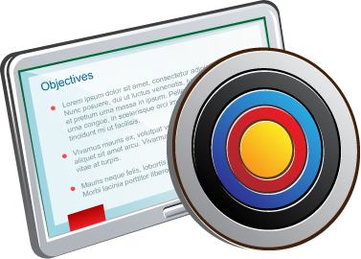
Objectives
After completing this lesson, you should be able to:
Explain how table data is stored in the database
Use SQL*Plus to:
Create and drop tablespaces
Alter tablespaces
View tablespace information
Implement Oracle Managed Files (OMF)
Use SQL*Plus to move and rename online data files
Implement tablespace encryption
Notes:
The size of a PDB can be described as the sum of all its tablespaces. As you manage your PDBs over time, you may need to enlarge them as usage increases. You can do that by creating new tablespaces, adding data files to existing smallfile tablespaces, increasing the size of data files, and providing for the dynamic growth of your data files. All these activities can be performed with SQL statements, although if you prefer working with a GUI, you can use Enterprise Manager Cloud Control or Enterprise Manager Database Express (EM Express).

Slide 3
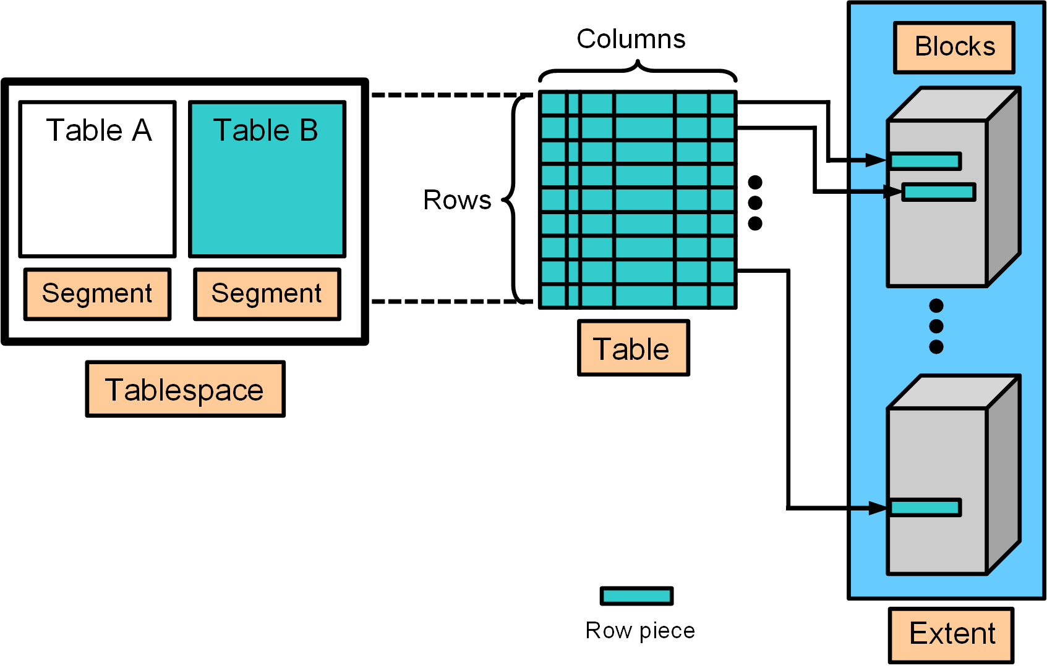
How Table Data Is Stored
Notes:
When a table is created, a logical "segment" is created to hold its data, as illustrated in the slide. A tablespace contains a collection of segments.
Logically, a table contains rows of column values. A row is ultimately stored in a database block in the form of a row piece (also illustrated in the slide). It is called a row piece because, under some circumstances, the entire row may not be stored in one place. This happens when an inserted row is too large to fit into a single block (chained row) or when an update causes an existing row to outgrow the available free space of the current block (migrated row). Row pieces are also used when a table has more than 255 columns. In this case, the pieces may be in the same block (intra-block chaining) or across multiple blocks.

Slide 4
Database Block Content
Block header
Growth
Free space
Row data
Notes:
A database block contains a block header, row data, and free space, as illustrated in the slide.
A block header contains the segment type (such as table or index), data block address, table directory, row directory, and transaction slots of approximately 23 bytes each, which are used when modifications are made to rows in the block. The block header grows downward from the top.
Row data is the actual data for the rows in the block. Row data space grows upward from the bottom.
Free space is in the middle of the block, enabling the header and the row data space to grow when necessary. Row data takes up free space as new rows are inserted or as columns of existing rows are updated with larger values. Examples of events that cause header growth:
Row directories that need more row entries
More transaction slots required than initially configured
Initially, the free space in a block is contiguous. However, deletions and updates may fragment the free space in the block. The free space in the block is coalesced by the Oracle server when necessary.

Slide 5
Creating Tablespaces
A tablespace is an allocation of space in the database that can contain schema objects.
Create a tablespace with the CREATE TABLESPACE statement or a graphical interface, such as EM Express.
You can create three types of tablespaces:
Permanent tablespace: Contains persistent schema objects. Objects in permanent tablespaces are stored in data files.
Undo tablespace: Is a type of permanent tablespace used by Oracle Database to manage undo data if you are running your database in automatic undo management mode. Oracle strongly recommends that you use automatic undo management mode rather than using rollback segments for undo.
Temporary tablespace: Contains schema objects only for the duration of a session. Objects in temporary tablespaces are stored in temp files.
Notes:
Prerequisites for CREATE TABLESPACE
Before you can create a tablespace, you must create a database to contain it, and the database must be open. You must also have the CREATE TABLESPACE system privilege. To create the SYSAUX tablespace, you must have the SYSDBA system privilege.
File Name and Size
You must include the DATAFILE or TEMPFILE clause when you create a tablespace. Use this clause to specify the name and location of the data file or temp file. A tablespace must have at least one data file or temp file. You must also specify an initial file size.
You can include the AUTOEXTEND ON clause to automatically extend the file when it is full. In this case, you'll need to specify an increment amount and a maximum file size, which can be unlimited. Remember, the size of the file is limited by the physical media on which it resides.
You can include the BIGFILE or SMALLFILE clause to override the default tablespace type (permanent or temporary) for the database. If you omit this clause, then Oracle Database uses the current default tablespace type.
A bigfile tablespace contains only one data file (or temp file), which can contain up to approximately 4 billion blocks. Bigfile tablespaces are used with extremely large databases, in which Automatic Storage Management (ASM) or other logical volume managers support the striping or redundant array of independent disks (RAID) and dynamically extensible logical volumes. For bigfile tablespaces, you can specify only one data file in the DATAFILE clause or one temp file in the TEMPFILE clause.
A smallfile tablespace is a traditional Oracle tablespace, which can contain 1022 data files or temp files, each of which can contain up to approximately 4 million blocks.

Slide 6
Notes:
Availability
You can include the ONLINE or OFFLINE clause to make the tablespace available (or not available) immediately after creation to users who have been granted access to the tablespace. ONLINE is the default. The data dictionary view DBA_TABLESPACES indicates whether each tablespace is online or offline. This clause cannot be used with temporary tablespaces.
Block Size
You can include the BLOCKSIZE clause to specify a nonstandard block size. To specify this clause, the DB_CACHE_SIZE and at least one DB_nK_CACHE_SIZE parameter must be set, and the integer you specify in this clause must correspond with the setting of one DB_nK_CACHE_SIZE parameter setting. You cannot specify nonstandard block sizes for a temporary tablespace or if you intend to assign this tablespace as the temporary tablespace for any users. If you don't specify a block size, the database will use the default 8 KB block size for the tablespace.
Extent Management
You can include the EXTENT MANAGEMENT clause to specify how the extents of the tablespace will be managed.
AUTOALLOCATE specifies that the tablespace is system managed. Users cannot specify an extent size. You cannot specify AUTOALLOCATE for a temporary tablespace.
UNIFORM value specifies that the tablespace is managed with uniform extents of SIZE bytes. The default SIZE is 1MB. All extents of temporary tablespaces are of uniform size, so this keyword is optional for a temporary tablespace. However, you must specify UNIFORM to specify SIZE. You cannot specify UNIFORM for an undo tablespace.
If you don't specify AUTOALLOCATE or UNIFORM, then the default is UNIFORM for temporary tablespaces and AUTOALLOCATE for all other types of tablespaces. If you do not specify the EXTENT_MANAGEMENT clause, then Oracle Database interprets the MINIMUM EXTENT clause and the DEFAULT STORAGE clause to determine extent management.
Also, with the EXTENT MANAGEMENT clause, you can specify where the metadata for allocated and unallocated extents is to be stored, either in the data dictionary (DICTIONARY) or in the tablespace itself (LOCAL). Tablespaces that record extent allocation in the dictionary are called dictionary-managed tablespaces. Tablespaces that record extent allocation in the tablespace header are called locally-managed tablespaces.
Logging
You can include the LOGGING clause to specify the default logging attributes of all tables, indexes, materialized views, materialized view logs, and partitions within a tablespace. The logging attribute controls whether certain DML operations are logged in the redo log file (LOGGING) or not (NOLOGGING). The default is LOGGING. This clause is not valid for a temporary or undo tablespace.

Slide 7
Notes:
If logging is not enabled, any direct loads using SQL*Loader and direct load INSERT operations are not written to the redo log, and the objects are thus unrecoverable in the event of data loss. When an object is created without logging enabled, you must back up those objects if you want them to be recoverable. Choosing not to enable logging can have a significant impact on the ability to recover objects in the future. Use with caution.
You can use the FORCE LOGGING clause to put the tablespace into FORCE LOGGING mode. Oracle Database will log all changes to all objects in the tablespace except changes to temporary segments, overriding any NOLOGGING setting for individual objects. The database must be open and in READ WRITE mode.
Segment Space Management
You can include the SEGMENT MANAGEMENT clause to specify whether Oracle Database should track the used and free space in the segments in the tablespace using by free lists or bitmaps (AUTO) or not (MANUAL).
AUTO: The Oracle Database server will use bitmaps to manage the free space in segments. The bitmap describes the status of each data block in a segment with respect to the amount of space in the block that is available for inserting rows. As more or less space becomes available in a data block, the new state is reflected in the bitmap. With bitmaps, the Oracle Database manages free space more automatically. As a result, this form of space management is called Automatic Segment Space Management (ASSM).
MANUAL: You want to use free lists for managing free space in segments. Free lists are lists of data blocks that have space available for inserting rows. This form of managing space in segments is called manual segment space management because of the need to specify and tune the PCTUSED, FREELISTS, and FREELIST GROUPS storage parameters for schema objects created in the tablespace. This is supported for backward compatibility; it is recommended that you use ASSM.
The SEGMENT MANAGEMENT clause applies to permanent, locally managed tablespaces only and is not valid for temporary tablespaces.
Data Segment Compression
When you create a tablespace, you can specify that all tables and indexes, or their partitions, created in a tablespace are compressed by default.
Data segment compression is disabled by default. Enabling data segment compression can save disk space usage, reduce memory use in the buffer cache, and speed up query execution during reads. There is, however, a cost in CPU overhead for data loading and DML. It is especially useful in online analytical processing (OLAP) systems, where there are lengthy read-only operations, but can also be used in online transaction processing (OLTP) systems.

Slide 8
Creating Permanent Tablespaces in a CDB
Tablespace creation during CDB creation:
With DBCA: USERS tablespace created in the CDB root
With CREATE DATABASE statement with USER_DATA TABLESPACE clause: Your defined tablespace created in the CDB root
Create a permanent tablespace in the CDB root:
Create a permanent tablespace in a PDB:
SQL> CONNECT system@cdb1
SQL> CREATE TABLESPACE tbs_CDB_users
DATAFILE '/u1/app/oracle/oradata/cdb/cdb_users01.dbf' SIZE 100M;
SQL> CONNECT system@PDB1
SQL> CREATE TABLESPACE tbs_PDB1_users
DATAFILE '/u1/app/oracle/oradata/cdb/pdb1/users01.dbf‘ SIZE 100M;
Notes:
In a non-CDB, all the tablespaces belong to one database.
In a CDB, one set of tablespaces belong to the CDB root, and each PDB has its own set of tablespaces.
The CREATE TABLESPACE command should be familiar. The change in its behavior in a CDB is that the tablespace is created in the container where the command is executed.
Separating the data files into different directories by PDB can help determine which files belong to which PDB, though it is not necessary.
You can use Oracle ASM storage to manage your disk storage.
The USER_DATA TABLESPACE clause in the CREATE DATABASE command allows you to specify a default tablespace other than USERS when using DBCA to create a database. This tablespace will also be used for XDB options.

Slide 9
Altering and Dropping Tablespaces
When you create a tablespace, it is initially a read/write tablespace.
Use the ALTER TABLESPACE statement to take a tablespace offline or online, add data files or temp files to it, or make it a read-only tablespace.
A tablespace can be in one of three different statuses or states:
Read Write
Read Only
Offline with one of the following options:
NORMAL
TEMPORARY
IMMEDIATE
Add space to an existing tablespace by either adding data files to the tablespace or changing the size of an existing data file.
Use the DROP TABLESPACE statement to drop a tablespace and its contents from the database if you no longer need its content.
Notes:
Changing the Status
A tablespace can be in one of three different statuses or states. Any of the following three states may not be available because their availability depends on the type of tablespace:
Read Write: The tablespace is online and can be read from and written to.
Read Only: Specify read-only to place the tablespace in transition read-only mode. In this state, existing transactions can be completed (committed or rolled back), but no further data manipulation language (DML) operations are allowed on the objects in the tablespace. The tablespace is online while in the read-only state. You cannot make the SYSTEM or SYSAUX tablespaces read-only. Note: The undo and temporary tablespaces cannot be made read-only.
Offline: You can take an online tablespace offline so that this portion of the database is temporarily unavailable for general use. The rest of the database is open and available for users to access data. When you take it offline, you can use the following options:
Normal: A tablespace can be taken offline normally if no error conditions exist for any of the data files of the tablespace. Oracle Database ensures that all data is written to disk by taking a checkpoint for all data files of the tablespace as it takes them offline.
Temporary: A tablespace can be taken offline temporarily even if there are error conditions for one or more files of the tablespace. Oracle Database takes the data files (which are not already offline) offline, performing checkpointing on them as it does so. If no files are offline, but you use the Temporary clause, media recovery is not required to bring the tablespace back online. However, if one or more files of the tablespace are offline because of write errors, and you take the tablespace offline temporarily, the tablespace requires recovery before you can bring it back online.

Slide 10
Notes:
Immediate: A tablespace can be taken offline immediately without Oracle Database taking a checkpoint on any of the data files. When you specify Immediate, media recovery for the tablespace is required before the tablespace can be brought online. You cannot take a tablespace offline immediately if the database is running in NOARCHIVELOG mode.
Note: System tablespaces may not be taken offline.
Changing the Size
You can add space to an existing tablespace by either adding data files to the tablespace or changing the size of an existing data file. You cannot add additional data files to bigfile tablespaces. You can make a tablespace either larger or smaller. However, you cannot make a data file smaller than the used space in the file. If you try to do so, you'll get an error.
Dropping Tablespaces
You can drop a tablespace and its contents (the segments contained in the tablespace) from the database if the tablespace and its contents are no longer required. You must have the DROP TABLESPACE system privilege to drop a tablespace.
When you drop a tablespace, the file pointers in the control file of the associated database are removed. If you are using Oracle Managed Files (OMF), the underlying operating system files are also removed. Otherwise, without OMF, you can optionally direct the Oracle server to delete the operating system files (data files) that constitute the dropped tablespace. If you do not direct the Oracle server to delete the data files at the same time that it deletes the tablespace, you must later use the appropriate commands of your operating system if you want them to be deleted.
You cannot drop a tablespace that contains segments with uncommitted updates from active transactions. For example, if a table in the tablespace is currently being used, or if the tablespace contains undo data that is needed to roll back uncommitted transactions, you cannot drop the tablespace. It is best to take the tablespace offline before dropping it.

Slide 11
Viewing Tablespace Information
Tablespace and data file information can be obtained by querying the following views:
Tablespace information:
CDB_TABLESPACES and DBA_TABLESPACES
V$TABLESPACE
Data file information:
CDB_DATA_FILES and DBA_DATA_FILES
V$DATAFILE
Temp file information:
CDB_TEMP_FILES and DBA_TEMP_FILES
V$TEMPFILE
Tables in a tablespace:
ALL_TABLES

Slide 12
Review: Implementing Oracle Managed Files (OMF)
Specify file operations in terms of database objects rather than file names.
Example:
Parameter | Description
DB_CREATE_FILE_DEST | Defines the location of the default file system directory for data files and temporary files
DB_CREATE_ONLINE_LOG_DEST_n | Defines the location for redo log files and control file creation
DB_RECOVERY_FILE_DEST | Gives the default location for the fast recovery area
SQL> ALTER SYSTEM SET DB_CREATE_FILE_DEST='/u01/app/oracle/oradata';
SQL> CREATE TABLESPACE tbs_1;
Notes:
Oracle Managed Files
Oracle Managed Files (OMF) eliminates the need for you to directly manage the operating system files in an Oracle database. You specify operations in terms of database objects rather than file names. The database internally uses standard file system interfaces to create and delete files as needed for the following database structures:
Tablespaces
Redo log files
Control files
Archived logs
Block change tracking files
Flashback logs
RMAN backups
A database can have a mixture of Oracle-managed and Oracle-unmanaged files. The file system directory specified by either of these parameters must already exist; the database does not create it. The directory must also have permissions for the database to create the files in it.
The table in the slide lists three initialization parameters that are used with OMF. The example in the slide shows that after the DB_CREATE_FILE_DEST initialization parameter is set, you can omit the DATAFILE clause from the CREATE TABLESPACE statement. The data file is created in the location specified by DB_CREATE_FILE_DEST.
In Oracle Database Cloud Service, OMF is enabled by default.

Slide 13
Notes:
Naming Formats
Oracle-managed files have a specific naming format. For example, on Linux- and UNIX-based systems, the following format is used:
<destination_prefix>/o1_mf_%t_%u_.dbf
Do not rename an Oracle-managed file. The database identifies an Oracle-managed file based on its name. If you rename the file, the database is no longer able to recognize it as an Oracle-managed file and will not manage the file accordingly.
File Size
By default, Oracle-managed data files, including those for the SYSTEM and SYSAUX tablespaces, are 100 MB and auto-extensible.
Note: By default, Automatic Storage Management (ASM) uses OMF files, but if you specify an alias name for an ASM data file at tablespace creation time or when adding an ASM data file to an existing tablespace, then that file will not be OMF.

Slide 14
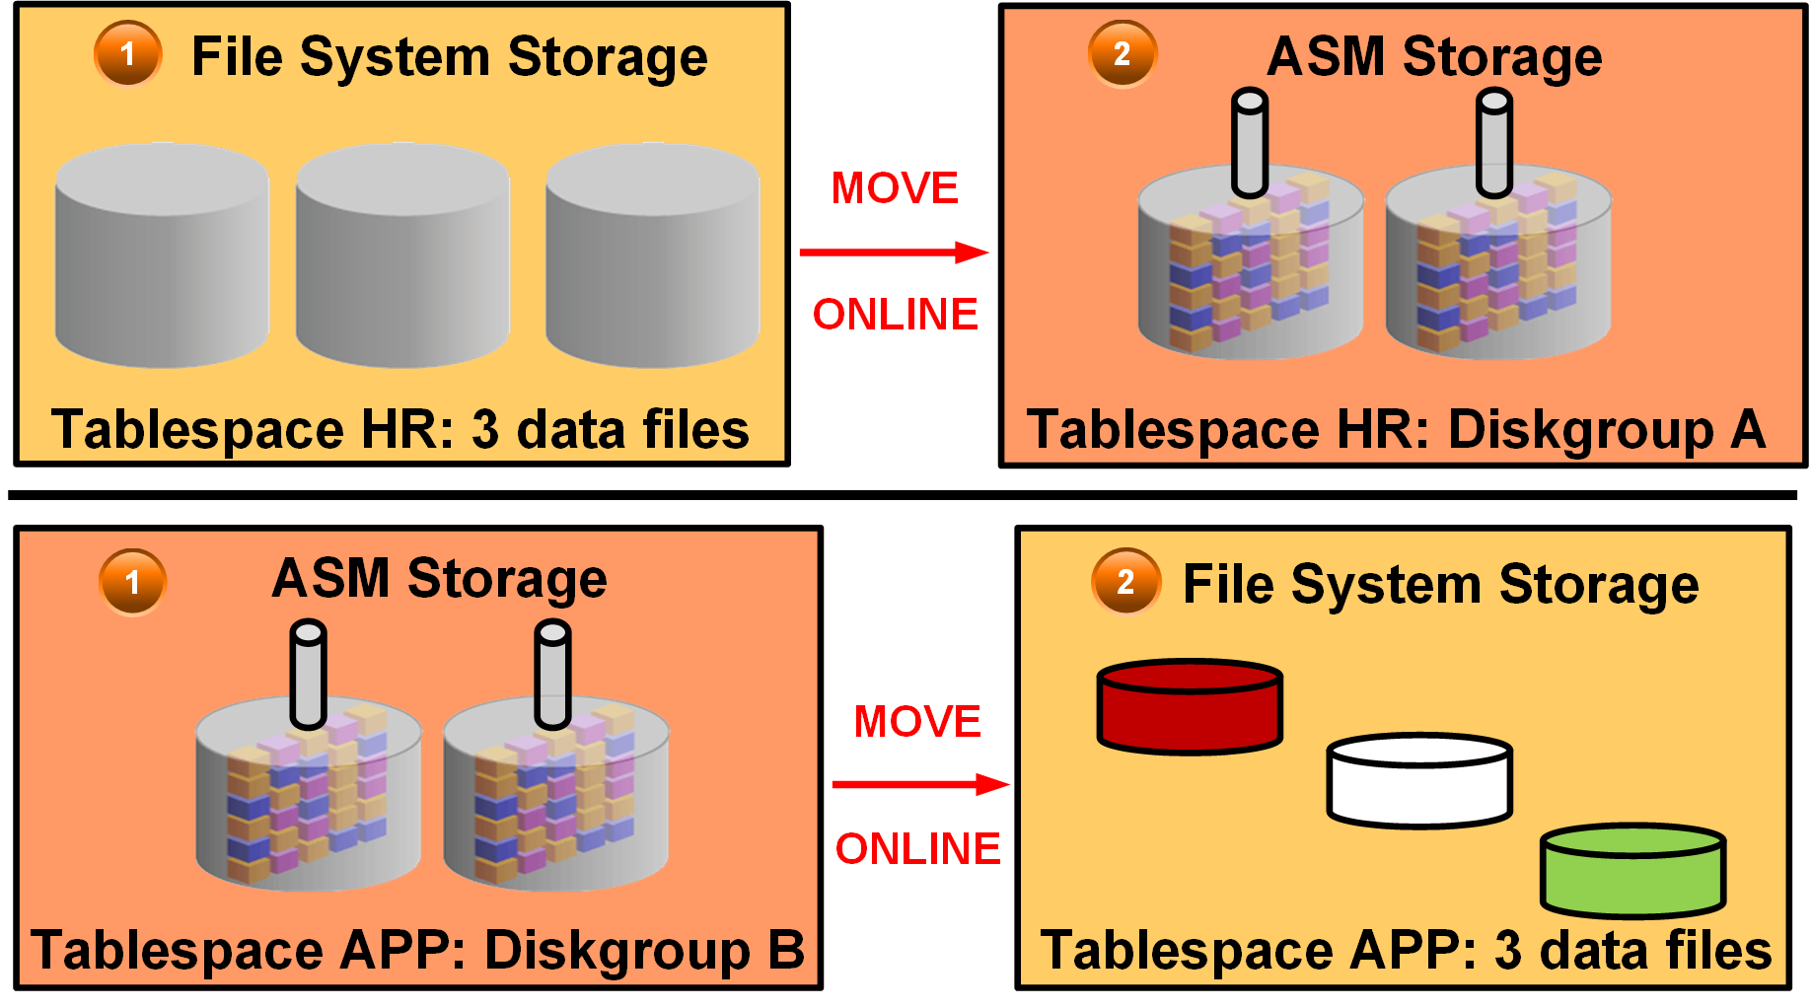
Moving or Renaming Online Data Files
Notes:
You can rename and move an online data file from one kind of storage system to another while the database is open and accessing the file. The first example in the diagram illustrates moving the HR tablespace (three data files) from file system storage to ASM storage (diskgroup A). The second example illustrates moving the APP tablespace from ASM storage (diskgroup B) to file system storage (three data files).
Queries and DML and DDL operations can be performed while the data file is being moved. For example:
SELECT statements against tables and partitions
Creation of tables and indexes
Rebuilding of indexes
Other notes:
If objects are compressed while the data file is moved, the compression remains the same.
You do not have to shut down the database or take the data file offline while you move a data file to another location, disk, or storage system.
You can omit the TO clause only when an Oracle-managed file is used. In this case, the DB_CREATE_FILE_DEST initialization parameter should be set to indicate the new location.
If the REUSE option is specified, the existing file is overwritten.
If the KEEP clause is specified, the old file will be kept after the move operation. The KEEP clause is not allowed if the source file is an Oracle-managed file.
Use the V$SESSION_LONGOPS view to display ongoing online move operations. Each ongoing operation has one row. The state transition of a successful online move operation is usually NORMAL to COPYING to SUCCESS and finally to NORMAL.

Slide 15
Examples: Moving and Renaming Online Data Files
Relocating an online data file:
Copying a data file from a file system to Automatic Storage Management (ASM):
Renaming an online data file:
SQL> ALTER DATABASE MOVE DATAFILE '/disk1/myexample01.dbf'
2 TO '/disk2/myexample01.dbf';
SQL> ALTER DATABASE MOVE DATAFILE '/disk1/myexample01.dbf'
2 TO '+DiskGroup2' KEEP;
SQL> ALTER DATABASE MOVE DATAFILE '/disk1/myexample01.dbf‘
2 TO '/disk1/myexample02.dbf';
Notes:
You do not have to shut down the database or take the data file offline while you move a data file to another location, disk, or storage system.
The TO clause can be omitted only when an Oracle-managed file is used. In this case, the DB_CREATE_FILE_DEST parameter should be set to indicate the new location.
If the REUSE option is specified, the existing file is overwritten.
If the KEEP clause is specified, the old file will be kept after the move operation. The KEEP clause is not allowed if the source file is an Oracle-managed file.
Use the V$SESSION_LONGOPS view to display ongoing online move operations. Each ongoing operation has one row. The state transition of a successful online move operation is usually NORMAL to COPYING to SUCCESS and finally to NORMAL.

Slide 16

Tablespace Encryption by Default in DBCS
In Oracle Database Cloud Service, user-created tablespaces are encrypted by default.
Tablespaces created when the database is first created (in the root container, PDB seed, and PDB1) are NOT encrypted.
The default encryption algorithm is AES128.
The underlying architecture supporting this feature is Transparent Data Encryption (TDE).
Notes:
All new tablespaces you create in a Database Cloud Service database are encrypted by default. In an Oracle Database 12c database, the tablespaces in the root (CDB$ROOT), the seed (PDB$SEED), and the PDB that is created when the database is created are not encrypted.
By default, any new tablespaces you create by using the SQL CREATE TABLESPACE command or any tool executing the CREATE TABLESPACE command are encrypted with the AES128 encryption algorithm. You do not need to include the USING 'encrypt_algorithm' clause to use the default encryption.

Slide 17
Controlling Tablespace Encryption by Default
Parameter Value | Description
ALWAYS | Any tablespace created will be transparently encrypted with the AES128 algorithm unless a different algorithm is specified in the ENCRYPTION clause.
CLOUD_ONLY (Default value) | Tablespaces created in a Database Cloud Service database will be transparently encrypted with the AES128 algorithm unless a different algorithm is specified in the ENCRYPTION clause. For non-Database Cloud Service databases, tablespaces will only be encrypted if the ENCRYPTION clause is specified.
DDL | Tablespaces are not transparently encrypted and are only encrypted if the ENCRYPTION clause is specified.
Notes:
The ENCRYPT_NEW_TABLESPACES initialization parameter controls default encryption of new tablespaces. In Database Cloud Service databases, this parameter is set to CLOUD_ONLY and should not be modified.

Slide 18
Managing the Software Keystore and Master Encryption Key
When the Database Cloud Service instance is created, a local auto-login software keystore is also created.
The keystore is local to the compute node and is protected by a system-generated password.
The auto-login software keystore is automatically opened when accessed.
Use the dbaascli utility to change (rotate) the master encryption key.
DBAAS> tde rotate masterkey
Executing command tde rotate masterkey
Enter keystore password:
Successfully rotated TDE masterkey
Notes:
When the Database Cloud Service instance is created, a local auto-login software keystore is created. The keystore is local to the compute node and is protected by a system-generated password. The auto-login software keystore is automatically opened when accessed.
You can change (rotate) the master encryption key by using the tde rotate masterkey subcommand of the dbaascli utility. When you execute this subcommand, you are prompted for the keystore password. Enter the password specified when the service instance was created.

Slide 19
Creating an Encrypted Tablespace by Using a Nondefault Algorithm
Use the ENCRYPTION USING clause to specify the algorithm:
Restrictions:
Temporary and undo tablespaces cannot be encrypted.
BFILE data type and external tables are not encrypted.
The key for an encrypted tablespace cannot be changed.
The SYSTEM tablespace cannot be encrypted.
SQL> CREATE TABLESPACE encrypt_ts
DATAFILE '$ORACLE_HOME/dbs/encrypt.dat' SIZE 100M
ENCRYPTION USING '3DES168'
DEFAULT STORAGE (ENCRYPT);
Notes:
The CREATE TABLESPACE command has an ENCRYPTION clause that sets the encryption properties and an ENCRYPT storage parameter that causes the encryption to be used. You specify USING 'encrypt_algorithm' to indicate the name of the algorithm to be used. Valid algorithms are 3DES168, AES128, AES192, and AES256. The default is AES128.
In Oracle Database Cloud Service, tablespaces are encrypted by default by using the AES128 algorithm. Specify the ENCRYPTION USING clause if you want to use a different algorithm.
You can view the encryption properties in the V$ENCRYPTED_TABLESPACES view.
Because tablespace encryption is performed at the I/O level, many of the restrictions that apply to TDE column encryption do not apply to tablespace encryption.
The following restrictions apply to tablespace encryption:
Temporary and undo tablespaces cannot be encrypted. But when a data buffer containing data from an encrypted tablespace is written to an undo or temporary tablespace, that data block is encrypted.
BFILE data type and external tables are not encrypted because they are not stored in tablespaces.
Transportable tablespaces across different endian platforms are not supported.
The key for encrypted tablespaces cannot be changed. A workaround is to create a tablespace with the desired properties and move all objects to the new tablespace.

Slide 20

Summary
In this lesson, you should have learned how to:
Explain how table data is stored in the database
Use SQL*Plus to:
Create and drop tablespaces
Alter tablespaces
View tablespace information
Implement Oracle Managed Files (OMF)
Use SQL*Plus to move and rename online data files
Implement tablespace encryption

Slide 21
Practice 12: Overview
12-1: Viewing Tablespace Information
12-2: Creating a Tablespace
12-3: Creating a Tablespace that is Encrypted by Default

