Slide 1
Tuning SQL

Slide 2

Objectives
After completing this lesson, you should be able to:
Describe the SQL tuning methodology
Manage optimizer statistics
Use SQL Tuning Advisor to identify and tune SQL statements that are using the most resources
Use SQL Access Advisor to tune a workload

Slide 3




SQL Tuning Process
1. Identify poorly tuned SQL statements.
ADDM
2. Tune the individual SQL statements.
SQL Tuning Advisor
SQL Access Advisor
3. Tune the application as a whole.
Notes:
SQL Tuning Process
1. Identify poorly tuned SQL statements: Generally, the tuning effort that yields the most benefit is SQL tuning. Poorly tuned SQL uses more resources than required. This inefficiency prevents scalability, uses more OS and database resources, and increases response time. To tune poorly tuned SQL statements, they must be identified and then tuned. SQL statements can be tuned individually, but often the solution that optimizes one statement can hurt the performance of several others. The SQL statements that use the most resources are, by definition, the statements in need of tuning. These are statements that have the longest elapsed time, use the most CPU, or do the most physical or logical reads. Automatic Database Diagnostic Monitor (ADDM) can detect high-load SQL statements.
2. Tune the individual statements: Tune the individual statements by checking the optimizer statistics, check the explain plan for the most efficient access path, test alternative SQL constructions, and test possible new indexes, materialized views, and partitioning. SQL Tuning Advisor and SQL Access Advisor, described later in this lesson, can help with this task.
3. Tune the application as a whole: Test the application as a whole by using the tuned SQL statements. Is the overall performance better?
The methodology is sound, but tedious. Tuning an individual statement is not difficult. Testing the overall impact of the individual statement tuning on an application can be very difficult.

Slide 4
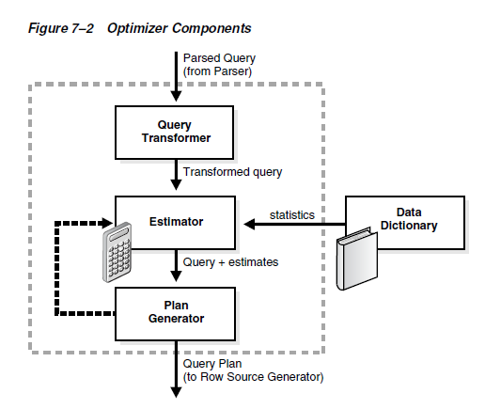
Oracle Optimizer
Notes:
The optimizer is the part of the Oracle Database server that creates the execution plan for a SQL statement. The determination of the execution plan is an important step in the processing of any SQL statement and can greatly affect execution time.
The execution plan is a series of operations that are performed in sequence to execute the statement. The optimizer considers many factors related to the referenced objects and the conditions specified in the query. The information necessary to the optimizer includes:
Statistics gathered for the system (I/O, CPU, and so on) as well as schema objects (number of rows, index, and so on)
Information in the dictionary
WHERE clause qualifiers
Hints supplied by the developer
The optimizer:
Evaluates expressions and conditions
Uses object and system statistics
Decides how to access the data and join tables
Determines the most efficient path
When you use diagnostic tools, such as Enterprise Manager, EXPLAIN PLAN, and SQL*Plus AUTOTRACE, you can see the execution plan that the optimizer chooses.

Slide 5
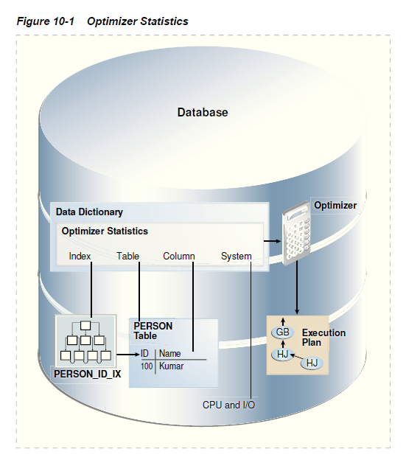
Optimizer Statistics
Notes:
Optimizer statistics include table, column, index, and system statistics. Statistics for tables and indexes are stored in the data dictionary. These statistics are not intended to provide real-time data. They provide the optimizer a statistically correct snapshot of data storage and distribution, which the optimizer uses to make decisions on how to access data.
The statistics that are collected include:
Size of the table or index in database blocks
Number of rows
Average row size and chain count (tables only)
Height and number of deleted leaf rows (indexes only)
As data is inserted, deleted, and modified, these statistics change. Because the performance impact of maintaining real-time data distribution statistics is prohibitive, these statistics are updated by periodically gathering statistics on tables and indexes.
Optimizer statistics are collected automatically by an automatic maintenance job that runs during predefined maintenance windows once daily by default. System statistics are operating system characteristics that are used by the optimizer. These statistics are not collected automatically. For details about collecting system statistics, see the Oracle Database Performance Tuning Guide.
Optimizer statistics are not the same as the database performance statistics that are gathered in the Automatic Workload Repository (AWR) snapshot.

Slide 6
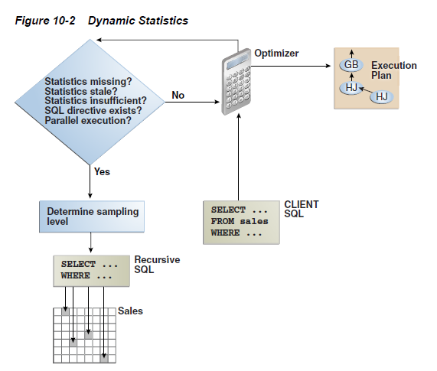
Optimizer Statistics Collection
Notes:
Optimizer statistics are collections of data that are specific details about database objects. These statistics are essential for the query optimizer to choose the best execution plan for each SQL statement. These statistics are gathered periodically and do not change between gatherings.
Statistics can be collected in the following ways:
Automatically: Automatic Maintenance Tasks
Manually: DBMS_STATS package
By setting database initialization parameters
By importing statistics from another database
The recommended approach to gathering optimizer statistics is to allow the Oracle Database server to automatically gather the statistics. Automatic Maintenance Tasks can be created automatically at database creation time and is managed by the Scheduler. It gathers statistics on all objects in the database that have either missing or stale optimizer statistics by default. You can change the default configuration through the Automatic Maintenance Tasks page.
System statistics describe the system’s hardware characteristics, such as I/O and CPU performance and utilization, to the query optimizer. When choosing an execution plan, the optimizer estimates the I/O and CPU resources required for each query. System statistics enable the query optimizer to more accurately estimate I/O and CPU costs and thereby choose a better execution plan. System statistics are collected by using the DBMS_STATS.GATHER_SYSTEM_STATS procedure. When the Oracle Database server gathers system statistics, it analyzes system activity in a specified period of time. System statistics are not automatically gathered. Oracle Corporation recommends that you use the DBMS_STATS package to gather system statistics.

Slide 7
Notes:
If you choose not to use automatic statistics gathering, you must manually collect statistics in all schemas, including system schemas. If the data in your database changes regularly, you also need to gather statistics regularly to ensure that the statistics accurately represent characteristics of your database objects. To manually collect statistics, use the DBMS_STATS package. This PL/SQL package is also used to modify, view, export, import, and delete statistics.
You can also manage optimizer and system statistics collection through database initialization parameters. For example:
The OPTIMIZER_DYNAMIC_SAMPLING parameter controls the level of dynamic sampling performed by the optimizer. You can use dynamic sampling to estimate statistics for tables and relevant indexes when they are not available or are too out of date to trust. Dynamic sampling also estimates single-table predicate selectivity when collected statistics cannot be used or are likely to lead to significant errors in estimation.
The STATISTICS_LEVEL parameter controls all major statistics collections or advisories in the database and sets the statistics collection level for the database. The values for this parameter are BASIC, TYPICAL, and ALL. You can query the V$STATISTICS_LEVEL view to determine which parameters are affected by the STATISTICS_LEVEL parameter.
Note: Setting STATISTICS_LEVEL to BASIC disables many automatic features and is not recommended.

Slide 8
Setting Optimizer Statistics Preferences
DBMS_STATS.GATHER_*_STATS procedures: Gather statistics for an entire database or for individual objects using default values
Use the SET_*_PREFS procedures to create preference values for any object that is not owned by SYS or SYSTEM
Query DBA_TAB_STAT_PREFS to view object-level preferences
Execute the DBMS_STATS.GET_PREFS procedure for each preference to see the global preferences
Notes:
The DBMS_STATS.GATHER_*_STATS procedures can be called at various levels to gather statistics for an entire database or for individual objects, such as tables. When the GATHER_*_STATS procedures are called, several of the parameters are often allowed to default. The supplied defaults work well for most of the objects in the database, but for some objects or schemas, the defaults need to be changed. Instead of running manual jobs for each of these objects, Oracle Database enables you to set values (called preferences) for individual objects, schemas, or databases or to change the default values with a global-level command.
The preferences specify the parameters that are given to the gather procedures. The SET_*_PREFS procedures create preference values for any object that is not owned by SYS or SYSTEM. The expected use is that the DBA will set the global preferences for any parameters that should be database-wide. These will be applied for any parameter that is allowed to default.
The SET_DATATBASE_PREFS procedure iterates over all the tables and schemas in the database, setting the specified preference. SET_SCHEMA_PREFS iterates over the tables in the specified schema. SET_TABLE_PREFS sets the preference value for a single table.
All object preferences—whether set at the database, schema, or table level—are held in a single table. Changing the preferences at the schema level overwrites the preferences that were previously set at the table level.
When the various gather procedures execute, they retrieve the object-level preferences that were set for each object. You can view the object-level preferences in the DBA_TAB_STAT_PREFS view. Any preferences that are not set at the object level will be set to the global-level preferences. You can see the global preferences by calling the DBMS_STATS.GET_PREFS procedure for each preference.

Slide 9
Notes:
For details about these preferences, see the DBMS_STATS documentation in the Oracle Database PL/SQL Packages and Types Reference.
Preferences may be deleted with the DBMS_STATS.DELETE_*_PREFS procedures at the table, schema, and database levels. You can reset the global preferences to the recommended values with the DBMS_STATS.RESET_PARAM_DEFAULTS procedure.

Slide 10
Optimizer Statistics Advisor
If best practices change in a new release, Optimizer Statistics Advisor encodes these practices in its rules.
The advisor always provides the most up-to-date recommendations.
Track and analyze how statistics are collected.
Class of findings: System, Operations, Objects
Scope of findings
Problems with gathering of statistics
Status of automatic statistic gathering jobs
Quality of current statistics
Suggestion for changes to the statistics collection
V$STATS_ADVISOR_RULES
NAME = UseAutoJob
RULE_TYPE = SYSTEM
V$STATS_ADVISOR_RULES
NAME = UseGatherSchemaStats
RULE_TYPE = OPERATION
V$STATS_ADVISOR_RULES
NAME = AvoidStaleStats
RULE_TYPE = OBJECT
Notes:
Since the introduction of the cost-based optimizer, optimizer statistics play a significant part in determining the execution plan for queries. Therefore, it is critical for the optimizer to have accurate and up-to-date statistics. The DBMS_STATS package serves this purpose and is improved in every release by adding new features. However, under many circumstances, these new features have not been fully utilized by customers or are being used in incorrect ways. Customers often use scripts and settings from one release to the next, based on earlier experience. These settings and methods may have been superseded or produce statistics that no longer give the most effective optimizer results.
Optimizer Statistics Advisor uses rules consistent with the current release to recommend changes to the way statistics are being gathered.
The advisor has a set of rules or recommended practices that are compared against the current statistics to generate findings. The rules are applied at the system, operation, or object level, such as whether the Automatic Gather Statistics jobs are scheduled, the statistics gathering procedures are using default parameters, and statistics are consistent across related objects. These rules check on issues related to the gathering of statistics—the schedules, parameters, and errors related to the automatic statistics gathering jobs. The rules include a variety of object-related issues, including whether incremental mode setting is efficient.

Slide 11
Optimizer Statistics Advisor Report
Report sections:
Header
Summary
Errors
Findings
Actions
Recommendations
Rules
Findings
Notes:
The Optimizer Statistics Advisor report has four basic concepts:
Rules: Check the current configuration, history, and current statistics. Rules are added and changed by release to reflect best practices.
Findings: They are generated when rules are not followed. An individual rule may generate many findings, but each finding is generated by only one rule. Some findings may be informational only, such as object staleness.
Recommendations: They are responses the customer could make to resolve the finding. It is possible that several recommendations could be generated, and further investigation would be required by the customer. One or more rationales are given for each recommendation. Not all findings generate recommendations.
Actions: They are PL/SQL statements or commands that the user can simply run in the command line to solve problems. They are provided in the form of scripts. Not all recommendations generate actions. For some recommendations, it is not possible to generate an action.
The report has sections for header, summary, errors, and findings. The header includes the advisor task parameters. The summary lists findings, and the errors section lists any errors the task encountered. The findings section includes the rule, findings, recommendations, and actions for each rule that produces a finding.

Slide 12
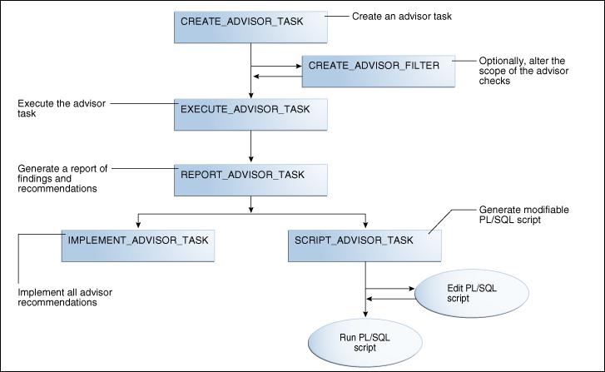
Executing Optimizer Statistics Advisor Tasks
DBA_ADVISOR_TASKS
DBA_ADVISOR_EXECUTIONS
DBA_ADVISOR_FINDINGS
DBA_ADVISOR_RECOMMENDATIONS
Notes:
An Optimizer Statistics Advisor task can be executed with PL/SQL calls. Each task must be provided a unique task name. The definition of the CREATE_ADVISOR_TASK() function parameters are:
TASK_NAME: Name of the Statistics Advisor task
TIME_LIMIT: The maximum duration the task can run
A filter list can be applied to the task to limit the scope of an advisor task using inclusion or exclusion lists for a user-specified set of rules, schemas, or operations. System rules are always checked. For example, you can configure an advisor task to include only recommendations for the SH schema. Also, you could exclude all violations of the rule for stale statistics.
You can create filters with the following DBMS_STATS procedures either individually or in combination: CONFIGURE_ADVISOR_OBJ_FILTER, CONFIGURE_ADVISOR_RULE_FILTER, and CONFIGURE_ADVISOR_OPR_FILTER. An Optimizer Statistics Advisor report can be generated with PL/SQL calls. The REPORT_ADVISOR_TASK function produces a report in text, HTML, or XML format. The IMPLEMENT_ADVISOR_TASK implements the recommendations of the task based on the filters in place. An additional parameter, LEVEL, can be set to either TYPICAL or ALL. TYPICAL is the default. ALL ignores the filters.

Slide 13
SQL Plan Directives
Plan Directive
Collect missing statistics.
Optimizer
Create column group statistics.
Perform dynamic sampling.
Execution Plan
Notes:
The Oracle Database 12c server can use a SQL plan directive, which is additional information and instructions that the optimizer can use to generate a more optimal plan. For example, a SQL plan directive might instruct the optimizer to collect missing statistics, create column group statistics, or perform dynamic sampling. During SQL compilation or execution, the database analyzes the query expressions that are missing statistics or that misestimate optimizer cardinality to create SQL plan directives. When the optimizer generates an execution plan, the directives give the optimizer additional information about objects that are referenced in the plan.
SQL plan directives are not tied to a specific SQL statement or SQL ID. The optimizer can use SQL plan directives for SQL statements that are nearly identical because SQL plan directives are defined on a query expression. For example, directives can help the optimizer with queries that use similar patterns, such as web-based queries that are the same except for a select list item. The database stores SQL plan directives persistently in the SYSAUX tablespace. When generating an execution plan, the optimizer can use SQL plan directives to obtain more information about the objects that are accessed in the plan.
Directives are automatically maintained, created as needed, and purged if not used after a year.
Directives can be monitored in DBA_SQL_PLAN_DIR_OBJECTS. SQL plan directives improve plan accuracy by persisting both compilation and execution statistics in the SYSAUX tablespace, allowing them to be used by multiple SQL statements.

Slide 14
Adaptive Execution Plans
Adaptive Query Optimization
Adaptive Plans
Adaptive Statistics
Join Methods
Parallel Distribution Methods
Dynamic Statistics
Automatic Reoptimization
SQL Plan Directives
Notes:
The Adaptive Execution Plans feature enables the optimizer to automatically adapt a poorly performing execution plan at run time and prevent a poor plan from being chosen on subsequent executions. The optimizer instruments its chosen plan so that at run time, it can be detected if the optimizer’s estimates are not optimal. Then the plan can be automatically adapted to the actual conditions. An adaptive plan is a plan that changes after optimization when optimizer estimates prove inaccurate.
The optimizer can adapt plans based on statistics that are collected during statement execution. All adaptive mechanisms can execute a plan that differs from the plan that was originally determined during hard parse. This improves the ability of the query-processing engine (compilation and execution) to generate better execution plans.
The two Adaptive Execution Plan techniques are:
Dynamic plans: A dynamic plan chooses among subplans during statement execution. For dynamic plans, the optimizer must decide which subplans to include in a dynamic plan, which statistics to collect to choose a subplan, and thresholds for this choice.
Re-optimization: In contrast, re-optimization changes a plan for executions after the current execution. For re-optimization, the optimizer must decide which statistics to collect at which points in a plan and when re-optimization is feasible.
Note: OPTIMIZER_ADAPTIVE_REPORTING_ONLY controls reporting-only mode for adaptive optimizations. When set to TRUE, adaptive optimizations run in reporting-only mode where the information required for an adaptive optimization is gathered, but no action is taken to change the plan.

Slide 15
Notes:
The optimizer can pick the best-performing plan during any execution of the statement, not just the first execution. If the underlying data changes, or if queries re-execute with different input data, then the optimizer can adapt its plan to match the statistics gathered in the current execution. The continuous adaptive query plan adapts for every execution of the same cursor instead of only once.

Slide 16
SQL Tuning Advisor: Overview
Comprehensive SQL tuning
Detect stale or missing
statistics
Tune SQL plan
(SQL profile)
SQL Tuning Advisor
Add missing index
Restructure SQL
Notes:
SQL Tuning Advisor is the primary driver of the tuning process. It performs several types of analyses:
Statistics Analysis: Checks each query object for missing or stale statistics and makes recommendations to gather relevant statistics
SQL Profiling: The optimizer verifies its own estimates and collects auxiliary information to remove estimation errors. It builds a SQL profile by using the auxiliary information and makes a recommendation to create it. When a SQL profile is created, it enables the query optimizer to generate a well-tuned plan.
Access Path Analysis: New indexes are considered if they significantly improve access to each table in the query. When appropriate, recommendations to create such objects are made.
SQL Structure Analysis: SQL statements that use bad plans are identified and relevant suggestions are made to restructure them. The suggested changes can be syntactic as well as semantic.
SQL Tuning Advisor considers each SQL statement included in the advisor task independently. Creating a new index may help a query, but may hurt the response time of DML. So, a recommended index or other object should be checked with SQL Access Advisor over a workload (a set of SQL statements) to determine whether there is a net gain in performance.
SQL Tuning Advisor runs automatically every night as the Automatic SQL Tuning Task. There may be times when a SQL statement needs immediate tuning action. You can use SQL Tuning Advisor to analyze SQL statements and obtain performance recommendations at any time. Typically, you run this advisor as an ADDM performance-finding action.

Slide 17
Notes:
Additionally, you can run SQL Tuning Advisor when you want to analyze the top SQL statements consuming the most CPU time, I/O, and memory.
Even though you can submit multiple statements to be analyzed in a single task, each statement is analyzed independently. To obtain tuning recommendations that consider the overall performance of a set of SQL, use SQL Access Advisor.

Slide 18
SQL Access Advisor: Overview
Workload specification
SQL statement
SQL Tuning Set
SQL cache contents
Statistics
Schema name
Recommendations
Indexes
Materialized views
Materialized view logs
Partitioning
SQL Access
Advisor
Notes:
SQL Access Advisor can recommend the proper set of materialized views, materialized view logs, partitioning, and indexes for a given workload. Understanding and using these structures is essential when optimizing SQL because they can result in significant performance improvements in data retrieval.
SQL Access Advisor recommends bitmap, function-based, and B-tree indexes. A bitmap index offers a reduced response time for many types of ad hoc queries and reduced storage requirements compared to other indexing techniques. B-tree indexes are most commonly used in a data warehouse to index unique or near-unique keys.
Another component of SQL Access Advisor also recommends how to optimize materialized views so that they can be fast refreshable and take advantage of general query rewrite.
Note: For more information about materialized views and query rewrite, see Oracle Database Performance Tuning Guide.

Slide 19

SQL Performance Analyzer: Overview
Predicts the impact of system changes
Builds different versions of SQL workload performance
Executes SQL serially
Analyzes performance differences
SQL Performance Analyzer
Offers fine-grained performance analysis on individual SQL
Notes:
Oracle Database includes SQL Performance Analyzer, which gives you an exact and accurate assessment of the impact of change on the SQL statements that make up the workload. SQL Performance Analyzer helps you forecast the impact of a potential change on the performance of a SQL query workload. This capability provides you with detailed information about the performance of SQL statements, such as before-and-after execution statistics, and statements with performance improvement or degradation. This enables you (for example) to make changes in a test environment to determine whether the workload performance will be improved through a database upgrade.
SQL Performance Analyzer includes the following capabilities:
Helps predict the impact of system changes on SQL workload response time
Builds different versions of SQL workload performance (that is, SQL execution plans and execution statistics)
Executes SQL serially (concurrency not honored)
Analyzes performance differences
Offers fine-grained performance analysis on individual SQL
Is integrated with SQL Tuning Advisor to tune regressions

Slide 20
Notes:
Use Cases
SQL Performance Analyzer can be used to predict and prevent potential performance problems for any database environment change that affects the structure of the SQL execution plans. The changes can include (but are not limited to) any of the following:
Database upgrades
Implementation of tuning recommendations
Schema changes
Statistics gathering
Database parameter changes
OS and hardware changes
You can use SQL Performance Analyzer to predict SQL performance changes that result from changes for even the most complex environments. As applications evolve through the development life cycle, database application developers can test changes to schemas, database objects, and rewritten applications to mitigate any potential performance impact.
SQL Performance Analyzer also enables the comparison of SQL performance statistics.
You can access SQL Performance Analyzer through Enterprise Manager or by using the DBMS_SQLPA package.
For details about the DBMS_SQLPA package, see the Oracle Database PL/SQL Packages and Types Reference Guide.

Slide 21

Summary
In this lesson, you should have learned how to:
Describe the SQL tuning methodology
Manage optimizer statistics
Use SQL Tuning Advisor to identify and tune SQL statements that are using the most resources
Use SQL Access Advisor to tune a workload

Slide 22
Practice 21: Overview
21-1: Using SQL Tuning Advisor
21-2: Using Optimizer Statistics Advisor

