Slide 1
Managing Database Storage Structures

Slide 2
Terminal Learning Objective
ACTION: Maintain Oracle Database Storage Structures
CONDITION: Given a student handout and Oracle DBA Handbook
STANDARD: Students will successfully create, maintain and delete tablespaces
Notes:
Oracle Database 12c: Administration Workshop I 8-<number>

Slide 3
Lesson Overview
After completing this lesson, you should be able to:
  Describe how table row data is stored in blocks
  Create and manage tablespaces
  Obtain tablespace information
  Create Permanent tablespaces in CDB and PDBs
  CreatingTemporary tablespaces in CDB and PDBs
Notes:
Oracle Database 12c: Administration Workshop I 8-<number>

Slide 4





Oracle Database 12c New /Enhanced Features
Enterprise Manager
and other tools
Enterprise Manager Cloud Control
Enterprise Manager Database Express
Other tools
CDB and PDBs
Basics
CDB and PDB Creation
CDB and PDB Mgt
Tablespaces and Users
B&R and Flashback
ADO and Storage
Heat Map and Automatic Data Optimization
Online Datafile Move
In-Database Archiving and Temporal Validity
Temporal History
Security
Unified Audit
Privilege Analysis
Data Redaction
HA
RMAN
Manageability
DB Operations
Schema Change Plans
Data Comparisons
Performance
SQL
Tuning
Real-Time
ADDM
Compare Period
ADDM
Resource
Mgr
Index, Table, ADR
Miscellaneous
Data Pump, SQL*Loader & External Tables
Partitioning
SQL
Other topics in referenced courses
Notes:
Oracle Database 12c: DBA 1 10 - <number>

Slide 5
Storage Structures
Logical
Physical
Database
Tablespace
OS file
Segment
Extent
Oracle data
block
OS
block
Notes:
Oracle Database 12c: Administration Workshop I 8-<number>
Storage Structures
A database is divided into logical storage units called tablespaces. Each tablespace has many logical Oracle data blocks. The DB_BLOCK_SIZE parameter specifies how large a logical block is. A logical block can range from 2 KB to 32 KB in size. The default size is 8 KB. A specific number of contiguous logical blocks form an extent. A set of extents that are allocated for a certain logical structure form one segment. An Oracle data block is the smallest unit of logical I/O.

Slide 6
How Table Data is Stored
Columns
Blocks
Table A
Table B
Rows
Segment
Segment
Table
Tablespace
Row piece
Extent
Notes:
Oracle Database 12c: Administration Workshop I 8-<number>
How Table Data Is Stored
When a table is created, a segment is created to hold its data. A tablespace contains a collection of segments. Logically, a table contains rows of column values. A row is ultimately stored in a database block in the form of a row piece. It is called a row piece because under some circumstances the entire row may not be stored in one place. This happens when an inserted row is too large to fit into a single block or when an update causes an existing row to outgrow its current space.

Slide 7
Tablespaces and Data Files
The Oracle database stores data logically in tablespaces and physically in data files.
  Tablespaces:
    Can belong to only one database
    Consist of one or more data files
    Are further divided into logical units of storage
  Data files:
    Can belong to only one
    tablespace and one database
    Are a repository for schema
    object data
Database
Tablespace
Data files
Notes:
Oracle Database 12c: Administration Workshop I 8-<number>
Tablespaces and Data Files
Databases, tablespaces, and data files are closely related but they have important differences:
An Oracle database consists of one or more logical storage units called tablespaces, which collectively store all the database’s data.
Each tablespace in an Oracle database consists of one or more files called data files, which are physical structures that conform to the operating system on which the Oracle software runs.
A database’s data is collectively stored in the data files that constitute each tablespace of the database. For example, the simplest Oracle database would have two tablespaces (the required SYSTEM and SYSAUX tablespaces), each with one data file. Another database can have three tablespaces, each consisting of two data files (for a total of six data files). A single database can potentially have as many as 65,534 data files.

Slide 8
Creating Permanent Tablespaces in a CDB
  Create a permanent tablespace in the root container:
  Create a permanent tablespace in a PDB:
SQL> CONNECT system@cdb1
SQL> CREATE TABLESPACE tbs_CDB_users DATAFILE
2 '/u1/app/oracle/oradata/cdb/cdb_users01.dbf'
3 SIZE 100M;
SQL> CONNECT system@PDB1
SQL> CREATE TABLESPACE tbs_PDB1_users DATAFILE
2 '/u1/app/oracle/oradata/cdb/pdb1/users01.dbf'
3 SIZE 100M;
Notes:
The CREATE TABLESPACE command should be familiar. The change in its behavior in a CDB is that the tablespace is created in the container where the command is executed.
Separating the data files into different directories by PDB can help determine which files belong to which PDB, though it is not necessary.
Oracle Database 12c: 5 - <number>

Slide 9

Assigning Default Tablespaces
Multitenant Container Database cdb1
root
  In the CDB:
  In the PBD:
SYSTEM
TBS_CDB_USERS
PDBHR
SYSTEM
PDBHR_USERS
PDBdev
SYSTEM
SQL> CONNECT system@cdb1
SQL> ALTER DATABASE
2> DEFAULT TABLESPACE tbs_CDB_users;
SQL> CONNECT pdb1_admin@pdbhr
SQL> ALTER PLUGGABLE DATABASE
2> DEFAULT TABLESPACE pdbhr_users;
Notes:
The default tablespace for a database is a database property. To change the default tablespace for a CDB root container you must: connect to the root container as a user with the proper privileges, and issue the ALTER DATABASE command. This operation does not change the default permanent tablespace of PDBs.
To change the default tablespace for a PDB you must connect to the PDB as a user with the proper permissions and issue the ALTER PLUGGABLE DATABASE command. When connected to the PDB, the ALTER DATABASE and ALTER PLUGGABLE DATABASE commands perform the same modifications to the PDB. The ALTER DATABASE command is allowed for backward compatibility.
Oracle Database 12c: 5 - <number>

Slide 10
Creating Local Temporary Tablespaces
  Only one default temporary tablespace or tablespace group is allowed per CDB or PDB.
  Each PDB can have temporary tablespaces or tablespace groups.
Multitenant Container Database CDB1
root
TEMP_ROOT
TEMP
PDBtest
PDBHR
LOCAL_TEMP
PDBdev
Notes:
A CDB can have only one default temporary tablespace or tablespace group. As with a non-CDB there can be other temporary tablespaces to which users can be assigned. The default temporary tablespace is a shared resource for all PDBs, that is any user in any PDB will use the CDB default temporary tablespace unless that user is assigned to a specific temporary tablespace.
PDBs can have temporary tablespaces for use by users in the PDB. These temporary tablespaces will be transported with the PDB when it is unplugged.
Oracle Database 12c: 5 - <number>

Slide 11
Assigning Default Temporary Tablespaces
  In the CDB:
  In the PBD:
or
SQL> CONNECT system@cdb1
SQL> ALTER DATABASE
2> DEFAULT TEMPORARY TABLESPACE temp_root;
SQL> CONNECT pdb1_admin@pdbhr
SQL> ALTER PLUGGABLE DATABASE
2> DEFAULT TEMPORARY TABLESPACE local_temp;
SQL> CONNECT pdb1_admin@pdbhr
SQL> ALTER DATABASE
2> DEFAULT TEMPORARY TABLESPACE local_temp;
Notes:
The default temporary tablespace for the CDB is set at the root container level. There is one default temporary tablespace (or tablespace group) for an entire CDB. There may be multiple temporary tablespaces, but only one can be the default.
A default temporary tablespace (or tablespace group) can be set for each PDB. A PDB may have multiple temporary tablespaces, but only one default per PDB.
When you create a user you can specify a temporary tablespace to be used by that user. If a temporary tablespace is not specified, the default tablespace for the PDB is used. If a default tablespace has not been specified for the PDB, the temporary tablespace for the CDB is used.
The default temporary tablespace in the CDB is shared by all the PDBs. The amount of space a single PDB can use in the shared temporary tablespace can be set in the PDB by:
ALTER PLUGGABLE DATABASE STORAGE (MAX_SHARED_TEMP_SIZE 500M);
When you unplug a PDB from a CDB, its temporary tablespaces are also unplugged.
Oracle Database 12c: 5 - <number>

Slide 12
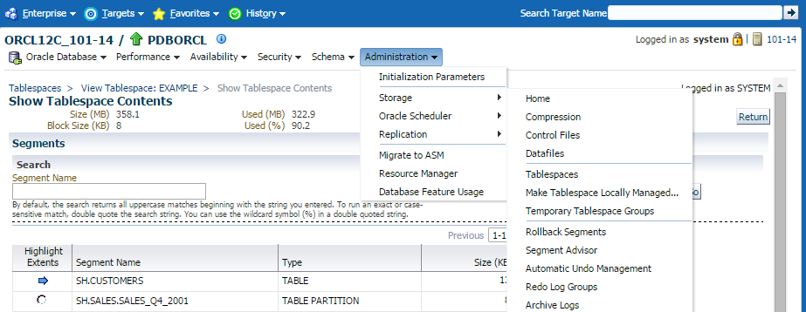
Exploring the Storage Structure
Click the links to view detailed information.
Notes:
Oracle Database 12c: Administration Workshop I 8-<number>
Exploring the Storage Structure
Logical data structures are stored in the physical files of the database. You can easily view the logical structures of your database through Enterprise Manager. Detailed information about each structure can be obtained by clicking the links in the Storage region of the Administration page.

Slide 13
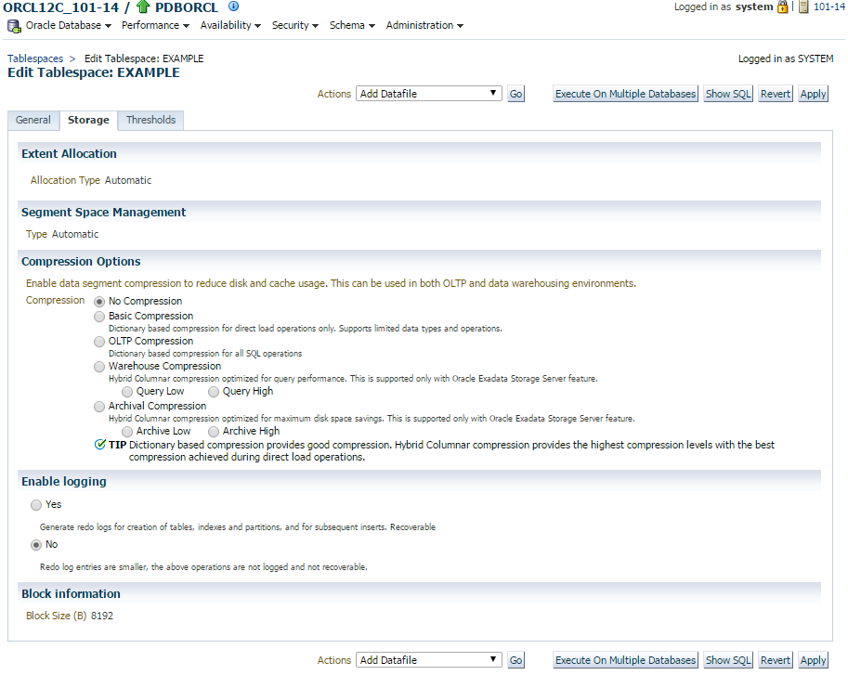
Storage for Locally Managed Tablespaces
Notes:
Oracle Database 12c: Administration Workshop I 8-<number>
Storage for Locally Managed Tablespaces
The extents within a locally managed tablespace can be allocated in one of these two ways:
Automatic: Also called autoallocate, it specifies that the sizes of the extents within the tablespace are system managed. You cannot specify an extent size. You cannot specify Automatic for a temporary tablespace.
Uniform: It specifies that the tablespace is managed with uniform extents of a size that you specify. The default size is 1 MB. All extents of temporary tablespaces are uniform and default to that value. You cannot specify Uniform for an undo tablespace.
Segment space management within a locally managed tablespace can be specified as:
Automatic: The Oracle database uses bitmaps to manage the free space within segments. The bitmap describes the status of each data block within a segment with respect to the amount of space in the block that is available for inserting rows. As more or less space becomes available in a data block, its new state is reflected in the bitmap. With bitmaps, the Oracle database manages free space more automatically and, thus, this form of space management is called Automatic Segment Space Management (ASSM).

Slide 14
(Notes Only Slide)
Storage for Locally Managed Tablespaces
Notes:
Oracle Database 12c: Administration Workshop I 8-<number>
Storage for Locally Managed Tablespaces (continued)
Manual: This specifies that you want to use free lists for managing free space within segments. Free lists are lists of data blocks that have space available for inserting rows. This form of managing space within segments is called manual segment space management because of the need to specify and tune the PCTUSED, FREELISTS, and FREELIST GROUPS storage parameters for schema objects created in the tablespace. This is supported for backward compatibility; it is recommended that you use ASSM.
Advantages of Locally Managed Tablespaces
Locally managed tablespaces have the following advantages over dictionary-managed tablespaces:
Local management avoids recursive space management operations. This occurs in dictionary-managed tablespaces if consuming or releasing space in an extent results in another operation that consumes or releases space in an undo segment or data dictionary table.
Because locally managed tablespaces do not record free space in data dictionary tables, they reduce contention on these tables.
Local management of extents automatically tracks adjacent free space, eliminating the need to coalesce free extents.
The sizes of extents that are managed locally can be determined automatically by the system.
Changes to the extent bitmaps do not generate undo information because they do not update tables in the data dictionary (except for special cases such as tablespace quota information).
Note: If you are managing a database that has dictionary-managed tablespaces and you want to convert them to locally managed tablespaces, use the DBMS_SPACE_ADMIN.TABLESPACE_MIGRATE_TO_LOCAL procedure to do this. For details about the use of this procedure, see PL/SQL Packages and Types Reference and the Database Administrator’s Guide.
Logging
Changes made to objects in the tablespace are written to the redo log. If logging is not enabled, then the creation of any objects and any subsequent direct load path inserts performed on those objects are not written to the redo log, and the objects are thus unrecoverable in the event of data loss. So, when an object is created without Logging enabled, you must back up those objects, if you want them to be recoverable.
For more details about the logging clause, see the Oracle Database SQL Reference.
Block Information
This region shows the block size that is used for the tablespace being created. It is displayed here as a read-only value. If you set any of the alternate block size initialization parameters (DB_nK_CACHE_SIZE), then those other values would be listed here as an option. For more information about defining other block sizes, see the Oracle Database Administrator’s Guide.

Slide 15
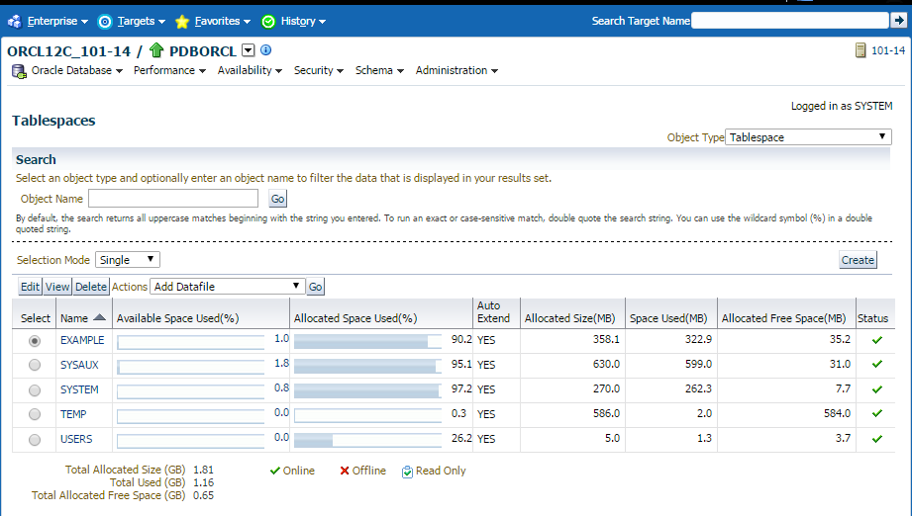
Tablespaces in the Pluggable Database
  SYSTEM
  SYSAUX
  TEMP
  USERS
  EXAMPLE
Notes:
Oracle Database 12c: Administration Workshop I 8-<number>
Tablespaces in the Preconfigured Database
The following tablespaces are created in the preconfigured database in this course:
SYSTEM: The SYSTEM tablespace is used by the Oracle server to manage the database. It contains the data dictionary and tables that contain administrative information about the database. These are all contained in the SYS schema and can be accessed only by the SYS user or other administrative users with the required privilege.
SYSAUX: This is an auxiliary tablespace to the SYSTEM tablespace. Some components and products that used the SYSTEM tablespace or their own tablespaces in earlier releases of the Oracle database, now use the SYSAUX tablespace. Every Oracle Database12c or later release must have a SYSAUX tablespace.
In Enterprise Manager, you can see a pie chart of the contents of this tablespace. To do this, click Tablespaces on the Administration page. Select SYSAUX and click Edit. Then, click the Occupants tab. After creation, you can monitor the space usage of each occupant inside the SYSAUX tablespace by using EM. If you detect that a component is taking too much space in the SYSAUX tablespace, or if you anticipate that it will, you can move the occupant into a different tablespace by selecting one of the occupants and clicking Change Tablespace.

Slide 16
(Notes Only Slide)
Tablespaces in the Preconfigured Database
Notes:
Oracle Database 12c: Administration Workshop I 8-<number>
Tablespaces in the Preconfigured Database (continued)
TEMP: Your temporary tablespace is used when you execute a SQL statement that requires the creation of temporary segments (such as a large sort or the creation of an index). Just like each user is assigned a default tablespace for storing created data objects, each user is assigned a temporary tablespace. The best practice is to define a default temporary tablespace for the database, which is assigned to any newly created user, unless otherwise specified. In the preconfigured database, the TEMP tablespace is specified as the default temporary tablespace. This means that if no temporary tablespace is specified when the user account is created, the Oracle database assigns this tablespace to the user.
UNDOTBS1: This is the undo tablespace used by the database server to store undo information. If a database uses Automatic Undo Management, then it must have exactly one active undo tablespace at any given time. This tablespace is created at database creation time.
USERS: This tablespace is used to store permanent user objects and data. In the preconfigured database, the USERS tablespace is the default tablespace for all objects created by nonsystem users. For the SYS and SYSTEM users (the system users), the default permanent tablespace remains SYSTEM.
EXAMPLE: This tablespace contains the sample schemas that can be installed when you create the database. The sample schemas provide a common platform for examples. Oracle documentation and courseware contain examples based on the sample schemas.
Note: To simplify administration, it is common to have a tablespace for indexes alone.

Slide 17
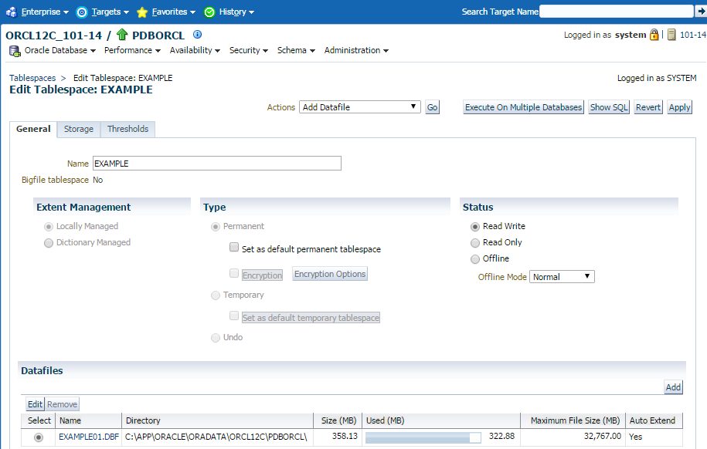
Altering a Tablespace
Normal
Temporary
Immediate
For Recover
Notes:
Oracle Database 12c: Administration Workshop I 8-<number>
Altering a Tablespace
After you create a tablespace, you can later alter it in several ways as the needs of your system change.
Renaming: Enter a new name for the tablespace and click Apply.
Changing the status: A tablespace can be in one of three different statuses or states. Any of the following three states may not be available because their availability depends on the type of tablespace:
Read Write: The tablespace is online and can be read from and written to.
Read Only: Specify read-only to place the tablespace in transition read-only mode. In this state, existing transactions can be completed (committed or rolled back), but no further data manipulation language (DML) operations are allowed on objects in the tablespace. The tablespace is online while in the read-only state. You cannot make the SYSTEM or SYSAUX tablespace read-only.

Slide 18
(Notes Only Slide)
Altering a Tablespace
Notes:
Oracle Database 12c: Administration Workshop I 8-<number>
Altering a Tablespace (continued)
Offline: You can take an online tablespace offline so that this portion of the database is temporarily unavailable for general use. The rest of the database is open and available for users to access data. When you take it offline, you can use the following options:
Normal: A tablespace can be taken offline normally if no error conditions exist for any of the data files of the tablespace. The Oracle database ensures that all data is written to disk by taking a checkpoint for all data files of the tablespace as it takes them offline.
Temporary: A tablespace can be taken offline temporarily even if there are error conditions for one or more files of the tablespace. The Oracle database takes the data files (which are not already offline) offline, performing checkpointing on them as it does so. If no files are offline, but you use the temporary clause, media recovery is not required to bring the tablespace back online. However, if one or more files of the tablespace are offline because of write errors, and you take the tablespace offline temporarily, the tablespace requires recovery before you can bring it back online.
Immediate: A tablespace can be taken offline immediately without the Oracle database taking a checkpoint on any of the data files. When you specify Immediate, media recovery for the tablespace is required before the tablespace can be brought online. You cannot take a tablespace offline immediately if the database is running in NOARCHIVELOG mode.
For Recover: The FOR RECOVER setting has been deprecated. The syntax is supported for backward compatibility.
Changing the size: You can add space to an existing tablespace by either adding data files to the tablespace or by changing the size of an existing data file.
To add a new data file to the tablespace, click Add and fill in the information about the data file on the Add Datafile page.
To change the size of an existing data file, select the data file in the Datafiles region of the Edit Tablespace page by clicking the name of the data file, or select the data file and click Edit. Then, on the Edit Datafile page, you can change the size of the data file. You can make the tablespace either larger or smaller. However, you cannot make a data file smaller than the used space in the file; if you try to do so, you get the following error:
ORA-03297: file contains used data beyond requested RESIZE value
Storage options: Click Storage to change the logging behavior of the tablespace.

Slide 19
(Notes Only Slide)
Altering a Tablespace
Notes:
Oracle Database 12c: Administration Workshop I 8-<number>
Altering a Tablespace (continued)
Thresholds: Click Thresholds to change the point at which a warning or critical level of space usage is reached on the tablespace. You have three options:
Use Database Default Thresholds: This uses preset defaults, and you have the option of setting these defaults.
Specify Thresholds: This enables you to set thresholds for this particular tablespace.
Disable Thresholds: This turns off space usage alerts for this tablespace.
Note: It may take a few minutes for a threshold alert to register.

Slide 20
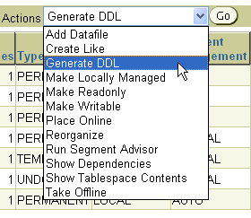
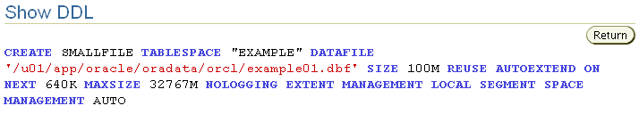
Actions with Tablespaces
Notes:
Oracle Database 12c: Administration Workshop I 8-<number>
Actions with Tablespaces
Using the Actions menu, you can perform a variety of tasks with your tablespaces. Select a tablespace and then the action that you want to perform:
Add Datafile: Adds a data file to the tablespace, which makes the tablespace larger
Create Like: Creates another tablespace by using the tablespace as a template
Generate DDL: Generates the data definition language (DDL) statement that creates the tablespace. This can then be copied and pasted into a text file for use as a script or for documentation purposes.
Make Locally Managed: Converts the tablespace to locally managed if the tablespace is currently dictionary managed. This conversion is only one way; you cannot convert the tablespace back to dictionary managed.
Make Readonly: Stops all writes to the tablespace. Current transactions are allowed to complete, but no new DML or other write activities are allowed to start on the tablespace. This appears only if the tablespace is currently not read-only.
Make Writable: Allows DML and other write activities to be initiated on objects in the tablespace. This appears only if the tablespace is currently not writable.

Slide 21
Actions with Tablespaces
(Notes Only Slide)
Notes:
Oracle Database 12c: Administration Workshop I 8-<number>
Actions with Tablespaces (continued)
Place Online: Brings a currently offline tablespace online
Reorganize: Starts the Reorganization Wizard, which you can use to move objects around within the tablespace to reclaim space that otherwise may not be used. This is a task that should be performed during off-peak usage of the objects in the tablespace.
Run Segment Advisor: Starts the Segment Advisor, which you can use to determine whether an object has space available for reclamation on the basis of the level of space fragmentation within the object. At the tablespace level, advice is generated for every segment in the tablespace.
Show Dependencies: Shows objects that this tablespace depends on or objects that depend on this tablespace
Show Tablespace Contents: Shows information about all the segments in the tablespace, including a graphical map of all of the extents
Take Offline: Makes a currently online tablespace unavailable. The tablespace is not deleted or dropped; it is just unavailable.

Slide 22
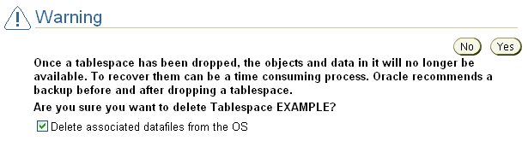
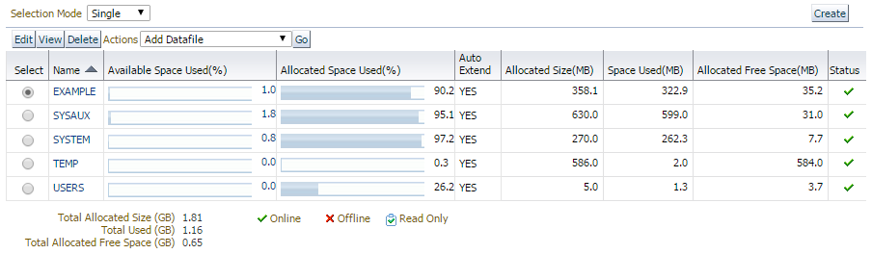
Dropping Tablespaces
Notes:
Oracle Database 12c: Administration Workshop I 8-<number>
Dropping Tablespaces
You can drop a tablespace and its contents (the segments contained in the tablespace) from the database if the tablespace and its contents are no longer required. You must have the DROP TABLESPACE system privilege to drop a tablespace.
When you drop a tablespace, the file pointers in the control file of the associated database are removed. You can optionally direct the Oracle server to delete the operating system files (data files) that constitute the dropped tablespace. If you do not direct the Oracle server to delete the data files at the same time as it deletes the tablespace, you must later use the appropriate commands of your operating system if you want them to be deleted.
You cannot drop a tablespace that contains any active segments. For example, if a table in the tablespace is currently being used or the tablespace contains undo data that is needed to roll back uncommitted transactions, you cannot drop the tablespace. The tablespace can be online or offline, but it is best to take the tablespace offline before dropping it.

Slide 23

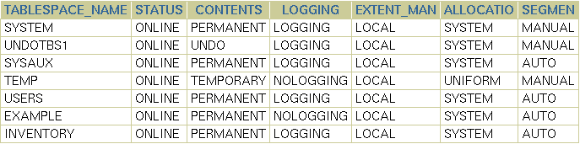
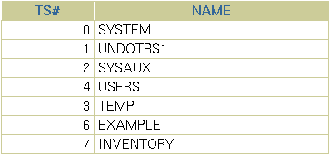
Viewing Tablespace Information
Notes:
Oracle Database 12c: Administration Workshop I 8-<number>
Viewing Tablespace Information
Click View to see information about the selected tablespace. On the View Tablespace page, you can also click Edit to alter the tablespace.
Tablespace and data file information can also be obtained by querying the following:
Tablespace information:
DBA_TABLESPACES
V$TABLESPACE
Data file information:
DBA_DATA_FILES
V$DATAFILE
Temp file information:
DBA_TEMP_FILES
V$TEMPFILE

Slide 24
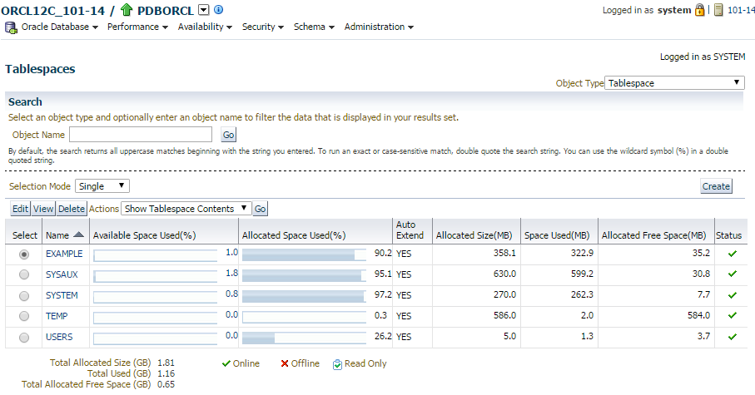
Gathering Storage Information
Notes:
Oracle Database 12c: Administration Workshop I 8-<number>
Gathering Storage Information
To view and modify tablespace information in EM, select Administration > Storage > Tablespaces. Use the buttons or the Actions drop-down list to navigate to your destination.

Slide 25
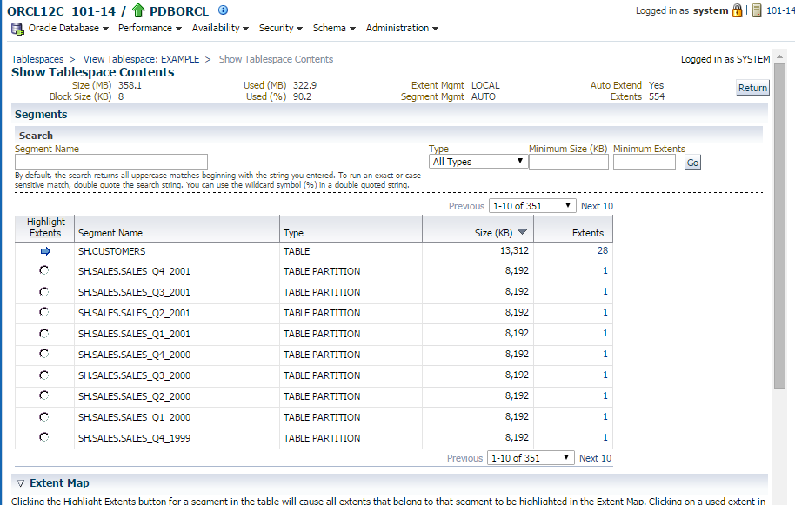
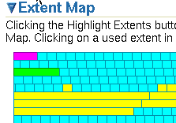

Viewing Tablespace Contents
Notes:
Oracle Database 12c: Administration Workshop I 8-<number>
Viewing Tablespace Contents
On the Show Tablespace Contents page, detailed information about the tablespace is displayed, including a list of the segments in the tablespace, the type of each segment, the segment size, and the number of extents that comprise each segment. Any of these four values can be used to sort the list by clicking the column header, or to filter the list by entering values in the Search region. For a dictionary-managed tablespace, additional columns are displayed:
Max Extents
Next
Percent Increase
To see a list of extents, click the link in the Extents column.
To view extents in a graphical way, expand the “Extent map” and move the cursor over individual extents. The following information is displayed:
Name of the segment the extent belongs to
Extent ID
Block ID
Extent size in blocks
Data file in which the extent is stored

Slide 26

Enlarging the Database
You can enlarge the database in the following ways:
  Creating a new tablespace
  Adding a data file to an existing tablespace
  Increasing the size of a data file
  Providing for the dynamic growth of a data file
Database
SYSTEM
tablespace
INVENTORY
tablespace
Notes:
Oracle Database 12c: Administration Workshop I 8-<number>
Enlarging the Database
These activities can be performed with Enterprise Manager or with SQL statements. In the end, the size of the database can be described as the sum of all of its tablespaces.

Slide 27
Practical Exercise
This practical exercise covers the following topics:
  Creating tablespaces
  Gathering information about tablespaces
Notes:
Oracle Database 12c: Administration Workshop I 8-<number>

Slide 28
Summary
In this lesson, you should have learned how to:
  Describe how table row data is stored in blocks
  Define the purpose of tablespaces and data files
  Create and manage tablespaces
  Obtain tablespace information
  Describe the main concepts and differences between a Container Tablespace and a PDB tablespace.
Notes:
Oracle Database 12c: Administration Workshop I 8-<number>

Slide 29
Terminal Learning Objective
ACTION: Maintain Oracle Database Storage Structures
CONDITION: Given a student handout and Oracle DBA Handbook
STANDARD: Students will successfully create tablespaces, tables and indexes
Notes:
Oracle Database 12c: Administration Workshop I 8-<number>

