Slide 1
Processes, Views, Parameters, Packages, and Privileges

Slide 2
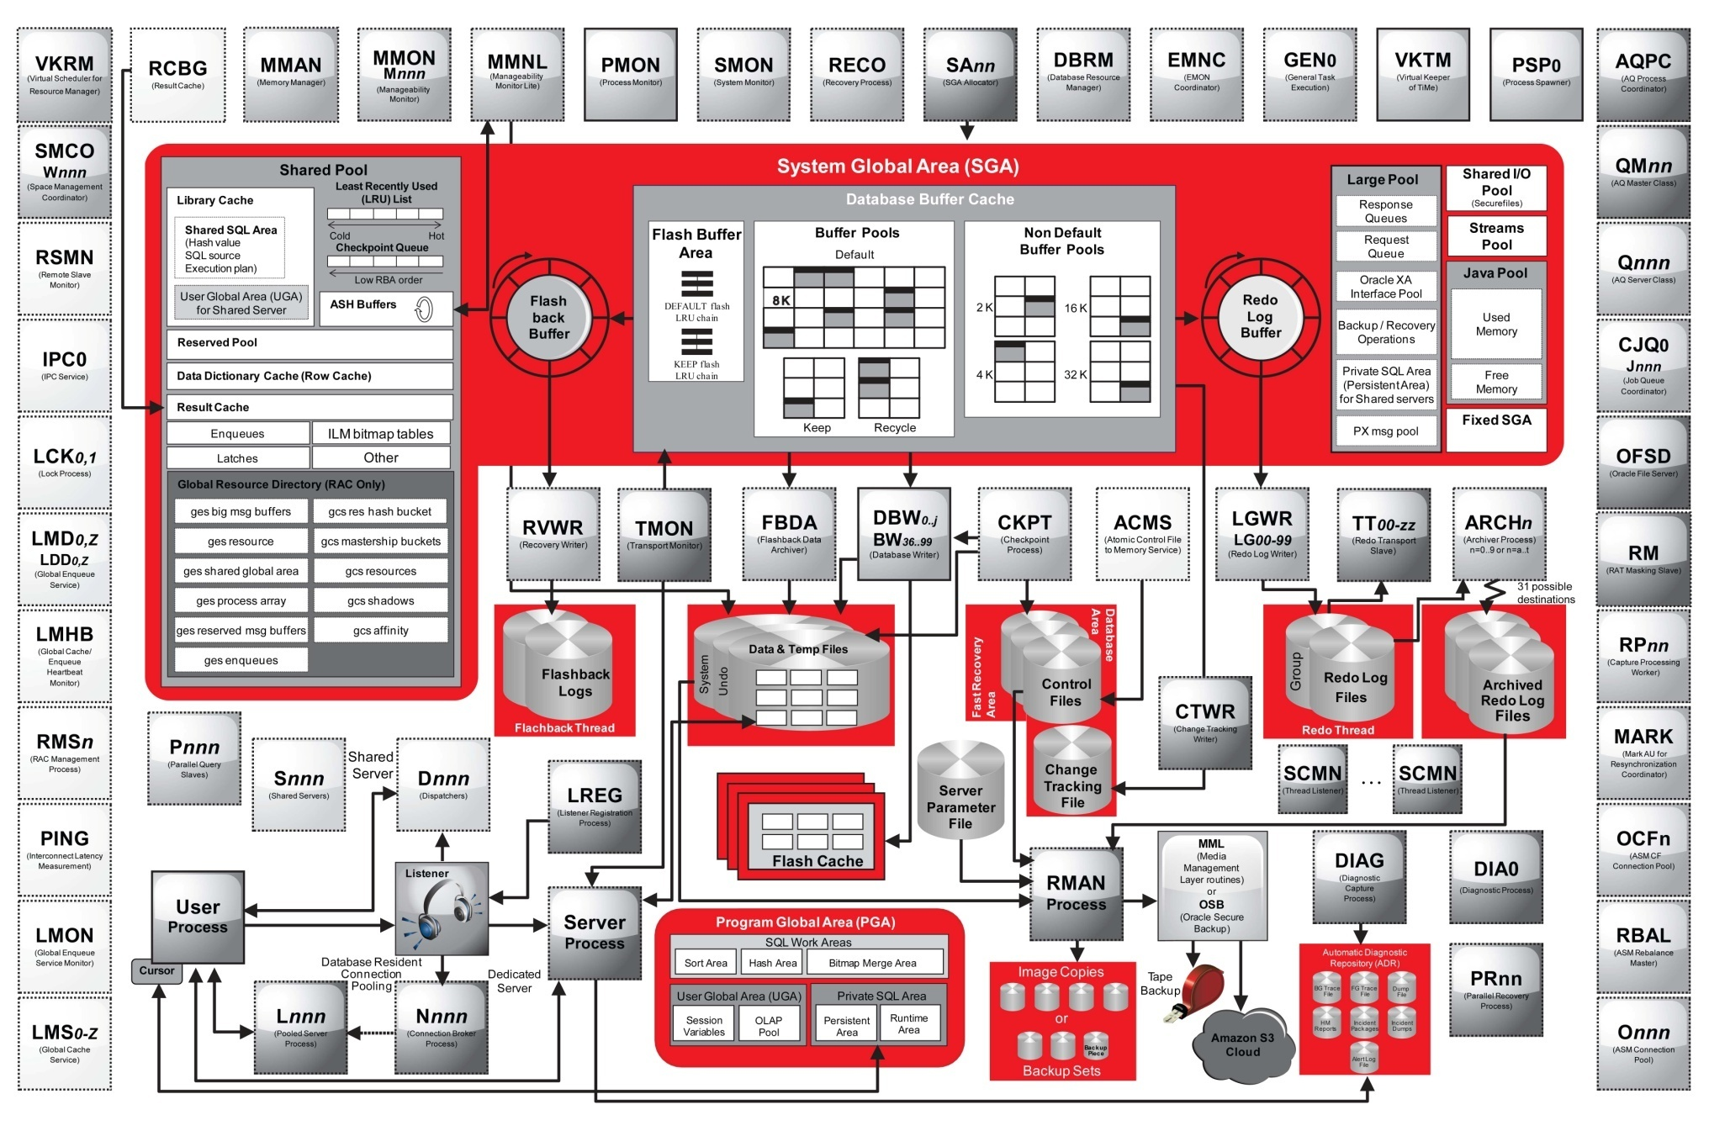
Instance and Database
Notes:
Captions:
Circle elements represent Oracle processes. If they are surrounded by dotted lines (equal dotted elements), they can run as either threads or OS processes. If they are surrounded by a solid line, they can run as only OS processes. The SCMN case is an exception. When using the multiprocess, multithreaded architecture, each OS process running more than one Oracle process also runs a special thread called SCMN, which is basically an internal listener thread. All thread creation is routed through this thread.
Darker circle elements are the new elements for DB 12c.
The two main different color nuances for circle elements are to make the distinction between RAC and non-RAC processes.
Files are represented by cylinders.
Storage location for those files is divided into three main areas: Fast Recover Area, Database Area, and Automatic Diagnostic Repository. Areas are designated by background rectangles by using three different colors. The exception is the server parameter file. If you find a file type part of two areas, it means that some corresponding files can be in both areas.
Inside one circle element, you may see two names. This is to indicate that the second (smaller letters) is a slave of the first.

Slide 3


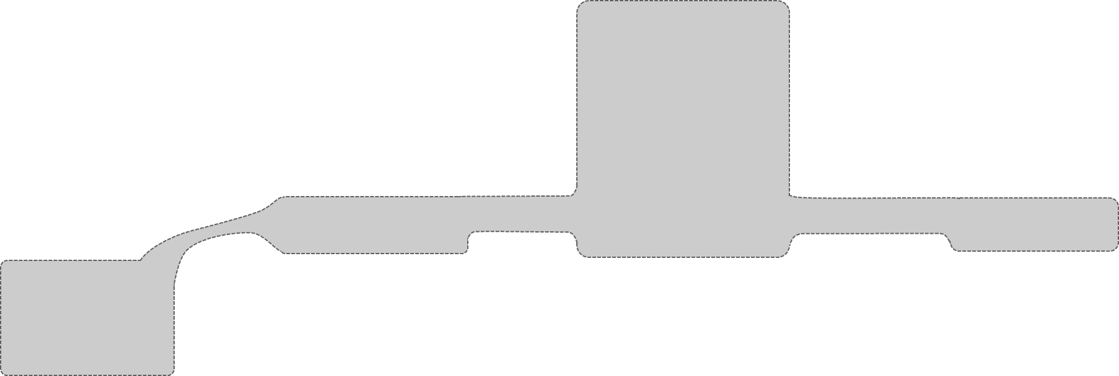

Multitenant Architecture
Listener
listener.ora
Multitenant Container Database
. . .
CDB root CDB$ROOT
PDB Container 1
PDB Container n
Dictionary Object Data
OBJ$
Dictionary Object Definition (Metadata)
CDB Views
SYS...
CDB Resource Plan
DBMS_*
CDB_SERVICES
Common User
C##...
PDB$SEED
Common Role
DBA, CDB_DBA...
DBA_OBJECTS
C##...
. .
Common Privilege
OBJ$
Data-links
Local Privilege
Metadata-link
App Common Role
Application Container
Common User
Application PDB
App PDB n
Local Privilege
. .
Common Role
Local Privilege
Application root APP
. .
Common Role
OBJ$
Local Role
.
OBJ$
Local Role
SYSTEM
SYSAUX
OBJ$
App Common Role
App Common Role
PDB Resource Plan
OBJ$
App Common User
PDB Resource Plan
App Common User
Tempfile
Common User
Local User
OBJ$
Local User
App Common User
Application root PDB Files
Common User
PDB1
. .
Application PDB Files
Application PDB Files
OBJ$
SYSTEM
SYSAUX
Tempfiles
Common User
SYSTEM
SYSAUX
Users
Undo
Tempfiles
app$SEED
SYSTEM
SYSAUX
Users
Undo
Tempfiles
SYSTEM
CDB Instance
SGA
Background processes
SYSAUX
PDBid1
PDBid1
PDBid1
PDBid2
Foreground processes
Tempfile
PDBid1
PDBid2
PDBid2
PDBid2
Root Files
Alert log
SYSTEM
Wallet
Control files
Redo log files
SYSAUX
Users
Tempfiles
Undo
Flashback logs
Archived redo log files
SPFILE
Datafiles

Slide 4
CDB and PDB Views and Columns
CDB_xxx: All of the objects in the CDB across all PDBs
DBA_xxx: All of the objects in a container or PDB
CDB_PDBS: All PDBs within CDB
CDB_TABLESPACES: All tablespaces within CDB
CDB_USERS: All users within CDB (common and local)
CDB_PDB_SNAPSHOTS: All PDB snapshots associated with PDBs
V$PDBS: Displays information about PDBs associated with the current instance
V$CONTAINERS: Displays information about PDBs and the root associated with the current instance
PDB_PLUG_IN_VIOLATIONS: Displays information about PDB violations after compatibility check with CDB
RC_PDBS: Recovery catalog view about PDB backups
19c

Slide 5
CDB and PDB Views and Columns
DBA_APPLICATIONS: Application created on top of application PDBs
Other views related to applications:
DBA_APP_PATCHES
DBA_APP_STATEMENTS
DBA_APP_ERRORS
DBA_APP_VERSIONS
New columns in V$CONTAINERS view:
APPLICATION_ROOT = YES|NO
APPLICATION_PDB = YES|NO
APPLICATION_SEED = YES|NO
APPLICATION_ROOT_CON_ID = <con_id>
APPLICATION_ROOT_CLONE = YES|NO
PROXY_PDB = YES|NO
PDB_COUNT = <nbr>
New columns in V$PDBS view:
PDB_COUNT = <nbr>

Slide 6
CDB and PDB Views and Columns
New columns or column values in CDB_PDBS view:
UPGRADE_PRIORITY = <nbr>
APPLICATION_ROOT = YES|NO
APPLICATION_PDB = YES|NO
APPLICATION_SEED = YES|NO
APPLICATION_ROOT_CON_ID = <con_id>
IS_PROXY_PDB = YES|NO
STATUS = NORMAL | RELOCATING | RELOCATED | REFRESHING | STUB
SNAPSHOT_MODE = NONE | MANUAL | AUTO
New columns in DBA_TABLES view:
CONTAINER_MAP_OBJECT = YES|NO
CONTAINERS_DEFAULT = YES|NO
CONTAINER_MAP = YES|NO
19c

Slide 7
CDB and PDB Views and Columns
New values in CDB_OBJECTS view, column SHARING = METADATA LINK | DATA LINK | EXTENDED DATA LINK | NONE
New column INHERITED = YES|NO in views:
CDB_USERS
CDB_ROLES
CDB_TAB_PRIVS
CDB_SYS_PRIVS
CDB_ROLE_PRIVS
ROLE_ROLE_PRIVS
ROLE_SYS_PRIVS
ROLE_TAB_PRIVS
AUDIT_UNIFIED_POLICIES
DVSYS.DBA_DV_REALM
DVSYS.DBA_DV_REALM_OBJECT

Slide 8
CDB and PDB Views and Columns
New values in PROPERTY_NAME, column in DATABASE_PROPERTIES view:
MAX_PDB_SNAPSHOTS = 8
CONTAINER_MAP, LOCAL_UNDO_ENABLED , LEAD_CDB = TRUE | FALSE
LEAD_CDB_URI = dblink:link_to_cdb_lead
CONTAINERS_HOST = <hostname>
CONTAINERS_PORT = 1521
New column in V$ENCRYPTION_WALLET view:
KEYSTORE_MODE = NONE | UNITED | ISOLATED
CDB_LOCKDOWN_PROFILES
V$RESTORE_POINT
19c
19c
19c
19c

Slide 9
CDB and PDB Views and Columns
AWR_ROOT_PDB_IN_SNAP
AWR_PDB_PARAMETER
AWR_PDB_RSRC_PDB_METRIC
AWR_PDB_SQL_SUMMARY
V$RSRCPDBMETRIC / V$RSRCPDBMETRIC_HISTORY / DBA_HIST_RSRC_PDB_METRIC
V$RSRC_PDB / V$RSRC_PDB_HISTORY

Slide 10
CDB and PDB Parameters
ENABLE_PLUGGABLE_DATABASE: Required to create a CDB at CDB instance startup
PDB_FILE_NAME_CONVERT: Maps names of existing files to new file names when processing a CREATE PLUGGABLE DATABASE statement
CDB_COMPATIBLE: Enables you to get behavior similar to a non-CDB
PDB_OS_CREDENTIAL: Enables another OS user than oracle to connect to PDBs
DB_PERFORMANCE_PROFILE
PDB_LOCKDOWN
SGA_MIN_SIZE
MAX_PDBS
WALLET_ROOT: Replaces the ENCRYPTION_WALLET_LOCATION parameter in the sqlnet.ora file, which is easier to use to set the location of keystores
TDE_CONFIGURATION: Sets the type of keystore to use
19c
19c

Slide 11
CDB and PDB New Packages
DBMS_PDB.DESCRIBE
DBMS_PDB.CHECK_PLUG_COMPATIBILITY
DVSYS.DBMS_MACADM.CREATE_REALM :
REALM_SCOPE =>
DBMS_MACUTL.G_SCOPE_COMMON
DBMS_MACUTL.G_SCOPE_LOCAL
ENABLED =>
DBMS_MACUTL.G_SIMULATION
DBMS_MACUTL.G_YES
DBMS_MACUTL.G_NO

